Slide 1

Enterprise Architect advanced capabilities
Attila Balogh-Biró 2019

Slide 2
Course agenda
Short refresher, modelling and EA basics
Project execirse
GIT version control, Git LFS and LemonTree introduction
Introduction to UML profiles
MDG technology introduction, apply custom UML profile
YAKINDU-EA Bridge demo

Slide 3

Model-Driven Software Engineering

Slide 4
MDSE definition
MDSE can be defined as a methodology
Model Driven Software Development (MDSD) is a style of software development that considers itself as an alternative to the traditional style of programming
To use MDSD you need tools that support ProjectionalEditing
MDSD is surrounded by a terminological mess
Notes:
The approach centers itself on building models of a software system.
These models are typically made manifest through diagrammatic design notations - the UML is one option.
The idea is that you use these diagrams, to specify your system to a modeling tool and then you generate code in a conventional programming language.
MDSD is surrounded by a terminological mess.
One particular vision of MDSD is ModelDrivenArchitecture (MDA) which is an OMG initiative based on the UML. Many people in the MDSD community, however, don't think that MDA or UML is the right vision for MDSD.
For a long time I would hear people talking about Model Driven Development (MDD) as the general concept and MDA as the OMG's specific vision.
However the OMG has trademarks on several "Model Driven *" and "Model Based *" phrases - including MDD. As a consequence people have to be careful about what model driven phrase they use

Slide 5
MDSE definition more detailed
Model-Driven Software Engineering (MDSE) is a software engineering paradigm
Models are considered as primary artifacts from which parts of a software system can be automatically generated
Models are usually more abstract representations of the system to be built
MDSE can improve productivity and communication
MDSE requires technologies and tools in order to be successfully applied
Various terms and approaches to MDSE – Model-driven architecture, model-driven engineering, model-driven development,

Slide 6
Important Aspects of MDSE
In MDSE approaches, the use of models and model transformations is proposed
Models are expressed in UML, an extension of UML, or a domain-specific language
The syntax and semantics of models used in a MDSE approach has to be clearly defined
The software development process is changed when an MDSE approach is adopted

Slide 7
MDSE primary question
How to get from requirements to running code satisfying requirements and user expectations?
Models are used in many development processes
–requirements for the system (e.g. use case model)
–software architecture (e.g. component model)
–behavioral description (e.g. statechart)

Slide 8
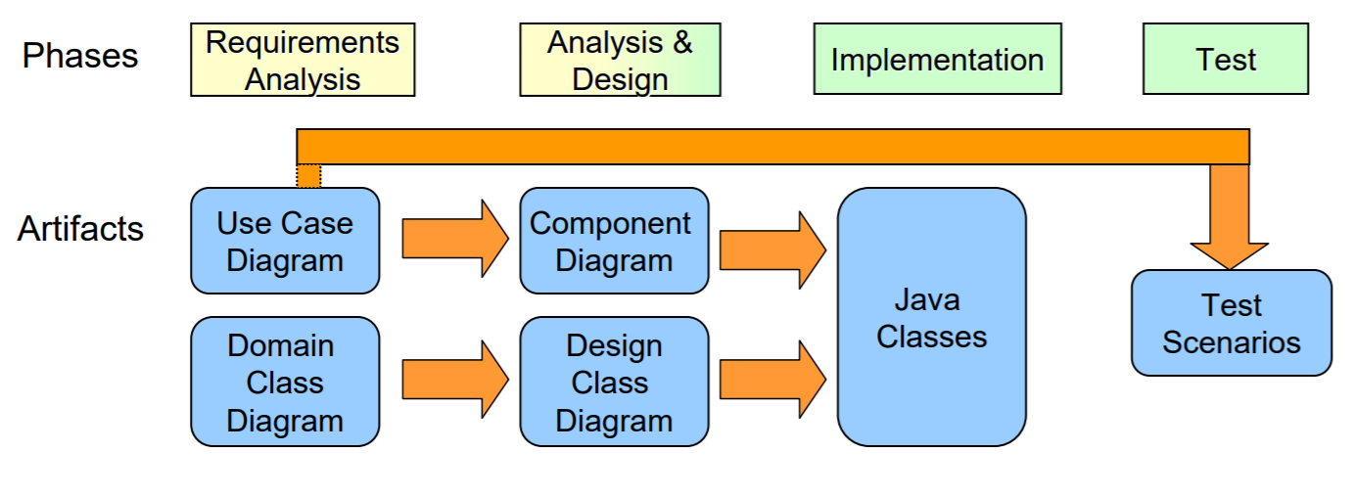
Usages of Models and Model Transformations in MDSE
Notes:
In each phase, different models are constructed
In each phase, we reuse parts of models as input for other models
– Test scenarios are partially derived from Use Case Diagrams – Design Class Diagram may reuse parts of Domain Class Diagram MDSE focuses on automatically generating parts of models or code from other models

Slide 9
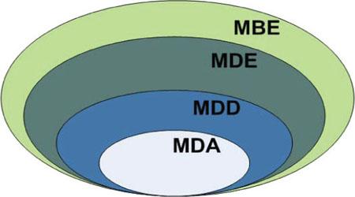
MBE vs MDE vs MDD vs MDA
Notes:
Model-Driven Development (MDD) is a development paradigm that uses models as the primary artifact of the development process. Usually, in MDD the implementation is (semi)automatically generated from the models.
Model-driven Architecture (MDA) is the particular vision of MDD proposed by the Object Management Group (OMG) and thus relies on the use of OMG standards. Therefore, MDA can be regarded as a subset of MDD, where the modeling and transformation languages are standardized by OMG.
On the other hand, MDE would be a superset of MDD because, as the E in MDE suggests, MDE goes beyond of the pure development activities and encompasses other model-based tasks of a complete software engineering process (e.g., the model-based evolution of the system or the model-driven reverse engineering of a legacy system).
Finally, we use “model-based engineering” (or “model-based development”) to refer to a softer version of MDE. That is, the MBE process is a process in which software models play an important role although they are not necessarily the key artifacts of the development (i.e., they do NOT “drive” the process as in MDE). An example would be a development process where, in the analysis phase, designers specify the domain models of the system but then these models are directly handed out to the programmers as blueprints to manually write the code (no automatic code-generation involved and no explicit definition of any platform-specific model). In this process, models still play an important role but are not the central artifacts of the development process and may be less complete (i.e., they can be used more as blueprints or sketches of the system) than those in a MDD approach. MBE is a superset of MDE. All model-driven processes are model-based, but not the other way round.
MDE does not focus on iterative model refinement by transformations, no intermediate models are created
Transformations are primarily used for translating models into code
A PIM model contains all necessary details to be translated into code which is then platform specific
Roundtrip engineering is avoided, design changes have to be made to the model Focus on software architecture

Slide 10
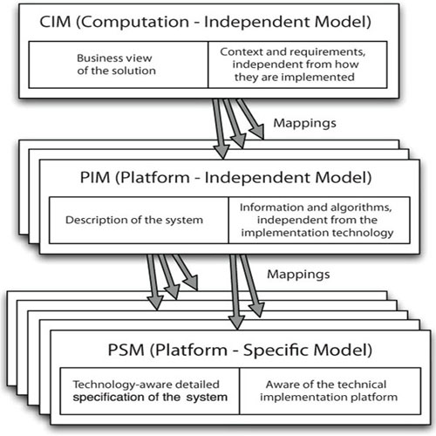
MDA Concept Overview
Notes:
Computation Independent Model (CIM) defines domain vocabulary
Platform Independent Model (PIM) captures domain related specifications
PIM does not contain platform details, independent of a platform Platform Specific Model (PSM) captures specifications with platform details For expressing PIM and PSM, domain-specific languages are used – UML profiles and other techniques for defining DSLs Model transformations transform PIMs into PSMs
Computation-Independent Model (CIM): The most abstract modeling level, which represents the context, requirements, and purpose of the solution without any binding to computational implications. It presents exactly what the solution is expected to do, but hides all the IT-related specifications, to remain independent of if and how a system will be (or currently is) implemented. The CIM is often referred to as a business model or domain model because it uses a vocabulary that is familiar to the subject matter experts (S
Platform-Independent Model (PIM): The level that describes the behavior and structure of the application, regardless of the implementation platform. Notice that the PIM is only for the part of the CIM that will be solved using a software-based solution and that refines it in terms of requirements for a software system
Platform-Specific Model (PSM): Even if it is not executed itself, this model must contain all required information regarding the behavior and structure of an application on a specific platform that developers may use to implement the executable code.

Slide 11
Project exercise

Slide 12
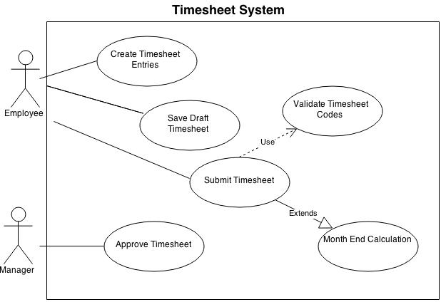
Timesheet management system

Slide 13
Exercise 1
Create a new EA project
Define a proper model structure with packages, views
Implement the use case model
Implement a class diagram

Slide 14
Enterprise Architect version controlling, GIT support

Slide 15
What does 'version control' mean in Enterprise Architect?
Enterprise Architect applies version control to Packages within a model
A Package is the primary organizational construct for UML models
Enterprise Architect supports two primary ways of version controlling Packages in a model
Notes:
Any Package may have version control applied to it - whether it is the model's Root node, a View or a sub-Package
Model Baselines: This built-in capability, stores point-in-time snapshots of a Package in the model repository itself.
The Model Baselines concept also forms the basis of Enterprise Architect's 'compare and merge' facility.
When deciding on approaches to version control, strong consideration should be given to the use of Model Baselines, especially where the need is essentially to maintain a revision history for purposes of comparison, merge and roll-back.
2. Version Control Integration: Enterprise Architect supports integration with third-party version control systems,
allowing users to store Package revisions in their preferred tool. Version control tools supported by Enterprise Architect include Subversion, CVS, Microsoft's TFS and SCC compatible tools, such as Accurev and Visual Source Safe

Slide 16
What does 'version control' mean in Enterprise Architect?
Enterprise Architect applies version control to Packages within a model
A Package is the primary organizational construct for UML models
Enterprise Architect supports two primary ways of version controlling Packages in a model → Baselines and version control integration
Notes:
Any Package may have version control applied to it - whether it is the model's Root node, a View or a sub-Package
Model Baselines: This built-in capability, stores point-in-time snapshots of a Package in the model repository itself.
The Model Baselines concept also forms the basis of Enterprise Architect's 'compare and merge' facility.
When deciding on approaches to version control, strong consideration should be given to the use of Model Baselines, especially where the need is essentially to maintain a revision history for purposes of comparison, merge and roll-back.
2. Version Control Integration: Enterprise Architect supports integration with third-party version control systems,
allowing users to store Package revisions in their preferred tool. Version control tools supported by Enterprise Architect include Subversion, CVS, Microsoft's TFS and SCC compatible tools, such as Accurev and Visual Source Safe

Slide 17
Team Deployment: Centralized or Distributed
Centralized Team
Distributed Team
Multiple Site Locations
Notes:
The primary consideration in deciding which approach to take in version controlling your model is how the model editors, or authors, are distributed: • Is each member of the team in the same central location and connected via a high-speed network? • Are the editors likely to work remotely and independently, perhaps disconnected from a shared network for extended periods of time? • Are there several key locations across the globe where the model will be shared and edited? Answers to these questions will determine how the Enterprise Architect model itself is shared1 and consequently how version control is applied. In the following sections we describe how to apply version control in some common scenarios. Listed below are the scenarios we will consider in detail:
Centralized Team: All editors are connected via a high-speed network and can therefore share the same physical model hosted in a Database Management System (DBMS).
Distributed Team: Editors are rarely connected to the same network. They may have to contribute to the model offline, and therefore require a local copy of the model on their own machine.
Multiple Site Locations: Several geographically dispersed sites contribute to the same model. There is no high-speed connection between sites. Teams at each site share access to a local copy of the model.

Slide 18
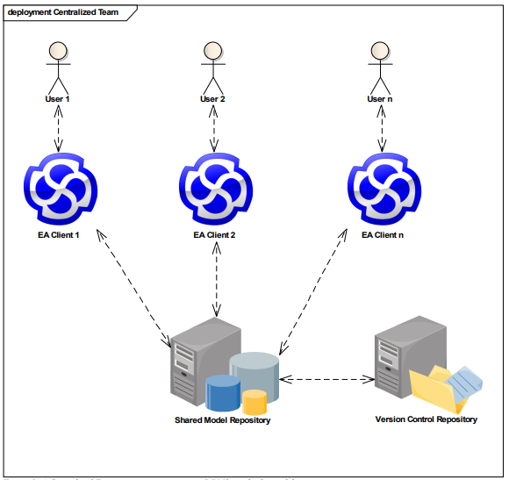
Centralized team setup
Notes:
In this scenario, we have the benefit of all team members being connected by high-speed network infrastructure.
If our team exceeds 5 members who concurrently access the model, we can no longer safely access a single EAP file located on a network share. Instead, it is recommended to use a dedicated DBMS to host our model. The advantage of using a shared DBMS in this situation (as opposed to local copies of the model) is that all team members view and edit the current-state model, without the need for a separate synchronization process required to “get the latest.”
Therefore, the role of the version control repository in this situation is not to provide a mechanism for distributing model information – a function that is already achieved by the DBMS. Instead, the version control repository helps to manage revisions and allow for roll-back of changes

Slide 19
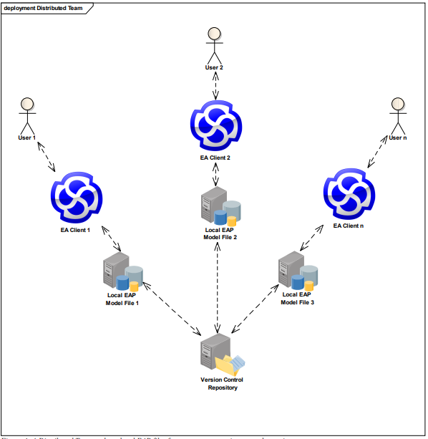
Distributed setup
Notes:
In this scenario we have multiple individuals editing the model, but without being connected via a shared Model Repository. Instead, each editor maintains a local copy of the model as an EAP file and periodically updates their copy from a shared Version Control Repository.
This approach facilitates broad-scale replication of the model without the need for administering a DBMS.
Set up an initial version controlled Enterprise Architect model:
a) Create a version control repository.
b) Using your version control system, create an entry in your version control repository that will be used to store your Enterprise Architect Package files.
c) Create a working copy in a local folder (for example, in CVS and Subversion this requires checking-out the entry created in the previous step).
d) Have one user create an Enterprise Architect project (EAP) file and define a version control configuration. The configuration provides access to the working copy files within Enterprise Architect.
e) In Enterprise Architect, apply version control to individual Packages. Refer to Appendix C for details.
2. Distribute the model to the rest of the team:
a) Once the model is created with version control applied, distribute the EAP file to the rest of the team.
b) Every team member that will access the version controlled Packages from Enterprise Architect must create a working copy as in step 1c.
c) As team members subsequently open the model for the first time, they will be prompted by Enterprise Architect to complete the definition for all version control configurations that are used by the model. This entails simply specifying the path to the local working copy files and saving the definition.
d) The model is now connected to version control and ready for use.

Slide 20
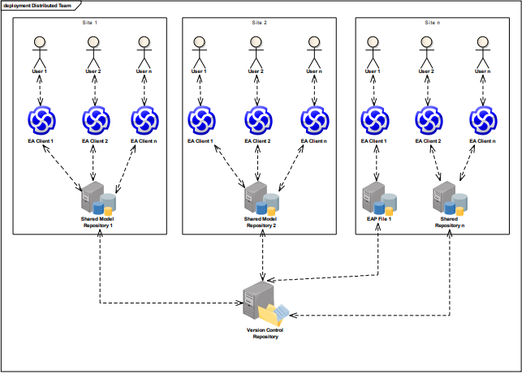
Multiple site location
Notes:
It is becoming increasingly common for large corporations to share model information across multiple, geographically dispersed development sites.
The challenge then is to keep each site updated with the latest model information.
While DBMS-level replication between sites may be possible using synchronization tools, leveraging version controlled Packages provides a simple, effective alternative. The situation represents a combination of the deployments defined in Scenarios 1 and 2. Each site may still benefit from a model repository hosted on a local DBMS, or EAP files may be used by individual editors, as shown in Figure 15.

Slide 21
GIT integration, and problems
EA uses exclusive locks on the package level before it can edited, we need a tool to handle targeted merging of changes
Because eap files are binaries, use GIT LFS!
The commercial add-in LemonTree could be a solution
Notes:
The primary consideration in deciding which approach to take in version controlling your model is how the model editors, or authors, are distributed: • Is each member of the team in the same central location and connected via a high-speed network? • Are the editors likely to work remotely and independently, perhaps disconnected from a shared network for extended periods of time? • Are there several key locations across the globe where the model will be shared and edited? Answers to these questions will determine how the Enterprise Architect model itself is shared1 and consequently how version control is applied. In the following sections we describe how to apply version control in some common scenarios. Listed below are the scenarios we will consider in detail:
Centralized Team: All editors are connected via a high-speed network and can therefore share the same physical model hosted in a Database Management System (DBMS).
Distributed Team: Editors are rarely connected to the same network. They may have to contribute to the model offline, and therefore require a local copy of the model on their own machine.
Multiple Site Locations: Several geographically dispersed sites contribute to the same model. There is no high-speed connection between sites. Teams at each site share access to a local copy of the model.

Slide 22
GIT LFS
Git LFS is an open-source project and is an extension to Git
Large files will grow the history of your repository every time they are updated
Large files will make fetching and pulling slower
An update of a binary file will be seen by Git as a complete file change
Notes:
The goal is to work more efficiently with large files and binary files into your repository
So, when you have large files in your repository and/or a lot of binaries, then it is advisable to use Git LFS. Git LFS uses pointers instead of the actual files when the files or file types are marked as LFS files. When a Git LFS file is pulled to your local repository, the file is sent through a filter which will replace the pointer with the actual file. The actual files are located on the remote server and the pulled actual files are located in a cache in your local repository. This means that your local repository will be limited in size, but the remote repository of course will contain all the actual files and differences.

Slide 23
GIT LFS
git lfs install // activate git LFS, this command will modify your .gitconfig and .git/hooks folder
git lfs track “*.eap” // Associate files with Git LFS, it will create a new file .gitattributes
You have to share the .gitattributes file with your team
git lfs ls-files // the result all tracked files
Notes:
The goal is to work more efficiently with large files and binary files into your repository
So, when you have large files in your repository and/or a lot of binaries, then it is advisable to use Git LFS. Git LFS uses pointers instead of the actual files when the files or file types are marked as LFS files. When a Git LFS file is pulled to your local repository, the file is sent through a filter which will replace the pointer with the actual file. The actual files are located on the remote server and the pulled actual files are located in a cache in your local repository. This means that your local repository will be limited in size, but the remote repository of course will contain all the actual files and differences.

Slide 24
GIT LFS migration
git lfs migrate import --include="*.jpg,largefiles/*.xml" --include-ref=refs/heads/master
git lfs prune // invalidate cache
Notes:
The goal is to work more efficiently with large files and binary files into your repository
So, when you have large files in your repository and/or a lot of binaries, then it is advisable to use Git LFS. Git LFS uses pointers instead of the actual files when the files or file types are marked as LFS files. When a Git LFS file is pulled to your local repository, the file is sent through a filter which will replace the pointer with the actual file. The actual files are located on the remote server and the pulled actual files are located in a cache in your local repository. This means that your local repository will be limited in size, but the remote repository of course will contain all the actual files and differences.
The local Git LFS cache will not be cleaned up automatically. Just like you have to prune remote branches on a regular basis, you also have to prune your Git LFS content with the following command: git lfs prune
Ensure that all the developers have Git LFS installed. When someone without Git LFS installed commits a file which should be associated with Git LFS, you will get some strange errors. They can be fixed, but it is better to prevent this from happening.

Slide 25
LemonTree
LemonTree is an external diff/merge program wich can work with EA binaries format (eap)
All action regarding diff/merge/conflict resolution made by LemonTree outside of EA
Notes:
LemonTree allows parallel editing of models by a team of developers, which are then subsequent merged. All changes are presented to the user in an intuitive, easy-to-understand fashion, whereby the user can decide which changes are relevant for display.
The LemonTree impact analysis shows changes in elements and their dependencies in advance in order to clearly see the relationships in the model. Before the automatic merging of the versions can be started, the user is presented with a preview of how the model will look after the merging process.
LemonTree includes a native option to integrate with version-control systems (VCS) such as SVN, Git or MKS/PTC, which is also why all of the features offered by popular clients (e.g. Tortoise) can be used for the models. (You can experience these features for yourself using SVN with the test version.)
Last, but not least, comparing versions is much faster in LemonTree than in Enterprise Architect

Slide 26
LemonTree
LemonTree allows parallel editing of models by a team of developers, which are then subsequent merged.
The LemonTree impact analysis shows changes in elements and their dependencies in advance in order to clearly see the relationships in the model.
LemonTree includes a native option to integrate with version-control systems (VCS) such as SVN, Git or MKS/PTC
Last, but not least, comparing versions is much faster in LemonTree than in Enterprise Architect
Notes:
LemonTree allows parallel editing of models by a team of developers, which are then subsequent merged. All changes are presented to the user in an intuitive, easy-to-understand fashion, whereby the user can decide which changes are relevant for display.
The LemonTree impact analysis shows changes in elements and their dependencies in advance in order to clearly see the relationships in the model. Before the automatic merging of the versions can be started, the user is presented with a preview of how the model will look after the merging process.
LemonTree includes a native option to integrate with version-control systems (VCS) such as SVN, Git or MKS/PTC, which is also why all of the features offered by popular clients (e.g. Tortoise) can be used for the models. (You can experience these features for yourself using SVN with the test version.)
Last, but not least, comparing versions is much faster in LemonTree than in Enterprise Architect

Slide 27
Exercise 2
Initialize a new Git repository
Enable Git LFS, make the proper filtering for eap files
Download and install LemonTree and configure as diff and merge tool

Slide 28
UML profiles

Slide 29
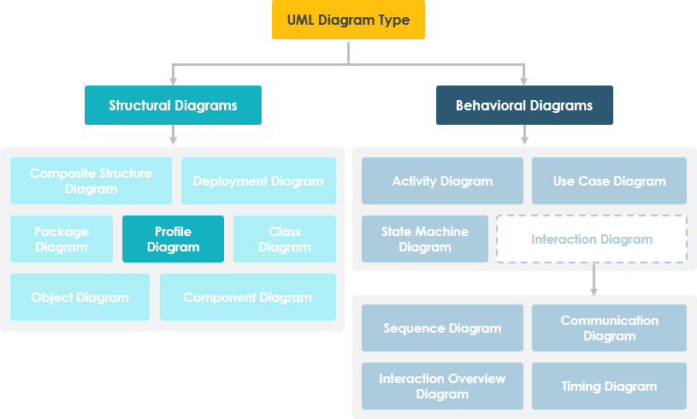
What is Profile Diagram in UML?
Notes:
Profile diagram, a kind of structural diagram in the Unified Modeling Language (UML), provides a generic extension mechanism for customizing
UML models for particular domains and platforms. Extension mechanisms allow refining standard semantics in strictly additive manner, preventing them from contradicting standard semantics.
Profiles are defined using stereotypes, tagged value definitions, and constraints which are applied to specific model elements, like Classes, Attributes, Operations, and Activities. A Profile is a collection of such extensions that collectively customize UML for a particular domain (e.g., aerospace, healthcare, financial) or platform (J2EE, .NET).

Slide 30
What is Profile Diagram in UML?
As a general purpose modeling language, UML provides a stable basis for a wide variety of requirements
It is not defined for specific application domains or for any specific technology
Profile diagram, a kind of structural diagram in the Unified Modeling Language (UML)
Profile diagram is structure diagram which describes lightweight extension mechanism

Slide 31
What is Profile Diagram in UML?
Profiles allow adaptation of the UML metamodel for different platforms or domains
It does not allow to modify existing metamodels or to create a new metamodel as MOF does
Profile only allows adaptation or customization of an existing metamode

Slide 32

Stereotypes
Notes:
Stereotypes allow you to increase vocabulary of UML.
You can add, create new model elements, derived from existing ones but that have specific properties that are suitable to your problem domain.
Stereotypes are used to introduce new building blocks that speak the language of your domain and look primitive. It allows you to introduce new graphical symbols.
Stereotype is a profile class which defines how an existing metaclass may be extended as part of a profile. It enables the use of a platform or domain specific terminology or notation in place of, or in addition to, the ones used for the extended metaclass.
Stereotype is applied when it is used on use case diagrams, class diagrams, deployment diagrams, etc.

Slide 33

Tagged values
Notes:
Tagged values are used to extend the properties of UML so that you can add additional information in the specification of a model element. It allows you to specify keyword value pairs of a model where keywords are the attributes.
Properties of a stereotype are referred to as tag definitions (or metaproperties).
Tagged values are graphically rendered as string enclose in brackets.
For Example: Consider a release team responsible for assembling,
testing and deployment of a system. In such case it is necessary to keep a track on version and test results of the main subsystem.
Tagged values are used to add such info.
Code generation
Version control
Configuration management
Authorship
Etc
Tagged Values are additional properties that can be assigned to UML elements and connectors. The UML defines properties such as name and description for elements and connectors, and Enterprise Architect adds a number of additional properties such as status, phase and author, but Tagged Values provide a means of defining your own properties (tags) and their values.

Slide 34

Constraints
Notes:
They are the properties for specifying semantics or conditions that must be held true at all the time. It allows you to extend the semantics of UML building block by adding new protocols. Graphically a constraint is rendered as string enclose in brackets placed near associated element.
For example: In development of a real time system it is necessary to adorn the model with some necessary information such as response time. A constraint defines a relationship between model elements that must be use {subset} or {xor}. Constraints can be on attributes, derived attributes and associations. It can be attached to one or more model elements shown as a note as well.

Slide 35
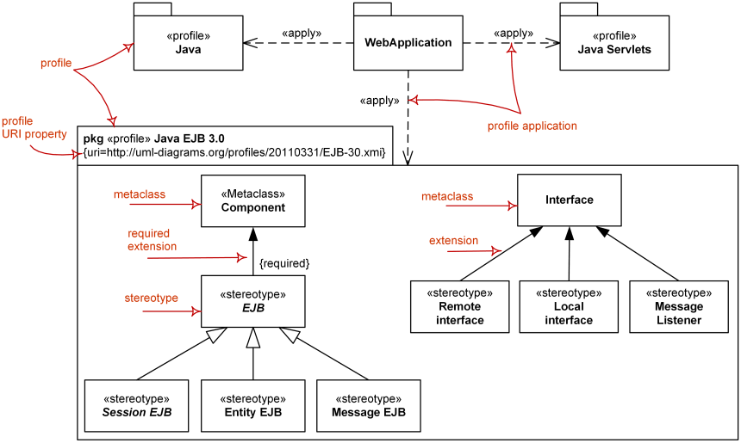
EJB Example
Notes:
In the figure below, we define a profile of EJB as a package. The bean itself is extended from component metamodel as an abstract bean. The abstract bean can be concreted as either an Entity Bean or Session Bean. An EJB has two types of remote and home interfaces. An EJB also contains a special kind of artifact called JAR file for storing a collection of Java code.

Slide 36
Exercise 3
Initialize a new Git repository
Enable Git LFS, make the proper filtering for eap files
Download and install LemonTree and configure as diff and merge tool

Slide 37
Introduction to MDG technology

Slide 38
Model Driven Generation
MDG Technologies allow users to extend Enterprise Architect's modeling capabilities to specific domains and notation
MDG Technologies seamlessly plug into Enterprise Architect to provide additional toolboxes, UML profiles, patterns, templates and other modeling resources
https://sparxsystems.com.au/resources/mdg_tech/

Slide 39
Model validation, testing with Yakindu-EA bridge

Slide 40

Thank you
atbalog@microsoft.com

