Slide 1
Programming basics 1. 20119.08.30 Attila Balogh-Biró

Slide 2
Learning objectives

Slide 3
Learning objectives
Programming languages concepts
Introduction to algorithms and basic programming concepts(controll statements, variables, loops)
„Hello World!”
Native vs Interpreted?

Slide 4
Programming languages concepts

Slide 5
What is programming language?
A programming language is a set of rules that provides a way of telling a computer what operations to perform
It provides a linguistic framework for describing computations
A programming language is a notational system for describing computation in a machine-readable and human-readable form. A programming language is a notational system for describing computation in a machine-readable and human-readable fo
Notes:
You can deploy, manage, and monitor all the resources for your solution as a group, rather than handling these resources individually.
You can repeatedly deploy your solution throughout the development lifecycle and have confidence your resources are deployed in a consistent state.
You can manage your infrastructure through declarative templates rather than scripts.
You can define the dependencies between resources so they're deployed in the correct order.
You can apply access control to all services in your resource group because Role-Based Access Control (RBAC) is natively integrated into the management platform.
You can apply tags to resources to logically organize all the resources in your subscription.
You can clarify your organization's billing by viewing costs for a group of resources sharing the same tag.

Slide 6
What is programming language?
English is a natural language.
It has words, symbols and grammatical rules.
A programming language also has words, symbols and rules of grammar.
The grammatical rules are called syntax.
Each programming language has a different set of syntax rules.
Notes:
You can deploy, manage, and monitor all the resources for your solution as a group, rather than handling these resources individually.
You can repeatedly deploy your solution throughout the development lifecycle and have confidence your resources are deployed in a consistent state.
You can manage your infrastructure through declarative templates rather than scripts.
You can define the dependencies between resources so they're deployed in the correct order.
You can apply access control to all services in your resource group because Role-Based Access Control (RBAC) is natively integrated into the management platform.
You can apply tags to resources to logically organize all the resources in your subscription.
You can clarify your organization's billing by viewing costs for a group of resources sharing the same tag.

Slide 7
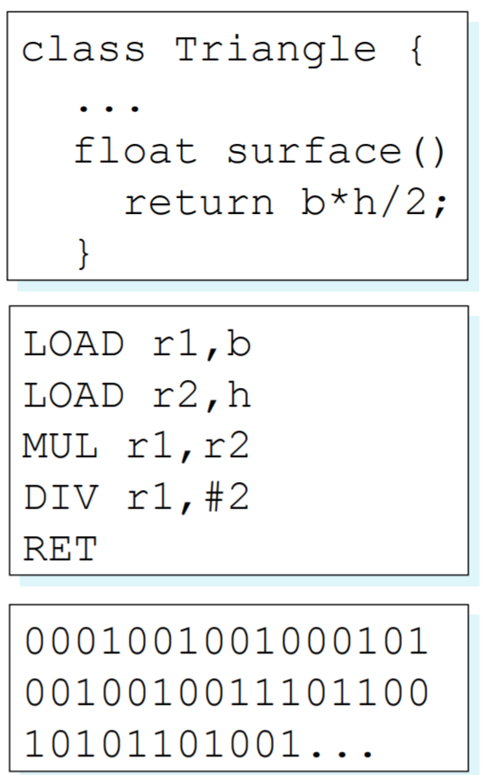
Abstraction levels of programming languages

Slide 8
The principal paradigms
Imperative Programming (C)
Object-Oriented Programming (Java)
Logic/Declarative Programming (Prolog, SQL)
Functional/Applicative Programming (Scala)

Slide 9
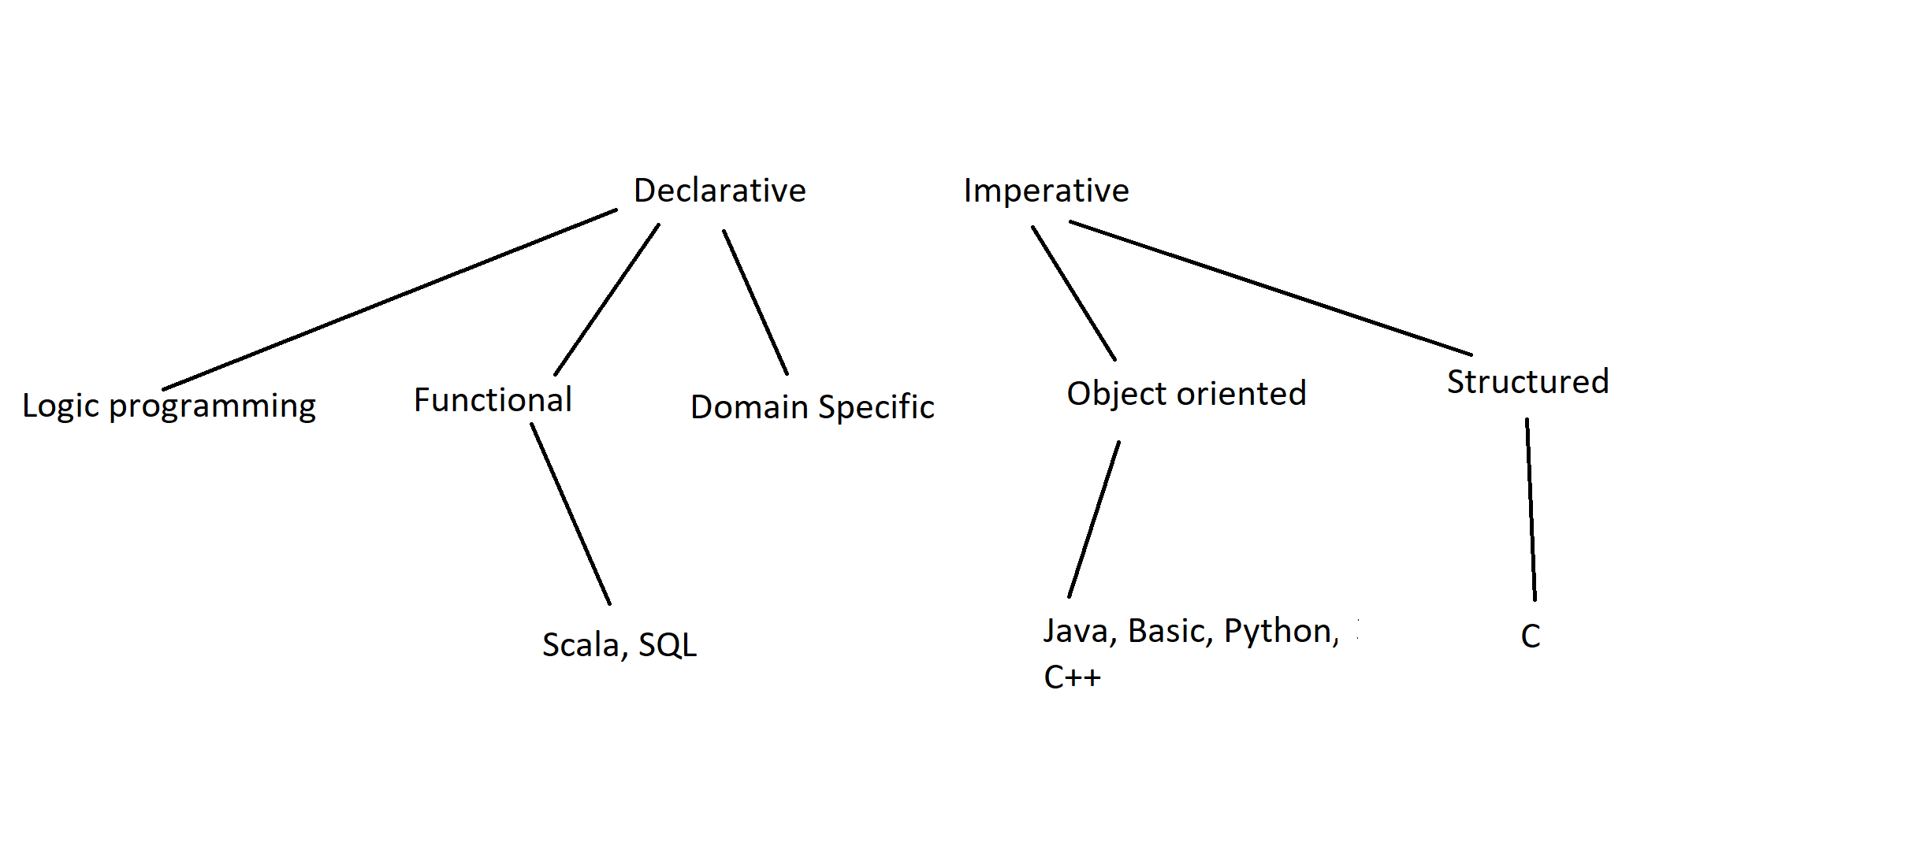
What are the differences?

Slide 10
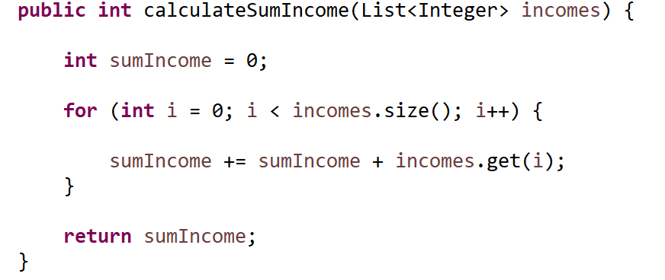
An imperative example

Slide 11
An imperative example
A declarative example

Slide 12
The basic building block of program writing and execution
Source code (text files with code (Java, C, C#, etc.)
Source code repository (GitHub, Azure Devops etc.)
Integrated development environment (Visual Studio, Eclipse etc.)
Compiler / Interpreter (compiles the source files to binaries)
Execution environment (JVM, .NET CLR etc)

Slide 13
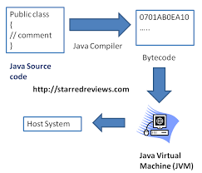
Development steps
Notes:
Itt beszelek majd a Native vs Interpretalt nyelvekrol stb…

Slide 14
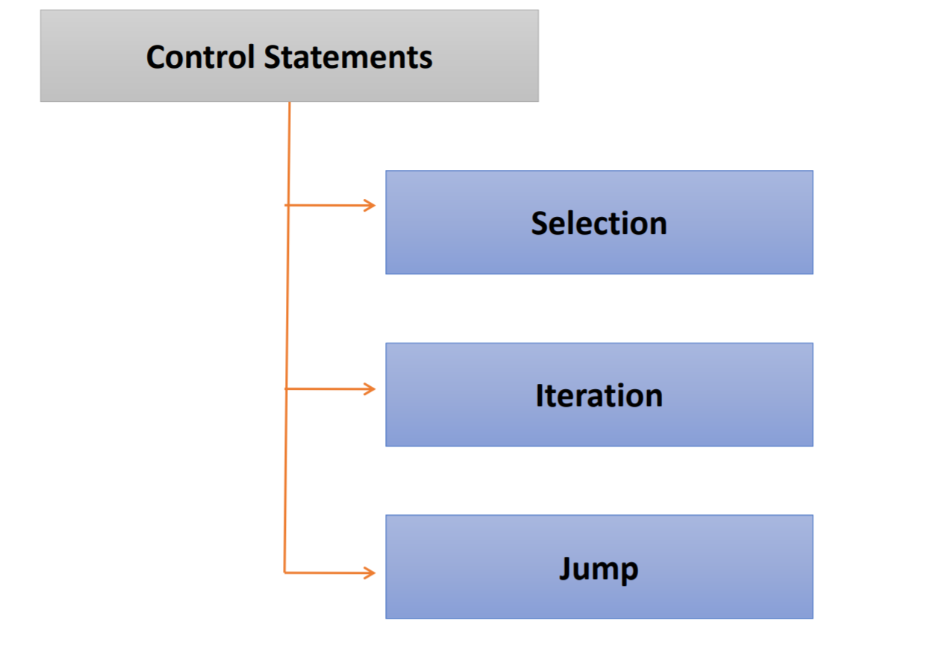
Outlines

Slide 15
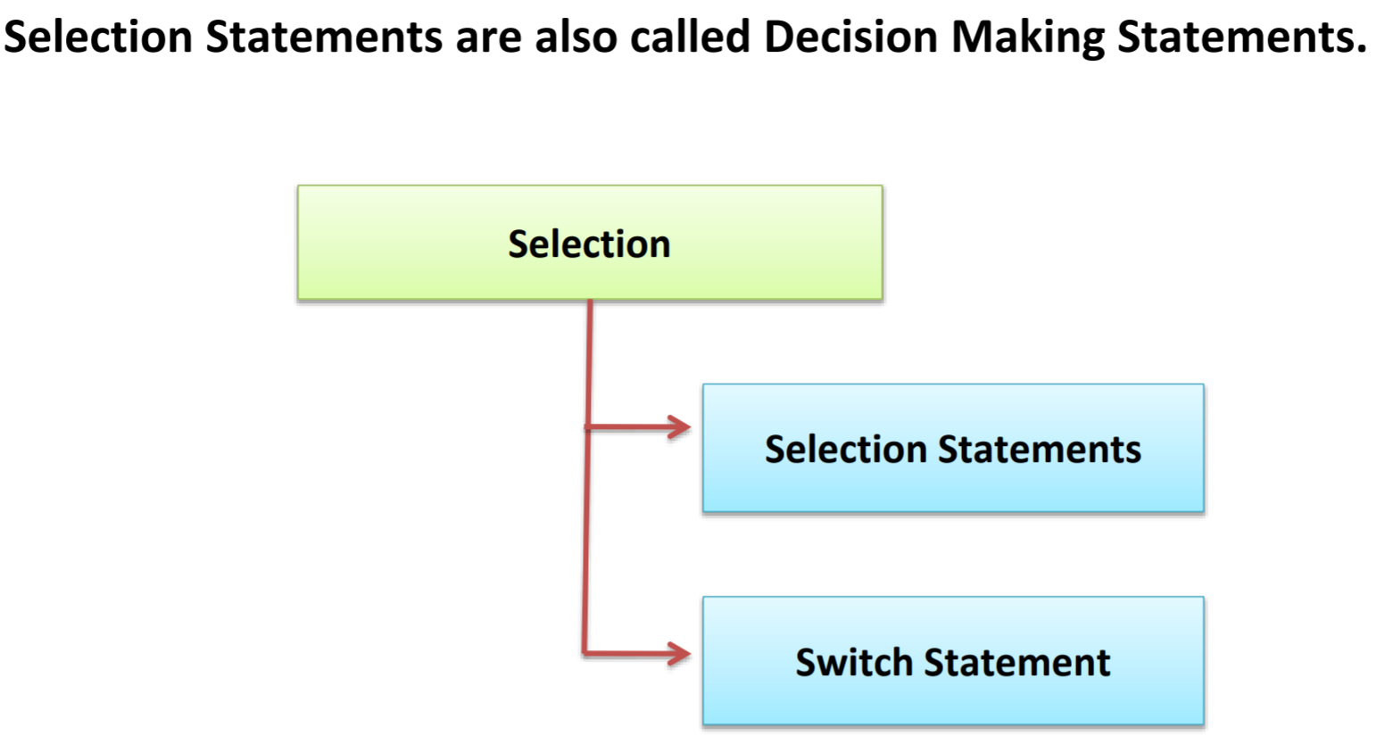
Selections

Slide 16
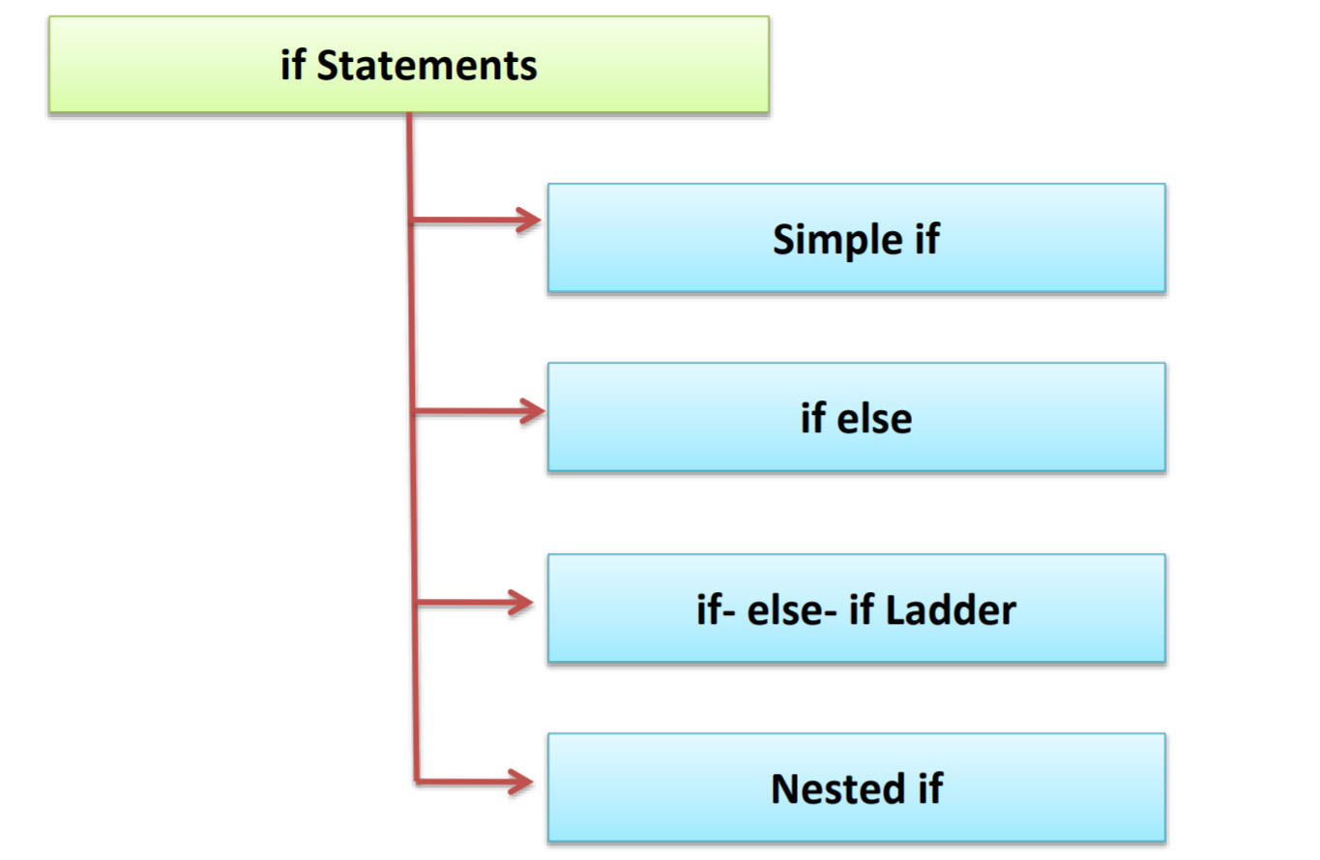
IF statement

Slide 17
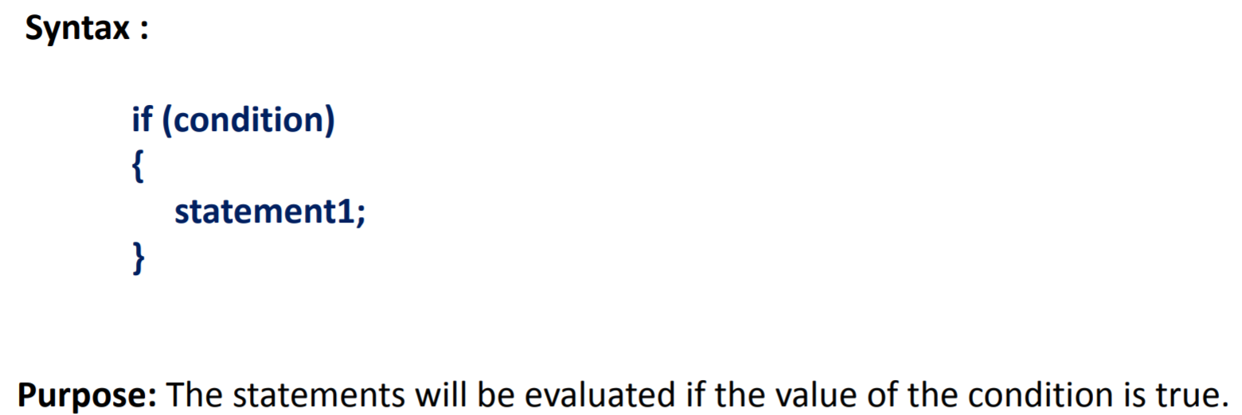
Simple IF

Slide 18
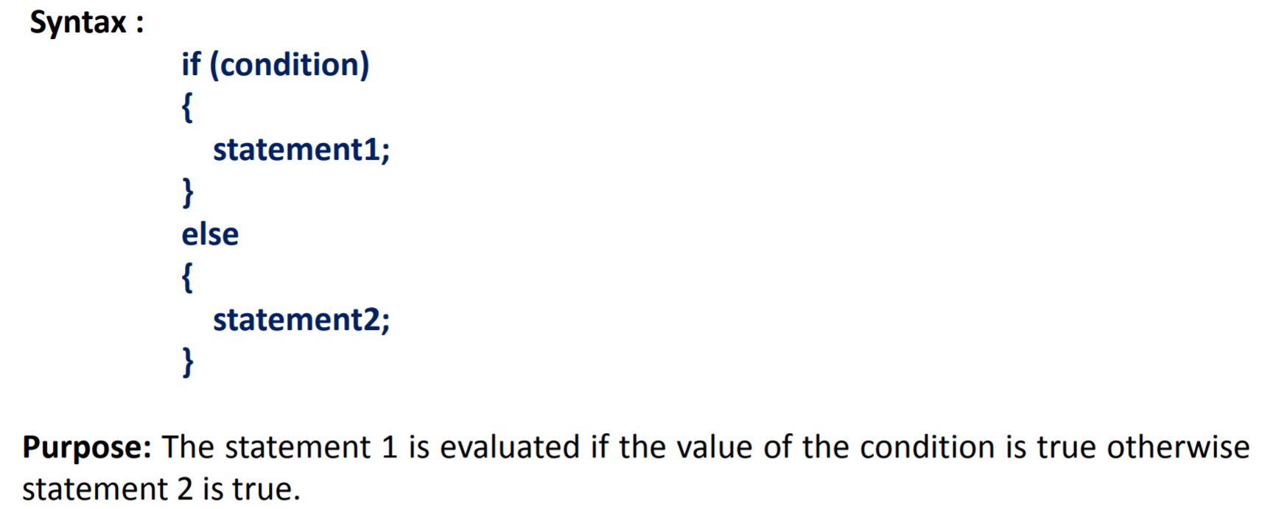
IF ELSE

Slide 19
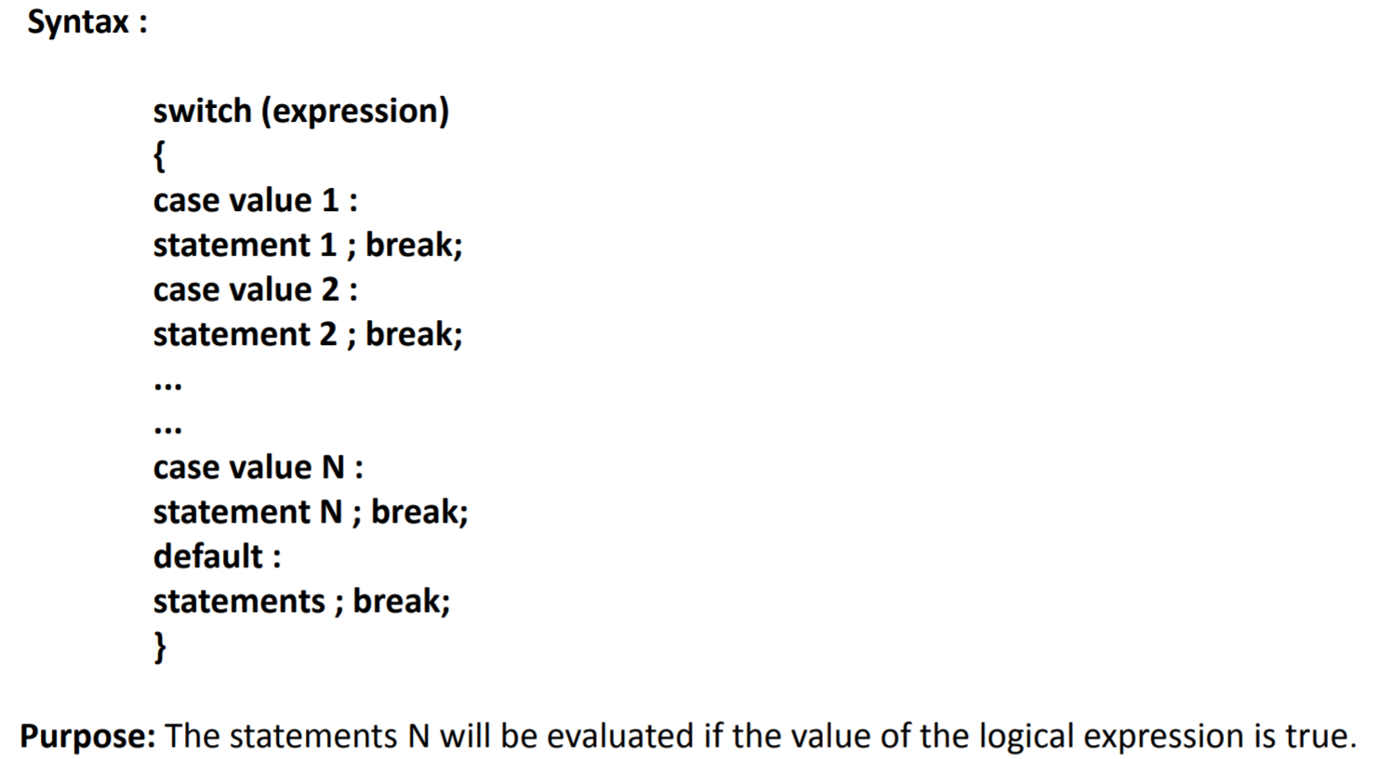
SWITCH

Slide 20
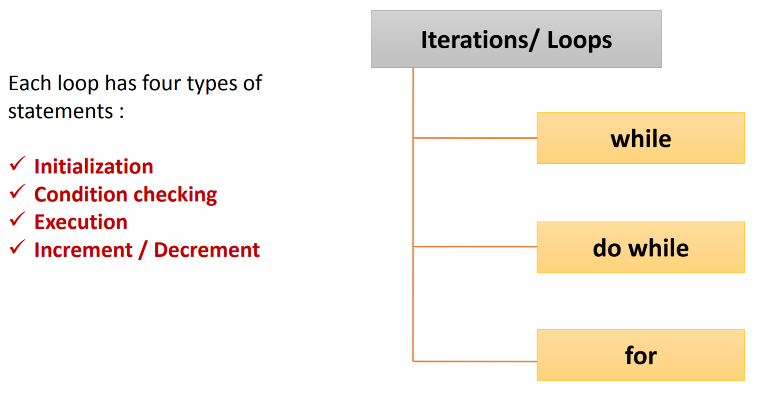
Iterations / Loops

Slide 21
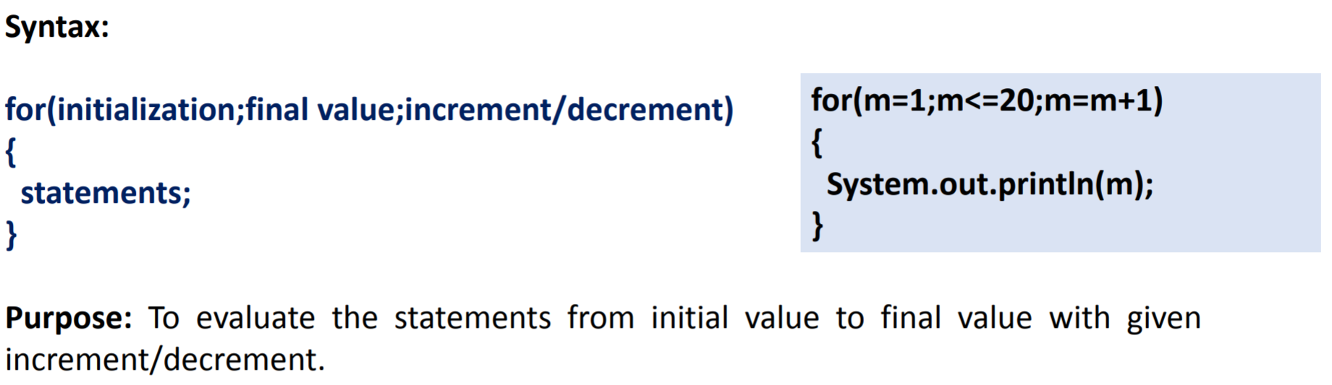
For cycle

Slide 22
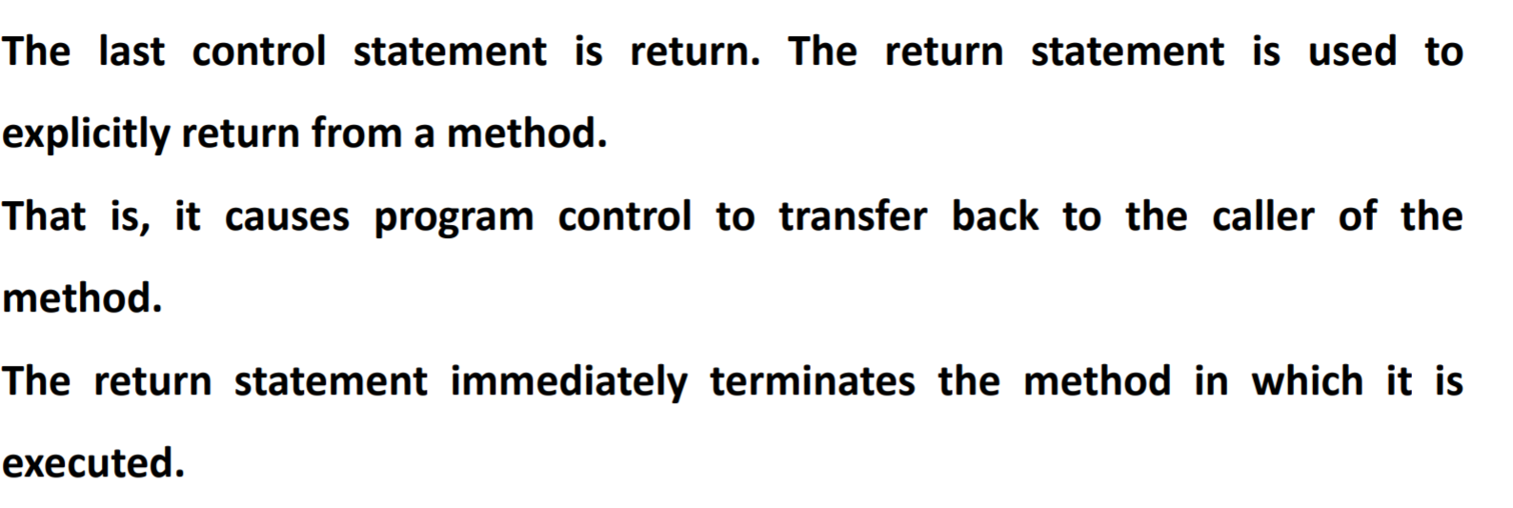
The return statement

Slide 23
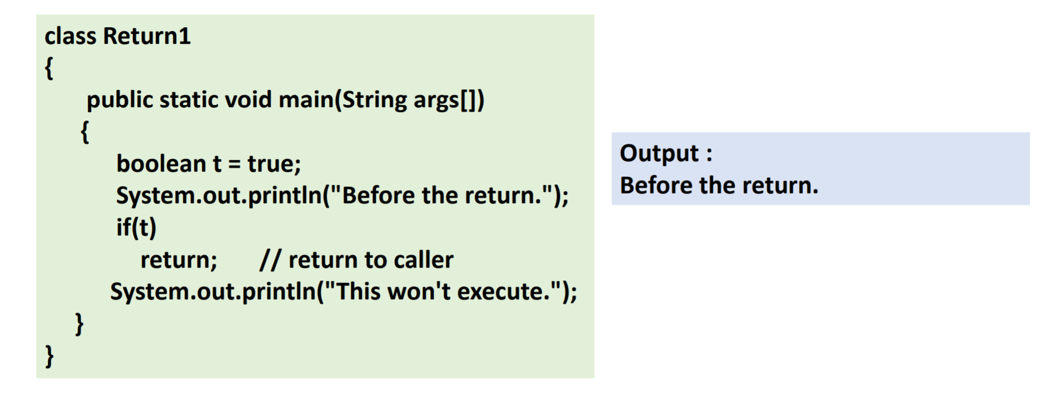
Return statement example

Slide 24
Our current development toolset
Eclipse (STS) integrated development environment
Java Development Kit 12
Git for Windows
CMD
Notepad++

Slide 25
Demo> Hello World!

Slide 26
THANK YOU!

