Slide 1


Slide 2





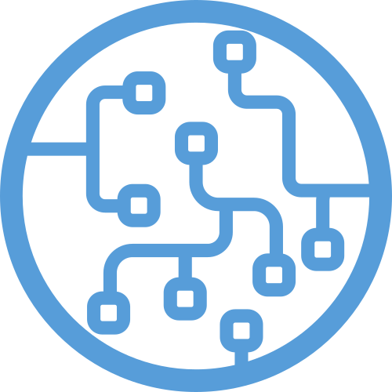

Slide 3
Introduction to MERN stack
Aswin Babu Karuvally

Slide 4
Why learn web programming?

Slide 5
Server side programming

Slide 6
Client side programming

Slide 7
Can we develop a client side only app?

Slide 8
What is a stack?

Slide 9
Why MERN stack?

Slide 10
Why use Linux?

