Slide 1
IFN – RIP

Slide 2
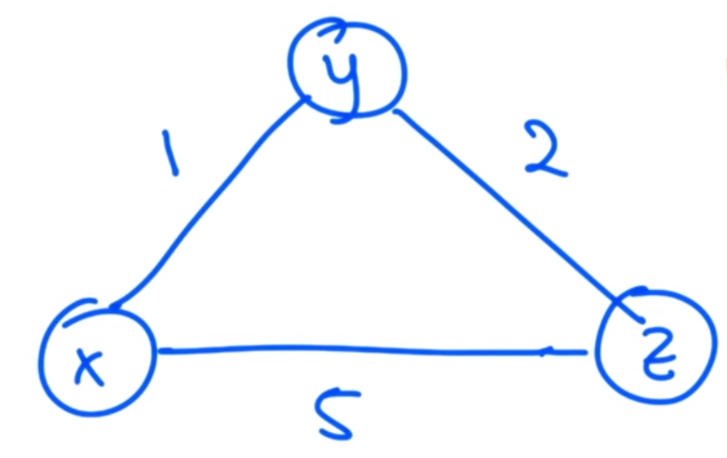
Distance vector algorithm
•the distance vector algorithm (Bellman Ford)
•The idea is to find the least cost path between two nodes.
•Each nodes sends its distance information vector to each adjacent node.
•Ex node X at the beginning of the network will have a distance vector looking like:
•Even though the path to Z is shorter going through Y, X doesn’t know that yet.
•When each node has received its adjacent nodes vector, it can update its routing table and us e the shortest path.
 | X | Y | Z
X | 0 | 1 | 5
Y
Z

Slide 3
Topology changes and preventing instability
•in RIP every router that participates in routing sends an update message to all its neighbors once every 30 seconds.
•If a node crashes or a connection is lost to a node an update message will not be sent, and the neighboring node will timeout the connection to the crashed node(180s)
•Routing table will be updated and the metric to the crashed node will be inf
•Messages could be lost with this implementation

Slide 4
Multicast addresses used by RIP
RIPv2
224.0.0.9
ff02::9

Slide 5
Split horizon mechanism
Implemented to prevent routing loops
”Do not advertise a route back out to a router/interface that youmlearned the route from”

Slide 6
Triggered updates
Whenever a router changes the metric for a route, its required to send update messages almost immediately
Update goes out to all its neighbors
Only neighbors who are effected by the update will use it, others will ignore it
However regular updates and trigged updates can interfere if trigged updates don’t happen quick enough

Slide 7
Protocol specification
Each entry for every destination that is reachable in a rip operating system consist at least:
The IPv4 address of the destination
A metric
The IPv4 address of the next destination (next hop)
A flag (if information about the route has changed)
Various timers associated with the route

Slide 8
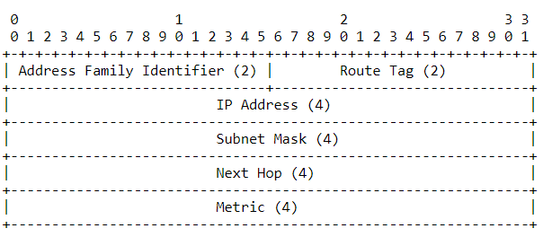
messages
RIP is a UDP-based protocol
RIP packet format is:

Slide 9
Considerations: Auth. And security message

