Slide 1
DHCP
Submittet by
Stinus Skovgaard
Daniel Tøttrup
Philip Schmidt

Slide 2
What problems does DHCP tackle?
Dynamic Host configuration Protocol
DHCP automatically provides an IP host with an IP address and other related configuration information like subnet mask, default gateway and DNS
Less administrative work

Slide 3
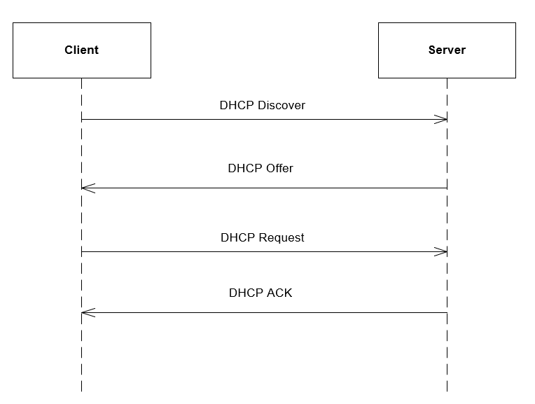
How does it work?

Slide 4
What protocol messages are included and what are the used for?

Slide 5
How could this be modeled using a state diagram

Slide 6
In what ways can you challenge yourself to get a deeper understanding of DHCP?
Use google
Read about DHCP in various books

