Slide 1
IFN – DHCP

Slide 2
DCHP - advantages
Dynamic Host configuration Protocol
DHCP automatically provides an IP host with an IP address and other related configuration information like subnet mask, default gateway and DNS
Less administrative work

Slide 3
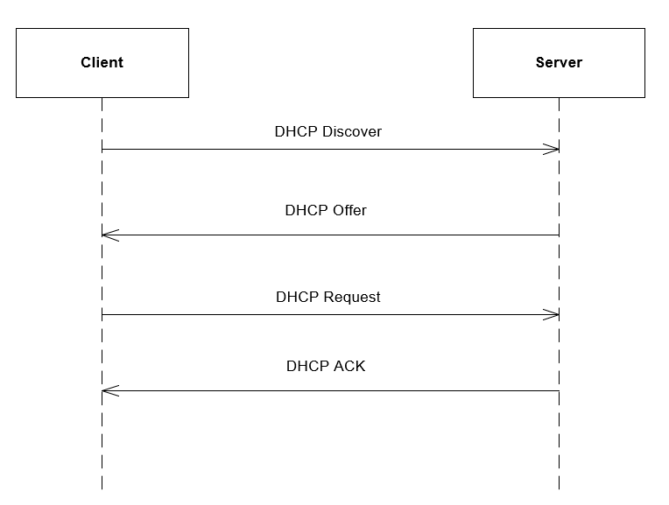
DHCP – How?

Slide 4
DHCP – Protocol messages
DHCPDISCOVERY
Broadcast to find DHCP servers
DHCPOFFER
Granting access (IP address, MAC addr, lease duration)
DHCPREQUEST
Choosing specific server as request
DHCPACKNOWLEDGEMENT
Returning ACK (Lease duration)

Slide 5
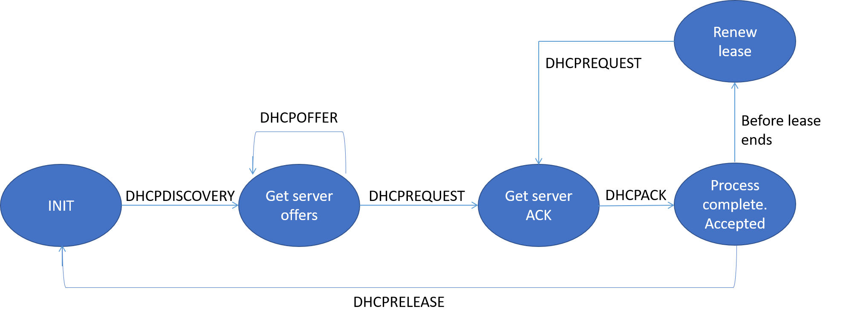
DHCP – states

Slide 6
DCHP – a deeper understanding?
Various books offering great detailed information about DHCP
Protocols, advantages etc.
Implementing a code-based DHCP project

