Slide 1
IFN – RIP

Slide 2
Distance vector algorithm

Slide 3
Topology changes and preventing instability

Slide 4
Multicast addresses used by RIP
RIPv2
224.0.0.9
ff02::9

Slide 5
Split horizon mechanism
Implemented to prevent routing loops
”Do not advertise a route back out to a router/interface that youmlearned the route from”

Slide 6
Triggered updates
Whenever a router changes the metric for a route, its required to send update messages almost immediately
Update goes out to all its neighbors
Only neighbors who are effected by the update will use it, others will ignore it
However regular updates and trigged updates can interfere if trigged updates don’t happen quick enough

Slide 7
Protocol specification
Each entry for every destination that is reachable in a rip operating system consist at least:
The IPv4 address of the destination
A metric
The IPv4 address of the next destination (next hop)
A flag (if information about the route has changed)
Various timers associated with the route

Slide 8
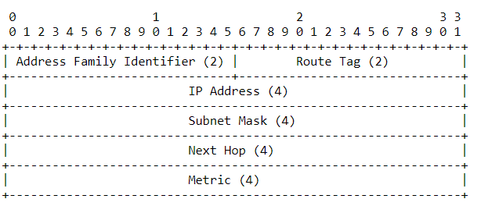
messages
RIP is a UDP-based protocol
RIP packet format is:

Slide 9
Considerations: Auth. And security message

