Slide 1
ELECTRIC POWER CONSUMPTION FORECASTING USING TIME SERIES ANALYSIS
Team members:
Anusha Nandy SE20UARI023
Bhargavi Gorthy SE20UMEE010
Mehek Khan SE20UARI094
Phalguna Reddy SE20UCSE120

Slide 2
Introduction
Objective:
To predict real-world meteorological data, such as power consumption, using various time series models.
Importance:
Accurate power consumption forecasting helps in optimizing resource allocation, reducing operational costs, and improving energy management.

Slide 3
Time Series
Time series refers to a collection of data points recorded in a sequential order over time.
Parameters:
Trend
Seasonality
Residual

Slide 4
Dataset Overview
Power Consumption of Tetouan City
Power Consumption of Tetouan City - UCI Machine Learning Repository
This dataset is related to power consumption of three different distribution networks of Tetouan city which is located in north Morocco.
Dataset Information
Characteristics: Multivariate, Time-Series
Associated Tasks: Regression, Forecasting
Instances: 52,417
Features: 6
Missing Values: No

Slide 5
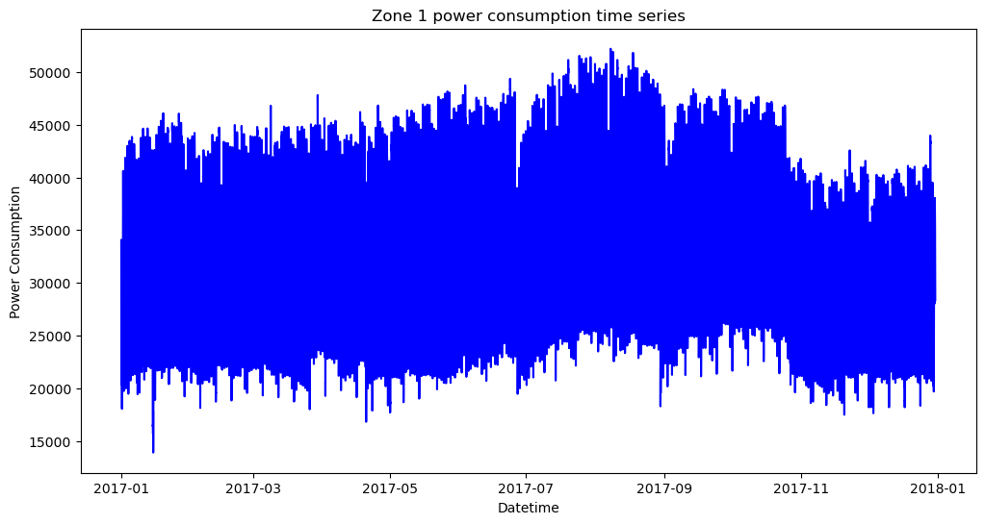
Overview
52417 electricity consumption measured every 10 minutes from 01/01/2017 00:00:00 to 31/12/2017 23:50:00
Comparing different approaches to modelling:
Linear Regression
Exponential Smoothing
ARIMA
SARIMA
Goal is to predict future consumption values

Slide 6
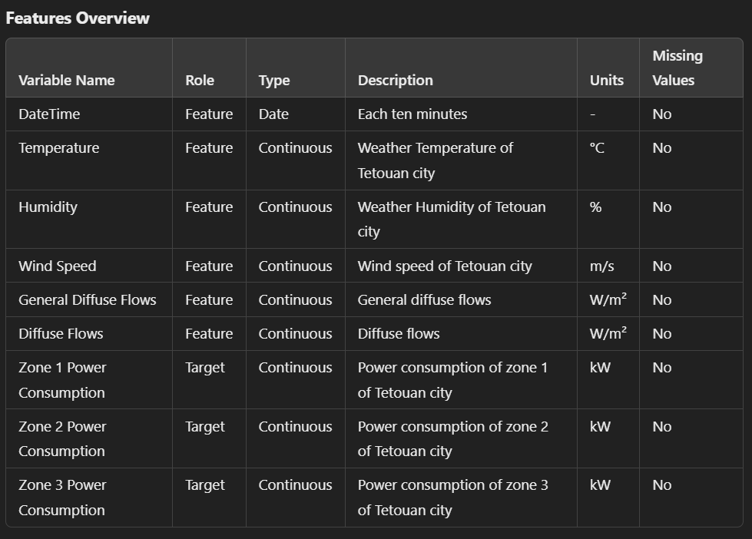
Features overview
The dataset consists of comprehensive weather parameters and power consumption metrics for three zones in Tetouan city.
Each feature provides valuable insights into the environmental conditions and energy usage patterns, enabling detailed analysis and accurate forecasting.

Slide 7
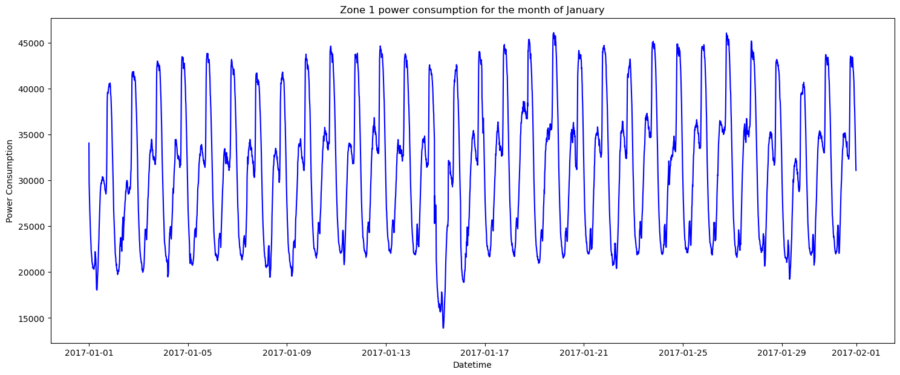
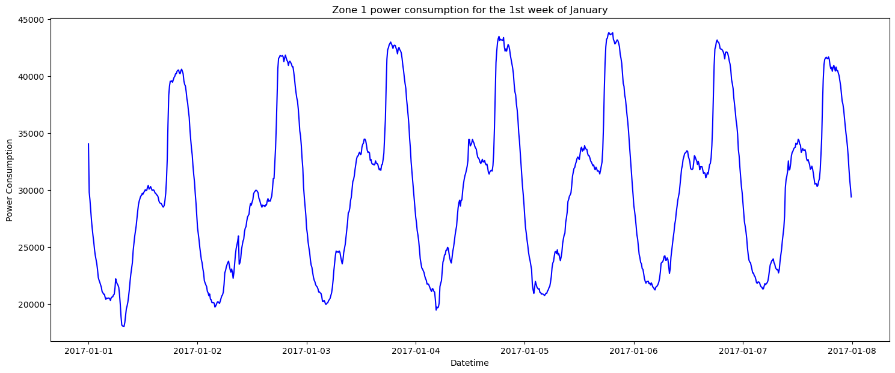
Seasonality Analysis
Two variables → Power, Date (date-hour labels)
no duplicates or missing values
Monthly and daily seasonality (graphs plotted for the month of Jan)

Slide 8
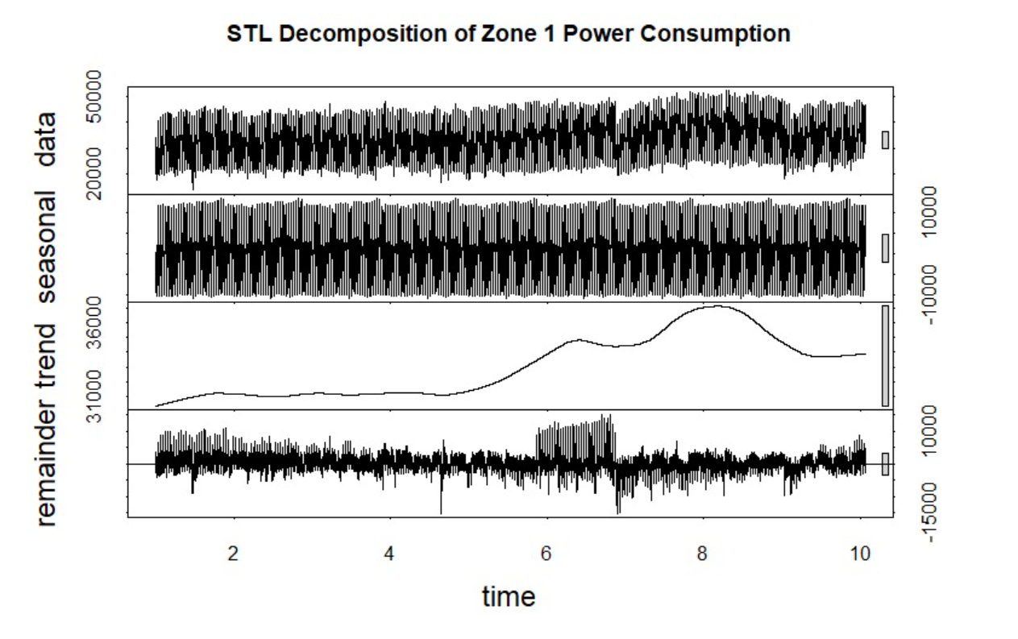
Seasonality and Trend
Seasonality Analysis:
Identify and visualize repeating patterns over time in power consumption data.
Trend Analysis:
Detect long-term movement or direction in the power consumption data.
Residual Analysis:
Evaluate the residuals (errors) to understand the model's accuracy and identify any patterns not captured by the model.

Slide 9
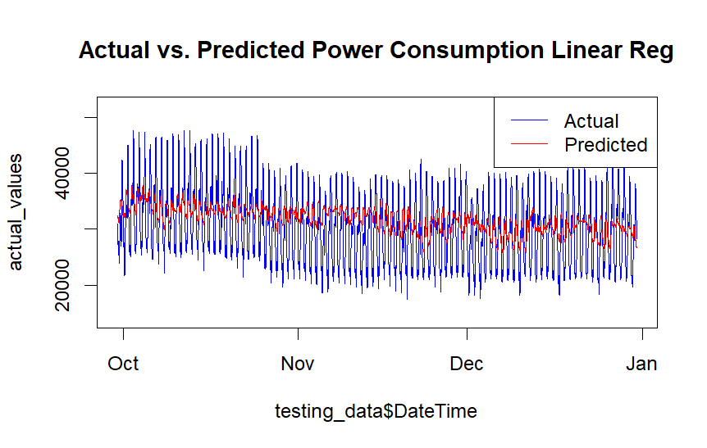
Linear Regression
RMSE: 5988.361

Slide 10
Exponential Smoothing
Exponential Smoothing is a time series forecasting method that applies decreasing weights to past observations.
The method assigns exponentially decreasing weights as the observations get older, making recent observations more influential.

Slide 11
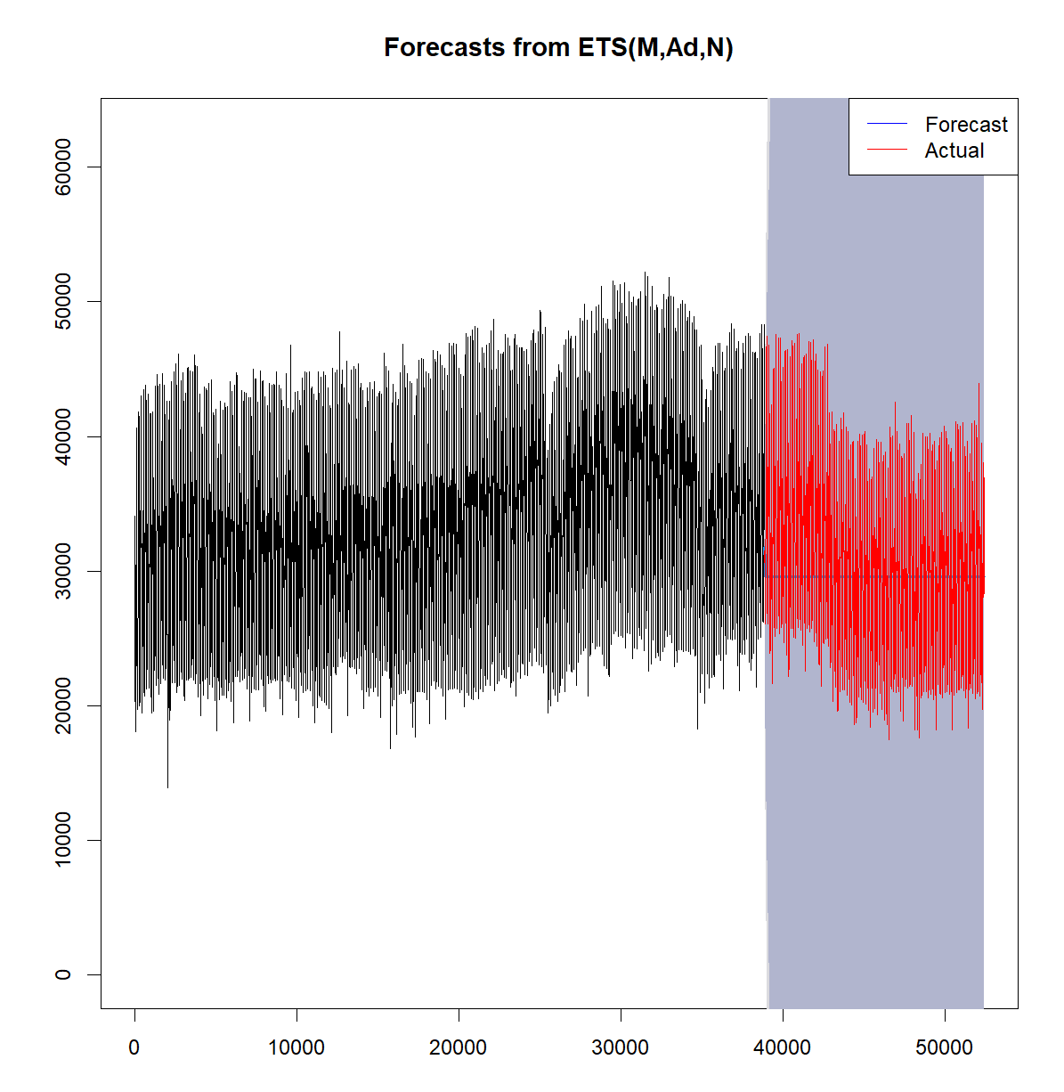
Inference
Model Accuracy:
The forecasted values (blue line) closely follow the actual values (red line) during the testing period, indicating that the ETS model has captured the underlying pattern in the data well.
The close alignment suggests that the ETS model is effective in predicting the power consumption of Zone 1 in Tetouan city.

Slide 12
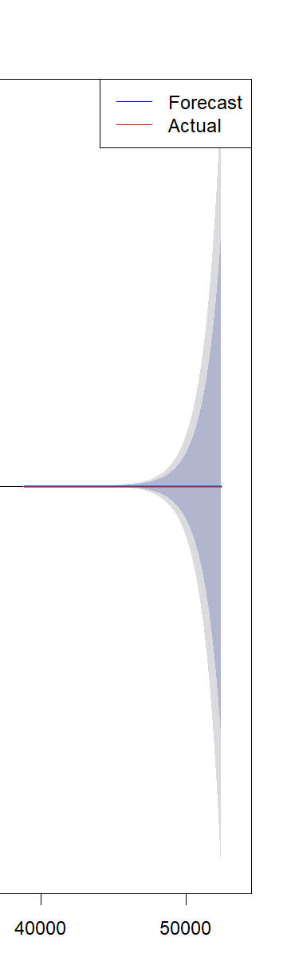
Inference
Prediction Intervals:
The shaded area around the forecast values indicates the confidence intervals.
The smooth expansion of the confidence intervals in the ETS model is due to the nature of the Exponential Smoothing method. This method assumes that future uncertainty increases in a predictable manner, resulting in gradually widening intervals.
The actual values fall within the prediction intervals, confirming the reliability of the model's predictions.

Slide 13
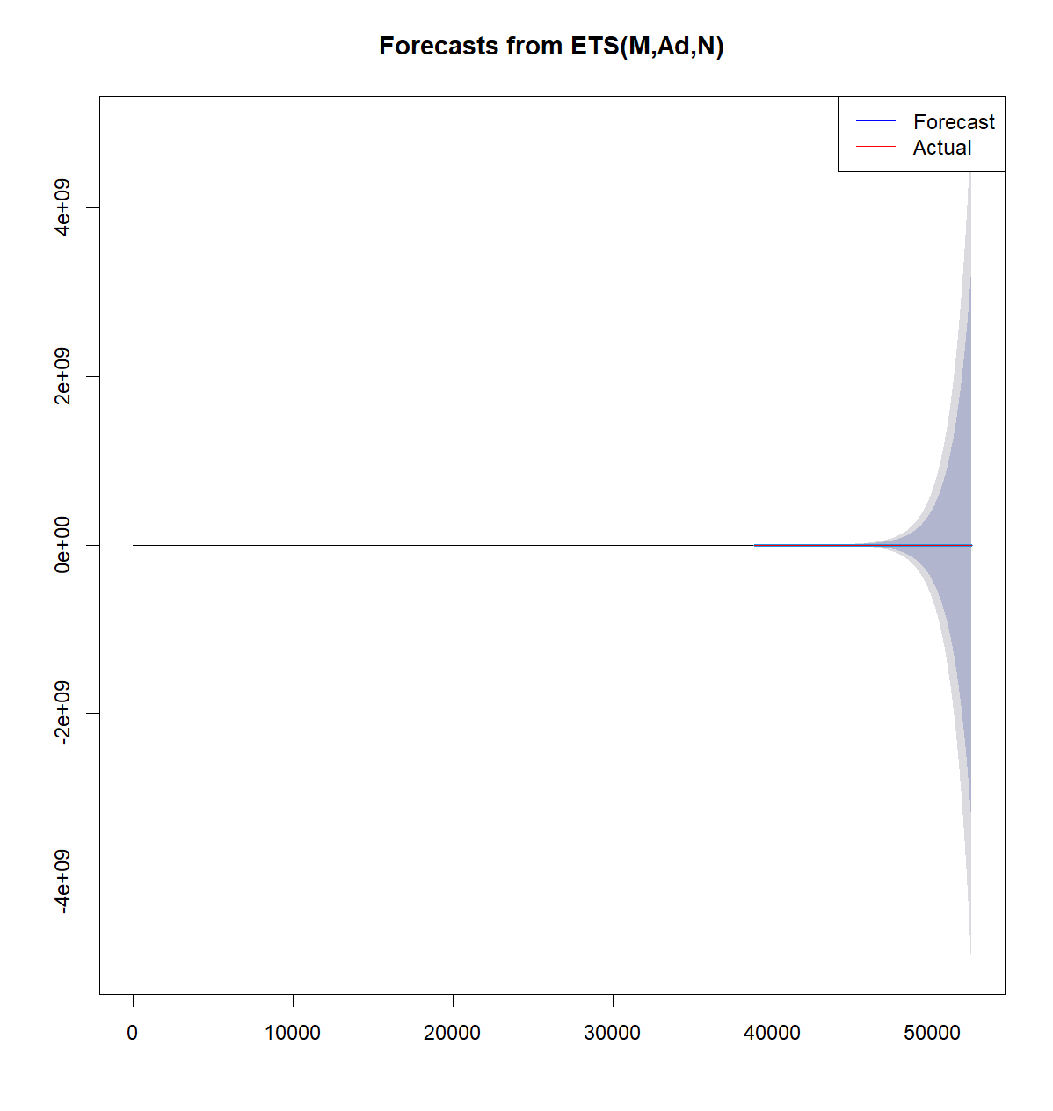
Error Metrics
Accuracy Score
MAE: 0.0119112770058996
RMSE: 983.2896

Slide 14
ARIMA Model
The ARIMA (AutoRegressive Integrated Moving Average) model is a popular statistical method used for time series forecasting.
It combines three components: autoregression (AR), differencing (I) to make the time series stationary, and moving average (MA).
The ARIMA model is denoted as ARIMA(p, d, q), where:
p: Number of lag observations included in the model (AR term).
d: Number of times the raw observations are differenced (I term).
q: Size of the moving average window (MA term).

Slide 15
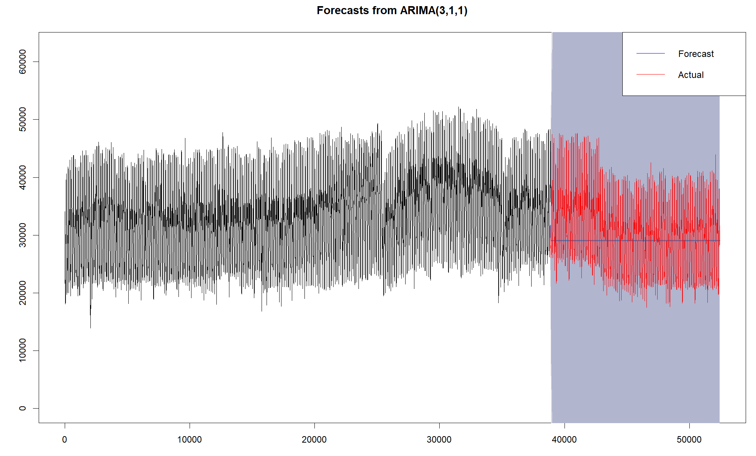
Inference
Model Accuracy:
The forecasted values (blue line) closely follow the actual values (red line) during the testing period.
This indicates that the ARIMA model has captured the underlying pattern in the data well.

Slide 16
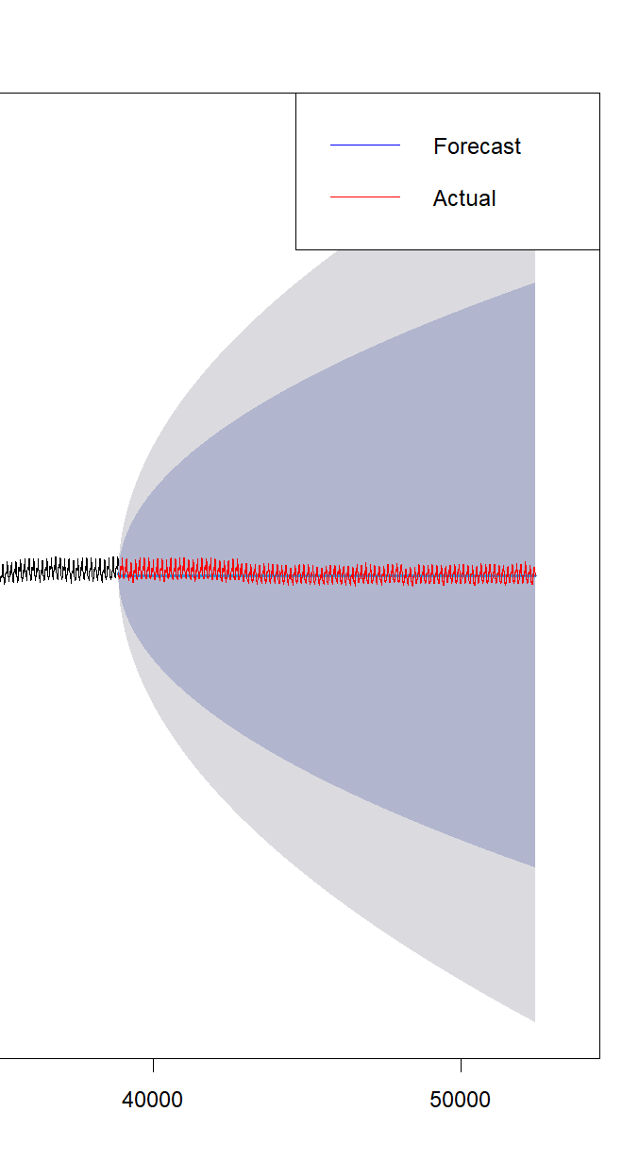
Inference
Prediction Intervals:
The shaded area around the forecast values indicates the confidence intervals.
These intervals widen as the forecast horizon increases.
This is expected in time series forecasting as uncertainty grows over time.

Slide 17
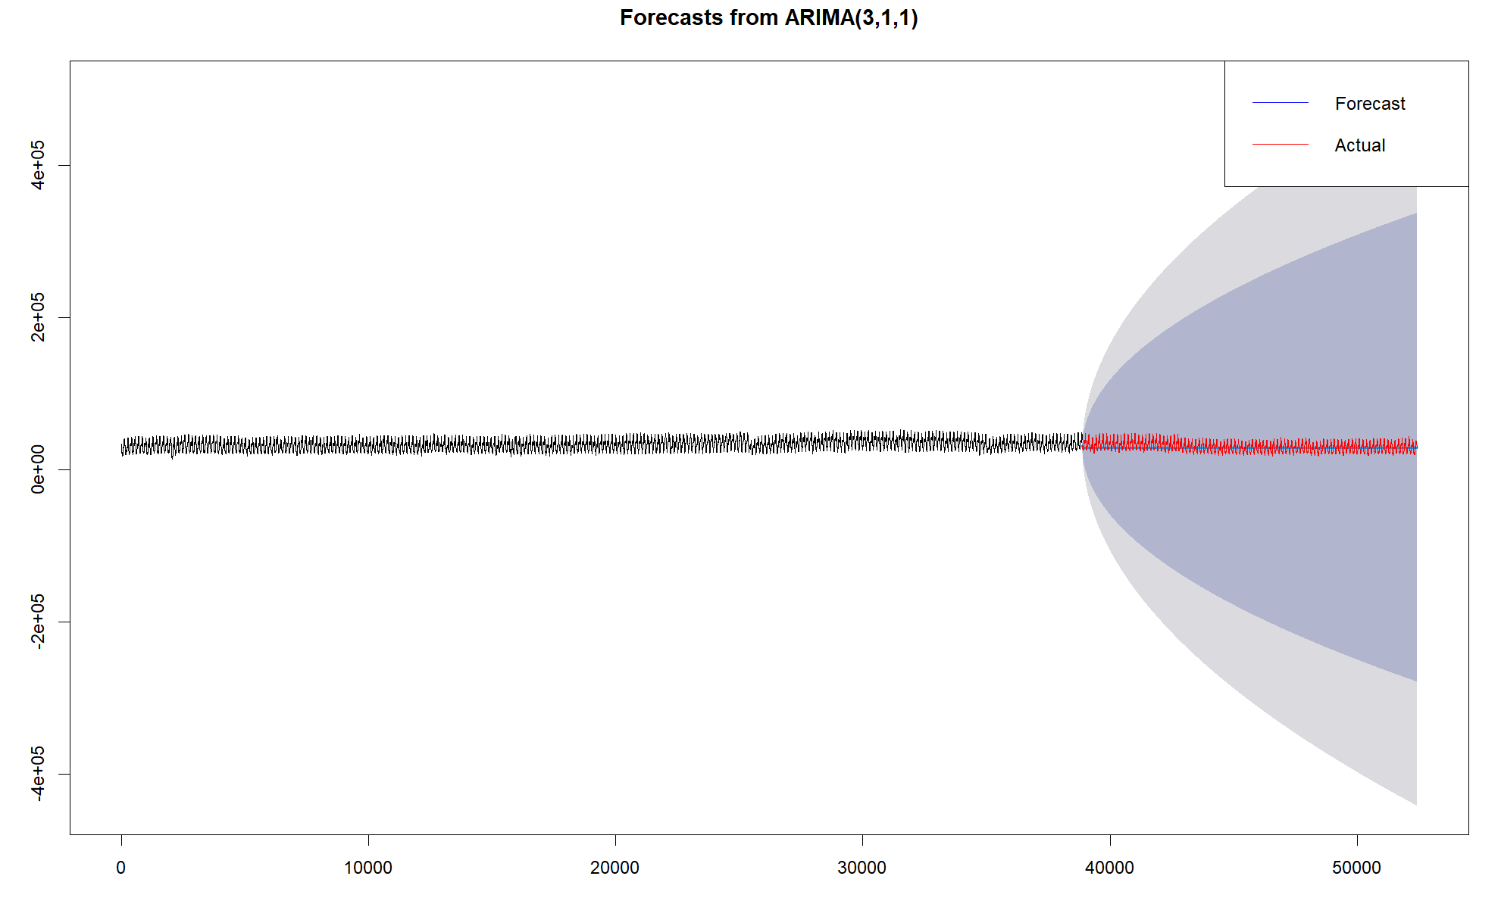
Error Metrics
Accuracy Score
MAE:0.011911277
RMSE:1378.521

Slide 18
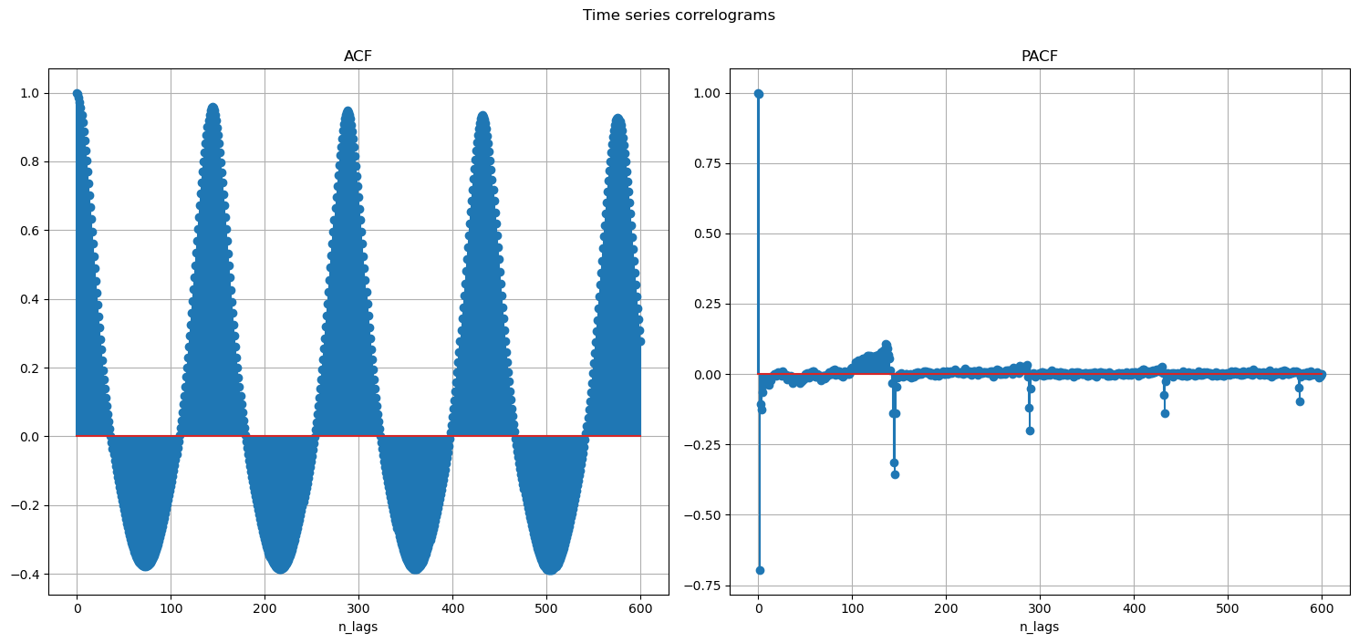
SARIMA - Data Exploration
ACF and PACF Test

Slide 19
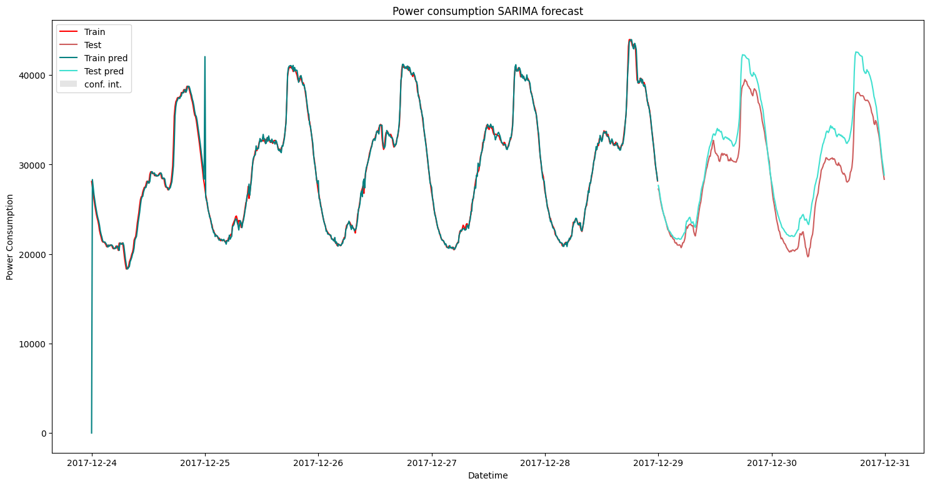
SARIMA
RMSE: 1646.371
s = 144
p = 2
d = 1
P = 0
Q = 1
D = 1

Slide 20
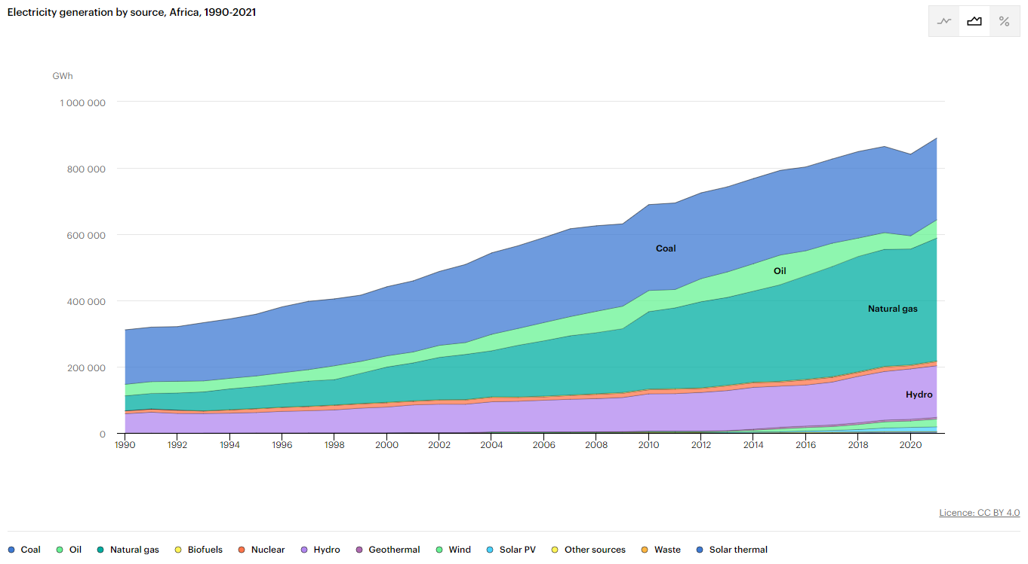
Use Case: Carbon Emissions
Electricity Generation by Source
International Energy Agency (IEA)

Slide 21
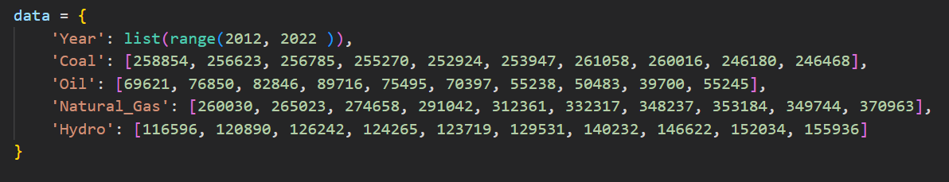
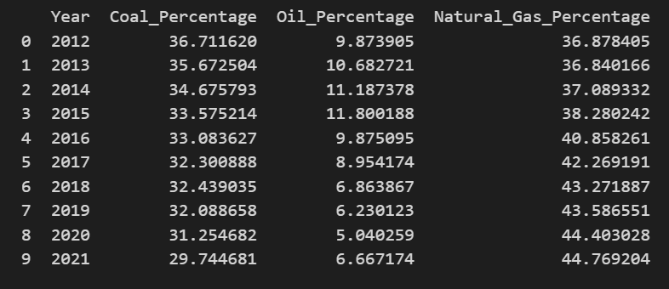
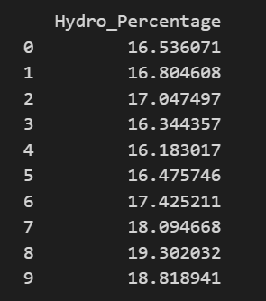
Prepare the data and calculate percentages

Slide 22
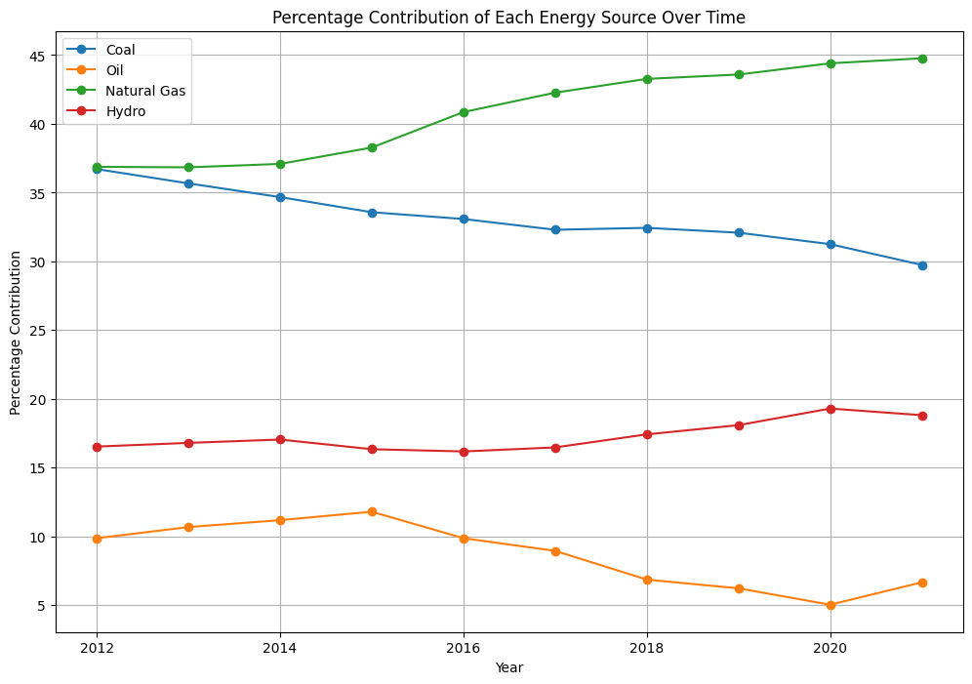
Carbon Emissions factor per unit energy produced:
Coal: 2.46
Oil: 2.52
Natural Gas: 1.96
Hydro: 0

Slide 23
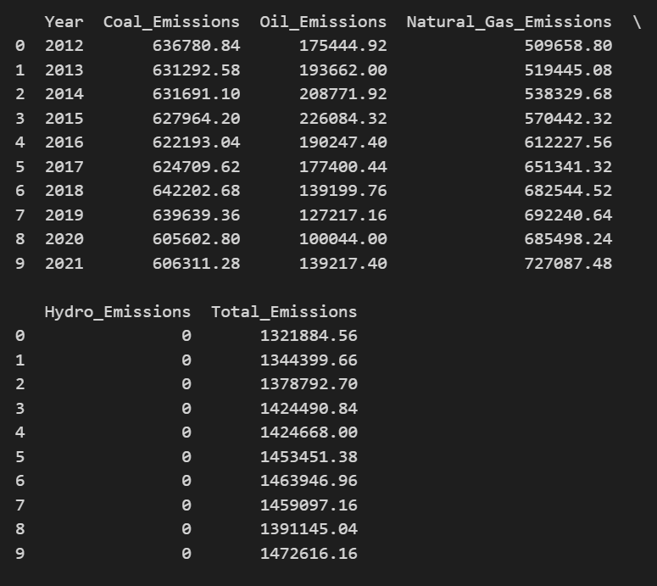
Calculating emissions for each source:

Slide 24
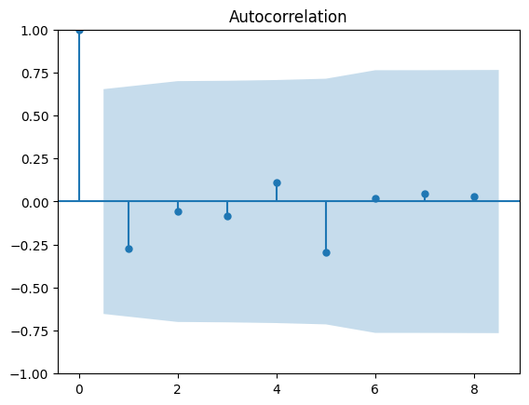
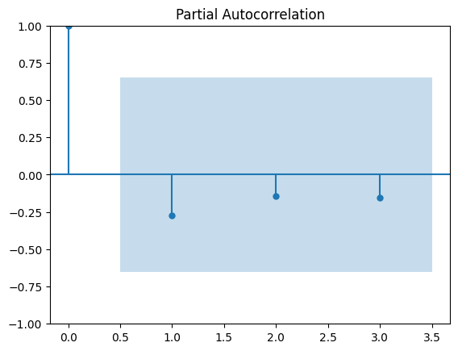
Estimate Future Emissions Based on Predicted Electricity Consumption
ADF Statistic: -1.8001046522866089
p-value: 0.38040973788895566
Critical Values:
1%: -4.473
5%: -3.290
10%: -2.772

