Slide 1
Optimizing Compilers
CISC 673
Spring 2011
Static Single Assignment
John Cavazos
University of Delaware

Slide 2
Placing Φ functions
Safe to put φ functions for every variable at every join point
But:
  inefficient – not necessarily sparse!
  loses information
Goal: minimal φ nodes, subject to need

Slide 3
Φ Function Requirement
Node Z needs φ function for v if:
  Z is convergence point for two paths
  both originating nodes contain assignments to v or also need φ functions for v
v = 1
v = 2
v₁ = 1
v₂ = 2
v₃=φ(v₁,v₂)
Z
Z

Slide 4
Minimal Placement of Φ functions
Naïve computation is expensive
Can be done in O(N) time
  Relies on dominance frontier computation
  [Cytron et al., 1991]

Slide 5
Some Dominance Relationships
x dominates y (x dom y)
  in CFG, all paths to y go through x
  Dom(v) = set of all nodes that dominate v
  Entry dominates every node
  Every node dominates itself

Slide 6
Finding Dominators
Dom(n) = {n}∪ ( ∩_{p ∈ PRED(n)} Dom(p) )
A node dominates
itself!
A node that dominates
all predecessors

Slide 7
Finding Dominators
Dom(n) = {n}∪ ( ∩_{p ∈ PRED(n)} Dom(p) )
Algorithm:
DOM(Entry) = {Entry}
For n ∈ V-{Entry}
DOM(n) = V
repeat
changed = false
for n ∈ V-{Entry}
olddom = DOM(n)
DOM(n) = {n} ∪ (∩_{p ∈ PRED(n)} DOM(p))
if DOM(n) ≠ olddom
changed = true
Notes:
1. Entry node is dominated only by itself
2. Initially set all nodes (except entry node) to be dominated by everything

Slide 8
Dominator Algorithm Example
DOM(Entry) = {Entry}
for v ∈ V-{Entry}
DOM(v) = V
repeat
changed = false
for n ∈ V-{Entry}
olddom = DOM(n)
DOM(n) = {n} ∪ (∩_{p∈2 PRED(n)} DOM(p))
if DOM(n) ≠ olddom
changed = true
A (Entry)
Dom
B
Dom
C
Dom
D
Dom
E
Dom
F
Dom
G (Exit)
Dom

Slide 9
Dominator Algorithm Example
DOM(Entry) = {Entry}
for v ∈ V-{Entry}
DOM(v) = V
repeat
changed = false
for n ∈ V-{Entry}
olddom = DOM(n)
DOM(n) = {n} ∪ (∩_{p∈2 PRED(n)} DOM(p))
if DOM(n) ≠ olddom
changed = true
A (Entry)
Dom: A
B
Dom: A,B
C
Dom: A, B, C
D
Dom: A, B, D
E
Dom: A, B, E
F
Dom: A, B, E, F
G (Exit)
Dom: A, B, E G

Slide 10
Other Dominators
Strict dominators
  Dom!(v) = Dom(v) – {v}
Immediate dominator
  Idom(v) = closest strict dominator of v
  Idom induces tree

Slide 11
Dominator Example
A (Entry)
Dom: A
Dom!
Idom
Dom: A, B
Dom!
Idom
B
Dom: A, B, C
Dom!
Idom
Dom: A, B, D
Dom!
Idom
C
D
Dom: A, B, E
Dom!
Idom
E
Dom: A, B, E, F
Dom!
Idom
Dom: A, B, E, G
Dom!
Idom
F
G (Exit)

Slide 12
Dominator Tree
A (Entry)
A (Entry)
B
B
C
D
C
D
E
E
F
G (Exit)
F
G (Exit)

Slide 13
Dominance Frontiers (intuitively)
The dominance frontier DF(X) is set of all nodes Y such that:
  X dominates a predecessor of Y
  But X does not strictly dominate Y
The fringe just beyond the region X dominates

Slide 14
Dominance Frontiers (formally)
DF(X) = {Y|(∃ P ∈ PRED(Y): X Dom P)
and X Dom! Y}

Slide 15
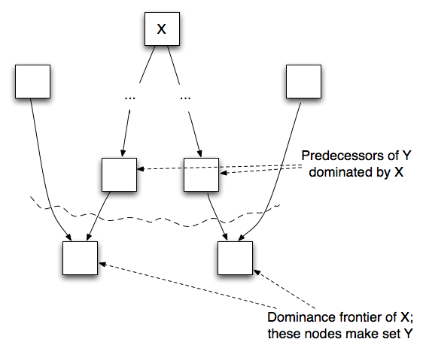
Dominance Frontiers (visually)

Slide 16
Why Dominance Frontiers
Dominance frontier criterion:
  if node x contains def of “a”, then any node z in DF(x) needs a φ function for “a”
intuition:
at least two non-intersecting paths converge to z, and one path must contain node strictly dominated by x

Slide 17
Dominance Frontier Example
S
node y is in dominance frontier of node x if:
x dominates predecessor of y but does not strictly dominate y
X
A
B
DF(X) = {Y|( ∃ P ∈ PRED(Y): X Dom P) and X Dom! Y)

Slide 18
Next Lecture
Computing dominance frontiers
Computing SSA form

