Slide 1
Detecting UAV flight faults from telemetry
Sensors versus command channels on the ALFA dataset (CMU AirLab)
Personal machine-learning portfolio project | Pham Anh Hoang
Notes:
One-second fault detection on real fixed-wing flights, using only past data.

Slide 2
Real flights with faults injected on purpose
46
30
37 + 9
flights used (one of 47 has no ground truth)
recording sessions
development flights + locked test flights
Fixed-wing UAV with sudden engine failures and control-surface faults (aileron, rudder, elevator).
Every flight has a logged fault start, so each second can be labeled before or after the fault.
Data: ALFA, CMU AirLab, CC BY 4.0. The data is not stored in the repository.
Notes:
ALFA: 47 processed flights, one has no ground truth, so 46 are used.

Slide 3
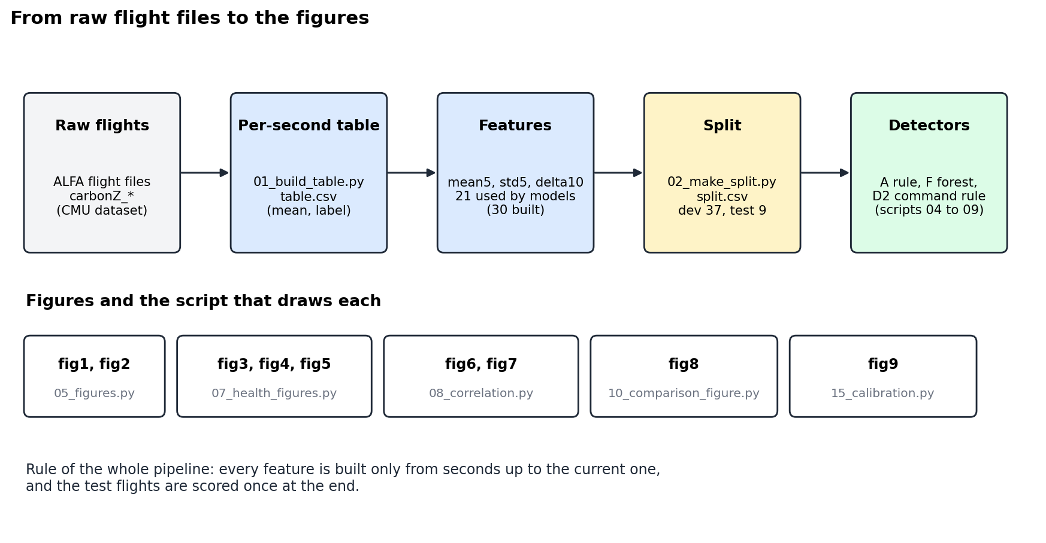
From raw logs to figures in a few scripts
Notes:
Each figure is drawn by one script; the repo has a code index.

Slide 4
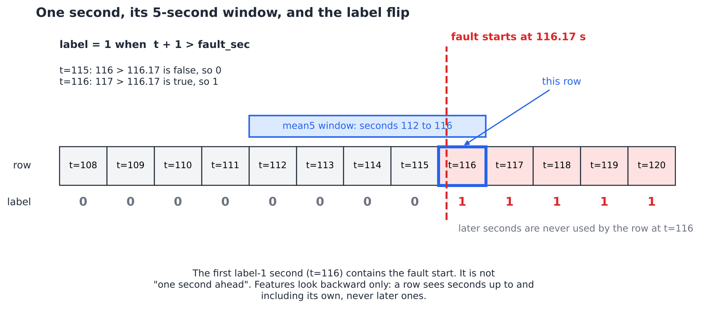
One row per second, features look backward only
label = 1 when t + 1 > fault_sec
The first label-1 second contains the fault start.
Features use readings up to the end of second t, never later, the same edge the label uses.

Slide 5
Three rolling features for each of ten signals
mean5
std5
delta10
Average of the last 5 seconds. Smooths the signal.
Standard deviation of the last 5 seconds. Shows how much it wobbles.
Change over the last 10 seconds: x now minus x ten seconds ago.
10 signals x 3 features = 30 columns built; the sensor models use 21 of them.
Sensor signals: altitude error, cross-track error, altitude, vertical velocity, and roll, pitch and yaw gap.

Slide 6
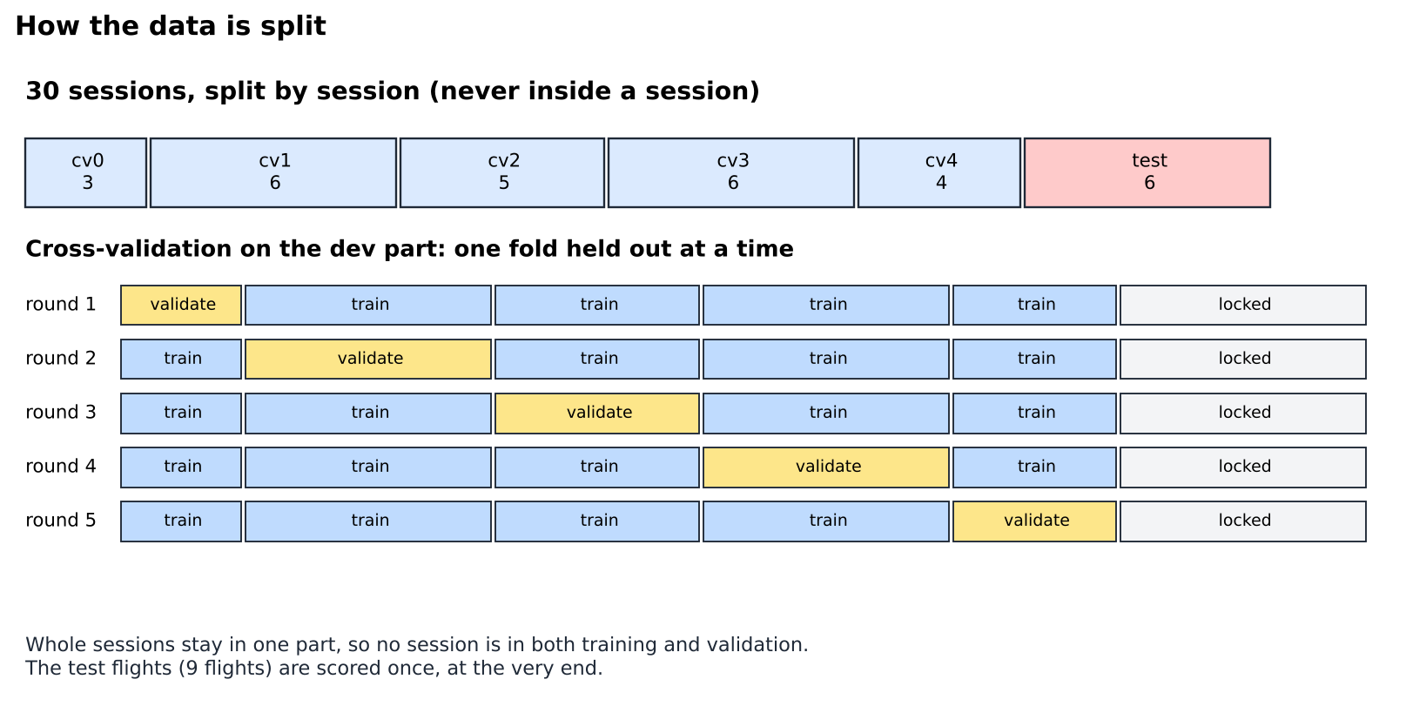
The split is by session, and the test set stays locked
Flights from one session look alike, so a finer split would leak near copies.
9 test flights were locked before any model was trained.
37 development flights: 5-fold cross-validation grouped by session.
The test set is scored once, at the end.

Slide 7
Three detectors, one question: what do they see?
A: sensor rule
F: random forest
D2: command side
One threshold on vertical velocity (vel_lin_z__mean5 at or below −0.833). Alarm after 3 seconds in a row.
300 trees on the 21 sensor features. Alarm when the probability is at least 0.5 for 3 seconds in a row.
Fires on a frozen control channel or a throttle cut. Reads the servo commands, not the sensors.
A and F are the honest sensor-only detectors. D2 reads data that already contains the injected fault.

Slide 8
Test result: the command side wins, but that is a ceiling
The sensor detectors find engine faults but are weak on the other types.
D2 catches every fault type because a frozen command channel is the injection itself.
So D2 shows how easy the task becomes when the injection is visible. The sensor result is the honest one.
Notes:
Test F1 on the locked test set: A 0.46, F 0.50, D2 0.87.

Slide 9
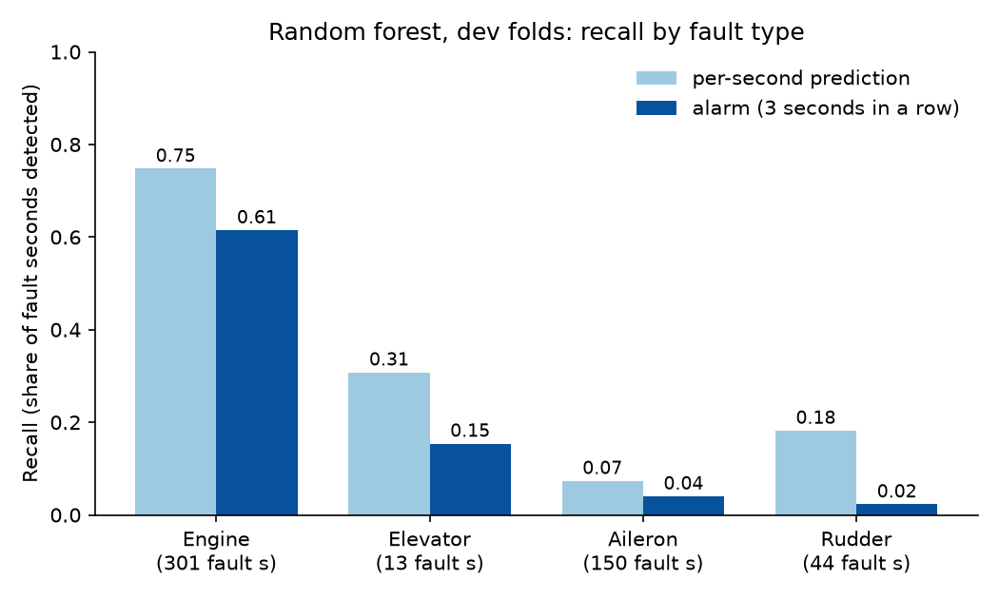
Engine faults are found; the other types mostly are not
Engine: 225 of 301 fault seconds flagged per second, 185 inside an alarm.
Aileron: 11 of 150 and 6 of 150.
Elevator has only 13 fault seconds, so its bars rest on very little data.
Random forest, development folds, out-of-fold predictions.

Slide 10
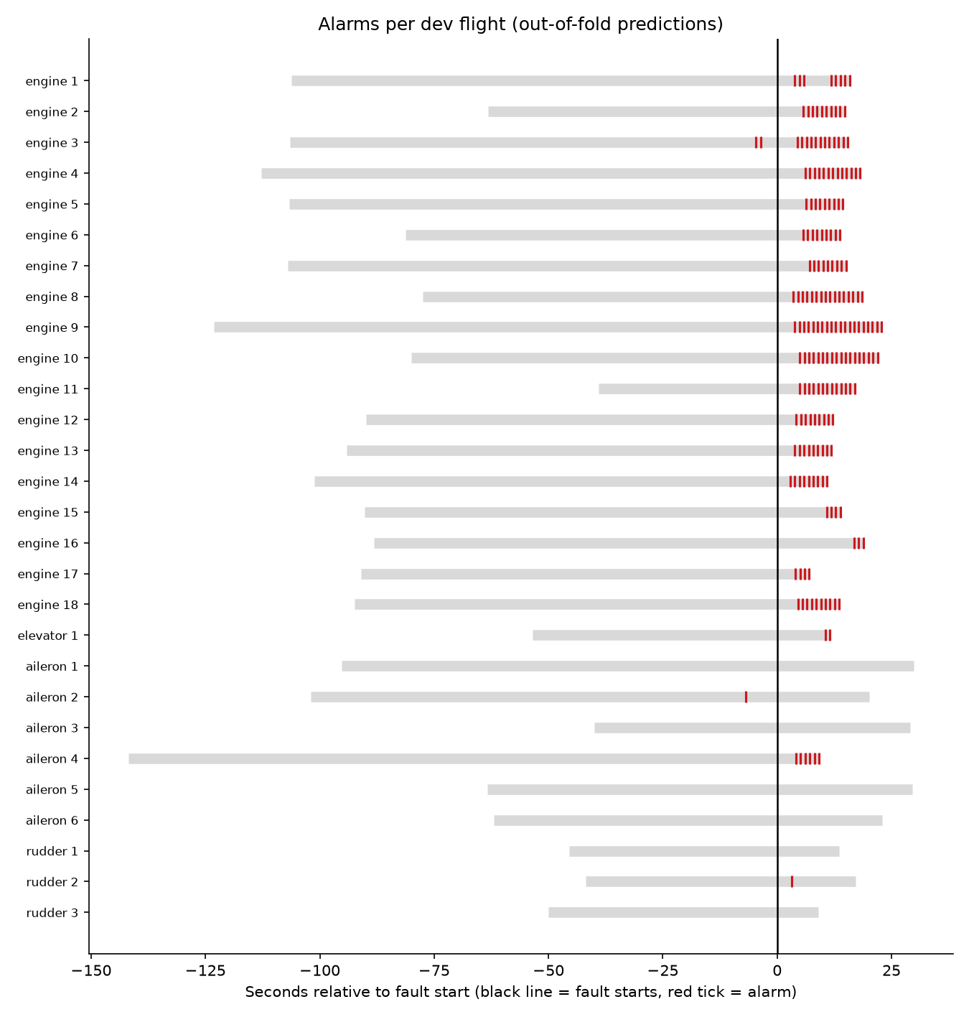
When do the alarms come? One bar per flight
Engine flights show a run of alarms a few seconds after the fault.
Most aileron and rudder flights show none.
A few alarms appear before the fault: those are false alarms.
The timeline shows timing, which a single percentage hides.

Slide 11
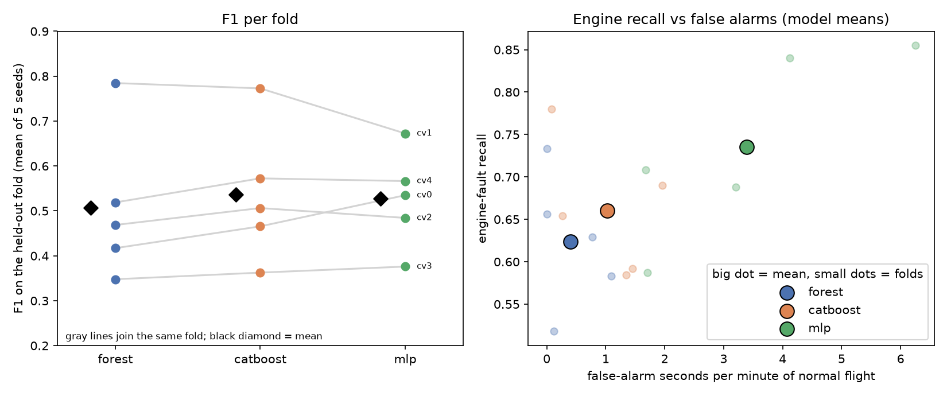
Three models, five folds, five seeds
Mean F1 over folds: forest 0.51, CatBoost 0.54, MLP 0.53.
The folds differ far more than the models do, so the ranking is not firm.
More engine recall came with more false alarms (right panel).

Slide 12
We checked our own results
Session overlap
Start-of-flight drift
Signal screening
6 session pairs overlap in time, but none shares a timestamp or a copied altitude trace. The split stands.
Dropping the first 30 s does not inflate the engine correlations. alt_error__mean5 stays at 0.65.
Redone on development flights only: the chosen signals rank 1, 2, 3, 5, 6, 8 and 15 of 26.
Scripts: src/20_session_overlap.py, experiments/drift_check.py, experiments/screening_dev_only.py

Slide 13
What this project does not show
Aileron, rudder and elevator faults are not found from the sensor features used here.
Few examples for some fault types (13 elevator fault seconds), so those numbers are noisy.
One dataset, one aircraft type, injected faults.
The command-side result cannot transfer to a real aircraft, where a fault is not written into the commands.
Thresholds and models are fitted on development flights only; the test score comes from one run.

Slide 14
Next steps
Non-engine faults
Small MCP server
Larger dataset
Find signals, or a model trained on normal flights only, that catch aileron, rudder and elevator faults.
A tool that scores a flight with the trained model.
Try the detector on the large PX4 flight dataset.
Code, figures, GIF walkthroughs and the full documentation: github.com/PhamAnhHoangg/alfa-fault-detection

