Slide 1

Customer Segmentation

Slide 2
RFM
To segmenting customer, there are some metrics that we can use, such as
When the customer buy the product for last time,
How frequent the customer buy the product,
How much the customer pays for the product.

Slide 3
RFM
To make the RFM table, we can create these columns, such as Recency, Frequency, and MonetaryValue column.
To get the number of days for recency column, we can subtract the snapshot date with the date where the transaction occurred.
To create the frequency column, we can count how much transactions by each customer.
Lastly, to create the monetary value column, we can sum all transactions for each customer.

Slide 4
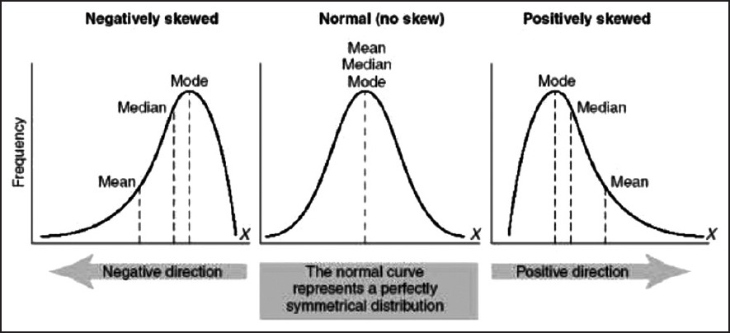
Skewness

Slide 5
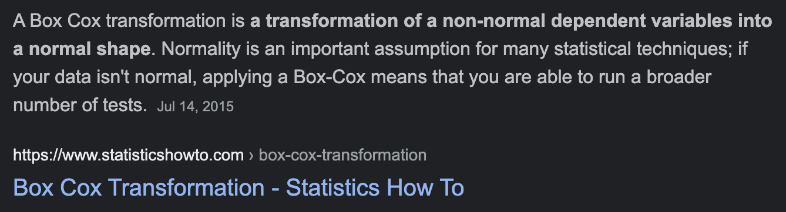
Transformation
log transformation
square root transformation
box-cox transformation
cube root transformation

