Slide 1
Socket Programming
presentation beHere is where your
gins

Slide 2
Table of Contents
01
02
03
04
Problem & Solution
You could describe the
topic of the section here
Market Analysis and Target
You could describe the
topic of the section here
Our Process
You could describe the
topic of the section here
Our Consultants
You could describe the
topic of the section here

Slide 3
01
Linux architecture
Notes:
A Guide to Using Raw Sockets - open source for you

Slide 4
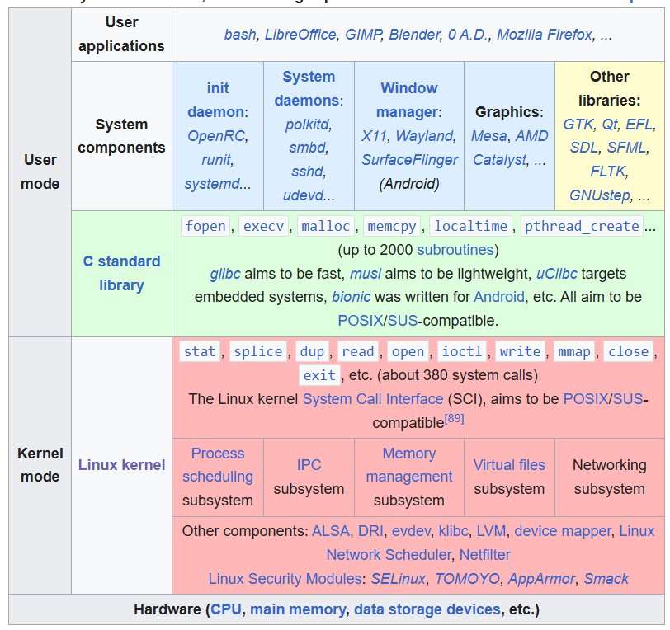
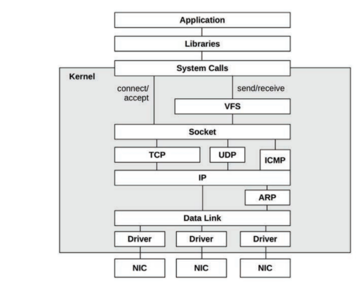
Our Solutions
Network
stack

Slide 5
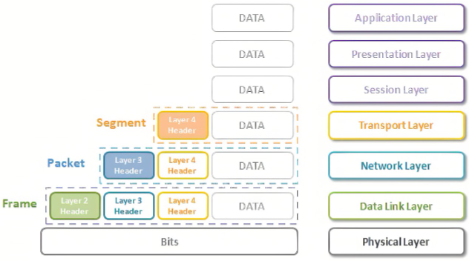
Our Solutions

Slide 6
03
Raw socket
Notes:
A Guide to Using Raw Sockets - open source for you
PPT - Raw Sockets Datalink Access PowerPoint Presentation, free download - ID:284299

Slide 7
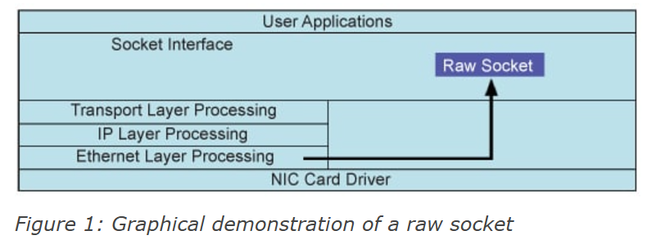
What’s raw socket?
Commonly, the socket API is used for inter-process communication at the transport layer (OSI layer 4). However, some special socket types can be employed to access the network layer (OSI layer 3) and the data link layer (OSI layer 2). These socket types are called raw sockets.

Slide 8
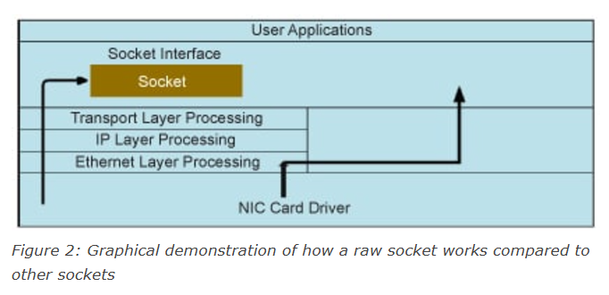
A raw socket vs other sockets
Other sockets like stream sockets and data gram sockets receive data from the transport layer that contains no headers but only the payload.
A raw socket allows an application to directly access lower level protocols, which means a raw socket receives un-extracted packets (see Figure 2).
Notes:
This means that there is no information about the source IP address and MAC address. If applications running on the same machine or on different machines are communicating, then they are only exchanging data.
Điều này cho phép ứng dụng nhận hoặc gửi các gói tin bao gồm cả phần header của giao thức mạng.

Slide 9

Raw Sockets at the Network layer
If we want to open a raw socket at the network layer (OSI layer 3), we must specify the AF_INET address family and the SOCK_RAW type. In the last argument, we need to define the Internet protocol number, which is included in the IP header field “Protocol”:
If we want to open a raw socket at the network layer (OSI layer 3), we must specify the AF_INET address family and the SOCK_RAW type. In the last argument, we need to define the Internet protocol number, which is included in the IP header field “Protocol”:

Slide 10

Raw Sockets at the Data-link layer
If we want to open a raw socket at the data link layer (OSI layer 2), we need to specify the AF_PACKET address family and the SOCK_RAW socket type:
At the data link layer, we need to build the frame by ourselves. Moreover, on a computer having more than one network interface controller (NIC), we should also specify the interface at which we want the frame to send or receive.

Slide 11
Applications of Raw Socket
- Packet Sniffing: Collect packets from the network like Wireshark or tcpdump.
- Packet Injection: Send custom packets, used for network testing or network attacks.
- Firewall: Build firewalls based on packet filtering.

Slide 12
Promiscuous Mode
Khái niệm chế độ Promiscuous
Cách chuyển chế độ với ioctl
Ứng dụng của Packet Sniffer.
Notes:
By default, a machine receives those packets that have the same destination address as that of the machine, and this mode is called the non-promiscuous mode. But if we want to receive all the packets, we have to switch into the promiscuous mode. We can go into the promiscuous mode with the help of ioctls.

Slide 13
A packet sniffer with a raw socket
To develop a packet sniffer, you first have to open a raw socket. Only processes with an effective user ID of 0 capability are allowed to open raw sockets.
A Guide to Using Raw Sockets - open source for you
Notes:
So, during the execution of the program, you have to be the root user.

