Slide 1

Home Application
Presenter: Pham Nhat Minh Tan
Mentor: Pham Ba Thanh

Slide 2
Content
1
Introduction
5
Processing flow
2
Requirements
6
Reference material
3
Architecture
7
Demo
4
User Interface

Slide 3
1. Introduction
Let’s start with the first set of slides

Slide 4
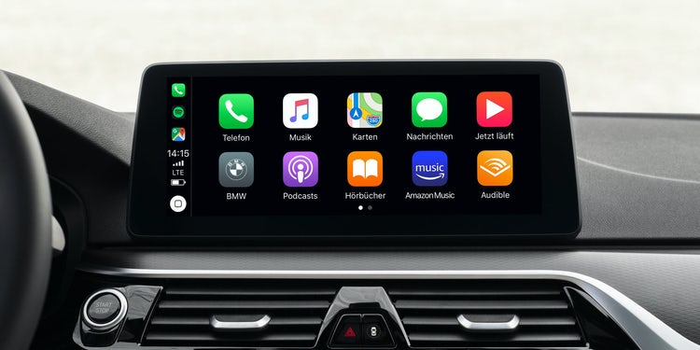
Introduction
Home application is the first application displayed on the in-vehicle infotainment system.
Displays icons that are entrances and the transfer point to go into other applications.
The Home application will create front screen for the driver

Slide 5
Process
Follow the steps:
Software Requirements Specification (SRS)
Software design: UX, UI, ...
Implementation
Software Testing

Slide 6
2. Requirements

Slide 7
Requirements
Home start screen is divided into 3 data display areas is Status Bar, Widget and Application Menu. * Refer Home_SRS_01.1 *
Status Bar area display information about Date - Time of system. * Refer Home_SRS_01.2 *
Widget area display information of other application such as Climate, Map and Media. * Refer Home_SRS_01.3 *
Application Menu area display application list. * Refer Home_SRS_01.4 *
Display the Back button when open the other application. * Refer Home_SRS_01.5 *

Slide 8
Requirements
Application list is stored in xml file. * Refer Home_SRS_02.1*
User can scroll application list when have more than 6 applications * Refer Home_SRS_02.3*
Reorder application list. * Refer Home_SRS_02.5*
Open the app or widget by clicking on it. * Refer Home_SRS_02.6 *

Slide 9
3. Architecture

Slide 10
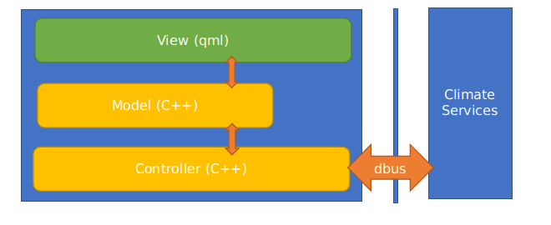
Architecture
- View (qml): This is where the screens are managed, components built with qml and the resources of the screen building.
- Model: As the data building for managing the state of the interface from C ++, it is the place to show the data for the state construction of the screen.
- Controller: As part of processing, program control, and responsible for connecting to the 3rd services (specifically here is climate services).

Slide 11
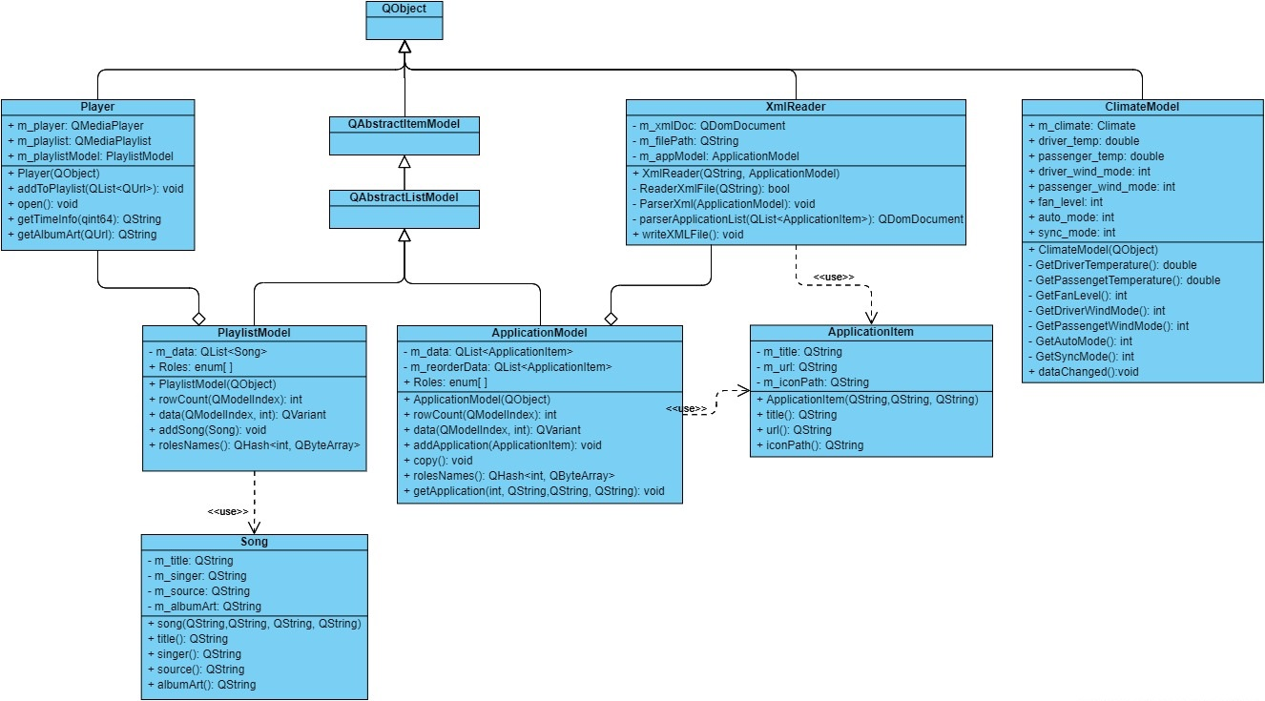
Class diagram

Slide 12
4. User Interface

Slide 13
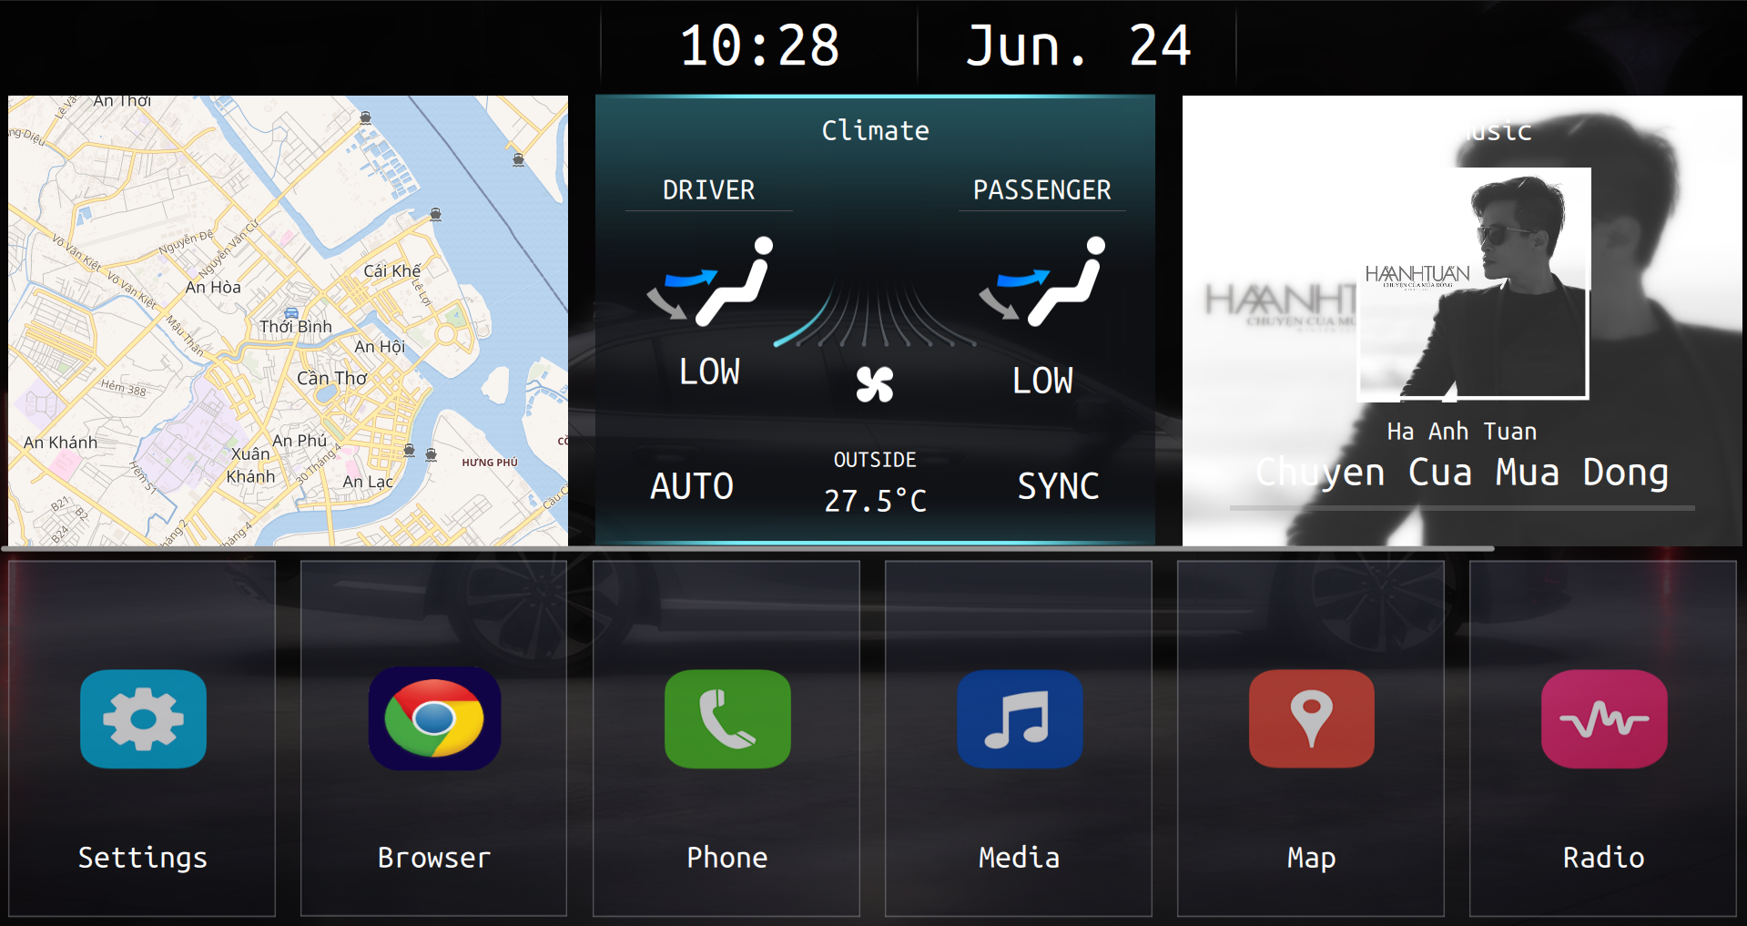
Home Screen
Status Bar area
Widget area
Application Menu area

Slide 14
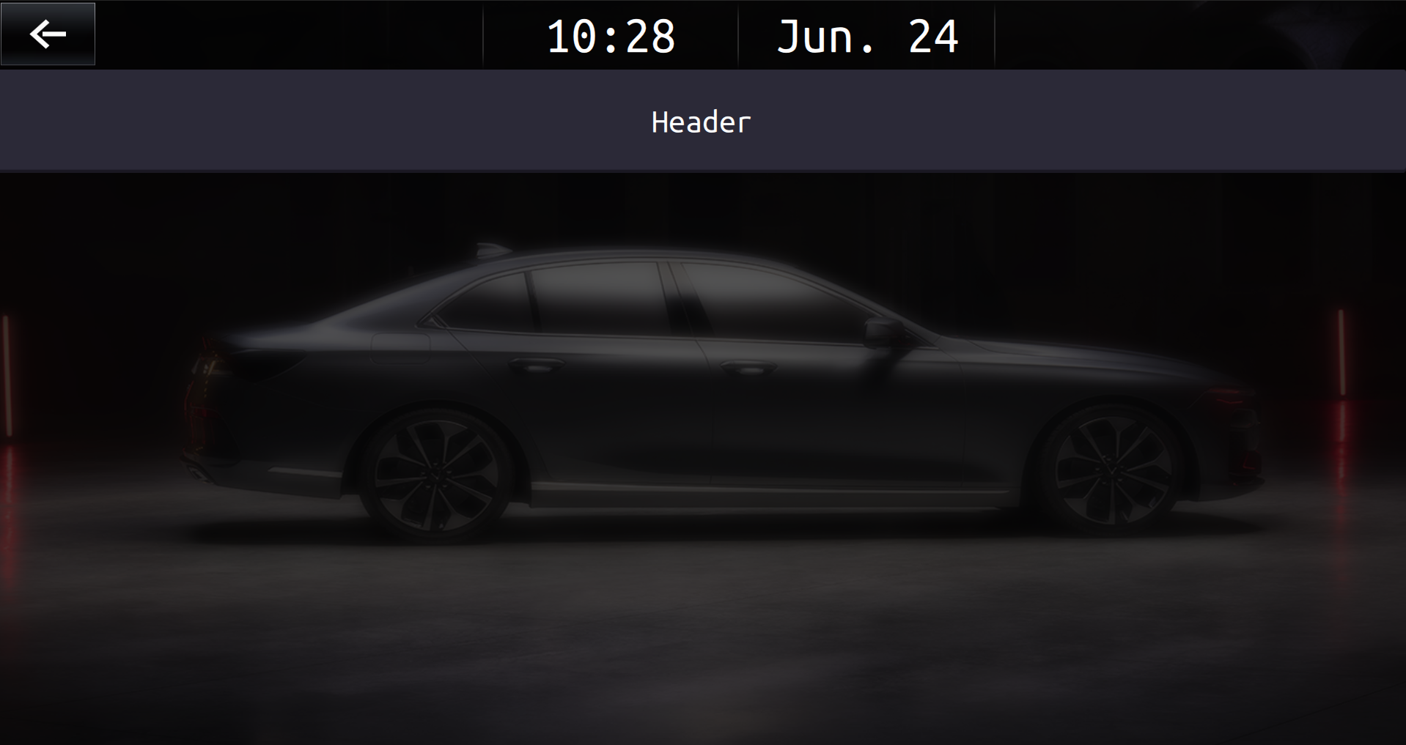
Other application screen
Status Bar area
Header Title
Application Screen

Slide 15
5. Processing flow

Slide 16
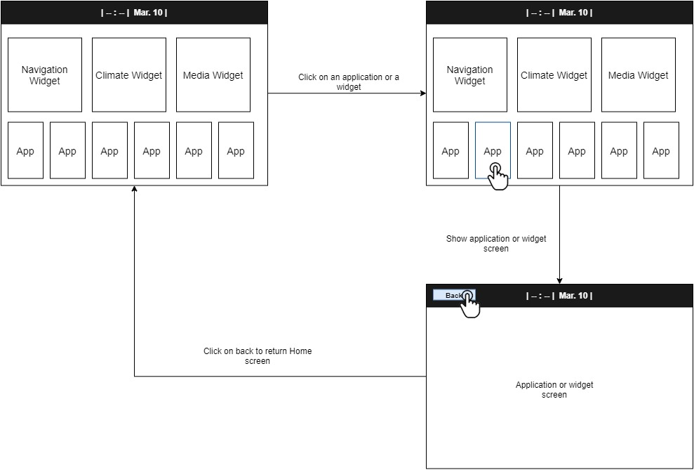
Open and close application

Slide 17
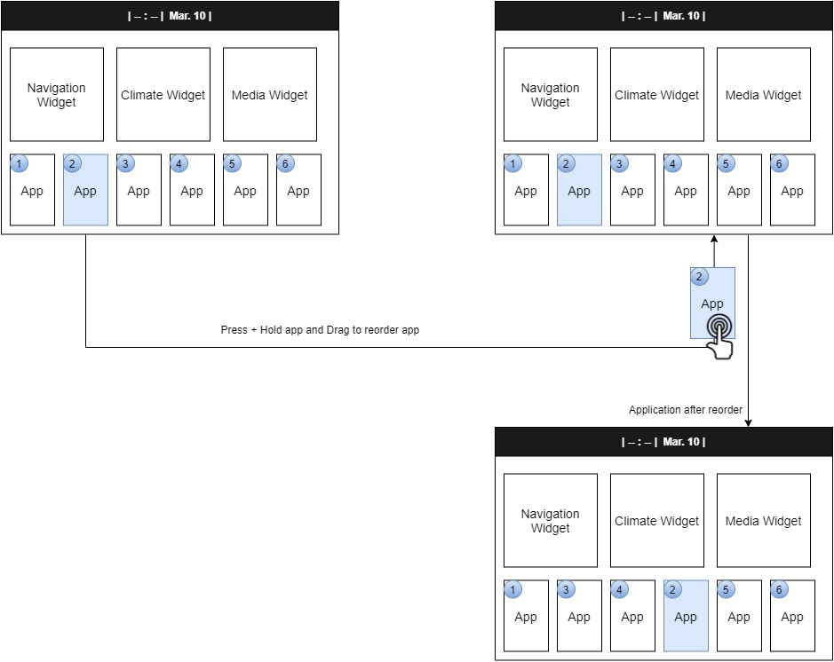
Reorder application list

Slide 18
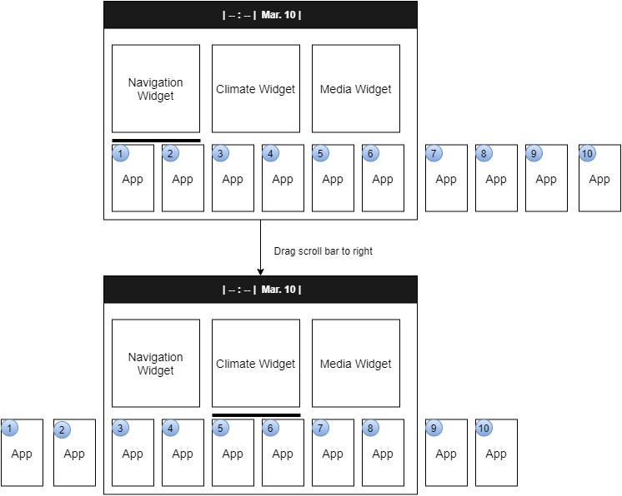
Scroll application list to left

Slide 19
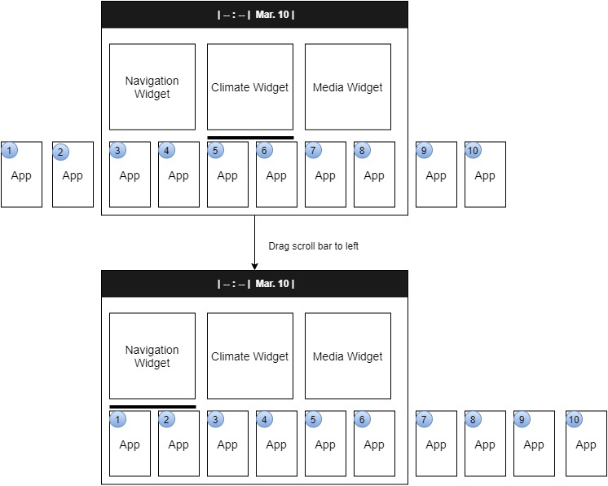
Scroll application list to right

Slide 20
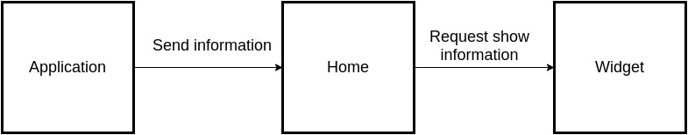
Send information from applicalition to widget

Slide 21
6. Reference material

Slide 22
Reference material
doc.qt.io (Read Qml/Qt’s document )
stackoverfow.com (Q&A, fix problems)
viblo.asia (Design diagram, flow)

Slide 23
7. Demo

Slide 24
Enviroment
Environment demo: Ubuntu 20.04
Qt version: 1.14.2

Slide 25
THANKS!
Any questions?

