Slide 1

CHAPTER 7
Operating Systems
Notes:
1.#

Slide 2
Objectives
After studying this chapter, the student should be able to:
Understand the role of the operating system in a computer.
Give the definition of an operating system.
Understand the process of bootstrapping to load the operating
system into memory.
List the components of an operating system.
Discuss the role of memory management in an operating system.
Discuss the role of the process manager in an operating system.
Discuss the role of the device manager in an operating system.
Discuss the role of the file manager in an operating system.
Understand the main features of three common operating
systems: Unix, Linux, and Windows

Slide 3
7.1 INTRODUCTION
A computer is a system composed of two major components: hardware and software. Computer hardware is the physical equipment. Software is the collection of programs that allows the hardware to do its job. Computer software is divided into two broad categories: the operating system and application programs (Figure 7.1). Application programs use the computer hardware to solve users’ problems. The operating system, on the other hand, controls the access to hardware by users.

Slide 4
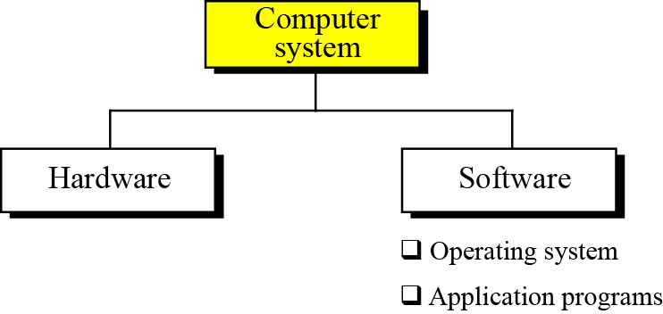
Figure 7.1 A computer system

Slide 5
7.1.1 Operating System
An operating system is complex, so it is difficult to give a simple universal definition. Instead, here are some common definitions:
An operating system is an interface between the hardware
of a computer and the user (programs or humans).
An operating system is a program (or a set of programs)
that facilitates the execution of other programs.
An operating system acts as a general manager supervising
the activity of each component in the computer system.

Slide 6

An operating system is an interface between the hardware of a computer and the user (programs or humans) that facilitates the execution of other programs
and the access to hardware and software resources.
Two major design goals of an operating system are:
❑ Efficient use of hardware.
❑ Easy of use of resources.

Slide 7
7.1.2 Bootstrap process
The operating system, based on the above definitions, provides supports for other programs. For example, it is responsible for loading other programs into memory for execution. However, the operating system itself is a program that needs to be loaded into the memory and be run. How is this dilemma solved?
The solution is a two-stage process. A very small section of memory is made of ROM and holds a small program called the bootstrap program. When the computer is turned on, the CPU counter is set to the first instruction of this bootstrap program and executes the instructions in this program. When loading is done, the program counter is set to the first instruction of the operating system in RAM.

Slide 8
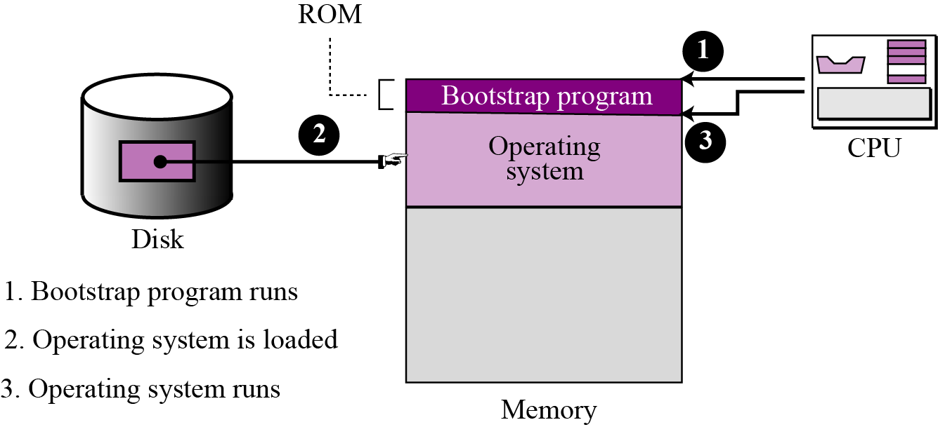
Figure 7.2 The bootstrap process

Slide 9
7-2 EVOLUTION
Operating systems have gone through a long history of evolution, which we summarize next.

Slide 10
7.2.1 Batch systems
Batch operating systems were designed in the 1950s to control mainframe computers.
Each program to be executed was called a job. A programmer who wished to execute a job sends a request to the operating system.
Operating system during this era were very simple: they only ensured that all computer resources transferred from one job to another

Slide 11
7.2.2 Time-sharing systems
To use computer system resources efficiently, multiprogramming was introduced. The idea is to hold several jobs in memory at a time, and only assign a resource to a job that needs it on the condition that the resource is available.
Multiprogramming brought the idea of time sharing: resources could be shared between different jobs, with each job being allocated a portion of time to use a resource.
Multiprogramming, and eventually timesharing, improved the efficiency of computer system tremendously.

Slide 12
7.2.3 Personal systems
When personal computers were introduced, there was a need for an operating system for this new type of computer. During this era, single-user operating systems such as DOS (Disk Operating System) were introduced.
7.2.4 Parallel systems
The need for more speed and efficiency led to the design of parallel systems: multiple CPUs on the same machine. Each CPU can be used to serve one program or a part of a program, which means that many tasks can be accomplished in parallel instead of serially. The operating systems required for this are more complex than those that support single CPUs.

Slide 13
7.2.5 Distributed systems
Networking and internetworking, as we saw in Chapter 6, have created a new dimension in operating systems. A job that was previously done on one computer can now be shared between computers that may be thousands of miles apart. Distributed systems combine features of the previous generation with new duties such as controlling security.
7.2.5 Real-time systems
A real-time system is expected to do a task within specific time constraint. They are used with real-time applications, which monitor, responds to, or control external processes or environments.

Slide 14
7-3 COMPONENTS
Today’s operating systems are very complex. An operating system needs to manage different resources in a computer system. It resembles an organization with several managers at the top level. Each manager is responsible for managing their department, but also needs to cooperate with others and coordinate activities. A modern operating system has at least four duties: memory manager, process manager, device manager, and file manager.

Slide 15
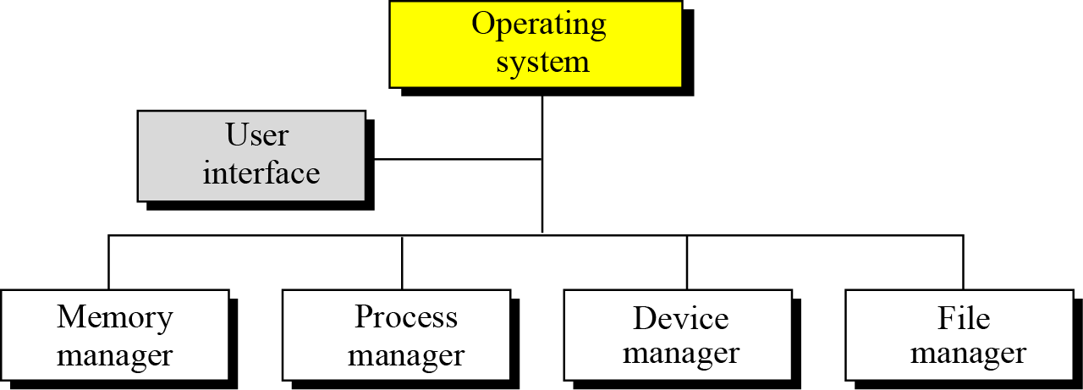
Figure 7.3 Components of an operating system

Slide 16
7.3.1 User interface
Each operating system has a user interface, a program that accepts requests from users (processes) and interprets them for the rest of the operating system. A user interface in some operating systems, such as UNIX, is called a shell. In others, it is called a window to denote that it is menu driven and has a GUI (graphical user interface) component.
7.<number>

Slide 17
7.3.2 Memory Management
One of the responsibilities of a modern computer system is memory management. Although the memory size of computers has increased tremendously in recent years, so has the size of the programs and data to be processed. Memory allocation must be managed to prevent applications from running out of memory. Operating systems can be divided into two broad categories of memory management: monoprogramming and multiprogramming.
7.<number>

Slide 18
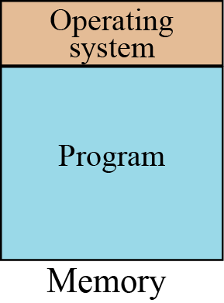
Monoprogramming
In monoprogramming, most of the memory capacity is dedicated to a single program; only a small part is needed to hold the operating system. In this configuration, the whole program is in memory for execution. When the program finishes running, the program area is occupied by another program.
Figure 7.4 Monoprogramming

Slide 19
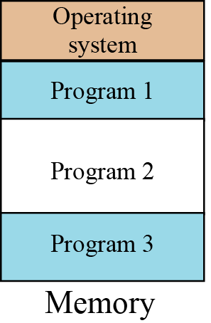
Multiprogramming
In multiprogramming, more than one program is in memory at the same time, and they are executed concurrently, with the CPU switching rapidly between the programs.
Figure 7.5 Multiprogramming

Slide 20
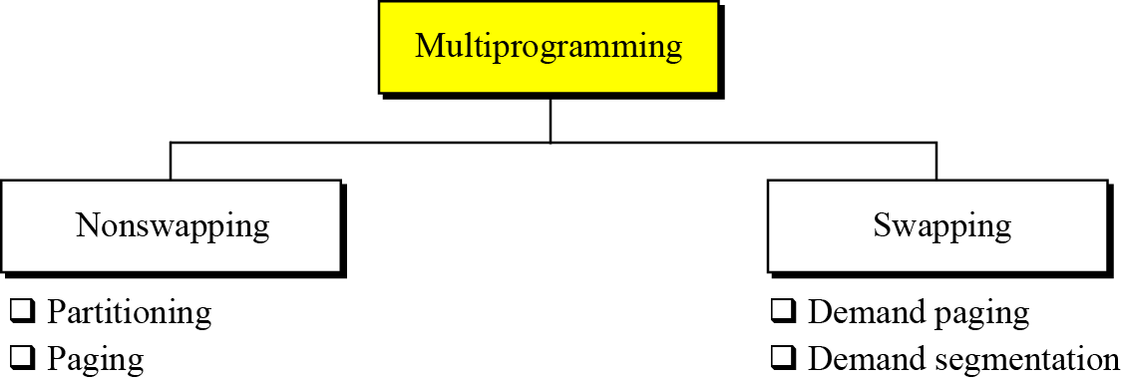
Figure 7.6 Categories of multiprogramming

Slide 21
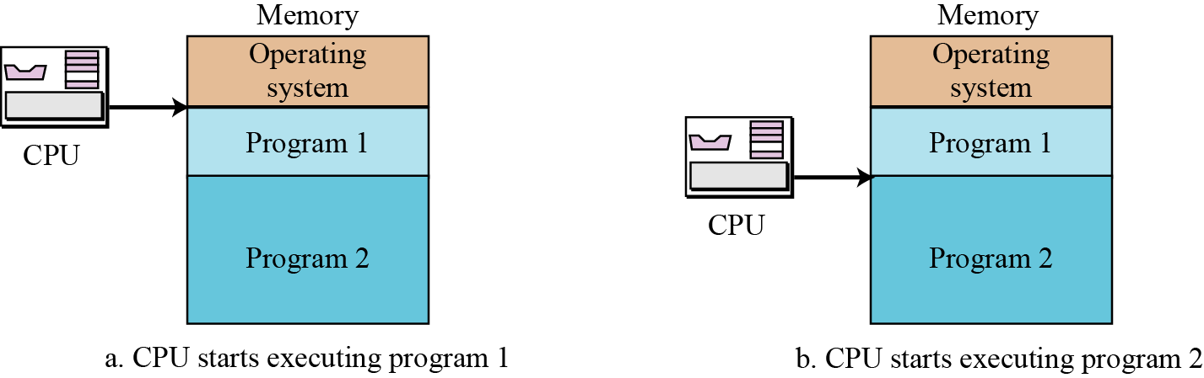
Figure 7.7 Partitioning

Slide 22
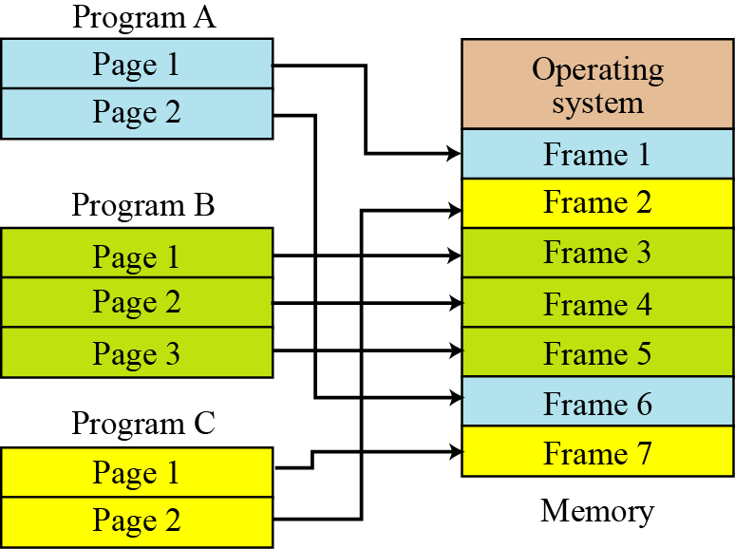
Figure 7.8 Paging

Slide 23
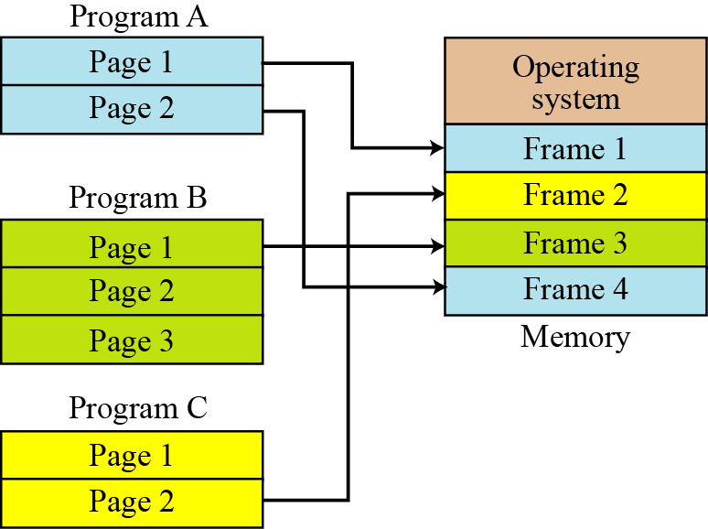
Figure 7.9 Demand paging

Slide 24
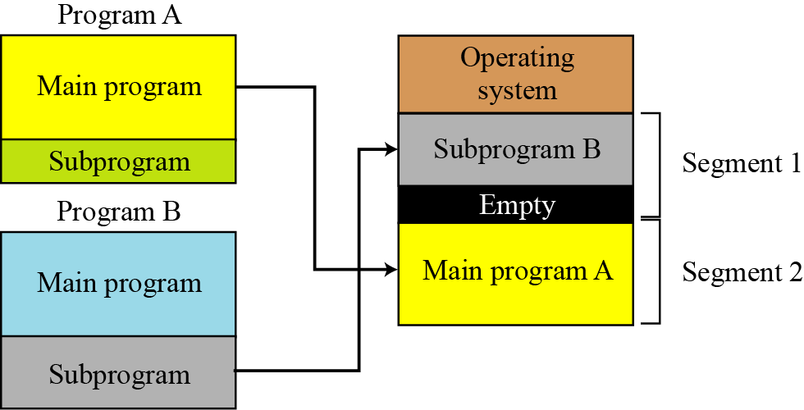
Figure 7.10 Demand segmentation

Slide 25
Virtual memory
Demand paging and demand segmentation mean that, when a program is being executed, part of the program is in memory and part is on disk. This means that, for example, a memory size of 10 MB can execute 10 programs, each of size 3 MB, for a total of 30 MB. At any moment, 10 MB of the 10 programs are in memory and 20 MB are on disk. There is therefore an actual memory size of 10 MB, but a virtual memory size of 30 MB. Figure 7.11 shows the concept. Virtual memory, which implies demand paging, demand segmentation, or both, is used in almost all operating systems today.

Slide 26
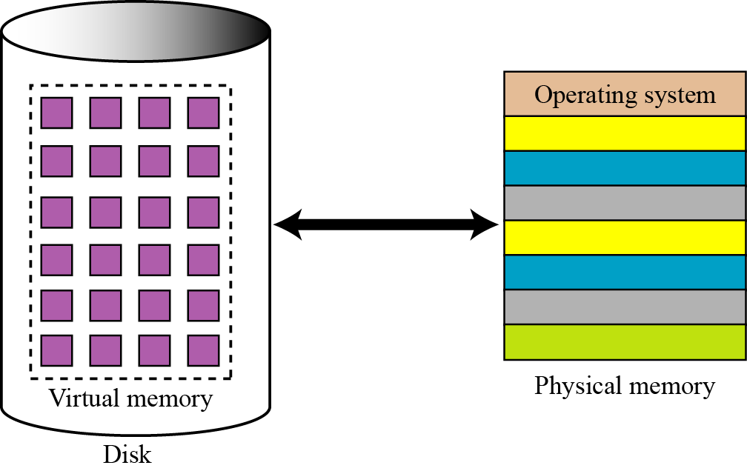
Figure 7.11 Virtual memory

Slide 27
7.3.3 Process manager
A second function of an operating system is process management, but before discussing this concept, we need to define some terms.
Program, job, and process
Modern operating systems use three terms that refer to a set of instructions: program, job, and process. Although the terminology is wage and varies from one operating system to another.

Slide 28
State diagrams
The relationship between a program, a job, and a process becomes clearer if we consider how a program becomes a job and how a job becomes a process. This can be illustrated with a state diagram that shows the different states of each of these entities.

Slide 29
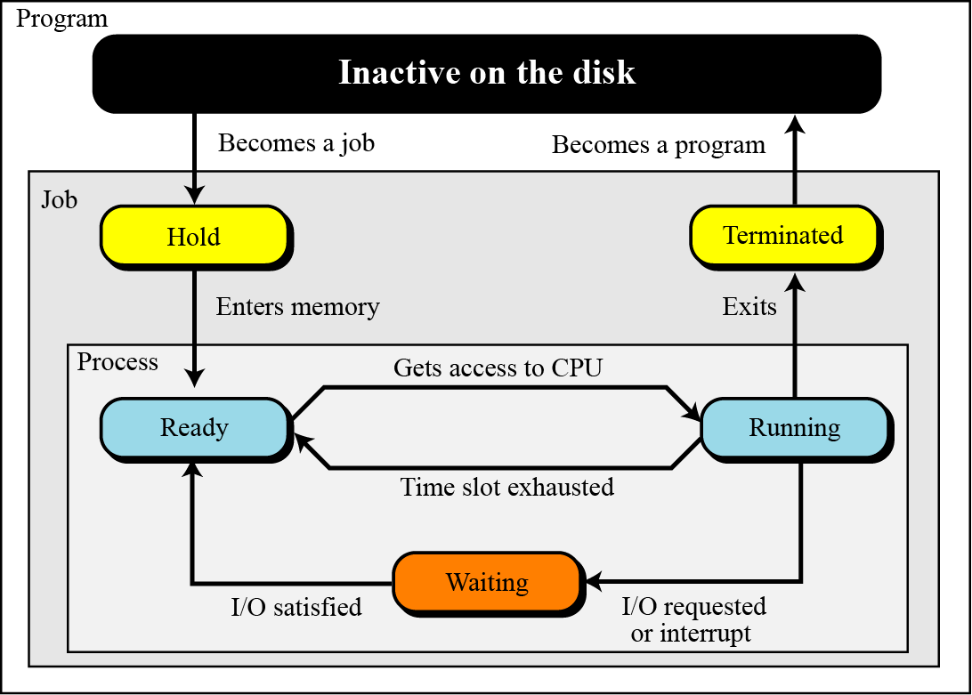
Figure 7.12 State diagram with boundaries

Slide 30
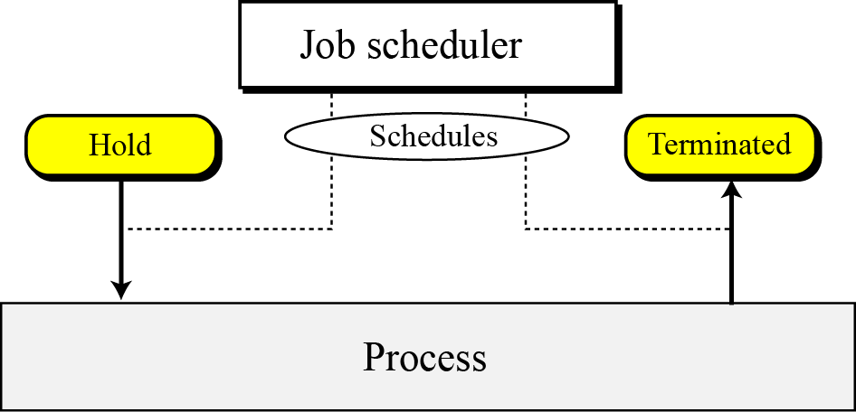
Schedulers
To move a job or process from one state to another, the process manager uses two schedulers: the job scheduler and the process scheduler.
Figure 7.13 Job scheduler

Slide 31
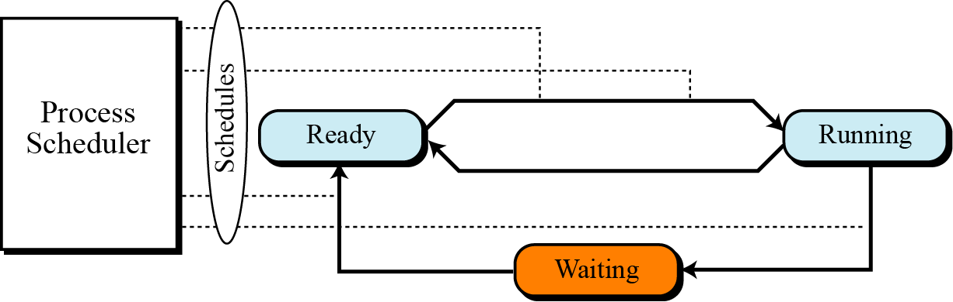
Figure 7.14 Process scheduler

Slide 32
Queuing
Our state diagram shows one job or process moving from one state to another. In reality, there are many jobs and many processes competing with each other for computer resources. To handle multiple processes and jobs, the process manager uses queues (waiting lists). A job control block or process control block is associated with each job or process. This is a block of memory that stores information about that job or process. The process manager stores the job or process control block in the queues instead of the job or process itself.
7.<number>

Slide 33
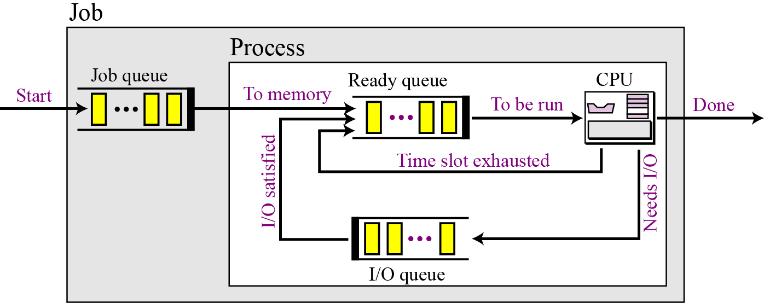
Figure 7.15 Queues for process management
7.<number>

Slide 34
Process synchronization
The whole idea behind process management is to synchronize different processes with different resources. Whenever resources can be used by more than one user (or process, in this case), we can have two problematic situations: deadlock and starvation.
7.<number>

Slide 35
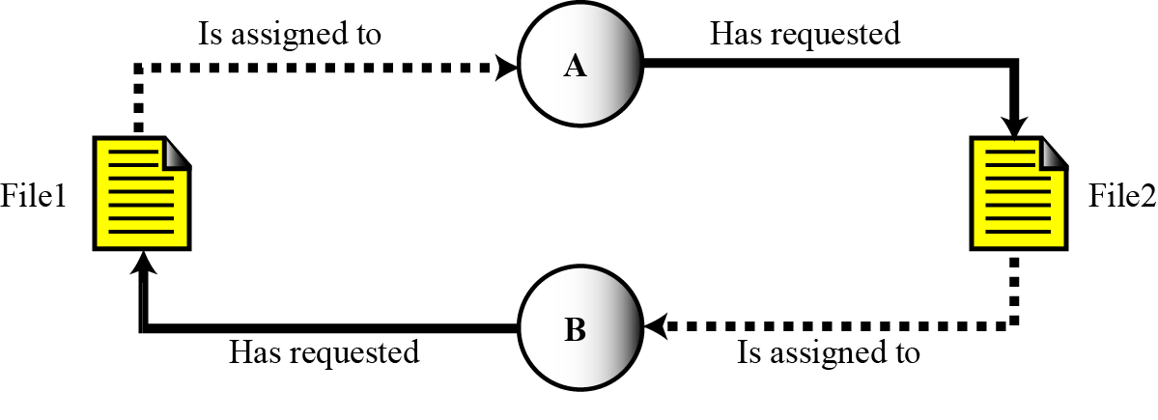

Figure 7.16 Deadlock
Deadlock occurs when the operating system does not
put resource restrictions on processes.

Slide 36
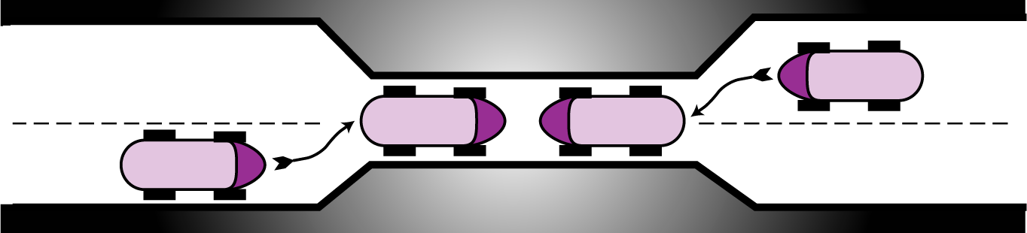
Figure 7.17 Deadlock on a bridge

Slide 37
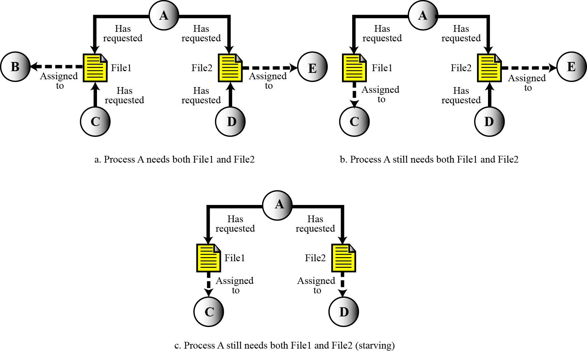
Figure 7.18 Starvation

Slide 38
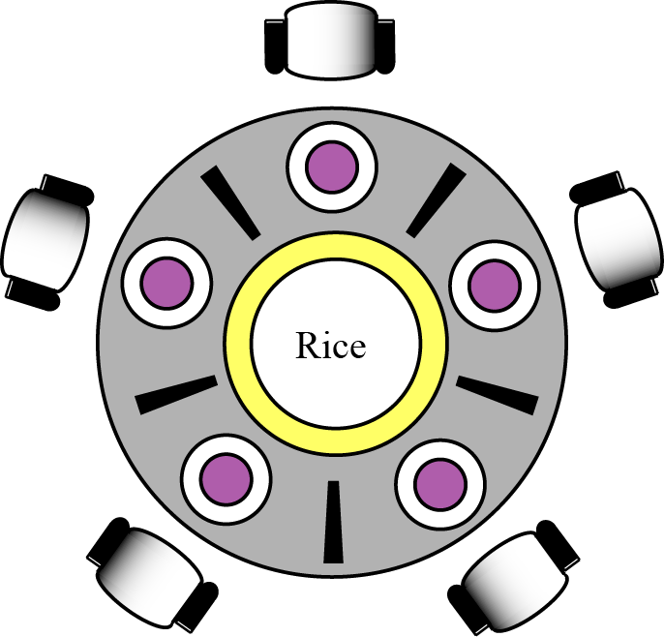

Figure 7.19 The dining philosophers problem
Starvation is the opposite of deadlock. It can happen when the operating system puts too many resource restrictions on a process.

Slide 39
Device manager
The device manager, or input/output manager, is responsible for access to input/ output devices. There are limitations on the number and speed of input/output devices in a computer system.
The device manager monitors every input/output device
constantly to ensure that the device is functioning properly.
The device manager maintains a queue for each input/output
device or one or more queues for similar input/output devices.
The device manager controls the different policies for accessing
input/output devices.

Slide 40
7.3.4 File manager
Operating systems today use a file manager to control access to files. A detailed discussion of the file manager also requires advanced knowledge of operating system principles and file access concepts that are beyond the scope of this book.
The file manager controls access to files.
The file supervises the creation, deletion, and modification of files.
The file manager controls the naming of files.
The file manager supervises the storage of files.
The file manager is responsible for archiving and backups.

Slide 41
7-4 A SURVEY OF OPERATING SYSTEMS
In this section we introduce some popular operating systems and encourage you to study them further. We have chosen three operating systems that are familiar to most computer users: UNIX, Linux, and Windows.
7.<number>

Slide 42

7.4.1 UNIX
UNIX was originally developed in 1969 by Thomson and Ritchie of the Computer Science Research Group at Bell Laboratories. UNIX has gone through many versions since then. It has been a popular operating system among computer programmers and computer scientists.
UNIX is a multiuser, multiprocessing, portable operating system.
It is designed to facilitate programming, text processing, and communication.
UNIX structure
UNIX consists of four major components: the kernel, the shell, a standard set of utilities, and application programs.

Slide 43
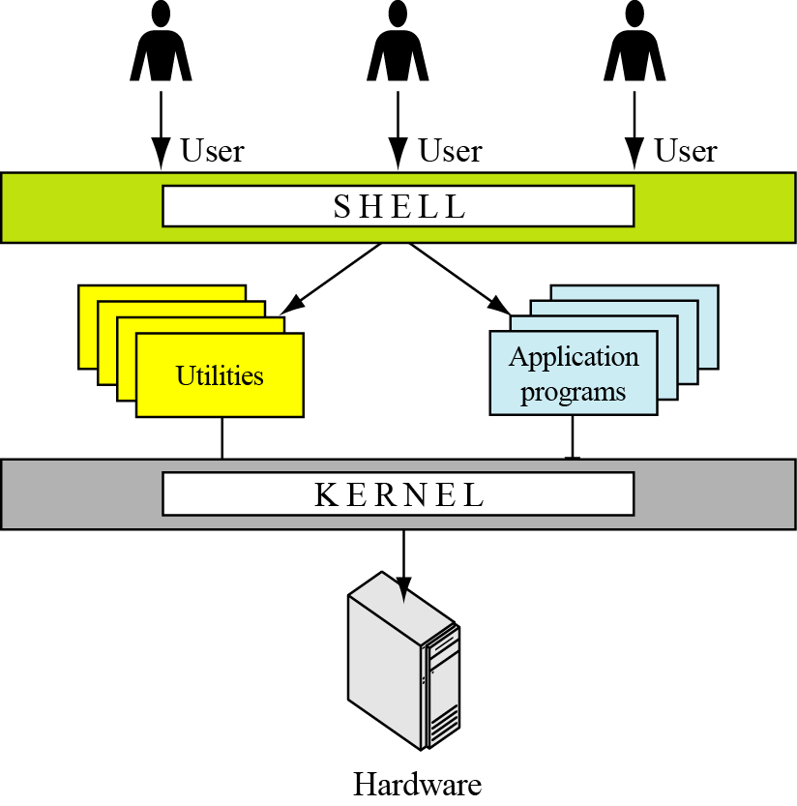
Figure 7.20 Components of the UNIX operating system

Slide 44
7.4.2 Linux
In 1991, Linus Torvalds, a Finish student at the University of Helsinki at the time, developed a new operating system that is known today as Linux. The initial kernel, which was similar to a small subset of UNIX, has grown into a full-scale operating system today. The Linux 2.0 kernel, released in 1997, was accepted as a commercial operating system: it has all features traditionally attributed to UNIX.
Components
Linux has three components: kernel, system libraries, and system utilities.

Slide 45
7.4.3 Windows
In the late 1980s, Microsoft started development of a new single-user operating system to replace MS-DOS (Microsoft Disk Operating System). Windows was the result. Several versions of Windows followed. We refer to all of these versions as Windows.
Design goals
Design goals released by Microsoft are extensibility, portability, reliability, compatibility, and performance.
Architecture
Windows uses a layer architecture as shown in Figure 7.21.

Slide 46
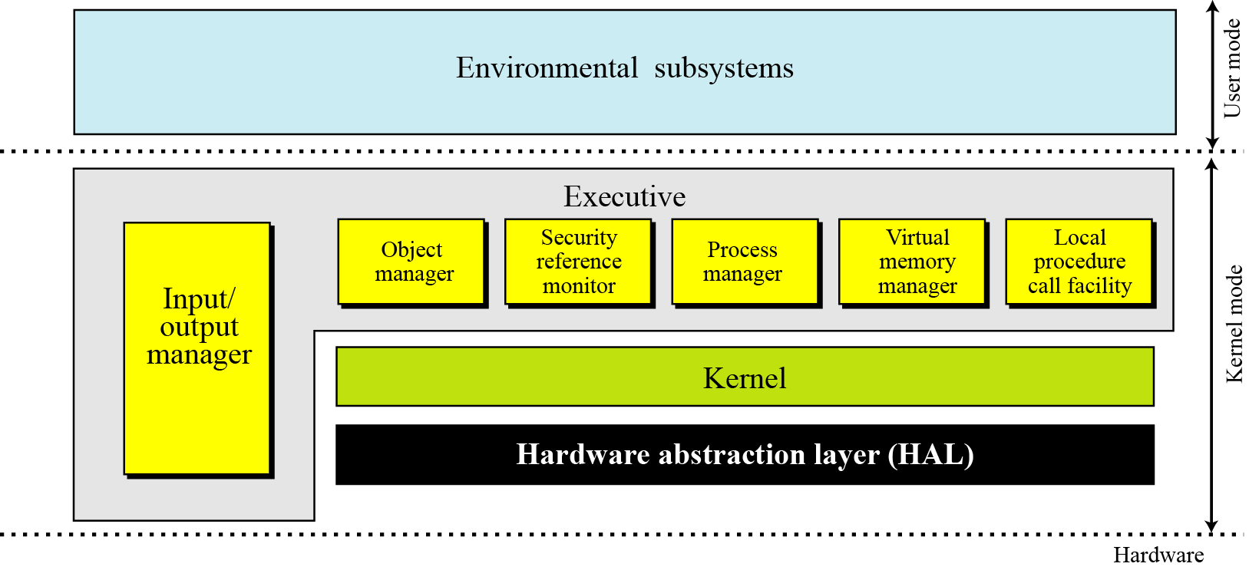
Figure 7.21 The architecture of Windows

