Slide 1
Chapter 9
Graphs

Slide 2
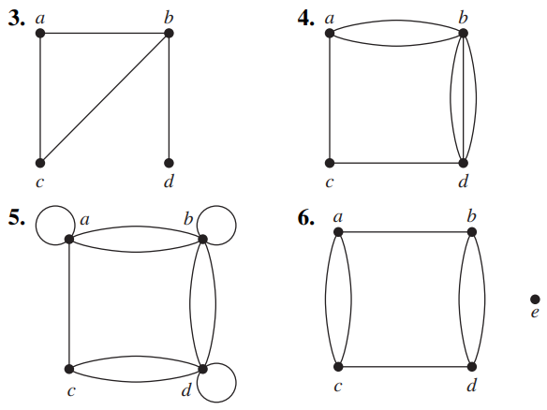
9.1 Graphs
1. Determine whether the graph shown has directed or undirected edges, whether it has multiple edges, and whether it has one or more loops.

Slide 3
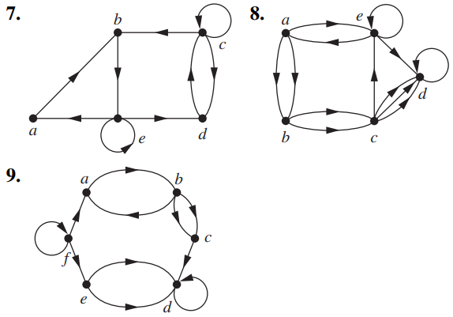
9.1 Graphs
1. Determine whether the graph shown has directed or undirected edges, whether it has multiple edges, and whether it has one or more loops.

Slide 4
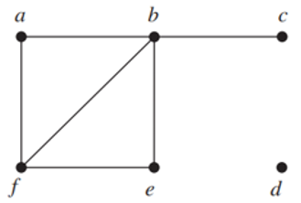
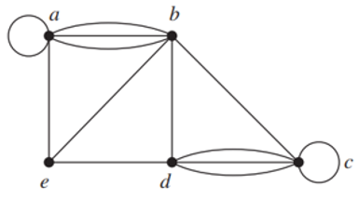
9.2 Graph Terminology
2. Find the number of vertices, the number of edges, and the degree of each vertex in the given undirected graph. Identify all isolated and pendant vertices.
a)
b)

Slide 5
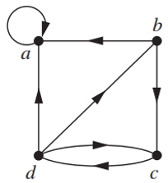
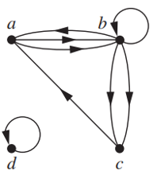
9.2 Graph Terminology
3. Determine the number of vertices and edges and find the
in-degree and out-degree of each vertex for the given directed multigraph.
a)
b)

Slide 6
9.2 Graph Terminology
4. Can a simple graph exist with 15 vertices each of degree five?

Slide 7

9.2 Graph Terminology
5. Draw these graphs.

Slide 8
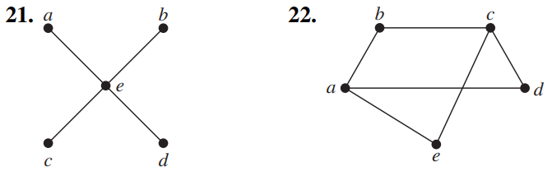
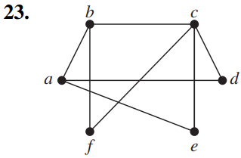
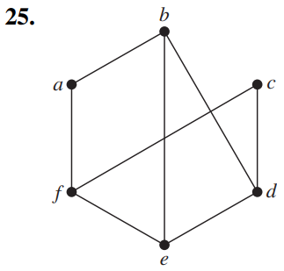
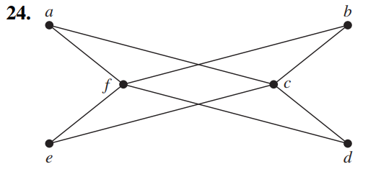
9.2 Graph Terminology
6. Determine whether the graph is bipartite.

Slide 9
9.2 Graph Terminology
7. How many vertices and how many edges do these graphs have?

Slide 10
9.2 Graph Terminology
8. Find the degree sequence of each of the following graphs.

Slide 11
9.2 Graph Terminology
9. How many edges does a graph have if its degree sequence is 4, 3, 3, 2, 2? Draw such a graph.

Slide 12
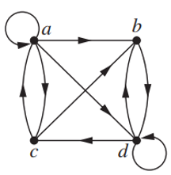

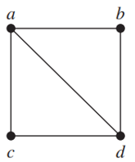

9.3 Representing Graphs
10. Use an adjacency list and an adjacency matrix to represent the given graph

Slide 13
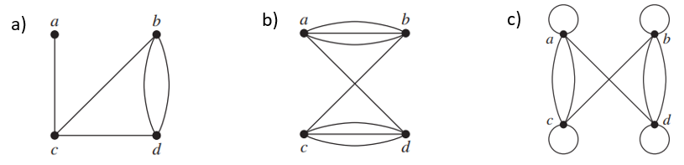
9.3 Representing Graphs
11. Represent the given graph using an adjacency matrix.

Slide 14
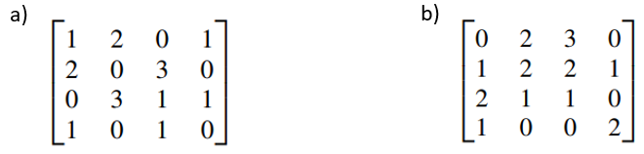
9.3 Representing Graphs
12. Draw a graph with the given adjacency matrix.

Slide 15
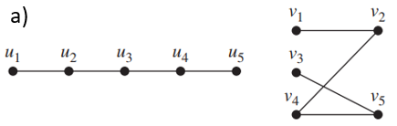
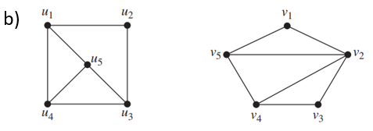
9.3 Representing Graphs
13. Determine whether the given pair of graphs is isomorphic.

Slide 16

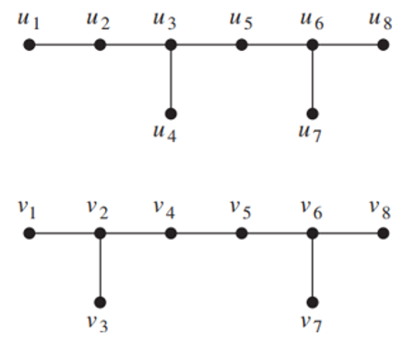
9.3 Representing Graphs
13. Determine whether the given pair of graphs is isomorphic.

Slide 17
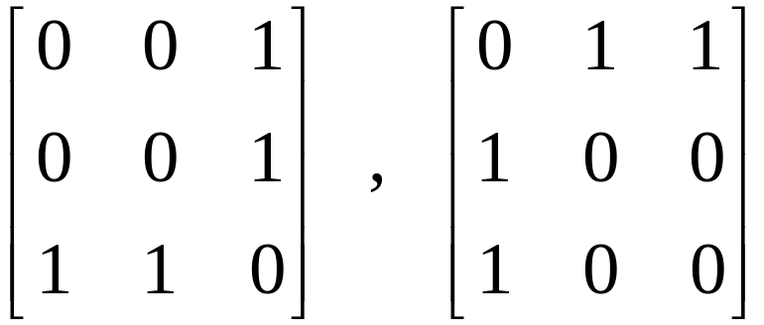

9.3 Representing Graphs
14. Are the simple graphs with the following adjacency matrices isomorphic?
a)
b)

Slide 18
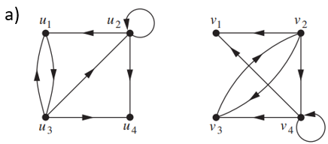
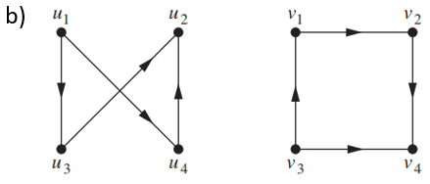
9.3 Representing Graphs
15. Determine whether the given pair of directed graphs are isomorphic.

Slide 19
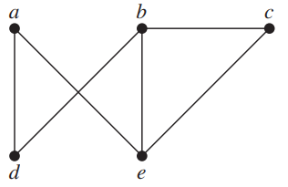
9.4 Connectivity
16. Does each of these lists of vertices form a path in the following graph? Which paths are simple? Which are circuits? What are the lengths of those that are paths?
a) a, e, b, c, b
b) a, e, a, d, b, c, a
c) e, b, a, d, b, e
d) c, b, d, a, e, c

Slide 20
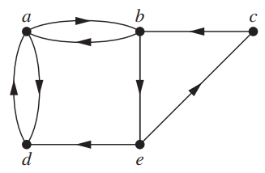
9.4 Connectivity
17. Does each of these lists of vertices form a path in the following graph? Which paths are simple? Which are circuits? What are the lengths of those that are paths?
a) a, b, e, c, b
b) a, d, a, d, a
c) a, d, b, e, a
d) a, b, e, c, b, d, a

Slide 21
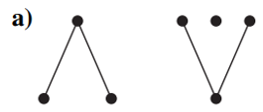
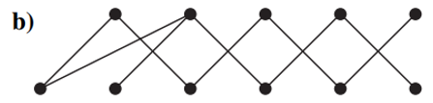
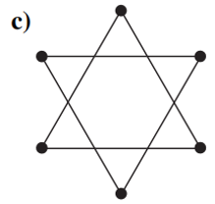
9.4 Connectivity
18. Which graphs is connected? How many connected components does each graph have? For each graph find each of its connected components.

Slide 22
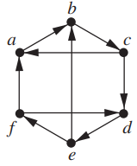
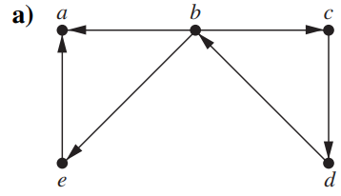

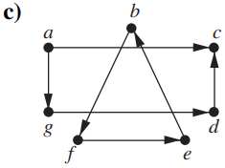
9.4 Connectivity
19. Determine whether each of these graphs is strongly connected and if not, whether it is weakly connected.

Slide 23
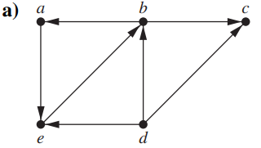
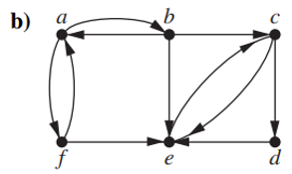
9.4 Connectivity
20. Find the strongly connected components of each of these graphs.

Slide 24
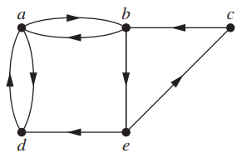
9.4 Connectivity
21. Find the number of paths from a to e in this directed graph of length:
a) 3. b) 4. c) 5.

Slide 25
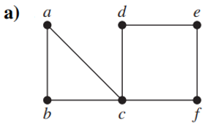
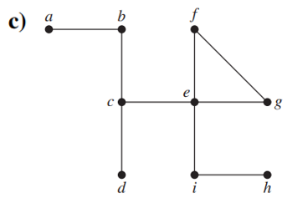
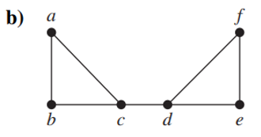
9.4 Connectivity
22. Find all the cut vertices of the given graph.

Slide 26
9.4 Connectivity
23. Find all the cut edges of the given graph.

Slide 27
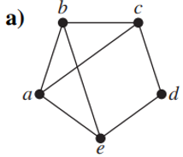
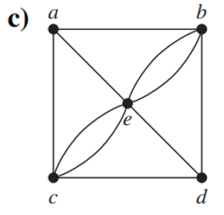
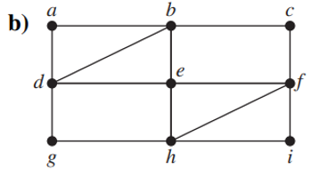
9.5 Euler and Hamilton Path
24. Determine whether the given graph has an Euler circuit. Construct such a circuit when one exists. If no Euler circuit exists, determine whether the graph has an Euler path and construct such a path if one exists.

Slide 28
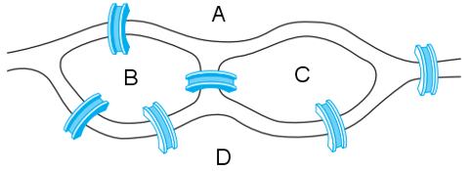
9.5 Euler and Hamilton Path
25. Can someone cross all the bridges shown in this map exactly once and return to the starting point?

Slide 29
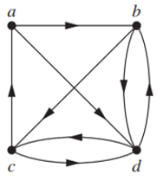

9.5 Euler and Hamilton Path
A directed multigraph:
Euler circuit if and only if the graph is weakly connected and the in-degree and out-degree of each vertex are equal.
Euler path but not an Euler circuit if and only if the graph is weakly connected and the in-degree and out-degree of each vertex are equal for all but two vertices, one that has in-degree one larger than its outdegree and the other that has out-degree one larger than its in-degree.
No Euler circuit.
Euler path:

Slide 30
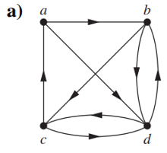
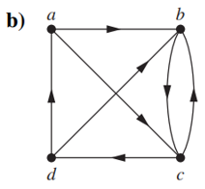
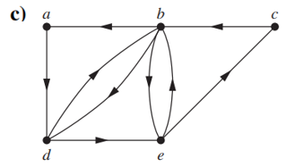
9.5 Euler and Hamilton Path
26. determine whether the directed graph shown has an Euler circuit. Construct an Euler circuit if one exists. If no Euler circuit exists, determine whether the directed graph has an Euler path. Construct an Euler path if one exists.

Slide 31
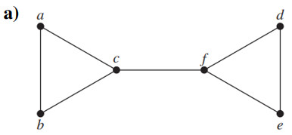
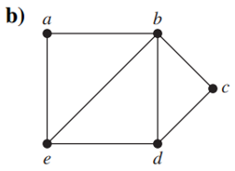
9.5 Euler and Hamilton Path
27. Determine whether the given graph has a Hamilton circuit or a Hamilton path. If it does, find such a circuit or a path.

Slide 32
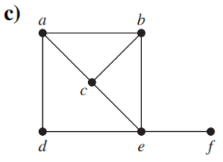
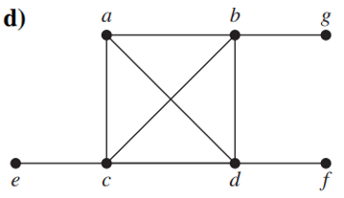
9.5 Euler and Hamilton Path
28. Determine whether the given graph has a Hamilton circuit or a Hamilton path. If it does, find such a circuit or a path.

Slide 33
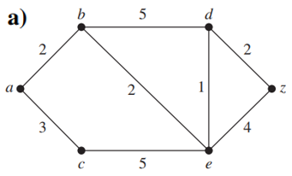
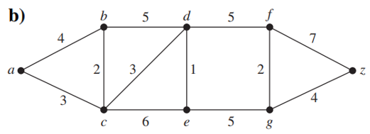
9.6 Shortest Path Problems
29. Find the length of a shortest path between a and z in the given weighted graph.

Slide 34
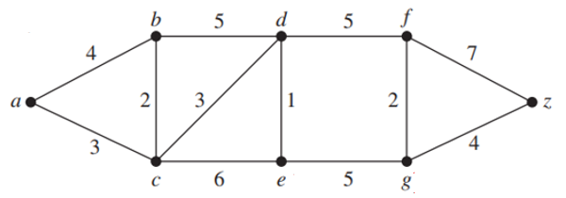
9.6 Shortest Path Problems
30. Find the length of a shortest path in the given weighted graph.
a) a and d
b) a and f
c) c and f
d) b and z

