Slide 1
Trees
Chapter 10

Slide 2
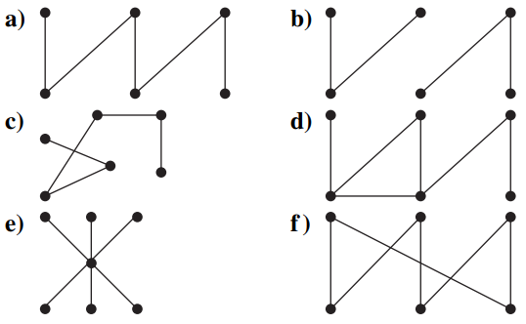
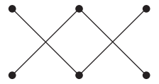
10.1 Introduction to Trees
1. Which of these graphs are trees?

Slide 3
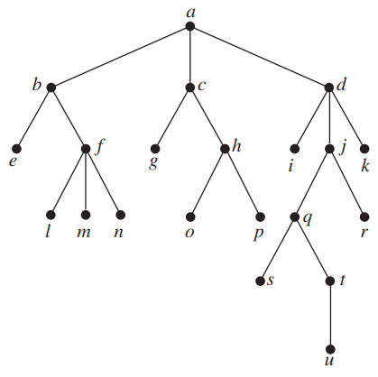
10.1 Introduction to Trees
2.
a) Which vertex is the root?
b) Which vertices are internal?
c) Which vertices are leaves?
d) Which vertices are children of j?
e) Which vertex is the parent of h?
f) Which vertices are siblings of o?
g) Which vertices are ancestors of m?
h) Which vertices are descendants of b?
i) Is the rooted tree a full m - ary tree for some positive integer m?
j) What is the level of each vertex of this rooted tree?
k) Draw the subtree of this tree that is rooted at
a) a. b) c. c) e.

Slide 4
10.1 Introduction to Trees
3. a) How many edges does a tree with 10,000 vertices have?
b) How many vertices does a full 5-ary tree with 100 internal vertices have?
c) How many edges does a full binary tree with 1000 internal vertices have?
d) How many leaves does a full 3-ary tree with 100 vertices have?

Slide 5
10.1 Introduction to Trees
4. Construct a complete binary tree of height 4 and a complete 3-ary tree of height 3.

Slide 6
10.2 Applications of Trees
5. Build a binary search tree for the words banana, peach, apple, pear, coconut, mango, and papaya using alphabetical order.

Slide 7
10.2 Applications of Trees
6. How many comparisons are needed to locate or to add each of these words in the search tree for Exercise 5, starting fresh each time?
a) pear
b) banana
c) kumquat
d) orange

Slide 8
10.2 Applications of Trees
7. a) How many weighings of a balance scale are needed to find a counterfeit coin among four coins if the counterfeit coin may be either heavier or lighter than the others?
b) How many weighings of a balance scale are needed to find a counterfeit coin among 12 coins if the counterfeit coin is lighter than the others?

Slide 9
10.2 Applications of Trees
8. Find the least number of comparisons needed to sort four elements and devise an algorithm that sorts these elements using this number of comparisons.

Slide 10
10.2 Applications of Trees
9. Which of these codes are prefix codes?
a) a: 11, e: 00, t: 10, s: 01
b) a: 0, e: 1, t: 01, s: 001
c) a: 101, e: 11, t: 001, s: 011, n: 010
d) a: 010, e: 11, t: 011, s: 1011, n: 1001, i: 10101

Slide 11
10.2 Applications of Trees
10. Construct the binary tree with prefix codes representing these coding schemes.
a) a: 11, e: 0, t: 101, s: 100
b) a: 1, e: 01, t: 001, s: 0001, n: 00001
c) a: 1010, e: 0, t: 11, s: 1011, n: 1001, i: 10001

Slide 12
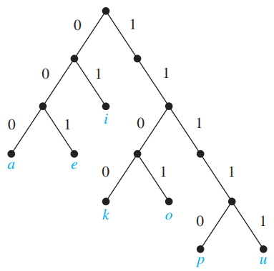
10.2 Applications of Trees
11. What are the codes for a, e, i, k, o, p, and u if the coding scheme is represented by this tree?

Slide 13
10.2 Applications of Trees
12. Given the coding scheme a: 001, b: 0001, e: 1, r: 0000, s: 0100, t: 011, x: 01010, find the word represented by
a) 01110100011.
b) 0001110000.
c) 01100101010.

Slide 14
10.2 Applications of Trees
13. Use Huffman coding to encode these symbols with given frequencies: a: 0.20, b: 0.10, c: 0.15, d: 0.25, e: 0.30. What is the average number of bits required to encode a character?

Slide 15
10.2 Applications of Trees
14. Use Huffman coding to encode these symbols with given frequencies: A: 0.10, B: 0.25, C: 0.05, D: 0.15, E: 0.30, F: 0.07,
G: 0.08. What is the average number of bits required to encode a symbol?

Slide 16
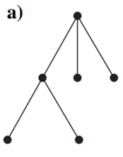
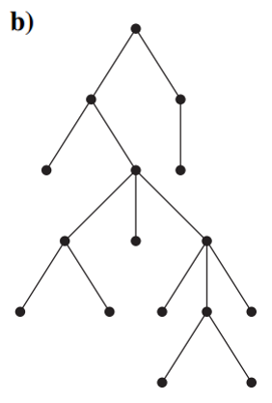
10.3 Tree Traversal
15. Construct the universal address system for the given ordered rooted tree. Then use this to order its vertices using the lexicographic order of their labels

Slide 17
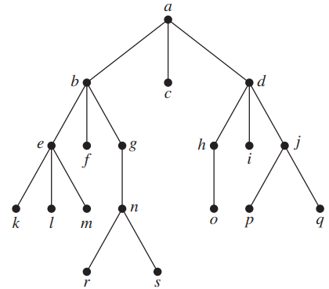
10.3 Tree Traversal
16. In which order are the vertices of the ordered rooted tree visited using:
a) A preorder traversal?
b) An inorder traversal?
c) A postorder traversal?

Slide 18
10.3 Tree Traversal
17. a) Represent the expression ((x + 2) ↑ 3) ∗ (y −(3 + x)) − 5 using a binary tree.
Write this expression in
b) prefix notation.
c) postfix notation.
d) infix notation.

Slide 19
10.3 Tree Traversal
18. a) Represent the expression ¬(p ∧ q) ↔ (¬p ∨ ¬q) using a binary tree.
Write this expression in
b) prefix notation.
c) postfix notation.
d) infix notation.

Slide 20
10.3 Tree Traversal
19. Draw the ordered rooted tree corresponding to each of these arithmetic expressions written in prefix notation. Then write each expression using infix notation.
a) + ∗ + − 5 3 2 1 4 b) ∗ / 9 3 + ∗ 2 4 − 7 6

Slide 21
10.3 Tree Traversal
20. What is the value of each of these prefix expressions?
a) − ∗ 2 / 8 4 3 b) ↑ − ∗ 3 3 ∗ 4 2 5

Slide 22
10.3 Tree Traversal
21. What is the value of each of these postfix expressions?
a) 5 2 1 − − 3 1 4 ++ ∗ b) 9 3 / 5 + 7 2 − ∗

Slide 23
10.4 Spanning trees
22. How many edges must be removed from a connected graph with n vertices and m edges to produce a spanning tree?

Slide 24
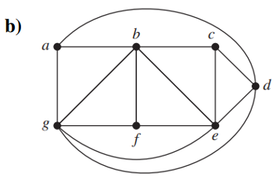
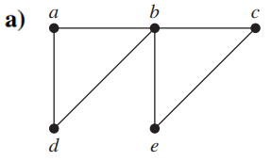
10.4 Spanning trees
23. Find a spanning tree for the graph shown by removing edges in simple circuits.

Slide 25






10.4 Spanning trees
24. Find a spanning tree for each of these graphs.

Slide 26
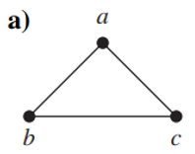
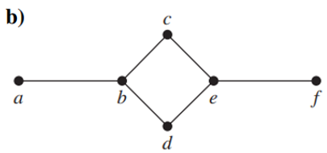
10.4 Spanning trees
25. Draw all the spanning trees of the given simple graphs.

Slide 27
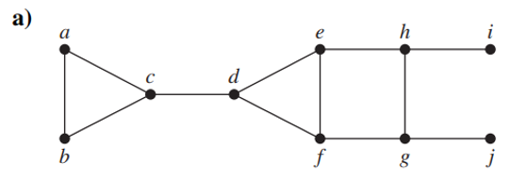
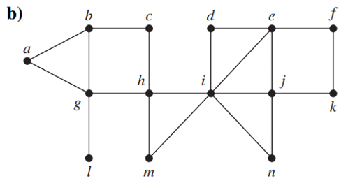
10.4 Spanning trees
26. Use depth-first search and breadth-first search to produce a spanning tree for the given simple graph. Choose a as the root of this spanning tree and assume that the vertices are ordered alphabetically.

Slide 28




10.4 Spanning trees
27. Use depth-first search and breadth-first search to find a spanning tree of each of these graphs.
a) starting at the vertex of degree 6
b)
c) , starting at a vertex of degree 3
d)

Slide 29
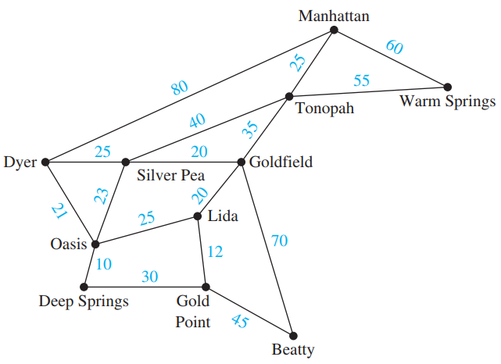
10.5 Minimum Spanning Trees
28. The roads represented by this graph are all unpaved. The lengths of the roads between pairs of towns are represented by edge weights. Which roads should be paved so that there is a path of paved
roads between each
pair of towns so that
a minimum road
length is paved?
(Note: These towns
are in Nevada.)

Slide 30
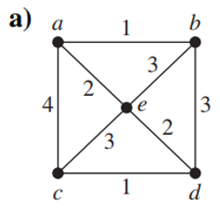
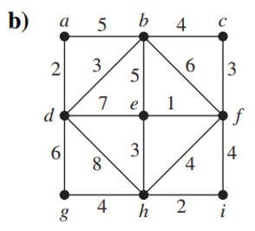
10.5 Minimum Spanning Trees
29. Use Prim’s algorithm and Kruskal’s algorithm to find a minimum spanning tree for the given weighted graph.

