Slide 1
Chapter 5 & 7
Counting

Slide 2
Objectives
Some questions we can face:
  “How can we determine the complexity of an algorithm?”
  “How many cases possible are there to arrange n objects?”
  “How can we generate input data from given initial data?”
  A password consists of six characters. How many such password with some criteria?
  How many bit strings of length n that do not have two consecutive 0s?

Slide 3
Contents
The basics of Counting
Recurrence relations
Divide – and – Conquer Algorithms and recurrence relations

Slide 4
5.1- The Basics of Counting
Basic Counting Principles : Product rule, sum rule, The Inclusion-Exclusion Principle
Tree Diagrams

Slide 5
Basic Counting Principle
Ex: Distribute 3 distinct balls to 2 bags
We must do 3 times, each time we have 2 ways to select a bags.
2.2.2 = 2³ ways
v
A
v
v
B
v
A
v
A
A
v
v
B
B
v
A
v
There are r^{n} ways to distribute n distinct objects to r bags
v
B
v
A
v
A
B
v
v
B
B

Slide 6
Basic Counting Principle
12 teams. How many ways to select 3 teams for the first, second and third teams
I
II
III
Select 1/ 12
→ 12 ways
After select 1 team for the first position, one of 11 teams can be select into the second team
➔ 11 ways
After select 1 team for the second position, one of 10 remaining teams can be select into the third team
➔ 10ways
12.11.10= 1320 ways

Slide 7
Basic Counting Principle: Product rule
Suppose that a procedure can be broken down into a sequence of two tasks. If there is n₁ ways to do the first task, there is n₂ ways to do the second task, then there are n₁n₂ ways to do the procedure.
Example 1: 2 persons, 12 rooms. How many ways are there to assign different room to these two person?
12 ways can be applied to assign the first
11 ways can be applied to assign the second after the first assigned.
➔ 12.11= 132 ways.
Examples 3, 4, 5,6,7,8,9: Refer to pages 336, 337

Slide 8
Basic Counting Principle: Sum rule
If a task can be done either in one of n₁ ways or in one of n₂ ways, where none of the set of n₁ ways is the same as any of the set of n₂ ways, then there are n₁ + n₂ ways to do this task.
Example 11: There are 37 faculties, 83 students. A person either a faculty or student can be choose to attend a committee. How many ways are there to select such person?
37 + 83= 120 ways
Examples 12, 13: Refer to page 339

Slide 9
Basic Counting Principles…
Example 14: Name of a variable in BASIC language, an case insensitive language, is a string of 1 or 2 characters in which the first must be a character, the second may be an alphanumeric characters, and must be different from 5 two-character keywords . How many different variable names are there?
26 characters (a..z), 10 digits (0..9)
Name with 1 character: 26
Name with 2 character: 26.36 -5 =931
➔ There are 957 different names

Slide 10
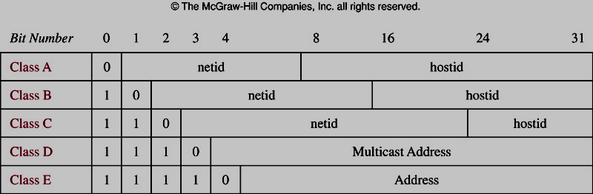
Basic Counting Principles…
Example 16 – page 341:Counting Internet Address
Class A address: largest networks
Class B address: medium-sized networks
Class C address: smallest networks.
IPv4

Slide 11
Basic Counting Principles:
The Inclusion-Exclusion Principle
Nguyên lý thêm vào rồi bỏ ra
Suppose that a task can be done in n₁ or n₂ ways, but that some ways in the set of n₁ ways are the same as some ways in the set of n₂ ways.
n_{s} : number of ways that are the same in two sets of ways.
Total ways n= n₁+ n₂ –n_{S}
Example 17: How many 8-bit strings either start with 1 or end with 00?
2⁷ + 2⁶ – 2⁵ = 160 – Refer to page 342
|A∪B|=|A| + |B| - |A∩B|

Slide 12
Basic Counting Principles:
The Inclusion-Exclusion Principle
Example 18:
350 applications, in which
A1: 220 people majored in IT
A2: 147 people majored in business
A3: 51 people majored both in IT and business
How many applicants majored neither in IT nor business?
Number of applicants who majored either IT or business = (|A1| + |A2| - |A3|) = 220+147-51=316
Result: 350 – 316 = 34

Slide 13
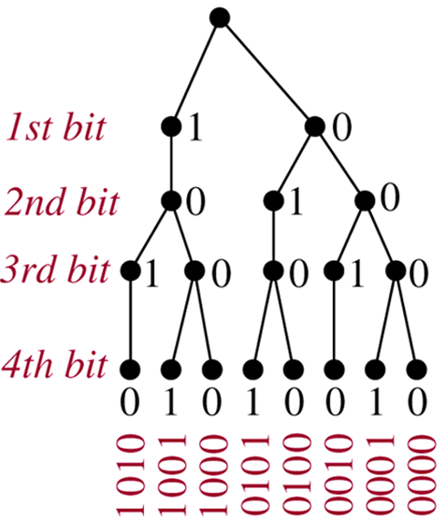
Tree Diagrams
Counting problem can be solved using Tree Diagram.
Example: How many 4-bit strings do not have two consecutive 1s?

Slide 14
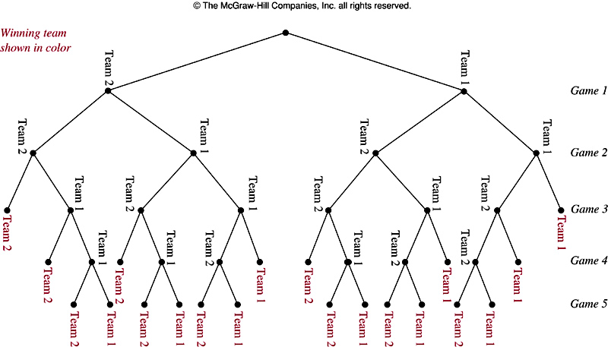
Example 20: A playoff between two teams consists of at lost 5 games. The first team that wins 3 games wins the playoff. In how many different ways can the playoff occur?

Slide 15
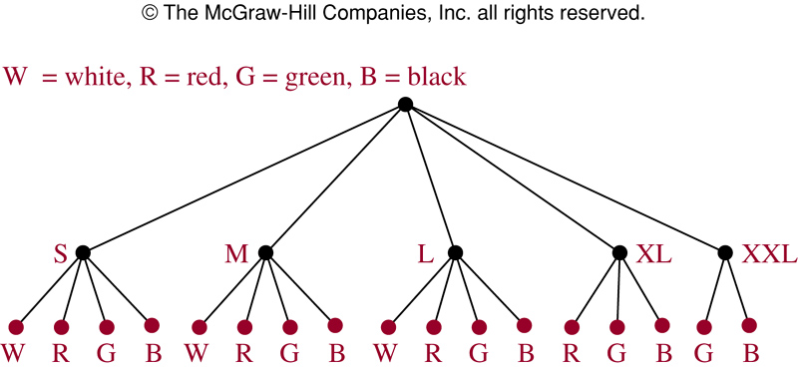
Example 22: T-Shirts come in 5 sizes: S, M, L, XL, XXL. Each size comes in 4 colors, W, R, G, B excepts for XL, which comes only in R, G, B, and XXL, which comes only in G and B.
How many different shirts a souvenir shop have to stock to have at least one of each available size and color of the T_shirt?

Slide 16
7.1. Recurrence Relations
Definition 1: Recurrence relation on the sequence { a_{n} }:
a_{n} is expressed in terms of one or more of previous items for all n with n ≥ n₀
{a_{n}} is called a solution of recurrence relation.
Example 1: a₀=3, a₁= 5 a_{n}=a_{n-1} – a_{n-2} , n>1
Example 2: Determine whether {a_{n}} = 3n, n ≥ 0 is a solution of the recurrence relation a_{n}= 2a_{n-1} – a_{n-2}, n ≥ 2?
Initial conditions: Terms that precede the first item where the recurrence takes effect.

Slide 17
Modeling with Recurrence Relations
Problem ← Modeling with recurrence relation
Example 3 (page 451): Compound interest Problem – Lãi gộp:
P₀: Initial deposite
r: interest rate per year
P_{n}: amount at the n^{th} year
P_{n}= P_{n-1} + rP_{n-1}
➔ P_{n}= (1+r)^{n}P₀

Slide 18
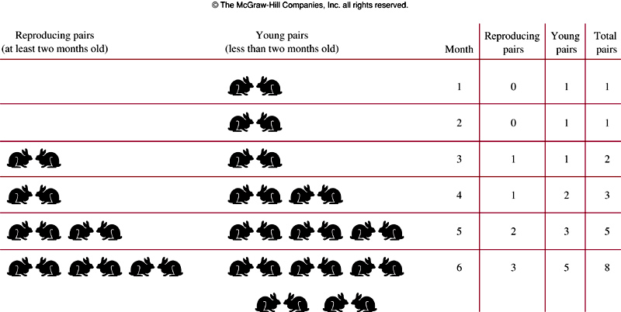
Fibonacci numbers of Leonardo Pisano
Example 4: : f₁=f₂=1; f_{n}= f_{n-2} + f_{n-1}

Slide 19
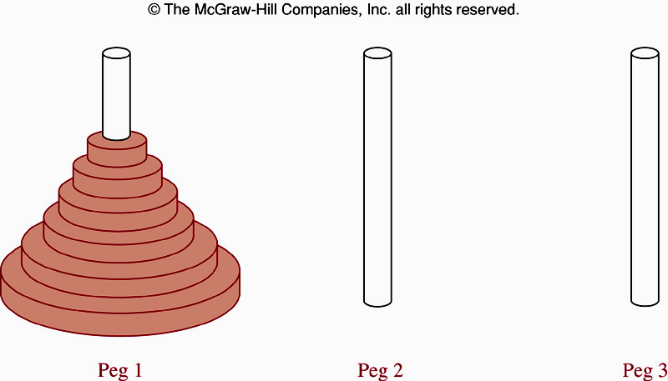
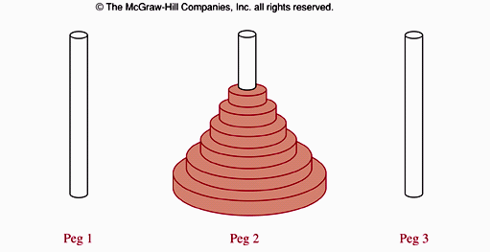
The Tower of Hanoi Problem- Ex5, page 452
How many steps this problem is solved if there is n disks on the peg 1?

Slide 20
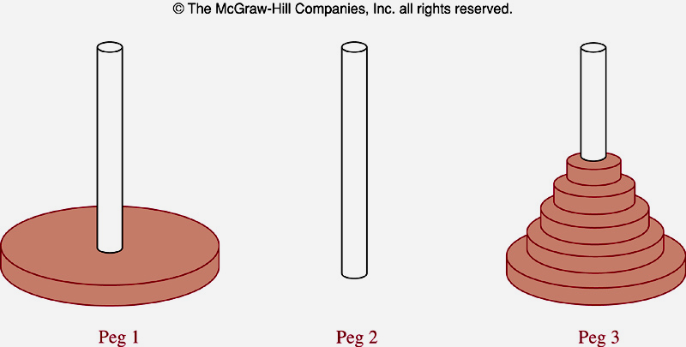
The Tower of Hanoi Problem- Ex5, page 452
Let H_{n} is the number of moves needed to solve the Tower of Hanoi problem. We will set up a recurrence relation for the sequence H_{n}.
Begin with n disk on peg 1.
We transfer the top n-1 disk from peg1 to peg3 → H_{n-1} moves .
We transfer the largest disk from peg1 to peg 2 → 1 move
We transfer n-1 disk from peg3 to peg 2
H_{n}= 2H_{n-1} + 1
H₁=1 ➔H_{n}= 2^{n} -1 ( See page 453)
n=64 → 2⁶⁴-1=18 446 744 073 709 551 615. With 1 move/sec → 500 billion years.

Slide 21
Find recurrence relation and give initial conditions for the number of bit strings of length n that do not have two consecutive 0s. How many such bit strings are there of length five.
a_{n}: number of bit string of length n that do not have two consecutive 0s.
One bit string can terminate with bit 1 or 0
Format of a bit string that do not have two consecutive 0s:
End with 1
Any bit string of length n-1 with no two consecutive 0s
1
End with 0
Any bit string of length n-2 with no two consecutive 0s
1 0
a_{n} = a_{n-1} + a_{n-2} for n ≥ 3 { Fibonacci sequence }
a₁=2 { two string “0” and “1” }
a₂= 3 { “10” , “01” , “11” }
With n=5
a₃ = a₂+ a₁ =5
a₄= a₃ + a₂ = 5+3=8
a₅=a₄ + a₃ = 8+5=13

Slide 22
Counting valid codewords valid codeword: String of decimal digits that contains an even number of 0 digits.
a_{n}: number of valid n-digit codewords
Find a recurrence relation for a_{n}
a₁=9 // “1”, “2”, …, “9” ➔ “0” is not used
Study a_{n}:
Valid codeword with n-1 digits
1..9
9a_{n-1} ways
Invalid codeword with n-1 digits ( number of 0s is odd)
0
10^{n-1} - a_{n-1} ways
All possible codewords minus valid codewords
a_{n}= 9a_{n-1} + 10^{n-1} - a_{n-1} = 8a_{n-1} + 10^{n-1}

Slide 23
7.3. Divide-and-Conquer Algorithms and recurrence Relations
Divide: Dividing a problem into one or more instances of the same problem of smaller size
Conquer: Using the solutions of the smaller problems to find a solution of the original problem, perhaps with some additional work.

Slide 24
Divide-and-Conquer Recurrence Relations
n : size of the original problem
n/b : size of the sub-problem
f(n) : number of operation required to solve the original problem.
→ f(n/b) : number of operation required to solve a sub-problem.
g(n): overhead for additional work of the step conquer.
Recurrence relation: f(n) = af(n/b) + g(n)

Slide 25
Recurrence Relations for Binary Search
procedure binary-search(x, i, j)
if i>j then location=0
m= ⎣(i+j)/2⎦
if x= a_{m} then location =m
else if x< a_{m} then location= binary-search(x, i, m-1)
else location= binary-search(x, m+1, j)
f(n) = f(n/2) +2

Slide 26
Recurrence Relations for Finding Maximum of a sequence
procedure max(i,j: integer ,a_{i},a₂₊₁,…,a_{j}: integers)
if i=j then
begin
max:= a_{i}
end
else
begin
m= ⎣(i+j)/2⎦
max1= max (i,m,a_{i},a_{i+1},…,a_{m})
max2= max (m+1,j,a_{m+1},a_{m+2},…,a_{j})
if max1>max2 then max:= max1
else max:=max2
f(n) = 2f(n/2) +1

Slide 27

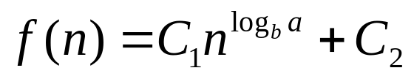
Theorem 1
Let f be an increasing function that satisfies the recurrence relation f(n)= af(n/b) + c
whenever n is divisible by b, where a ≥ 1 , b is an integer and greater than 1, and c is a positive real number. Then
Furthermore, when n=b^{k}, where k is a positive integer,
Where C₁=f(1) + c/(a-1) and C₂= -c/(a-1)
Proof: page 477

Slide 28
Using Theorem 1
Example 6: f(n)= 5f(n/2) + 3, f(1)=7. Find f(2^{k}), k is a positive integer. Estimate f(n) if f is increasing function.
Using theorem 1: a= 5, b=2, c=3, n=2^{k}
C₁=f(1) + c/(a-1) = 7+3/(5-1)= 7+3/4=31/4
C₂= -c/(a-1) = -3/(5-1)= -3/4
n^{loga} = 2^{kloga} = a^{k} { loga ≡ log₂a }
f(n)= f(2^{k}) C₁a^{k} + C₂ = a^{k}.31/4 -3/4
f is increasing function , a>1 → f(n) = O(n^{loga}) = O(n^{log5})
Estimate the number of comparisons used by a binary search
f(n) = f(n/2) +2, a=1 → f(n) = O(log n) // theorem 1
Estimate the number of comparisons to locate the maximum element in a sequence
f(n) = 2f(n/2) +1, a=2 → f(n) = O(n^{log a}) = O(n) // theorem 1

Slide 29
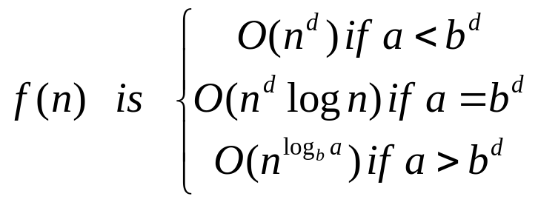
Theorem 2: Master Theorem
Let f be an increasing function that satisfies the recurrence relation f(n) = af(n/b) + cn^{d}
Whenever n= b^{k}, where k is a positive integer, a ≥ 1, b is an integer greater than 1, and c and d are real numbers with c positive and d nonnegative. Then

Slide 30
An Demonstration: Closest-Pair Problem
n points in the plane. How to determine the closest-pair of points?
(1) Determine the distance of every pair of points.
(2) Determine the pair of points that have minimum distance.
➔ C(n,2)= n(n-1)/2= O(n²)
Michal Samos proposed an approach that is O(nlogn) only.
Michal Samos’s approach
(1) Sorting points in order of increasing x coordinates → O(nlog(n))
(2) Sorting points in order of increasing y coordinates → O(nlog(n))

Slide 31
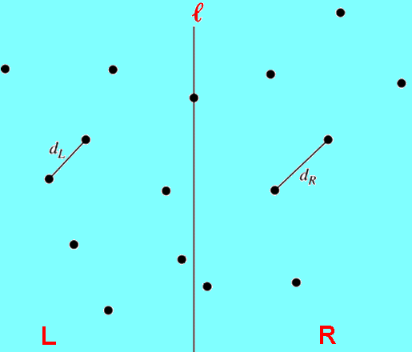
An Demonstration: Closest-Pair Problem
(3) Using recursive approach to divide the problem into 2 subproblem with n/2 points (left and right points based on x coordinates). Let ℓ is the line that partitions two subproblems. If there is any point on this dividing line, we decide these points among the two parts if necessary)
(4) Finding out closest-pair of points in two side ( d_{L}, d_{R})
(5) Let d=min(d_{L}, d_{R})
16 points
8 points
8 points

Slide 32
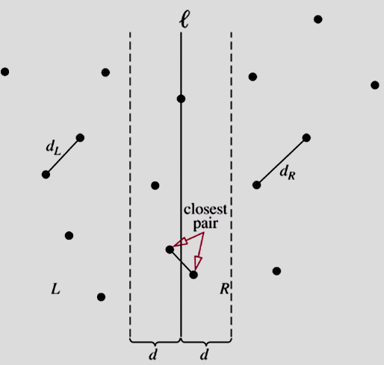
An Demonstration: Closest-Pair Problem
(6) Studying area [l-d,l+d]. This area may be contains the result.
(7) Because we sorted points by their y coordinate. We examine for points p in the strip of width 2d that has the line l as its center with upward direction.

Slide 33
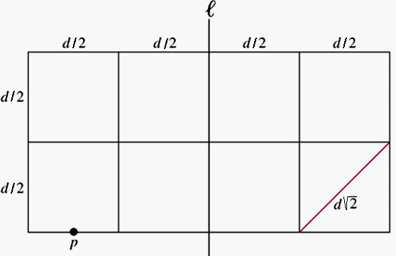
An Demonstration: Closest-Pair Problem
Total number of points in the strip does not exceed n and there are at most 8 points, including p, can lie in or on the 2dxd rectangle.
➔A point will be computed with 7 others.
At most 7n distances need to be compare with d to find the minimum distance between points.
The increasing function f(n) satisfies the recurrence relation :
f(n) = 2f(n/2) + 7n
➔ By the Master Theorem, it follows that f(n) is O(nlogn)

Slide 34
Summary
Product rule: Suppose that a procedure can be broken down into a sequence of two tasks. If there is n1 ways to do the first task, there is n2 ways to do the second task, then there are n1n2 ways to do the procedure.
Sum rule: If a task can be done either in one of n1 ways or in one of n2 ways, where none of the set of n1 ways is the same as any of the set of n2 ways, then there are n1 + n2 ways to do this task.

Slide 35
Summary
Inclusion-Exclusion Principle: Suppose that a task can be done in n1 or n2 ways, but that some ways in the set of n1 ways are the same as some ways in the set of n2 ways.

Slide 36
Summary
Recurrence relation on the sequence { a_{n} } is an expression in which a_{n} is expressed in terms of one or more of previous items for all n with n ≥ n₀ . {an} is called a solution of recurrence relation.
Initial conditions: Terms that precede the first item where the recurrence takes effect.
Modeling with recurrence relation: Finding out an recurrence relation for input of a problem.

Slide 37
Summary
Divide: Dividing a problem into one or more instances of the same problem of smaller size
Conquer: Using the solutions of the smaller problems to find a solution of the original problem, perhaps with some additional work
Recurrence relation: f(n) = af(n/b) + g(n)

Slide 38
Summary – Theorem 1
Let f be an increasing function that satisfies the recurrence relation f(n)= af(n/b) + c
whenever n is divisible by b, where a ≥ 1 , b is an integer and greater than 1, and c is a positive real number. Then
Furthermore, when n=b^{k}, where k is a positive integer,
Where C₁=f(1) + c/(a-1) and C₂= -c/(a-1)
Proof: page 477

Slide 39
Summary – Theorem 2- Master Theorem
Let f be an increasing function that satisfies the recurrence relation f(n) = af(n/b) + cn^{d}
Whenever n= b^{k}, where k is a positive integer, a ≥ 1, b is an integer greater than 1, and c and d are real numbers with c positive and d nonnegative. Then

Slide 40
THANKS

