Slide 1
Session 17
Chapter 7 – Triggers
Database Systems

Slide 2
Objectives
1
Know what is a trigger
2
Know why use triggers
3
Know components of triggers
4
Know how to create a trigger

Slide 3
Contents
1
Trigger definition
2
Why use triggers?
3
Components of trigger
4
Trigger Guideline

Slide 4
1. Trigger definition
A trigger is a procedure that is only awakened when certain events, specified by the database programmer, occur.
Events could be:
  insert, delete, update to a particular relation
  transaction end
Trigger carry out actions when their triggering conditions are met
Triggers are available in most current commercial DB products

Slide 5
Why use triggers?
Triggers can implement business rules
    E.g. creating a new loan when a customer’s account is overdrawn.
Triggers be used to ensure data integrity
Triggers may also be used to maintain data in related database tables.
    E.g. Updating derived attributes when underlying data is changed, or maintaining summary data.

Slide 6
Trigger components
Event (activates the trigger)
  A specified modification to the DB
    May be an insert, deletion or change.
    May be limited to special tables.
    The trigger may fire before or after the transaction
Action (what happens if the trigger runs)
  A trigger’s action can be very far-ranging, e.g.
    Execute queries.
    Make modifications to the DB.
    Create new tables.
    Call procedures

Slide 7
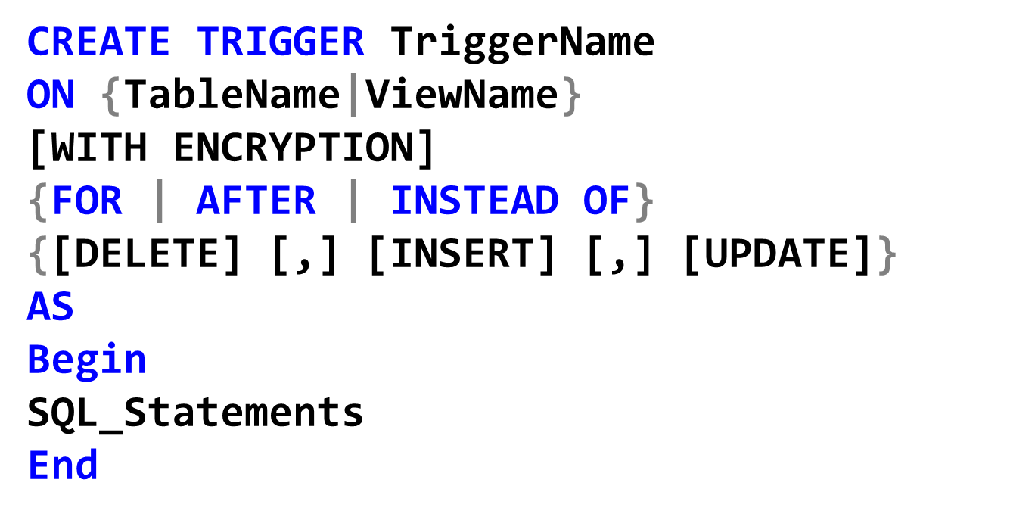
Creation of Trigger

Slide 8
The options for trigger design
Possible triggering events are:
  UPDATE: The trigger is activated whenever a row is modified.
  INSERT: The trigger is activated whenever a new row is inserted into the table.
  DELETE: The trigger is activated whenever a row is deleted from the table.
The action of trigger can consist of multiple SQL statements, surrounded by BEGIN… END.

Slide 9
The options for trigger design
Synchronization of the trigger with the activating statement
  AFTER or FOR: triggers’ actions are executed after the triggering events.
    Cannot use AFTER trigger for view
  INSTEAD OF: triggers’ actions are executed instead of the triggering events.
WITH ENCRYPTION:
  Obfuscate the text of the CREATE TRIGGER statement so that the other users cannot view the content of the trigger.

Slide 10
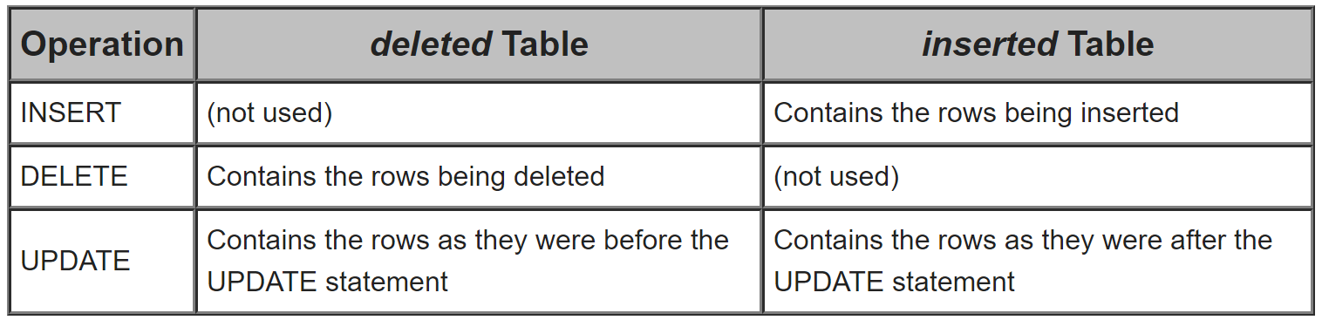
The options for trigger design
Inserted, deleted tables:
  Logical tables containing rows being effected by the trigger event
  The schema of the inserted and deleted tables is identical to that of the table or view on which the trigger is defined.
  We could use queries on inserted, deleted tables in the trigger

Slide 11
The options for trigger design
In SQL statements of trigger, we could use:
  IF UPDATE(column_Name): for verifying if a column is updated by the triggering event.
  IF UPDATE(Column1) [{AND | OR} UPDATE (Column2)]: for verifying the modification of multiple columns by the triggering event.

Slide 12
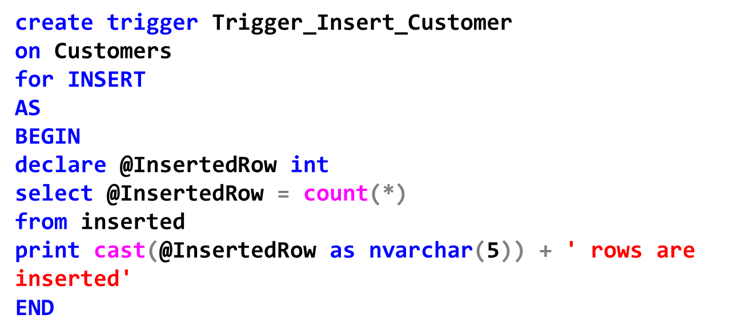
Examples: Trigger for INSERT event
Trigger for the INSERT statement on the table Customers
The trigger fire after an INSERT statement into Customers table.

Slide 13
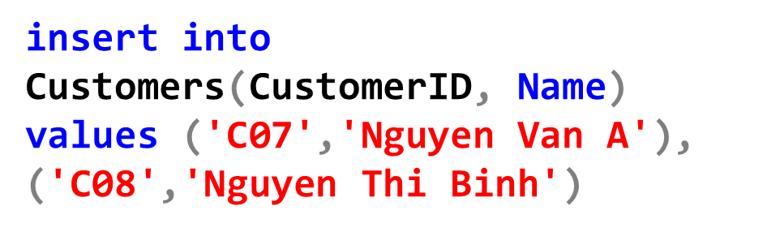
Examples: Trigger for INSERT event
The previous trigger is activated after the following statement:

Slide 14
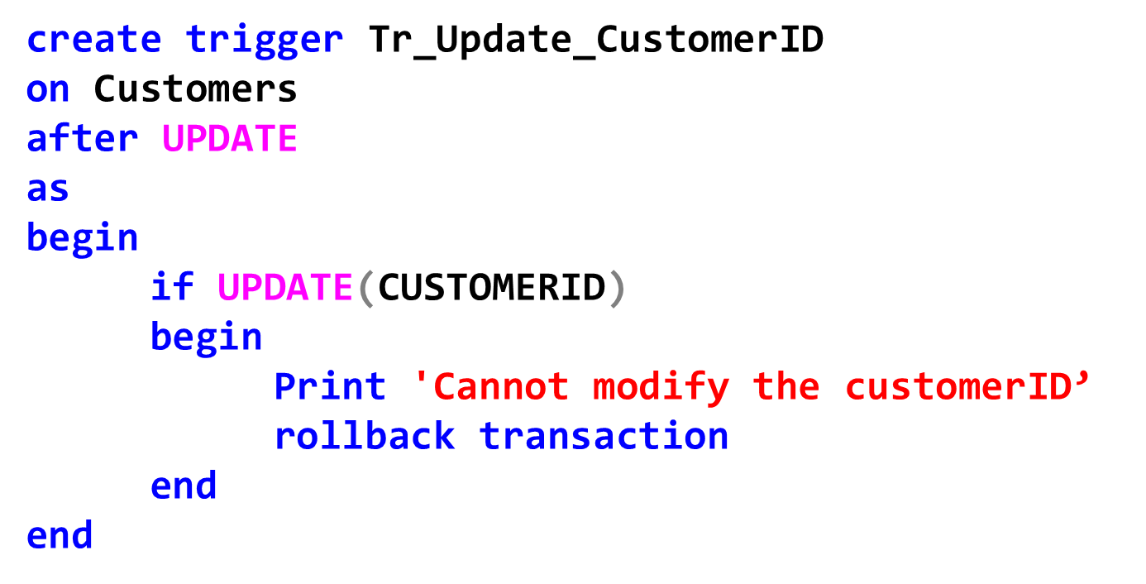
Example: Trigger for Update event
Trigger for preventing the update of CustomerID on Customers table:

Slide 15
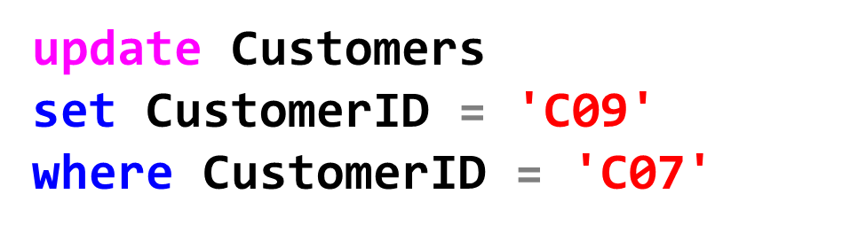
Examples: Trigger for UPDATE event
The previous trigger is activated after the following statement:

Slide 16
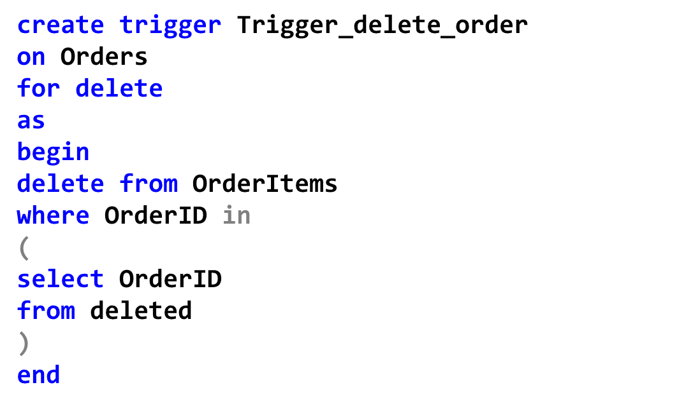
Example: Trigger for DELETE event
Trigger for deleting all corresponding OrderItems(OrderID, ProductCode, Quantity) when removing an order in Orders(OrderID, CustomerID, date):

Slide 17

Examples: Trigger for DELETE event
The previous trigger is activated after the following statement:
The rows corresponding to order ‘Or001’ will also be deleted from OrderItems.

Slide 18

Modification of Trigger

Slide 19
Delete Trigger

Slide 20
Thank You !

