Slide 1
Session 18
Chapter 9 – Stored Procedures
Database Systems

Slide 2
Objectives
1
Know what is a stored procedure
2
Know advantages of stored procedures
3
Know how to create, alter and drop stored procedures
4
Know how to return a relation in stored procedures
5
Know how to passing data to a stored procedure
6
Know how to return data from a stored procedure

Slide 3
Contents
1
Stored procedure definition
2
Advantages of stored procedures
3
Managing Stored procedures
4
Stored Procedure Guideline

Slide 4
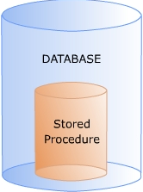
1. Stored Procedure definition
A stored procedure is a group of SQL statements that acts as a single block of code that performs a specific task
This block of code is assigned name and is stored in the database in a compiled form

Slide 5

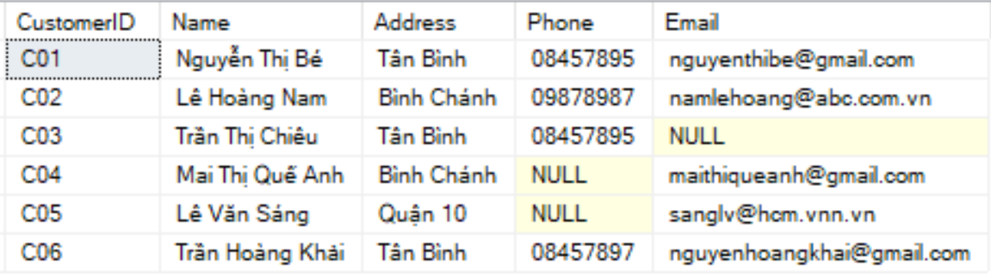
Example: Stored Procedure
The following code creates a custom stored procedure, Show_Customers which display the details of Customers.
Select * from Customers
Execute Show_Customers

Slide 6
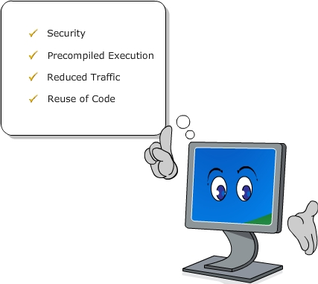
2. Advantages of stored procedures
DB developers write stored procedures to perform a variety of tasks related to database access and managements. This eliminates the need to write SQL statements every time the same task is to be repeated
Using stored procedures offers many advantages over using SQL statements. These are:
  Improved Security
  Precompiled execution
  Reduced traffic
  Reuse of code

Slide 7
2.1. Advantages of stored procedures: Improved security
DB administrator can improve the security by associating database privileges with stored procedures.
A user can be given permission to execute a stored procedure even if that user doesn’t have permission to access the tables or views

Slide 8
Example: Improved Security
Select * from Customers
Execute Show_Customers
Suppose a user doesn’t have the permission to access to the CUSTOMERS table but SHOW_CUSTOMERS procedure
So, he still can access the data of CUSTOMERS via SHOW_CUSTOMERS procedure

Slide 9
2.2. Advantages of stored procedures:
Precompiled Execution
Stored procedures are compiled during the first execution. For every subsequent execution, SQL Server reuses this precompiled version
This reduces the time and resources required for compilation

Slide 10
Example: Precompiled
Select * from Customers
Execute Show_Customers
Each time SQL Server executes the statement “SELECT * FROM customers”, it takes time for SQL Server to parse that statement first
But when executing the SHOW_CUSTOMERS procedure, SQL Server only does the parsing once

Slide 11
2.3. Advantages of stored procedures:
Reduced traffic
Stored procedures help in reducing network traffic.
When SQL statements are executed individually, there is network usage separately for execution of each statement
But when a stored procedure is executed, SQL statements are executed together as a single unit. So, network path is not used separately for execution of each individual statement. This reduces network traffic

Slide 12
Example: Reduced traffic
Select * from Customers
Execute Show_Customers
Each time Client wants to execute the statement “SELECT * FROM Customers”, it must send this statement to the Server.
Of course, we see that, the length of that statement is longer than the length of “Show_Customers”

Slide 13
2.4. Advantages of stored procedures:
Reuse of code
Stored procedures can be used multiple times
This eliminates the need to repetitively type out hundreds of SQL statements every time a similar task is to be performed

Slide 14
2. Managing Stored procedures
Managing Stored
Procedure
Creating Stored
Procedure
Altering Stored
Procedure
Dropping Stored
Procedure
Encrypting Stored
Procedure

Slide 15
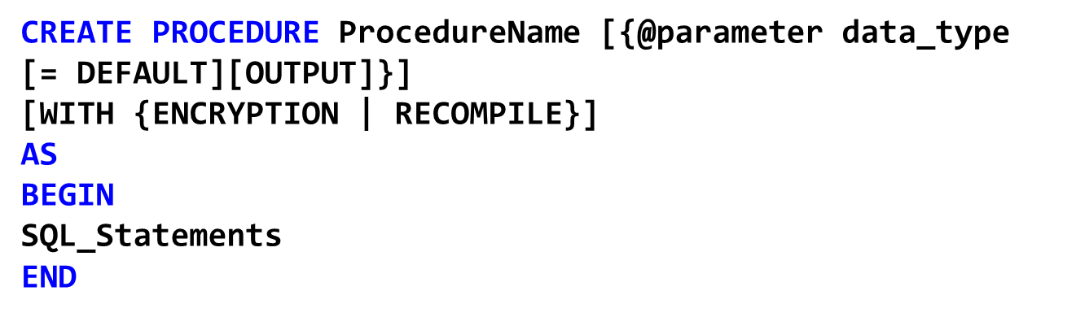
2.1.Creating stored procedures
ProcedureName: the name of the procedure (less than 128 characters).
@parameter data_type: parameters with corresponding data types
DEFAULT: specifies the default value for a parameter
OUTPUT: specifies that the parameter is an output parameter
SQL_statements: one or more SQL statements of the procedure
WITH ENCRYPTION: encrypts the stored procedure definition
WITH RECOMPILE: indicates that the stored procedure is compiled at run time

Slide 16
Example: Creating Stored Procedure
The following code creates a custom stored procedure, Show_Customers which display the details of Customers.
Select * from Customers
Execute Show_Customers

Slide 17
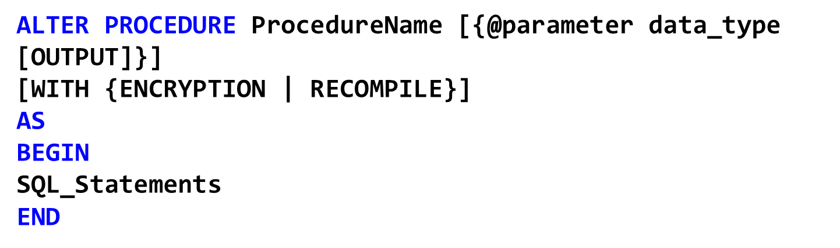
2.2. Altering stored procedures

Slide 18
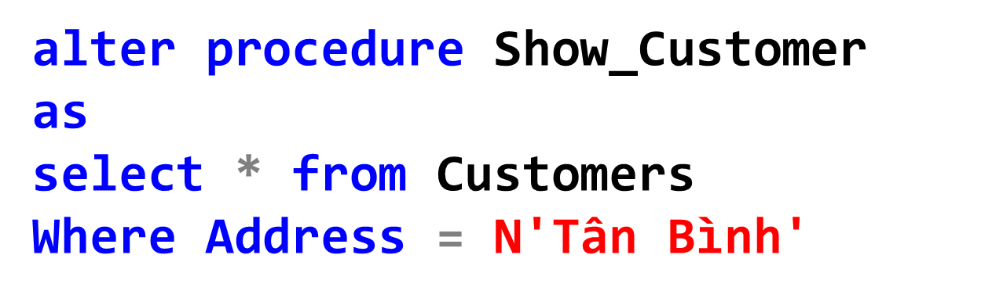
Example: Altering Stored Procedure
The following code alters the Show_Customers for display only customers in ‘Tân Bình’

Slide 19

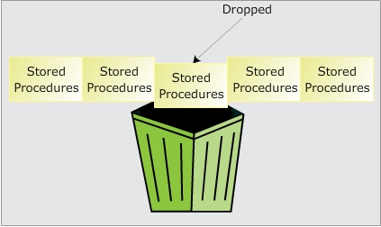
2.3.Dropping stored procedures

Slide 20
2.4. Encrypting stored procedures
When the stored procedures created, the text for them is saved in the SysComments table. The text is not stored for the execution of the stored procedures but only so that it may be retrieved later when the stored procedures need to be modified
If the stored procedures are created with the “WITH ENCRYPTION” then the text in SysComments is not directly readable
It’s common practice for third-party vendors to encrypt their codes.

Slide 21
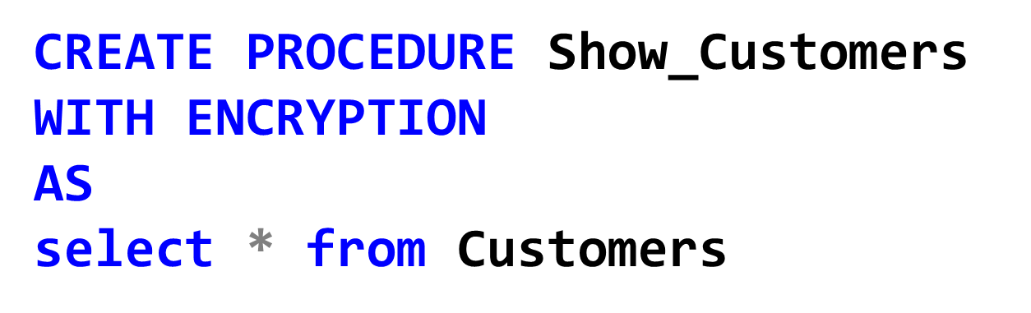
Example: Encrypting stored procedure

Slide 22
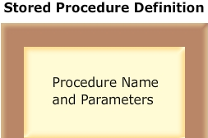
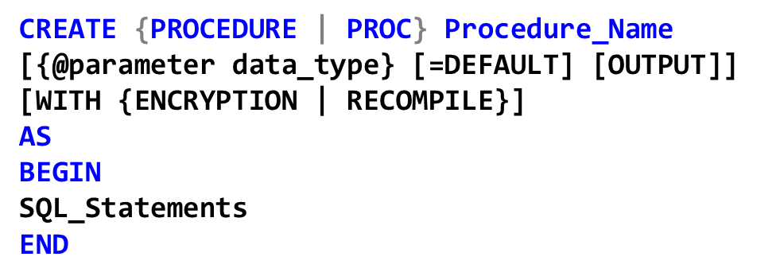
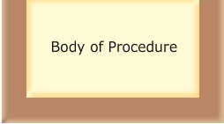
3. Stored Procedure Guideline
The definition of a stored procedure consists 2 parts:
  Name, input and output parameters of the stored procedure
  Body of the stored procedure

Slide 23
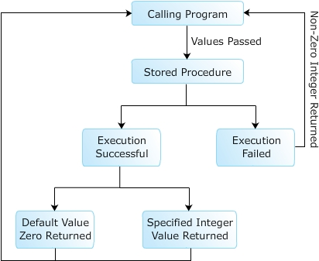
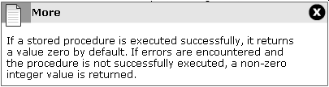
3.1. Returning values
Values are passed to Stored Procedures by calling program when the stored procedures are executed.
The procedures perform required tasks using these values and then, by default, returns a zero or non-zero integer.
The returned value is referred to as a return code indicating whether or not the procedures were successfully executed
Instead of returning the default return code, SQL Server allows you to explicitly specify an integer value to be returned by using RETURN statement

Slide 24

3.1. Returning values
The RETURN statement passes control back to the calling program. Any statement following RETURN are not executed
When RETURN statement is used in a stored procedure, it can not return a NULL value

Slide 25
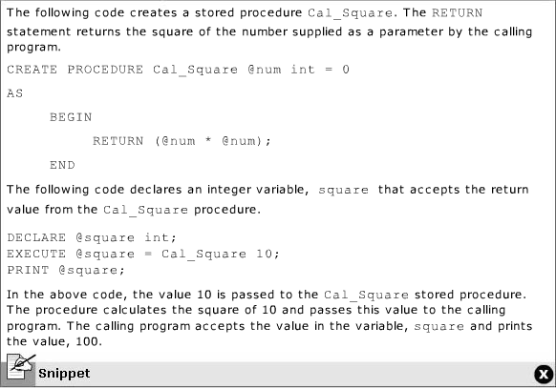
Example: RETURN statement

Slide 26
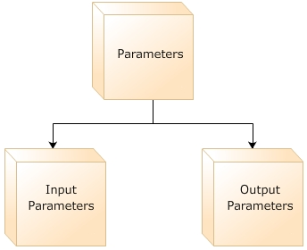
3.2. Using Parameters
The data transferred between stored procedures and its calling programs is called parameter
The parameters are divided into 2 types:
  Input parameters: allow calling programs to pass values to a stored procedure
  Output parameters: allow a stored procedure passing values back to the calling programs

Slide 27
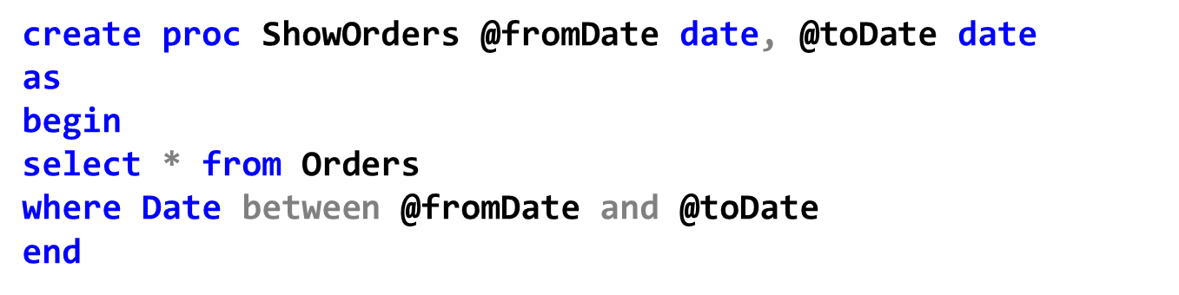
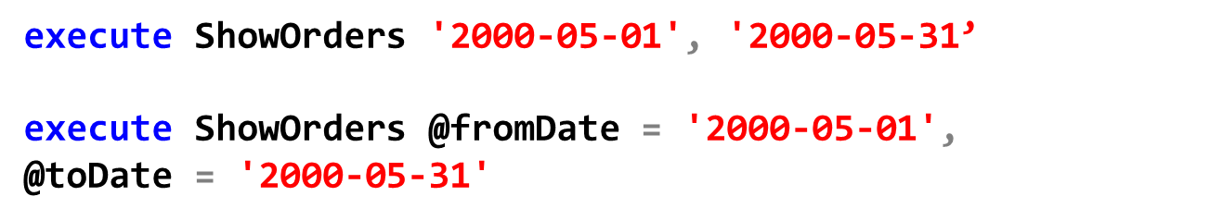
Example: Input parameters
The following stored procedure, ShowOrders, has 2 parameters fromDate and toDate to display orders between these dates.
To execute the procedure, we could use:

Slide 28
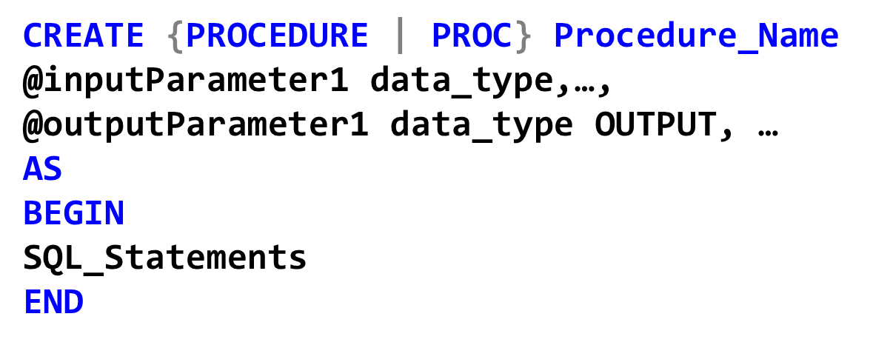
Output parameters
The output parameters can not be of text or image data type
The calling program must contain a variable to receive the return value
Output parameters can be cursor place-holders

Slide 29
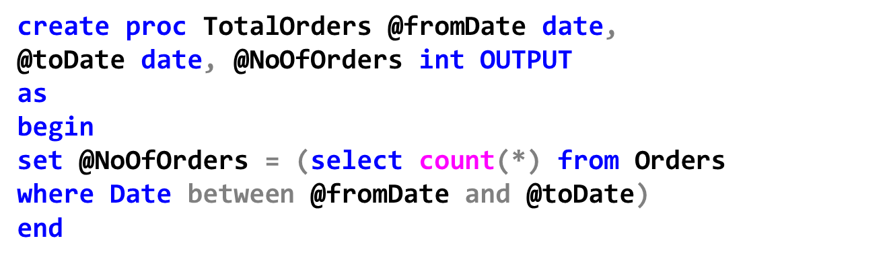

Example: Output parameters
The following stored procedure, ShowOrders, has 2 parameters fromDate and toDate to display orders between these dates.
To execute the procedure, we could use:

Slide 30
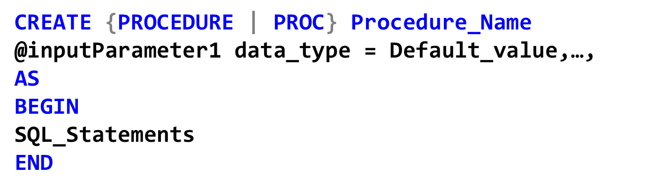
Parameters with default values
By specifying the default value for a parameter, the procedure will be executed with the default value when no value is provided during the execution

Slide 31
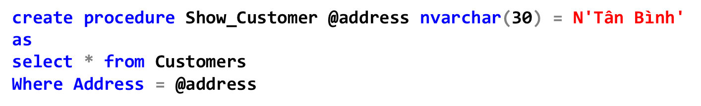

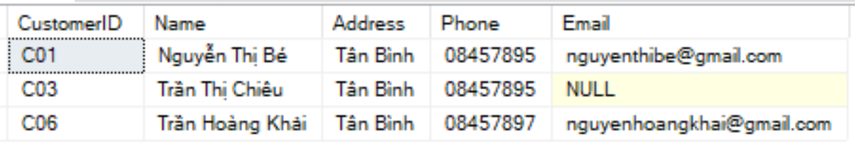

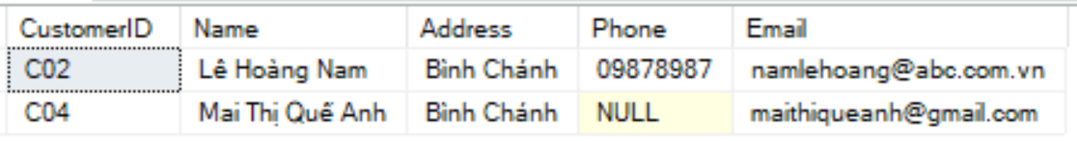
Example: Parameters with default values
The following stored procedure, Show_Customer, has default value N’Tân Bình’ for @address

Slide 32
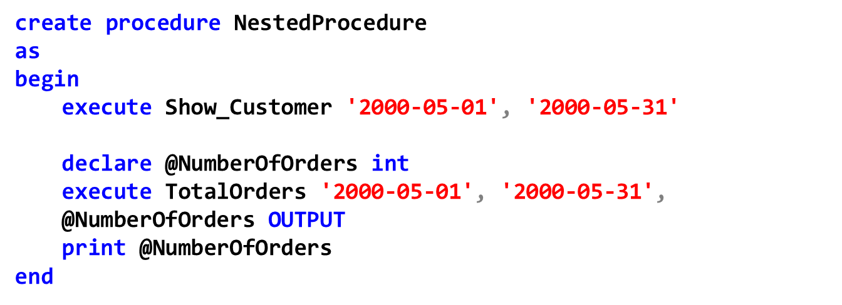
3.3. Nested stored procedures
The following stored procedure, NestedProcedure, calls these other procedures, Show_Customer and ToralOrders
There can be a maximum of 32 levels of nesting, but there is no limit as to the number of stored procedure that can be called from a given stored procedure.

Slide 33
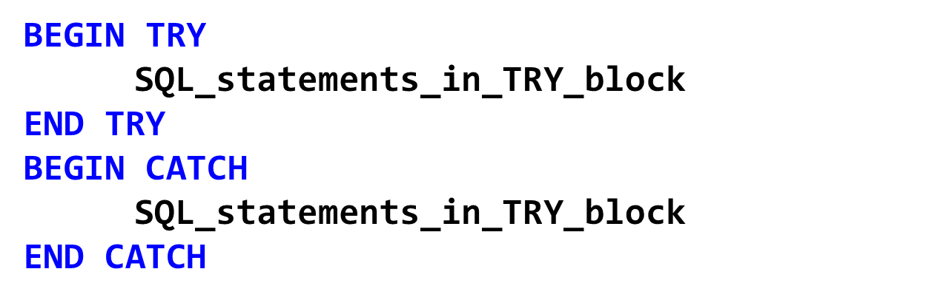
3.4. Handling errors
The TRY …. CATCH construct is used to handle errors
When an error is detected in an SQL statement inside TRY block, SQL_statements in CATCH block will be executed

Slide 34
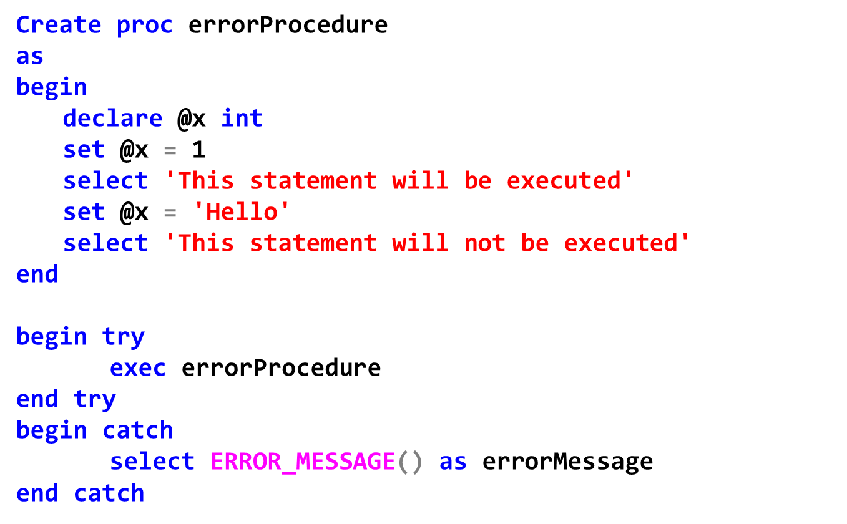
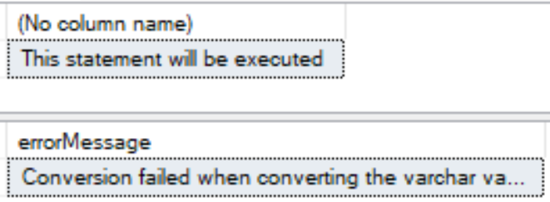
Example: Handling errors

Slide 35
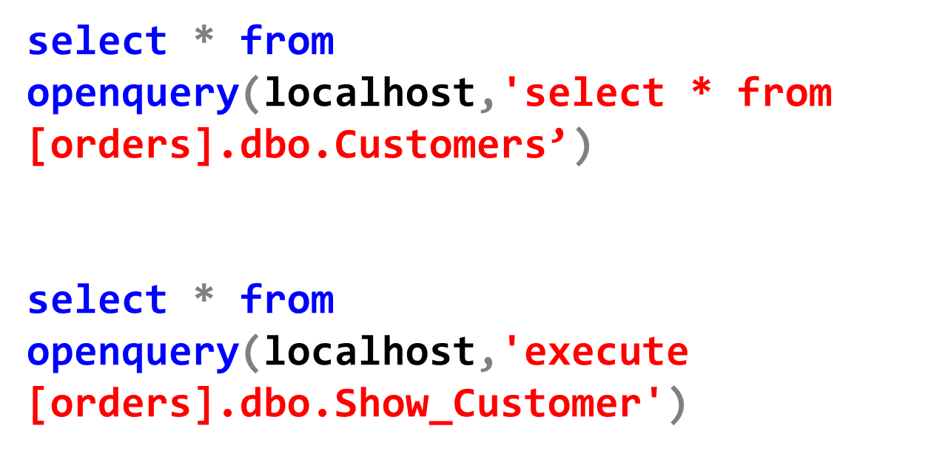
3.5. Using Stored Procedures in Queries
Syntax: OPENQUERY ( linked_server , 'query' )

Slide 36
4. Functions
Similar to the stored procedure, functions is a group of SQL statements that acts as a single block of code that performs a specific task
Function return result via its name.
Function could return:
  A scalar value
  A table-valued

Slide 37
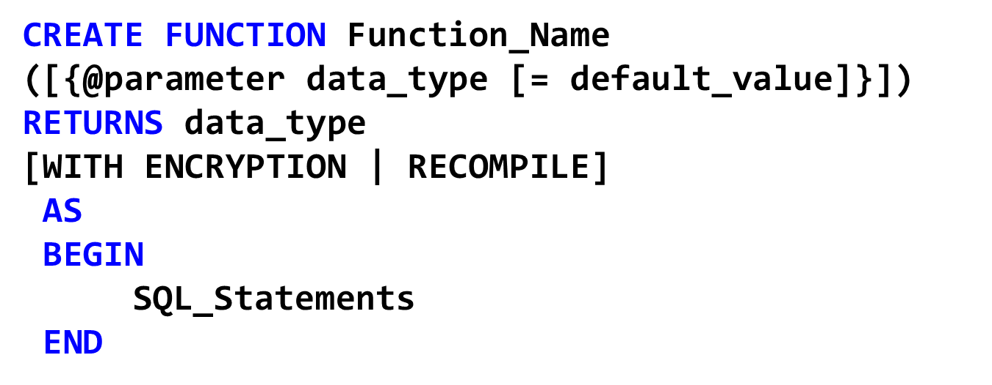
4.1 Function returns scalar value
In the SQL_Statements, we should have a RETURN statement to return the result of the function

Slide 38
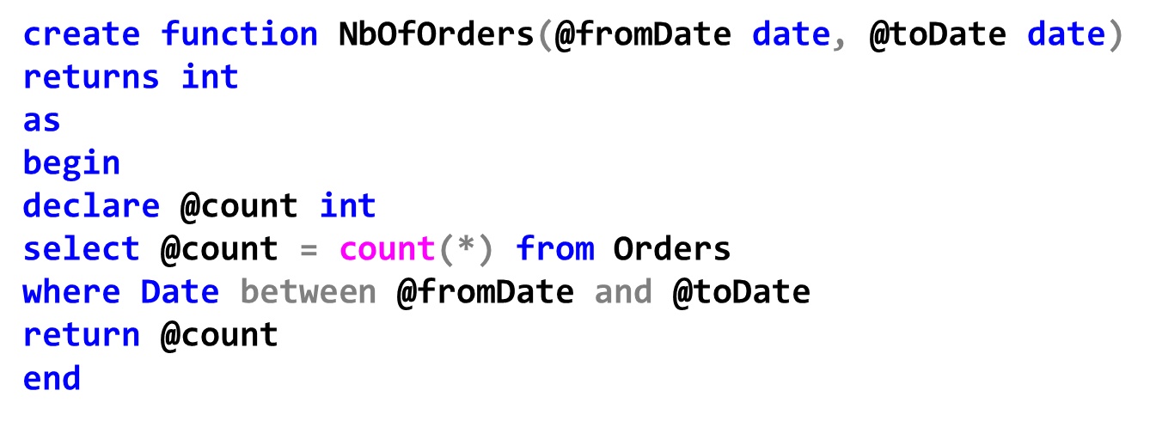
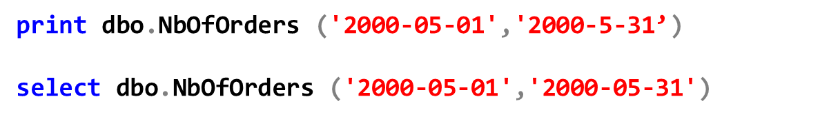
Example: Function returns scalar value
The function could be used as follows or in WHERE clause of queries:

Slide 39
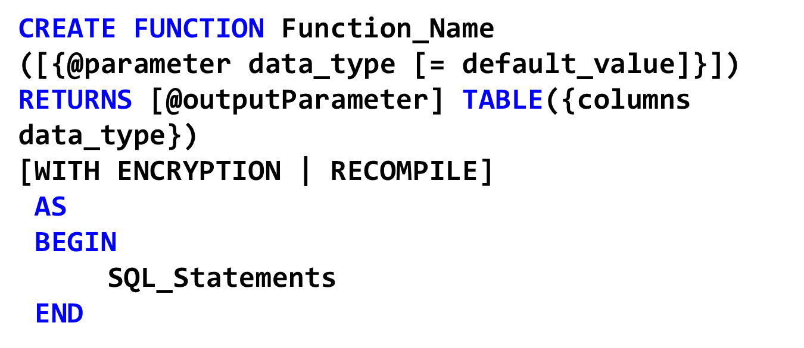
4.2 Function returns table
In the SQL_Statements, we should have a RETURN statement to return the result of the function

Slide 40
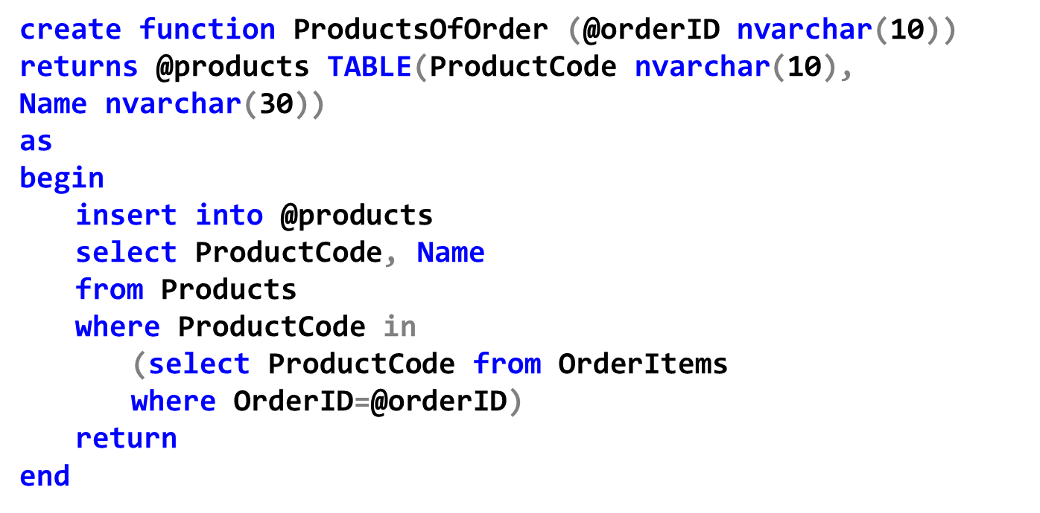
Example: Function returns table
Function could be used in FROM clause:

Slide 41
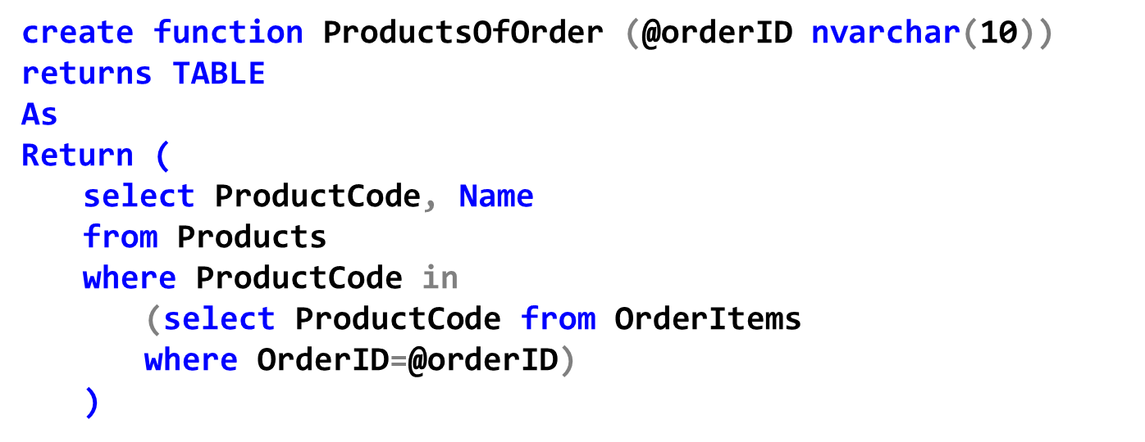
Example: Function returns table
Another way:

Slide 42
Thank You !

