Slide 1
Session 3 Chapter 2 - Relational Model of Data - Part 2 Defining a Relation Schema in SQL
Database Systems

Slide 2
Objectives
1
Understand how to use SQL to define relation schemas
2

Slide 3
2.3. Defining a relation Schema in SQL

Slide 4
2.3. Defining a Relation Schema in SQL
2.3.1. Relations in SQL
2.3.2. Data Types
2.3.3. Database
2.3.4. Simple Table Declarations
2.3.5. Modifying Relation Schemas
2.3.6. Default Values
2.3.7. Declaring Keys

Slide 5
2.3.1 Relations in SQL Server
3 kinds of relations in SQL:
Stored relations (tables): a relation that exist in the database and that can be modified by changing its tuples, as well as queried
Views: relations defined by a computation. They are not stored, but are constructed when needed.
Temporary tables: constructed by the SQL language processor when it performs querie executions or data modifications.

Slide 6
2.3.2 Data Types in SQL Server (1)
String, text data types:
Data type | Explication
CHAR(n) | Fixed-length string of up to n characters (n<=8000) (‘foo’ string will be stored as ‘foo ’ for an attribute of CHAR(5))
VARCHAR(n) | Variable length string of up to n characters (n<=8000)
Text | Variable length string of up to 2GB text data
NCHAR(n) | Fixed-length Unicode string of up to n characters (n<=4000)
NVARCHAR(n) | Variable length Unicode string of up to n characters (n<=4000)
Ntext | Variable length Unicode string of up to 2GB text data

Slide 7
2.3.2 Data Types in SQL Server (2)
Date, time data types:
Data type | Explication
Datetime | From January 1, 1753 to December 31, 9999 (Format: YYYY-MM-DD hh:mm:ss[.nnn])
Datetime2 | From January 1, 0001 to December 31, 9999 (Format: YYYY-MM-DD hh:mm:ss[.nnnnnnn])
smalldatetime | From January 1, 1900 to June 6, 2079 (Format: YYYY-MM-DD hh:mm:ss)
Date | Store a date only. From January 1, 0001 to December 31, 9999 (Format: YYYY-MM-DD)
Time | Store a time only (Format: hh:mm:ss[.nnnnnnn])
E.g.: ‘2018-12-24’, ‘24 December 2018’, ‘12/24/2018’, ‘20181224’, ‘2018/12/24’ are different ways to represent the date 24 December 2018.

Slide 8
2.3.2 Data Types in SQL Server (3)
Number data types:
Data type | Explication
bit | Integer that can be 0, 1, or NULL, could be used as boolean data (0 (FALSE), 1 (TRUE))
tinyint | Allows whole numbers from 0 to 255 (1 byte)
smallint | Allows whole numbers between -32,768 and 32,767 (2 bytes)
int | Allows whole numbers between -2,147,483,648 and 2,147,483,647 (4 bytes)
bigint | Allows whole numbers between -9,223,372,036,854,775,808 and 9,223,372,036,854,775,807 (8 bytes)
float | Floating precision number data from -1.79E + 308 to 1.79E + 308.
real | Floating precision number data from -3.40E + 38 to 3.40E + 38
Decimal(p,s) or Numeric(p,s) | Fixed precision and scale number from -10^38 +1 to 10^38 –1 (p decimal digits and maximum s digits stored to the right of the decimal point)

Slide 9
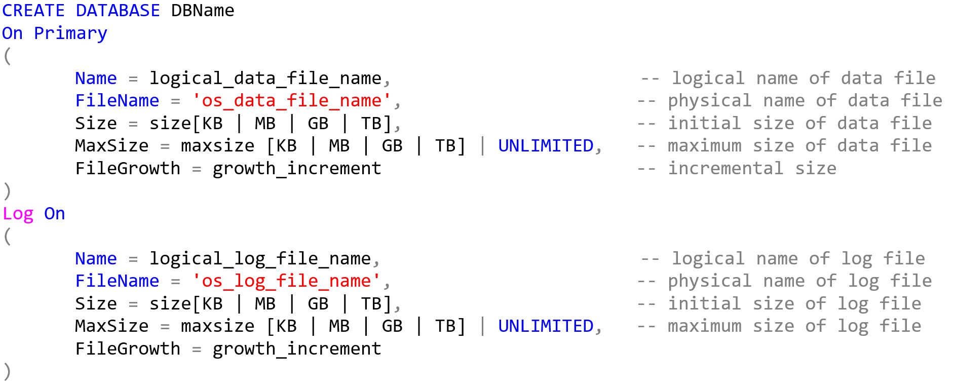
2.3.3a Create Database
Every SQL Server database has at least two operating system files: a data file and a log file.
Data files contain data and objects (tables, stored procedures, and views,…)
Log files contain the information that is required to recover all transactions in the database.

Slide 10
2.3.3a Create Database
Example:
Create a database named QLSV with 10MB at the beginning for the primary file and 5MB at the beginning for the log file. Size of primary file and log file can be up to 50 MB and 25 MB. The files are stored in D:\DBI202.

Slide 11
2.3.3a Create Database
CREATE DATABASE QLSV
On Primary
(
Name=QLSV_Data,
Filename= 'D:\DBI202\QLSV_dat.mdf',
Size=10 MB,
MaxSize=50MB,
Filegrowth = 2
)
Log On
(
Name = QLSVLog,
FileName='D:\DBI202\QLSV_log.ldf',
Size=5MB,
MaxSize=25MB,
Filegrowth = 2
)

Slide 12
2.3.3b Delete Database
Syntax:
DROP DATABASE DatabaseName
Example:
DROP DATABASE QLSV

Slide 13
2.3.3c Modify Database Name
Syntax:
ALTER DATABASE database_name
Modify Name = new_database_name
Example:
ALTER DATABASE QLSV
Modify Name = QLSV_new

Slide 14
2.3.3d Modify Database File
ALTER DATABASE QLSV
MODIFY File(
Name=QLSV_Data,
Filename= 'D:\DBI202\QLSV_dat.mdf',
Size=15 MB,
MaxSize=50MB
)
Note: Give only information that you want to modify

Slide 15
2.3.4. Simple Table Declarations
Use ‘CREATE TABLE’ followed by the name of the relation and a parenthesized, comma-seperated list of the attribute names and their types:
[Use Database_Name]
CREATE TABLE TableName(
Attribute1 datatype [options],
Attribute2 datatype [options],
...
AttributeN datatype [options]
)

Slide 16
Example
CREATE TABLE Movies(
title char(100),
year int,
length int,
genre char(10),
studioName char(30),
producerC# int
)

Slide 17
2.3.5. Modifying Relation Schemas
Delete table:
[USE Database_Name]
DROP TABLE TableName;
Add attribute:
[USE Database_Name]
ALTER TABLE TableName
ADD
Attribute1 Datatype [Options],
Attribute2 Datatype [Options],
…;

Slide 18
2.3.5. Modifying Relation Schemas
Modify attribute:
[USE Database_Name]
ALTER TABLE TableName
ALTER COLUMN Attribute Datatype [Options];
Delete attribute:
[USE Database_Name]
ALTER TABLE TableName
DROP COLUMN Attribute1, Attribute2,…;

Slide 19
2.3.6. NULL Option
NULL: attribute could have null value
NOT NULL: attribute could not have null value
Defined when creating or modifying table
CREATE TABLE Movies(
title char(100) not null,
year int not null,
length int null,
genre char(10) not null,
studioName char(30) not null,
producerC# int not null
)

Slide 20
2.3.7. Default values
DEFAULT option: specify a default value for an attribute when no value is provided
DEFAULT could be defined when creating or modifying table
CREATE TABLE Movies(
title char(100) not null,
year int not null DEFAULT 1990,
length int null,
genre char(10) not null,
studioName char(30) not null,
producerC# int not null
)
ALTER TABLE Movies
ADD DEFAULT 1990 for year

Slide 21
2.3.8. Declaring Keys
PRIMARY KEY:
[USE DatabaseName]
CREATE TABLE Table_Name(
Attribute1_Name Datatype PRIMARY KEY,
Attrbute2_Name DataType [OPTIONS],
…
);
Or
[USE DatabaseName]
CREATE TABLE Table_Name(
Attribute1_Name Datatype [OPTIONS],
…
PRIMARY KEY(AttributeKey1, AttributeKey2,…)
);
Or
[USE DatabaseName]
ALTER TABLE Table_Name ADD PRIMARY KEY(AttributeKey1, AttributeKey2,…);

Slide 22
2.3.8. Declaring Keys
UNIQUE KEY:
[USE DatabaseName]
CREATE TABLE Table_Name(
Attribute1_Name Datatype [OPTIONS],
Attrbute2_Name DataType [OPTIONS] UNIQUE, …);
Or
[USE DatabaseName]
CREATE TABLE Table_Name(
Attribute1_Name Datatype [OPTIONS],
Attrbute2_Name DataType [OPTIONS],
…
UNIQUE(UniqueAttribute1, UniqueAttributeKey2,…)
);
Or
[USE DatabaseName]
ALTER TABLE Table_Name ADD UNIQUE(UniqueAttribute1, UniqueAttributeKey2,…));

Slide 23
2.3.9. Identity option
IDENTITY:
IDENTITY (seed_value, increment_value);
Seed_value: initial value
Increment_value: increment step
CREATE TABLE Students(
ID int IDENTITY(1,1),
Name nvarchar(30)
)

Slide 24
2.3.10. INSERT data in table
INSERT:
INSERT into Table_Name(Attribute1, Attribute2, …)
VALUES (Attribute1_value1, Attribute2_value1, …),
(Attribute1_value2, Attribute2_value2, …),
…;
Example

Slide 25
2.3.10. UPDATE data in table
UPDATE:
UPDATE Table_Name
SET AttributeName = value,
[,…, Attribute_k= value_k]
[FROM ...]
[WHERE Conditions]
Example

Slide 26
2.3.10. DELETE data in table
DELETE:
DELETE From Table_Name
[FROM ...]
[WHERE Conditions]
Example

Slide 27
Thank You !

