Slide 1
Session 5 Chapter 2 - Relational Model of Data - Part 4
Database Systems

Slide 2
Objectives
1
Understand Constraints on Relations
2
Know how to express constrains by relational algebra

Slide 3
Contents
1
Defining different constraints on relations
2
Relational algebra as a constraint language

Slide 4
2.5. Constraints on Relations
How to express constraints via Relation Algebra

Slide 5
Introduction
We now take up the third important aspect of a data model: the ability to restrict the data that may be stored in a database
In this section, we show how to express both key constraints and “referential-integrity” constraints

Slide 6
Introduction
A constraint is a mechanism that may be used to limit the values entered into a column.
CONSTRAINTS
NULL
CHECK
FOREIGN
PRIMARY
Attribute-based check
Tube-based check
Assertions

Slide 7
2.5.1. Relation Algebra as a constraint Language
2 ways to express constraints with RA
Express Foreign Key Constraints
Express Key Constraints
Express Check Constraint

Slide 8
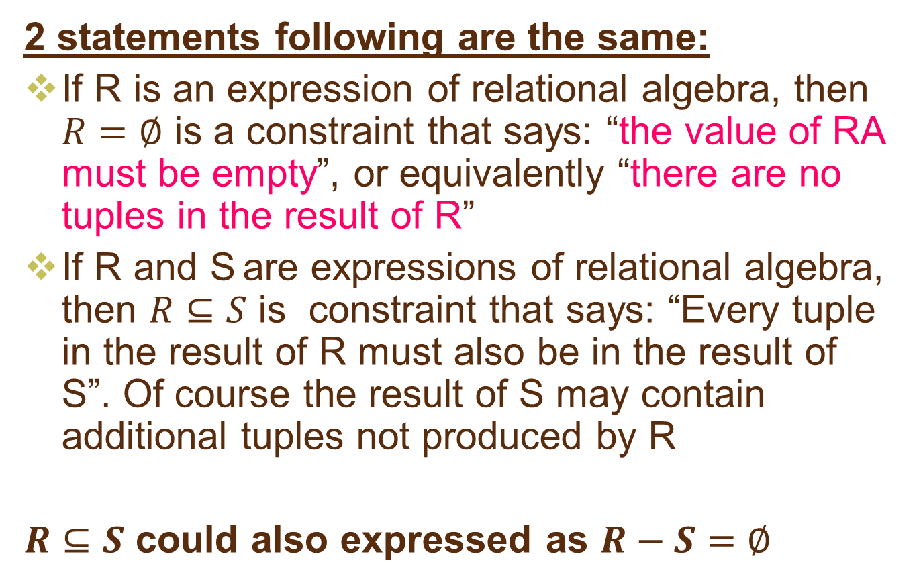
Two ways to express constraints with RA
2 statements following are the same:
If R is an expression of relational algebra, then $R=∅$ is a constraint that says: “the value of RA must be empty”, or equivalently “there are no tuples in the result of R”
If R and S are expressions of relational algebra, then $R⊆S$ is constraint that says: “Every tuple in the result of R must also be in the result of S”. Of course the result of S may contain additional tuples not produced by R
$R⊆S$ could also expressed as $R−S=∅$

Slide 9
Express Foreign Key Constraints
Foreign key constraints (or referential integrity constraint) asserts that a value appearing in one context also appears in another related context.
Example:
Classes(ClassID, ClassName, year)
Students(StudentID, Name, BirthDate, ClassID)
If we found a ClassID ‘SE1016’ in relation Students, we would expect that ‘SE1016’ appears as the ID of one class in relation ‘Classes’

Slide 10
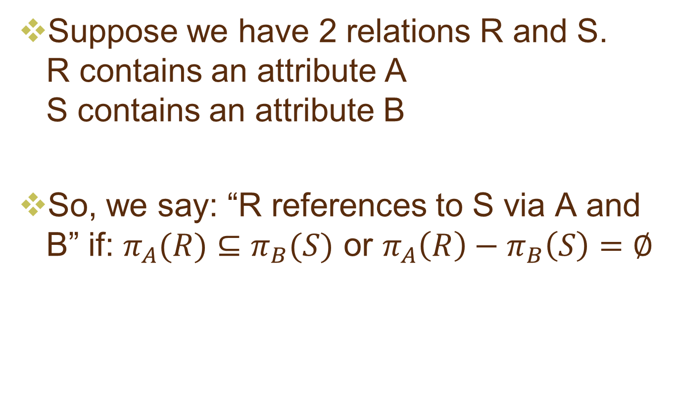
Express Foreign Key Constraints
Suppose we have 2 relations R and S. R contains an attribute A S contains an attribute B
So, we say: “R references to S via A and B” if: $π_{A}(R)⊆π_{B}(S)$ or $π_{A}\left(R\right)−π_{B}\left(S\right)=∅$

Slide 11
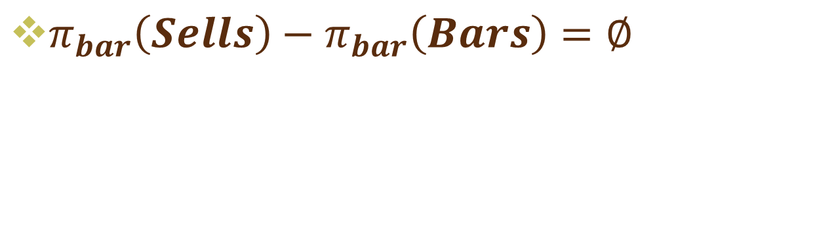
Example: Express Foreign Key Constraints
Sells( bar, beer, price ) Bars( bar, addr )
Joe’s Bud 2.50 Joe’s Maple St.
Joe’s Miller 2.75 Sue’s River Rd.
Sue’s Bud 2.50
Sue’s Coors 3.00
$π_{bar}\left(Sells\right)−π_{bar}\left(Bars\right)=∅$

Slide 12
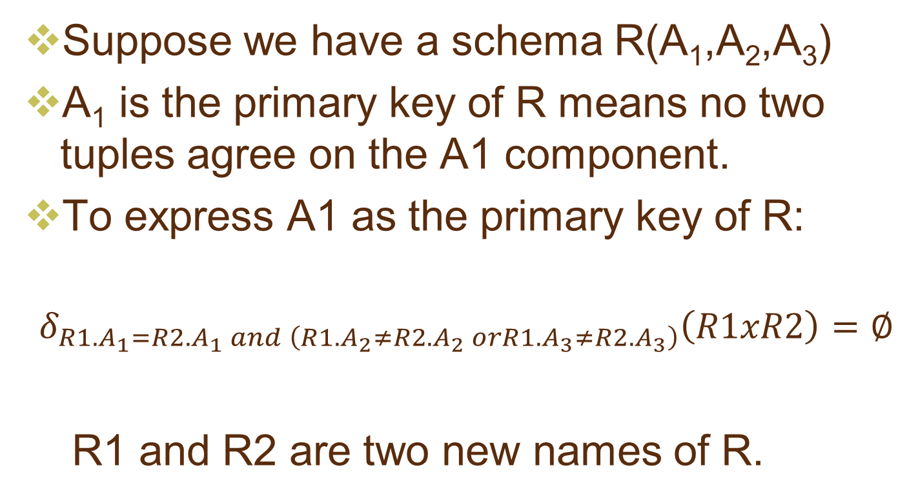
Express Primary Key Constraints
Suppose we have a schema R(A₁,A₂,A₃)
A₁ is the primary key of R means no two tuples agree on the A1 component.
To express A1 as the primary key of R:
$$δ_{R1.A_{1}=R2.A_{1} and \left(R1.A_{2}≠R2.A_{2} orR1.A_{3}≠R2.A_{3}\right)}\left(R1xR2\right)=∅$$
R1 and R2 are two new names of R.

Slide 13
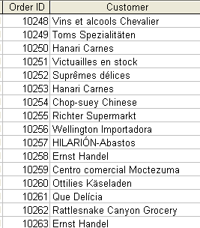
Example: Express Primary Key Constraints
δR1.OrderId = R2.OrderId AND R1.Customer≠R2.Customer(R1 x R2) = Φ

Slide 14
Express Check Constraints
Give a schema: EMPLOYEE(EmpId, Name, Sex)
If we want to specify that the only legal values for SEX attribute are ‘F’ and ‘M’, we can write: δ _{sex <> ‘F’ and sex <> ‘M’} (EMPLOYEE) = Φ

Slide 15
3. Exercises 1
Give a schema: PC (Model, Speed, RAM, HDD, Price)
Use Relational Algebra to express following constraints: A PC with a processor speed less than 3.00 must not sell for more than $800

Slide 16
3. Exercises 2
Give a schema: LAPTOP (Model, speed, RAM, HDD, Screen, Price)
Use Relational Algebra to express following constraints: A laptop with a screen size less than 15.4 inches must have at least a 120GB hard disk or sell for less than $1000

Slide 17
3. Exercises 3
PC (Model, Speed, RAM, HDD, Price)
LAPTOP (Model, speed, RAM, HDD, Screen, Price)
Use Relational Algebra to express following constraints: If a laptop has a larger RAM than a PC, then the laptop must also have a higher price than the PC

Slide 18
3. Exercises 4
PC (Maker, Model)
PRINTER (Maker, Model)
Use Relational Algebra to express following constraints: No manufacturer of PC’s may also make printers

Slide 19
3. Exercises 5
PRODUCT (Maker, model)
PC (Model, speed, ram, hd, price)
PRINTER (Model, color, type, price)
Use Relational Algebra to express following constraints: No manufacturer of PC’s may also make printers

Slide 20
3. Exercises 6
PC (Model, Speed, RAM, HDD, Price)
Use Relational Algebra to express following constraints:
Higher model, higher price
With the same model, higher Speed and RAM and HDD, higher price

Slide 21
Thank You !

