Slide 1
Session 7 - 8
Chapter 3 – Design of Relational Database Schema – Normal forms
Database Systems

Slide 2
Objectives
1
Understand what are anomalies
2
Understand why must decompose a relation
3
Understand the good, bad and ugly of decomposition
4
Understand what are normal forms (1NF, 2NF, 3NF, BCNF)

Slide 3
Contents
1
Anomalies
2
What are decomposition?
3
Decomposition: The good, bad and the ugly
4
1NF, 2NF, 3NF, BCNF definition
5
Algorithms to decompose a relation into BCNF, 3NF

Slide 4
1. Anomalies introduction
Careless selection of a relational database schema can lead to redundancy and related anomalies
So in this session we shall tackle the problems of relational database designing
Problems such as redundancy that occur when we try to cram too much into a single relation are called anomalies

Slide 5
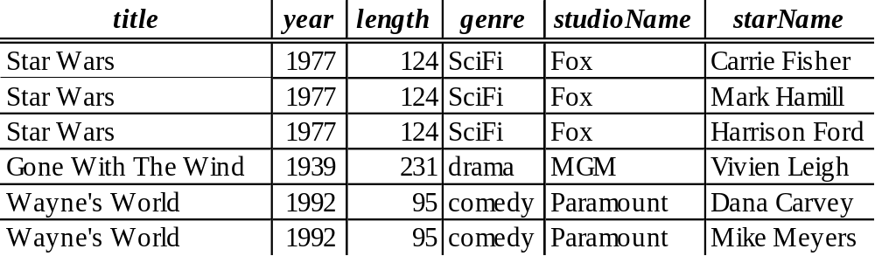
1. Anomalies
The principal kinds of anomalies that we encounter are:
Redundancy: information maybe repeated unnecessarily in several tuples (e.g.: the length, genre and studioName)
Update Anomalies: We may change information in one tuple but leave the same information unchanged in another (e.g.: if we found that Star Wars is 125 minutes long, we may change the length in the first tuple but not in the second and third tuples)
Deletion Anomalies: If a set of values becomes empty, we may lose other information as a side effect (e.g.: if we delete Vivien Leigh as star for “Gone with the wind”, we may lost information of the movie “Gone with the wind” as it it the last tuple of the movie)

Slide 6
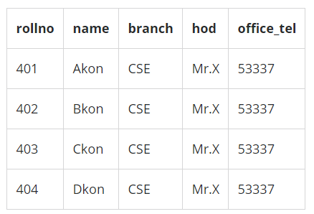
1. Anomalies
+ Điều gì sẽ xảy ra nếu ta cần thêm 100 SV cùng branch?
+ Điều gì sẽ xảy ra nếu ta cần thêm 1 SV nhưng SV đó chưa chọn đc branch?
+ Điều gì sẽ xảy ra nếu branch CSE đổi số điện thoại? Hoặc đổi ông hod?
+ Điều gì sẽ xảy ra nếu có cả trường có 1 SV mã 405, tên là Dkon, ở branch AI, hod là Mr.T, office_tel là 12345 tốt nghiệp?

Slide 7
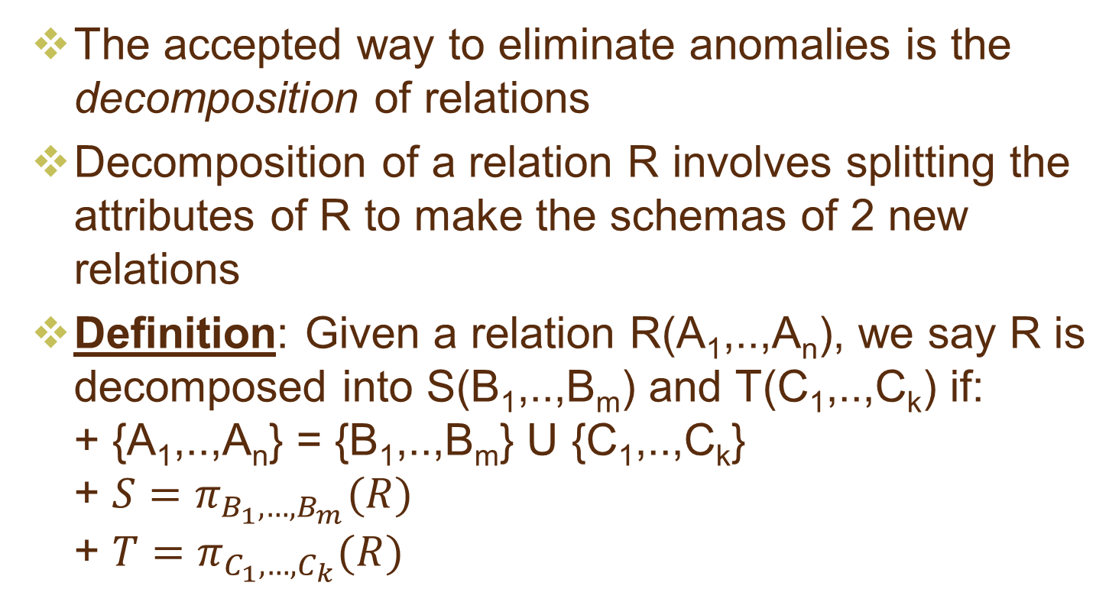
2. Decomposing relations

Slide 8
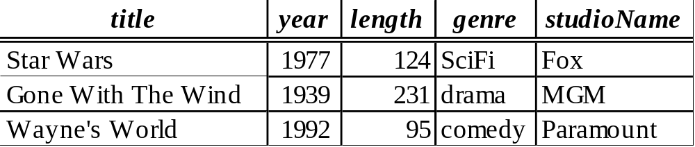
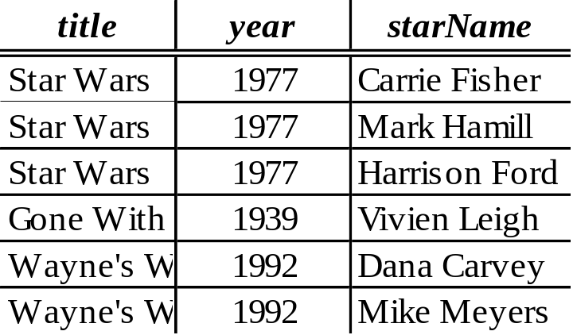
Example: Decomposition

Slide 9
Discuss
The redundancy is eliminated (the length of each film appears only once)
The risk of an update anomaly is gone (we only have to change the length of Star Wars in one tuple)
The risk of a deletion anomaly is gone (if we delete all the stars for Gone with the wind, that deletion makes the movie disappear from the right but still be found in the left)

Slide 10
3. Decomposition: The Good, Bad and Ugly
We observed that before we decompose a relation schema into smaller relations, it can exhibit anomalies; That’s the “Good”
But, decomposition can also have some bad:
  Maybe we can’t recovery the original information; OR
  After reconstruction the original relation by joining, the result may not satisfy the original FDs

Slide 11
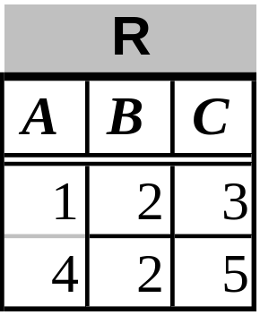
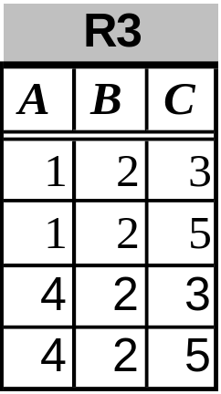
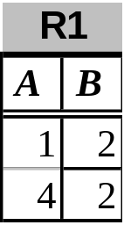
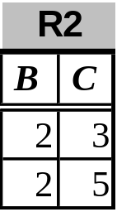
Example: Loss of information after decomposition
Suppose we have R(A,B,C)
R is decomposed into R1 and R2 as above
When we try to re-construct R by Natural Join of R1 and R2, we have: R3 = R1 X R2 (but R3 <> R1 => We lost information)

Slide 12
Example: Dependency Loss
If we check the projected FD’s in the relations of the decomposition, can we can be sure that when we reconstruct the original relation from the decomposition by joining, the result will satisfy the original FD’s?

Slide 13
4. Normal Forms
First Normal Form (1NF)
Second Normal Form (2NF)
Third Normal Form (3NF)
Boyce-Codd Normal Form (BCNF)

Slide 14

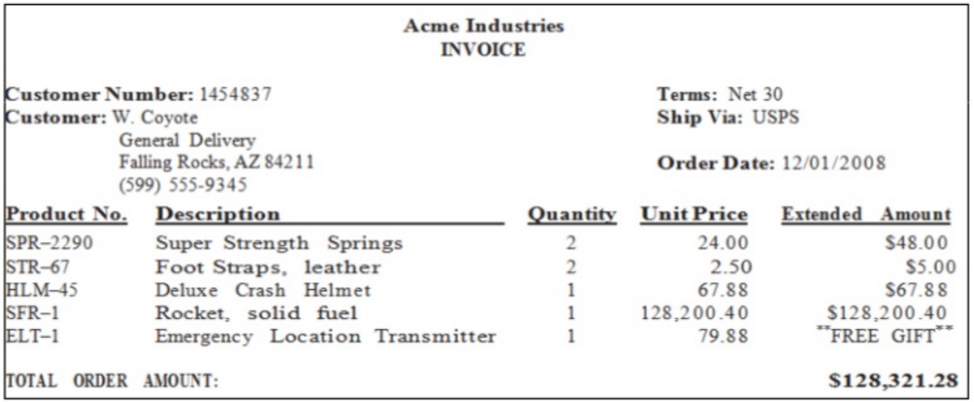
Example

Slide 15
Example
INVOICE
Invoice ID | Customer Number | Customer | Terms | Ship Via | Order Date | Product No. | Description | Quantity | Unit Price | Extended Amount
1 | 1454837 | W.Coyote, General delivery,… | Net 30 | USPS | 12/01/2008 | SPR-2290 | Super Strength Springs | 2 | 24.00 | $48.00
1 | 1454837 | W.Coyote, General delivery,… | Net 30 | USPS | 12/01/2008 | SRT-67 | Foot Straps, leather | 2 | 2.50 | $5.00
1 | 1454837 | W.Coyote, General delivery,… | Net 30 | USPS | 12/01/2008 | HLM-45 | Deluxe Crash Helmet | 1 | 67.88 | $67.88
1 | 1454837 | W.Coyote, General delivery,… | Net 30 | USPS | 12/01/2008 | SFR-1 | Rocket, Solid fuel | 1 | 128,200.4 | $128,200.4
1 | 1454837 | W.Coyote, General delivery,… | Net 30 | USPS | 12/01/2008 | ELT-1 | Emergency Location Transmitter | 1 | 79.88 | $0

Slide 16
Example
FDs hold for INVOICE?
Customer Number → Customer
Product No. → Description, Unit Price
Invoice ID → Customer Number, Customer, Terms, Ship Via, Order Date
Invoice ID, Product No. → Quantity, Extended Amount
Key for INVOICE?
(Invoice ID, Product No.)

Slide 17
First Normal Form (1NF)
A relation R is in first normal form (1NF) if and only if
  All underlying domains contain atomic (indivisible) values only
  The value of each attribute contains only a single value from that domain

Slide 18
First Normal Form (1NF)
Non-atomic value
First Name | Surname
Peter | Smith
Laura | Veirs
Fullname
First Name | Surname
Peter | Smith
Laura | Veirs
Fullname
Peter Smith
Laura Veirs

Slide 19
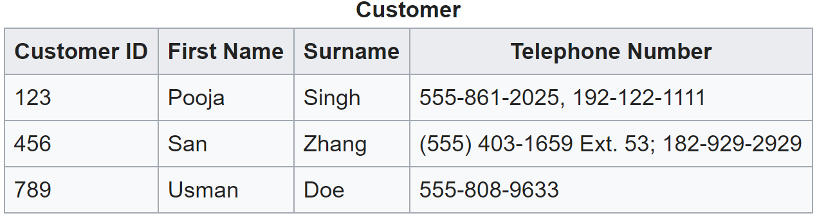
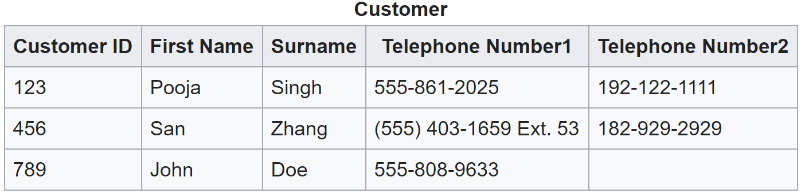
First Normal Form (1NF)
Multiple values

Slide 20
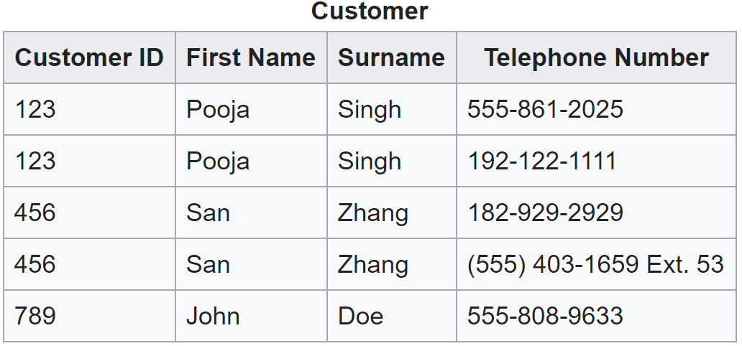
First Normal Form (1NF)
Multiple values

Slide 21
Example
INVOICE: we divide customer into Cname and Address
Invoice ID | Customer Number | CName | Address | Terms | Ship Via | Order Date | Product No. | Description | Quantity | Unit Price | Extended Amount
1 | 1454837 | W.Coyote | General delivery,… | Net 30 | USPS | 12/01/2008 | SPR-2290 | Super Strength Springs | 2 | 24.00 | $48.00
1 | 1454837 | W.Coyote | General delivery,… | Net 30 | USPS | 12/01/2008 | SRT-67 | Foot Straps, leather | 2 | 2.50 | $5.00
1 | 1454837 | W.Coyote | General delivery,… | Net 30 | USPS | 12/01/2008 | HLM-45 | Deluxe Crash Helmet | 1 | 67.88 | $67.88
1 | 1454837 | W.Coyote | General delivery,… | Net 30 | USPS | 12/01/2008 | SFR-1 | Rocket, Solid fuel | 1 | 128,200.4 | $128,200.4
1 | 1454837 | W.Coyote | General delivery,… | Net 30 | USPS | 12/01/2008 | ELT-1 | Emergency Location Transmitter | 1 | 79.88 | $0
Customer Number → Cname, Address
Product No. → Description, Unit Price
Invoice ID → Customer Number, Cname, Address, Terms, Ship Via, Order Date
Invoice ID, Product No. → Quantity, Extended Amount

Slide 22
Second normal Form (2NF)
A relation R is in second normal form (2NF) if and only if it is in 1NF and every non-key attribute is fully dependent on the primary key
Example: INVOICE is in 1NF but not 2NF because of:
  Product No. → Description, Unit Price
  Invoice ID → Customer Number, Cname, Address, Terms, Ship Via, Order Date

Slide 23
Second normal Form (2NF)
Example: Decompose INVOICE to have 2NF:
  Product No. → Description, Unit Price
  Invoice ID → Customer Number, Cname, Address, Terms, Ship Via, Order Date
  PRODUCT (Product No., Description, Unit Price)
  INVOICE (Invoice ID, Customer Number, Cname, Address, Terms, Ship Via, Order Date)
  INVOICE_ITEM(Invoice ID, Product No., Quantity, Extended Amount)

Slide 24
Example
INVOICE
Invoice ID | Customer Number | CName | Address | Terms | Ship Via | Order Date
1 | 1454837 | W.Coyote | General delivery,… | Net 30 | USPS | 12/01/2008
PRODUCT
INVOICE_ITEM
Product No. | Description | Unit Price
SPR-2290 | Super Strength Springs | 24.00
SRT-67 | Foot Straps, leather | 2.50
HLM-45 | Deluxe Crash Helmet | 67.88
SFR-1 | Rocket, Solid fuel | 128,200.4
ELT-1 | Emergency Location Transmitter | 79.88
Invoice ID | Product No. | Quantity | Extended Amount
1 | SPR-2290 | 2 | $48.00
1 | SRT-67 | 2 | $5.00
1 | HLM-45 | 1 | $67.88
1 | SFR-1 | 1 | $128,200.4
1 | ELT-1 | 1 | $0

Slide 25
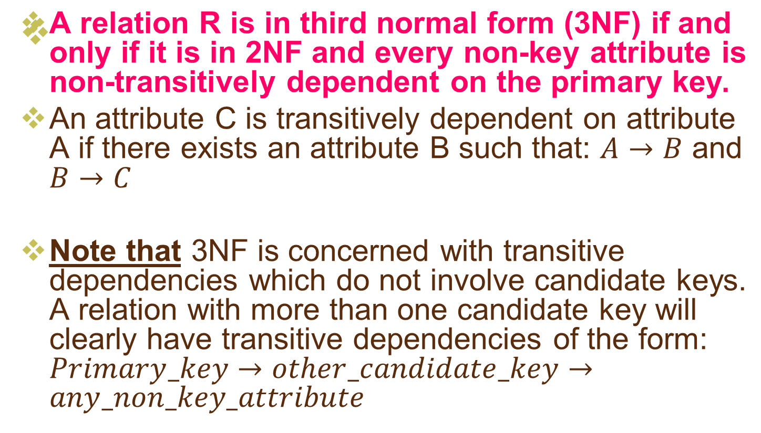
Third Normal Form (3NF)

Slide 26
Third Normal Form (3NF)
INVOICE is not in 3NF because of:
  Customer is transitive dependent with InvoiceID via Customer Number: Customer Number → Cname, Address
Decompose to 3NF:
  PRODUCT (Product No., Description, Unit Price)
  CUSTOMER (Customer Number, Cname, Address)
  INVOICE (Invoice ID, Customer Number, Terms, Ship Via, Order Date)
  INVOICE_ITEM(Invoice ID, Product No., Quantity, Extended Amount)

Slide 27
Example
INVOICE
CUSTOMER
Invoice ID | Customer Number | Terms | Ship Via | Order Date
1 | 1454837 | Net 30 | USPS | 12/01/2008
Customer Number | CName | Address
1454837 | W.Coyote | General delivery,…
PRODUCT
INVOICE_ITEM
Product No. | Description | Unit Price
SPR-2290 | Super Strength Springs | 24.00
SRT-67 | Foot Straps, leather | 2.50
HLM-45 | Deluxe Crash Helmet | 67.88
SFR-1 | Rocket, Solid fuel | 128,200.4
ELT-1 | Emergency Location Transmitter | 79.88
Invoice ID | Product No. | Quantity | Extended Amount
1 | SPR-2290 | 2 | $48.00
1 | SRT-67 | 2 | $5.00
1 | HLM-45 | 1 | $67.88
1 | SFR-1 | 1 | $128,200.4
1 | ELT-1 | 1 | $0

Slide 28
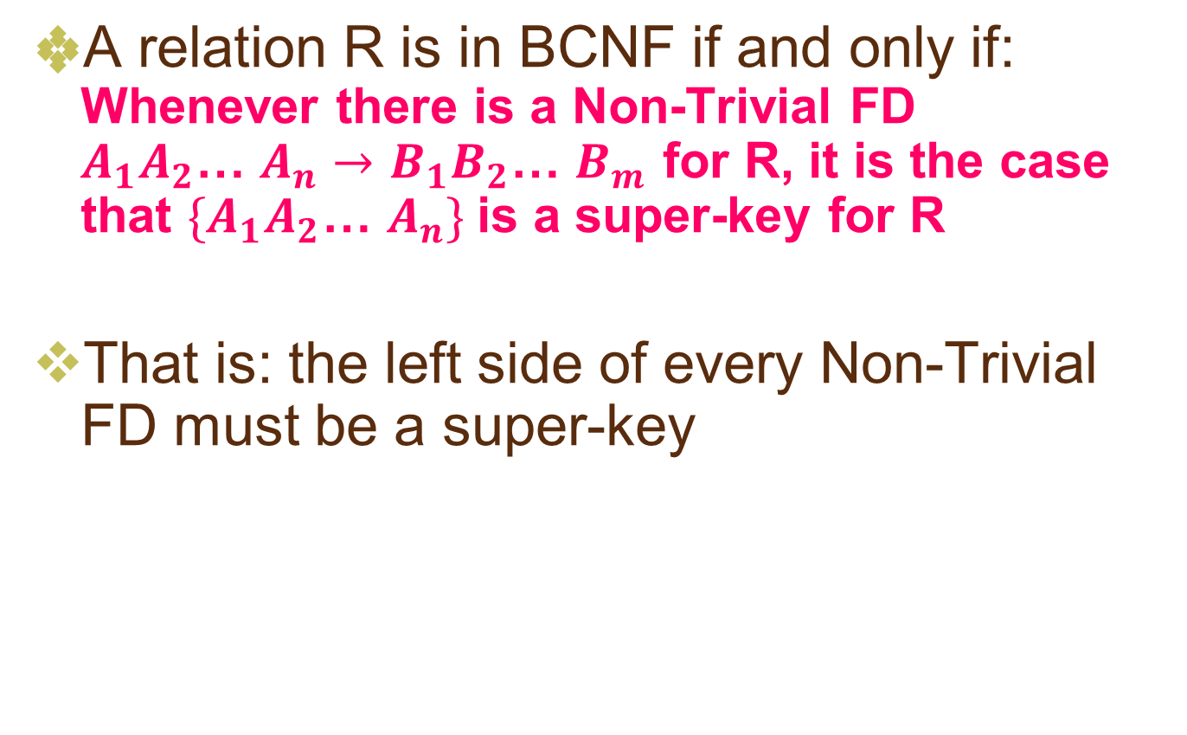
(Boyce-Codd Normal Form) BCNF

Slide 29
Example: BCNF or not
The above relation is not in BCNF because:
Consider the FD:
{title,year} -> {length, genre, studioName}
We know that {title, year} is not a super-key

Slide 30
Example: BCNF or not
The above relation is in BCNF because:
{title,year} -> {length, genre, studioName}
And: neither title nor year by itself functionally determines any of the other attributes

Slide 31
Example: BCNF or not
The above relation is in BCNF because: it has no Non-Trivial FD

Slide 32
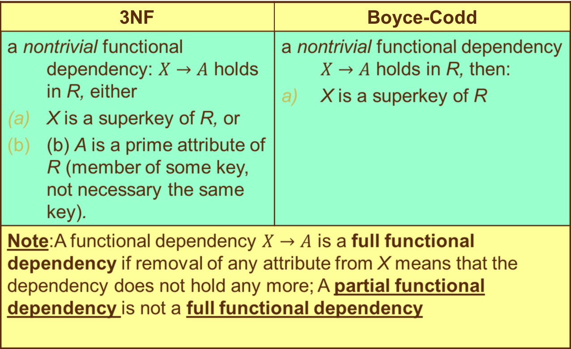
Differences between BCNF and 3NF

Slide 33
VD các bước chuẩn hóa
https://viblo.asia/p/tim-hieu-cac-dang-chuan-trong-co-so-du-lieu-RQqKLLa4K7z

Slide 34
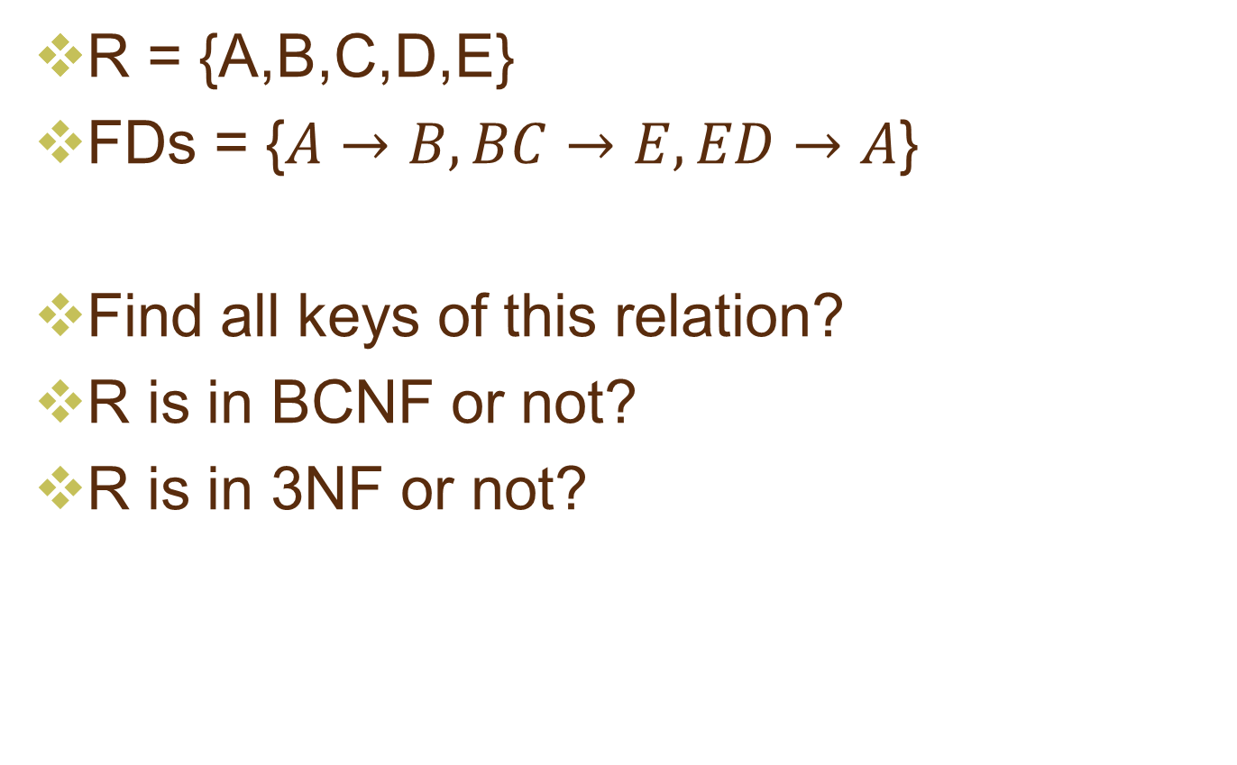
Example

Slide 35
5. Decompose a relation into BCNF, 3NF
The goal of decomposition is to replace a relation by several relations that do not exhibit anomalies
So, it turns out, a simple condition under which the anomalies can be guaranteed not to exist. This condition is called Boyce-Codd Normal Form, or BCNF

Slide 36
5. Decompose a relation into BCNF, 3NF
BCNF is a solution for eliminating Anomalies
But, BCNF can lead to the loss of information and functional dependencies (in some cases, after decomposition into BCNF, we can’t keep both the lossless-join and dependency-preservation properties)
So, 3NF is the solution that have both the lossless-join and dependency-preservation properties

Slide 37
BCNF decomposition algorithm
Input: A relation R with a set of FD’s F
Output: A BCNF decomposition of R with lossless join Method:
  At each step compute the key for the sub-relation R
  if R is not in BCNF, pick any FD X->Y which violates
  break the relation into 2 sub-relations
    R1(X+)
    R2(X,R\X+)
    this has a lossless join
    project FD's onto each sub-relation R1 and R2
  continue until no more offending FD's

Slide 38
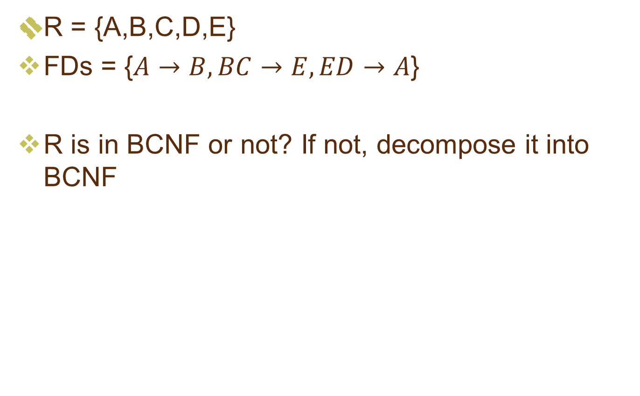
Example

Slide 39
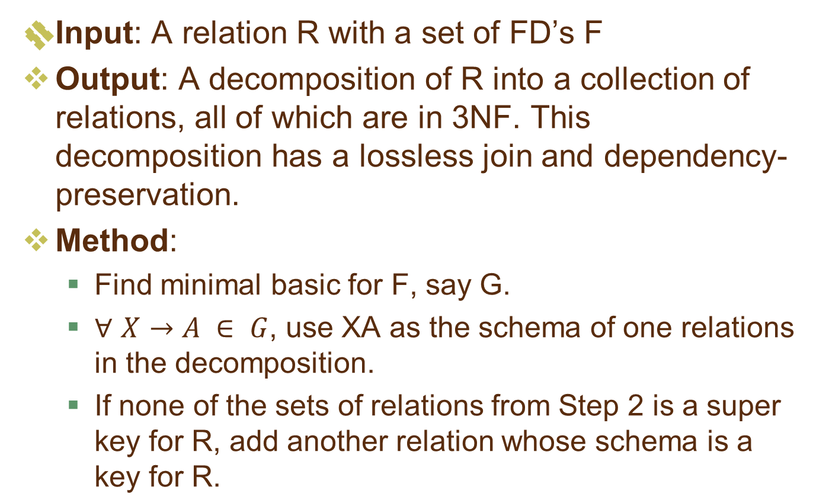
3NF decomposition algorithm

Slide 40
3NF decomposition example
Example: Consider r(ABCDEF) subject to the following FDs:
F = {A →BCE, B →DE, ABD →CF, AC →DE }
Find a 3NF database for r under F.
Solution: Find a canonical cover for (R,F):
F= { A →B, B → DE, A →CF } same as
F= { A →BCF, B →DE }
Final decomposition: r = ( ABCF, BDE )

Slide 41
3NF decomposition example
Example: Consider R(ABCDE) subject to the following FDs:
F = {AB →C, C →B, A →D }
Find a 3NF database for R under F.
Solution:
F= { AB →C, C → B, A →D } is minimal basis
Then we have R1(ABC), R2(BC), R3(AD)
R has two key {A,B,E} and {A,C,E}: none of R1, R2, R3 is a super key.
then we add R4(ABE) or R4(ACE)
Final decomposition: R = ( ABC, BC, AD, ABE )

Slide 42
Exercises
Are the following relations in BCNF? 3NF? (if R is not in BCNF, decompose it to BCNF; if R is not in 3NF, decompose it to 3NF)
  R(X,Y, Z,T,V): XY->Z, Y->T, Z->V
  R(X,Y,Z,T): X->Y, Y->Z, Z->T
  R(A,B,C): AB->C, B->A, C->B
  R(ABCD): BD->C, AB->D, AC->B, BD->A
  R(ABCD): AD->C, CD->B, BD->C
  R(ABCD): A->C, B->A, A->D, AD->C
  R(ABCD): A->D, C->A, D->B, AC->B
  R(XYZT): XYT->Z, ZT->X, XZ->Y, XZ->T
  R(XYZT): XY->Z, XYT->Z, XYZ->T, XZ->T
  R(XYZT): YT->Z, XY->T, XZ->Y, YT->X
  R(XYZT): YZ->X, XT->Z, ZT->Y, YT->Z

Slide 43
Summary 1
Decompose a relation into BCNF is a solution for eliminating anomalies
But BCNF can cause information loss and dependency loss
3NF is a relax solution of BCNF that keep loss-less join and dependency-preservation properties

Slide 44
Summary 2:
2NF | 3NF | Boyce-Codd
every nonprime attribute A in R is not partially dependent on any key of R | a nontrivial functional dependency: X => A holds in R, either X is a superkey of R, or (b) A is a prime attribute of R. | a nontrivial functional dependency X => A holds in R, then: X is a superkey of R
Note:A functional dependency X => Y is a full functional dependency if removal of any attribute A from X means that the dependency does not hold any more; A partial functional dependency is not a full functional dependency

Slide 45
Thank You !

