Slide 1

Upload & Download Files

Slide 2
Objectives
Introduction Upload
Demo Upload with Single Upload and Multiple Upload
Introduction and Demo Download

Slide 3
What is Upload?
It is the process of sending data from a personal computer to a server or an online platform.
For example, when you post a photo on social media or upload a file to Google Drive, you are performing an upload.

Slide 4
Uploading Large Files in Node.js
Uploading large files in Node.js can be challenging due to limitations in file size and server memory.
However, there are several advanced techniques that can be used to efficiently upload large files in Node.js.
Some of the best practices for uploading large files:
Using Multer *
Using Amazon S3
Using a CDN

Slide 5
Using Multer
Multer - middleware for handling multipart/form-data (used for file upload forms).
Install package: npm install multer

Slide 6
Demo 1: Using Multer with Single File

Slide 7
1. Create a simple server to handle uploads: To support file upload processing in a Node.js application using Express, a specific route needs to be set up.
Here's how to set up the uploadRoutes.js file to handle file upload requests:
Set up a router using express and multer, specialized middleware for handling multipart/form-data, which is the data type commonly used for file uploads.
Create the corresponding folder: uploads

Slide 8
// routers/uploadRoutes.js
const express = require('express');
const multer = require('multer');
const router = express.Router();
// 1. Configure the storage location and file name
const storage = multer.diskStorage({
destination: function (req, file, cb) {
cb(null, 'uploads/’);
// 2. Make sure you have created this folder in your project
},
filename: function (req, file, cb) {
cb(null, file.fieldname + '-' + Date.now() + '.' + file.originalname.split('.').pop());
}
});
const upload = multer({ storage: storage });
// 3. Route to handle POST request for file upload
router.post('/upload', upload.single('file'), function (req, res, next) {
if (!req.file) {
return res.status(400).send('No files were uploaded.');
}
res.send('File ' + req.file.originalname + ' uploaded successfully');
});
module.exports = router;
multer.diskStorage: Configure where to save files and file name format saved on the server.
destination: Function to determine where to save the uploaded file.
filename: Function to determine the file name when saved on the server.
upload.single('file'): Multer middleware processes a file uploaded with name="file" in form data.

Slide 9
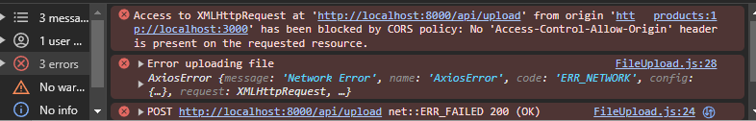
const express = require('express');
const uploadRoutes = require('./routes/uploadRoutes');
const app = express();
const cors = require('cors');
// CORS options if you want to customize them
const corsOptions = {
origin: 'http://localhost:3000’,
// or use '*' to allow all origins
optionsSuccessStatus: 200
// some legacy browsers (IE11, various SmartTVs) choke on 204
};
app.use(cors(corsOptions));
// Middlewares
app.use(express.json());
app.use(express.urlencoded({ extended: true }));
// Routes
app.use('/api', uploadRoutes);
// Static files
app.use(express.static('public'));
app.listen(8000, () => {
console.log('The server is running on port 8000');
});
1. Create a simple server to handle uploads – cont’d: Use router in server.js
After you have defined uploadRoutes, you need to include this router in your main application.

Slide 10
import React, { useState } from 'react';
import axios from 'axios';
function FileUpload() {
const [file, setFile] = useState(null); // Function to handle when file is selected
const onFileChange = event => {setFile(event.target.files[0]); }; // Function to handle when the user presses the "Upload" button
const onFileUpload = () => {
const formData = new FormData();
formData.append(
"file",
file,
file.name
); // Add files to the FormData object // Send FormData to the '/upload' endpoint on the server
axios.post("http://localhost:8000/api/upload", formData).then(response => {
console.log('File is uploaded successfully', response);
alert('File is uploaded successfully');
}).catch(err => {
console.error('Error uploading file', err);alert('Error uploading file');
});
}; return (
<div>
<h1>File Upload</h1>
<input type="file" onChange={onFileChange} />
<button onClick={onFileUpload}>
Upload!
</button>
</div>
);
} export default FileUpload;
2. In React UI
Next, React will send a request to the /api/upload endpoint to upload the file.
This endpoint has been defined in the Express server's uploadRoutes.js file

Slide 11
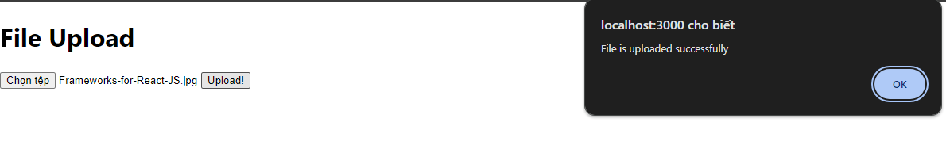
2. In React UI – cont’d
import FileUpload from "./Components/FileUpload";
function App() {
return (
<div className="App">
<header className="App-header">
<FileUpload />
</header>
</div>
);
}
export default App;

Slide 12
Demo 2: Using Multer with Multiple File

Slide 13
// routers/uploadMultipeRoutes.js
const express = require('express');
const multer = require('multer');
const router = express.Router();
// 1. Configure the storage location and file name
const storage = multer.diskStorage({
destination: function (req, file, cb) {
cb(null, 'uploads/');
},
filename: function (req, file, cb) {
cb(null, file.fieldname + '-' + Date.now() + '.' + file.originalname.split('.').pop());
}
});
const upload = multer({ storage: storage });
// 2. Route to handle POST request for multiple file uploads
router.post('/upload', upload.array('files', 5), function (req, res, next) { // Replace 'file' with 'files' and limit the number to 5
if (!req.files || req.files.length === 0) {
return res.status(400).send('No files were uploaded.');
}
// Get the list of uploaded files
const uploadedFiles = req.files.map(file => file.originalname);
res.send('Files ' + uploadedFiles.join(', ') + ' uploaded successfully');
});
module.exports = router;
In Server:
To handle uploading multiple files at once, you will need to use Multer's upload.array or upload.fields method instead of upload.single.
Here's how you can modify the code in uploadMultipleRoutes.js to handle uploading multiple files:
const downloadRoutes = require('./routes/downloadRoutes');
// Using downloadRoutes
app.use('/api', downloadRoutes);

Slide 14
// Components/FileUploadMultiple.js
import React, { useState } from 'react';
import axios from 'axios'; function FileUpload() {
const [files, setFiles] = useState([]); // Function to handle when files are selected
const onFileChange = event => {
setFiles(event.target.files); // Let state be an array of files
}; // Function to handle when the user presses the "Upload" button
const onFileUpload = () => {
const formData = new FormData();
// Add all files to the FormData object
for (let i = 0; i < files.length; i++) {
formData.append(
"files", // The field name must correspond to the name used in the backend
files[i],
files[i].name
);
} // Send FormData to the '/upload' endpoint on the server
axios.post("http://localhost:8000/api/upload", formData, {
headers: { 'Content-Type': 'multipart/form-data' }
}).then(response => {
alert('Files are uploaded successfully');
}).catch(err => { console.error('Error uploading files', err); });
}; return (
<div>
<h1>File Upload</h1>
<input type="file" multiple onChange={onFileChange} />
<button onClick={onFileUpload}>
Upload!
</button>
</div>
);
} export default FileUpload;
In React UI:
To allow multiple file uploads, you need to change the way you handle file state and FormData

Slide 15
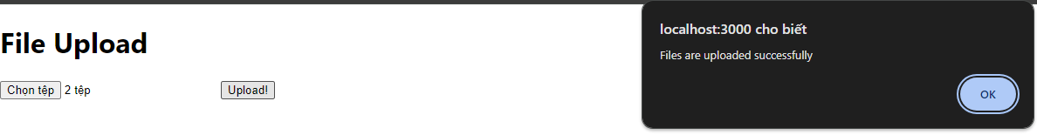
Demo:
import FileUploadMultiple from "./Components/FileUploadMultiple";
function App() {
return (
<div className="App">
<header className="App-header">
<FileUploadMultiple />
</header>
</div>
);
}
export default App;

Slide 16
What is Download?
It is the process of receiving data from the Internet or a server to your computer or device.
For example, when you download an app from the App Store or save a file from email to your computer, you are performing a download.

Slide 17
Demo 3: Download File

Slide 18
// routers/fileRoutes.js
const express = require('express');
const router = express.Router();
const fs = require('fs');
const path = require('path');
// Route to handle file list
router.get('/files', (req, res) => {
const uploadsDir = path.join(__dirname, '../uploads');
fs.readdir(uploadsDir, (err, files) => {
if (err) {
console.log(err);
return res.status(500).send('Unable to scan directory: ' + err);
}
res.json(files);
});
});
module.exports = router;
Create an API endpoint on the Node.js server to list all files in the Upload folder.
const fileRoutes = require('./routes/fileRoutes’);
// Using fileRoutes
app.use('/api', fileRoutes);

Slide 19
// FileList.js
import React, { useState, useEffect } from 'react';
import axios from 'axios';
import DownloadFile from './DownloadFile';
function FileList() {
const [files, setFiles] = useState([]);
useEffect(() => {
axios.get('http://localhost:8000/api/files')
.then(response => {
setFiles(response.data);
})
.catch(error => {
console.error('Error fetching files', error);
});
}, []);
return (
<div>
<h2>Uploaded Files</h2>
<ul>
{files.map((file, index) => (
<li key={index}>
{file} <DownloadFile filename={file} />
</li>
))}
</ul>
</div>
);
}
export default FileList;
Send a request from the React app to this API endpoint and display the results.

Slide 20
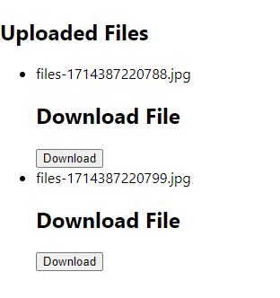
import FileList from "./Components/FileList";
function App() {
return (
<div className="App">
<header className="App-header">
<FileList />
</header>
</div>
);
}
export default App;

Slide 21
Summary
Concepts were introduced:
Introduction Upload
Demo Upload with Single Upload and Multiple Upload
Introduction and Demo Download

