Slide 1

Cross-Origin Resource Sharing

Slide 2
Objectives
What is CORS?
Install and Use CORS

Slide 3
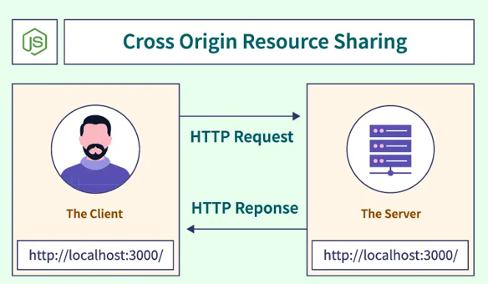
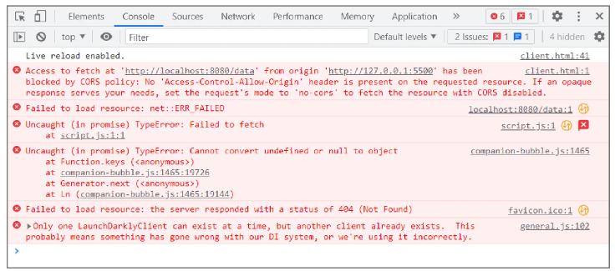
What is CORS?
Cross-Origin Resource Sharing (CORS) is a security feature implemented by web browsers to prevent malicious websites from accessing resources and data from a different domain without permission.
CORS is a protocol that uses additional HTTP headers to tell browsers to give a web application running at one origin, access to selected resources from a different origin.

Slide 4
How CORS Works?
CORS works by adding new HTTP headers that define the rules for allowing or rejecting requests based on the origin they are made from. Here are key headers involved:
Access-Control-Allow-Origin: Specifies the domains allowed to access resources.
Access-Control-Allow-Methods: Specifies the methods (GET, POST, etc.) allowed when accessing the resources.
Access-Control-Allow-Headers: Specifies the headers that can be used during the actual request.
Access-Control-Max-Age: Specifies how long the results of a preflight request can be cached.

Slide 5
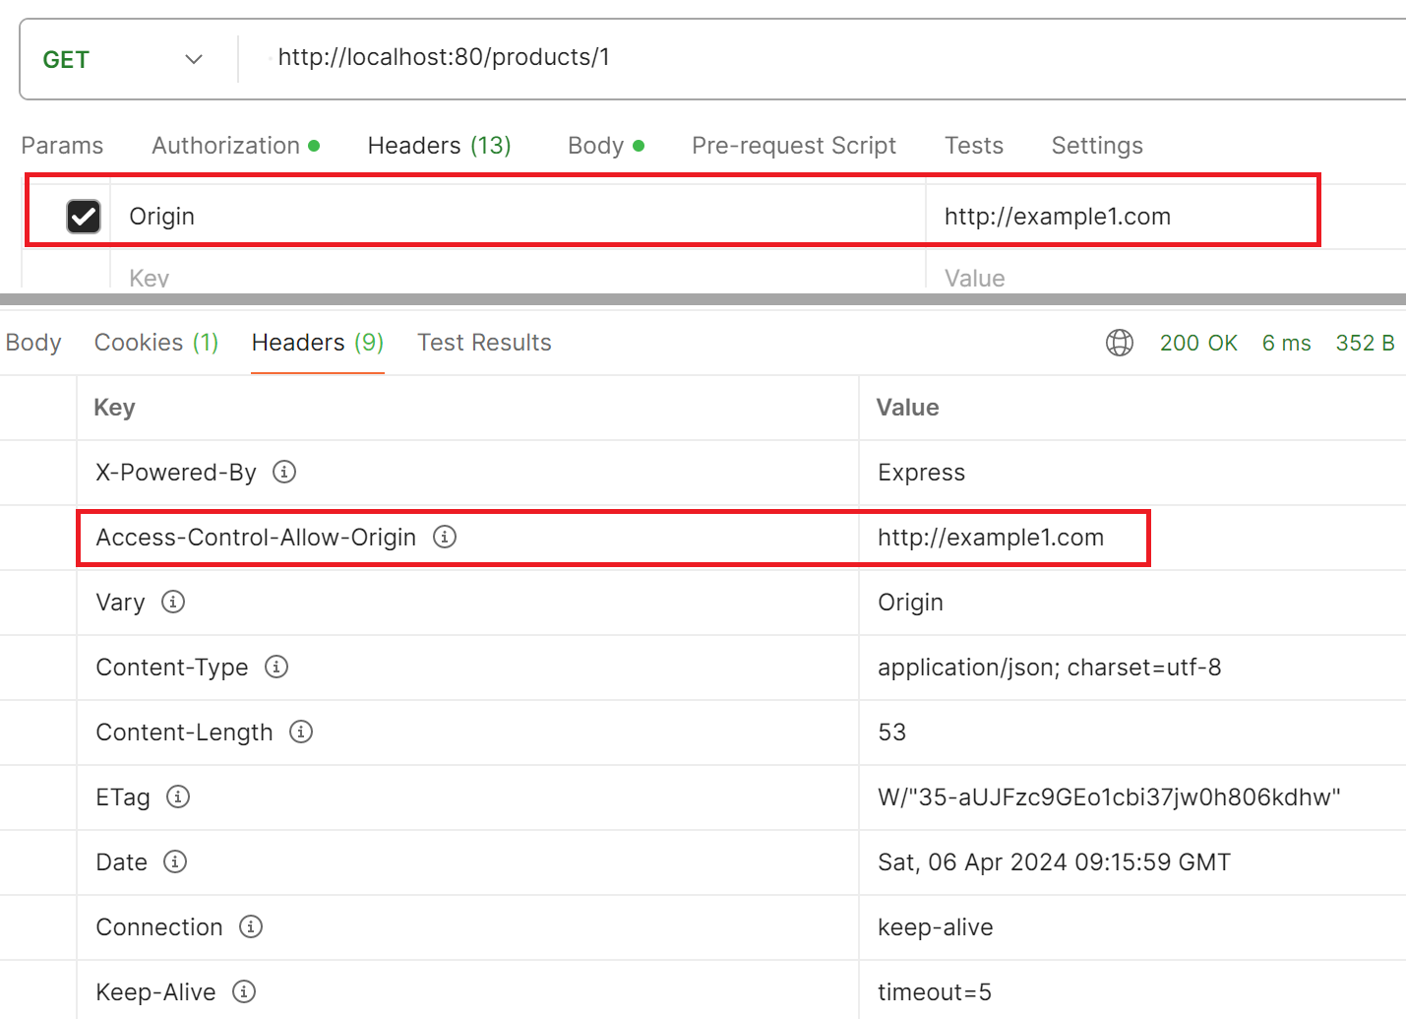
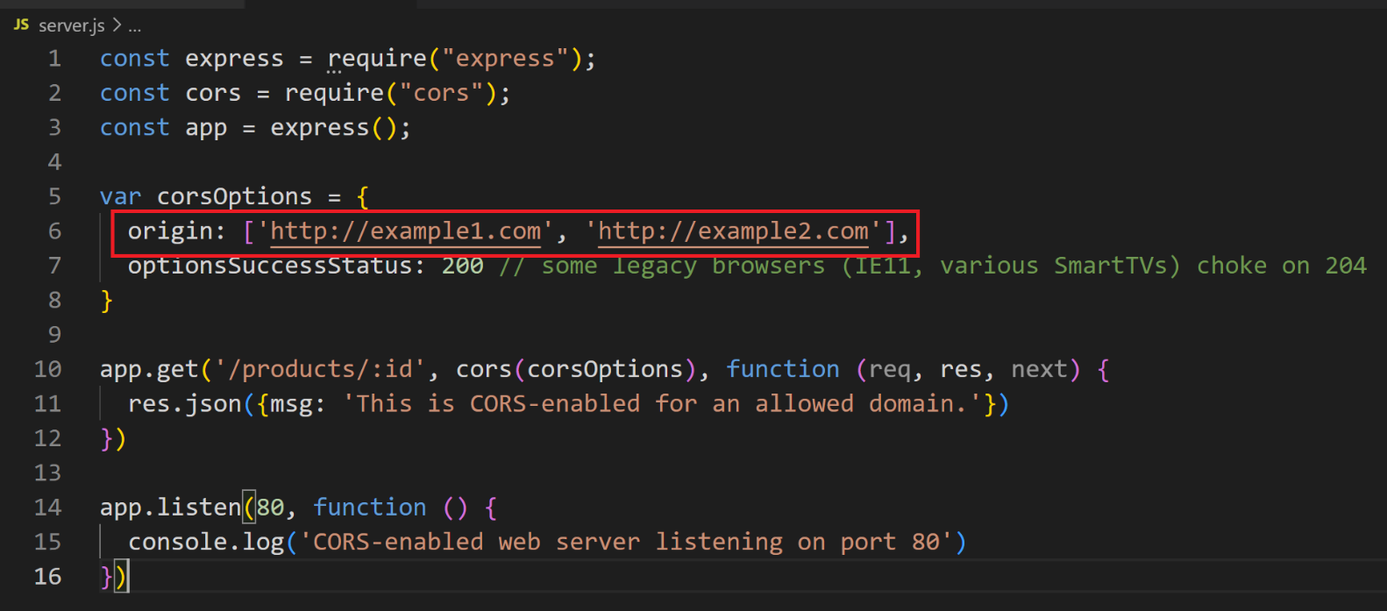
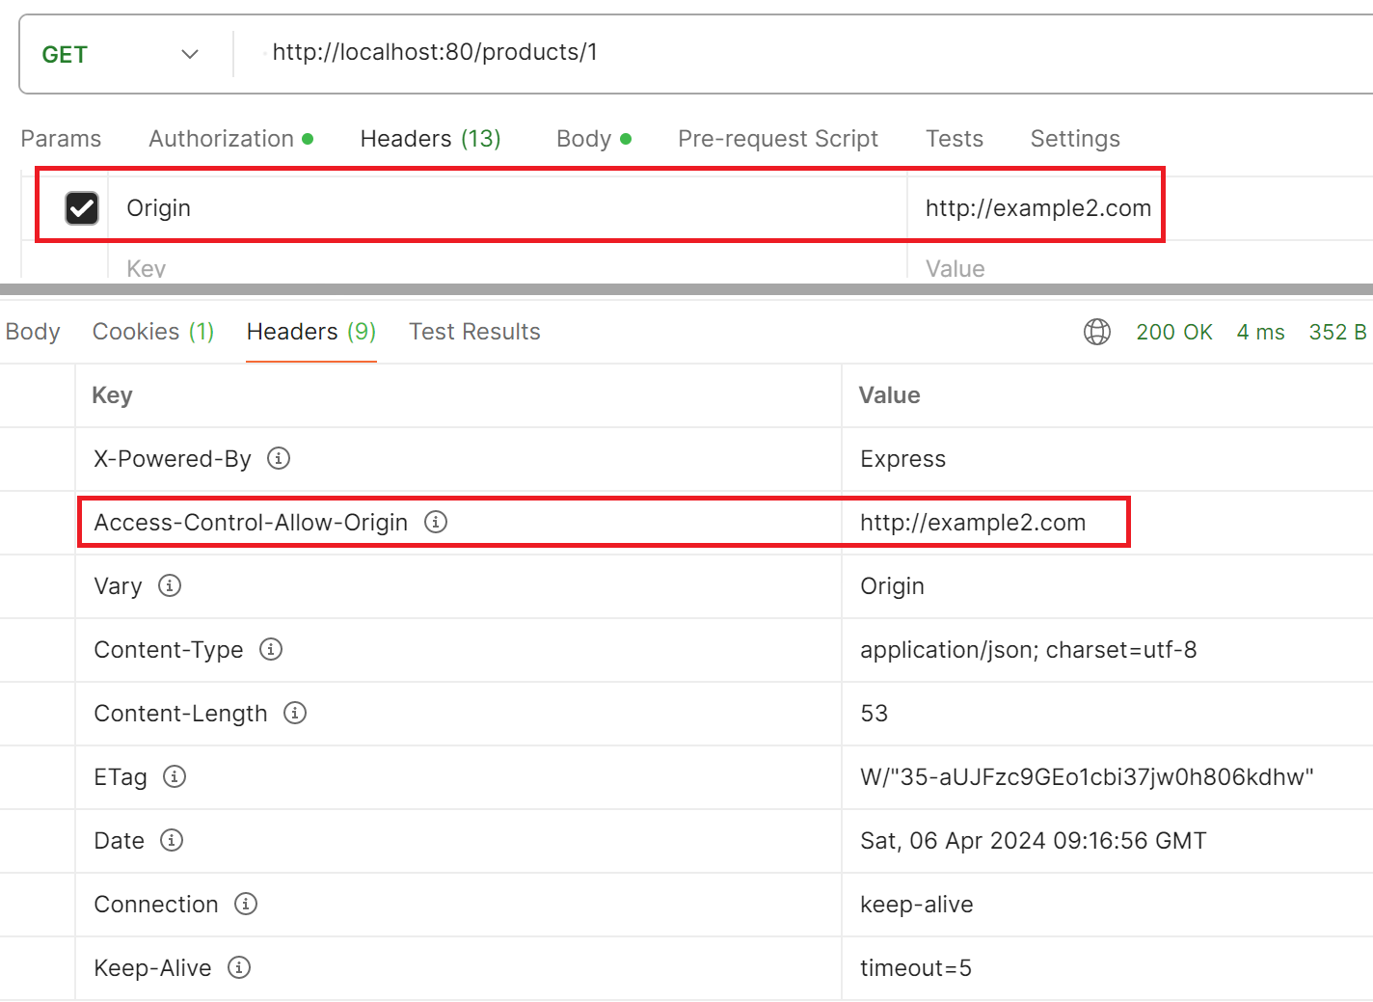
How CORS Works? – cont’d

Slide 6
Install and Use CORS
Install CORS Middleware: npm install cors
Set Up an Express Server with CORS
const express = require('express');
const cors = require('cors');
const app = express();
// Enable All CORS Requests
app.use(cors());
app.get('/', function (req, res) {
res.send('Hello World!');
});
const PORT = process.env.PORT || 3000;
app.listen(PORT, () => {
console.log(`Server running on port ${PORT}`);
});
app.use(cors()); enables CORS for all routes and origins.
If you need to configure CORS for specific routes or set options like allowed origins or headers, you can customize the CORS middleware.

Slide 7
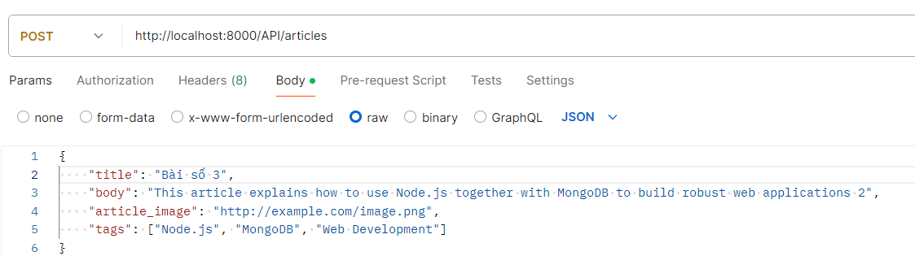
Test the endpoints by POSTMAN
Send a POST request

Slide 8
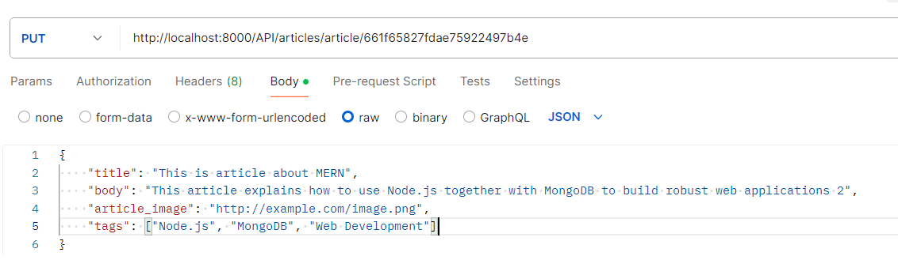
Test the endpoints by POSTMAN - 2
Send a PUT request

Slide 9
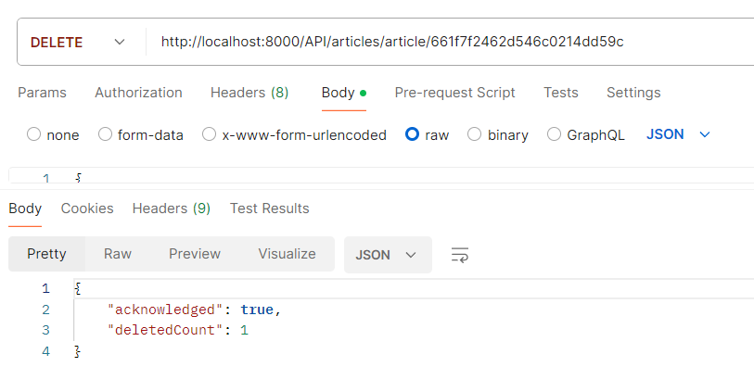
Test the endpoints by POSTMAN - 3
Send a DELETE request

Slide 10
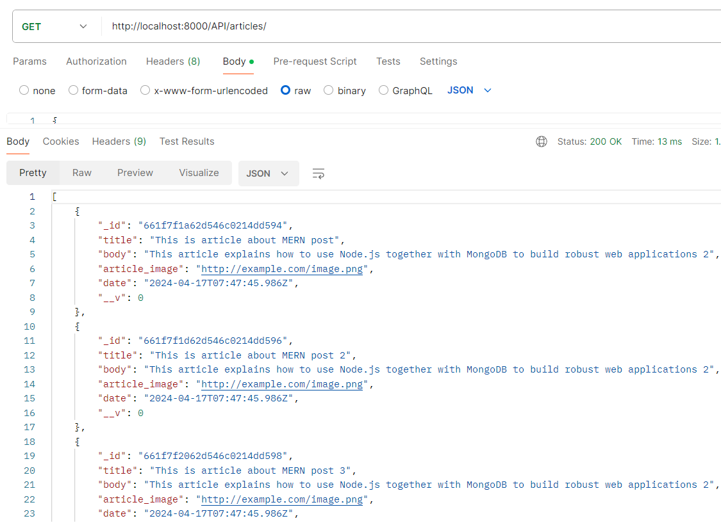
Test the endpoints by POSTMAN - 4
Send a GET request

Slide 11
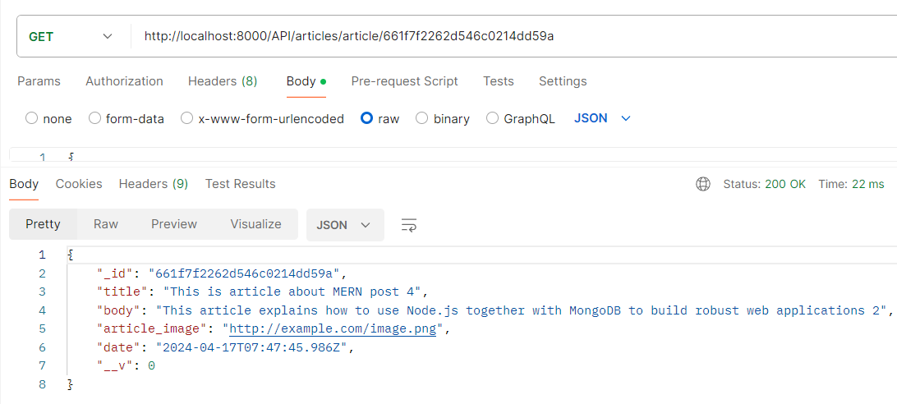
Test the endpoints by POSTMAN - 5
Send a GET request By Id

Slide 12
Exercise: HTTPS and CORS

Slide 13
Summary
Concepts were introduced:
Introduction RESTful API
What is RESTful API design?
Building the Models, Services, Controllers, Routes
Test the endpoints by POSTMAN
What is CORS? Install and Use CORS

