Slide 1

Backend as a Service (BaaS)

Slide 2
Objectives
Introduction BaaS.
Introduction PaaS, IaaS, SaaS.
Using Heroku and Firebase to quickly build backend support for your applications.

Slide 3
Backend Services
Build your own backend approach that we discussed earlier is cumbersome
Server setup and configuration issues
Backend storage and database provisioning
Developing the REST API and configuration
Additional services like notifications, user management, social networking etc. adds to the burden on developers
Can we package the whole backend services into a easily deployable, configurable and manageable service?

Slide 4
Deploy A Backend?
Several service providers offer managed solutions when it comes to how to deploy a backend in the cloud. These include Amazon Web Services, Back4App, Heroku, etc.
Each of these services offers different features and pricing depending on the application. However, their deployment models are usually based on the following:
PaaS
IaaS
SaaS

Slide 5
What is Backend as a Service (BaaS)?
BaaS is a cloud service model that provides developers with a way to connect web and mobile applications to cloud-based servers via APIs and SDKs.
BaaS platforms offer a suite of features that typically include database management, user authentication, cloud storage, push notifications, server-side logic, and more, without the need for developers to manage or maintain the underlying server infrastructure.

Slide 6
Why Use BaaS?
Simplification: BaaS provides pre-built backend components, like databases, authentication systems, cloud storage, and server-side logic, allowing developers to focus on building the frontend and user experience of their applications.
Scalability: Most BaaS platforms automatically scale based on the applications use. This means that infrastructure can handle increased usage without a lot of manual changes.
Cost Efficiency: For some small to medium-sized projects, using a BaaS can decrease upfront investments in server hardware of long-term contracts with cloud services.
Faster Time to Market: Because developers don't have to worry about creating complex backends, they're able to go to market more quickly.
Security: BaaS platforms typically offer built-in security features, including data encryption, authentication, and compliance with various regulatory standards.

Slide 7
Additional features of BaaS
Security
Automated backups
Monitoring tools

Slide 8
What does BaaS Provide?
Push Notifications
File Storage & Sharing
Social network integration
Messaging & Chat capabilities
User Management
Usage Analysis tools
Build & execute business logic

Slide 9
What does BaaS Provide?
A data storage API for cloud based storage
Binary Storage
Device synchronizing & caching capabilities
Online/offline workflow
Third party Integration
Secure connectivity
Auto generation of REST based interfaces
SDKs for typical mobile platforms

Slide 10
What is Platform as a Service (PaaS)
PaaS (Platform as a Service) is another cloud-based service for deploying and managing applications. It provides an automated platform for developers to deploy backend. It works without worrying about how to configure the infrastructure components.
Organizations that need to set up complex applications with cloud deployment often use PaaS services. These services usually offer the following features to help ensure the applications’ performance:
Reliability
Hardware scaling
Monitoring
Security

Slide 11
What is Infrastructure as a Service (IaaS)
IaaS (Infrastructure as a Service) is a cloud-based service for deploying and managing applications. It provides an automated platform to provision:
Virtual machines
Storage
Databases
Along with other resources without the need to set up and configure physical hardware. It is ideal for organizations that want to deploy their backend with minimal effort quickly.
Additionally, they provide APIs and SDKs. These make it easy to integrate with third-party services. So, your app gets other functionalities such as databases, storage services, and authentication providers.

Slide 12
What is Software as a Service (SaaS)
This model delivers software applications over the Internet, which are usually accessed by users through a web browser. SaaS providers manage the infrastructure, platforms, and even the applications themselves.
Examples include Google Workspace, Microsoft Office 365, and Salesforce. While not typically used just for deploying backends, some aspects of SaaS can intersect with backend functionality, especially in terms of user management and integration services.

Slide 13
Heroku

Slide 14
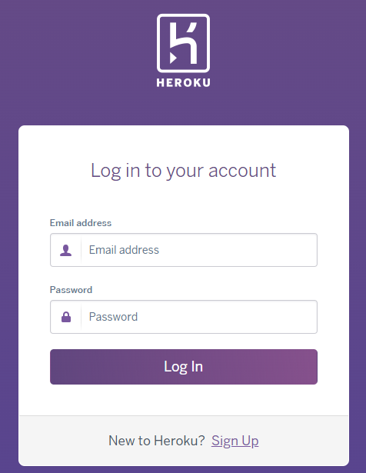
Introduction Heroku
Heroku is a PaaS provider that allows developers to deploy their backend with minimal effort instantly.
It provides a platform for hosting web applications.
Some of its features include scalability, monitoring, and security.

Slide 15
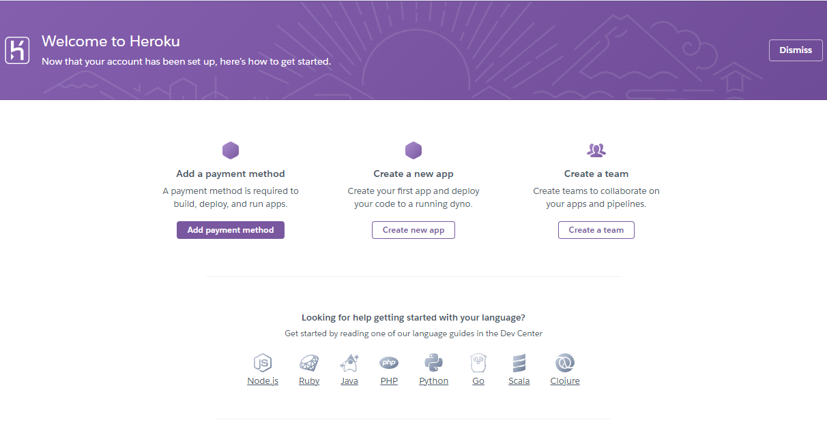
Deploying sample Node.js application
Create a Heroku account for free here. If you already have an account then log in and go to the dashboard.

Slide 16
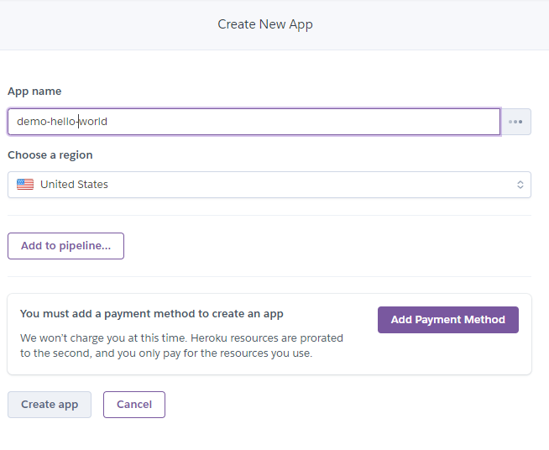
Deploying sample Node.js application - 2
Here you need to create a new app.
And enter a unique App name.
To be able to successfully create an App, you need to have an online payment account. Click the Add Payment Method button to do it the first time (no need next time)

Slide 17
Deployment using Heroku CLI
You need to install Heroku CLI on your machine you can install it from here, and verify the installation by running heroku –version
Add Heroku to PATH Manually
Right-click on Computer (Windows), select Properties > Advanced system settings > Environment Variables.
Under System Variables, find and select the Path variable, then click Edit.
Click New and add the path (C:\Program Files\Heroku\bin) to the Heroku CLI bin directory.
Click OK to close all dialogs.

Slide 18
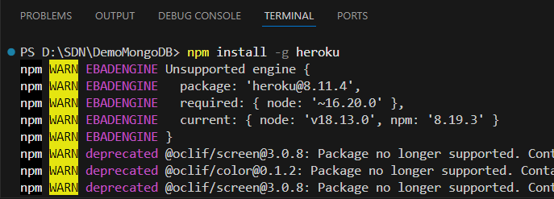

Deployment using Heroku CLI - 2
If you are facing any issue with the above installation method you can run npm install -g heroku command assuming you have npm and node installed and try to verify again.

Slide 19

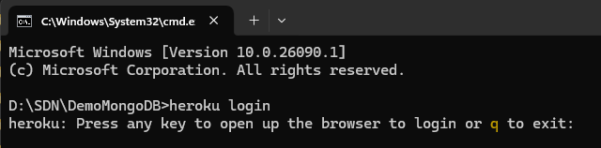
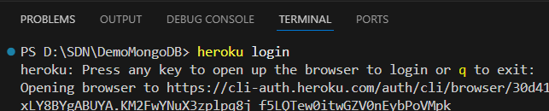
Deployment using Heroku CLI - 3
Now once the installation is successful you need to go to your server-side project and run the below command in the terminal.
heroku login

Slide 20
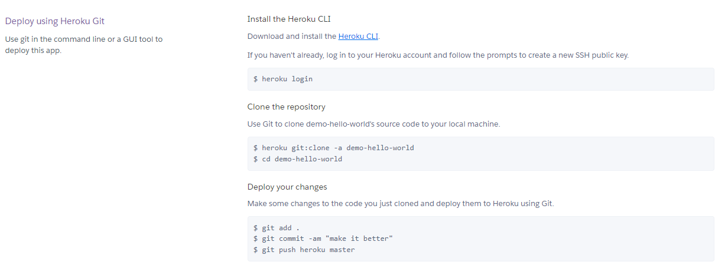
Deploy using Heroku Git
Now initialize git repository inside your working directory and connect that to your Heroku app using the second command with your app name.

Slide 21

Deploy using Heroku Git - 2
Once you are done you will be able to see that the build and deployment are successful in the latest activity section of the Heroku app overview.
Now you can click the app button on the top to view your node application.

Slide 22
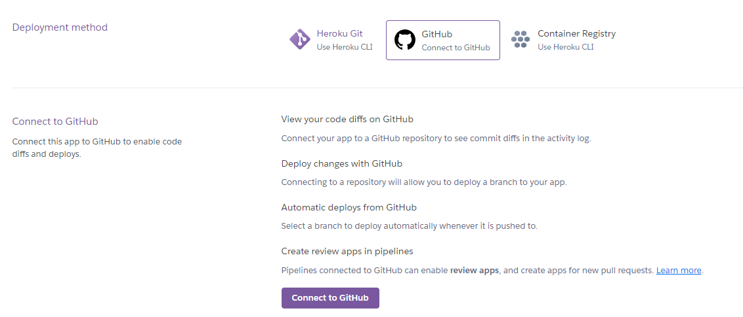
Deploy using Git
Another way is to connect Github inside Heroku

Slide 23
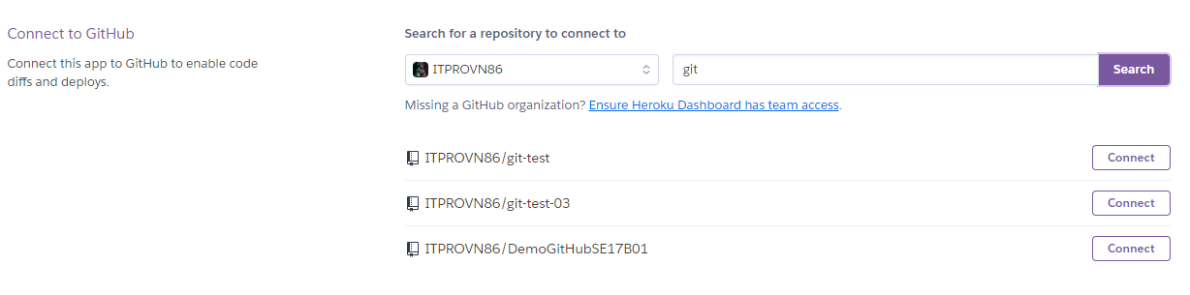
Deploy using Git - 2
Enter the repository name -> click search -> Select correct repository -> Click connect.

Slide 24
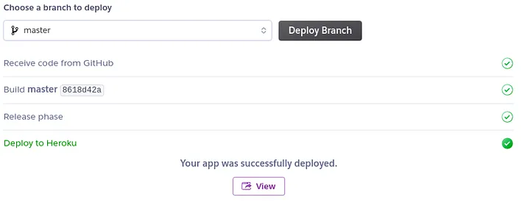
Deploy using Git - 3
Click on “Enable automatic deploys” button which would mean that whenever you add any code to your GitHub repository, Heroku will update your hosted app too.
And finally, click on “Deploy branch”. Wait for a couple of minutes and let the deploying process finish.
After successfully deploying the website you will get a success message as shown.

Slide 25
Firebase

Slide 26
What is Firebase?
Firebase is a web and mobile application development platform developed by Google.
It provides many tools and services that make it easier to develop, test, and improve applications.
Firebase provides Backend-as-a-Service (BaaS) solutions, allowing developers to focus on building great user experiences without worrying too much about server infrastructure management.

Slide 27
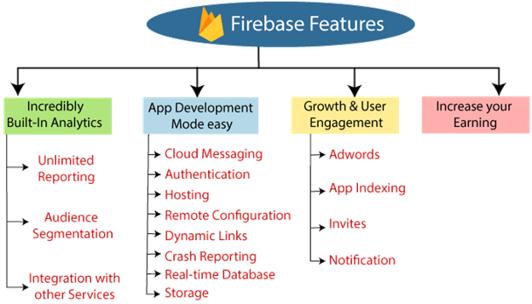
Key features of Firebase

Slide 28
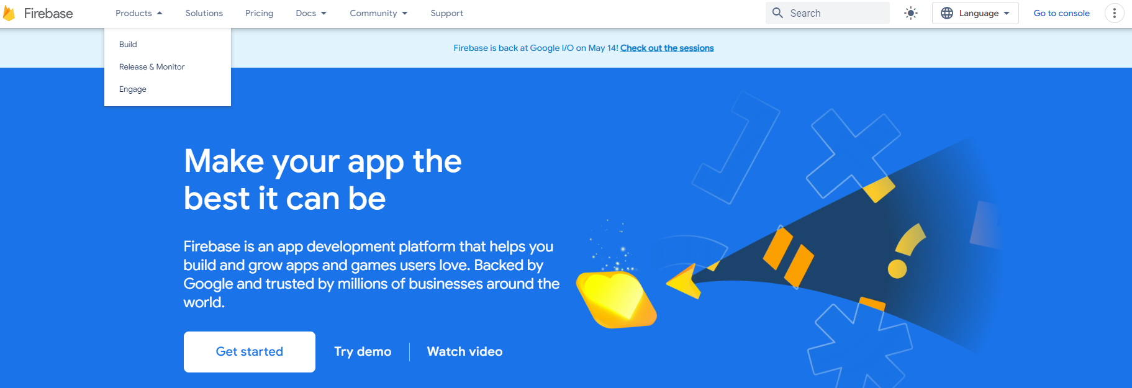
Set Up Firebase
To use Firebase Hosting, make sure you have made firebase project. Go to https://firebase.google.com/ and click on Get Started.

Slide 29
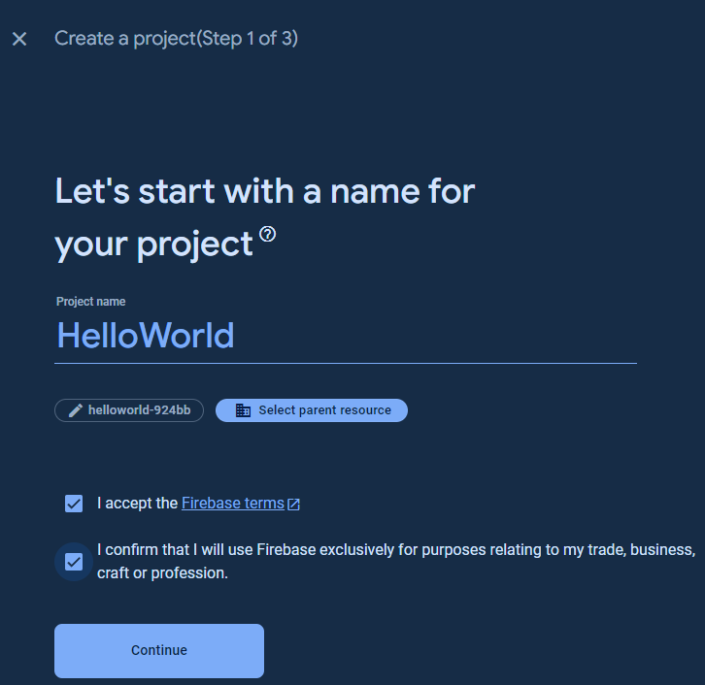


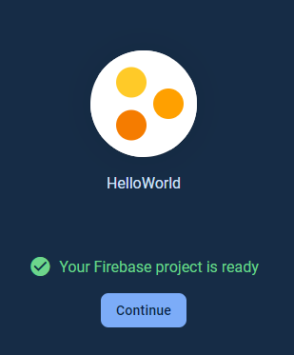
Create a Firebase project
Proceed to click on Create a project.
Enter a project name and check yes if you wish to add analytics to your project.
Wait for the project to be created.

Slide 30
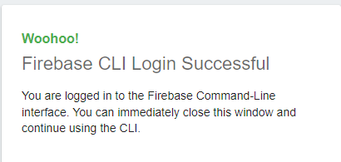

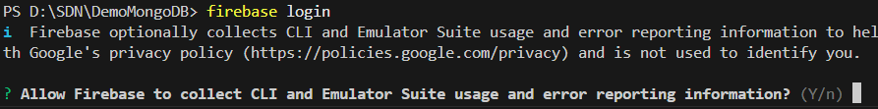
Create a Firebase project - 2
Install the Firebase Command Line Interface (CLI) by entering
npm install -g firebase-tools
Log in to Firebase using the CLI: firebase login
Initialize the Firebase project. In the terminal or command prompt, navigate to the root directory of the Node.js project and run the firebase init command.
Deploy Firebase by running: firebase deploy

Slide 31
Firebase Hosting vs. Heroku | Comparison
 | Firebase | Heroku
Category | Backend as a Service (BaaS) | Platform as a Service (PaaS)
Founded in | 2011 | 2007
Parent Company | Google | Salesforce, Inc.
Core Features | Cloud Firestore Authentication Remote Config Cloud Functions | Heroku Dynos Heroku Postgres Heroku OpEx Private Spaces
Free Tier | Yes | No
Databases | NoSQL | SQL & NoSQL
Developer Centric | Yes | Yes
Pricing Model | Pay-as-you-go | Resource-based

Slide 32
Summary
Concepts were introduced:
Introduction BaaS
Introduction PaaS, IaaS, SaaS
Using Heroku and Firebase to quickly build backend support for your applications

