Slide 1

Frameworks: NestJS & Hono

Slide 2
Objectives
Introduction NestJS Framework.
Demo NestJS
Introduction Hono Framework.
Demo Hono
Compare between Hono and NestJS

Slide 3
What is Nest.js?
Nest.js is a progressive Node.js framework that takes inspiration from both Angular and Spring.
It provides a solid foundation for building scalable and maintainable server-side applications.
Launched in 2017, Nest.js quickly gained popularity in the JavaScript community thanks to its powerful features and developer-friendly approach.

Slide 4
Why Nest.js?
Why you should consider Nest.js for your next project:
Modularity: Nest.js promotes a modular architecture, making it easy to organize and manage your codebase. It uses decorators and modules to create a structured application.
TypeScript: Nest.js is built with TypeScript, a statically typed superset of JavaScript. This helps catch errors at compile time, resulting in more reliable code.
Dependency Injection: It leverages the concept of dependency injection, allowing you to create reusable and testable components. This enhances code maintainability and testability.
Express Compatibility: Nest.js is built on top of Express.js, one of the most popular Node.js web frameworks. This means you can seamlessly integrate existing Express middleware and libraries.
Scalability: Nest.js is designed with scalability in mind. It supports microservices architecture, making it suitable for large and complex applications.

Slide 5
Key Concepts in Nest.js
To understand Nest.js better, let’s delve into some of its key concepts:
Modules: Nest.js applications are divided into modules, each encapsulating a feature or functionality. Modules organize components, routes, and services.
Controllers: Controllers define the routes for your application. They handle incoming requests, process them, and return responses.
Providers: Providers are responsible for business logic, data access, and other operations. They can be injected into controllers or other providers.
Decorators: Nest.js uses decorators to add metadata to classes, which helps the framework understand the role of each class.
Middleware: Middleware functions can be used to intercept requests and responses, allowing for custom processing at various stages of request handling.

Slide 6
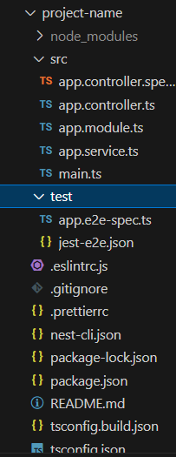
Getting Started with Nest.js
To start using Nest.js, we need Node.js and npm (Node Package Manager) installed on system.
Create a new Nest.js project using the Nest CLI (Command Line Interface).
Here’s a simple command:
npm i -g @nestjs/cli
nest new project-name
Running the application:
npm run start

Slide 7
Overview of core files
app.controller.ts | A basic controller with a single route.
app.controller.spec.ts | The unit tests for the controller.
app.module.ts | The root module of the application.
app.service.ts | A basic service with a single method.
main.ts | The entry file of the application which uses the core function NestFactory to create a Nest application instance.

Slide 8
What is NestFactory?
To create a Nest application instance, we use the core NestFactory class.
NestFactory exposes a few static methods that allow creating an application instance.
The create() method returns an application object, which fulfills the INestApplication interface.
This object provides a set of methods which are described in the coming chapters.
In the main.ts example above, we simply start up our HTTP listener, which lets the application await inbound HTTP requests.
import { NestFactory } from '@nestjs/core';
import { AppModule } from './app.module';
async function bootstrap() {
const app = await NestFactory.create(AppModule);
await app.listen(3000);
}
bootstrap();
Note that a project scaffolded with the Nest CLI creates an initial project structure that encourages developers to follow the convention of keeping each module in its own dedicated directory.

Slide 9
Hot Reload
The highest impact on application's bootstrapping process is TypeScript compilation.
With webpack HMR (Hot-Module Replacement), we don't need to recompile the entire project each time a change occurs.
This significantly decreases the amount of time necessary to instantiate application, and makes iterative development a lot easier.

Slide 10
Hot Reload - 2
First install the required packages:
npm i --save-dev webpack-node-externals run-script-webpack-plugin webpack
Once the installation is complete, create a webpack-hmr.config.js file in the root directory of your application.

Slide 11
Hot Reload - 3
const nodeExternals = require('webpack-node-externals');
const { RunScriptWebpackPlugin } = require('run-script-webpack-plugin');
module.exports = function (options, webpack) {
return {
...options,
entry: ['webpack/hot/poll?100', options.entry],
externals: [
nodeExternals({
allowlist: ['webpack/hot/poll?100'],
}),
],
plugins: [
...options.plugins,
new webpack.HotModuleReplacementPlugin(),
new webpack.WatchIgnorePlugin({
paths: [/\.js$/, /\.d\.ts$/],
}),
new RunScriptWebpackPlugin({ name: options.output.filename, autoRestart: true }),
],
};
};

Slide 12
Hot Reload - 4
Hot-Module Replacement
To enable HMR, open the application entry file (main.ts) and add the following webpack-related instructions:
declare const module: any;
import { NestFactory } from '@nestjs/core';
import { AppModule } from './app.module';
async function bootstrap() {
const app = await NestFactory.create(AppModule);
await app.listen(3000);
if (module.hot) {
module.hot.accept();
module.hot.dispose(() => app.close());
}
}
bootstrap();

Slide 13
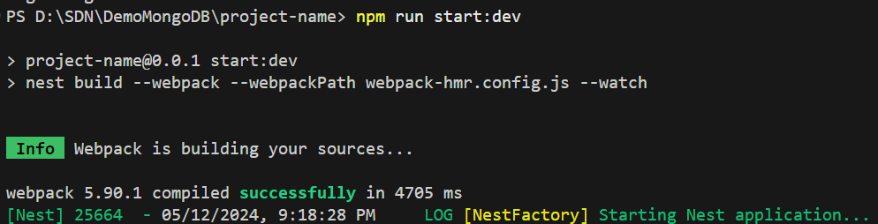
Hot Reload - 5
To simplify the execution process, add a script to your package.json file.
Now simply open your command line and run the following command:
npm run start:dev
"start:dev": "nest build --webpack --webpackPath webpack-hmr.config.js --watch"

Slide 14

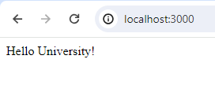
Hot Reload - 6
Demo with TypeScript compilation
//app.service.ts
import { Injectable } from '@nestjs/common';
@Injectable()
export class AppService {
getHello(): string {
return 'Hello World!';
}
}
//app.service.ts
import { Injectable } from '@nestjs/common';
@Injectable()
export class AppService {
getHello(): string {
return 'Hello University!';
}
}

Slide 15
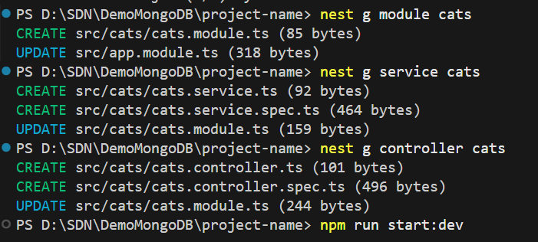
Using Nest CLI
nest generate module cats
nest generate controller cats
nest generate service cats

Slide 16
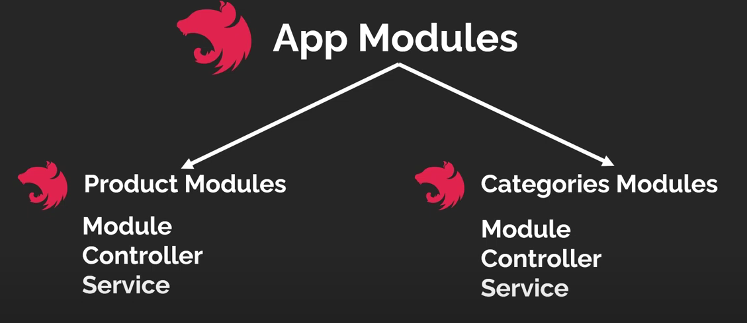
App Modules
A module is a class annotated with a @Module() decorator. The @Module() decorator provides metadata that Nest makes use of to organize the application structure.
Use Nest CLI to create modules: nest g module cats

Slide 17
Model
We will be storing cat information in memory, you can create a simple class cat.entity.ts:
export class Cat {
id: number;
name: string;
age: number;
breed: string;
}

Slide 18
App Modules - 2
Use Nest CLI to create modules: nest g module cats
import { Module } from '@nestjs/common';
import { CatService } from './cats.service';
import { CatController } from './cats.controller';
@Module({
providers: [CatService],
controllers: [CatController]
})
export class CatsModule {}

Slide 19
Service
import { Injectable } from '@nestjs/common';
import { Cat } from './cat.entity';
@Injectable()
export class CatService {
private readonly cats: Cat[] = [];
create(cat: Cat) {
this.cats.push(cat);
}
findAll(): Cat[] {
return this.cats;
}
findOne(id: number): Cat {
return this.cats.find(cat => cat.id === id);
}
update(id: number, cat: Cat) {
const index = this.cats.findIndex(c => c.id === id);
if (index > -1) {
this.cats[index] = cat;
}
}
delete(id: number) {
const index = this.cats.findIndex(c => c.id === id);
if (index > -1) {
this.cats.splice(index, 1);
}
}
}
This service will be responsible for data storage and retrieval, and is designed to be used by the CatsController, so it's a good candidate to be defined as a provider.
Use Nest CLI to create modules: nest g service cats

Slide 20
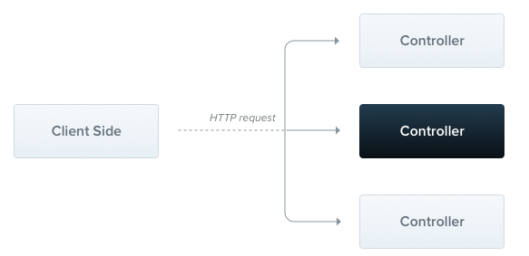
Controllers
Controllers are responsible for handling incoming requests and returning responses to the client.
A controller's purpose is to receive specific requests for the application.
The routing mechanism controls which controller receives which requests. Frequently, each controller has more than one route, and different routes can perform different actions.

Slide 21
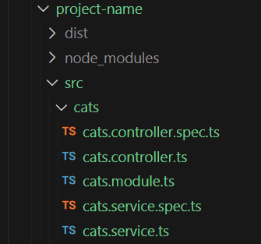
Controllers - 2
import { Controller, Get, Post, Put, Delete, Body, Param } from '@nestjs/common';
import { CatService } from './cats.service';
import { Cat } from './cat.entity';
@Controller('cats')
export class CatController {
constructor(private readonly catService: CatService) {}
@Post()
create(@Body() cat: Cat) {
this.catService.create(cat);
}
@Get()
findAll(): Cat[] {
return this.catService.findAll();
}
@Get(':id')
findOne(@Param('id') id: number): Cat {
return this.catService.findOne(id);
}
@Put(':id')
update(@Param('id') id: number, @Body() cat: Cat) {
this.catService.update(id, cat);
}
@Delete(':id')
delete(@Param('id') id: number) {
this.catService.delete(id);
}
}
Use Nest CLI to create modules: nest g controller cats

Slide 22
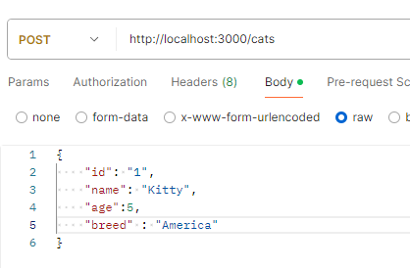
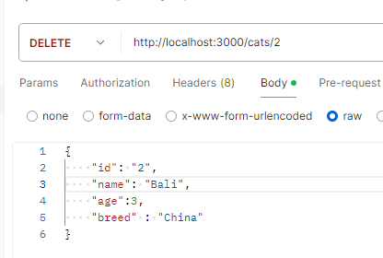
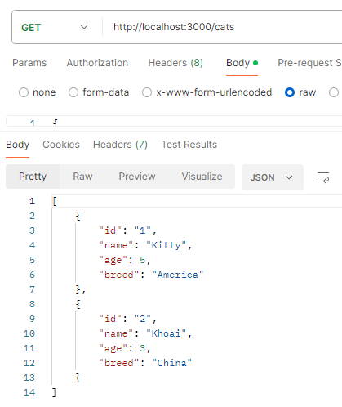
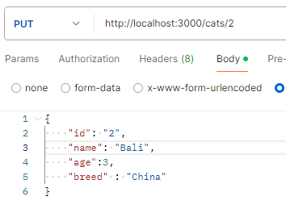
Test Postman

Slide 23
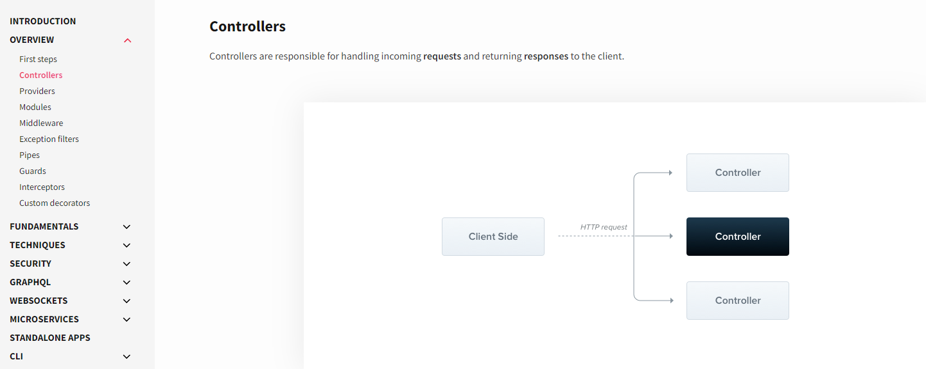
Reference NestJS
https://docs.nestjs.com/

Slide 24
What is Hono?
Hono is a lightweight, fast, and extensible web framework for Node.js, specifically designed for building serverless applications on platforms like Cloudflare Workers, Deno Deploy, and Fastly.
It leverages modern JavaScript features and aims to provide an easy-to-use API for developers to quickly create web applications without the overhead of more extensive frameworks.

Slide 25
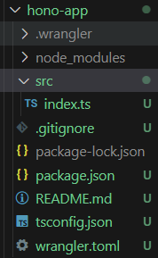
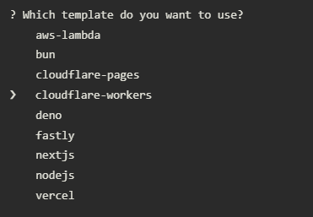
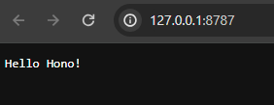
Getting Started with Hono
Starter templates are available for each platform. Use the following "create-hono" command.
npm create hono@latest hono-app
Then you will be asked which template you would like to use. Let's select Cloudflare Workers for this example.

Slide 26
Return JSON
Returning JSON is also easy.
The following is an example of handling a GET Request to /api/hello and returning an application/json Response.
app.get('/api/hello', (c) => {
return c.json({
ok: true,
message: 'Hello Hono!',
})
})

Slide 27
Request and Response
Getting a path parameter, URL query value, and appending a Response header is written as follows.
We can easily handle POST, PUT, and DELETE not only GET.
app.get('/posts/:id', (c) => {
const page = c.req.query('page')
const id = c.req.param('id')
c.header('X-Message', 'Hi!')
return c.text(`You want see ${page} of ${id}`)
})
app.post('/posts', (c) => c.text('Created!', 201))
app.delete('/posts/:id', (c) => c.text(`${c.req.param('id')} is deleted!`))

Slide 28
Return raw Response
You can also return the raw Response
app.get('/', (c) => {
return new Response('Good morning!')
})

Slide 29
Using Middleware
Middleware can do the hard work for you. For example, add in Basic Authentication.
There are useful built-in middleware including Bearer and authentication using JWT, CORS and ETag.
Hono also provides third-party middleware using external libraries such as GraphQL Server and Firebase Auth.
And, you can make your own middleware.
import { basicAuth } from 'hono/basic-auth'
// ...
app.use(
'/admin/*',
basicAuth({
username: 'admin',
password: 'secret',
})
)
app.get('/admin', (c) => {
return c.text('You are authorized!')
})

Slide 30
Adapter
There are Adapters for platform-dependent functions, e.g., handling static files.
For example, to handle static files in Cloudflare Workers, import hono/cloudflare-workers.
import { serveStatic } from 'hono/cloudflare-workers'
app.get('/static/*', serveStatic({ root: './' }))

Slide 31
Compare between Hono and Nest
Criteria | Hono | Nest
Design | Micro-framework, lightweight and fast | Full-stack framework, modular architecture
Purpose | Optimized for performance, suitable for edge computing and serverless environments | Suitable for large and complex enterprise applications
Language | JavaScript, TypeScript | TypeScript
Community & Support | Smaller community, limited documentation | Large community, extensive and detailed documentation
Features | Simple, focuses on HTTP handling | Supports extensive features like MVC, WebSockets, Microservices, GraphQL
Best Suited For | Simple APIs, microservices, serverless environments | Large applications requiring clear and deep architecture
Database Integration | Minimal focus on database integration | Strong support for ORM/ODM like TypeORM, Mongoose
Middleware System | Basic middleware support | Robust and flexible middleware system
Server-side Rendering | Not focused on server-side rendering | Capable of supporting server-side rendering well
Deployment | Optimized for edge computing and serverless environments | Flexible, suitable for various environments from traditional to cloud

Slide 32
Summary
Concepts were introduced:
Introduction NestJS Framework.
Demo NestJS
Introduction Hono Framework.
Demo Hono
Compare between Hono and NestJS

