Slide 1

Using API

Slide 2
Objectives
Understand the Networking Essentials
Introduction to API
Distinguish between SOAP and REST APIs
How Do Apis Work?
Distinguish between JSON and XML

Slide 3
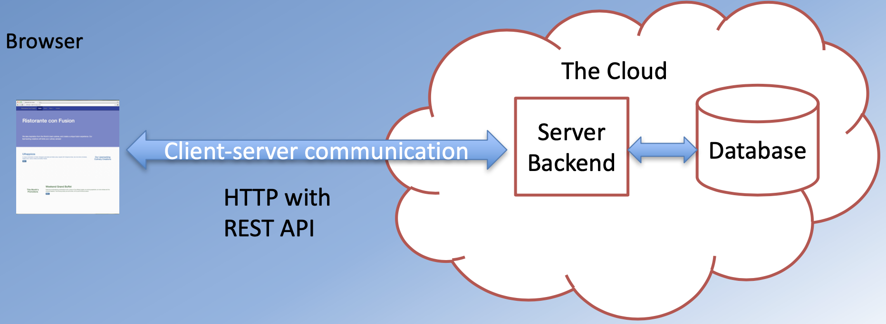
Client and Server
Web applications are not stand-alone
Many of them have a “Cloud” backend

Slide 4
Client-Server Communication
Network operations cause unexpected delays
You need to write applications recognizing the asynchronous nature of communication
Data is not instantaneously available

Slide 5
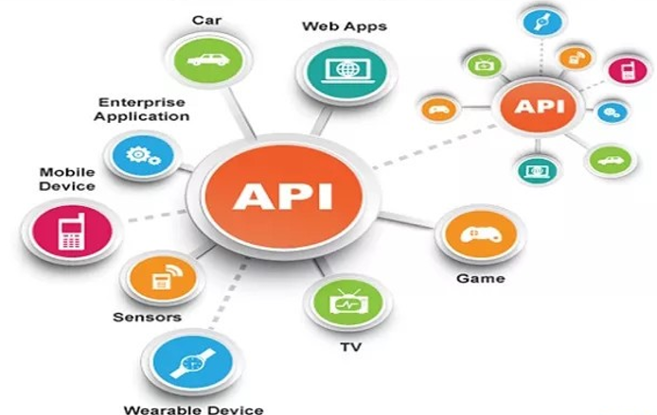
What is API?
API is the acronym for Application Programming Interface.
A type of software interface that let two programs communicate with one another.
An API define features that have nothing to do with the execution of each implementation
APIs enable programmers to regularly reuse difficult, repetitive operations with only a little amount of code

Slide 6
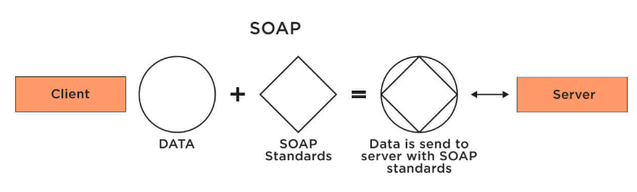
SOAP APIs
SOAP stands for Simple Object Access Protocol.
This type of API is popular due to its strict structure and independence from any specific programming language.
Examples of SOAP APIs include the folowing:
Salesforce SOAP API.
Workday SOAP API.
Sabre SOAP API.

Slide 7
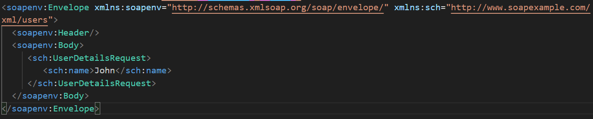
Example about SOAP
Using SOAP, the request to the API is an HTTP POST request with an XML request body. The request body consists of an envelope which is a type of SOAP wrapper that identifies the requested API, and a SOAP body that holds the request parameters. In this case, we want to fetch the user with the name “John.”

Slide 8
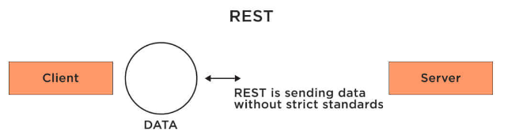
REST APIs
The acronym REST stands for Representational State Transfer.
A RESTful API has all the features of the REST architecture, but it differs slightly in that it has a transport protocol and keeps cached data available at all times rather than deleting it when the API is not in use. Due to its unique features, a RESTful API tends to be more flexible yet less secure.
Examples of REST APIs include:
Amazon Product Advertising REST API.
Flickr REST API.
YouTube REST API.

Slide 9
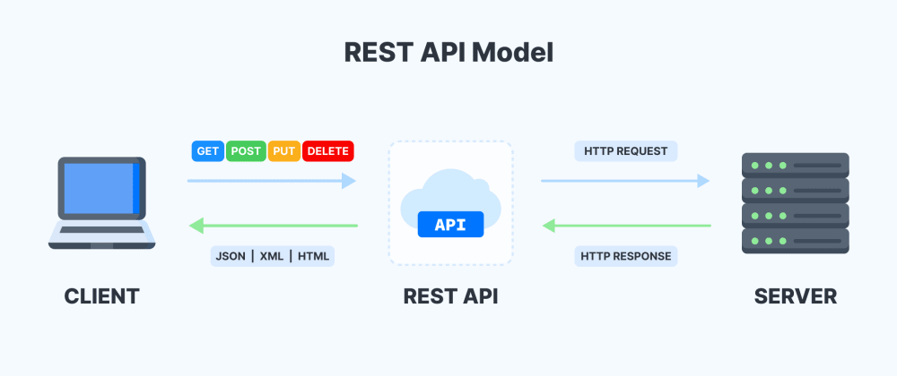
REST APIs – cont’d

Slide 10
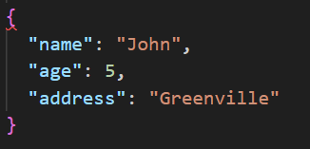
Example about REST APIs
REST APIs can be called with all of the HTTP verbs. To get a resource, in this case, a user, a GET request is used. While the SOAP request holds the user’s name in the body, a REST API accepts GET parameters from the URI.
GET https://restexample.com/users?name=John
As mentioned, REST APIs typically use the data format JSON. The user is represented in JSON like this:

Slide 11
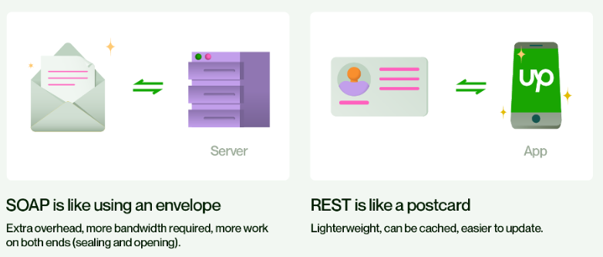
Compare between SOAP and REST APIs

Slide 12
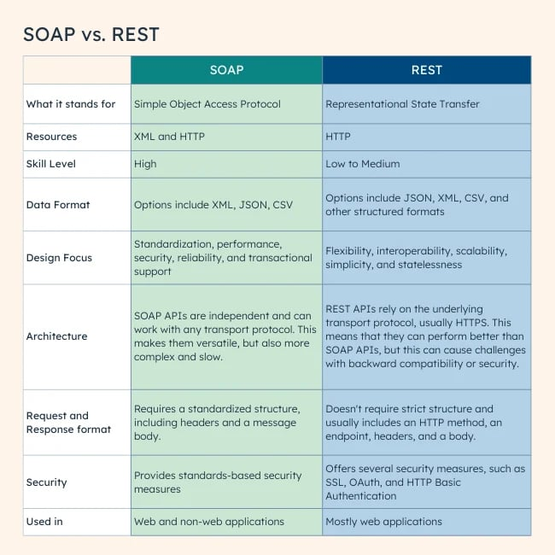

Slide 13
A RESTful API
Has all the features of the REST architecture, but it differs slightly in that it has a transport protocol
Keeps cached data available at all times rather than deleting it when the API is not in use
A RESTful API tends to be more flexible yet less secure.

Slide 14
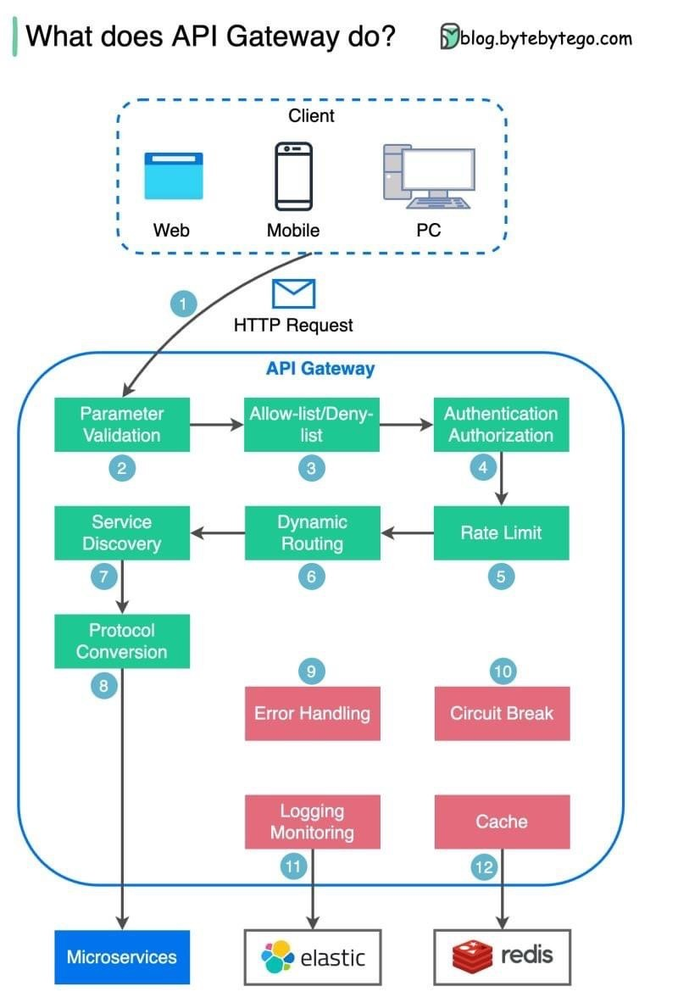
What does API gateway do?
The diagram below shows the detail.
Step 1 - The client sends an HTTP request to the API gateway.
Step 2 - The API gateway parses and validates the attributes in the HTTP request.
Step 3 - The API gateway performs allow-list/deny-list checks.
Step 4 - The API gateway talks to an identity provider for authentication and authorization.
Step 5 - The rate limiting rules are applied to the request. If it is over the limit, the request is rejected.

Slide 15
What does API gateway do? – cont’d
The diagram below shows the detail.
Steps 6 and 7 - Now that the request has passed basic checks, the API gateway finds the relevant service to route to by path matching.
Step 8 - The API gateway transforms the request into the appropriate protocol and sends it to backend microservices.
Steps 9-12: The API gateway can handle errors properly, and deals with faults if the error takes a longer time to recover (circuit break). It can also leverage ELK (Elastic-Logstash-Kibana) stack for logging and monitoring. We sometimes cache data in the API gateway.
Notes:
Ask students:
What’s the difference between a load balancer and an API gateway?
Do we need to use different API gateways for PC, mobile and browser separately?

Slide 16
WHAT DOES AN API DO?
Through an API, two computers can talk to one another.
To communicate with the server, which is where the data is stored, the client uses the language that the server provides.
Servers never provide data without a client asking for it, even though developers have come up with numerous techniques to get around this with webhooks.

Slide 17
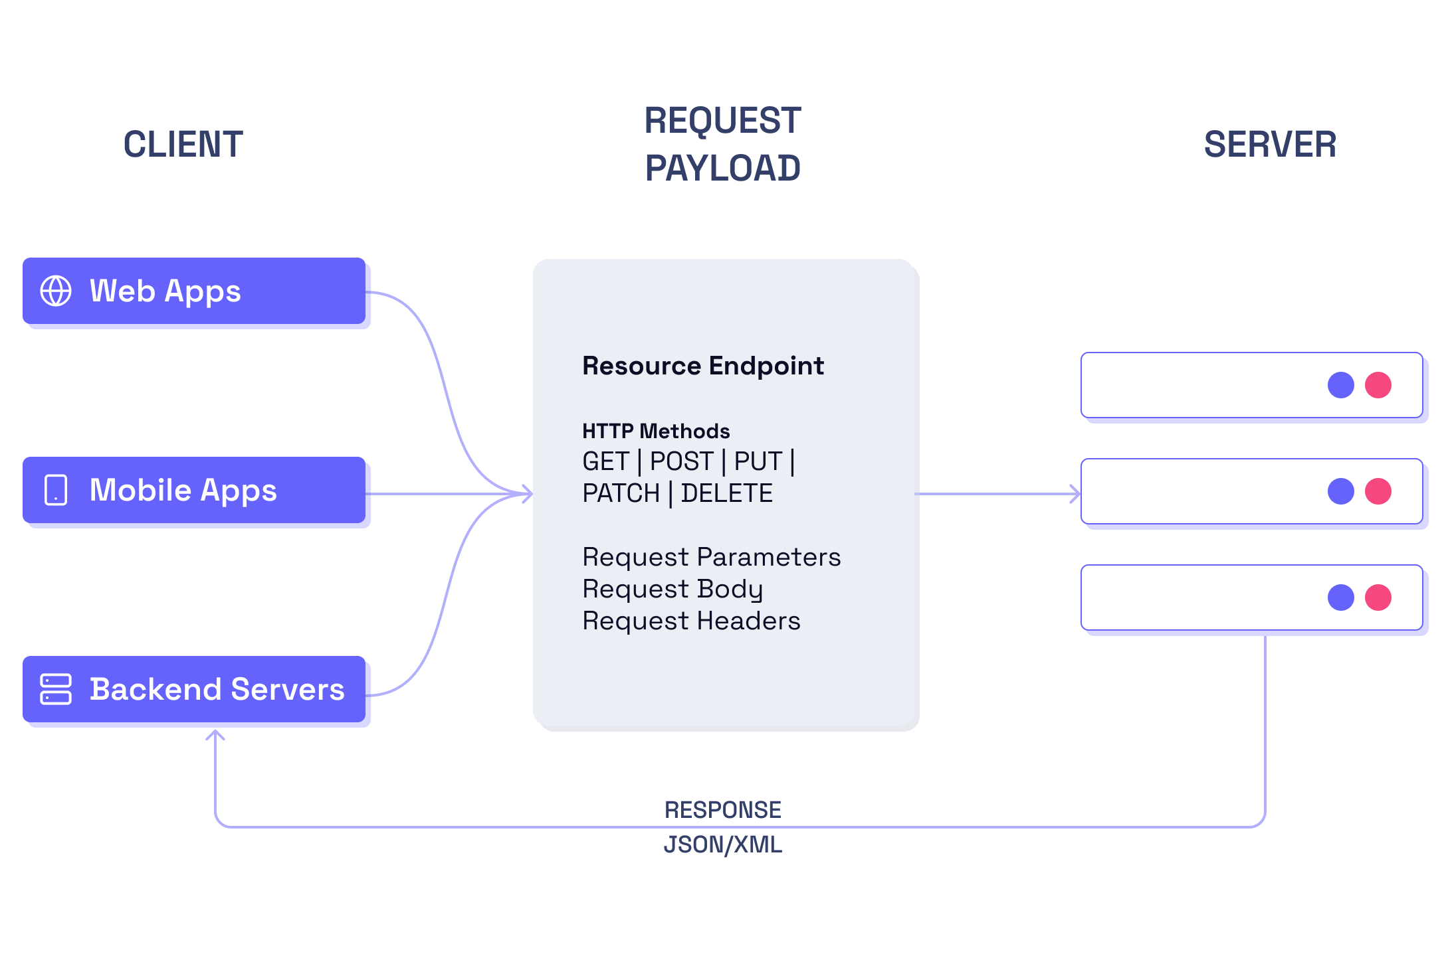
WHAT DOES AN API DO? – cont’d
An API can perform the four types of actions listed below:
GET: Requests data from a server.
POST: Transmits updates from the client to the server; consider a POST request as creating a new record in the server's database.
PUT: Revises or adds to existing information.
DELETE: Deletes existing information

Slide 18
Important Benefits of Using API
Using API allows you to create a seamless stream of data transfer between applications and devices in real time.
Improve the quality of the user experience.
Speed of development and budget saving.
Complex operations become simple.
Scaling options.
Based on API, things such as maps and routes, all kinds of mobile and desktop clients for social networks and other products that people use on a daily basis are built.

Slide 19
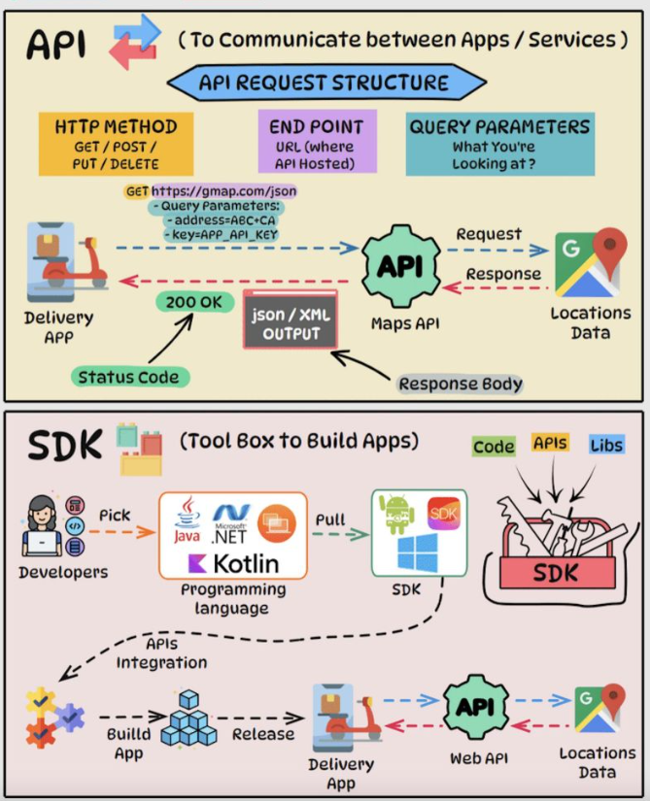
API vs SDK: Key Differences
𝗔𝗣𝗜
An API is a set of rules and protocols that allows different software applications and services to communicate and share data.
𝗦𝗗𝗞
An SDK is a comprehensive package of tools, libraries, sample code, and documentation to simplify building apps on a specific platform, framework, or hardware.
Notes:
API: 1. Defines a standard interface for components to interact.
2. Allows integration between software written in different languages and frameworks.
3. Typically provides endpoints for requesting and serving data.
SDK: 1. Provides higher-level abstractions to ease development for a target platform.
2. Designed to integrate seamlessly with the underlying platform for compatibility and performance.
3. Grants access to platform-specific capabilities and features that may be complex to implement from scratch.

Slide 20
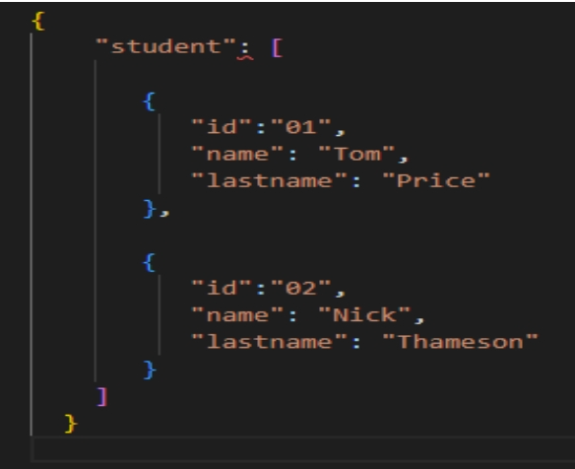
What is JSON?
JSON is a text-based data format that follows the JavaScript object syntax made well-known by Douglas Crockford.
JSON can be used as a string for data transmission over a network.
Data structured as:
A collection of
name/value pairs: Ordered list of values

Slide 21
History of JSON
These significant events helped shape JSON's history:
Douglas Crockford defined the JSON format at the start of the new millennium.
The of official website debuted in 2002.
In December 2005, Yahoo! started offering online services based on JSON.
JSON was acknowledged as a global standard by ECMA in 2013.
The most recent JSON format standard was published in 2017.

Slide 22
Features of JSON
Easy to use: Commonly used use cases can be streamlined thanks to the high-level façade given by JSON API.
Performance: JSON is suitable for large object graphs or systems because it is relatively speedy and needs very little memory.
Free tool: The JSON library is a free, open-source resource.
It is not essential to construct mapping because the Jackson API already has default mapping for many objects that can be serialized.
Clean JSON: Generates results that are easy to read, compatible, and clean JSON.
Dependency: The JSON library can be used to process data without the use of any other libraries.

Slide 23
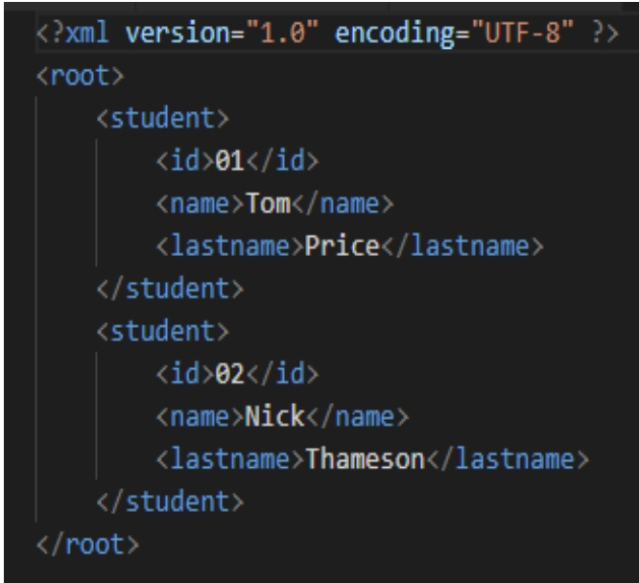
What is XML?
XML is the acronym for Extensible Markup Language.
It provide data formats that are used to store data for database records, transactions, and many other types of data.

Slide 24
History of XML
These significant events in the development of XML are listed below:
SGML was used to create XML.
XML version 1.0 was released in February 1998.
XML Media Types: January 2001 IETF Proposed Standard.
Explicit Markup Language (XML).
Charles Goldfarb, Ed Mosher, and Ray Lorie founded GML in 1970.
In 1996, Sun Microsystems started developing XML.

Slide 25
Features of XML
XML tags are not predened. Your customized tags must be specified.
XML was designed to transmit data, not to display it.
XML markup code is simple for humans to grasp.
In contrast, the structured format is easy to read and write from programs.
XML is an extensible markup language, just like HTML.

Slide 26
Difference between JSON and XML
The screenshot below captured the prime difference between JSON vs XML:

Slide 27
 | JSON | XML
Stands for | JSON means JavaScript Object Notation. | XML means Extensible Markup Language.
History | Douglas Crockford and Chip Morningstar released JSON in 2001. | The XML Working Group released XML in 1998.
Format | JSON uses a maplike structure with key-value pairs. | XML stores data in a tree structure with namespaces for different data categories.
Syntax | The syntax of JSON is more compact and easier to read and write. | The syntax of XML substitutes some characters for entity references, making it more verbose.
Parsing | You can parse JSON with a standard JavaScript function. | You need to parse XML with an XML parser.
Schema documentation | JSON is simple and more flexible. | XML is complex and less flexible.
Data types | JSON supports numbers, objects, strings, and Boolean arrays. | XML supports all JSON data types and additional types like Boolean, dates, images, and namespaces.
Ease of use | JSON has smaller file sizes and faster data transmission. | XML tag structure is more complex to write and read and results in bulky files.
Security | JSON is safer than XML. | You should turn off DTD when working with XML to mitigate potential security risks.

Slide 28
Summary
Concepts were introduced:
Understand the Networking Essentials
Introduction to API
Distinguish between SOAP and REST APIs
How Do Apis Work?
Distinguish between JSON and XML

