Slide 1

Node & HTTP

Slide 2
Objectives
Introduction to Http, include: Http Request and Http Response
What are HTTP Methods?
What is/ How to use Node Http Modules
How to Read and Write Files and Directories?
Introduction to File System Interaction
Demo about File System Interaction: File Server and File Path

Slide 3
What is the HTTP (Hypertext Transfer Protocol)
It is the foundation of communication between clients and servers on the web
Stateless, Application-layer protocol for dealing with distributed services.
Requests are sent across the TCP/IP layer, and responses are returned.
HTTP Versions.

Slide 4
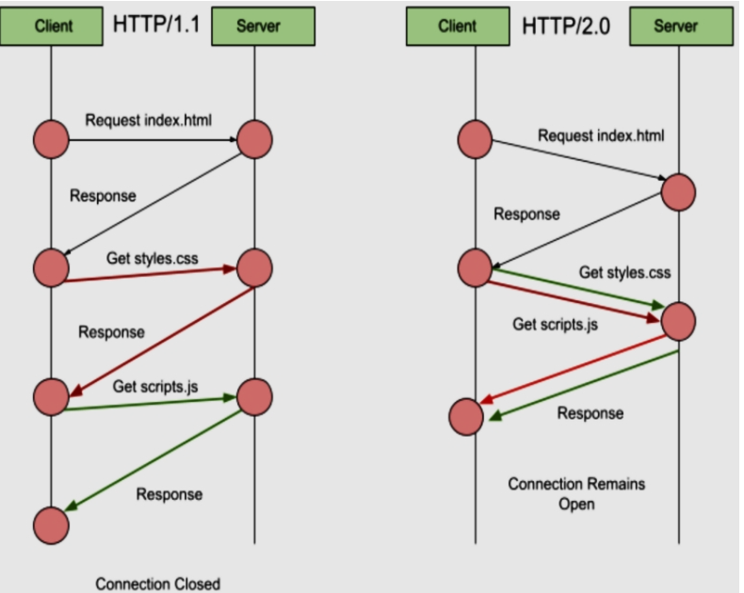
HTTP (Hypertext Transfer Protocol) – cont’d
HTTP/1.1
Modification was made in 2014
Each TCP/IP connection is limited to one open request in this version
HTTP/0.9 was the protocol's first version. Currrntly, this version is entirely obsolete.
HTTP/2.0
The most recent iterations of Chrome, Firefox, Safari, and Edge all support HTTP/2.0.
When using this HTTP version, the client can send numerous queries at once.
It accelerates the speed at which a page loads.

Slide 5
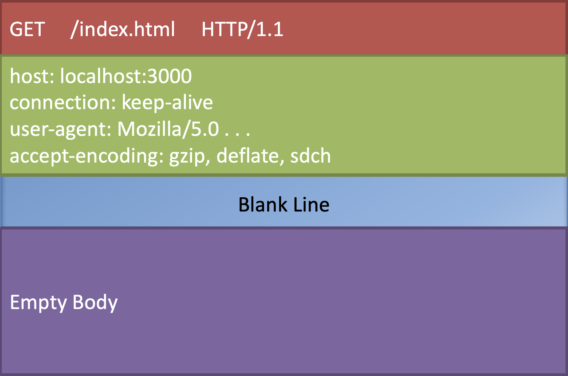
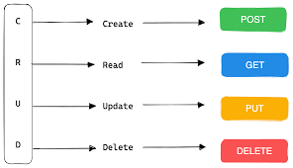
HTTP Requests
HTTP Request Verbs
There are four universally applicable HTTP verbs in a request:
GET
POST
PUT
DELETE

Slide 6
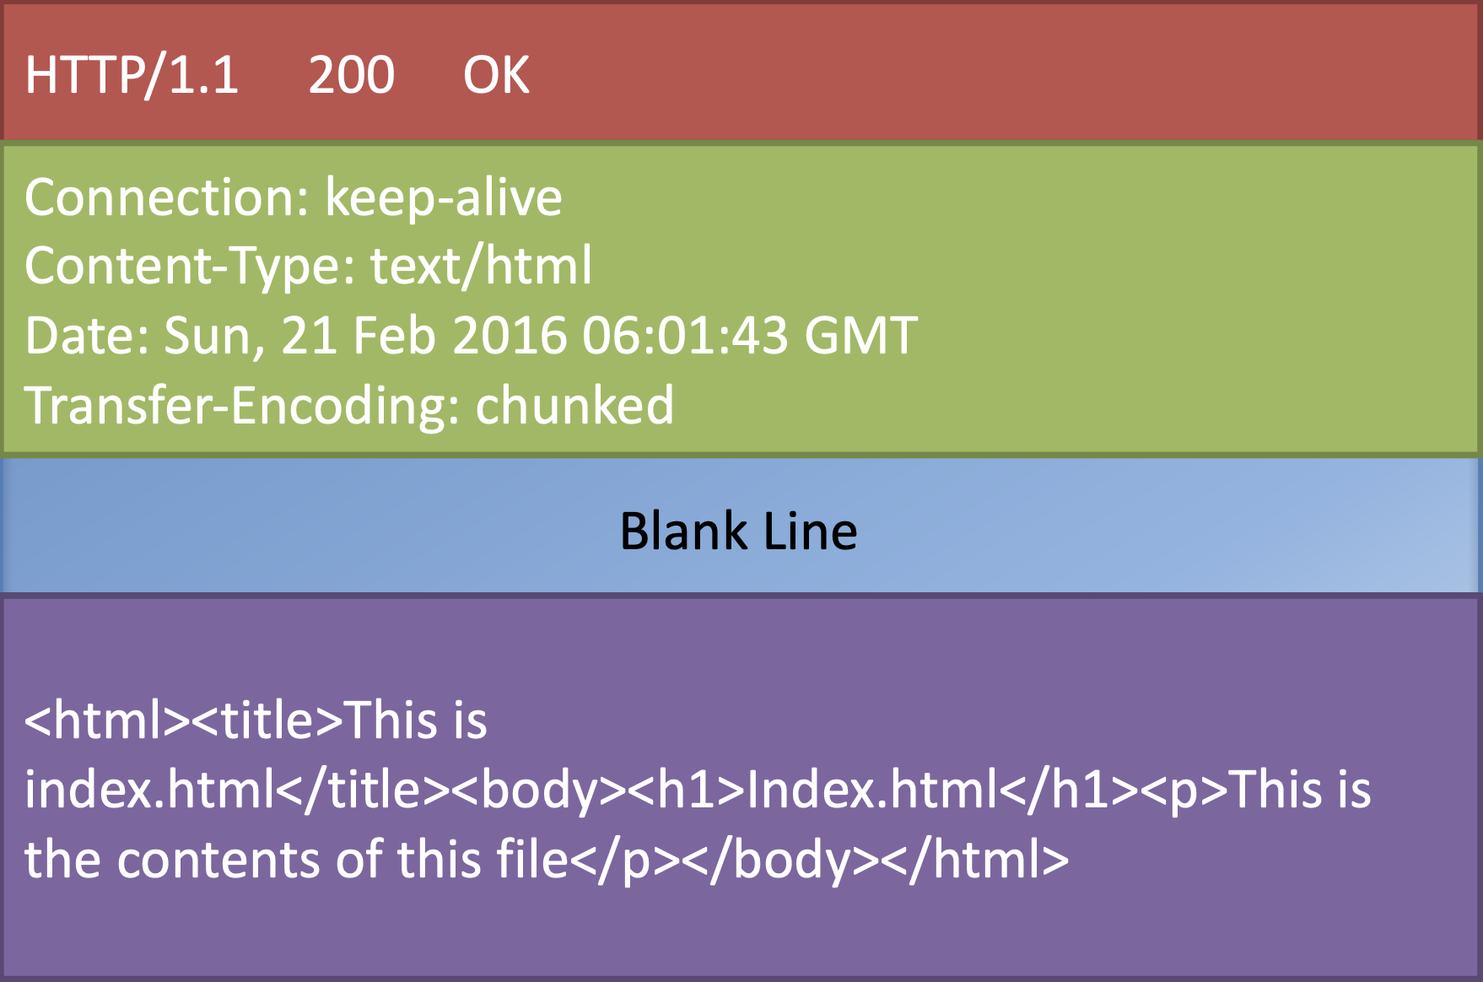
HTTP Responses
The format of the response message is largely the same as that of a request message, except for the status line and headers.
Status line: Describes the request's success (status code 200) or failure (status code 401). Also supplied are the HTTP version and a very brief status description.
Headers: Extra information about the response, such as the server's details or the response's content type.
Body: The content of the response is (optional). For instance, this could be the HTML content of the requested web page or the binary data of an image.

Slide 7
What are HTTP Methods
HTTP methods, which are also known as HTTP verbs, are responsible for defining the actions that can be performed on resources identified by Uniform Resource Identifiers (URIs).
HTTP defines several methods, each serving a specific purpose in handling resource requests and responses.
The most common HTTP methods include: GET, POST, PUT, DELETE, HEAD, OPTIONS, CONNECT, and TRACE
Notes:
The GET method retrieves information from the server, while the POST method sends data to the server to create, update, or delete resources. The PUT method is used to update a resource, and the DELETE method is used to delete a resource. The HEAD method retrieves only the header information of a resource, while the OPTIONS method retrieves the available methods that can be used on a resource. The CONNECT method establishes a network connection, and the TRACE method echoes the received request back to the client.

Slide 8
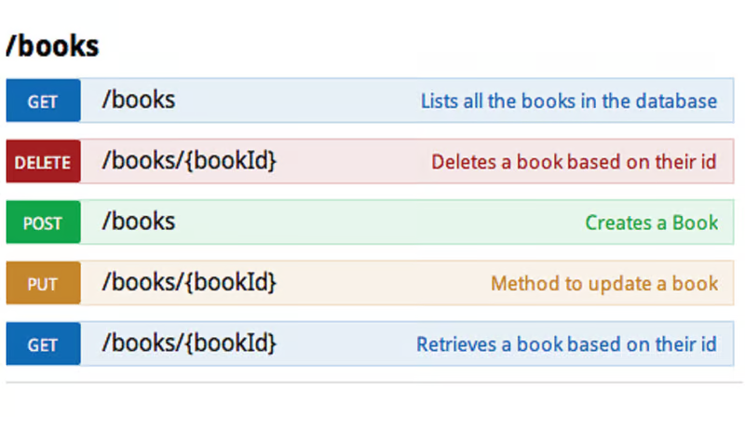
What are HTTP Methods – cont’d

Slide 9
GET Method
It is used to request data from a specified resource. The data is included in the URL as parameters. Requests using GET should only retrieve data.
GET /api/users?id=123

Slide 10
POST Method
Unlike GET, POST requests do not append data to the URL; instead, they include the data in the request body.
It is used when you want to send some data to the server, for example, file update, form data, etc.
The POST method often causes a change in state or side effects on the server.
POST /api/users
Content-Type: application/json
{
"name": "John Doe",
"email": "john@example.com"
}

Slide 11
PUT Method
It requires the client to send the entire updated resource representation.
If the resource does not exist, PUT can create a new resource with the provided data.
In RESTful web services, the HTTP method PUT is typically used for both creating new data and updating existing data.
PUT /api/users/123
Content-Type: application/json
{
"name": "Updated Name",
"email": "updated@example.com"
}

Slide 12
DELETE Method
DELETE is used to remove a resource from the server.
It is an idempotent method, meaning repeated DELETE requests will have the same effect as a single request.
DELETE /api/users/123

Slide 13
HEAD Method
The HEAD method is similar to GET, but it retrieves only the headers of a resource without the actual data.
It is useful when you need to check the headers before downloading the entire resource.
HEAD /api/users/123

Slide 14
OPTIONS Method
The OPTIONS method is used to determine the communication options available for a given resource.
It helps the client understand which HTTP methods and headers are supported.
OPTIONS /api/users

Slide 15
PATCH Method
PATCH is used to apply partial modifications to a resource.
It is more efficient than PUT when updating only specific fields of a resource.
PATCH /api/users/123
Content-Type: application/json
{
"email": "newemail@example.com"
}

Slide 16
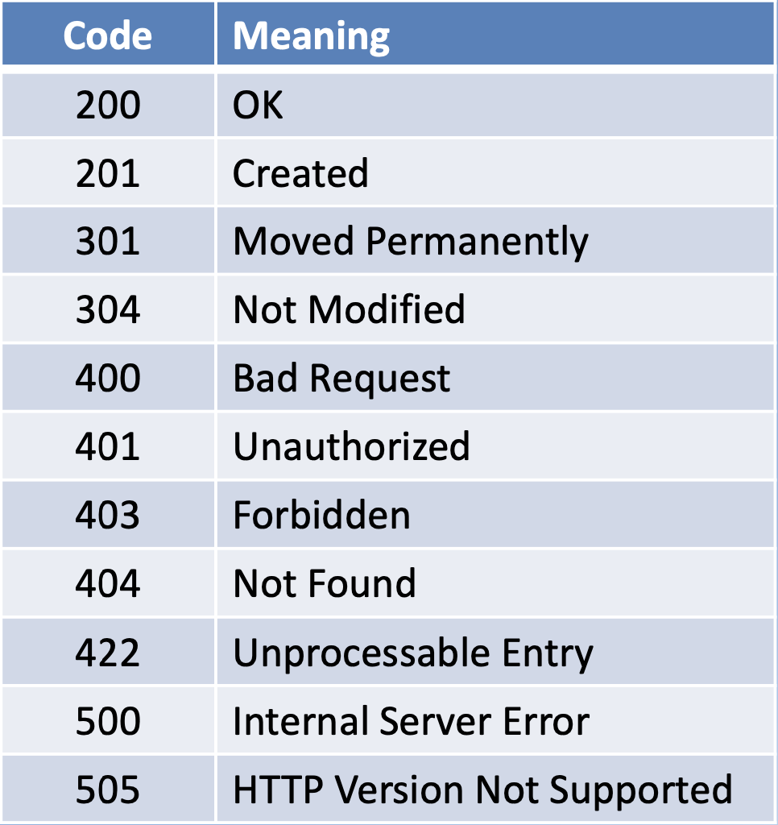
Status Codes

Slide 17
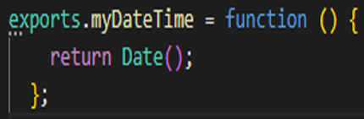

Node HTTP module
Using the module: const http = require('http');
Creating module:
Creating a server: const server = http.createServer(function(req, res){ . . . });
Starting the server: server.listen(port, . . . );
Install http: npm i http

Slide 18
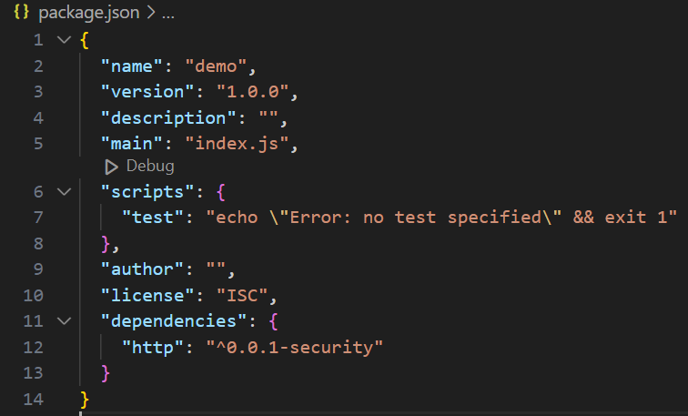
Node HTTP module – cont’d
//index.js
var http = require("http");
const hostname = "localhost";
const port = 3000;
http.createServer(function (request, response) {
//Send the Http header
console.log(request.headers);
//HTTP Status: 200 => OK
response.statusCode = 200;
//Content Type: text/plain
response.writeHead(200, { 'Content-Type': 'text/plain' });
//Send the response body as "Hello World"
response.end('Hello, World!\n');
}).listen(port);
//Console will print the message
console.log(`Server running at http://${hostname}:${port}/`);

Slide 19
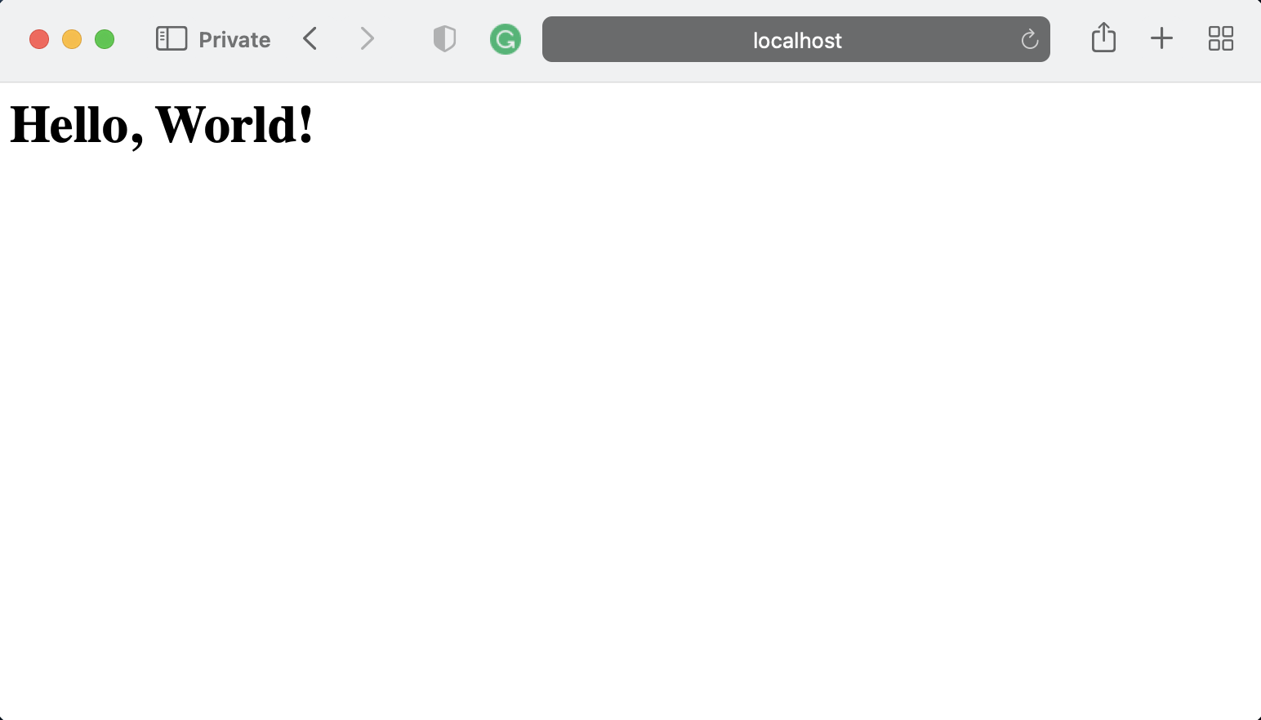
A Simple HTTP Server
Start the server by typing the following at the prompt:
node index.js
Then you can type http://localhost:3000 in your browser address bar and see the result.
Notes:
You can also use postman chrome extension to send requests to the server and see the response. Alternately, you can download the stand-alone Postman tool from http://getpostman.com and install it on your computer

Slide 20

What is POSTMAN?
Postman is a popular tool used for API testing. It helps developers to easily and efficiently send HTTP requests, view and analyze responses from APIs.
Postman can be used for purposes ranging from simple API testing to building and managing complex test chains.
Installation link here:
https://postman.com/downloads

Slide 21
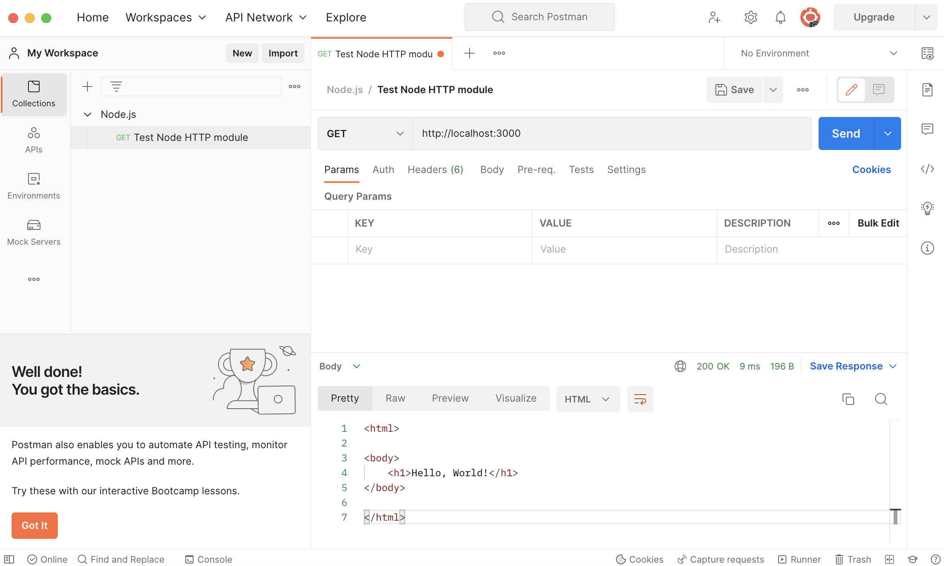
Using Postman to test HTTP Server

Slide 22
Implement a server that returns html files from a folder

Slide 23
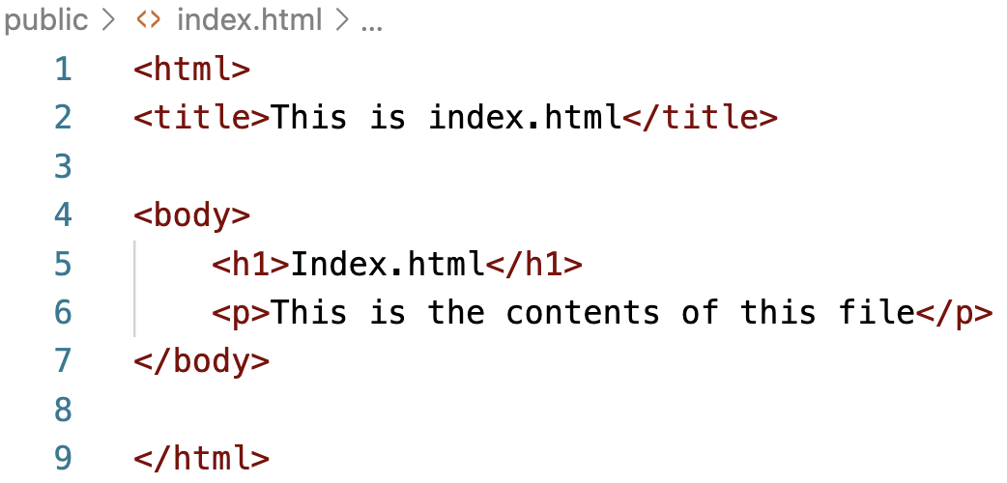
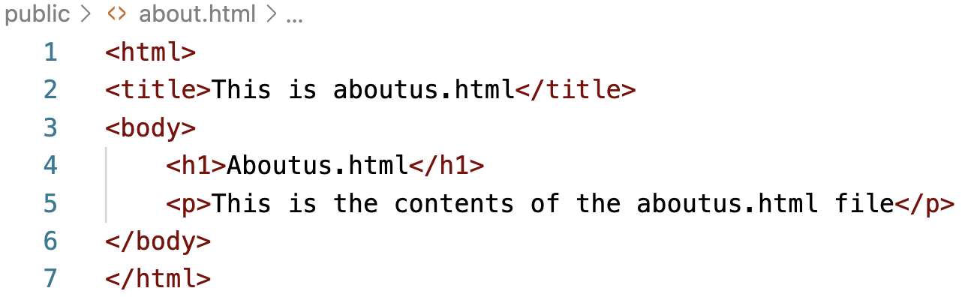
Serving HTML Files
In the public folder, create a file named index.html and add the following code to it:
Similarly create an aboutus.html file and add the following code to it:

Slide 24
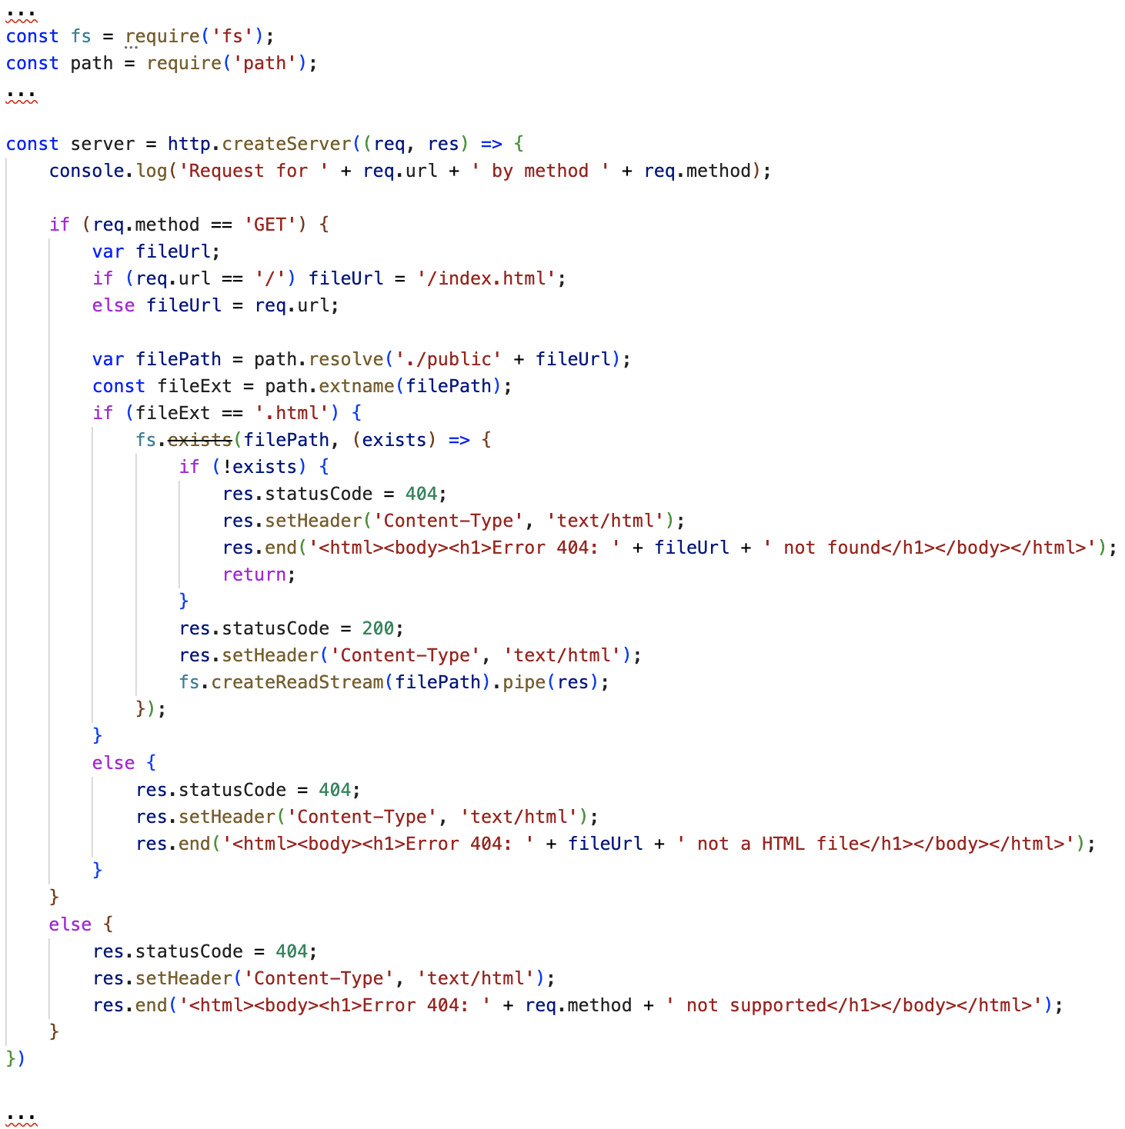
Serving HTML Files
Then update index.js as follows:

Slide 25
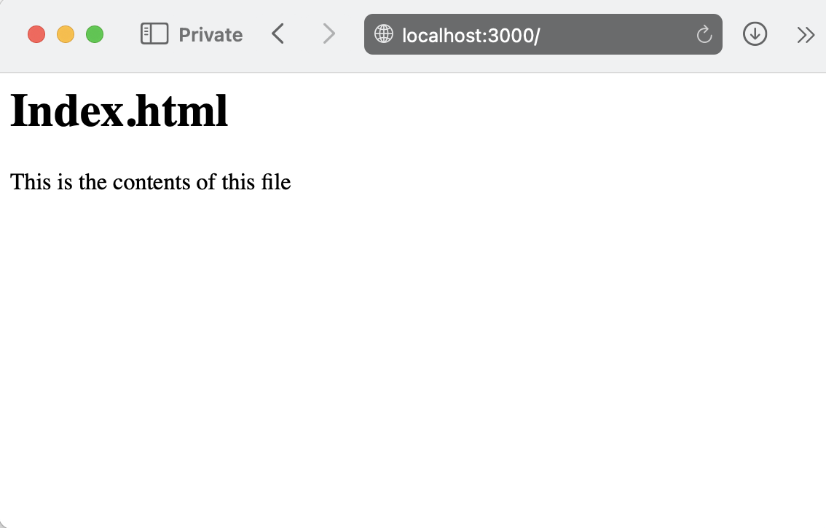
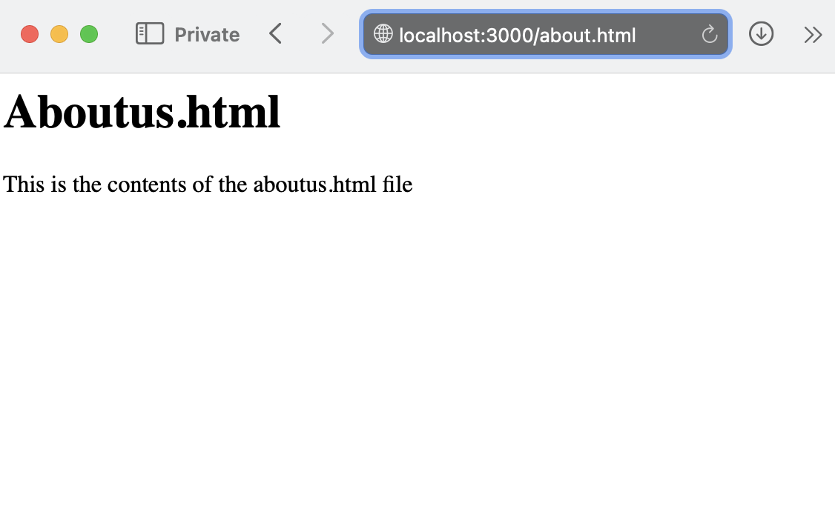
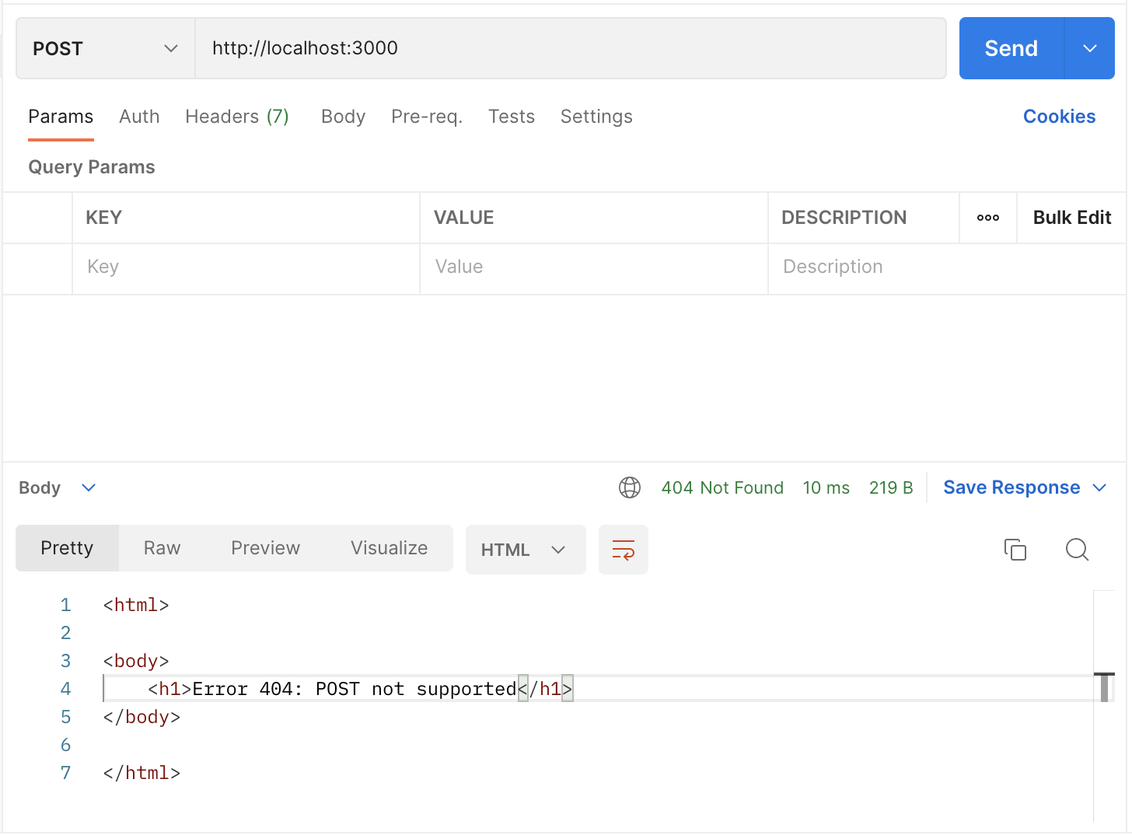
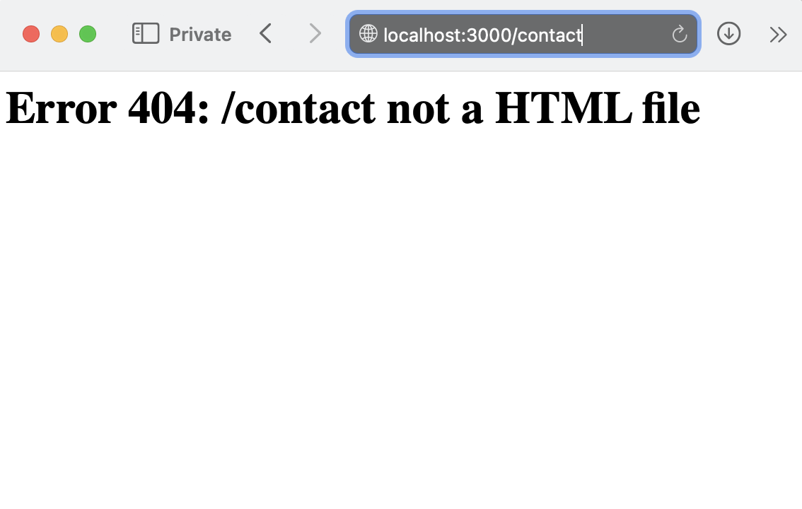
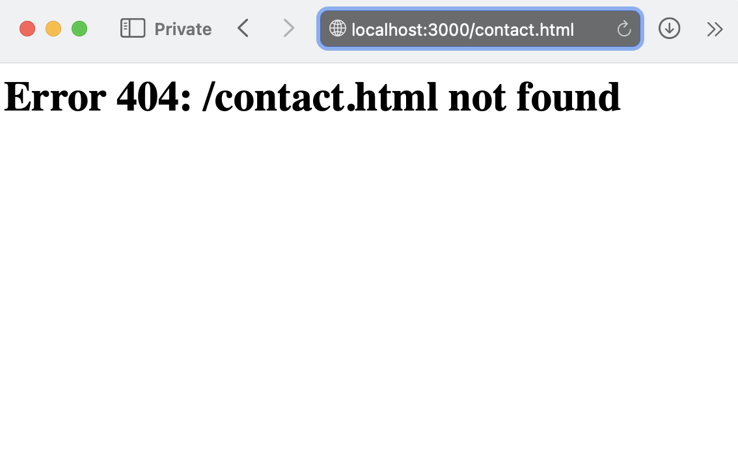
Start the HTTP Server

Slide 26
Exercise: Using HTTP in Node.js

Slide 27
How to Read and Write Files and Directories
The Node.js fs module enables us to work with the file system, which is one of the most fundamental tasks when writing programs.
Include:
Reading Files
Writing to a File

Slide 28

Reading Files
README.md is a markdown file that contains the text: Hello world.
index.js is the file that contains the Node.js code that we will execute.
const fs = require('fs')
// fs.readFile takes the file path and the callback
fs.readFile('README.md', (err, data) => {
// if there's an error, log it and return
if (err) {
console.error(err)
return
}
// Print the string representation of the data
console.log(data.toString())
})

Slide 29
Writing to a File
It will create a new file README.md and write Hello World to it. If the file already exists, then it will be overwritten.
const fs = require('fs')
fs.writeFile('README.md', 'Hello World', (err) => {
// If there is any error in writing to the file, return
if (err) {
console.error(err)
return
}
// Log this message if the file was written to successfully
console.log('wrote to file successfully')
})

Slide 30
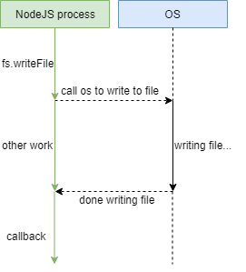
Asynchronous and Synchronous File System APIs
The APIs that we used in the previous example were asynchronous, which means they have a callback.

Slide 31
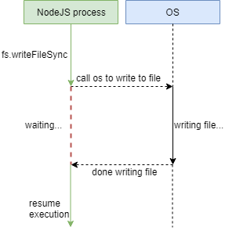
Asynchronous and Synchronous File System APIs – 2
The fs sync API, on the other hand, blocks the NodeJS process until the OS completes its task:

Slide 32
Asynchronous and Synchronous File System APIs – 3
The fs module still provides synchronous APIs, which you can use as follows:
Although they may look simpler to use, it’s generally recommended to use the async APIs for their better performance thanks to non-blocking I/O.
const fs = require('fs')
// The writeFileSync API takes the location of the file
// and the contents to be written to it
fs.writeFileSync('README.md', 'Hello Sync API!')
// The readFileSync API reads the file and returns a
// Buffer, whose `toString` method gives the string
// representation of the file
console.log(fs.readFileSync('README.md').toString())

Slide 33
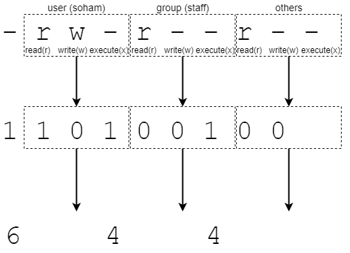
Changing File Permissions
Every file has permissions associated with them. These permissions determine who can read, write and execute a particular file on your system.
On linux systems, running ls -l will print information about the files and their permissions:

Slide 34
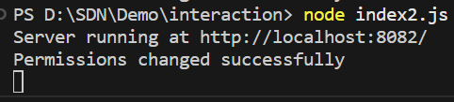
Changing File Permissions – cont’d
We can use the fs module to change the permission of README.md to add write access for the user group (664) :
const fs = require('fs')
fs.chmod('README.md', 0o644, (err) => {
if (err) {
console.error(err)
}
console.log('Permissions changed successfully');
})

Slide 35
Streaming Files
When we use the readFile and writeFile methods of the fs module, we treated the file as one chunk of data that we can read from or write to.
While this approach works for small files, it won’t scale for larger files. In this case, we need to think of each file as a stream of data, rather than a single large chunk.

Slide 36
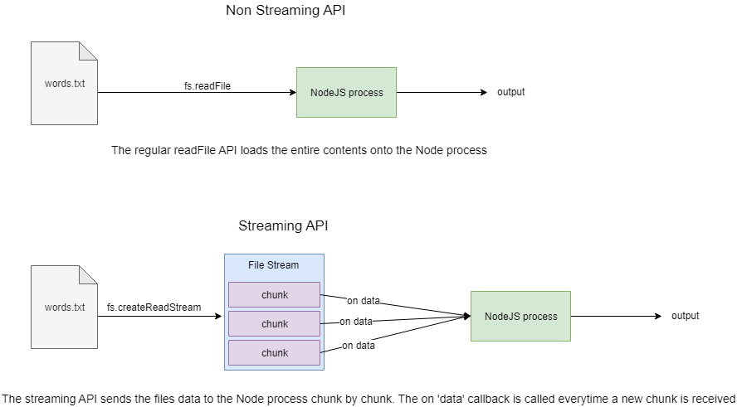
Streaming Files – cont’d
Data streams allow us to work with large data without compromising the limited memory or CPU of our system. The fs module allows us to make use of streams for this purpose.

Slide 37
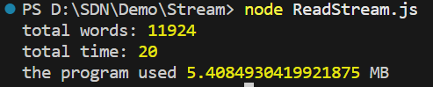
Read Stream
const fs = require('fs')
// Initialize the time at which the program started
const startTime = new Date()
// create a read stream from the `words.txt` file
const rStream = fs.createReadStream('words.txt')
// initialize total word count
let total = 0;
// the `on data` method registers a handler for everytime we
// receive new data from the file stream
rStream.on('data', b => {
// `b` here is the chunk of data received from the
// file stream
const bStr = b.toString()
// We split the string by spaces and new lines and add it to the
// total-- we subtract one because of the extra space/newline/broken word
// at the end of the chunk
// we shouldn't do this for the last chunk of data, which we handle later
total += bStr.split(/[\s\n]+/).length - 1
});
rStream.on('end', () => {
// Finally, the `on end` handler is called once the data stream completes
// we add one to the total, because we shouldn't subtract 1 from the last
// chunk of data in the `data` handler, for which we're compensating here
console.log('total words:', total + 1)
// Print the total time taken, as well as the total used program memory
console.log('total time:', (new Date()) - startTime)
const memoryUsedMb = process.memoryUsage().heapUsed / 1024 / 1024
console.log('the program used', memoryUsedMb, 'MB')
})
To illustrate how read streams work, let’s read a large text file (named words.txt) and count the total number of words in the file, using file streams:

Slide 38
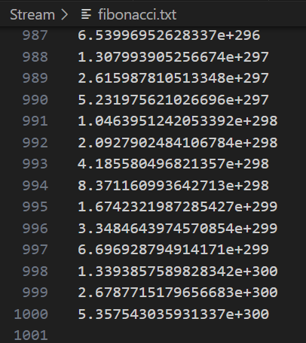
Write Streams
Write streams are like read streams but in the other directions. Similar to how read streams work, we open a write stream to a file, and write to it in chunks, ending the stream once we’re done.
Here’s an example of how we can use write streams to store the first thousand numbers in the Fibonacci sequence:

Slide 39
Write Streams – cont’d
// Iniitalize a writeStream to a a new file "fibonacci.txt"
const writeStream = fs.createWriteStream('fibonacci.txt')
// the on ready callback gets called once the file is available to write
writeStream.on('ready', () => {
// initialize a new object of the Fibonacci class
const f = new Fibonacci()
// For each iteration, obtain the next number in the sequence
// and write to the file, adding a newline each time
for (let i = 0; i < 1000; i++) {
const n = f.next()
writeStream.write(String(n) + '\n', err => {
// if there is any error in writing, log it
if (err) {
console.error('error writing:', err)
}
})
}
// The `end` method closes the write stream, once we're done
writeStream.end()
})
const fs = require('fs')
class Fibonacci {
// The Fibonacci class has the previous number and current
// number as its instance attributes
constructor() {
this.prev = 0
this.current = 1
}
// the next method returns the current value, and
// increments the current value by adding the past value to it
next() {
const current = this.current
this.prev = current
this.current = current + this.prev
return current
}
}

Slide 40
File System Interaction
Any programming language wil require interaction with the file system, which is both crucial and common.
To communicate with the file system, NodeJS comes with two built-in modules: fs and path.
The path module serves as a kind of aid module to obtain file paths, join paths, etc.
while the fs module serves as the primary module for interaction with the file system.

Slide 41
File System Interaction: File Server
You can interact with your computer’s file system using the Node.js file system module.
Use the require() function to incorporate the File System module.
See syntax below:
var fs = require('fs');

Slide 42
Demo about File System Interaction – File Server

Slide 43
Create a new folder and Install the fs module using the following command: npm i fs
Create a file fileServer.js and add the following code:
//fileServer.js
const fs = require('fs');
const createFile = async (filename) => {
try {
await fs.promises.writeFile(filename, 'Hello world!');
console.log(`File '${filename}' created successfully`);
}
catch (err) {
console.log(`Error creating file '${filename}':`, err);
}
};
const readFile = async (filename) => {
try {
const data = await fs.promises.readFile(filename, 'utf8');
console.log(`Content of file '${filename}':`, data);
}
catch (err) {
console.log(`Error reading file '${filename}':`, err);
}
};

Slide 44
Full code snippet with functions such as creating files, reading files, inserting content into files, deleting files
const appendFile = async (filename) => {
try {
await fs.promises.appendFile(filename, '\nThis is additional content');
console.log(`Content appended to file '${filename}' successfully`);
}
catch (err) {
console.log(`Error appending file '${filename}':`, err);
}
};
const deleteFile = async (filename) => {
try {
await fs.promises.unlink(filename);
console.log(`File '${filename}' deleted successfully`);
}
catch (err) {
console.log(`Error deleting file '${filename}':`, err);
}
};
module.exports = { createFile, readFile, appendFile, deleteFile };

Slide 45
Install the fs module using the following command: npm i http
Create a file index.js and add the following code
//index.js
var http = require("http");
const fs = require('fs');
const {readFile, createFile, appendToFile, deleteFile} = require('./fileServer');
const hostname = "localhost";
const port = 8082;
http.createServer(function (request, response) {
console.log(request.headers);
const filename = 'index.html';
createFile(filename);
appendToFile(filename);
readFile(filename)
.then((data)=>{
response.setHeader('Content-Type','text/html');
response.statusCode = 200;
fs.createReadStream(filename).pipe(response);
})
.catch((err)=>{
console.error(`Error reading file:`, err);
response.statusCode = 500;
response.end('Internal Server Error');
});
deleteFile(filename);
}).listen(port);
console.log(`Server running at http://${hostname}:${port}/`);
Notes:
Node index.js

Slide 46
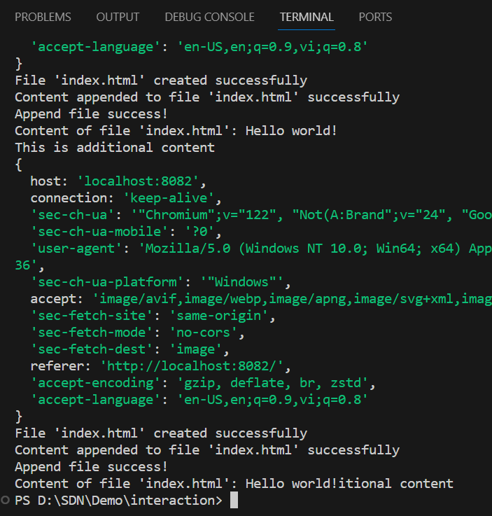
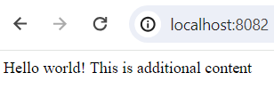
Open terminal and run the following command to launch the web service
node index.js
The results of the program are below:

Slide 47
File System Interaction: File Path
Relative paths, absolute paths, resolving file paths by supplying file names, connecting file paths, etc. are all aspects of managing the file system.
Provides helpful methods for working with file paths
__dirname: Represents the absolute path of the current script file's directory.
__filename: Represents the absolute path of the current script file.
path.extname(): check the extension of a file path

Slide 48
Demo about File System Interaction – File Path

Slide 49
//index.js
var http = require("http");
const path = require('path');
const fs = require('fs');
const { readFile } = require('./fileServer');
const hostname = "localhost";
const port = 8082;
http.createServer(function (request, response) {
console.log(request.headers);
if (request.method == 'GET') {
var fileUrl;
if (request.url == '/') fileUrl = 'index.html';
else fileUrl = request.url;
var filePath = path.resolve('./' + fileUrl);
const fileExt = path.extname(filePath);
if (fileExt == '.html') {
readFile(filePath)
.then((data) => {
response.setHeader('Content-Type', 'text/html');
response.statusCode = 200;
console.log(`file:` + data);
response.end(data);
})
.catch((err) => {
console.error(`Error reading file:`, err);
response.statusCode = 500;
response.end('Internal Server Error');
});
}
else {
response.statusCode = 404;
response.setHeader('Content-Type', 'text/html');
response.end('Internal Server Error');
}
}
}).listen(port);
console.log(`Server running at http://${hostname}:${port}/`);
Reuse fileServer.js for the filePath example below.
Full code snippet:

Slide 50
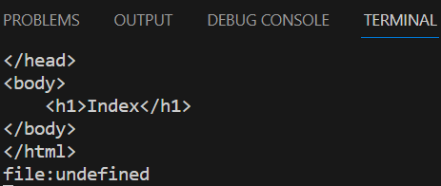
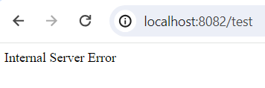
Open terminal and run the following command to launch the web service
node index.js
The results of the program are below:

Slide 51
Exercise: Building a Simple REST API with Node.js

Slide 52
Summary
Concepts were introduced:
Introduction to Http, include: Http Request and Http Response
What are HTTP Methods?
What is/ How to use Node Http Modules
How to Read and Write Files and Directories?
Introduction to File System Interaction
Demo about File System Interaction: File Server and File Path

