Slide 1
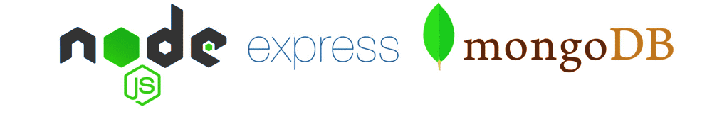
Express JS

Slide 2
Objectives
Introduction to Express
Using Express Js To Create Your First Application
Restful Routing With Express
Understand And Use Middleware For Node Applications
Types Of Middleware In Node.Js
Writing Express Middleware
Receiving an HTTP Request with Express
Introduction to Express-Generator

Slide 3
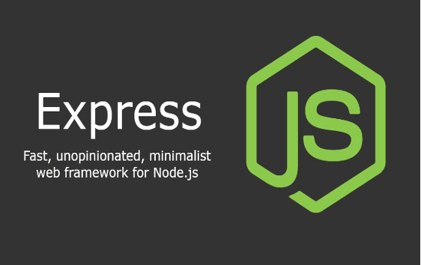
What is Express JS?
The Back-end web application framework for Node.js.
It is made as free and open-source software under the MIT License.
It is made for creating APIs and online applications.
Express: Fast, unopinionated, minimalist web framework for Node.js (from expressjs.com)
Web application framework that provides a robust set of features
Many third-party middleware to extend functionality
It offers a variety of features for creating both web and mobile applications.

Slide 4
Why is Express JS?
Express was developed to simplify the creation of APIs and web apps while cutting the amount of coding effort required virtually in half.
Express is used by many new developers to enter the area of web development with simplicity because it is written in JavaScript, which is an easy language to learn even if you have no prior experience with any language.
The reason behind creating an express framework for node js is:
Time-efficient
Fast
Economical
Simple to learn
Asynchronous

Slide 5
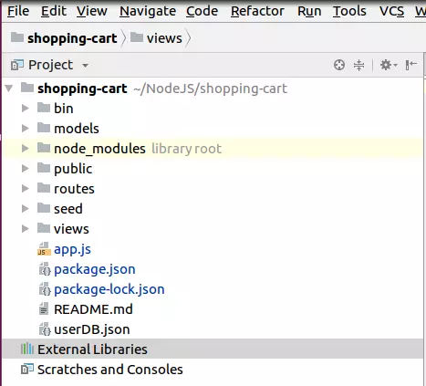
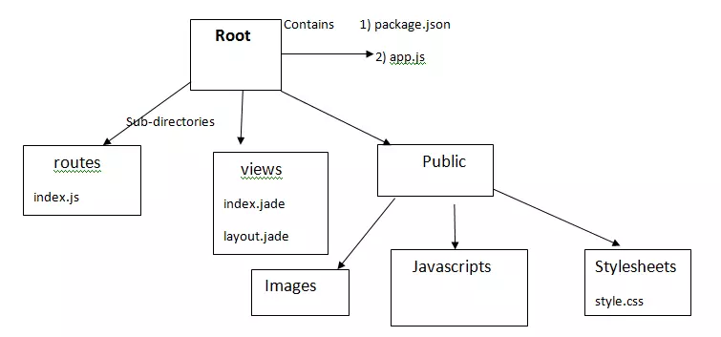
Structure of ExpressJS
Notes:
app.js contains information about configuration, declarations, definitions,... so that our application runs ok.
package.json contains the packages for the application to run.
Folder routes: contains routes in the application.
Folder view: contains view/template for the application.
The public folder contains css, js, images,... files for the application.

Slide 6
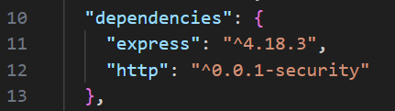
Install Express JS
Run the following command in terminal or command prompt:
npm install -g express
Using save wil add the express.js dependency to the package.json file
npm install express --save

Slide 7
Express Middleware
Middleware provide a lot of plug-in functionality that can be used within your Express application
Example: morgan for logging
var morgan = require(‘morgan’);
app.use(morgan(‘dev’));
Serving static web resources:
app.use(express.static(__dirname + ‘/public’));
Note:__filename and__dirname give you the full path to the file and directory for the current module

Slide 8
A Brief Tour of a Node Module
Examine package.json file
Semantic Versioning
<Major Version>.<Minor Version>.<Patch>
npm install can specify the acceptable package version:
Exact: npm install express@4.x.x
Patch acceptable: npm install express@“~4.x.x”
Minor version acceptable: npm install express@“^4.x.x”

Slide 9

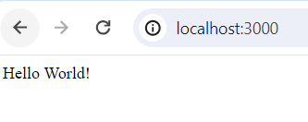
Using Express JS to create your first program
Create a new file in your project, for example app.js, and add the following code to set up a basic server using Express:
const express = require('express');
const app = express();
const port = 3000;
app.get('/', (req, res) => {
res.send('Hello World!');
});
app.listen(port, () => {
console.log(`Example app listening at http://localhost:${port}`);
});

Slide 10
What is Routes?
The application's response to a client request for a specific endpoint is determined by routing
An HTTP GET, POST, PUT, or DELETE request can be made by a client, for instance, for any of the URLs listed below.
http://localhost:3000/Hello
When a route is matched, one or more handler functions for that route are called.
The general syntax for a route is shown below:
app.METHOD(PATH, HANDLER)
app: Refers to an instance of the Express application.
METHOD: Represents an HTTP method such as GET, POST, PUT, DELETE, etc.
PATH: Specifies the URL path or route for which the handler function will be invoked.
HANDLER: Refers to the function that will be executed when the specified HTTP method and path match an incoming request.
app.get('/Hello', (req, res) => {
res.send('Hello, World!');
});

Slide 11
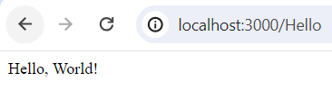
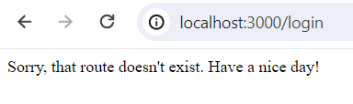

Creating Node and Express-Based Servers
const express = require('express');
const app = express();
const port = 3000;
app.get('/', (req, res) => {
res.send('<b>My First</b> Express http server');
});
app.get('/Hello', (req, res) => {
res.send('Hello, World!');
});
//Change the 404 message modifing the middleware
app.use(function(req, res, next){
res.status(404).send("Sorry, that route doesn't exist. Have a nice day!");
});
app.listen(port, () => {
console.log(`Example app listening at http://localhost:${port}`);
});

Slide 12
Restful Routing with Express
Express's routing is simple, flexible, and reliable.
Requests that are sent to the code that handles them using a URL and an HTTP method are routed using a system called routing.
A route must accomplish the following to be fully restful:
Isolate the client and server.
Avoid keeping state between requests (i.e. all information necessary to respond to a request is available in each request: no data or state, is held by the server from request to request).
Employ HTTP and HTTP techniques. Be dependable (for e.g most APIs follow the restful route pattern when specifying the process for authentication and important URLs).

Slide 13
Express Application Routes
We examined REST in the previous lecture
Identify an end point with a URI
Apply the verb on the URI
Express supports this through app.all, app.get, app.post, app.put, app.delete methods

Slide 14
Express Application Routes
Application Routes: app.all(‘/articles’, function(req,res,next) { . . . });
app.get(‘/articles’, function(req,res,next) { . . . }); app.post(‘/articles’, function(req,res,next) { . . . }); app.put(‘/articles’, function(req,res,next) { . . . }); app.delete(‘/articles’, function(req,res,next) { . . . });

Slide 15
Routes with Parameters
Example: app.get(‘/articles/:Id’, (req,res,next) => {
res.end(‘Will send details of the dish: ’ + req.params.Id + ‘ to you!’)
});

Slide 16
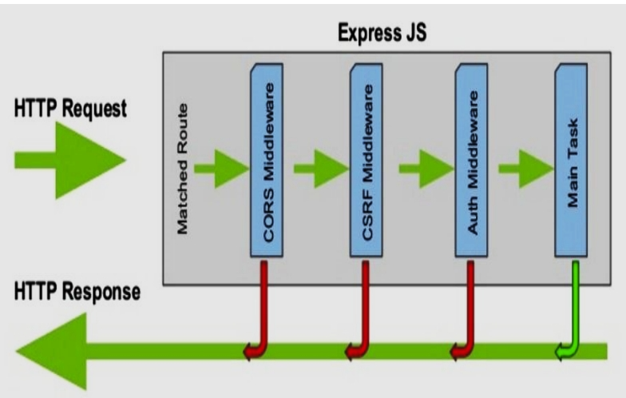
Middleware for Node Applications
A layer of abstraction known as middleware serves as a bridge between the various software levels.
Any piece of middleware has access to every HTTP request and can respond to any path to which it is connected.
Middleware functions can perform the following tasks:
Execute any code.
Modify the objects representing the request and the response.
Stop the cycle of requests and answers.
Invoke the following middleware on the stack.
Way to utilize middleware
app.use(middlewareFunction);

Slide 17
Types Of Middleware In Node.Js
Application-level middleware
Router-level middleware
Build-in middleware
Error-handling middleware
Third-party middleware

Slide 18
Writing Express Middleware
You need specific pre-installed components to generate, use, and test the Express middleware.
Install Node and NPM: npm -v && node –v
Creating middleware Installing
Node.js is a must for developing middleware in the language. Additionally, an Express.js application needs to be set up.
There are four critical actions to take:
Structuring
Modifying the req object
Modifying the res object
Ending the cycle

Slide 19
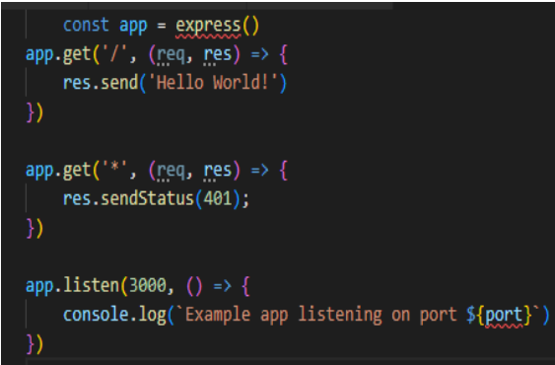
Receiving an HTTP Request with Express
Express provides a simple API for building web servers. I won't go into the particulars of the API here. Instead, I'll give you an example of how Express uses HTTP requests and answers.

Slide 20
Demo about these Routes and Middleware would be described for a article page

Slide 21
Table corresponding to HTTP methods
Name | Path | HTTP Verb / method | Reason/purpose
index | /articles | GET | Lists all article
new | /articles/new | GET | Shows new form for new article entry
create | /articles | POST | Creates a new blog post
show | /articles/:ID | GET | Shows the article post with the given id
edit | /articles/:id/edit | GET | Edit the blog post with the given ID
update | /articles/:id | PUT | Update the article post with the given id
destroy | /articles/:id | DELETE | Delete the blog post with the given id

Slide 22
In the main application file (app.js), add the following code:
Start the server by running the node app.js command
//app.js
var express = require('express');
const app = express();
const port = 3000;
//Process data here
app.listen(port, () => {
console.log(`Example app listening at http://localhost:${port}`);
});
module.exports = app;
Notes:
Express 4.x and later, using body-parser is no longer required as Express has built-in much of the body-parser functionality via express.json() and express.urlencoded()

Slide 23
Define JSON data by creating an articles.js file with the content below:
//articles.js
const article = [
{
title: "My Favorite Vacation",
date: "2024-03-03",
text: "We spent seven days in Italy..."
}
];
module.exports = article;

Slide 24
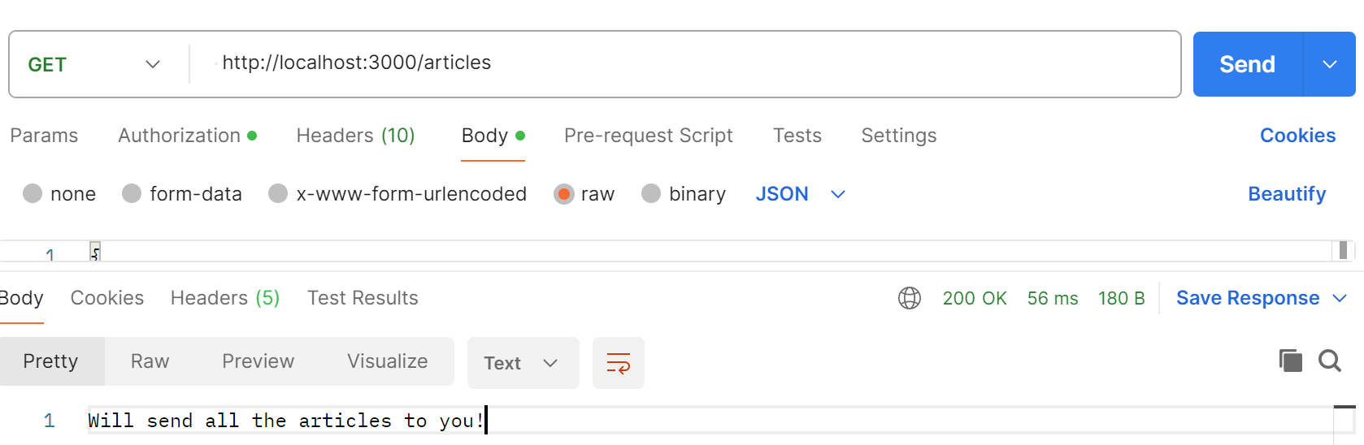
//Import data from articles.js
const articles = require('./articles’);
Import data from articles.js
Create a route to return JSON data
//GET all articles
app.get('/articles', async (req, res) => {
try {
res.status(200).end('Will send all the articles to you!');
} catch (err) {
res.status(500).json({ message: err.message });
}
});

Slide 25
To extend the API you are building with Express by adding POST, PUT, and DELETE methods, you need to implement processing logic for each method accordingly.
Before you can process POST or PUT requests, you need to install middleware to parse the data sent from the client.
// For parsing application/json
app.use(express.json());
// For parsing application/x-www-form-urlencoded
app.use(express.urlencoded({ extended: true }));

Slide 26
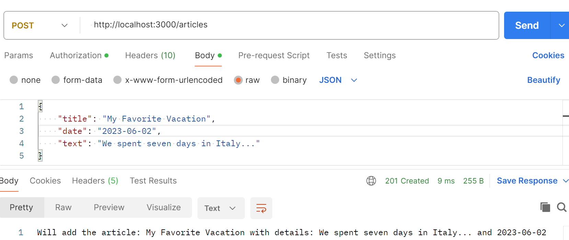
Add a new post (POST)
// POST a new article
app.post('/articles', async (req, res) => {
try {
res.status(201).end('Will add the article: ' + req.body.title + ' with details: ' + req.body.text + ' and ' + req.body.date);
} catch (err) {
res.status(400).json({ message: err.message });
}
});
Notes:
app.post('/articles', (req, res) => {
// Create a new post from the data in req.body
const newArticle = {
id: articles.length + 1, // This is simply an example and is not safe in a production environment
title: req.body.title,
date: req.body.date,
text: req.body.text
};
articles.push(newArticle);
res.status(201).json(newArticle);
});

Slide 27
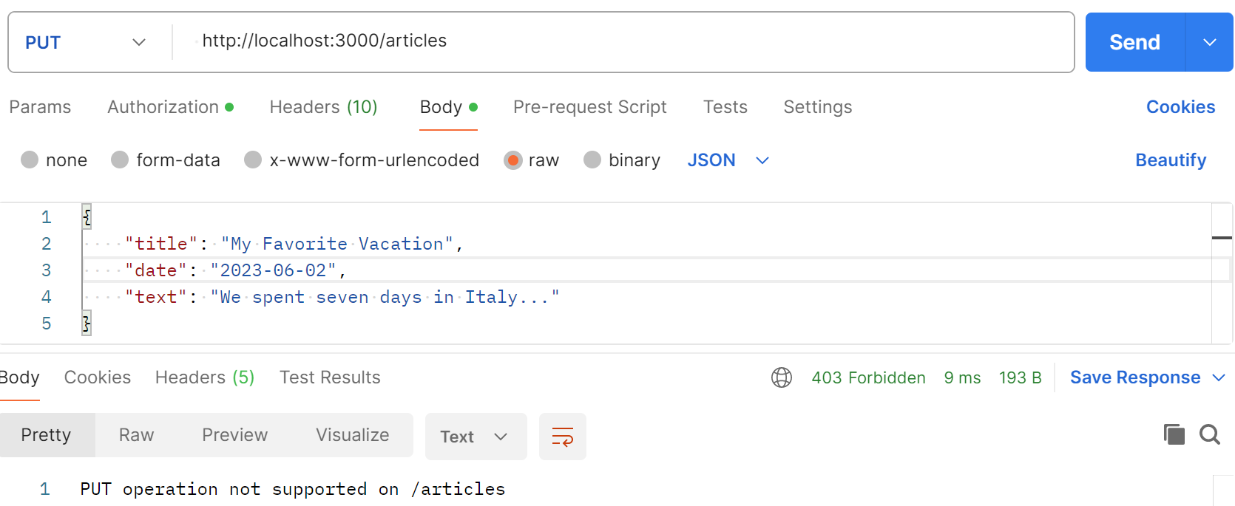
Update a post (PUT)
// PUT a new article
app.put('/articles', async (req, res) => {
try {
res.status(403).end('PUT operation not supported on /articles');
} catch (err) {
res.status(400).json({ message: err.message });
}
});
Notes:
app.put('/articles/:id', (req, res) => {
// Find the article's index in the array
const index = articles.findIndex(article => article.id === parseInt(req.params.id));
if (index === -1) return res.status(404).send('Article not found');
// Updated article with new data from req.body
articles[index] = {
...articles[index],
...req.body
};
res.json(articles[index]);
});

Slide 28
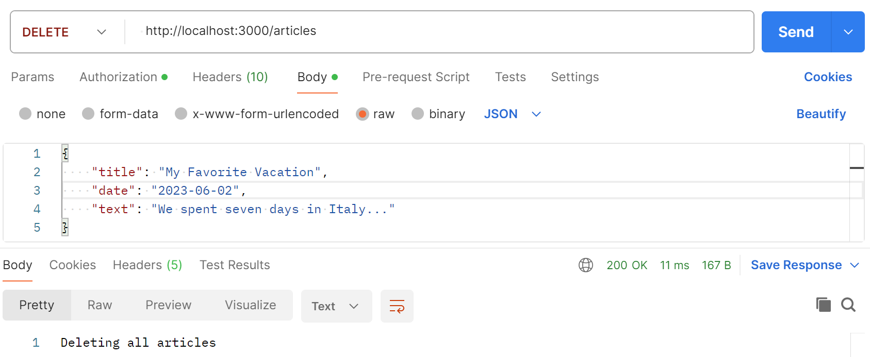
Delete a post (DELETE)
// DELETE all articles
app.delete('/articles', async (req, res) => {
try {
res.status(200).end('Deleting all articles');
} catch (err) {
res.status(400).json({ message: err.message });
}
});
Notes:
app.delete('/article/:id', (req, res) => {
const index = articles.findIndex(article => article.id === parseInt(req.params.id));
if (index === -1) return res.status(404).send('Article not found');
// Remove posts from the array
const deletedArticle = articles.splice(index, 1);
res.status(204).json(deletedArticle);
});

Slide 29
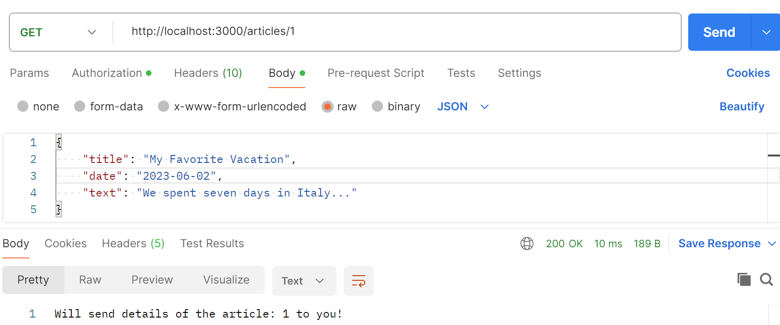
GET a specific article
// GET a specific article
app.get('/articles/:id', async (req, res) => {
try {
res.status(200).end('Will send details of the article: ' + req.params.id + ' to you!');
} catch (err) {
res.status(500).json({ message: err.message });
}
});
Notes:
app.delete('/article/:id', (req, res) => {
const index = articles.findIndex(article => article.id === parseInt(req.params.id));
if (index === -1) return res.status(404).send('Article not found');
// Remove posts from the array
const deletedArticle = articles.splice(index, 1);
res.status(204).json(deletedArticle);
});

Slide 30
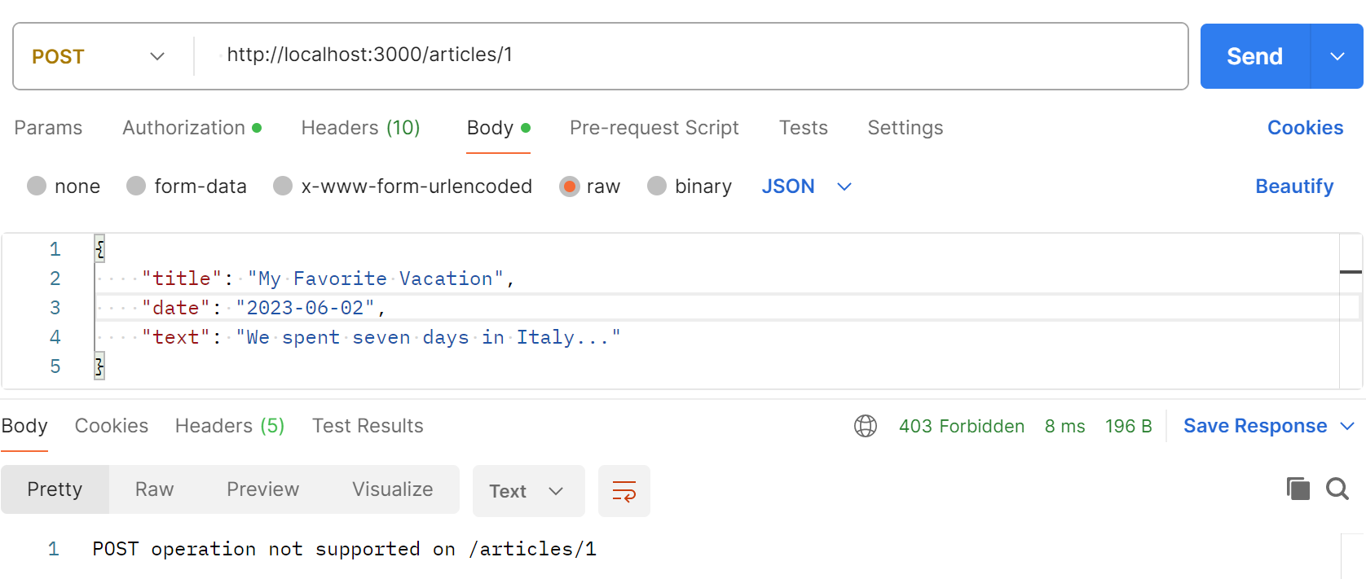
POST a specific article
// POST a specific article
app.post('/articles/:id', async (req, res) => {
try {
res.status(403).end('POST operation not supported on /articles/' + req.params.id);
} catch (err) {
res.status(400).json({ message: err.message });
}
});
Notes:
app.delete('/article/:id', (req, res) => {
const index = articles.findIndex(article => article.id === parseInt(req.params.id));
if (index === -1) return res.status(404).send('Article not found');
// Remove posts from the array
const deletedArticle = articles.splice(index, 1);
res.status(204).json(deletedArticle);
});

Slide 31
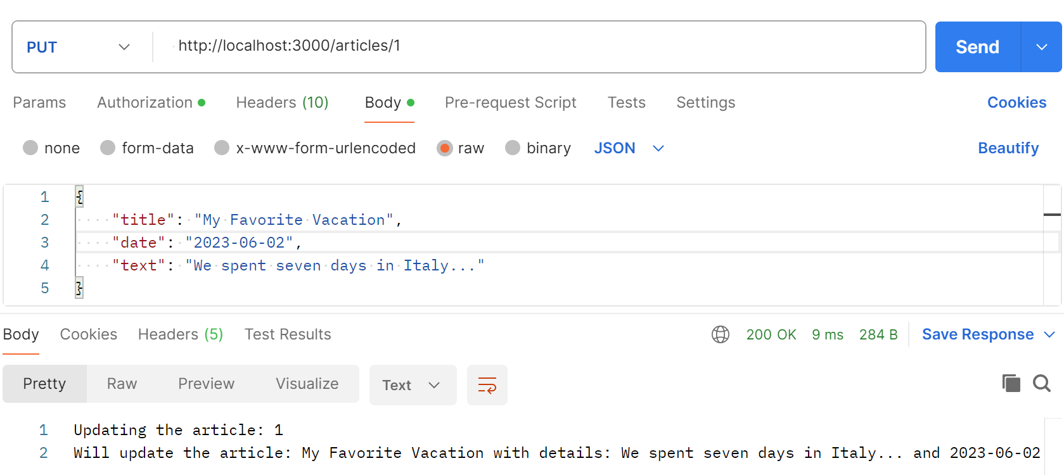
PUT a specific article
// PUT a specific article
app.put('/articles/:id', async (req, res) => {
try {
res.write('Updating the article: ' + req.params.id + '\n');
res.status(201).end('Will update the article: ' + req.body.title + ' with details: ' + req.body.text + ' and ' + req.body.date);
} catch (err) {
res.status(400).json({ message: err.message });
}
});
Notes:
app.delete('/article/:id', (req, res) => {
const index = articles.findIndex(article => article.id === parseInt(req.params.id));
if (index === -1) return res.status(404).send('Article not found');
// Remove posts from the array
const deletedArticle = articles.splice(index, 1);
res.status(204).json(deletedArticle);
});

Slide 32
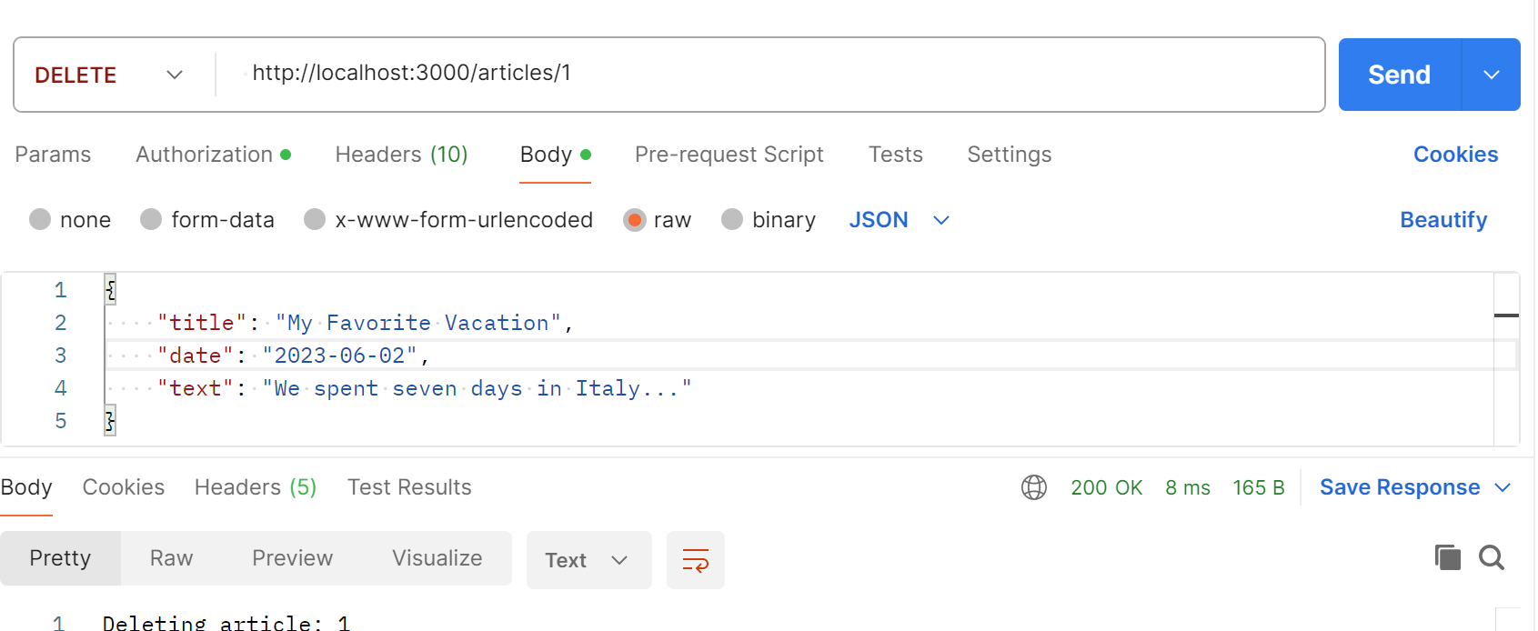
DELETE a specific article
// DELETE a specific article
app.delete('/articles/:id', async (req, res) => {
try {
res.status(200).end('Deleting article: ' + req.params.id);
} catch (err) {
res.status(500).json({ message: err.message });
}
});
Notes:
app.delete('/article/:id', (req, res) => {
const index = articles.findIndex(article => article.id === parseInt(req.params.id));
if (index === -1) return res.status(404).send('Article not found');
// Remove posts from the array
const deletedArticle = articles.splice(index, 1);
res.status(204).json(deletedArticle);
});

Slide 33
Exercise: Creating a simple server with Express framework

Slide 34
Exercise 6, 7: Create Routes in Express JS (consists of 2 parts)

Slide 35
What is Express Generator?
It is a command-line tool that helps you quickly generate the basic structure and files for an Express.js application.
It sets up a project skeleton with the necessary files and folders, allowing you to focus on building your application's features instead of setting up the initial boilerplate code.

Slide 36
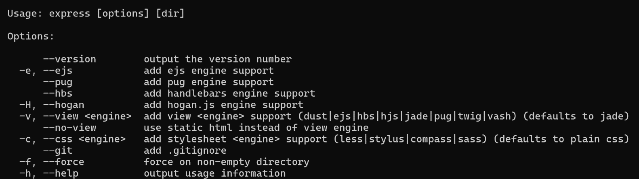
Express application generator
Use the application generator tool, express-generator, to quickly create an application skeleton.
npm i -g express-generator
Display the command options with the -h option:
express -h

Slide 37
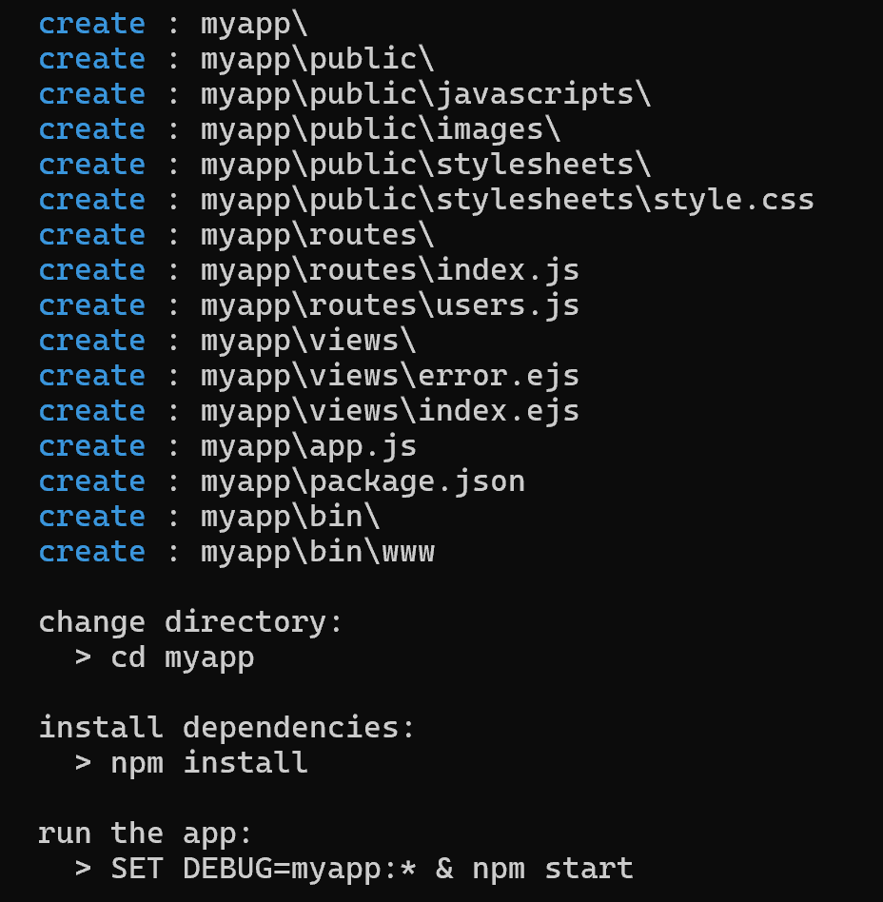
Express application generator - 2
For example, the following creates an Express app named myapp. The app will be created in a folder named myapp in the current working directory and the view engine will be set to EJB.
express --view=pug myapp

Slide 38
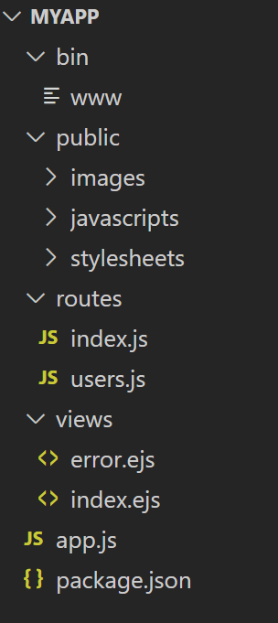
Express application generator - 3
The generated app has the following directory structure:
Then install dependencies:
npm install
set DEBUG=myapp:*
npm start

Slide 39
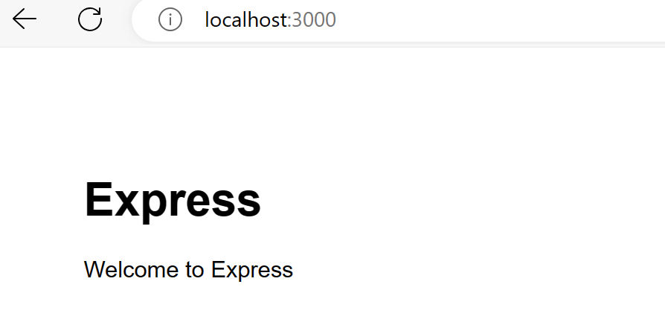
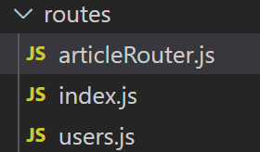
Express application generator - 4
Then load http://localhost:3000/ in your browser to access the app.
From demo myapp, create new file articleRouter.js in routes folder

Slide 40
Express application generator - 5
const express = require('express');
const articleRouter = express.Router();//Routers allow you to route requests to specific handles based on URL and HTTP method (GET, POST, etc.)
articleRouter.use(express.json());//Middleware express.json() is used here to automatically parse JSON request bodies into JavaScript objects
articleRouter.use(express.urlencoded({ extended: true }));//This middleware is used to parse URL-encoded request bodies. The extended: true parameter allows objects and arrays to be encoded in the URL. This is useful when you need to process data from HTML forms.
articleRouter.route('/')//creates a new route object and allows defining handles for a specific path (in this case the router's root path '/').

Slide 41
Express application generator - 6
//Get all article
.get(async (req, res) => {
try {
res.status(200).end('Will send all the articles to you!');
} catch (err) {
res.status(500).json({ message: err.message });
}
})

Slide 42
Express application generator - 7
// POST a new article
.post(async (req, res) => {
try {
res.status(201).json('Will add the article: ' + req.body.title +
' with details: ' + req.body.text + ' and ' + req.body.date);
} catch (err) {
res.status(400).json({ message: err.message });
}
})

Slide 43
Express application generator - 8
// PUT a new article
.put(async (req, res) => {
try {
res.status(403).json('PUT operation not supported on /articles');
} catch (err) {
res.status(400).json({ message: err.message });
}
})

Slide 44
Express application generator - 9
// DELETE all articles
.delete(async (req, res) => {
try {
res.status(200).json('Deleting all articles');
} catch (err) {
res.status(400).json({ message: err.message });
}
})

Slide 45
Express application generator - 10
articleRouter.route('/:id')//This allows you to handle HTTP requests to URLs that contain a dynamic value in that part of the path
// GET a specific article
.get(async (req, res) => {
try {
res.status(200).end('Will send details of the article: ' + req.params.id + ' to you!');
} catch (err) {
res.status(500).json({ message: err.message });
}
})
// POST a specific article
.post(async (req, res) => {
try {
res.status(403).end('POST operation not supported on /articles/' + req.params.id);
} catch (err) {
res.status(400).json({ message: err.message });
}
})

Slide 46
Express application generator - 11

Slide 47
Express application generator - 12
// PUT a new article
.put(async (req, res) => {
try {
res.write('Updating the article: ' + req.params.id + '\n');
res.status(201).end('Will update the article: ' + req.body.title + ' with details: ' + req.body.text + ' and ' + req.body.date);
} catch (err) {
res.status(400).json({ message: err.message });
}
})
// DELETE an article
.delete(async (req, res) => {
try {
res.status(200).end('Deleting article: ' + req.params.id);
} catch (err) {
res.status(500).json({ message: err.message });
}
});
module.exports = articleRouter;

Slide 48
Express application generator - 13

Slide 49
Exercise: Handling errors

Slide 50
Exercise: Custom middleware

Slide 51
Summary
Concepts were introduced:
Introduction to Express
Using Express Js To Create Your First Application
Restful Routing With Express
Understand And Use Middleware For Node Applications
Types Of Middleware In Node.Js
Writing Express Middleware
Receiving an HTTP Request with Express
Introduction to Express-Generator

