Slide 1

NOSQL Database with MongoDB

Slide 2
Objectives
What is Serialization?
Introduction to NoSQL Database
Introduction to MongoDB
How to use MongoDB Shell and MongoDB Compass?
How to use CRUD Operations in MongoDB?
How to use Mapping Relationships?

Slide 3
Databases
Databases are used to store structured information
Databases support various operations on the data
– Query
– Insert
– Update
– Delete

Slide 4
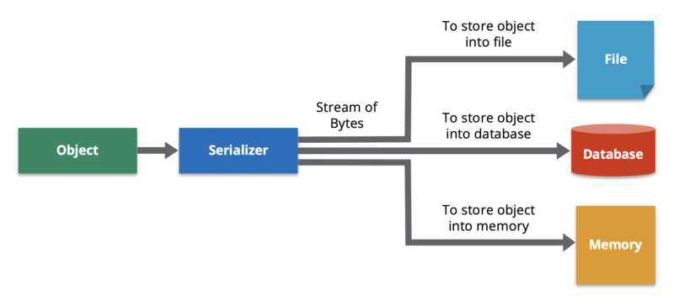
What is Serialization?
Serialization is the process of converting a data object—a combination of code and data represented within a region of data storage—into a series of bytes that saves the state of the object in an easily transmittable form.
Data serialization is the process of converting an object into a stream of bytes to more easily save or transmit it.

Slide 5
Why is Data Serialization Important for Distributed Systems?
In some distributed systems, data and its replicas are stored in different partitions on multiple cluster members. If data is not present on the local member, the system will retrieve that data from another member. This requires serialization for use cases such as:
Adding key/value objects to a map
Putting items into a queue, set, or list
Sending a lambda function to another server
Processing an entry within a map
Locking an object
Sending a message to a topic

Slide 6
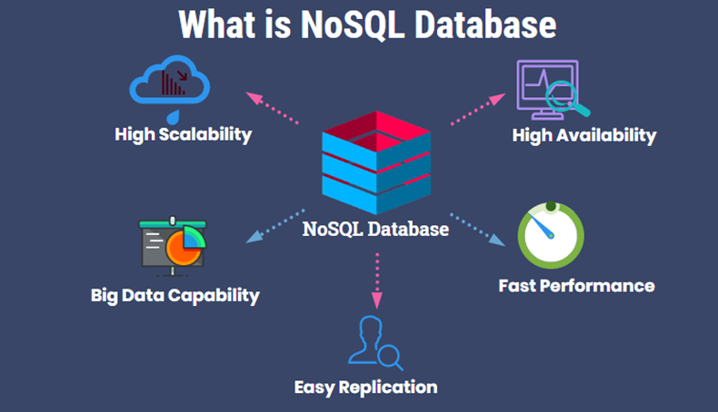
What is NoSQL Database?
No use a relational data modeling technique
High efficiency and speed in terms of creating up to millions of queries a second
Horizontally scalable

Slide 7
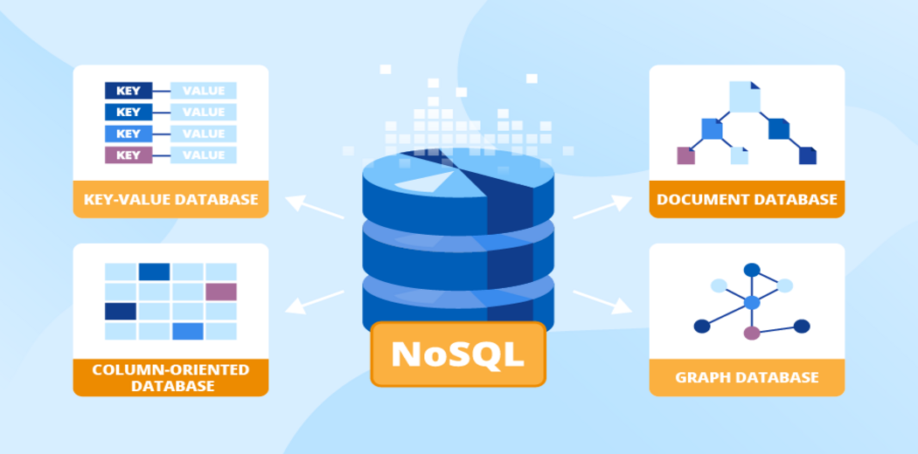
Four Types of NoSQL Databases

Slide 8
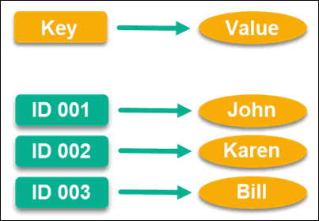
Key-Value Store
Key-value stores use key values with pointers to store data
This pointer is unique and links directly to a piece of information, which can be anything you’d like it to be.

Slide 9
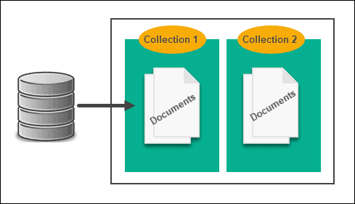
Document-Based Store
All data is stored in one table, so there’s no need for cross-referencing and instead of storing information in a table, it’s stored in a document.

Slide 10
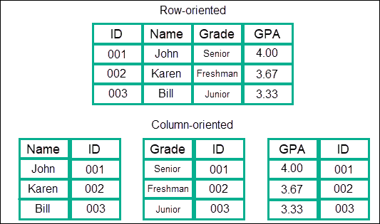
Column-Based Store
Data is stored in columns, which are grouped into families, and these families are further grouped into more columns.

Slide 11
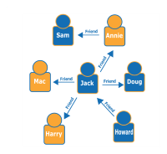
Graph-Based Store
Graph or network data models essentially treat the relationship between any two pieces of information as being just as important as the information itself.

Slide 12
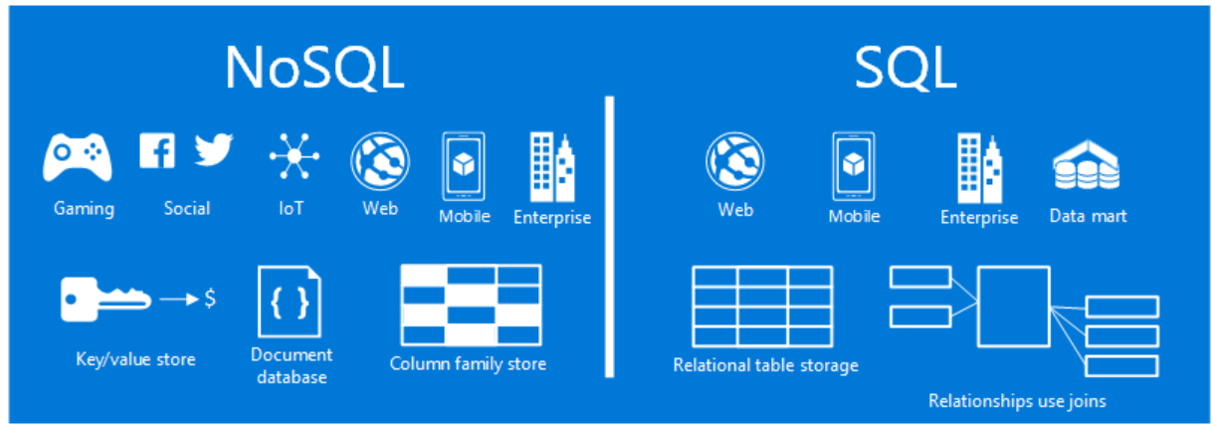
Difference between SQL and NoSQL databases

Slide 13
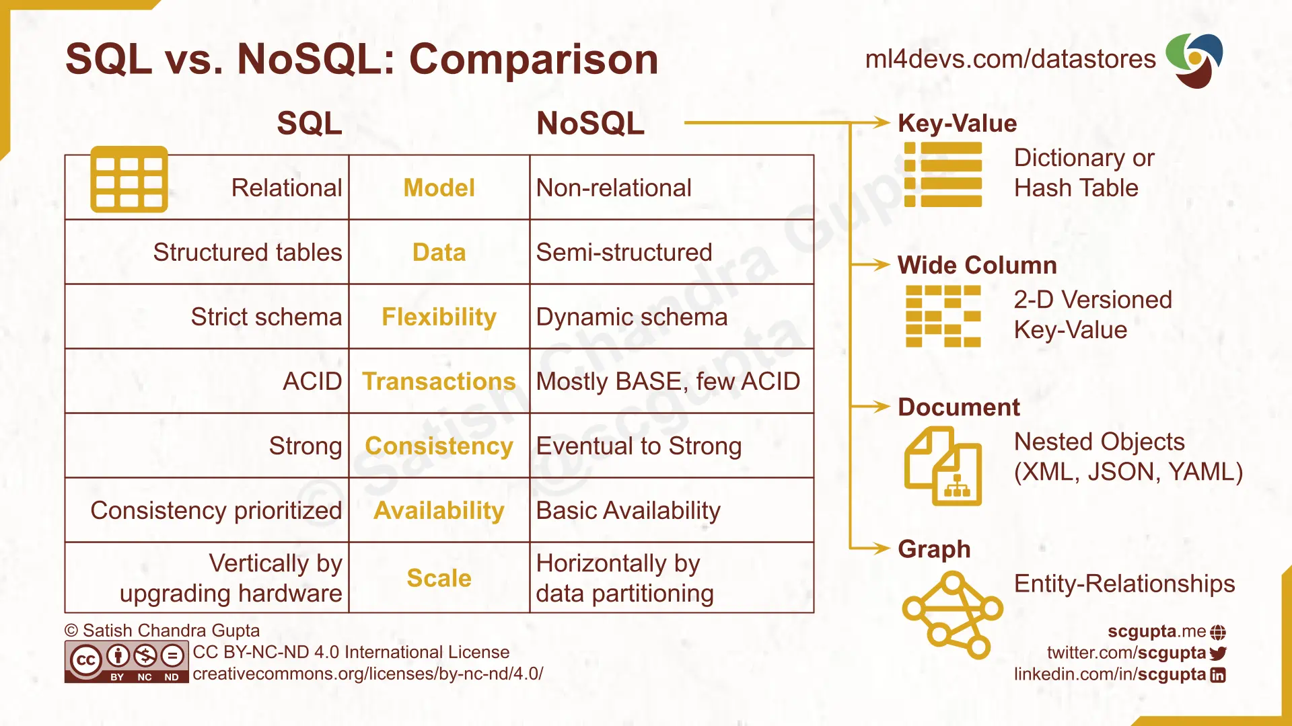
Difference between SQL and NoSQL databases - 2

Slide 14
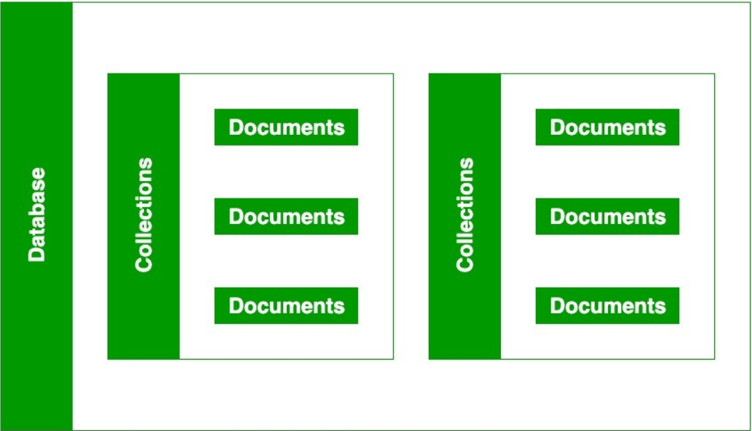
MongoDB – Database, Collection, and Document
There are important parts of MongoDB without them you are not able to store data on the MongoDB server.
A Database contains a collection, and a collection contains documents and the documents contain data, they are related to each other.

Slide 15
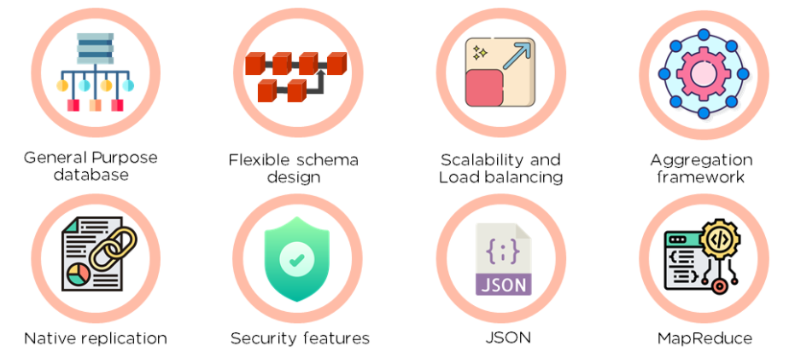
Document Database (MongoDB)
MongoDB is a document database
A document is a type of data structure made up of pairs of fields and values
Document: A self-contained piece of information
E.g., a JSON document:

Slide 16
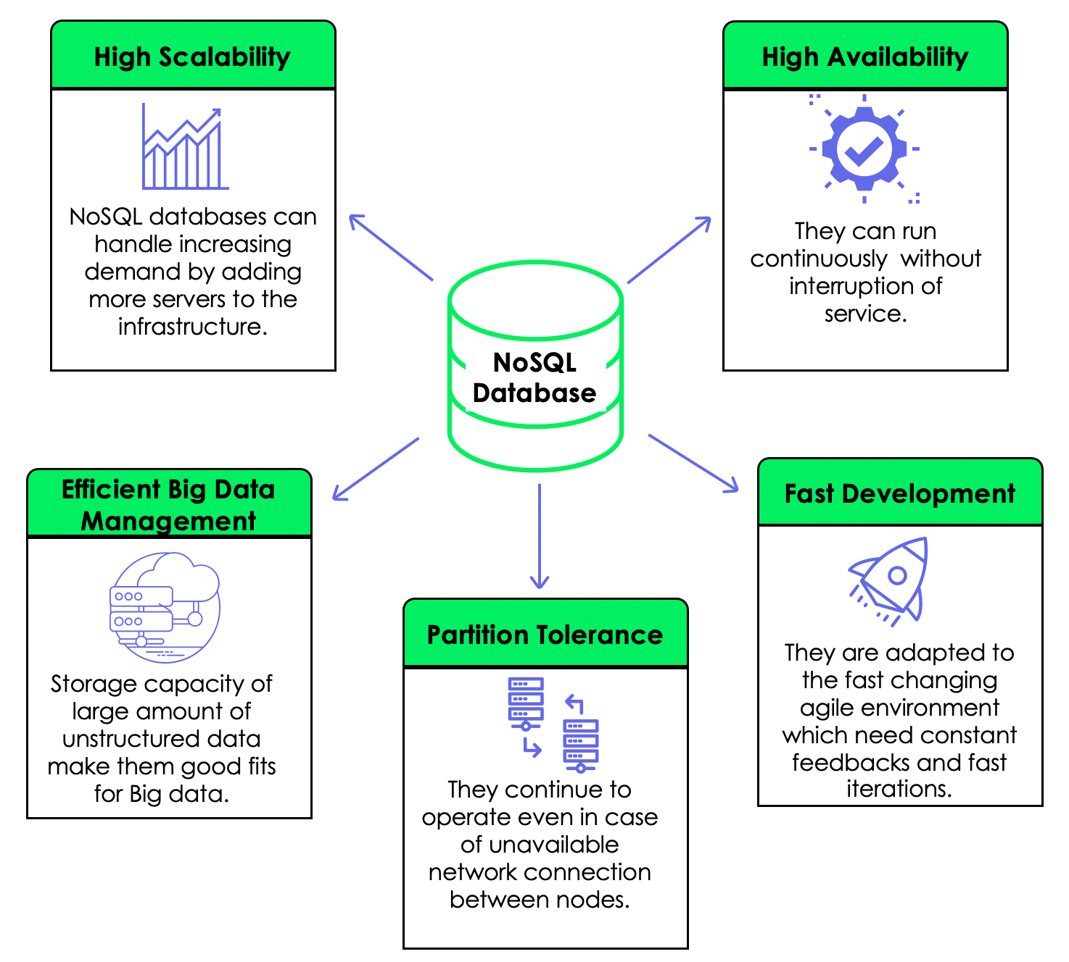
Why NoSQL?
Scalability
– Availability
– Consistency – Partition tolerance
Ease of deployment
– No object-relation mapping required.

Slide 17
MongoDB
Document Database
Server can support multiple databases
A database consists of a set of collections
A collection is a set of documents
Document is effectively a JSON document with some additional features

Slide 18
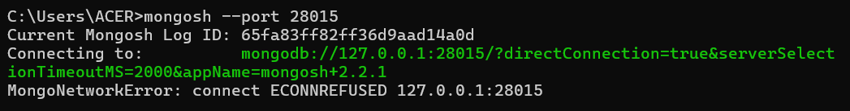
What is MongoDB Shell?
MongoDB Shell (mongosh) is an interactive JavaScript interface to MongoDB, which allows you to query and update data and perform administrative operations.
Local MongoDB Instance on Default Port 27017: mongosh
Local MongoDB Instance on a Non-default Port: mongosh --port 28015

Slide 19
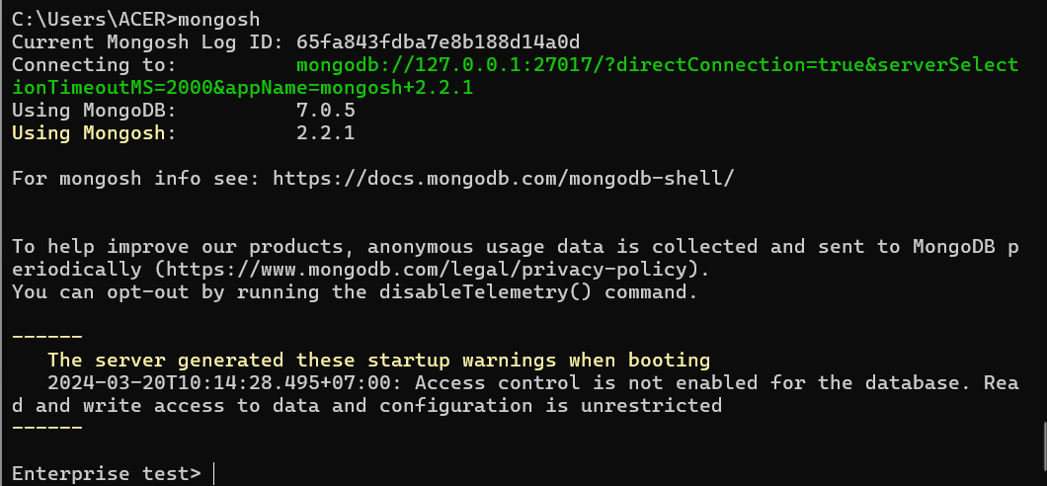
What is MongoDB Shell? – cont’d

Slide 20
Exercise: How To Install MongoDB Shell

Slide 21
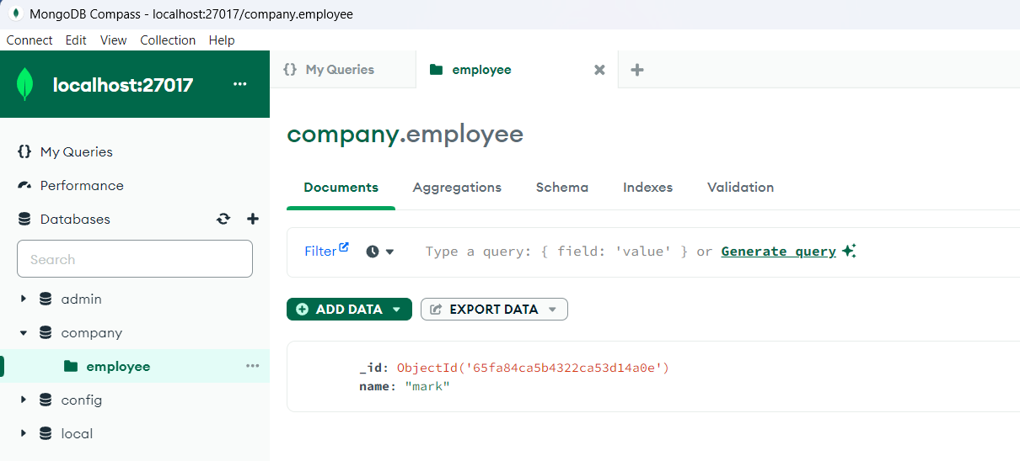
What is MongoDB Compass?
MongoDB Compass is a graphical client that provides a GUI to interact with your MongoDB databases.

Slide 22
Exercise: How To Install MongoDB Compass

Slide 23


Switch Databases
To display the database you are using, type db:
The operation should return test, which is the default database.
To switch databases, issue the use <db> helper, as in the following example:

Slide 24
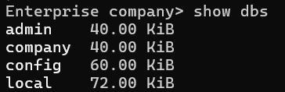
Switch Databases – cont’d
To access a different database from the current database without switching your current database context, see the db.getSiblingDB() method.
To list the databases available to the user, use the helper show dbs.

Slide 25
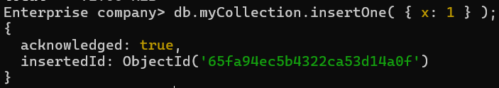
Create a New Database and Collection
To create a new database, issue the use <db> command with the database that you would like to create.
For example, the following commands create both the database company and the collection myCollection using the insertOne() operation:
use myNewDatabase
db.myCollection.insertOne( { x: 1 } );
If a collection does not exist, MongoDB creates the collection when you first store data for that collection.

Slide 26
Terminate a Running Command
To terminate a running command or query in mongosh, press Ctrl + C.
When you enter Ctrl + C, mongosh:
interrupts the active command,
tries to terminate the ongoing, server-side operation, and
returns a command prompt.

Slide 27
MongoDB Management
MongoDB offers a range of tools for managing and administering your database, such as:
mongod: The database server itself.
mongos: The routing service for sharding.
mongo: The interactive shell used for managing the database.
Compass: The GUI for MongoDB.
Atlas: MongoDB’s fully-managed database as a service.

Slide 28
DataTypes in MongoDB
The documents are stores in BSON, which is the binary encoded format of JSON and using BSON we can make remote procedure calls in MongoDB. BSON data format supports various data-types.
Below are the enlisted MongoDB data types:
String
Integer
Double
Boolean
Null
Array
Object
Object Id
UndefinedBinary
DataDate
Min & Max key
Symbol
Regular Expression
JavaScript
JavaScript with Scope
Timestamp
Decimal

Slide 29
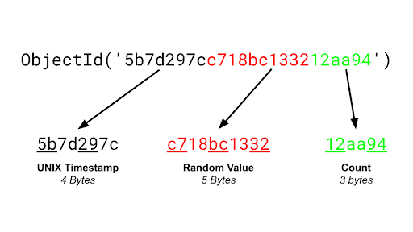
What is ObjectId in MongoDB?
Every document in the collection has an “_id” field that is used to uniquely identify the document in a particular collection it acts as the primary key for the documents in the collection. “_id” field can be used in any format and the default format is ObjectId of the document.
It is a 12-byte Field Of BSON type
The first 4 bytes representing the Unix Timestamp of the document
The next 3 bytes are the machine Id on which the MongoDB server is running.
The next 2 bytes are of process id
The last Field is 3 bytes used for increment the objectid.

Slide 30
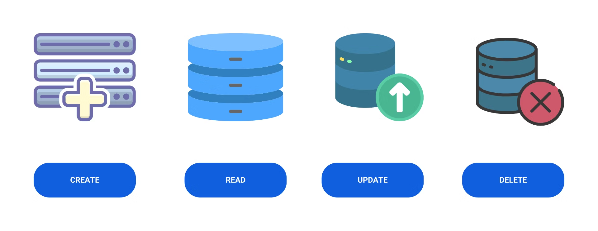
Perform CRUD Operations
CRUD operations create, read, update, and delete documents

Slide 31
CRUD Operations - Create
Create or insert operations add new documents to a collection. If the collection does not exist, create operations also create the collection.
Can insert a single document or multiple documents in a single operation.

Slide 32
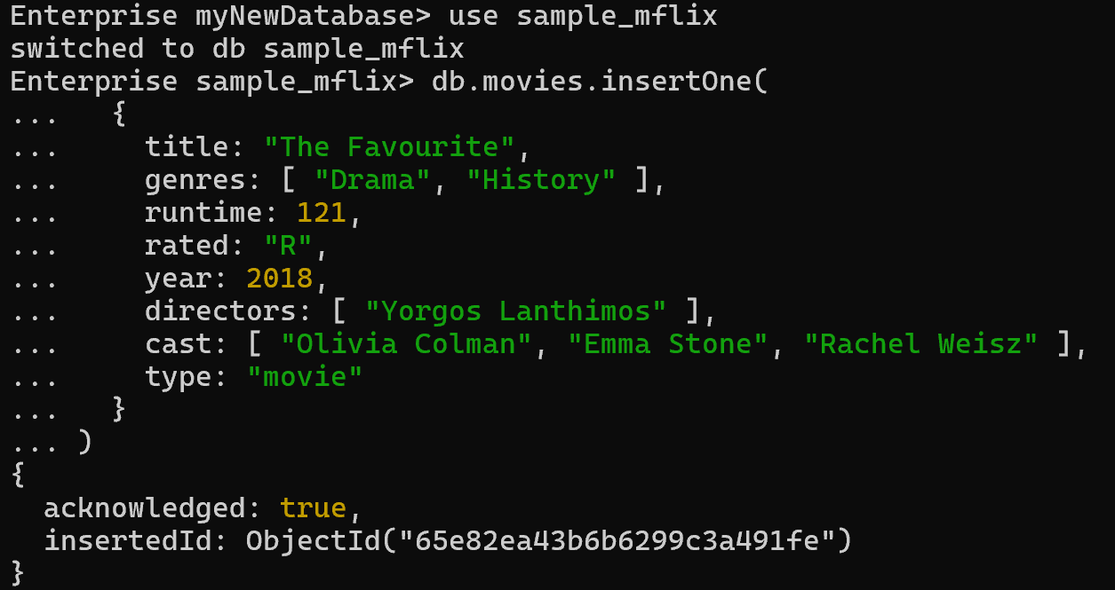
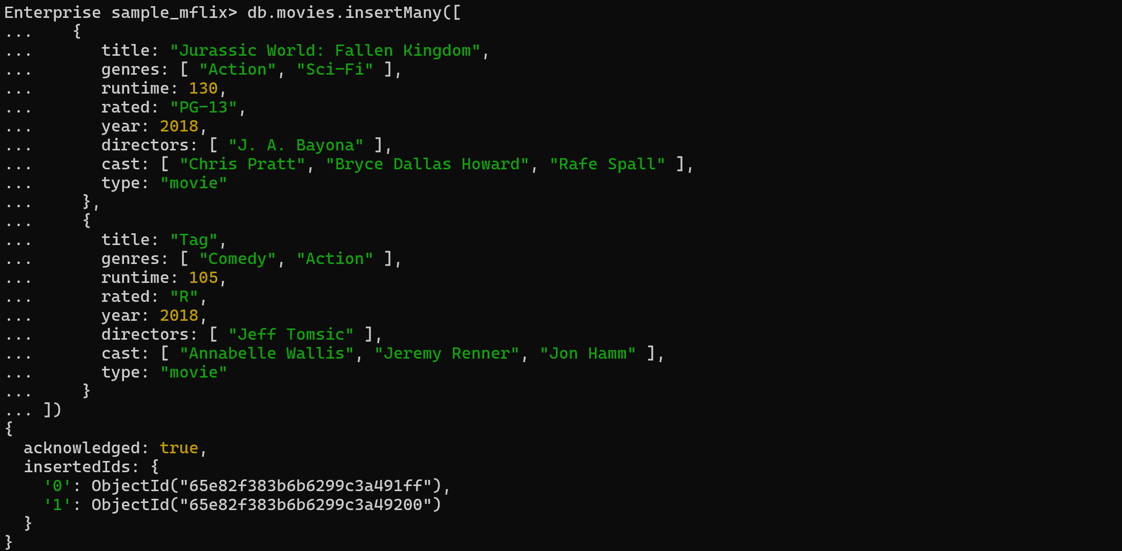
CRUD Operations – Create – cont’d
To insert a single document, use db.collection.insertOne()
To insert multiple documents, use db.collection.insertMany().

Slide 33
CRUD Operations - Read
Retrieve documents from a collection; i.e. query a collection for documents.
Can specify criteria, or filters, that identify the documents to return.
Use the db.collection.find()

Slide 34
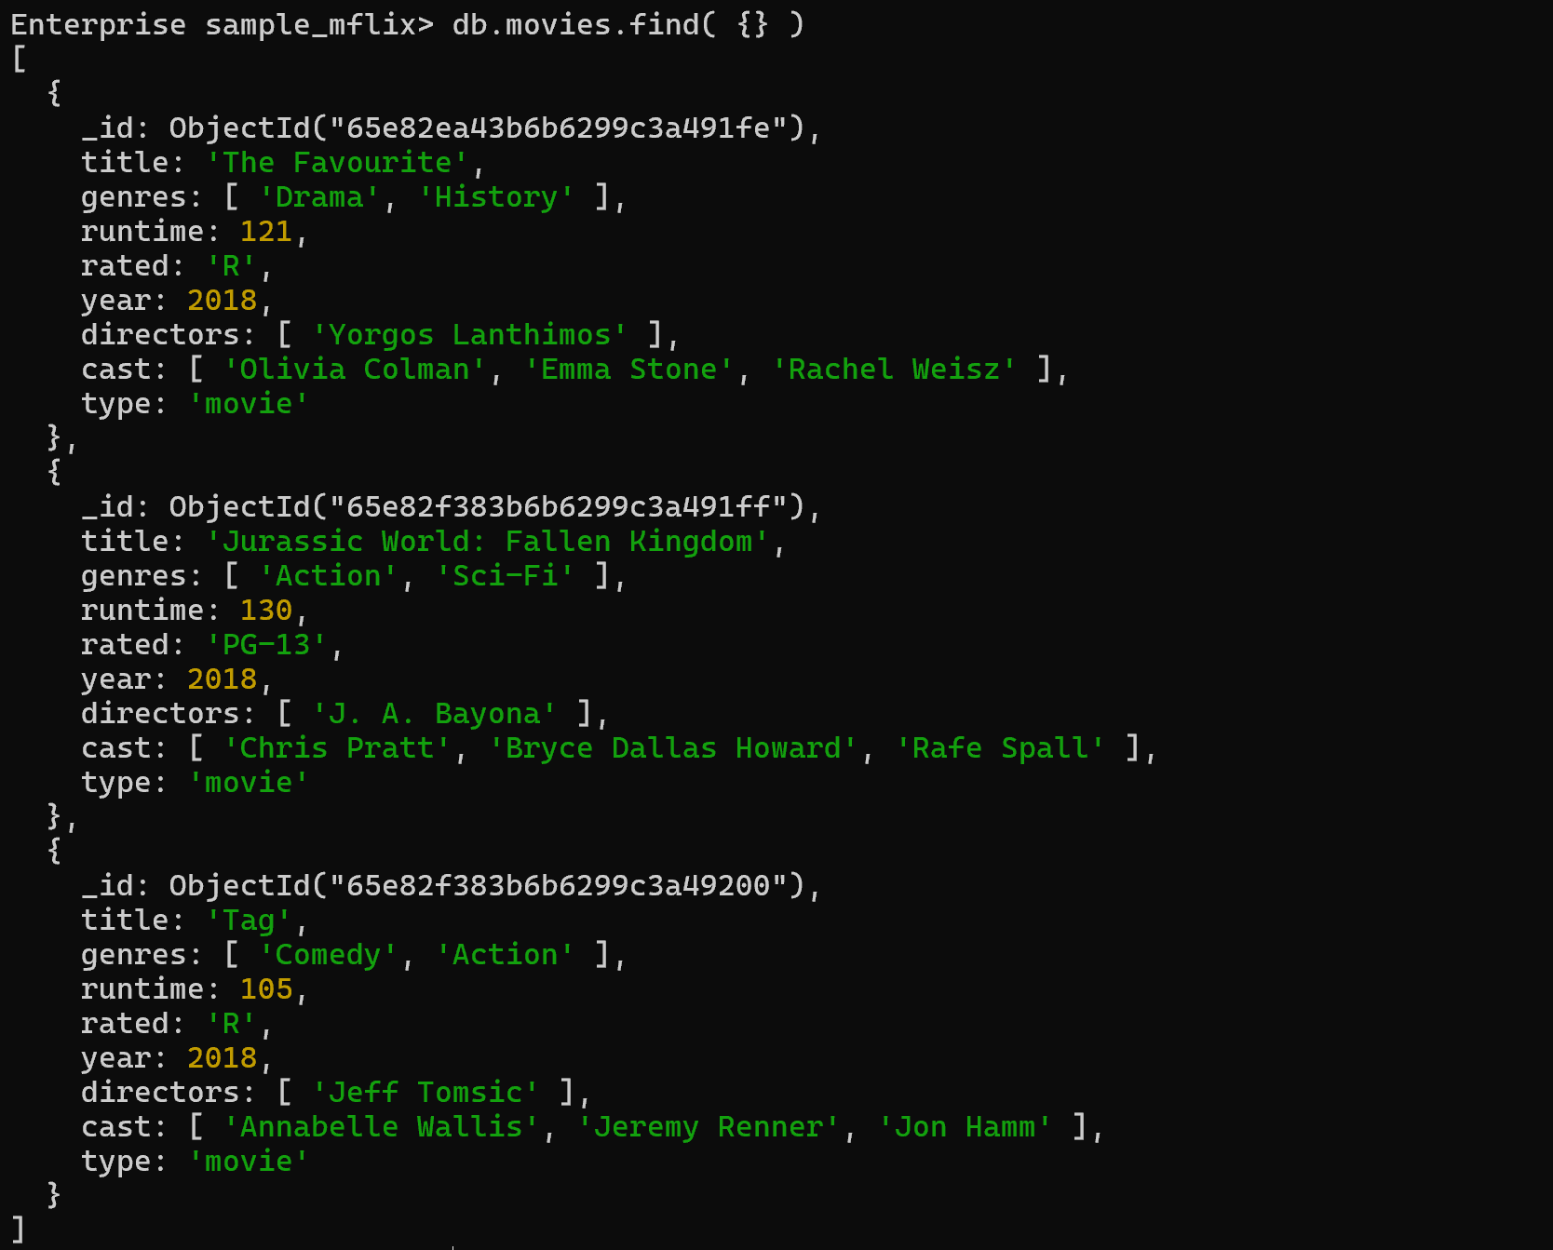
CRUD Operations – Read - 2
To return all documents from the sample_mflix.movies collection. This operation is equivalent to the following SQL statement:
SELECT * FROM movies

Slide 35
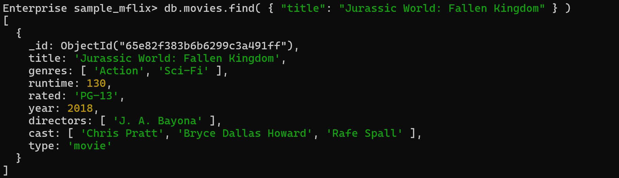
CRUD Operations – Read - 3
To return all movies where the title equals Jurassic World: Fallen Kingdom from the sample_mflix.movies collection.
This operation corresponds to the following SQL statement:
SELECT * FROM movies WHERE title = "Jurassic World: Fallen Kingdom"

Slide 36
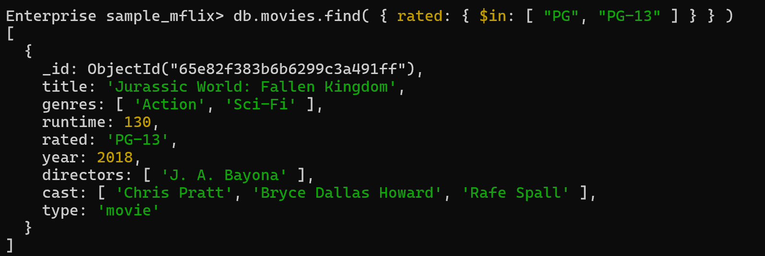
CRUD Operations – Read - 4
To return all movies from the sample_mflix.movies collection which are either rated PG or PG-13
This operation corresponds to the following SQL statement:
SELECT * FROM movies WHERE rated in ("PG", "PG-13")

Slide 37
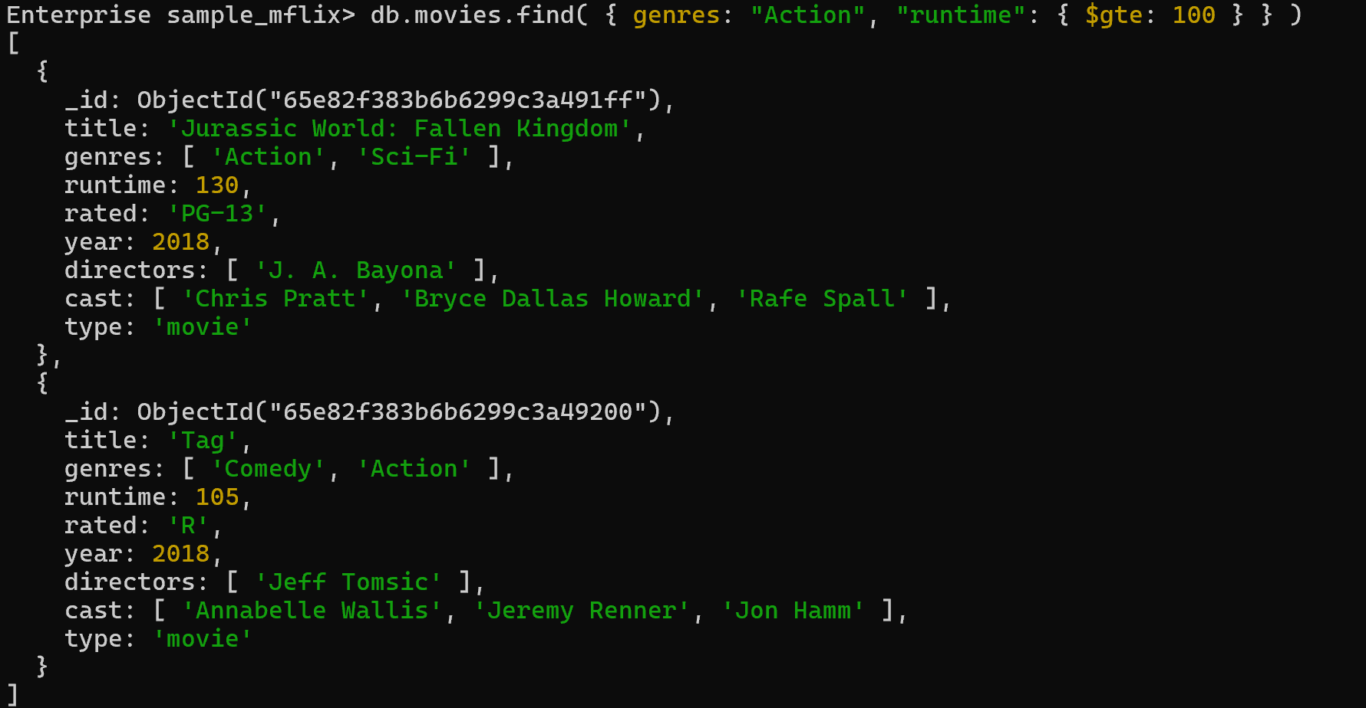
CRUD Operations – Read - 5
To return movies which were action film and have a runtime of at least 100

Slide 38
CRUD Operations – Update
Modify existing documents in a collection. You can update a single document or multiple documents in a single operation.
Can specify criteria, or filters, that identify the documents to update. These filters use the same syntax as read operations.
To update a single document, use db.collection.updateOne()

Slide 39
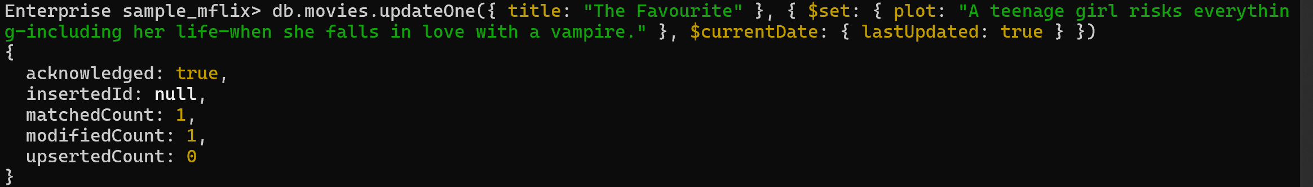
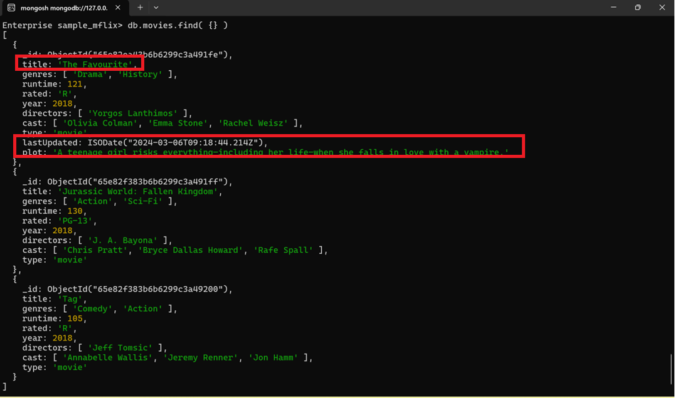
CRUD Operations – Update - 2
To update the first document in the sample_mflix.movies collection where title equals "The Favourite"

Slide 40
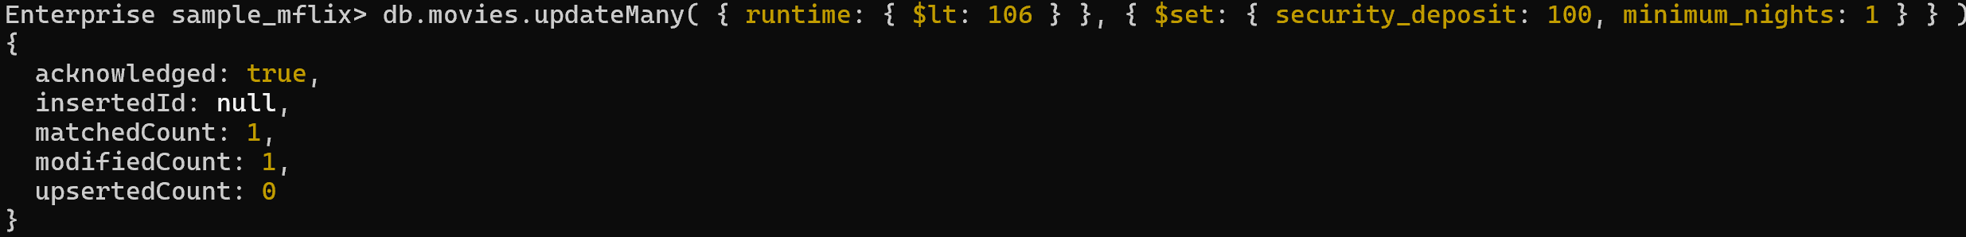
CRUD Operations – Update - 3
To update multiple documents, use db.collection.updateMany().
To update all documents in the sample_mflix.movies collection to update where runtime is less than 106

Slide 41
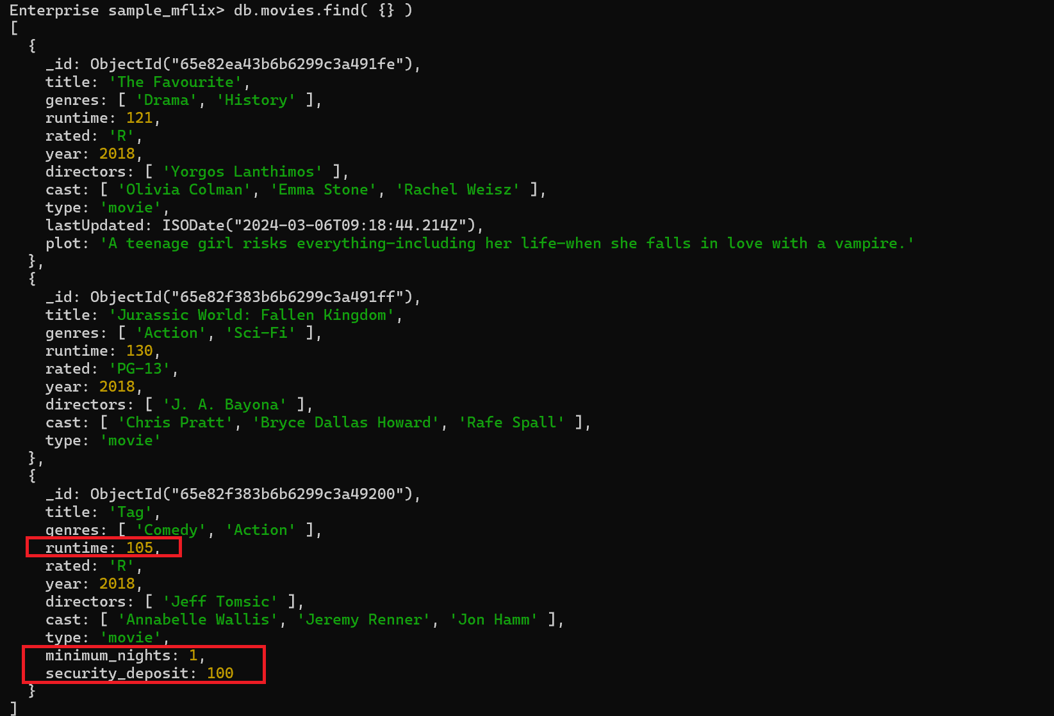
CRUD Operations – Update - 4

Slide 42
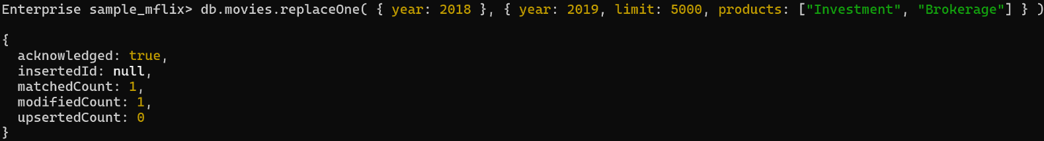
CRUD Operations – Update - 5
To replace a document, use db.collection.replaceOne().
To replace the first document from the sample_mflix.movies collection where year: 2018

Slide 43
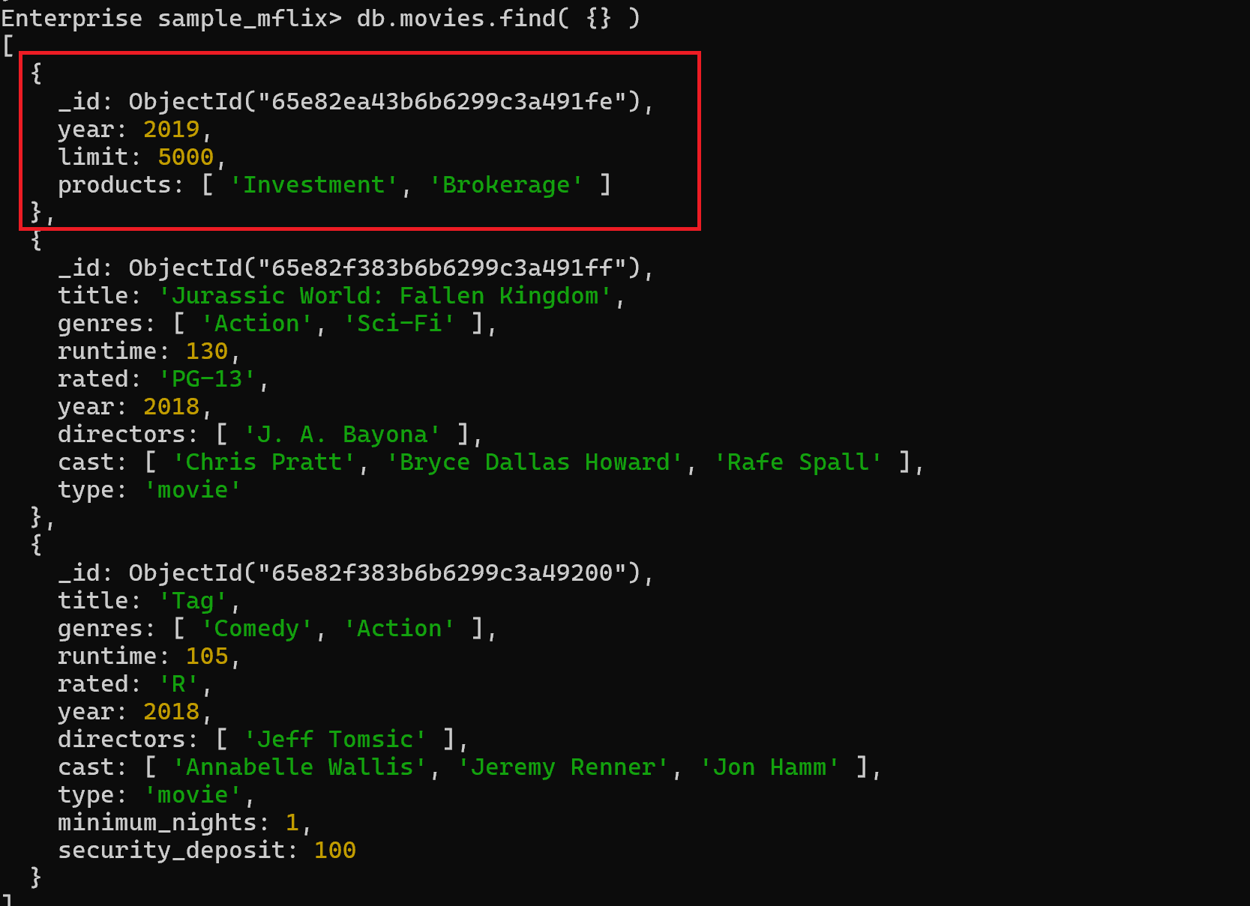
CRUD Operations – Update - 6

Slide 44
CRUD Operations – Delete
Remove existing documents from a collection. You can remove a single document or multiple documents in a single operation.
Can specify criteria, or filters, that identify the documents to remove. These filters use the same syntax as read operations.
To delete a single document, use db.collection.deleteOne()
To delete multiple documents, use db.collection.deleteMany()

Slide 45
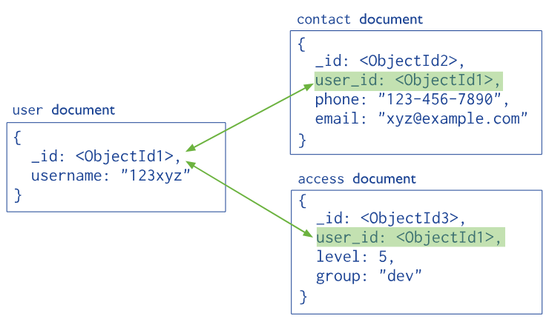
Mapping Relationships – 1/6
A relationship is mapped according to the types of mapping that are made available in database relationships.
This mapping will either be One-to-One or One-to-Many relationship mapping.
MongoDB also made it possible to map relationships.

Slide 46
Mapping Relationships – 2/6
// patron document
{
_id: "joe",
name: "Joe Bookreader"
}
// address document
{
street: "123 Fake Street",
city: "Faketon",
state: "MA",
zip: "12345"
}
{
_id: "joe",
name: "Joe Bookreader",
address: {
street: "123 Fake Street",
city: "Faketon",
state: "MA",
zip: "12345"
}
}
Model One-to-One Relationships with Embedded Documents: Presents a data model that describes one-toone connections between related data using embedded documents.

Slide 47
Mapping Relationships – 3/6
Model One-to-Many Relationships with Embedded Documents: Presents a data model that describes one-tomany relationships between related data by using embedded texts.
// address two
{
street: "1 Some Other Street",
city: "Boston",
state: "MA",
zip: "12345"
}
{
"_id": "joe",
"name": "Joe Bookreader",
"addresses": [
{
"street": "123 Fake Street",
"city": "Faketon",
"state": "MA",
"zip": "12345"
},
{
"street": "1 Some Other Street",
"city": "Boston",
"state": "MA",
"zip": "12345"
}
]
}
// patron document
{
_id: "joe",
name: "Joe Bookreader"
}
// address one
{
street: "123 Fake Street",
city: "Faketon",
state: "MA",
zip: "12345"
}

Slide 48
Mapping Relationships – 4/6
{
title: "MongoDB: The Definitive Guide",
author: ["Kristina Chodorow", "Mike Dirolf"],
published_date: ISODate("2010-09-24"),
pages: 216,
language: "English",
publisher: {
name: "O'Reilly Media",
founded: 1980,
location: "CA"
}
}
{
title: "50 Tips and Tricks for MongoDB Developer",
author: "Kristina Chodorow",
published_date: ISODate("2011-05-06"),
pages: 68,
language: "English",
publisher: {
name: "O'Reilly Media",
founded: 1980,
location: "CA"
}
}
Model One-to-Many Relationships with Document References: Presents a data model for describing one-tomany relationships between documents via references.

Slide 49
Mapping Relationships – 5/6
{
name: "O'Reilly Media",
founded: 1980,
location: "CA",
books: [123456789, 234567890, ...]
}
{
_id: 123456789,
title: "MongoDB: The Definitive Guide",
author: ["Kristina Chodorow", "Mike Dirolf"],
published_date: ISODate("2010-09-24"),
pages: 216,
language: "English"
}
{
_id: 234567890,
title: "50 Tips and Tricks for MongoDB Developer",
author: "Kristina Chodorow",
published_date: ISODate("2011-05-06"),
pages: 68,
language: "English"
}
To avoid repetition of the publisher data, use references and keep the publisher information in a separate collection from the book collection.

Slide 50
Mapping Relationships – 6/6
{
_id: "oreilly",
name: "O'Reilly Media",
founded: 1980,
location: "CA"
}
{
_id: 123456789,
title: "MongoDB: The Definitive Guide",
author: ["Kristina Chodorow", "Mike Dirolf"],
published_date: ISODate("2010-09-24"),
pages: 216,
language: "English",
publisher_id: "oreilly"
}
{
_id: 234567890,
title: "50 Tips and Tricks for MongoDB Developer",
author: "Kristina Chodorow",
published_date: ISODate("2011-05-06"),
pages: 68,
language: "English",
publisher_id: "oreilly"
}
To avoid mutable, growing arrays, store the publisher reference inside the book document:

Slide 51
Exercise: Getting familiar with mongosh

Slide 52
Exercise: Getting familiar with MongoDB Compass

Slide 53
Summary
Concepts were introduced:
What is Serialization?
Introduction to NoSQL Database
Introduction to MongoDB
How to use MongoDB Shell and MongoDB Compass?
How to use CRUD Operations in MongoDB?
How to use Mapping Relationships?

