Slide 1
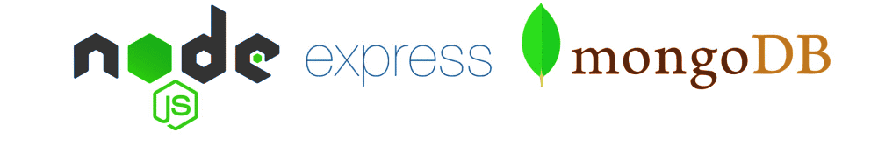
Mongoose

Slide 2
Objectives
Understand Mongoose ODM
Install and Enviroment Setup
What is MVC Pattern in Mongoose?
What is Scheme and Model?
Execute CRUD queries with Mongoose
Understand using Mongoose to interact with MongoDB server from the Node application
What is Middleware in Mongoose?

Slide 3
Mongoose ODM
MongoDB stores data in the form of documents
No structure imposed on the document
Any document can be stored in any collection
Relies on developer’s discipline to maintain the structure of the documents
Mongoose ODM
Object Data Model
Object Document Mapping
Object relational mapping (ORM)
Adds structure to MongoDB documents through schema

Slide 4

What is Mongoose?
Mongoose is described as “elegant MongoDB object modeling for Node.js.”
Mongoose is an ODM (Object Data Modeling) library for MongoDB and Node.js.
Mongoose to help with data modeling, schema enforcement, model validation, and general data manipulation.

Slide 5
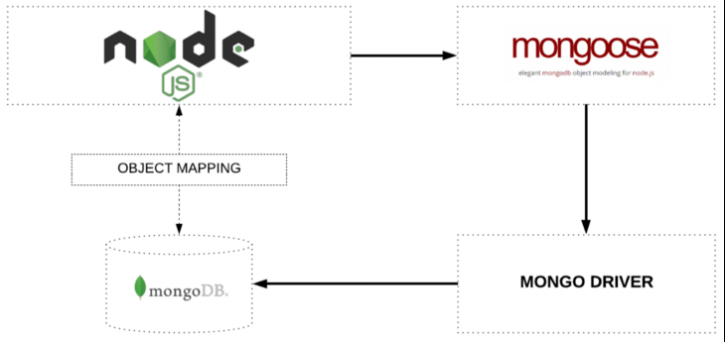
How Mongoose Works?

Slide 6
Why Mongoose?
MongoDB has a flexible data model.
MongoDB databases very easy to alter and update in the future.
But a lot of developers are accustomed to having rigid schemas.
Mongoose forces a semi-rigid schema from the beginning. With Mongoose, developers must define a Schema and Model.

Slide 7
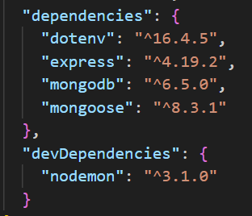
Environment setup - Install
Connect to the MongoDB database: npm i mongoose
Install the package of nodemon: npm i -D nodemon
In there,
-D: Short for --save-dev, a flag specifying that the installed package should be added to the devDependencies section of the project's package.json file.
Nodemon: This package will restart our backend server the moment we make any change in the code.
Uses an .env file to save secrets in a project: npm i dotenv
Let’s add a script to our package.json file to run our project
"scripts": {
"dev": "nodemon server.js"
}
Notes:
use ES Modules instead of Common JS, so we’ll add the module type as well. This will also allow us to use top-level await.

Slide 8
Environment setup - Config
Create an .env file with the following content:
Use the dotenv library in Node.js to load environment variables from an .env file into process.env, allowing you to access those environment variables in your Node.js application.
Exam:
NODE_ENV = development
PORT=8000
MONGO_URI=mongodb://127.0.0.1:27017/mydatabase
require('dotenv').config();
const port = process.env.PORT || 5000;

Slide 9
What is a schema?
A schema defines the structure of your collection documents. A Mongoose schema maps directly to a MongoDB collection.
With schemas, we define each field and its data type. Permitted types are:
String
Number
Date
Buffer
Boolean
Mixed
ObjectId
Array
Decimal128
Map
const blog = new Schema({
title: String,
slug: String,
published: Boolean,
author: String,
content: String,
tags: [String],
createdAt: Date,
updatedAt: Date,
comments: [{
user: String,
content: String,
votes: Number
}]
});

Slide 10

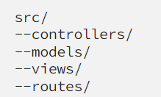
MVC - Model View Controler in Mongoose
MVC is a software architectural pattern that involves the separation of the application logic into three interconnected elements the Model, View, and Controller.
MVC used in building Web Servers that focus on reliability and making the development process much simpler and easier since it composes the Web Server.

Slide 11
MVC - Model
Model: represents the structure of the data in MongoDB database. Each model is built on a Mongoose Schema, which describes the structure of documents in a collection and is used to create and read data from MongoDB.
const mongoose = require('mongoose');
const { Schema } = mongoose;
const blogSchema = new Schema({
title: String,
content: String,
author: String,
createdAt: Date
});
const Blog = mongoose.model('Blog', blogSchema);

Slide 12
MVC - Controller
Controller: uses the Model to retrieve data and then decides which View should display that data. The controller handles the application logic, receiving requests from users and returning responses.
const Blog = require('../models/blog');
exports.getBlogPosts = async (req, res) => {
try {
const posts = await Blog.find();
res.render('blogPosts', { posts }); // Use a View to display posts
} catch (error) {
console.error('Error fetching blog posts:', error);
res.status(500).send('Error fetching blog posts');
}
};

Slide 13
MVC - View
View: is the component that displays data to the user. In an Express.js application, Views are usually template files (e.g. EJS, Handlebars, Pug) that are rendered by the server and sent as HTML to the client.
<!-- views/blogPosts.ejs -->
<!DOCTYPE html>
<html>
<head><title>Blog Posts</title></head>
<body>
<h1>Blog Posts</h1>
<ul>
<% posts.forEach(post => { %>
<li><%= post.title %> by <%= post.author %></li>
<% }) %>
</ul>
</body>
</html>

Slide 14
What is a model?
Models take your schema and apply it to each document in its collection.
Models are responsible for all document interactions like creating, reading, updating, and deleting (CRUD).
Note: The first argument passed to the model should be the singular form of collection name. Mongoose automatically changes this to the plural form, transforms it to lowercase, and uses that for the database collection name.
Exam:
const Blog = mongoose.model('Blog', blog);

Slide 15
Connecting to MongoDB
Create database.js file and use Mongoose to connect to MongoDB.
//connect/database.js
const mongoose = require('mongoose');
const connectDB = async () => {
try {
const connect = await mongoose.connect(process.env.MONGO_URI);
console.log(`MongoDB Connected: ${connect.connection.host}`);
} catch (err) {
console.log(err);
process.exit(1);
}
}
module.exports = connectDB;

Slide 16
Creating a schema and model
Before we do anything with our connection, we’ll need to create a schema and model.
Ideally, you would create a schema/model file for each schema that is needed.
So we’ll create a new folder/file structure: models/Blog.js.
import mongoose from 'mongoose';
const { Schema, model } = mongoose;
const blogSchema = new Schema({
title: String,
slug: String,
published: Boolean,
author: String,
content: String,
tags: [String],
createdAt: Date,
updatedAt: Date,
comments: [{
user: String,
content: String,
votes: Number
}]
});
const Blog = model('Blog', blogSchema);
module.exports = Blog;

Slide 17
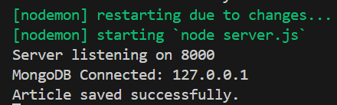
Inserting data
Case 1: This requires two actions: instantiating the object, and then saving it.
Import the Blog model that we created.
Next, create a new blog object and then use the save() method to insert it into MongoDB database.
// controllers/blogController.js
const Blog = require("../models/Blog");
async function createInitialBlogPost() {
const article = new Blog({
title: 'Awesome Post!',
slug: 'awesome-post',
published: true,
content: 'This is the best post ever',
tags: ['featured', 'announcement'],
});
try {
await article.save();
console.log('Article saved successfully.');
} catch (error) {
console.error('Error saving article:', error);
}
}
module.exports = { createInitialBlogPost };

Slide 18
Inserting data - 2
Case 2: Using the Mongoose create() method.
This method is much better! We insert our document, but we also get returned the document along with its _id when we console log it.
async function createInitialBlogPost() {
// Create a new blog post and insert into database
const article = await Blog.create({
title: 'Awesome Post 2!',
slug: 'awesome-post',
published: true,
content: 'This is the best post ever 2',
tags: ['featured', 'announcement'],
});
console.log(article);
}

Slide 19
Inserting data - 3
Let’s run the code!
With Terminal: npm run dev
const express = require('express');
require('dotenv').config();
const connectDB = require('./connect/database');
const { createInitialBlogPost } = require('./controllers/blogController');
const port = process.env.PORT || 5000;
connectDB().then(() => {
createInitialBlogPost();
});
const app = express();
app.use(express.json()); // For parsing application/json
app.use(express.urlencoded({ extended: true })); // For parsing application/x-www-form-urlencoded
app.listen(port, () => console.log(`Server listening on ${port}`));

Slide 20
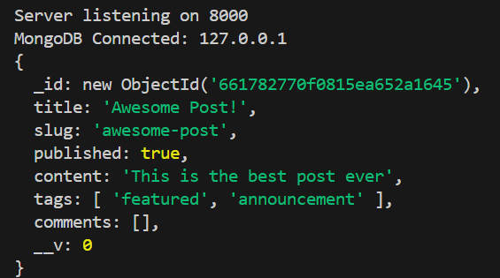
Find Data - 1
// controllers/blogController.js
const Blog = require("../models/Blog");
async function createInitialBlogPost() {…}
async function findBlogPost() {
const firstArticle = await Blog.findOne({});
console.log(firstArticle);
}
module.exports = { createInitialBlogPost, findBlogPost };
Find a single blog post
Get by ObjectId
const { createInitialBlogPost,findBlogPost } = require('./controllers/blogController');
connectDB().then(() => {
findBlogPost();
});
const article = await Blog.findById('661782770f0815ea652a1645');

Slide 21
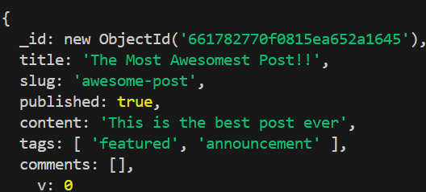
Update data
We can directly edit the local object, and then use the save() method to write the update back to the database
// controllers/blogController.js
const Blog = require("../models/Blog");
async function updateBlogPost() {
const article = await Blog.findById('661782770f0815ea652a1645');
article.title = "The Most Awesomest Post!!";
await article.save();
console.log(article);
}
module.exports = {updateBlogPost };

Slide 22
Deleting data
We have the deleteOne() and deleteMany() methods
Deletes the first document that matches conditions from the collection
Deletes all of the documents that match conditions from the collection
const blog = await Blog.deleteOne({ author: "Jesse Hall" })
const blog = await Blog.deleteMany({ author: "Jesse Hall" })

Slide 23
Validation
const blogSchema = new Schema({
title: {
type: String,
required: [true,'Article title is required’],
//Value-level validation
minlength:[5, 'Title must be at least 5 characters.’],
//String-level validation
trim: true
},
slug: {
type: String,
required: true,
lowercase: true,
},
published: {
type: Boolean,
default: false,
},
author: {
type: String,
required: true,
},
content: String,
tags: [String],
createdAt: {
type: Date,
default: () => Date.now(),
immutable: true,
},
updatedAt: Date,
comments: [{
user: String,
content: String,
votes: Number
}]
});
Mongoose provides built-in and custom validators, and it allows you to define mandatory fields and default values. This ensures the data meets certain criteria before it's saved to the database.
Let’s set some required fields in Blog.js schema.
Validators only run on the create or save methods.

Slide 24

Other useful methods
Mongoose uses many standard MongoDB methods plus introduces many extra helper methods that are abstracted from regular MongoDB methods.
The exists() method returns either null or the ObjectId of a document that matches the provided query.
const blog = await Blog.exists({ title: "Awesome Post!" })

Slide 25
Other useful methods - 2
The where() method allows us to chain and build queries.
To include projection when using the where() method, chain the select() method after your query.
// Instead of using a standard find method
const blogFind = await Blog.findOne({ title: { $regex: 'Awesome', $options: 'i' } });
// Use the equivalent where() method
const blogWhere = await Blog.where("title").equals({ $regex: 'Awesome', $options: 'i' });
const blogWhere = await Blog.where("title").equals({ $regex: 'Awesome', $options: 'i' }).select("title author");
Notes:
$options: 'i': This is the option to make the main rule expression case-insensitive. It allows searching without having to worry about whether the word "Awesome" is capitalized or not.

Slide 26
Multiple schemas
In MongoDB, data that is accessed together should be stored together.
Nest data within the same schema when it makes sense.
If you have the need for separate schemas, Mongoose makes it a breeze.
Exam:
We’ll create a new file, User.js, in the model folder.
For the email, we are using a new property, minLength, to require a minimum character length for this string.
import mongoose from 'mongoose';
const {Schema, model} = mongoose;
const userSchema = new Schema({
name: {
type: String,
required: true,
},
email: {
type: String,
minLength: 10,
required: true,
lowercase: true
},
});
const User = model('User', userSchema);
module.exports = User;

Slide 27
Multiple schemas - 2
import mongoose from 'mongoose';
const { Schema, SchemaTypes, model } = mongoose;
const blogSchema = new Schema({
...,
author: {
type: SchemaTypes.ObjectId,
ref: 'User',
required: true,
},
...,
comments: [{
user: {
type: SchemaTypes.ObjectId,
ref: 'User',
required: true,
},
content: String,
votes: Number
}];
});
...
Exam – cont’d:
Now we’ll reference this new user model in our blog schema for the author and comments.user.
Set the author and comments.user to SchemaTypes.ObjectId and added a ref, or reference, to the user model.
This will allow us to “join” our data a bit later.

Slide 28
Multiple schemas - 3
Exam – cont’d:
And don’t forget to destructure SchemaTypes from mongoose at the top of the file.
Lastly, let’s update the index.js file. We’ll need to import our new user model, create a new user, and create a new article with the new user’s _id.
...
import User from './model/User.js';
...
const user = await User.create({
name: 'Jesse Hall',
email: 'jesse@email.com',
});
const article = await Blog.create({
title: 'Awesome Post!',
slug: 'Awesome-Post',
author: user._id,
content: 'This is the best post ever',
tags: ['featured', 'announcement'],
});
console.log(article);

Slide 29
Multiple schemas - 4
Exam – cont’d:
Notice now that there is a users collection along with the blogs collection in the MongoDB database.
You’ll now see only the user _id in the author field. So, how do we get all of the info for the author along with the article?
We can use the populate() Mongoose method - lets you reference documents in other collections as though you were doing a join in a relational database.
Now the data for the author is populated, or “joined,” into the article data. Mongoose actually uses the MongoDB $lookup method behind the scenes.
const article = await Blog.findOne({ title: "Awesome Post!" }).populate("author");
console.log(article);

Slide 30
Middleware - 1
Mongoose provides middleware, also known as pre and post hooks, that make it easy to customize and control the flow of our database operations.
For example,
You can define a pre-save hook on your schema that hashes users' passwords before storing them in the database.
Let’s update the updated date every time an article is saved or updated. We’ll add this to our Blog.js model.

Slide 31
Middleware - 2
For example – cont’d,
Then in the index.js file, we’ll find an article, update the title, and then save it.
Besides pre(), there is also a post() mongoose middleware function.
//models/Blog.js
…
blogSchema.pre('save', function (next) {
this.updatedAt = Date.now();
// update the date every time a blog post is saved
next();
});
…
//server.js
const article = await Blog.findById("6617b40acc1abfceffc8aabb").exec();
article.title = "Updated Title";
await article.save();

Slide 32
Connections
Mongoose manages a connection pool internally to handle database operations efficiently.
It has a straightforward API for handling database connections and can manage a single or multiple database connections.

Slide 33
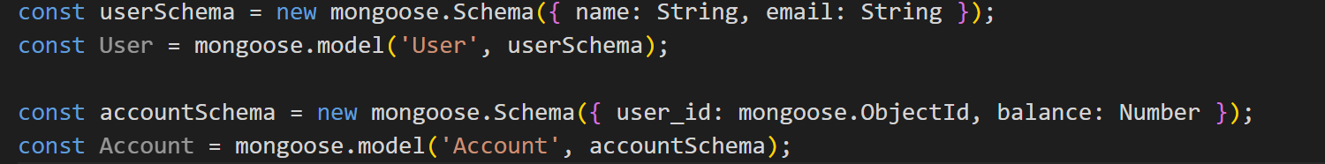
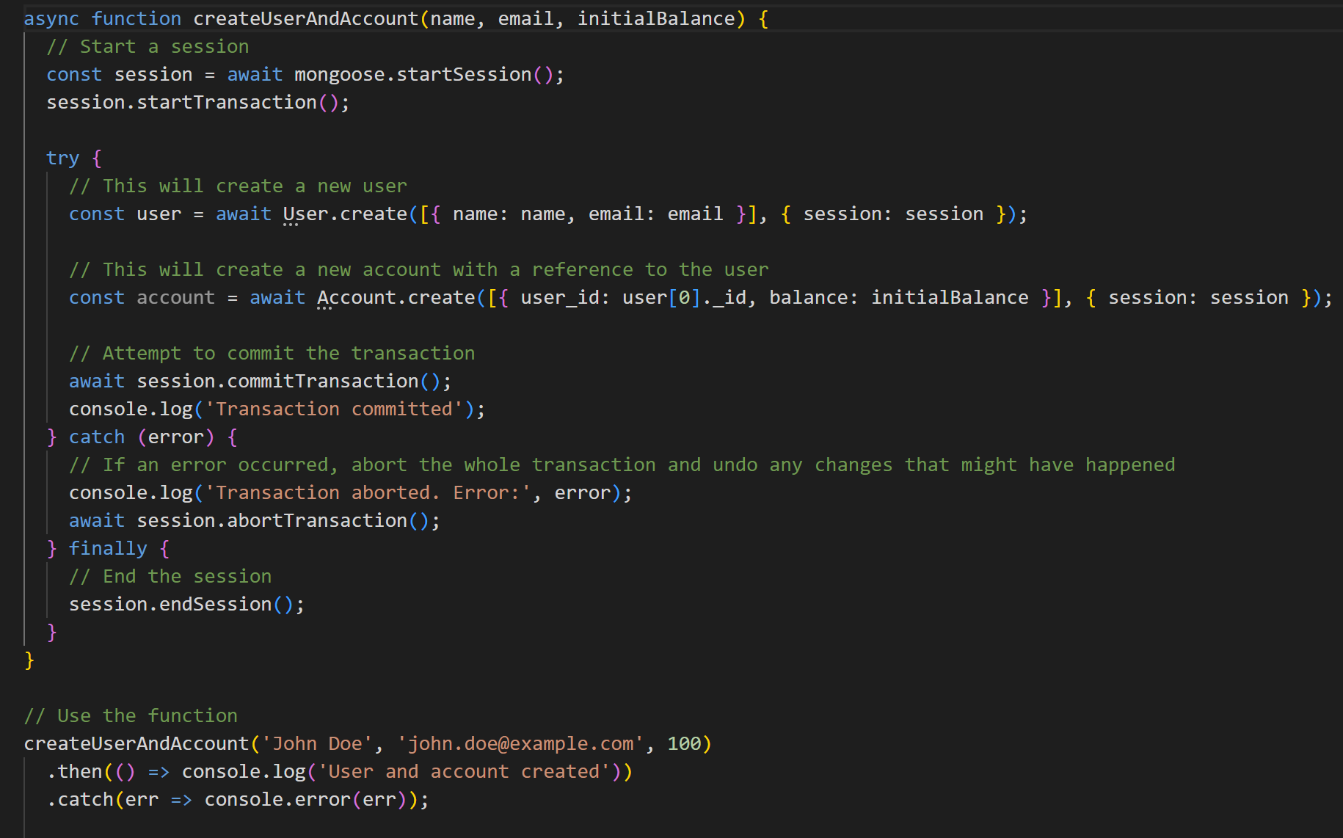
Transactions
Mongoose supports transactions with MongoDB, allowing you to execute multiple operations in isolation and potentially roll them back if something goes wrong.

Slide 34
Reference
Mongoose models provide several static helper functions for CRUD operations.
Each of these functions returns a mongoose Query object.
Link: https://mongoosejs.com/docs/queries.html

Slide 35
Exercise: Mongoose

Slide 36
Summary
Concepts were introduced:
Understand Mongoose ODM
Install and Enviroment Setup
What is MVC Pattern in Mongoose?
What is Scheme and Model?
Execute CRUD queries with Mongoose
Understand using Mongoose to interact with MongoDB server from the Node application
What is Middleware in Mongoose?

