Slide 1

RestfulApi with Express, Mongodb and Mongoose

Slide 2
Objectives
Introduction RESTful API
What is RESTful API design?
Building the Models, Controllers, Routes
Test the endpoints by POSTMAN

Slide 3
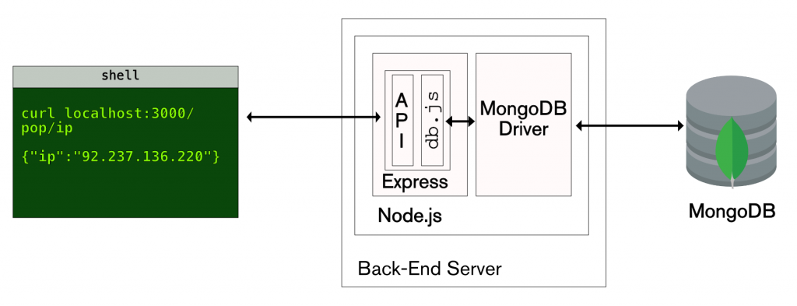
What is Restful API?
REST is an acronym for Representation State Transfer, API on the other hand is an acronym for Application Programme Interface.
A RESTful API is an architectural style for an application program interface (API) that uses HTTP requests to access and use data.

Slide 4
RESTful API design
RESTful API design refers to the practice of building web services according to the principles of REST (Representational State Transfer), a style of software architecture for distributed systems such as the World Wide Web.
When designing RESTful APIs, the goal is to make use of standard web protocols and patterns to facilitate communication between clients and servers.

Slide 5
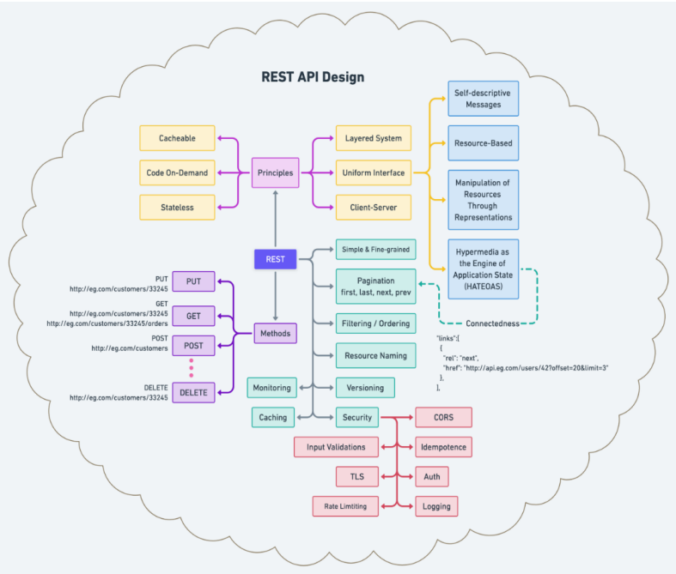

Slide 6
Principles of RESTful API Design
Client-Server Architecture: client and server interact in a request-response cycle. This separation allows each part to evolve independently.
Statelessness: Each request from the client to the server must contain all the information the server needs to understand and fulfill the request. The server does not store any state about the client session on the server side.
Cacheability: designed to explicitly or implicitly support caching. Therefore, Responses be defined as cacheable or non-cacheable, which can improve the efficiency and performance of the application.
Uniform Interface: This is a fundamental principle of RESTful design, which simplifies and decouples the architecture, enabling each part to evolve independently. The uniform interface includes using standard HTTP methods, resource-based URLs, media types for data representation, and stateless communication.
Layered System: REST allows for a layered system architecture where client-server interactions can be mediated by intermediary layers (e.g., load balancers, shared caches) for enhanced scalability and security.
Code on Demand (optional): Servers can temporarily extend or customize the functionality of a client by transferring executable code (e.g., JavaScript within an HTML response).

Slide 7
Principles of RESTful API Design - 2
Resource Identification Through URI: Resources should be identified in requests using URIs. The URIs should be structured logically around resources and sub-resources, for example, /users for accessing users and /users/123 for accessing a specific user.
Use of Standard HTTP Status Codes: Responses should use standard HTTP response codes to indicate the success or failure of an API request. For example, 200 OK for successful requests, 404 Not Found for invalid requests, and 500 Internal Server Error for server errors.
Provide Meaningful Response Content: Responses should include not only the status codes but also appropriate resource data (in formats like JSON or XML) and helpful error messages when necessary.
Versioning: When APIs change in ways that might break existing clients, versioning the API ensures that clients can continue to operate without interruption. API versions can be indicated in the URL (like /api/v1/users) or in HTTP headers.
Security Practices: Incorporate standard security practices such as HTTPS, authentication, authorization, and validation of inputs to protect the API from common vulnerabilities.

Slide 8
HTTP Methods Appropriately
GET for retrieving resources.
POST for creating new resources.
PUT for updating existing resources or creating them at a specific URL.
DELETE for removing resources.
PATCH for partial updates to resources.
GET /articles
POST /articles
GET /articles/article/:id
PATCH /articles/article/:id
PUT /articles/article/:id
DELETE /articles/article/:id

Slide 9
RESTful API using Node?
node.js is super fast and handles asynchronous without having to think about coding, it is javascript based and runs on such a small footprint that it is just the way things should be.
The api uri precedes all API endpoints and the following endpoints are currently available.

Slide 10
Express Router + MongoDB + Mongoose
Router().route(‘/uri’)
.get(
) .post (
)
...
Mongoose Schema + MongoDB
Articles.find({},
);
Articles.create(
)

Slide 11
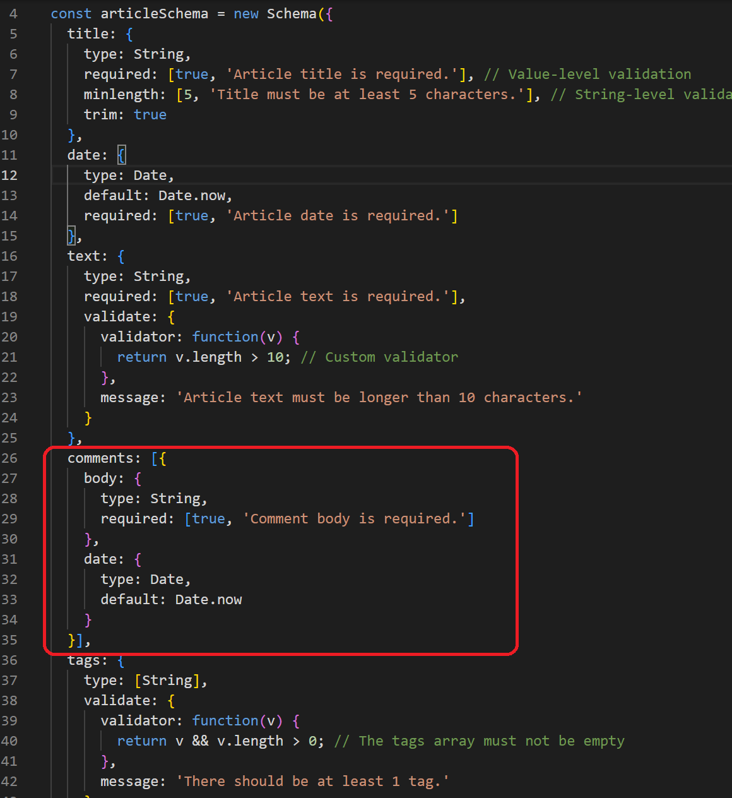
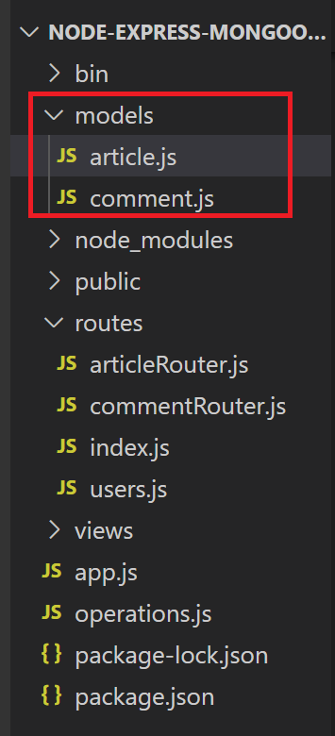
Building the Model
Create a new folder within the root directory of the project (models).
Navigate into the folder, and create a new file named article.js, comment.js
Code to create the model for API.

Slide 12
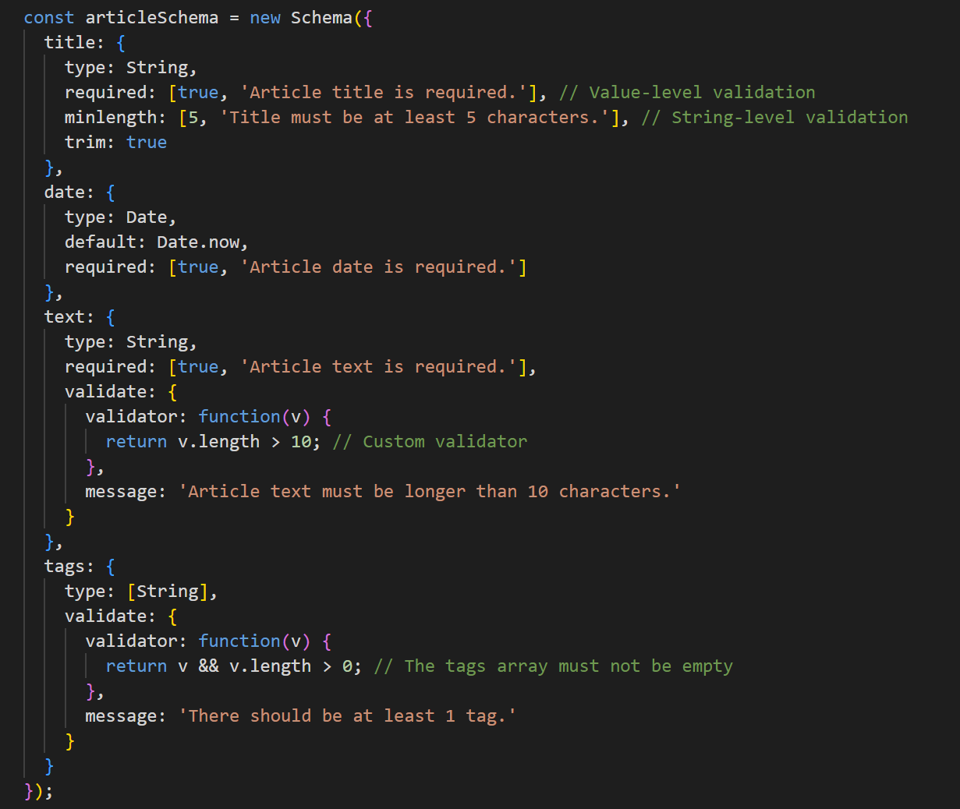
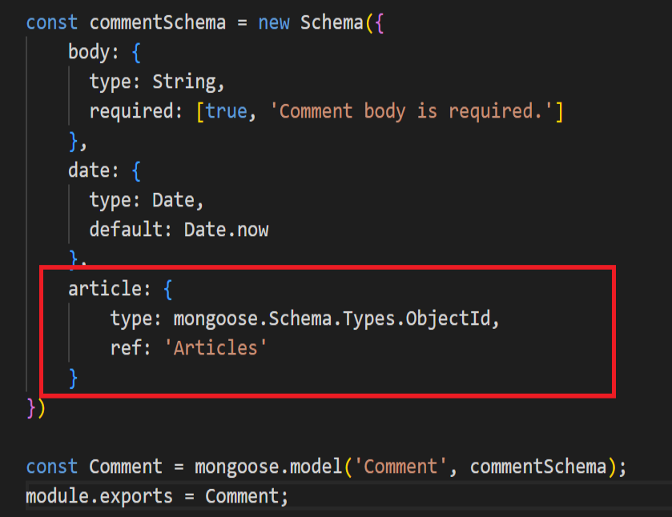
Building the Model -2

Slide 13
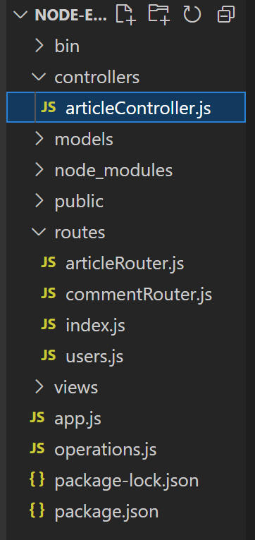
Building the Controller
Create a controller to handle the logic for your routes.
This controller will interact with the model to create, read, update, and delete resources

Slide 14
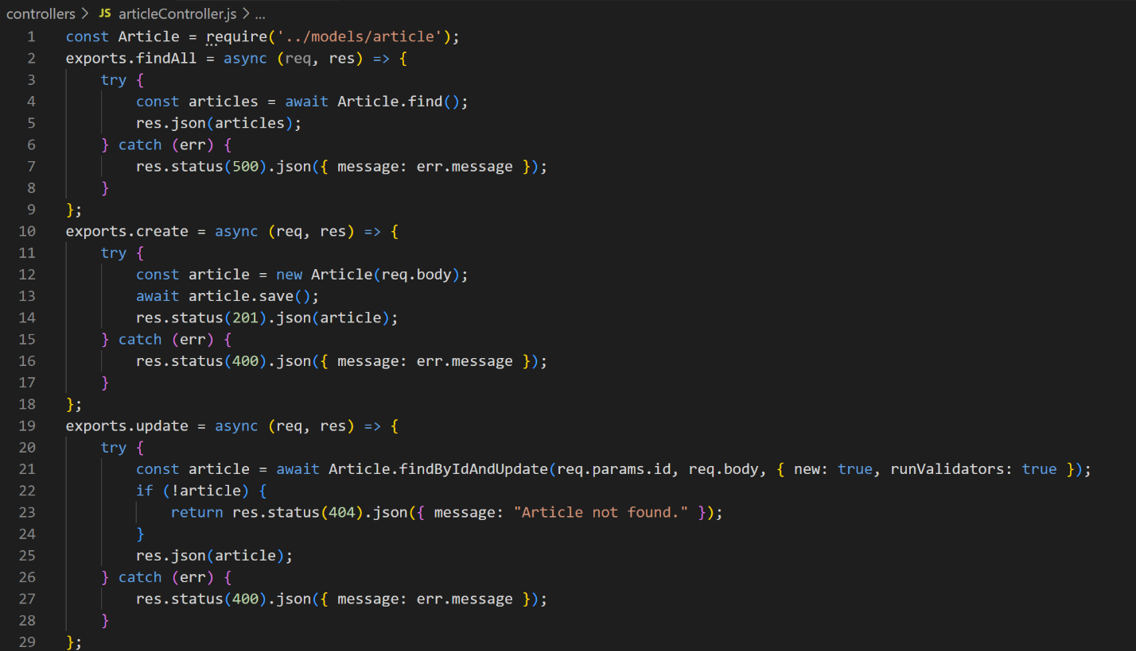
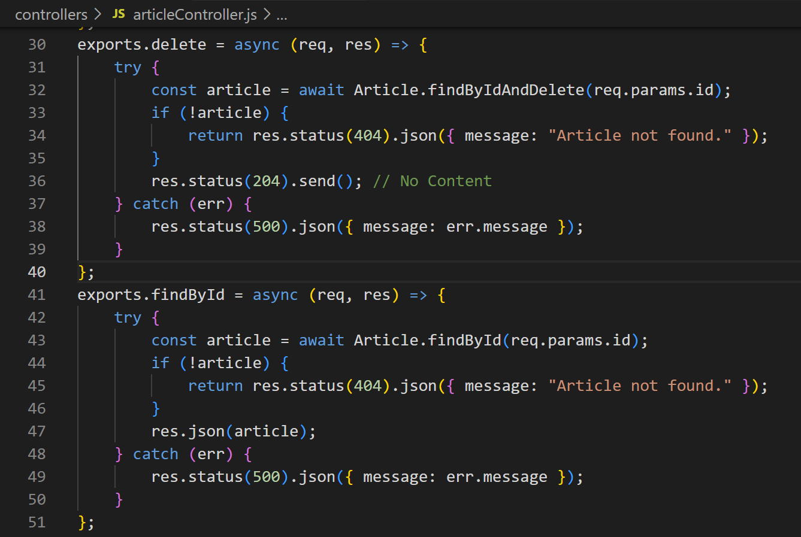
Building the Controller - 2

Slide 15
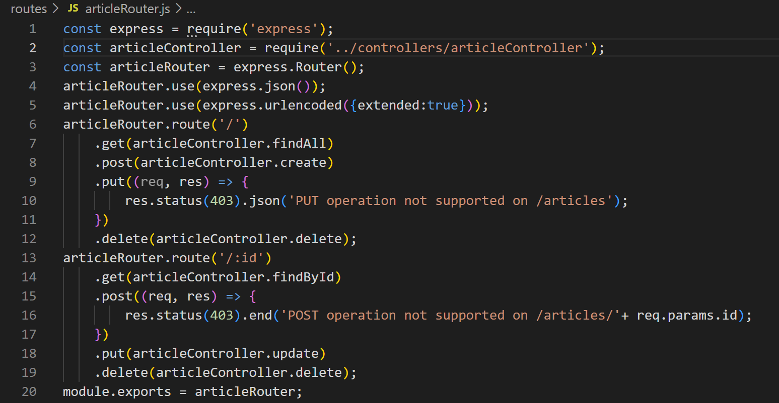
Building the routes
To communicate with our endpoints we need to set up our routes with corresponding requests.
Create a new folder named routes.
Inside the folder, create a new file named articleRoutes.js.

Slide 16
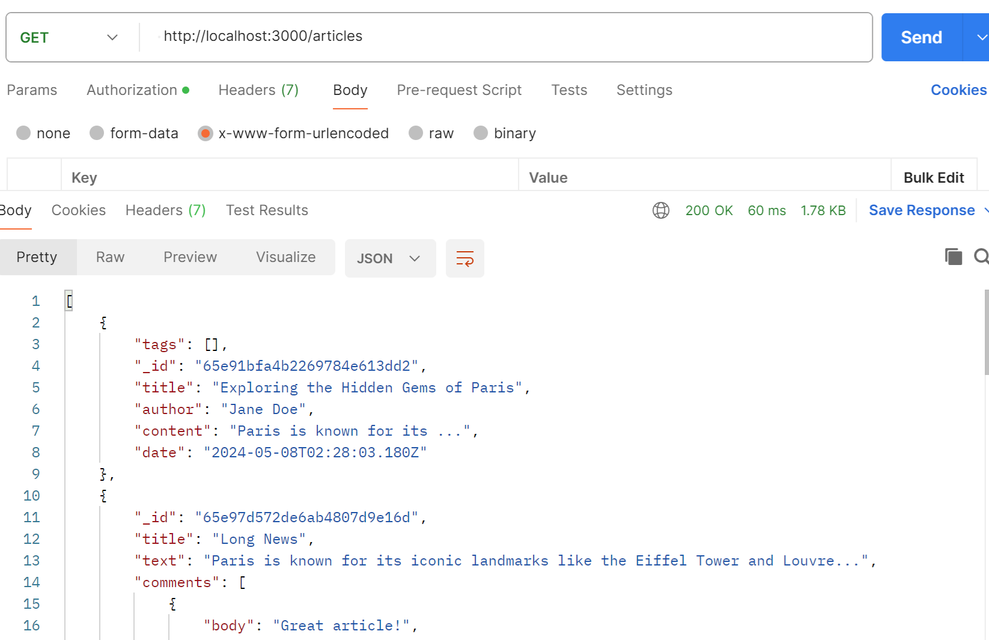
Test the endpoints by POSTMAN
Send a GET request

Slide 17
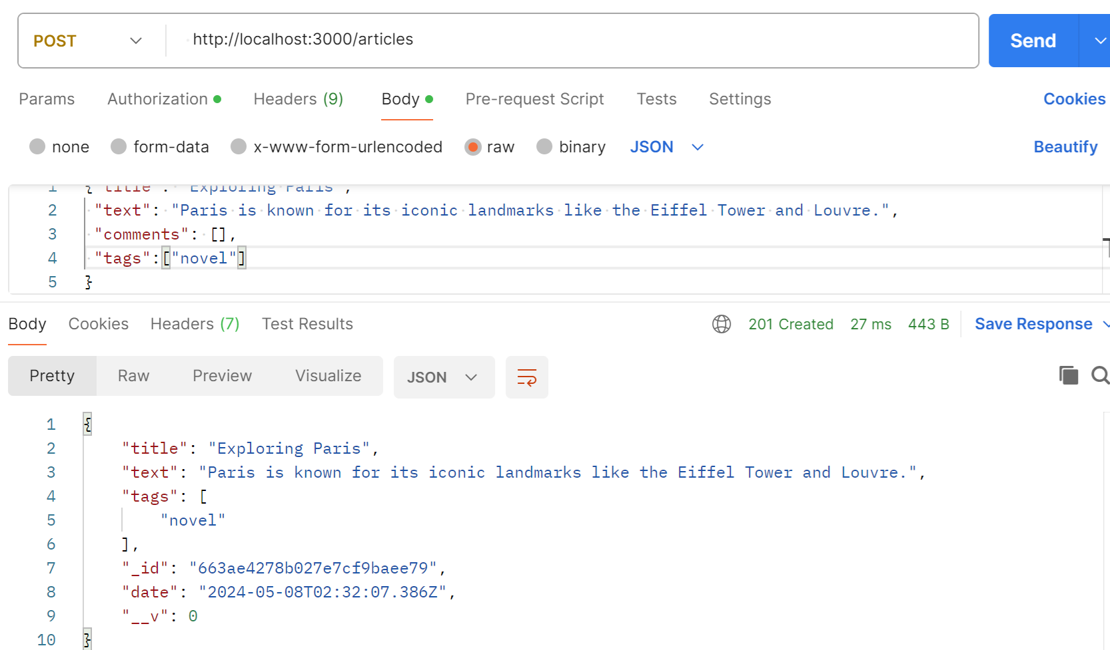
Test the endpoints by POSTMAN - 2
Send a POST request

Slide 18
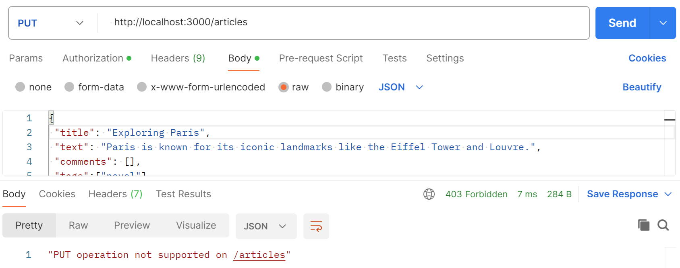
Test the endpoints by POSTMAN - 3
Send a PUT request

Slide 19
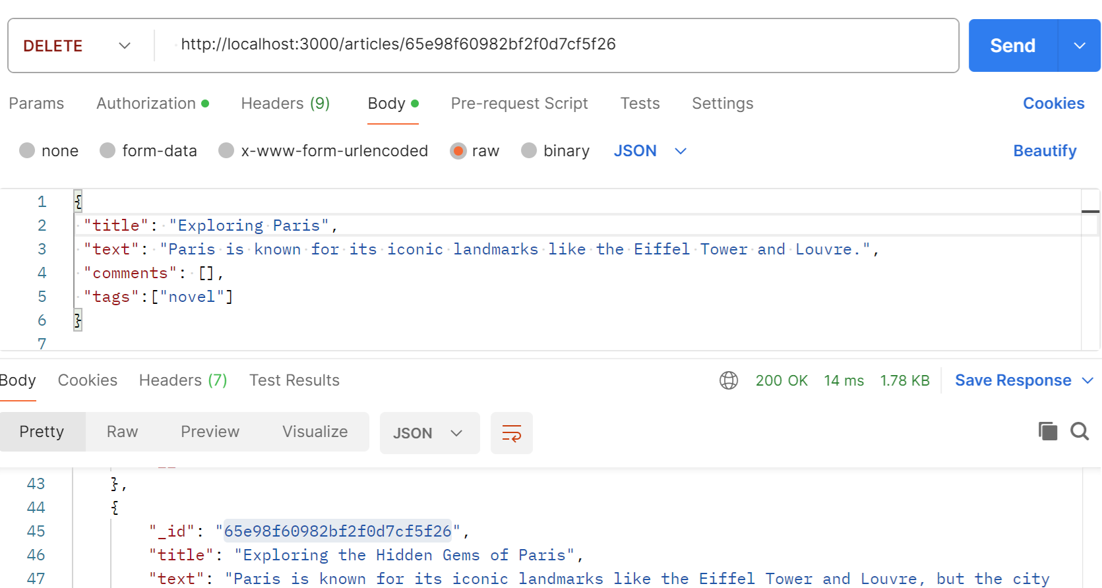
Test the endpoints by POSTMAN - 4
Send a DELETE request

Slide 20
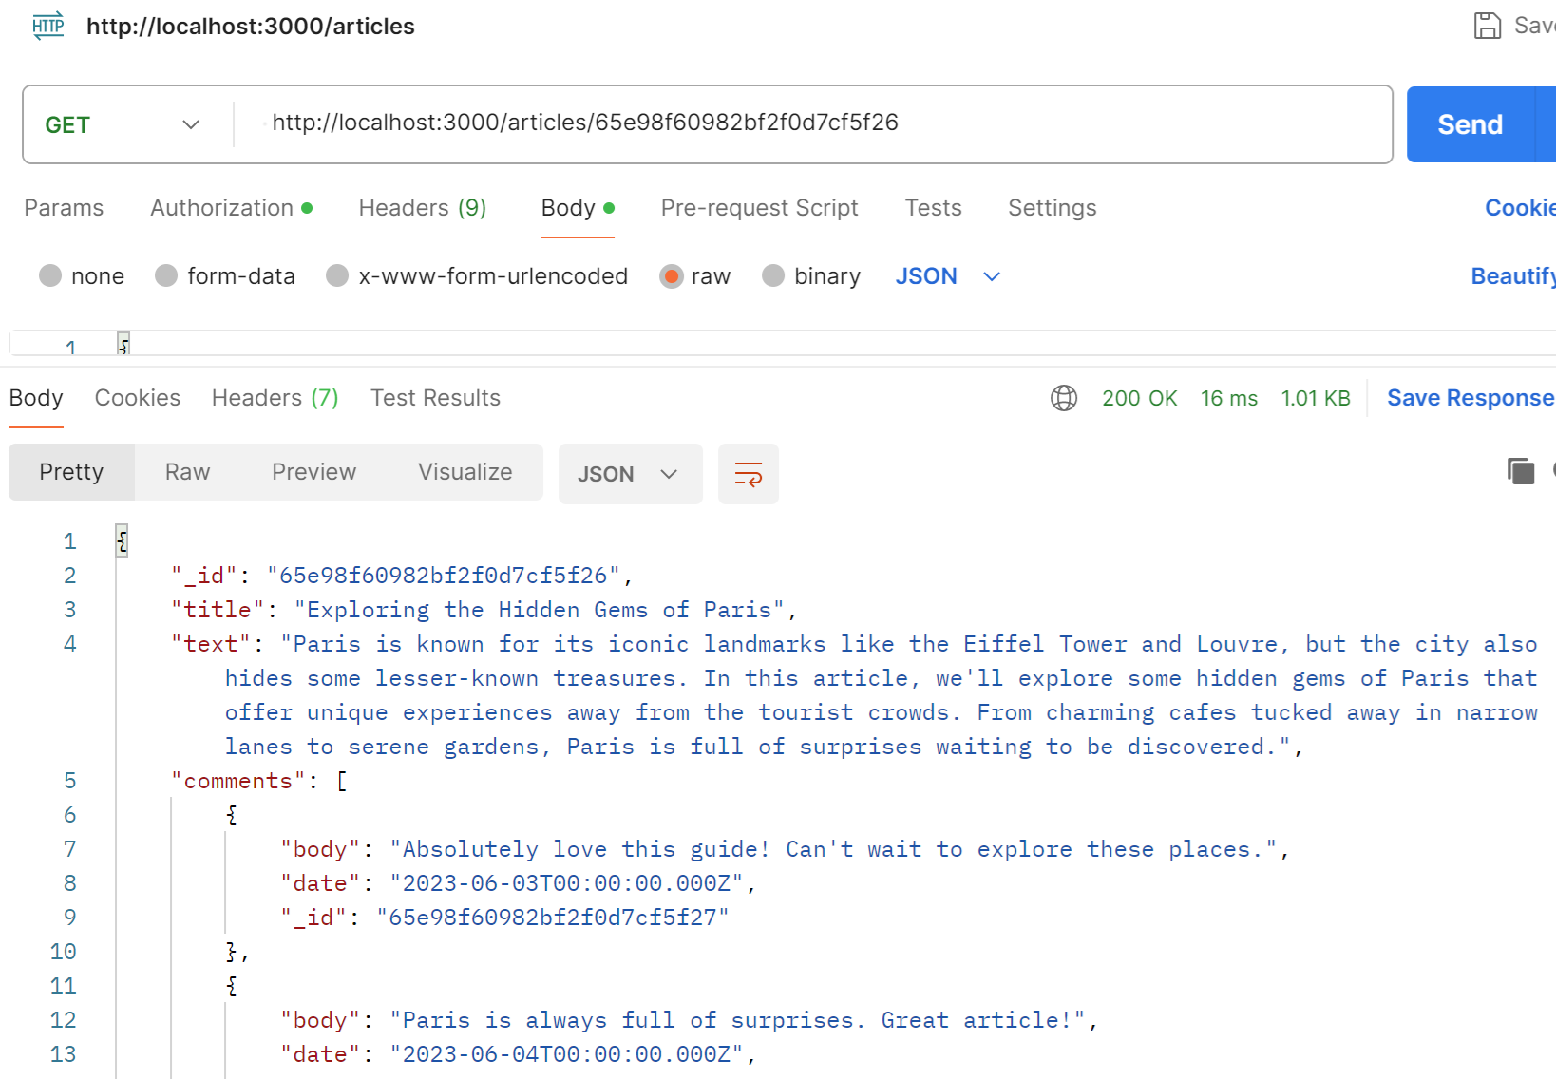
Test the endpoints by POSTMAN - 5
Send a GET request By Id

Slide 21
Exercise: Restful API with Node app and MongoDB, Mongoose

Slide 22
Summary
Concepts were introduced:
Introduction RESTful API
What is RESTful API design?
Building the Models, Controllers, Routes
Test the endpoints by POSTMAN

