Slide 1

Embedded Javascript (EJS)

Slide 2
Objectives
Introduction to EJS
Understand What Ejs Does And How To Use It With Node And Express
Templating With EJS
Compare between EJS and JSX

Slide 3
What is EJS
A simple templating language that lets you generate HTML markup with plain JavaScript.
No religiousness about how to organize things.
No reinvention of iteration and control-flow.
It's just plain JavaScript.
Reference link: https://ejs.co/

Slide 4
Features of EJS
Use plain JS
Fast Speed execution
Fast development time
Easy debugging
Simple syntax
Active development

Slide 5
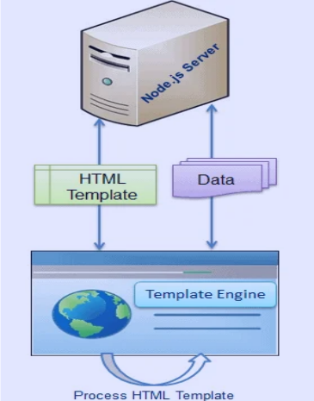
Templating with EJS
A system that inserts data into your app's HTML template from the client side is known as a template or templating engine for Node.js.
See the screenshot side, which illustrates the Template Engine Data Rendering Process.

Slide 6
Using EJS
Install EJS with NPM: npm install ejs
Configure Express to Use EJS
Set up EJS as template engine
Set up the directory containing EJS files
Create an EJS template file in the directory
Create a file named index.ejs with the following content:
app.set('view engine', 'ejs');
app.set('views', './templates');
<!DOCTYPE html>
<html lang="en">
<head>
<meta charset="UTF-8" />
<meta name="viewport" content="width=device-width, initial-scale=1.0" />
<title>Home Page</title>
</head>
<body>
<h1>Hello, <%= name %>!</h1>
</body>
</html>

Slide 7
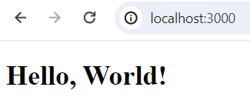
Using EJS – 2
Using Template in Route Handler
When accessing the path /, the browser displays "Hello, World!".
app.get('/', (req, res) => {
res.render('index', { name: 'World' });
});

Slide 8
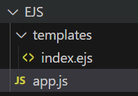
Using EJS – 3
// app.js
const express = require('express');
const app = express();
// Set up EJS as template engine
app.set('view engine', 'ejs');
// Set up the directory containing EJS files
app.set('views', './templates');
app.get('/', (req, res) => {
res.render('index', { name: 'World' });
});
// Start the server
const port = 3000;
app.listen(port, () => {
console.log(`Server running on port ${port}`);
});

Slide 9
Options of EJS
cache | Compiled functions are cached, requires filename
filename | Used by cache to key caches, and for includes
root | Set project root for includes with an absolute path (e.g, /file.ejs). Can be array to try to resolve include from multiple directories
views | An array of paths to use when resolving includes with relative paths.
context | Function execution context
compileDebug | When false no debug instrumentation is compiled
client | Returns standalone compiled function
delimiter | Character to use for inner delimiter, by default '%'
openDelimiter | Character to use for opening delimiter, by default '<'
closeDelimiter | Character to use for closing delimiter, by default '>'

Slide 10
Options of EJS – cont’d
debug | Outputs generated function body
strict | When set to `true`, generated function is in strict mode
_with | Whether or not to use with() {} constructs. If false then the locals will be stored in the locals object. (Implies `--strict`)
localsName | Name to use for the object storing local variables when not using with Defaults to locals
rmWhitespace | Remove all safe-to-remove whitespace, including leading and trailing whitespace. It also enables a safer version of -%> line slurping for all scriptlet tags (it does not strip new lines of tags in the middle of a line).
escape | The escaping function used with <%= construct. It is used in rendering and is .toString()ed in the generation of client functions. (By default escapes XML).
outputFunctionName | Set to a string (e.g., 'echo' or 'print') for a function to print output inside scriptlet tags.
async | When true, EJS will use an async function for rendering. (Depends on async/await support in the JS runtime.

Slide 11
Tags of EJS
<% | 'Scriptlet' tag, for control-flow, no output
<%_ | ‘Whitespace Slurping’ Scriptlet tag, strips all whitespace before it
<%= | Outputs the value into the template (HTML escaped)
<%- | Outputs the unescaped value into the template
<%# | Comment tag, no execution, no output
<%% | Outputs a literal '<%'
%> | Plain ending tag
-%> | Trim-mode ('newline slurp') tag, trims following newline
_%> | ‘Whitespace Slurping’ ending tag, removes all whitespace after it

Slide 12
EJS vs JSX: Key Differences
EJS and JSX are popular templating languages used in web development. Key differences:
 | EJS | JSX
Syntax | uses <% %> | curly braces {}
Execution | server-side | client-side
Tool Dependencies | requires server-side support and needs to be installed as a dependency in the backend framework or server | requires a build step using tools like Babel or webpack to transform JSX code into regular JavaScript
Conditional Rendering | achieved using embedded JavaScript code and traditional control structures like if-else statements | allows developers to use JavaScript expressions and conditional rendering directly within the HTML-like syntax
Component Reusability | to an extent, but it requires manual separation and inclusion of partial templates | allowing for easy and reusable component creation with props and state
Development Ecosystem | has been around for a while and has a mature ecosystem, with support for various backend frameworks and libraries | has a huge and active development ecosystem with a rich set of tools and libraries

Slide 13
When use EJS, JSX?
If your project is a simple web application that doesn't require a lot of dynamic interactions, and you want to keep things fast and simple on the server-side, EJS might be a good choice.
If you're building a complex, dynamic web application with a lot of user interaction and want to take advantage of SPA, or you're ready to use React, JSX is the way to go.

Slide 14
Demo about EJS and JSX

Slide 15
[
{
"id": 1,
"title": "Exploring the Hidden Gems of Paris",
"date": "2023-06-02",
"author": "Jane Doe",
"video":"https://www.youtube.com/embed/hLluNp5xlJE",
"content": "Paris is known ..."
},
{
"id": 2,
"title": "The Evolution of Web Development",
"date": "2023-06-03",
"author": "John Smith",
"video":"https://www.youtube.com/embed/7R6oAzie4Lc",
"content": "Web development has significantly ..."
},
{
"id": 3,
"title": "Sustainable Living: Tips for Reducing Your Carbon Footprint",
"date": "2023-06-05",
"author": "Alice Johnson",
"video":"https://www.youtube.com/embed/J8kGzt9X-TA",
"content": "As awareness about ..."
}
]
To illustrate how to use data from a data.json file for a list of articles using EJS and JSX, below are examples of both methods. We assume the ‘data.json’ file is as follows:

Slide 16
For EJS(app.js) and TemplateEJS(views/articles.ejs)
//app.js
const express = require('express');
const app = express();
const articles = require('./data.json');
app.set('view engine', 'ejs');
app.get('/', (req, res) => {
res.render('articles', { articles: articles });
});
const PORT = process.env.PORT || 3000;
app.listen(PORT, () => console.log(`Server running on http://localhost:${PORT}`));

Slide 17

<!DOCTYPE html>
<html lang="en">
<head>
<meta charset="UTF-8" />
<title>News</title>
</head>
<body>
<h1>News</h1>
<ul>
<% articles.forEach(article => { %>
<li>
<h2><%= article.title %></h2>
<p>Date: <%= article.date %></p>
<p>
<iframe
width="560"
height="315"
src=<%= article.video %>
></iframe>
</p>
<p><%= article.content %></p>
</li>
<% }) %>
</ul>
</body>
</html>

Slide 18
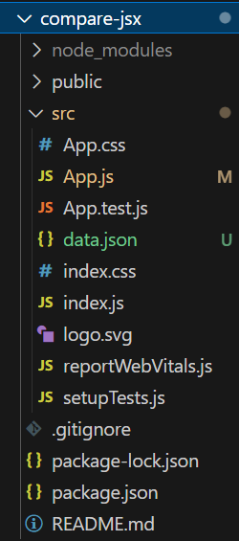
For JSX, Create React apps
npx create-react-app my-react-app
cd my-react-app
Add the data.json file to the src folder

Slide 19
Consume data in a React component (src/App.js)
import articles from './data.json';
function App() {
return (
<div>
<h1>News</h1>
<ul>
{articles.map((article) => (
<li key={article.id}>
<h2>{article.title}</h2>
<p>Date: {article.date}</p>
<p>
<iframe width="560" height="315" src={article.video}></iframe>
</p>
<p>{article.content}</p>
</li>
))}
</ul>
</div>
);
}
export default App;

Slide 20
Exercise: How To Use EJS to Template Your Node Application

Slide 21
Summary
Concepts were introduced:
Introduction to EJS
Understand What EJS Does And How To Use It With Node And Express
Templating With EJS
Compare between EJS and JSX

