Slide 1
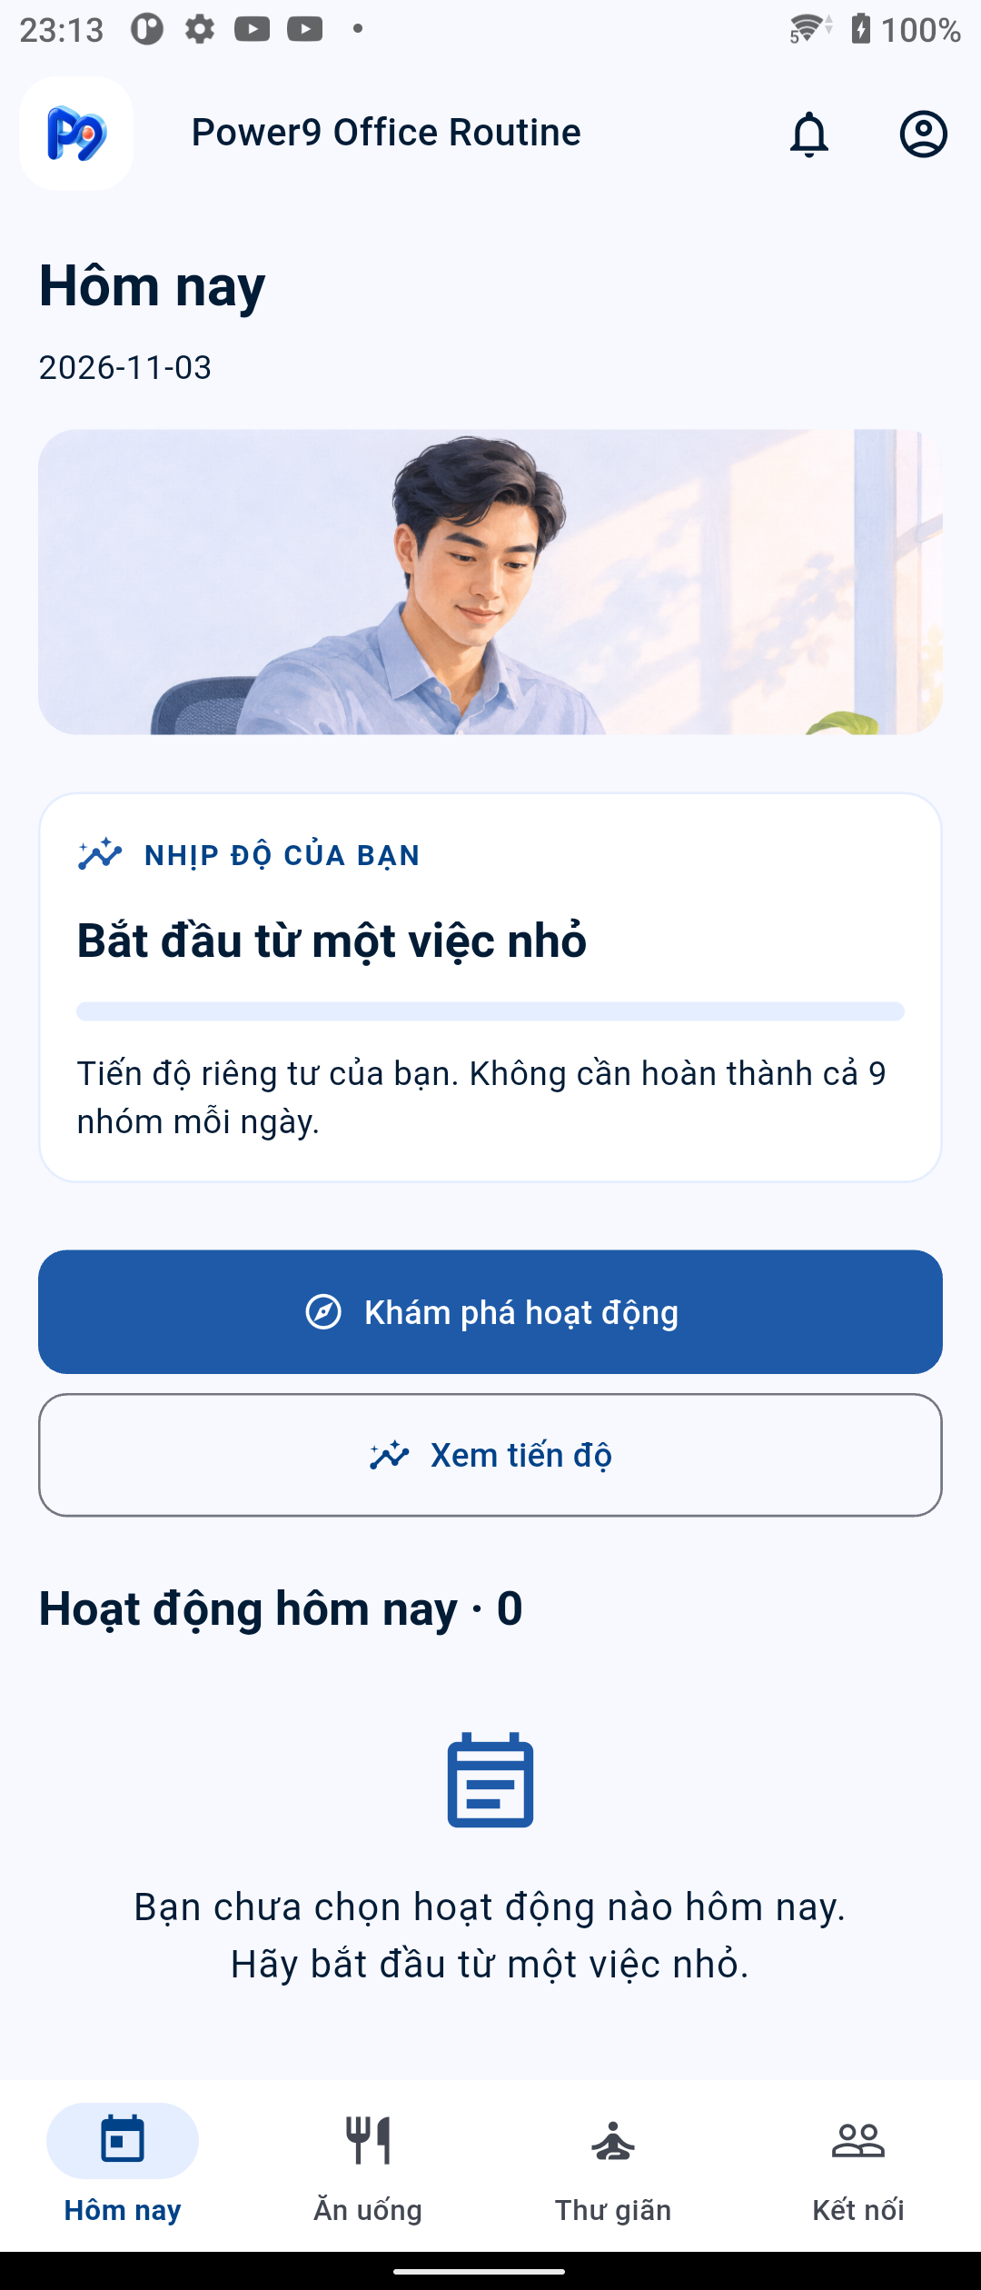
Power9 Office Routine
Plan short activities.
Keep the day flexible.
A mobile routine planner with a web Admin console
PRM393 · LAB 3 · FLUTTER + FIREBASE
Discover · Schedule · Complete · Review progress
POWER9 / LAB 3
01
Notes:
Overview: Power9 Office Routine is a Flutter Android app with a Flutter Web Admin portal. Mobile users discover workplace activities, schedule them, record completion and review daily progress. Admins manage the catalog, review user proposals, publish approved activities and send announcements. The screenshot is a genuine Xperia capture dated 3 November 2026. The project has not measured health outcomes or user adoption.
Project sources: README.md; docs/ui-refresh-2026-11-03.md; web/README.md

Slide 2
Three design personas
All three personas have equal priority. They are design inputs, not research participants.
PERSONA 01
PERSONA 02
PERSONA 03
P01 · HUY, 28
P02 · MAI, 24
P03 · LINH, 39
Software developer with long meetings. Needs movement, posture checks and quick schedule changes.
New marketer with shifting campaign work. Needs simple lunch, stress-relief and voluntary social activities.
Administrative team lead balancing meetings and family. Needs personal boundaries and flexible recovery plans.
All personas can use all nine habit groups; the app does not require a 9/9 daily target.
POWER9 / LAB 3
02
Notes:
The project brief defines Huy, Mai and Linh as equal-priority personas. The ages and routines are design assumptions. No interviews, usability sessions or timing studies have validated them.
Project sources: ux/persona.md; ux/user-flow.md

Slide 3
Problem hypotheses to validate
The current evidence is design rationale, not user-research findings.
01
Find a suitable action
Users need category and duration filters for short breaks.
02
Adapt a plan safely
Meetings change; cancelling an edit must preserve the last saved schedule.
03
Separate plan from action
Progress must distinguish scheduled activities from completed records.
No measured frequency, task-time or outcome baseline is available.
POWER9 / LAB 3
03
Notes:
The pain points below are hypotheses derived from the approved personas. The repository contains no user-study sample, frequency baseline, measured task duration or impact estimate. Validate these claims with office workers before describing them as observed problems.
Project sources: ux/persona.md; docs/office-direction.md; docs/gap-review.md

Slide 4
Solution scope and MVP boundaries
Need | Implemented response | Boundary
Discover | Published catalog, group and duration filters, Gemini suggestions | AI suggestion is optional; manual discovery remains available
Plan | One Schedule per activity per date; stable document key | Reminder time is stored; no local timed alert is sent
Record | Check-in, checklist or timer Completion | Check-in has no duration; timer stores elapsed seconds
Admin | Catalog CRUD, proposal review and publishing, announcements | Cross-role interactions verified with Firebase Emulator
Review | Daily Progress and PDF report | PDF stays local; production Storage upload is off
Core platform: Flutter Android + Flutter Web Admin + Firebase services.
POWER9 / LAB 3
04
Notes:
The MVP includes the mobile and Admin journeys listed on the slide. Scheduled reminder delivery is not implemented: reminderEnabled is stored only. PDF creation and local save were verified; production Firebase Storage upload remains disabled because the project stays on Spark.
Project sources: docs/lab3-status.md; docs/data-model.md; docs/fcm-pdf-storage.md; web/README.md; docs/ai-feature.md

Slide 5
System actors and authorization boundaries
Android user
Firebase services
Flutter Web Admin
Discover activities, plan a day,
record completion and review progress
Auth · Firestore
FCM · Analytics and diagnostics
Manage the catalog, review proposals
and publish announcements
Mobile records are scoped under users/{uid}; Admin writes require the Admin role.
POWER9 / LAB 3
05
Notes:
Mobile users can create and read their own activity proposals, schedules and completions. Admin users can review proposals and manage catalog items and announcements. Firestore rules check the signed-in UID and Admin role. Firebase is an external platform, not a human actor.
Project sources: docs/cross-role-flow.md; docs/data-model.md; web/README.md; lib/services

Slide 6
Product capabilities and priority workflows
WF-01
Discover and schedule
9 habit groups, search, duration filters, short instructions, missing-time validation
WF-02
Complete and review
Check-in, checklist and measured timer; Progress, undo and daily totals
WF-03
Maintain a plan
Edit time, cancel without writing, confirm deletion; retain Completion history
Other modules: Admin catalog and proposals · Gemini · FCM inbox · Remote Config · Crashlytics · local PDF.
POWER9 / LAB 3
06
Notes:
The main demo uses F01, F02 and F03 because each has Xperia and Firestore evidence. Admin proposal handling is a separate cross-role flow, verified in the Auth and Firestore emulators. Gemini suggestions are optional and do not create a schedule.
Project sources: docs/lab3-demo-guide.md; docs/lab3-status.md; docs/ai-feature.md; web/README.md

Slide 7
End-to-end mobile business flow
A Schedule is the plan; a Completion is the recorded activity.
MOBILE USER
APP + FIREBASE
Discover
published activity
Choose activity
and date
Validate and save
Schedule
Perform the
activity
Save Completion
and review Progress
Validation or network error
Retain draft · retry
Saving a plan never creates a Completion.
POWER9 / LAB 3
07
Notes:
The diagram shows the personal mobile journey. Firestore confirms writes before the app shows success. A validation or transaction error keeps the user draft available for correction or retry. Schedule and Completion are separate subcollections.
Project sources: docs/cross-role-flow.md; docs/data-model.md; docs/lab3-demo-guide.md

Slide 8
Timer session state machine
SESSIONVIEWMODEL STATES
start
pause
Idle
no active session
Running
monotonic elapsed
Paused
clock stopped
finish
resume
stop
Finished
record / retry
Guard: one Completion per activity and date. Discard resets without writing; schedule deletion preserves existing Completion.
Running reaches target; Running or Paused may end early.
POWER9 / LAB 3
08
Notes:
SessionViewModel uses Idle, Running, Paused and Finished states. Start begins a monotonic clock, pause excludes paused time, resume continues elapsed time, and end-early saves only measured seconds. Leaving an unrecorded session requires an explicit Stay or Discard choice. A failed write retains elapsed time for retry.
Project sources: docs/architecture.md; docs/lab3-demo-guide.md; docs/data-model.md

Slide 9
System architecture and deployment
Two Flutter clients share Firebase services; Admin and user permissions remain distinct.
Android
Flutter client
Riverpod
ViewModels
Services
Firebase SDKs
Firebase
Auth · Firestore
Analytics · FCM · Remote Config · Crashlytics · App Check · AI Logic
PDF stays on device
Flutter Web Admin
Firebase Hosting
Other integrations: Gemini via Firebase AI Logic · App Check · FCM · Analytics · Crashlytics · Remote Config.
POWER9 / LAB 3
09
Notes:
Android and Flutter Web Admin use Firebase Auth and Firestore. Firestore rules enforce UID ownership and Admin role checks. Gemini requests use Firebase AI Logic and App Check. FCM, Analytics, Crashlytics and Remote Config are integrated. PDF generation is local; production Storage upload remains disabled.
Project sources: docs/architecture.md; lib/screens; lib/viewmodels; lib/services; firebase.json; web/README.md; docs/ai-feature.md

Slide 10
Technology stack and versioned dependencies
Layer | Technology / version | Project responsibility
Mobile + Admin Web | Flutter 3.47.3 · Dart 3.13.3 | Shared Flutter codebase; Android app and Flutter Web portal
State / DI | Riverpod 3.4.3 | Providers, dependency injection and async state
Firebase core | Firebase Core 5.1.0 · Auth 7.0.1 · Firestore 7.1.0 | Login, document streams and transactions
Firebase operations | Messaging 17.0.1 · Analytics 13.0.1 · Crashlytics 6.0.1 · Remote Config 7.0.1 | Push, event telemetry, crash reports and remote feature controls
AI / PDF / security | Firebase AI Logic 5.1.0 · App Check · pdf 3.13.1 · Storage 14.0.1 | Gemini suggestions, attestation, local reports; Storage code is not production upload evidence
Firebase project: power9-office-se180724 · Firestore region: asia-southeast1 · billing: Spark.
POWER9 / LAB 3
10
Notes:
Versions below come from project manifests available in the repository. Pubspec.lock has changed in the workspace; final dependency resolution should be checked before release. Firebase Hosting deploys the Flutter Web Admin from web/build/hosting.
Project sources: pubspec.yaml; pubspec.lock; firebase.json; docs/architecture.md; web/pubspec.yaml

Slide 11
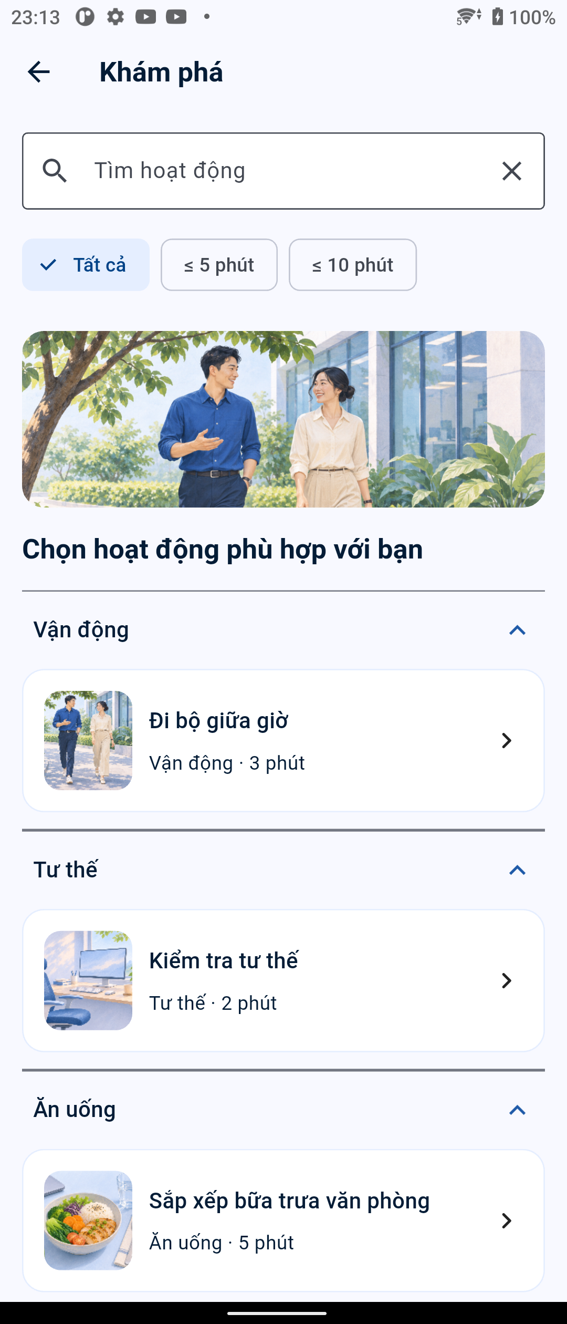
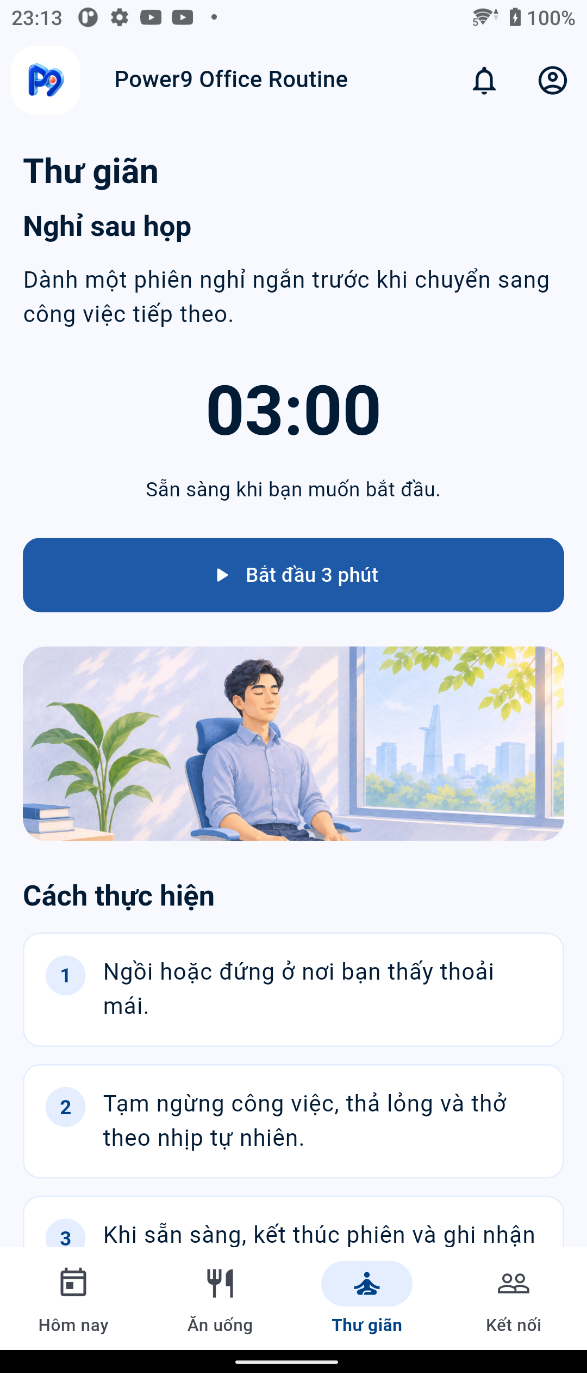
UI/UX system and screen coverage
The product screenshots show the current Vietnamese-language Android UI.
TODAY
DISCOVER
RELAX TIMER
POWER9 / LAB 3
11
Notes:
These are product screenshots, not Figma mockups. The product contains 10 primary screens across Today, Discover, Activity detail, Schedule, Relax, Food, Progress, Notification Center, Profile and Login. Fifteen screens were checked at 360 and 412 dp with 1.5x text scale. Eight product illustrations were integrated. User feedback changed image use, action placement and screen density; it was not a formal usability study.
Project sources: evidence/ui-refresh/2026-11-03/today.png; evidence/ui-refresh/2026-11-03/discover.png; evidence/ui-refresh/2026-11-03/relax.png; docs/ui-refresh-2026-11-03.md; design/screen-spec.md

Slide 12
Sequence diagram: create or update a Schedule
User / ScheduleScreen
ScheduleViewModel
ScheduleService
Cloud Firestore
1 save(scheduleDraft)
2 validate + check session
3 transaction upsert(activityId_dateKey)
4 server-confirmed snapshot
5 success or error
6 update state and Home
Failure path: keep the draft, show an actionable error and allow retry.
POWER9 / LAB 3
12
Notes:
Component names reflect the repository architecture. The server transaction upserts the stable activityId_dateKey document. Missing reminder time fails validation before any write. Firestore confirmation gates the success state; errors retain the draft.
Project sources: docs/architecture.md; docs/lab3-demo-guide.md; lib/viewmodels/schedule_view_model.dart; lib/services

Slide 13
Slide 13
Class Design — Responsibilities & Relationships
A class diagram explains code responsibilities and collaboration; it is not an ERD.
QUESTION TO ANSWER
DURATION
MANDATORY EVIDENCE
How does the code divide responsibility? Where do validation and persistence rules live?
30 s
Class names and relationships must be traceable in source code.
CONTENT TO PRESENT
CLASS RESPONSIBILITY MAP
1
Core classes in one important workflow or module.
ScheduleScreen
ScheduleViewModel
ScheduleService
2
Key attributes, operations and class dependencies.
+ render form
+ submit / cancel
+ validateDraft()
+ save(activity)
+ watchDay()
+ save() / delete()
3
Separate UI, ViewModel, service/repository and domain model.
4
Trace each business rule to its owning class and source.
FirestoreScheduleService
RULE OWNERSHIP
+ transaction upsert() · map snapshots
ViewModel: reminder requires a time.
Service: stable daily ID and server-confirmed write.
CAUTION
Schedule (domain)
Do not convert every database collection into a class with trivial getters and setters.
activityId · dateKey
minuteOfDay · reminderEnabled
Saving a Schedule records a plan; Completion is a separate domain record.
POWER9 / LAB 3
13
Notes:
Class diagram describes the implementation, not a copy of the Firestore schema. ScheduleScreen sends UI actions to ScheduleViewModel; the ViewModel validates the draft and depends on the ScheduleService interface. Riverpod injects FirestoreScheduleService. Reminder-time validation belongs to the ViewModel; FirestoreScheduleService owns deterministic IDs, transactions and snapshot mapping. Saving a Schedule does not create a Completion.
Project sources: docs/architecture.md; lib/models/schedule.dart; lib/viewmodels/schedule_viewmodel.dart; lib/services/schedule_service.dart; lib/services/firestore_schedule_service.dart; lib/screens/schedule_screen.dart

Slide 14
Database design: conceptual entity model
User
uid · role
Schedule
owner + activity + date
ActivityProposal
pending / approved / rejected
Approved proposal is published once as an Activity.
Activity
published catalog
Completion
owner + activity + date
Announcement
Admin-authored inbox item
Schedules and Completions are separate records with the same daily identity rule.
POWER9 / LAB 3
14
Notes:
The conceptual model distinguishes the shared published catalog from each user’s private schedule and completion records. Proposal review and announcements connect the mobile product to Admin operations. Publishing creates an Activity from an approved proposal in a transaction.
Project sources: docs/data-model.md; docs/cross-role-flow.md

Slide 15
Database design: Firestore paths and integrity rules
Firestore path | Key fields | Access / integrity rule
activities/{activityId} | title · groupId · purpose · minutes · steps · published | Users read published items; Admin manages catalog
users/{uid}/schedules/{activityId_dateKey} | dateKey · minuteOfDay · reminderEnabled · createdAt · updatedAt | UID owner only; stable ID; createdAt immutable
users/{uid}/completions/{activityId_dateKey} | source · durationSeconds · dateKey · createdAt | UID owner only; create-if-absent; no client update
activityProposals/{uid~id} | ownerUid · status · reason · reviewerUid · publishedActivityId | User creates own pending proposal; Admin decides once
announcements/{id} · users/{uid}/reports/{sha256} | body / title · dateKey · fileName · sha256 · storagePath | Admin creates announcements; owner stores immutable report metadata
Timer duration is an integer from 1 to the activity limit; check-in/checklist durationSeconds is null.
POWER9 / LAB 3
15
Notes:
Firestore uses security rules with default deny, UID ownership, role checks and field validation. Schedule transactions preserve createdAt when editing. Completion creation is create-if-absent and immutable after acceptance. Local PDF metadata may use storagePath=null; this is not cloud upload.
Project sources: docs/data-model.md; firebase/firestore.rules

Slide 16
Traceability matrix: features to code, data and evidence
Feature | Screen / actor | Code responsibility | Data contract | Verification evidence
WF-01 schedule | Discover · detail · user | DiscoverViewModel · ScheduleViewModel | Schedule | Missing-time validation · Firestore record
WF-02 completion | Today · Relax · user | SessionViewModel · CompletionService | Completion | Timer 72s · check-in / undo
WF-03 schedule CRUD | Schedule detail · Progress | ScheduleViewModel · ScheduleService | Schedule | Xperia CRUD · same ID · createdAt
Admin proposal | Explore · Review queue | Proposal services · Admin role guard | activityProposals | Approve / reject / publish on Emulator
Gemini suggestions | Discover · user | AI Logic client · candidate validation | Published activity IDs | 3 real requests · unknown / duplicate IDs rejected
Acceptance coverage links each requirement to a screen, service, data model, security rule and test evidence.
POWER9 / LAB 3
16
Notes:
Rows are representative traceability paths, not a complete coverage claim. Automated unit/widget, Firestore rules, emulator workflows and native Xperia smoke tests are separate evidence types.
Project sources: docs/design-traceability.md; docs/test-report.md; evidence/flows/crud/native-crud-result.json; evidence/f02; docs/ai-feature.md; web/README.md

Slide 17
Demo plan: three persona-led workflows
WF-01 · MAI
WF-02 · HUY
WF-03 · LINH
Create a plan
Record completion
Adapt a plan
Find a short activity, review instructions, save for today
Use check-in or timer, then inspect Progress
Change time, cancel safely, then confirm deletion
Setup: authenticated test account · Xperia · known date · prepared data · 6:35 backup recording.
POWER9 / LAB 3
17
Notes:
The personas define the intended scenario framing; they are not real participants. Demo each workflow with one test account and records created for the demonstration. A 6:35 app and Firebase Console video exists as backup. Reset only the records created during the demo.
Project sources: docs/lab3-demo-guide.md; output/lab3/DEMO-RUNBOOK.md; ux/persona.md

Slide 18

Demo WF-01 · Discover and create a Schedule
ACTOR
Mai · Android user
Needs a short activity that fits her lunch break.
TRIGGER
Open Discover
Filter by group/duration, inspect activity steps, choose a date.
RESULT
One server-confirmed Schedule
Home displays the saved activity after Firestore confirms the write.
Exception: reminder enabled with no time. Validation keeps the form and creates no record.
POWER9 / LAB 3
18
Notes:
Native Xperia evidence: Home started with no schedule, Discover opened the published “Midday walk” activity, missing reminder time was rejected, then a valid schedule was saved. Firestore server verification found one activity/date document. A later edit changed minuteOfDay to 1381 while preserving the same document and createdAt.
Project sources: docs/lab3-demo-guide.md; evidence/flows/schedule-validation-xperia.png; evidence/flows/firestore-server-verification.json

Slide 19

Demo WF-02 · Record completion and review Progress
CHECK-IN
No time is inferred
source=checkin; durationSeconds=null.
TIMER
Measured with Stopwatch
The end-early example saved 72 seconds, not the catalog target.
UNDO
Schedule stays in place
Undo deletes only the Completion record.
POWER9 / LAB 3
19
Notes:
Xperia timer end-early test saved 72 seconds, shown as 1 minute 12 seconds in Progress. Check-in uses source=checkin and durationSeconds=null. Undo removes only Completion; the Schedule remains. A separate full timer run saved 180 seconds.
Project sources: docs/lab3-demo-guide.md; evidence/f02/progress-early-end-xperia.png; docs/data-model.md; evidence/flows/completion-early.json

Slide 20
Demo WF-03 · Edit, cancel and delete a Schedule
01
02
03
04
Edit time
Cancel
Delete plan
Review history
Same document ID; createdAt preserved
No write; saved value unchanged
Confirmation required
Completion remains
Evidence: native Xperia CRUD · server metadata comparison · test records cleaned up.
POWER9 / LAB 3
20
Notes:
Native Xperia CRUD evidence covers create, read, update and delete. Editing the time updated the same Firestore document and preserved createdAt. Cancel left server values unchanged. Deleting the schedule retained the completion history.
Project sources: docs/lab3-demo-guide.md; evidence/flows/crud/native-crud-result.json; evidence/flows/firestore-server-verification.json

Slide 21
Verification results by test level
49 / 49
32 / 33
189 sec
Lab 3 Flutter unit/widget suite
ARTEMIS unique run IDs
Pro exploration
Scope | Result | Interpretation
Lab 3 Flutter | 49/49 passed | Unit/widget; not E2E
ARTEMIS | 32/33 verified | TC10 run 3 unresolved; 63 attempts retained
Pro exploratory | 189.02 seconds | Below the 15-minute requirement
Static analysis | No issues | Static analysis; not usability evidence
POWER9 / LAB 3
21
Notes:
Do not combine different test levels into a single pass rate. Flutter 49/49 refers to the Lab 3 unit/widget suite. ARTEMIS has 32/33 unique run IDs verified, including one delayed-terminal audit; TC10 run 3 remains unresolved. Pro exploratory lasted 189.02 seconds and did not meet the 15-minute requirement.
Project sources: docs/test-report.md; docs/lab3-e2e-results.md; docs/lab3-status.md; evidence/artemis/lab3-summary.json; docs/firebase-observability.md

Slide 22
Verified outcomes across the product
Mobile product
Flutter Android · Google Auth · Firestore schedules and completions
Interface
8 illustrations · 15 screens checked at 360/412 dp with 1.5× text
Account privacy
A to B and back to A verified; schedules, completions and inbox stayed isolated
Firebase services
FCM three states · two Remote Config behavior changes · Crashlytics records
Gemini
Three real suggestion requests returned eligible activities for 3, 5 and 10 minutes
Admin Web
Catalog, dashboard, proposal review/publish and announcements tested on Emulator
Submission
APK · 6:35 demo video · report · editable presentation
POWER9 / LAB 3
22
Notes:
Mobile and Admin verification are separate suites. Admin CRUD, proposal review, publishing and inbox were verified with Firebase Emulator; the hosted Admin login opened, while three production cross-role rounds have not been measured. Gemini returned valid recommendations at 3, 5 and 10-minute limits. FCM Console test messages were received in foreground, background and terminated app states.
Project sources: docs/lab3-status.md; docs/ui-refresh-2026-11-03.md; docs/fcm-pdf-storage.md; docs/test-report.md; docs/ai-feature.md; output/lab3/README.md

Slide 23
Limitations, impact and next steps
Open limitation | Impact | Next step
ARTEMIS TC10 run 3 | 32/33 unique run IDs verified | Complete only with approved budget and evidence plan
Pro: 189.02 seconds | Does not meet 15-minute exploration | Plan a valid exploration before spending another run
Storage upload disabled | PDF is on-device, not cloud-stored | Agree on an acceptable assignment alternative
TalkBack scope | Three manual flow groups passed; Google picker and all states untested | Complete remaining accessibility cases
No usability study | Personas and benefit statements are unvalidated | Recruit office workers; record tasks, sample and completion times
Hosted Admin integration | Emulator flows passed; production cross-role timing unmeasured | Run three real-account cross-role rounds
Report verified progress; do not claim full project completion.
POWER9 / LAB 3
23
Notes:
The latest status is based on evidence through 4 November 2026. ARTEMIS TC10 run 3 remains unresolved; Pro remains below the required exploratory duration. Storage production was intentionally left off to keep Firebase Spark and avoid billing. Three manual TalkBack flow groups were confirmed, but the Google account picker and all possible states were not covered. PR #4 is open and unmerged.
Project sources: docs/lab3-status.md; docs/lab3-e2e-results.md; docs/fcm-pdf-storage.md; docs/lab3-accessibility-check.md; docs/gap-review.md; evidence/code-review/lab3-pr.json

Slide 24
Conclusion
01
A working mobile and web product
Flutter clients backed by Firebase
02
Three device-verified workflows
Create schedule · record completion · edit/delete
03
Evidence and limitations are explicit
49 Flutter tests · 32/33 ARTEMIS IDs
Repository: github.com/PhamQuangDuc1/PRM.POWER9
POWER9 / LAB 3
24
Notes:
Close with the verified product scope and the known gaps. The repository is public, but GitHub PR #4 remains open and unmerged as of the latest project notes. Keep this slide visible for questions.
Project sources: README.md; output/lab3/README.md; docs/lab3-status.md

Slide 25
Appendix A1 · Cross-role proposal and publishing flow
Android user
creates proposal
Firestore
pending
Web Admin
review queue
Approve or reject
with reason
Publish transaction
creates Activity
On rejection, preserve the original proposal and show the review reason in “My proposals.”
After publication, Android discovers the new item through published=true. Admin announcements appear in the mobile inbox.
Rules: owner UID creates pending proposals · Admin decides once · publication uses a Firestore transaction.
POWER9 / LAB 3
25
Notes:
The mobile proposal, Admin decision, publication transaction and Android catalog refresh were verified in Firebase Emulator. The Admin Hosting login is deployed; three production cross-role rounds with real-role accounts have not been measured.
Project sources: docs/cross-role-flow.md; docs/data-model.md; web/README.md; docs/test-report.md

Slide 26
Appendix A2 · Gemini activity suggestions
User selects
group + duration
Filter published
Firestore catalog
Gemini Developer API
Firebase AI Logic
Validate IDs
max 3 suggestions
Open detail
user chooses next step
Privacy boundary
Prompt contains candidate IDs, groups and duration only. It excludes search query and personal data.
Safety boundary
Reject unknown IDs, deduplicate results, cap at three and preserve manual search/filter when AI fails.
Evidence: 3-, 5- and 10-minute real API requests returned eligible recommendations; selecting one opens Activity detail and does not create a schedule.
POWER9 / LAB 3
26
Notes:
Firebase AI Logic sends at most 30 eligible activity candidates, each containing only an activity ID, group ID and duration. Search text, names, email and personal records are excluded. App Check is required. The app validates returned IDs, removes unknown/duplicate values and renders at most three suggestions. Three Emulator requests produced eligible results for 3, 5 and 10-minute limits; all returned the same three items.
Project sources: docs/ai-feature.md; pubspec.yaml; evidence/assignment

Slide 27
Appendix A3 · Firebase services: evidence and scope
Service | Verified evidence | Limit / presentation note
Auth + Firestore | Google sign-in, offline retry/logout/back, account A/B isolation; UID/schema rules. Separate Admin suite: 22 Rules + 53 Flutter tests. | Admin cross-role runtime timing has not been measured in production
FCM | Console test message received foreground/background/terminated; tap opened app | Permission-denied recovery is a separate Android-version scope
Analytics | 11/12 event types had SDK evidence; server DebugView later received view_activity(move-walk) | During the 6:35 recording Debug Device=0; do not claim that recording proved event receipt
Crashlytics | Reporting API showed a fatal debug test crash and non-fatal network failure | Historical records; no new crash was generated for the final video
Remote Config | discover_max_minutes and connection_checkin_enabled changed behavior without rebuild | Values were returned to defaults after verification
App Check + Gemini | Debug token enabled three eligible AI requests; remote flag hid Gemini while manual discovery remained | Do not include debug token in presentation or logs
Storage | Rules/uploader code and Emulator tests exist; PDF metadata can reference local bytes | Production upload disabled; Spark plan retained
POWER9 / LAB 3
27
Notes:
Each row reports a separate service state. SDK logs are not substituted for server-side evidence. Do not represent the old DebugView capture during the demo recording as a server receipt; a later server screenshot verified view_activity for move-walk.
Project sources: docs/firebase-observability.md; docs/fcm-pdf-storage.md; docs/lab3-status.md; docs/ai-feature.md; docs/test-report.md

Slide 28
Appendix A4 · ARTEMIS case coverage
Case | Verified run IDs | Attempts retained
TC02 | 3/3 | 4
TC03 | 3/3 | 6
TC04 | 3/3 | 6
TC06 | 3/3 | 5
TC07 | 3/3 | 5
TC08 | 3/3 | 3
TC09 | 3/3 | 5
TC10 | 2/3 | 9
TC11 | 3/3 | 6
TC13 | 3/3 | 6
TC16 | 3/3 | 8
32/33 unique run IDs verified · 31 pytest-verified · 1 audit-only · 63 attempts retained
Run 3 of TC10 remains unresolved; no status has been converted from failed to passed.
POWER9 / LAB 3
28
Notes:
Verified repetition counts are unique run IDs, not pytest attempt pass rates. The published summary has 32/33 unique run IDs verified: 31 with valid pytest evidence plus one audit-only delayed-terminal observation. All 63 attempts, including failures, remain retained. TC10 run 3 is the only unresolved run ID.
Project sources: evidence/artemis/lab3-summary.json; docs/lab3-e2e-results.md

Slide 29
Appendix A5 · Firestore invariants and security contracts
Invariant | Implementation | Why it matters
Stable daily identity | activityId_yyyy-MM-dd document ID in each user subcollection | Retry and multi-device writes do not create duplicate daily records
Owner isolation | users/{uid}/schedules and /completions; rule checks request.auth.uid | Account A data does not appear in account B
Server-confirmed save | Transaction must succeed before UI reports success | Offline/cache-pending writes are not described as saved
Immutable completion | Create-if-absent; client may delete but cannot update accepted record | Retry cannot overwrite measured duration
Duration contract | Check-in/checklist: null; timer: integer 1..activity.minutes×60 | Do not infer time from catalog duration
Deletion semantics | Schedule delete does not cascade to Completion | History remains available after plan removal
Firestore Rules suites and Flutter widget tests are reported separately; neither substitutes for the outstanding ARTEMIS run.
POWER9 / LAB 3
29
Notes:
Security rules default to deny, validate owner UID and enforce allowed schema transitions. Schedule can be edited and deleted by its owner. Completion is created once and cannot be overwritten by a client. Timer and check-in have distinct duration semantics.
Project sources: docs/data-model.md; firebase/firestore.rules; firebase/tests; docs/test-report.md

Slide 30
Appendix A6 · Demo setup, recovery and handoff
Live Admin Hosting
https://power9-office-se180724.web.app/
Hosted login is available; full three-round production cross-role timing remains unmeasured.
GitHub repository
github.com/PhamQuangDuc1/PRM.POWER9
PR #4 is open and unmerged; do not describe it as merged.
Demo recording
Power9_Lab3_Demo_Final.mp4 · 6 min 35 sec
App + Firebase Console footage; Vietnamese narration and captions.
Android package
Power9-Lab3-debug-arm64.apk
Debug APK used for the latest Xperia UI verification.
Environment recovery
Remove only demo-created data; restore account, network, debug flags and accessibility settings
Do not send FCM or create Crashlytics records during the core data workflows.
Source of record: repository docs, filtered evidence files and the project’s latest status notes.
POWER9 / LAB 3
30
Notes:
For live demo, use a test account and test data, verify the current date and app session, and prepare the 6:35 backup video. Restore network, permissions and configuration afterward. Delete only records created in the demo and return to the original account/Home. The AVD script is documented but has not been rehearsed.
Project sources: docs/lab3-demo-guide.md; output/lab3/DEMO-RUNBOOK.md; docs/demo-android-emulator-2026-11-04.md; evidence/code-review/lab3-pr.json; output/lab3/README.md

