Slide 1


PROJECT OVERVIEW
Power9
thành viên
vấn đề
Môi trường sống "chống lại" thói quen
Quỹ thời gian bị xé lẻ
Sự cô lập xã hội
Đo lường sai cách gây áp lực ngược
Phạm Quang Đức -se182178
Văn Quang Duy
Nguyễn Tống Khánh Vĩnh
Đặng Đình Long
đối tượng
Bận rộn & Quá tải (Primary Persona)
Tìm kiếm Cân bằng & Chữa lành
Bảo dưỡng cơ thể
github
figma

Slide 2

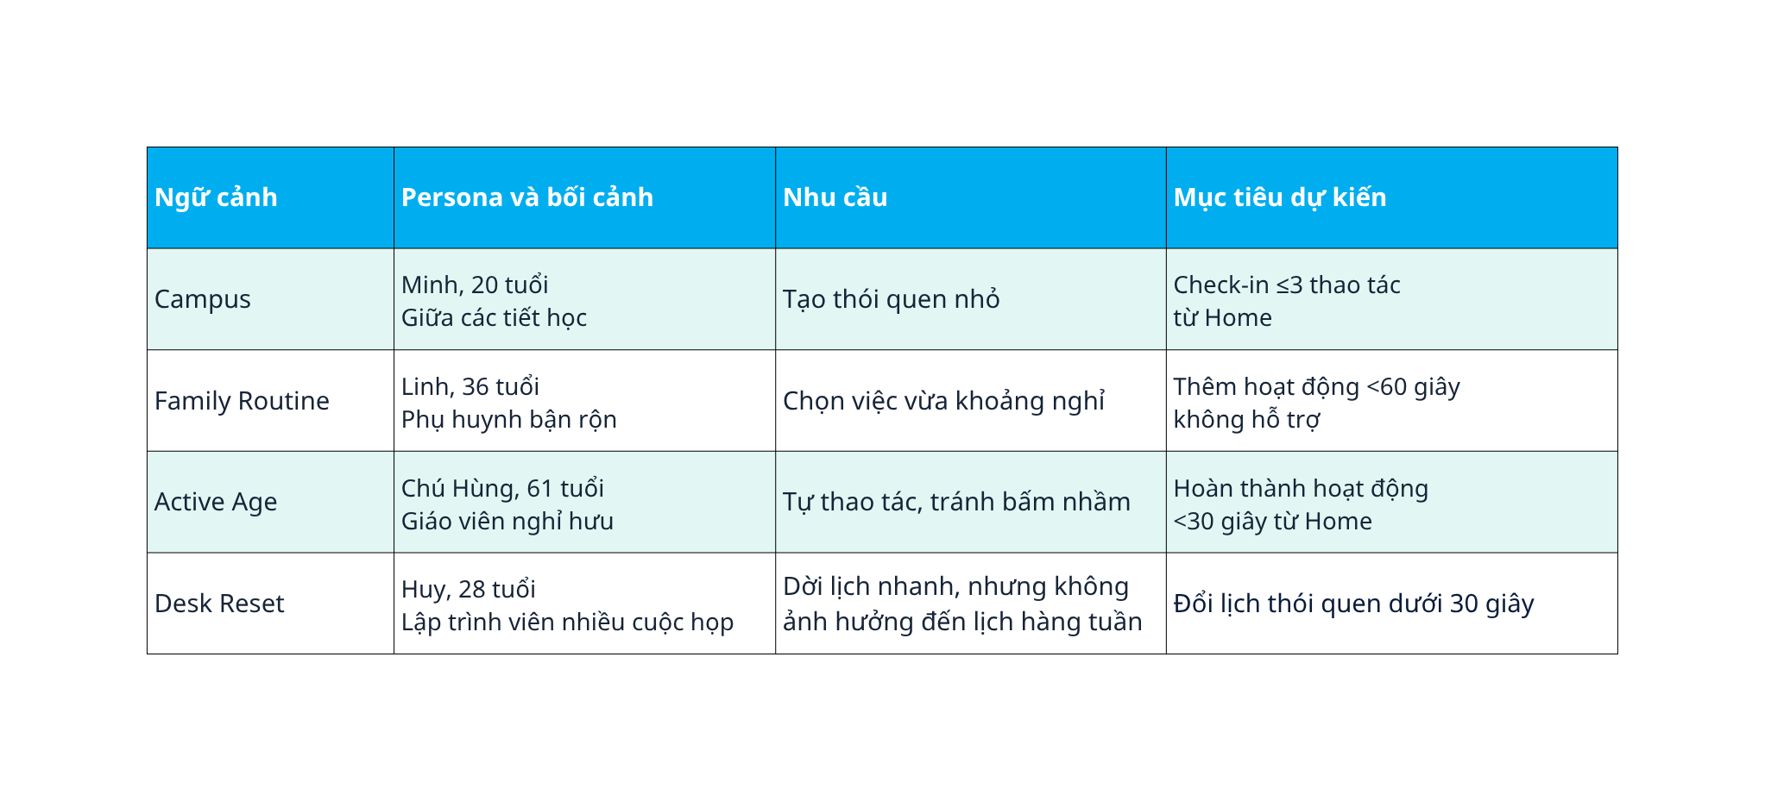
PROBLEM & PERSONA
problem statement
cần một cách để chọn và theo dõi các thói quen

Slide 3


INFORMATION ARCHITECTURE
We are a company engaged in the business sector. We not only provide success to your business but also provide an excellent attitude, approach, and treatment to our clients.

Slide 4


THREE USER FLOWS
Determine the promotion technique
Evaluate business statistics
Determine company strategy
Make plans for next year

Slide 5
AI- UI GENERATION
Determine the promotion technique
Evaluate business statistics
Determine company strategy
Make plans for next year

Slide 6

AI ITERATIONS & CRITIQUE
Planning
Management
Strategizing
Goals

Slide 7


DESIGN DECISIONS
Next slide

Slide 8

WIREFRAME → FINAL UI
  $ 1,36 billion Total net assets
  150+ Projects On Going
  350+ Projects
  500+ Employee
  9.000 Clients

Slide 9
DESIGN SYSTEM
  $ 1,36 billion Total net assets
  150+ Projects On Going
  350+ Projects
  500+ Employee
  9.000 Clients

Slide 10
ACCESSIBILITY / RESPONSIVE
We are a company engaged in the business sector. We not only provide success to your business but also provide an excellent attitude, approach, and treatment to our clients.

Slide 11




LIVE PROTOTYPE
Cahaya Dewi
Daniel Gallego
Aaron Loeb
Head of marketing
Lead Digital Creative
Business manager

Slide 12

FLUTTER HANDOFF / SUMMARY
Hopefully, this year's report can make our company even better

