Slide 1
REST & RESTful APIs

Slide 2
Content
REST
What is REST?
REST Constraints
HTTP Methods
REST resource naming guide
RESTful APIs
Web services and APIs
RESTful APIs
SOAP vs RESTful APIs

Slide 3
I. REST
What is REST?
REpresentational State Transfer
Architectural style that defines set of rules for creating web services
First presented by Roy Fielding in 2000
Notes:
Provides standards for easier communication between computer systems on the web
REST does not enforce any rule regarding how it should be implemented at lower level → REST puts high level design guidelines → Free to think of ur own implementation
http://people.cs.pitt.edu/~chang/265/C14/c14_2.html

Slide 4
I. REST
Resource
Any named information can be a resource (document, image, audio, temporal service,...)
REST uses resource identifier to identify particular resource

Slide 5
I. REST
Resource Representation
State of resource at any particular timestamp
Consists of:
Data, metadata describing the data
Hypermedia links (HATEOAS) (Optional)
Data format of representation is known as media type (JSON, XML,...)

Slide 6
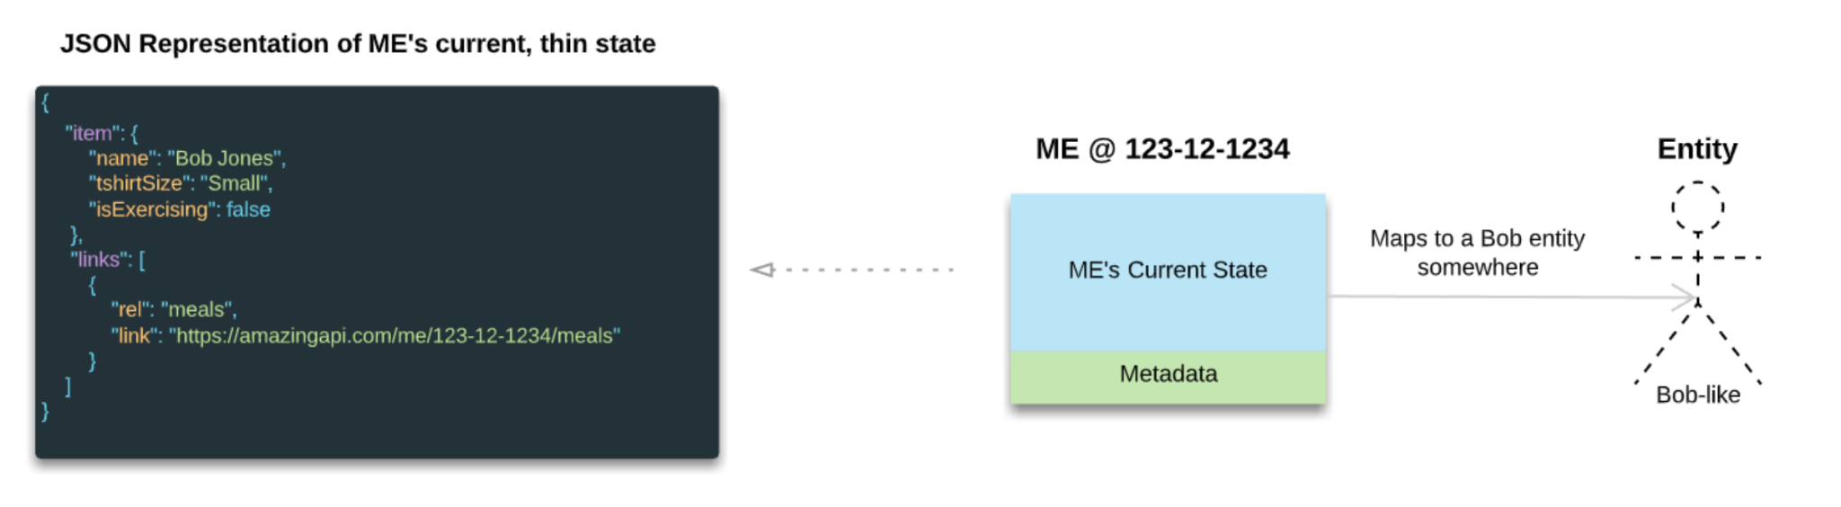
Resource Representation

Slide 7
I. REST
2. Architectural Constraint
Uniform Interface
Client - Server
Stateless
Cacheable
Layered System
Code on Demand (Optional)

Slide 8
I. REST
Uniform Interface
Identification of resources
Manipulation of resources through representations
Self-descriptive messages
Hypermedia as the engine of application state (HATEOAS)
Notes:
Uniform interface is a constraint that describes a contract between clients and servers
MIME (Multipurpose Internet Mail Extensions): classify file types on the Internet

Slide 9
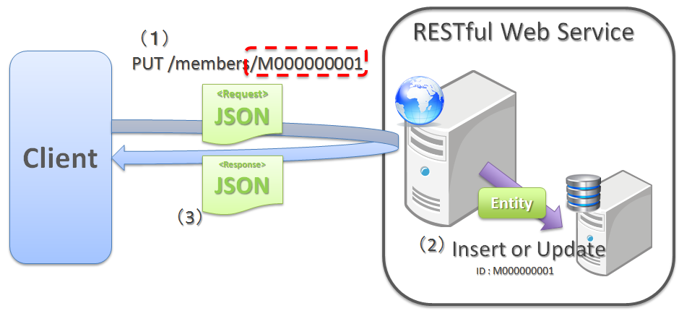
I. REST
Identification of Resource
Each resource has a unique URI

Slide 10
I. REST
Manipulation of resources through representations
Client has representation of resource
Manipulate resource representations via HTTP Methods

Slide 11
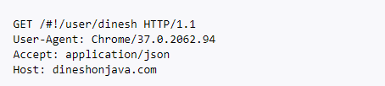
I. REST
Self-descriptive message
Each message includes enough information to describe how to process the message

Slide 12
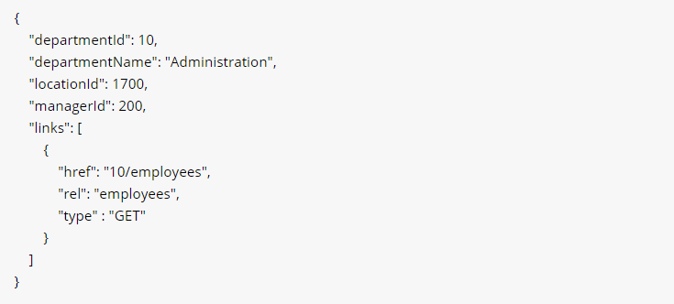
I. REST
HATEOAS
Client navigates within response through the hierarchy in order to get complementary information

Slide 13
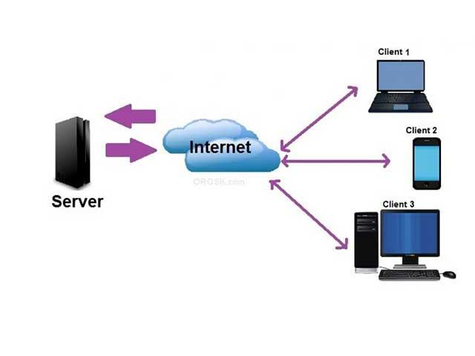
I. REST
Client - Server
Client and server should not have any dependency → May be replaced and developed independently
Client should only know resource URIs

Slide 14
I. REST
Stateless
Server would not store anything related to the session
State to handle the request is contained within the request itself

Slide 15
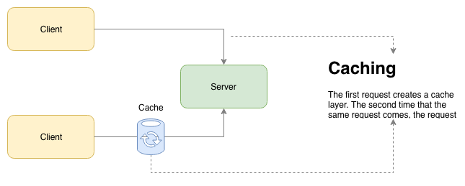
I. REST
Cacheable
Caching can eliminate some client-server interactions
Improve scalability and performance

Slide 16
I. REST
Layered System
Intermediary between client and end server
Cache, load balancer,...

Slide 17
I. REST
Code on Demand (Optional)
Resources can be returned as executable code (Applets or scripts) to extend client functionality
Simplify client by reducing amount of features required to be pre-implemented

Slide 18
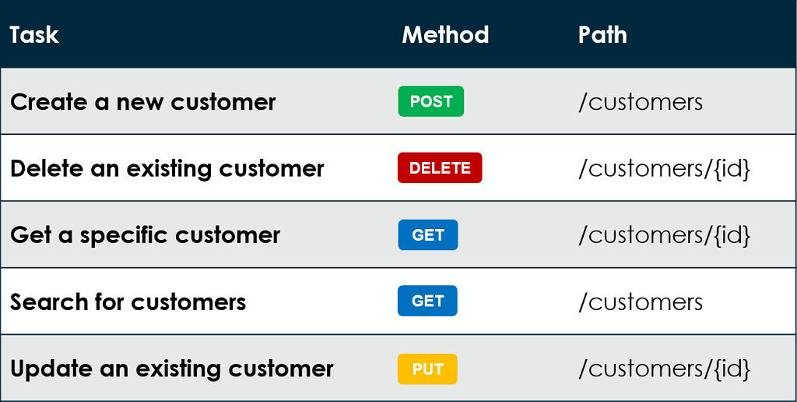
I. REST
3. HTTP Methods
GET
POST
PUT
DELETE
PATCH

Slide 19
I. REST
HTTP GET
Retrieve resource representation/information
URIs: Resource collections or single resource
HTTP GET http://api/schools
HTTP GET http://api/schools/1

Slide 20
I. REST
HTTP POST
Create new subordinate resource
URIs: Collection of resources:
HTTP POST http://api/schools
HTTP POST http://api/schools/1/students

Slide 21
I. REST
HTTP PUT
Update existing resource
URIs: Single resource
HTTP PUT http://api/schools/1
HTTP PUT http://api/schools/1/students/1

Slide 22
I. REST
HTTP DELETE
Delete resources
URIs: Single resource
HTTP DELETE http://api/schools/1

Slide 23
I. REST
HTTP PATCH
Partial update on a resource
PUT - Replace >< PATCH - Modify
URIs: Single resource
HTTP PATCH http://api/schools/1

Slide 24
I. REST
4. REST resource naming guide
REST uses URIs to address resources
Well named resources → APIs are easy to read and use
HTTP GET http://api/schools/1/students
Named poorly → Hard to read and understand
HTTP GET http://api/getAllStudentsInTheFirstSchool/

Slide 25
I. REST
Use nouns to represent resources
Never use CRUD function names in URIs
Use query component to filter URI collection
Conventions
Use “/” to indicate hierarchical relationships
Don’t use trailing “/” in URIs
Use “-” instead of “_”
Use lowercase
Don’t use file extensions

Slide 26
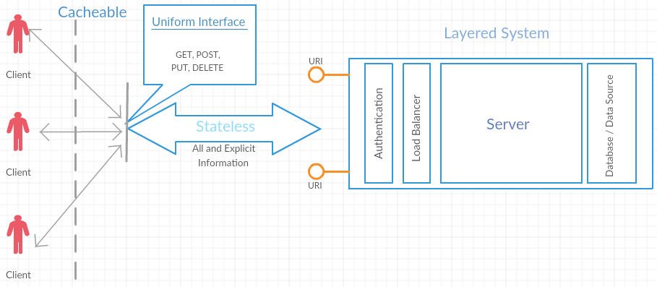
I. REST
Notes:
In REST architectural style, data and functionality are considered resources and are accessed using URIs. The resources are acted upon by using a set of simple, well-defined operations. The clients and servers exchange representations of resources by using a standardized interface and protocol – typically HTTP.
Resources are decoupled from their representation so that their content can be accessed in a variety of formats, such as HTML, XML, plain text, PDF, JPEG, JSON, and others. Metadata about the resource is available and used, for example, to control caching, detect transmission errors, negotiate the appropriate representation format, and perform authentication or access control. And most importantly, every interaction with a resource is stateless.
All these principles help RESTful applications to be simple, lightweight, and fast.

Slide 27
II. Web Services and APIs
Parameter | Web services | APIs
Definition | Set of definitions and protocols
 | Frequently used for exchanging data between systems or applications. | Allow applications to interact and communicate with each other
Accessibility | Must always be accessed through a network | Not always accessible over a network
Format supported | XML | Any given format
Notes:
Web server on one computer receives requests from others over network
Resources can be JSON, HTML, XML, images, audio files,...

Slide 28
II. Web Services and APIs
Parameter | Web services | APIs
Style of communication | REST, SOAP, XML-RPC | Any style of communication
Protocol supported | Only HTTP protocol | HTTP/S protocol
Notes:
Web server on one computer receives requests from others over network
Resources can be JSON, HTML, XML, images, audio files,...

Slide 29
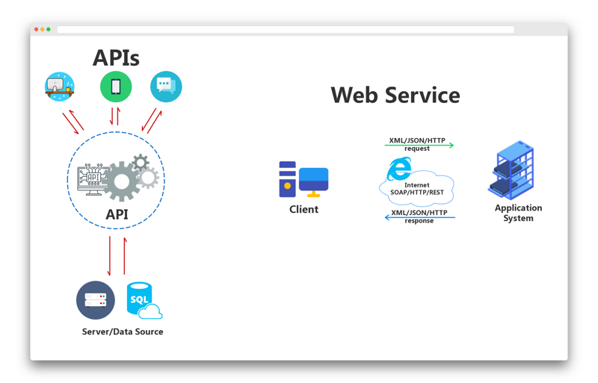
II. Web Services and APIs
All web services are APIs
Not all APIs are web services
Notes:
Web server on one computer receives requests from others over network
Resources can be JSON, HTML, XML, images, audio files,...

Slide 30
III. RESTful APIs
APIs follow REST constraints are called RESTful APIs
You are still making RESTful APIs even if violating one or two constraints, but not “truly RESTful”

Slide 31
III. RESTful APIs
SOAP
Simple Object Access Protocol
Messaging protocol where XML data is shared via HTTP requests

Slide 32
III. RESTful APIs
SOAP vs REST APIs
Protocol
SOAP is protocol for developing SOAP-based APIs
REST is architectural style

Slide 33
III. RESTful APIs
SOAP vs REST APIs
Data Format
SOAP only uses XML
REST: XML, JSON, CSV, RSS,...

Slide 34
III. RESTful APIs
SOAP vs REST APIs
Statefulness
SOAP: normally stateless but can be easily changed to stateful
REST: completely stateless

Slide 35
III. RESTful APIs
SOAP vs REST APIs
HTTP Methods
SOAP: all SOAP requests are sent through HTTP POST
REST: GET, POST, PUT, DELETE, PATCH

Slide 36
III. RESTful APIs
SOAP vs REST APIs
Caching *
SOAP: uses HTTP POST requests → Cannot be cached at HTTP level
REST: can be cached by HTTP GET

Slide 37
III. RESTful APIs
SOAP vs REST APIs
Security
SOAP: well standardized WS-Security, feature-rich and easy to implement
REST: based on HTTP, very insecure protocol. Supports basic authentication and encryption through TLS.

Slide 38
III. RESTful APIs
SOAP vs REST APIs
Asynchronous Processing
SOAP: SOAP 1.2, reliability and security
REST: return HTTP response code 202 Accepted and location of queue where status of task completion will be updated frequently

Slide 39
III. RESTful APIs
SOAP vs REST APIs
Summary
SOAP: difficult to develop, security, can be changed to stateful, asynchronous processing
REST: easy to develop, using when limited resources and bandwidth, caching, stateless

