Slide 1

TDT ASIA
BASIC OF DATABASE
TDT ASIA – GLOBAL SOCIAL SOLUTIONS

Slide 2
I. What is a Database?
II. DDL
III. DML
IV. Data type
V. Views And Index
VI. Function
VII. Store Procedure
VIII. Transaction
IX. Trigger

Slide 3
I. Database defined
- A database is an organized collection of structured information, or data, typically stored electronically in a computer system.

Slide 4
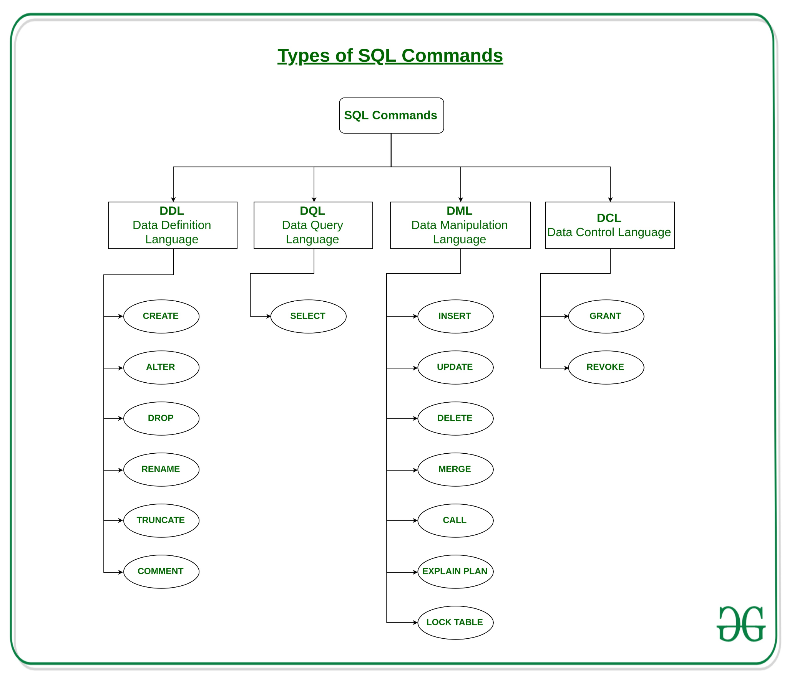

Slide 5
II. DDL – Data Definition Language
CREATE
DROP
ALTER
TRUNCATE
COMMENT
RENAME
link

Slide 6
II. DDL – CREATE
CREATE – is used to create the database or its objects (like table, index, function, views, store procedure and triggers).

Slide 7
II. DDL – CREATE: DATABASE
Syntax: CREATE DATABASE database_name;
* database_name: name of the database.
Example Query: CREATE DATABASE my_database;

Slide 8
II. DDL – CREATE: TABLE
Syntax:
CREATE TABLE table_name
(
column1 data_type(size),
column2 data_type(size),
column3 data_type(size),
....
);
* table_name: name of the table.
* column1: name of the first column.
* data_type: Type of data we want to store in the particular column.For example,int for integer data.
* size: Size of the data we can store in a particular column.

Slide 9
II. DDL – CREATE: TABLE
Example Query:
CREATE TABLE Students
(
ROLL_NO int(3),
NAME varchar(20),
SUBJECT varchar(20),
);
* table_name: Students
* ROLL_NO: type int and can store an integer number of size 3.

Slide 10
II. DDL – DROP
DROP object object_name
Examples:
DROP TABLE table_name;
table_name: Name of the table to be deleted.
DROP DATABASE database_name;
database_name: Name of the database to be deleted.

Slide 11
II. DDL – TRUNCATE
TRUNCATE TABLE table_name;
table_name: Name of the table to be truncated.
DATABASE name - student_data

Slide 12
II. DDL – ALTER TABLE: ADD
ALTER TABLE table_name
ADD (Columnname_1 datatype,
Columnname_2 datatype,
…
Columnname_n datatype);
Ex: ALTER TABLE Student ADD (AGE number(3),COURSE varchar(40));

Slide 13
II. DDL – ALTER TABLE: DROP
ALTER TABLE table_name
DROP COLUMN column_name;
Ex: ALTER TABLE Student DROP COLUMN COURSE;

Slide 14
II. DDL – ALTER TABLE: MODIFY
Syntax(Postgre):
ALTER TABLE table_name
ALTER COLUMN column_name TYPE new_data_type;
Ex: ALTER TABLE Students
ALTER COLUMN address TYPE VARCHAR;

Slide 15
II. DDL – ALTER: RENAME
Syntax:
ALTER TABLE table_name
RENAME COLUMN column_name TO new_column_name;
Ex: ALTER TABLE Student RENAME COLUMN NAME TO FIRST_NAME;

Slide 16
II. DDL – COMMENT
Syntax:
-- single line comment
-- another comment
SELECT * FROM Customers;
/* multi line comment
another comment */

Slide 17
III. DML – Data Manipulation Language
INSERT
UPDATE
DELETE
link

Slide 18
III. DML INSERT
Syntax:
INSERT INTO table_name(column1, column2, …)
VALUES (value1, value2, …);
Example:
CREATE TABLE links (
id SERIAL PRIMARY KEY,
url VARCHAR(255) NOT NULL,
name VARCHAR(255) NOT NULL,
description VARCHAR (255),
last_update DATE
);
INSERT INTO links (url, name)
VALUES('https://www.postgresqltutorial.com','PostgreSQL Tutorial');

Slide 19
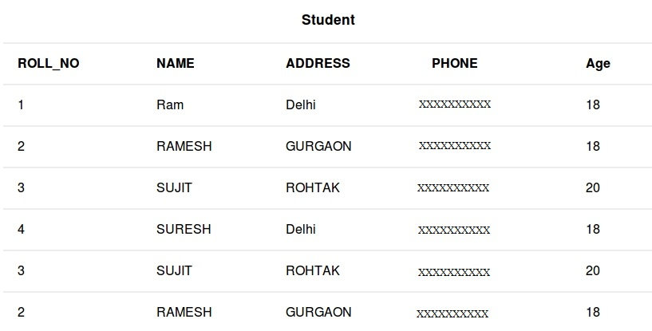
III. DML UPDATE
Syntax:
UPDATE table_name SET column1 = value1, column2 = value2,...
WHERE condition;
UPDATE Student SET NAME = 'PRATIK' WHERE Age = 20;
UPDATE Student SET NAME = 'PRATIK', ADDRESS = 'SIKKIM' WHERE ROLL_NO = 1;

Slide 20
III. DML DELETE
Syntax:
DELETE FROM table_name WHERE some_condition;
DELETE FROM Student WHERE NAME = 'Ram';

Slide 21
DQL - Data Query Language
Basic Syntax:
SELECT column1, column2
FROM table_name
column1 , column2: names of the fields of the table
table_name: from where we want to fetch

Slide 22
DQL - Data Query Language
The SELECT statement has the following clauses:
Select distinct rows using DISTINCT operator.
Sort rows using ORDER BY clause.
Filter rows using WHERE clause.
Select a subset of rows from a table using LIMIT clause.
Group rows into groups using GROUP BY clause.
Filter groups using HAVING clause.
Join with other tables using joins such as INNER JOIN, LEFT JOIN, FULL OUTER JOIN, RIGHT JOIN clauses.
Perform set operations using UNION, INTERSECT,EXCEPT.

Slide 23
Database Language
Query
Ascending and descending order：
Ascending order sorts data in ascending order
Descending order sorts data in descending order
Example
SELECT * FROM COMPANY ORDER BY NAME ASC
Sub query：
Format in which another SELECT statement is embedded in the SQL statement
Example
SELECT * FROM COMPANY
WHERE NAME NOT IN (SELECT NAME FROM COMPANY)

Slide 24
DISTINCT
Syntax:
SELECT DISTINCT column1
FROM table_name;
Example: SELECT DISTINCT FirstName
FROM [Employees]

Slide 25
ORDER BY
Syntax:
SELECT
select_list
FROM
table_name
ORDER BY
sort_expression1 [ASC | DESC],
...
sort_expressionN [ASC | DESC];
Example:
SELECT * FROM [Products] ORDER BY price DESC

Slide 26
WHERE
Syntax:
SELECT select_list
FROM table_name
WHERE condition
ORDER BY sort_expression;
Example: SELECT * FROM [Products] WHERE Price > 100;

Slide 27
LIMIT
Syntax:
SELECT select_list
FROM table_name
ORDER BY sort_expression
LIMIT row_count
Example: SELECT * FROM [Products] LIMIT 10;

Slide 28
GROUP BY
Group
Example SELECT ROLE, COUNT(*) FROM COMPANY
GROUP BY ROLE
SELECT ROLE, SUM(ROLE) FROM COMPANY
GROUP BY ROLE
HAVING SUM(ROLE) > 2
SQL | Function
COUNT | The number of data
SUM | Sum
AVG | Average
MAX | Max
MIN | Min

Slide 29
GROUP BY
Syntax:
SELECT column_1, column_2, ...,
aggregate_function(column_3)
FROM table_name
GROUP BY column_1, column_2, ...;
Example:
SELECT
customer_id,
SUM (amount)
FROM payment
GROUP BY customer_id;

Slide 30
HAVING
Syntax:
SELECT
column1,
aggregate_function (column2)
FROM table_name
GROUP BY column1
HAVING condition;
SELECT
customer_id,
SUM (amount)
FROM
payment
GROUP BY
customer_id
HAVING
SUM (amount) > 200;

Slide 31
IV. Database
Key
Super key: An attribute that can uniquely identify data
Candidate key: Spoke key without extra attributes
Primary key: One selected from candidate keys
Foreign key: An attribute that refers to a candidate key of a table

Slide 32
IV. Database language
Join
Connect two or more tables
Example
SELECT A.NAME, B.DEPT_NAME
FROM EMPLOYEE A, DEPARTMENT B
WHERE A.DEPT_CD = B.DEPT_CD
SELECT A.NAME, B.DEPT_NAME
FROM EMPLOYEE A INNER JOIN DEPARTMENT B ON A.DEPT_CD = B.DEPT_CD

Slide 33
IV. Database
L14
Exercise
https:www.w3schools.com/sql/trysql.asp?filename=trysql_asc//
Lọc ra các khách hàng ở Germany
Lọc ra các khách hàng có tên bắt đầu bằng ký tự ‘An’
Lọc ra các khách hàng đặt hàng trong khoảng thời gian OrderDate từ 1996-09-01 đến 1996-12-01.
Xóa thông tin nhà cung cấp đến từ USA
Thống kê số lượng đơn theo từng khách hàng (CustomerID), sắp xếp theo thứ tự đơn tăng dần
Join 3 table để hiển thị thông tin đơn, mặt hàng từng đơn và thông tin shipper

Slide 34
IV. Database
Integrity constraints
Mechanism to ensure the correctness of data
Constraint | Description
NOT NULL | Does not allow NULL values
Unique | Uniquely identify a row
Primary | Does not allow NULL values. It uniquely identifies the row
Referential | When there is data referring to another table in a certain table, it is necessary to register data referred to in the other table in advance.

Slide 35
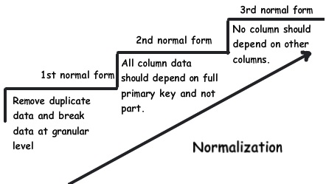
IV. Database
Normalization
Design the table so that it can be used efficiently without losing the table association, reducing the redundancy of the data inside.

Slide 36
IV. Database
Non-normal form
Staff code | Staff Name | Role Code | Role Name | Department
1000 | Cuong | 100 | PG | DEV
1001 | Nhung | 100 | PG | DEV、HR
1002 | Trang | 101 | Comter | HR
1003 | Vuong | 102 | CTO | DEV、ITA
1st Normal Form
1st Normal Form
Staff code | Staff name | Role Code | Role Name | Department
1000 | Cuong | 100 | PG | DEV
1001 | Nhung | 100 | PG | DEV
1001 | Nhung | 100 | PG | HR
1002 | Trang | 101 | Comter | HR
1003 | Vuong | 102 | CTO | DEV
1003 | Vuong | 102 | CTO | ITA

Slide 37
IV. Database
2nd Normal Form
2nd Normal Form
Staff code | Staff Name | Role Code | Role Name
1000 | Cuong | 100 | PG
1001 | Nhung | 100 | PG
1002 | Trang | 101 | Comter
1003 | Vuong | 102 | CTO
Staff code | Department
1000 | DEV
1001 | DEV
1001 | HR
1002 | HR
1003 | DEV
1003 | ITA
3rd Normal Form
3rd Normal Form
Staff Code | Staff Name | Role Code
1000 | Cuong | 100
1001 | Nhung | 100
1002 | Trang | 101
1003 | Vuong | 102
Role code | Role Name
100 | PG
101 | Comter
102 | CTO
Staff code | Department
1000 | DEV
1001 | DEV
1001 | HR
1002 | HR
1003 | DEV
1003 | ITA

Slide 38
IV.
Numeric
String
Date and Time
Others (Binary, XML, ….)

Slide 39
IV. Database – data types
Numeric data types
Integer
Real (with decimal point)
Decimal, Numeric
Float, double

Slide 40
IV. Database – data types
Numeric data types in MySQL
Float(p)
Float(M,D)
Double(M,D)
Decimal(M,D)

Slide 41
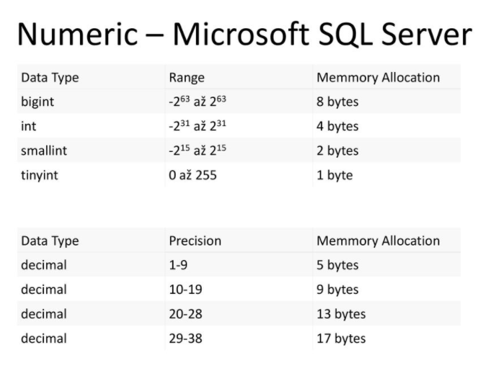
IV. Database – data types

Slide 42
IV. Database – data types
Numeric data types in MySQL
Float(p)
Float(M,D)
Double(M,D)
Decimal(M,D)
Example
Salary DECIMAL(5,2)
Values can be stored in the salary column range from -999.99 ~ 999.99

Slide 43
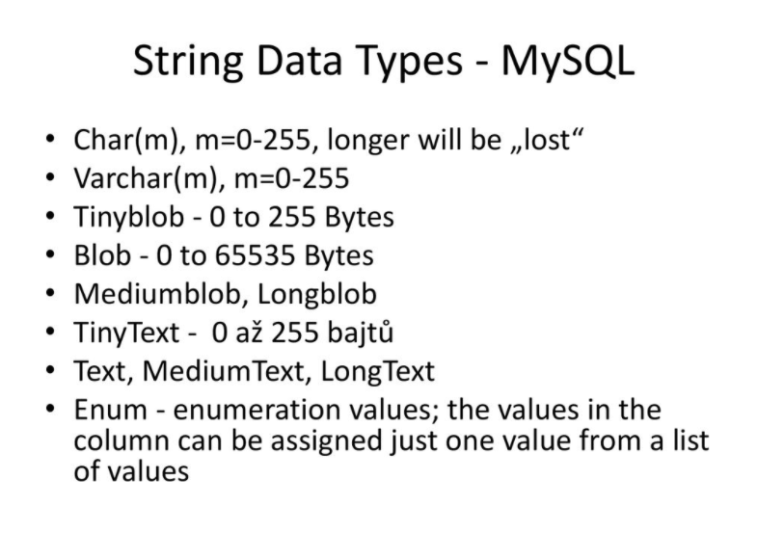
IV. Database – data types

Slide 44
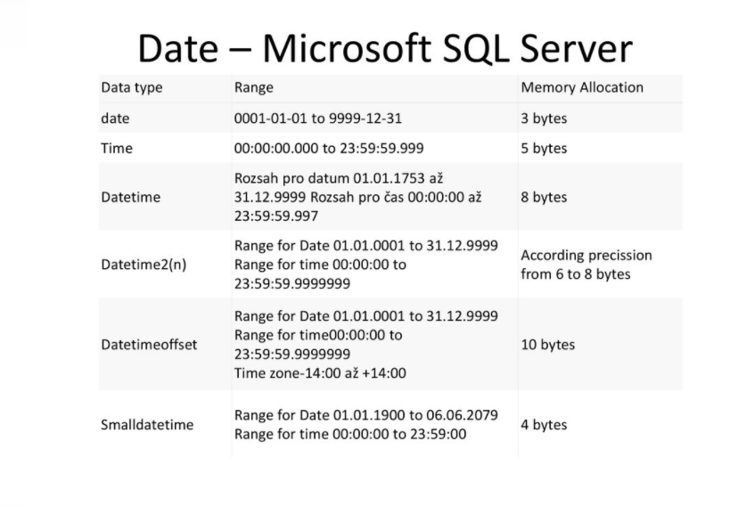
IV. Database – data types

Slide 45
IV. Database – data types
Automatically generated number
MySQL – AUTO_INCREMENT
MS SQL - IDENTITY
Oracle – sequence
Postgresql – SERIAL or DEFAULT nextval(‘xxx’)

Slide 46
V. Views and Index
Other
View：
Virtual table created from one or more tables
Index
A mechanism for improving search performance.
Method: B-Tree, bitmap index, etc.
CREATE INDEX index_name ON table_name (column_name);

Slide 47
V. Views and Index
Create View: CREATE VIEW view_name AS
SELECT col1, col2.....
FROM ten_bang
WHERE [...];
Update View: ALTER VIEW view_name [col1, col2.....] AS SELECT_QUERY
Delete View: DROP VIEW view_name;

Slide 48
V. Views and Index
- Difference between table and view? + When adding a column. + When indexing.

Slide 49
II. Function
A function is an object in the database that consists of a set of statements grouped together and created for the purpose of reuse. - Includes scalar-valued function (scalar function) that returns a single value and table-valued function (table function) that returns data records.
1. Scalar function in SQL Server requires one or more parameters and returns a single value.
Create scalar function in SQL Server:
CREATE FUNCTION sales.udfNetSale
(
@quantity INT,
@list_price DEC(10,2),
@discount DEC(4,2)
)
RETURNS DEC(10,2)
AS
BEGIN
RETURN @quantity * @list_price * (1 - @discount);
END;

Slide 50
II. Function
- Edit scalar function in SQL Server:
ALTER FUNCTION [schema_name.]function_name
(
parameter_list
)
RETURN data_type AS
BEGIN
statements
RETURN value
END
- Remove scalar function in SQL Server:
DROP FUNCTION [schema_name.]function_name;

Slide 51
II. Function
2. Table functions in SQL Server: - Table function is a user-defined function that returns table data. The return type of the table function is a table, so you can use the table function just like you would use a table.
Create table function in SQL Server:
CREATE FUNCTION udfProductInYear
(
@model_year INT
)
RETURNS TABLE
AS
RETURN
SELECT
product_name,
model_year,
list_price
FROM
production.products
WHERE
model_year = @model_year;

Slide 52
II. Function
Modify the table function in SQL Server:
ALTER FUNCTION udfProductInYear (
@start_year INT,
@end_year INT
)
RETURNS TABLE
AS
RETURN
SELECT
product_name,
model_year,
list_price
FROM
production.products
WHERE
model_year BETWEEN @start_year AND @end_year
Delete function in SQL Server:
DROP FUNCTION [ IF EXISTS ] [ schema_name. ] function_name;

Slide 53
III. Store Procedure
- Store Procedure is used to group one or more Transact-SQL statements into logical units. Stored procedures are stored as named objects in the SQL Server database server.
Create stored procedure in SQL Server:
CREATE PROC uspGetProductList
(
@model_year SMALLINT
) AS
BEGIN
DECLARE @product_list VARCHAR(MAX);
SET @product_list = '';
SELECT
@product_list = @product_list + product_name
FROM
production.products
WHERE
model_year = @model_year
ORDER BY
product_name;
PRINT @product_list;
END;

Slide 54
III. Store Procedure
- Modifying stored procedures in SQL Server :
ALTER PROCEDURE uspFindProducts
(
@min_list_price AS DECIMAL,
@max_list_price AS DECIMAL
)
AS
BEGIN
SELECT
product_name,
list_price
FROM
production.products
WHERE
list_price >= @min_list_price AND
list_price <= @max_list_price
ORDER BY
list_price;
END;
- Delete stored procedures in SQL Server :
DROP PROC sp_name;
- Executing Stored Procedures in SQL Server :
EXEC uspFindProducts 100

Slide 55
IV. Transaction
1. Transaction in SQL is a group of SQL statements. If a transaction is done successfully, all data changes made in the transaction are saved to the database. If a transaction fails and is rolledback, then all data modifications are deleted (data is restored to the state it was in before the transaction was executed).

Slide 56
IV. Transaction
2. Transaction handling
COMMIT command:
- The COMMIT command is used to save the changes invoked by a transaction to the database. - The COMMIT command saves all transactions to the database since the last COMMIT or ROLLBACK command. - The syntax of the COMMIT command is as follows: COMMIT;
Example: Suppose the table CUSTOMERS has the following records:
 | +----+----------+-----+-----------+----------+ | ID | NAME | AGE | ADDRESS | SALARY | +----+----------+-----+-----------+----------+ | 1 | Ha Anh | 32 | Da Nang | 2000.00 | | 2 | Van Ha | 25 | Ha Noi | 1500.00 | | 3 | Vu Bang | 23 | Vinh | 2000.00 | | 4 | Thu Minh | 25 | Ha Noi | 6500.00 | | 5 | Hai An | 27 | Ha Noi | 8500.00 | | 6 | Hoang | 22 | Ha Noi | 4500.00 | | 7 | Binh | 24 | Ha Noi | 10000.00 | +----+----------+-----+-----------+----------+

Slide 57
IV. Transaction
Following is an example that can delete records from a table with age=25 and then COMMIT changes in the database. DELETE FROM CUSTOMERS
WHERE AGE = 25;
COMMIT;
So two rows from the table will be deleted and the SELECT statement will give the following result.
+----+----------+-----+-----------+----------+
| ID | NAME | AGE | ADDRESS | SALARY |
+----+----------+-----+-----------+----------+
| 1 | Ha Anh | 32 | Da Nang | 2000.00 |
| 3 | Vu Bang | 23 | Vinh | 2000.00 |
| 5 | Hai An | 27 | Ha Noi | 8500.00 |
| 6 | Hoang | 22 | Ha Noi | 4500.00 |
| 7 | Binh | 24 | Ha Noi | 10000.00 |
+----+----------+-----+-----------+----------+

Slide 58
IV. Transaction
ROLLBACK command :
The ROLLBACK command is used to undo transactions that have not been saved to the database. This command can only be used to undo transactions since the last COMMIT or ROLLBACK command was issued. The syntax of the ROLLBACK command is as follows: ROLLBACK;
Example: Suppose the table CUSTOMERS has the following records:
+----+----------+-----+-----------+----------+
| ID | NAME | AGE | ADDRESS | SALARY |
+----+----------+-----+-----------+----------+
| 1 | Ha Anh | 32 | Da Nang | 2000.00 |
| 2 | Van Ha | 25 | Ha Noi | 1500.00 |
| 3 | Vu Bang | 23 | Vinh | 2000.00 |
| 4 | Thu Minh | 25 | Ha Noi | 6500.00 |
| 5 | Hai An | 27 | Ha Noi | 8500.00 |
| 6 | Hoang | 22 | Ha Noi | 4500.00 |
| 7 | Binh | 24 | Ha Noi | 10000.00 |
+----+----------+-----+-----------+----------+

Slide 59
IV. Transaction
Following is an example, it is possible to delete records from a table with age=25 and then DELETE the changes in the database:
DELETE FROM CUSTOMERS
WHERE AGE = 25;
ROLLBACK;
So the delete operation will not affect the table and the SELECT statement will give the following result.
+----+----------+-----+-----------+----------+
| ID | NAME | AGE | ADDRESS | SALARY |
+----+----------+-----+-----------+----------+
| 1 | Ha Anh | 32 | Da Nang | 2000.00 |
| 2 | Van Ha | 25 | Ha Noi | 1500.00 |
| 3 | Vu Bang | 23 | Vinh | 2000.00 |
| 4 | Thu Minh | 25 | Ha Noi | 6500.00 |
| 5 | Hai An | 27 | Ha Noi | 8500.00 |
| 6 | Hoang | 22 | Ha Noi | 4500.00 |
| 7 | Binh | 24 | Ha Noi | 10000.00 |
+----+----------+-----+-----------+----------+

Slide 60
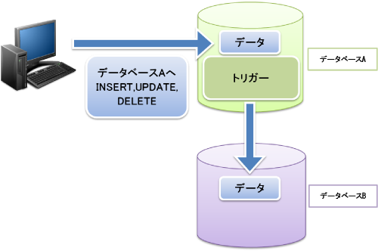
IX. Trigger
Trigger
It is executed when a specific operation is performed in the database and a condition is satisfied.

Slide 61
X. Home work
1. Tạo 1 view trong sql server ( gọi ra nhiều trường(> 2))
2. Tạo 1 table function trong sql server (tra ra view vừa tạo)
3. Tạo 1 store proseduce có gọi table function trong sql server

