Slide 1
Flow-2 AI Execution Report
Option 2 — Task/To-Do CRUD Management
vypv · Developer (Flezi-E1-Dev) · 01 Oct 2026
Direct the AI. Prove your judgement. Evidence everything.
13/13
5/5
0
automated tests passing
spec Given/When/Then scenarios covered
npm dependencies (Node.js built-ins only)
Report deck · Flow2_vypv_Flezi-E1-Dev_Option_2.pptx
Notes:
Flow-2 report for Option 2 (Task/To-Do CRUD Management). Account vypv, program Flezi-E1-Dev.

Slide 2
Executive summary
Task: Option 2 — Task/To-Do CRUD Management. Per-user to-do CRUD with strict ownership, validation and a reactive list UI.
Outcome: Task list UI (add, inline edit, toggle, delete, filters), 4 endpoints, 13 passing tests (all 5 spec scenarios).
Tooling: Claude Code agent in VS Code (model: Claude Opus 5.5) · Node.js 24 built-ins · no npm packages.
Credits used: Not yet recorded — add the actual figure from your usage page (see slide 20).
Key learning: The first draft is not the evidence. Running the tests and reviewing real screenshots exposed defects (lost 413 response, toast pile-up, layout bugs) that reading the code missed.
13/13
tests passing (npm test)
6/6
acceptance criteria traced to code + tests
4
AI outputs corrected or rejected (slide 10)
Flow-2 AI Execution Report · vypv · Flezi-E1-Dev · Option 2
2
Notes:
Summarize the project and final results.

Slide 3
Requirement understanding
What the story asks for, and the decisions made where the spec left room
As a logged-in user, I want to create, view, update, and delete my tasks, so that I can track my daily work in one place.
Interpretations & decisions
Cross-owner access returns 404 (not 403) so task IDs cannot be probed for existence; spec allows either.
PUT is a partial update (title / description / status), at least one field required.
Toggle sends the target status ({status:"done"}), not "flip", so duplicates are idempotent.
List is newest-first; ?status= filter validated (open | done).
Sign-in reuses Option 1's signed token + HttpOnly cookie (identity for ownership checks).
Acceptance criteria (from the spec)
Only own tasks; others → 403/404
Title required; desc optional; status; timestamps
Create → 201 with resource
Edit title/description + toggle status
Delete is permanent; list updates now
Missing id → 404
Flow-2 AI Execution Report · vypv · Flezi-E1-Dev · Option 2
3
Notes:
Show you understood the requirement before building.

Slide 4
Story point estimation
Fibonacci scale: complexity, effort and risk
Factor | Assessment
Complexity | Medium: ownership checks + optimistic UI with rollback
Effort | Medium: 4 endpoints, list UI with inline edit + filters, 13 tests
Uncertainty / Risk | Low: well-known CRUD pattern
Estimate | 5 points
Rationale | Back end alone ≈ 3; optimistic UI, double-click and other-tab cases add real work
Estimate proposed with the AI from the spec and what was actually built; the final number is the learner's judgement — adjust it if your team calibrates differently.
Flow-2 AI Execution Report · vypv · Flezi-E1-Dev · Option 2
4
Notes:
Explain how the estimate was reached.

Slide 5
AI tool, mode & model selection
Which mode did which job, and why
Activity | Mode | Tool / model | Why this choice
Read spec, guideline, template | Agent: file reading | Claude Code · Claude Opus 5.5 | Reads the local PDFs/PPTX directly, no copy-paste
Plan & design decisions | Agent planning (≈ Chat) | Claude Code · Claude Opus 5.5 | Weighed 403 vs 404, cookie vs storage, snapshot pricing
Implement API + UI | Agent coding (≈ Codex) | Claude Code · Claude Opus 5.5 | Multi-file repo changes: the coding-agent use case
Run tests & debug | Agent coding (≈ Codex) | node --test (local) | Real failures fixed in the loop, no model cost
Capture evidence | Script | playwright-core + local Edge | Repeatable, real screenshots of the running app
Build report deck | Agent (≈ Work) | pptxgenjs script | Deck generated from the real artifacts
Licence & model-tier check The guideline default is ChatGPT Enterprise + Codex (GPT Luna, step up to Terra; Sol+ is out of scope). Claude may be used only if your FSU/BU/client provides the licence. Confirm that licence, and that the model tier is in scope for Flow-2, before submitting.
Flow-2 AI Execution Report · vypv · Flezi-E1-Dev · Option 2
5
Notes:
Justify each mode/model choice.

Slide 6
Architecture & key design decisions
Thin layers, rules enforced twice: in code and in the database
Browser UI
node:http router
Service layer
SQLite (node:sqlite)
Vanilla JS, no framework; same-origin fetch
JSON parsing, 16 KB limit, security headers, error shape
Validation + business rules (pure functions)
UNIQUE / CHECK constraints, indexes
Decision | Why
WHERE id = ? AND owner_id = ? | Ownership enforced in every query, not after fetching
DB CHECK constraints | Non-empty title and status ∈ {open, done} even if code regresses
Optimistic UI + rollback | Instant feedback; restores state and shows a toast on error
Per-task in-flight guard | Rapid double-clicks send one request
Zero npm dependencies | Nothing to install; no supply-chain risk; runs on any Node ≥ 22.5
Flow-2 AI Execution Report · vypv · Flezi-E1-Dev · Option 2
6
Notes:
Walk through the structure of the solution.

Slide 7
Prompting & engineering
The prompt as actually sent, an honest critique, and the structure to reuse
Prompt as sent (verbatim, with the two attached screenshots)
Structured prompt to reuse (Role · Context · Task · Constraints · Output)
"do all this tassk and zip for me
my name is vypv"
Follow-up mid-run:
"sorry not the zip file
pptx file"
ROLE Senior full-stack Node.js developer.
CONTEXT Flow-2 Option 2 spec (Task/To-Do CRUD Management) PDF, report template PPTX, guideline v1.3.
TASK Implement back end + front end + one unit test per Given/When/Then row; README with run steps and the estimation table.
CONSTRAINTS Public sample data only; no new dependencies; parameterised SQL; no writes outside ./options; ask before deciding ambiguous rules.
OUTPUT Files changed, test results, open questions; then one PPTX report deck.
Honest critique
Under-specified: no role, constraints or output format.
The agent compensated by reading the guideline (13 pages), the template and the spec PDF before writing code.
A stated output format would have avoided the zip → pptx correction.
Why this structure Role sets the quality bar. Context points at files instead of pasting them. Constraints encode the guideline's red flags (data, dependencies, unapproved writes). Output makes the result easy to review.
Flow-2 AI Execution Report · vypv · Flezi-E1-Dev · Option 2
7
Notes:
Paste one representative prompt verbatim and explain its structure.

Slide 8
AI chat session
Agent — Option 2 API + UI + tests + deck — 1 Oct
What happened in the session (in order)
ADD BEFORE SUBMITTING
Screenshot or export of this Claude Code session
Export the VS Code Claude Code conversation (or screenshot its key turns) and place it on this slide; add more slides if needed.
Label it: "Agent — Option 2 API + UI + tests + deck — 1 Oct".
Do not tidy it: the weak first prompt and the zip → pptx correction are the evidence.
Redact anything confidential first.
1
Read the Flow-2 guideline, the template deck and the Option spec PDF.
2
Chose a zero-dependency Node 24 stack (node:http, node:sqlite, node:crypto, node:test).
3
Built the shared HTTP and token modules, then this option's service, API and UI.
4
Ran npm test, fixed real failures, re-ran until green.
5
Drove the app in headless Edge, reviewed every screenshot, fixed UI defects, re-captured.
6
Wrote the README; learner redirected the output from zip to PPTX; deck generated.
Flow-2 AI Execution Report · vypv · Flezi-E1-Dev · Option 2
8
Notes:
Map each chat session to a slide; do not tidy it.

Slide 9
Human-in-the-loop: review gates
Where a human (or a hard check) had to say yes before work moved on
No external writes
ADD BEFORE SUBMITTING
Your approval evidence
Add a screenshot showing you reviewing or approving the agent's work, e.g. a permission prompt, a diff review, or you running npm test.
One line on what you checked and what you would have rejected.
1
Agent worked only in local folders: no git push, PR, Jira or upload. Nothing left the machine without the learner.
Tests gate the evidence
2
Screenshots captured only after npm test was green (13/13 for this option, 74/74 across all five).
Screenshot review
3
Every captured screenshot was inspected; UI defects found there were fixed and re-captured (slide 10).
Learner sign-off
4
Learner reviews the code, runs the app and approves this deck before uploading it to the PowerApps form.
Flow-2 AI Execution Report · vypv · Flezi-E1-Dev · Option 2
9
Notes:
Make your sign-off visible.

Slide 10
Corrections & rejections of AI output
Each row really happened in this session; "found by" says who or what caught it
AI output | Problem | Found by | Fix / decision
"Title must not be empty" message | Stayed visible after the user started typing again | Screenshot review of captured evidence | Clear the error on input
Shared JSON body reader called req.destroy() on bodies over 16 KB | Client got "socket closed" instead of a 413 response | Failing test (Option 1: "rejects extremely long input") | Check Content-Length up front, drain instead of destroy; test now green
Toast messages on every write action | Six toasts stacked over the UI after rapid actions | Screenshot review of captured evidence | Keep only the 3 most recent toasts (shared client.js)
Deliverable plan: zip archive of all work | Learner wanted the PPTX report decks, not a zip | Learner (mid-session message: "not the zip file, pptx file") | Re-scoped output to one PPTX deck per option; no zip produced
ADD BEFORE SUBMITTING
Add at least one correction from your own review
Flow-2 AI Execution Report · vypv · Flezi-E1-Dev · Option 2
10
Notes:
Show 3+ places where AI output was corrected or rejected.

Slide 11
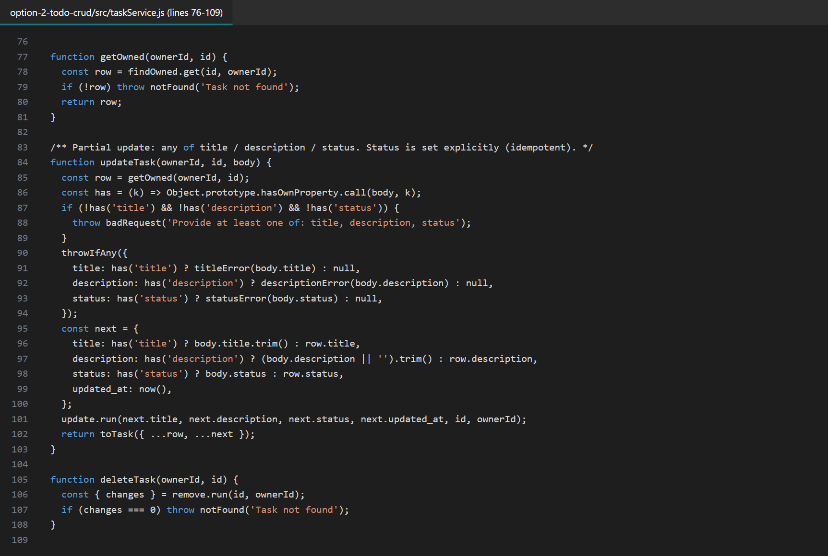
Output evidence: source code
What this shows
taskService.js: every lookup is owner-scoped; partial update validates only provided fields
Where the code lives
options/option-2-todo-crud/
src/ (server, services, db)
public/ (UI)
test/ (node:test)
README.md
Flow-2 AI Execution Report · vypv · Flezi-E1-Dev · Option 2
11
Notes:
Walk through the real artifact.

Slide 12
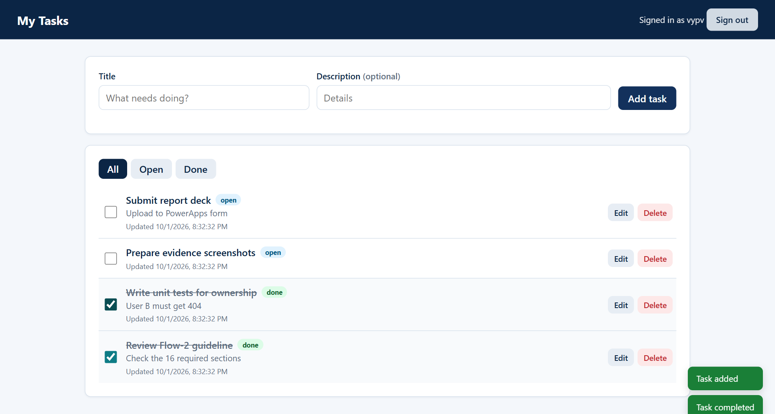
Output evidence: app UI (1/4)
Real screenshot of the running app (headless Edge, 01 Oct 2026)
What this shows
Open vs done (strikethrough + badge), edit/delete per task
Flow-2 AI Execution Report · vypv · Flezi-E1-Dev · Option 2
12
Notes:
Walk through the real artifact.

Slide 13
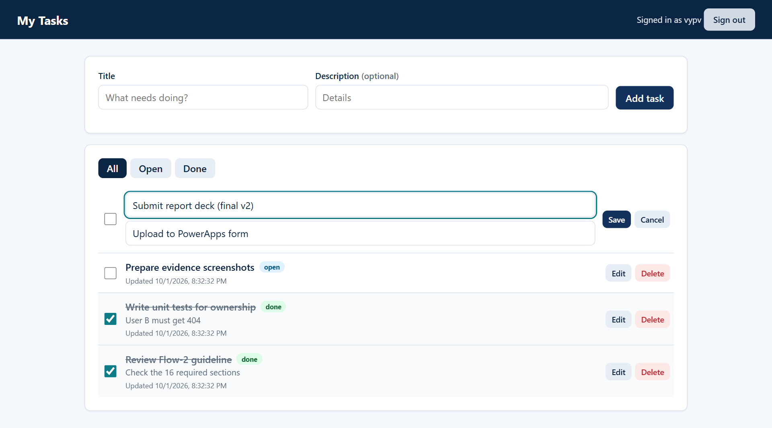
Output evidence: app UI (2/4)
Real screenshot of the running app (headless Edge, 01 Oct 2026)
What this shows
Inline edit (Enter saves, Esc cancels); whitespace-only title rejected above
Flow-2 AI Execution Report · vypv · Flezi-E1-Dev · Option 2
13
Notes:
Walk through the real artifact.

Slide 14
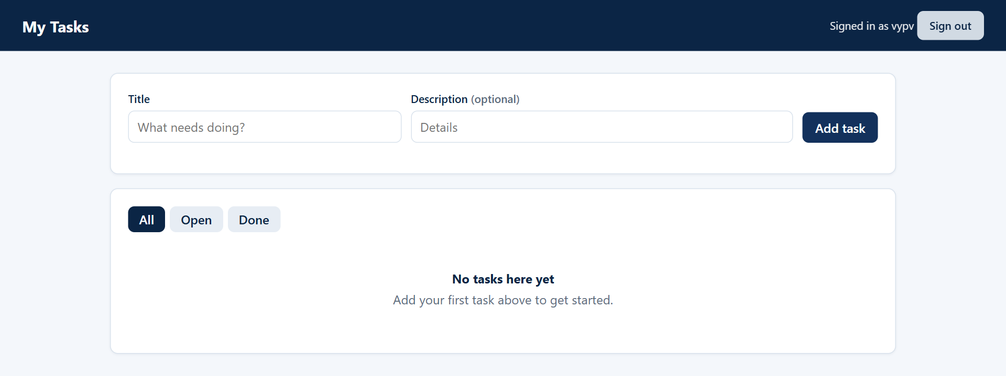
Output evidence: app UI (3/4)
Real screenshot of the running app (headless Edge, 01 Oct 2026)
What this shows
Empty state for a new user
Flow-2 AI Execution Report · vypv · Flezi-E1-Dev · Option 2
14
Notes:
Walk through the real artifact.

Slide 15
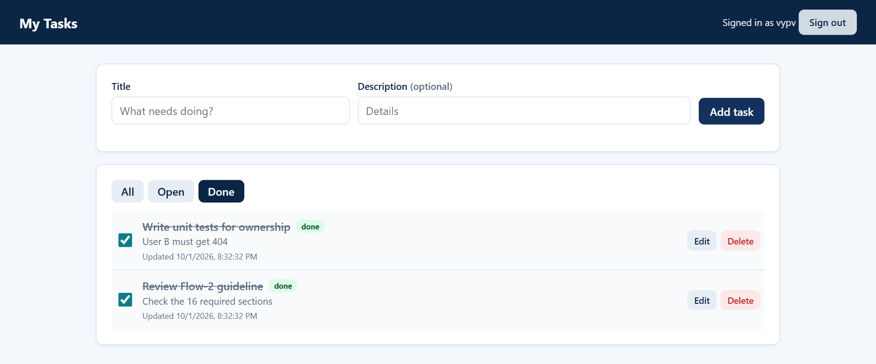
Output evidence: app UI (4/4)
Real screenshot of the running app (headless Edge, 01 Oct 2026)
What this shows
Filter tabs call GET /tasks?status=done
Flow-2 AI Execution Report · vypv · Flezi-E1-Dev · Option 2
15
Notes:
Walk through the real artifact.

Slide 16
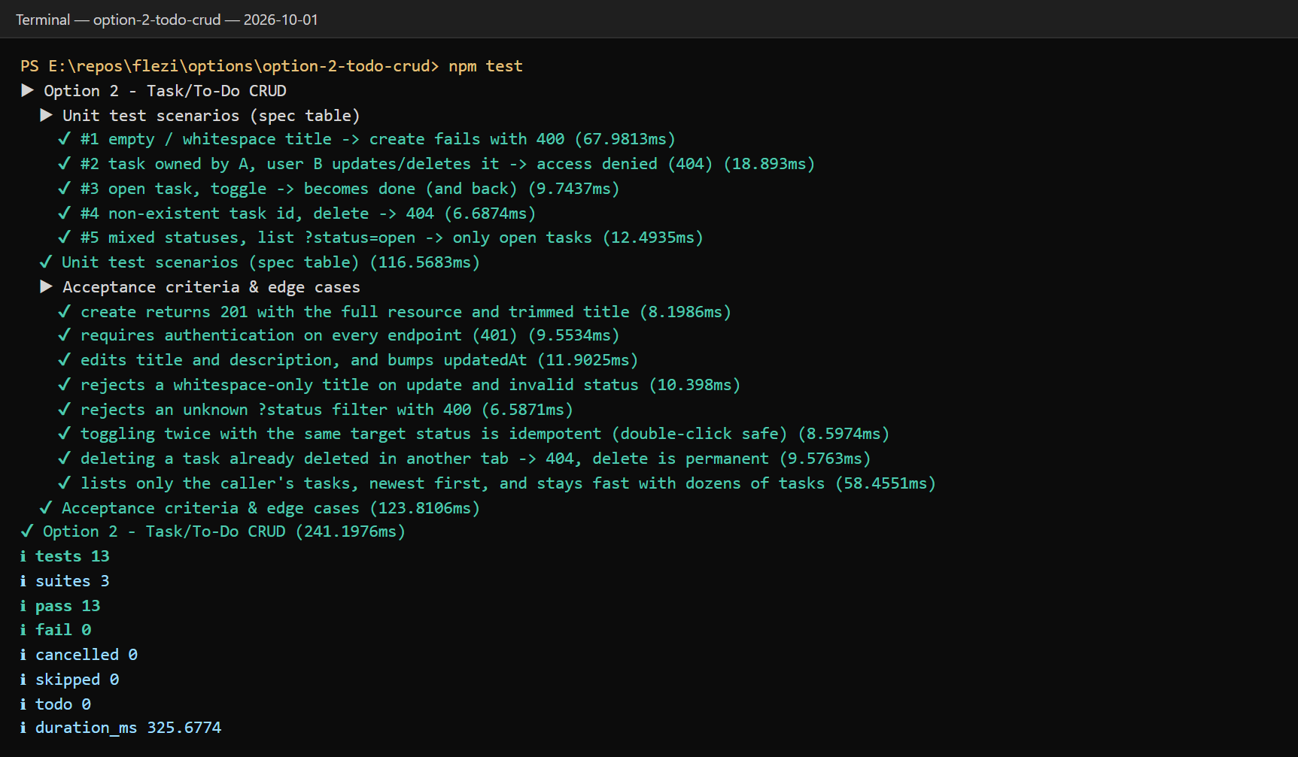
Test evidence: spec scenarios
npm test → 13 passed, 0 failed (captured run output)
# | Given / When / Then (spec table) | Result
1 | Empty / whitespace title → 400 | PASS
2 | User B updates/deletes A's task → denied (404) | PASS
3 | Open task, toggle → done (and back) | PASS
4 | Non-existent id, delete → 404 | PASS
5 | Mixed statuses, ?status=open → only open | PASS
Plus 8 extra tests for acceptance criteria and edge cases (slides 17–18). Each run uses a fresh in-memory database, so results are repeatable.
Flow-2 AI Execution Report · vypv · Flezi-E1-Dev · Option 2
16
Notes:
Show the tests actually ran and passed.

Slide 17
Acceptance criteria → code → tests
Every criterion is implemented and verified
Acceptance criterion | Implemented in | Verified by
Only own tasks; others → 403/404 | Owner-scoped SQL → 404 | #2, list-isolation test
Title required; desc optional; status; timestamps | Validation + DB CHECK | #1, create test
Create → 201 with resource | POST /tasks | Create test
Edit title/description + toggle status | PUT /tasks/:id (partial) | #3, edit test
Delete is permanent; list updates now | DELETE + optimistic removal | Delete test, UI
Missing id → 404 | getOwned() / changes === 0 | #4
Flow-2 AI Execution Report · vypv · Flezi-E1-Dev · Option 2
17
Notes:
Prove each requirement is covered.

Slide 18
Edge cases, security & non-functional
The spec's edge-case list, handled and checked
Edge case | Handling | Verified by
Whitespace-only title | 400 on create and update; UI blocks it | Test + UI shot
Rapid double-click toggle | In-flight guard + idempotent target status | Concurrency test
Deleted in another tab | 404 → row removed + info toast | Test
Other user's task | 404 on update/delete; never listed | #2
Dozens of tasks | 60-task list < 500 ms; indexed (owner_id, status) | Test
Write feedback | Toast on every add/save/toggle/delete | UI
Flow-2 AI Execution Report · vypv · Flezi-E1-Dev · Option 2
18
Notes:
Show negative paths were handled.

Slide 19
MCP selection & justification
Which server fits this task, and what was actually used
MCP server | What it would give the agent | Fit for this task | Decision
Playwright | A real browser the agent can drive | Verify UI flows, capture evidence | Selected
Context7 | Up-to-date library docs | node:sqlite is a newer API; avoid stale examples | Selected
GitHub | Repos, PRs, CI status | Useful once code is pushed for review | Later
Filesystem | Read/write a local folder | Agent already has local file access | Not needed
Database | Queries against a test DB | Embedded SQLite, inspected by tests | Not needed
Actual use in this run No MCP server was connected. The same browser automation was done with a playwright-core script driving the local Edge browser (the UI screenshots in this deck). So the MCP usage bonus (+5) is not claimed. Next step: connect the Playwright MCP so the agent can verify flows itself, with tool-call evidence.
Flow-2 AI Execution Report · vypv · Flezi-E1-Dev · Option 2
19
Notes:
Selecting the right server and saying why is required; using it is a bonus.

Slide 20
Credit / token consumption
Report actual consumption and the spending decisions behind it
ADD BEFORE SUBMITTING
Usage screenshot + credits used (actual / 250)
Screenshot your usage page after the task (redact anything private).
Copy the number to slide 2 ("Credits used").
If Claude usage is billed separately from the 250 ChatGPT credits, say so here.
Spending decisions in this run
One agent session built all five options; no re-runs "to see if it's better".
Shared modules (HTTP, token, UI helpers) were written once and reused, cutting repeated generation.
Tests and screenshots ran locally: verification cost no model tokens.
Zero-dependency stack: no install or dependency-debugging cycles.
Deck generated by a script from real artifacts, not drafted slide by slide in chat.
Flow-2 AI Execution Report · vypv · Flezi-E1-Dev · Option 2
20
Notes:
Report actual consumption and meaningful spending decisions.

Slide 21
Reusable workflow
A governed loop that works for any spec-driven story
1
2
3
4
5
Trigger / input
Prompt & context
AI action
Human review gate
Verify & hand off
Story spec with Given/When/Then, guideline, report template.
Role · Context · Task · Constraints · Output; point the agent at the spec files.
Agent coding mode: service → API → UI → tests, in small verified increments.
Read the diff, run npm test, review screenshots; reject or adjust. No external writes without preview.
Scripted evidence capture, README, report deck generated from real artifacts.
Reuse conditions Any story with explicit acceptance criteria and test scenarios. The stack can change; the gates cannot: tests before evidence, human review before anything leaves the machine, and public or sample data only.
Flow-2 AI Execution Report · vypv · Flezi-E1-Dev · Option 2
21
Notes:
Turn the work into a repeatable governed workflow.

Slide 22
Final self-check
Status before upload: green items are done, amber items need the learner
Check | Status | Evidence
Every option requirement is satisfied and evidenced | Done | Slides 11–18, README
3+ visible examples of AI output corrected or rejected | Done | Slide 10 (+ add your own)
Mode, model tier and MCP choice are justified | Done | Slides 5, 19 (confirm licence)
Every substantive chat session is labelled and submitted | Learner to do | Slide 8: add session export
Screenshots readable; sensitive data redacted | Done | Sample data only; no client data
Credit use reported; no out-of-scope model used | Learner to do | Slide 20 + licence check, slide 5
Pass rule: 80+ overall and no criterion at Level 1.
Flow-2 AI Execution Report · vypv · Flezi-E1-Dev · Option 2
22
Notes:
A pass requires 80+ and no Level 1 criterion.

