Slide 1
DEVELOPING A WEB APPLICATION FOR MUSIC GENERATION FROM VIDEO USING NATURAL LANGUAGE AS INTERMEDIARY USING OPEN SOURCE AI MODELS
MINISTRY OF EDUCATION AND TRAINING
CAN THO UNIVERSITY
UNIVERSITY THESIS DEFENSE
TOPIC NAME
Name: Phan Trung Thuan
Student code: B2111957
Instructor: Dr. Lam Nhut Khang
Major: Information and technology

Slide 2
DEVELOPING A WEB APPLICATION FOR MUSIC GENERATION FROM VIDEO USING NATURAL LANGUAGE AS INTERMEDIARY USING OPEN SOURCE AI MODELS
MINISTRY OF EDUCATION AND TRAINING
CAN THO UNIVERSITY
UNIVERSITY THESIS DEFENSE
TOPIC NAME
Name: Phan Trung Thuan
Student code: B2111957
Instructor: Dr. Lam Nhut Khang
Major: Information and technology

Slide 3
TABLE OF CONTENT
01
INTRODUCTION
02
PROPOSED APPROACHES
03
EXPERIMENT RESULTS
04
CONCLUSION AND
FUTURE WORK
05
DEMOSTRATION

Slide 4
1 - INTRODUCTION
PROBLEM STATEMENTS
Short duration music segments
End-to-end black-box models
Limited interpretability and user control

Slide 5
1 - INTRODUCTION
OBJECTIVES
Propose a language-mediated video-to-music generation framework
Use natural language as an intermediate semantic representation
Fully open-source and web-based system

Slide 6



















2 - PROPOSED APPROACHES
PROPOSED PIPELINE
Scenes
NL Prompt Generation
Captioning
Video with Music
Video
VideoChat R1.5
Qwen3
Render
PySceneDetect
Qwen3
MusicGen
Clustering
Music generation
Segments
Music features
suggestion

Slide 7
2 - PROPOSED APPROACHES
Scene clustering
short duration
Scenes
Embedding
distance
cluster
Segments
long duration
Notes:
To support retrieval methods, I designed a data pipeline with carefully chosen chunking and metadata.
First, I collect and clean data from trusted medical websites about STDs.
Then, I split the documents into chunks using a strategy that balances length and
semantic coherence, for example by paragraph or section.
Each chunk is stored with metadata such as source, language, topic, and section
heading.
These metadata fields are used for filtering and better retrieval, for example,
focusing on prevention, symptoms, or treatment guidelines.
Finally, I build BM25 indexes for lexical search and vector indexes in FAISS for
semantic search over these chunks

Slide 8
2 - PROPOSED APPROACHES
Intermediate language steps
Captioning
Music feature suggestion
Prompt preparation
Qwen3 4B Instruct 2507
Qwen3 4B Instruct 2507
VideoChat R1.5
All models are quantized in 4bit
All steps are segments independent
Music features: Genre, Mood, Style, Instruments, Context
Notes:
Data about medical articles will be recorded in CSV files, and these files are first split into
chunks of data – each chunk is a small paragraph with its own metadata.
The chunks are then indexed in two ways.
First, the BM25 retriever builds a classic keyword index over these chunks, so it can
quickly match exact terms like “chlamydia” or “condom use”.
At the same time, the chunks are converted into embedding vectors and stored in the
FAISS vector store.
When a user asks a question, the system doesn’t let the LLM answer alone.
Instead, it sends the query to the retrieval layer.
Using the nearest-neighbor search over the FAISS store, combined with the BM25
signal, the system finds the most relevant chunks from the knowledge base.
These retrieved chunks are then fed back into the LLM, which uses them as grounded
context to generate a safer and more accurate answer for the user.

Slide 9
2 - PROPOSED APPROACHES
Examples
Music features suggestion | Prompt preparation
Genre: “Sci-fi thriller” Mood: “Foreboding, tense” Style: “Minimalist, atmospheric” Instruments: “Synths, ambient drones, subtle percussion” Context: “From mystery to revelation” | “A tense, pulsing electronic score with deep synths and low-frequency drones, featuring a steady, driving rhythm and subtle percussion.”
Genre: “Ambient Electronic” Mood: “Reflective, Introspective” Style: “Minimalist, Atmospheric” Instruments: “Pulsing synth, ambient pads” Context: “Urban solitude, quiet determination” | “A minimalist ambient electronic track with a steady pulsing synth and atmospheric pads, featuring a calm yet focused energy.”
Genre: “Action” Mood: “High-energy” Style: “Electronic pulse” Instruments: “Synths, drums, bass” Context: “Racing and athletic intensity” | “A high-energy electronic pulse with driving drums, pulsing synths, and deep bass, capturing the intensity of racing and athletic motion.”
Notes:
To merge the results from BM25 and FAISS, I apply a hybrid fusion method based
on Reciprocal Rank Fusion, or RRF.
The idea is to look at the rank of each document in each ranking list and sum them
using the formula:
score_RRF = Σ 1 / (k + rankᵢ) -> “score R-R-F equals the sum over i of one over k
plus rank sub i.”
Here, documents that are highly ranked in both BM25 and FAISS will get a higher
final score.
This approach prioritizes consensus between the two retrieval methods and avoids
problems with different score scales.
In practice, this hybrid strategy helps the chatbot retrieve more relevant and robust
passages, especially for noisy or ambiguous user questions.

Slide 10
2 - PROPOSED APPROACHES
MUSIC GENERATION
Prompt-based music generation using MusicGen
Segment-based generation with continuation strategy
Loudness normalization and audio-video merging
Output rendered as a final video
Max duration: 50 seconds
Second time generation
(30 seconds)
First time generation
(30 seconds)
10 seconds overlap
Notes:
Besides the standard hybrid RAG, I also explore GraphRAG.
The main idea of GraphRAG is to represent the knowledge base as a graph, where
nodes can be entities or chunks, and edges represent relationships such as “is related
to”, “explains”, or “belongs to the same topic”.
When answering a question, the system can first identify relevant nodes and then
expand along the graph, aggregating context from connected clusters instead of
treating every chunk independently.
This helps the chatbot generate answers that are not only locally relevant, but also
globally coherent, especially for multi-step or high-level questions like prevention
strategies or comparing different STDs

Slide 11
3 – EXPERIMENT RESULTS
Test set: 20 videos from SymMV [1] (vocals removed)
Baseline: GVMGen [2]
Metrices:
Music quality Computational cost
Total Harmonic Distortion (THD)
Computational time (seconds)
Spectral Flatness (SF)
Memory usage (GB VRAM)
Spectral Centroid Variability (SCV)
Number of parameters (Billions)
Zero-Crossing Rate (ZCR)
[1] Zhuo, Le et al, "Video Background Music Generation: Dataset, Method and Evaluation," in Proceedings of ICCV, 2023.
[2] Zuo, Heda et al, "Gvmgen: A general video-to-music generation model with hierarchical attentions," in Proceedings of AAAI, 2025.
Notes:
This slide presents the overall architecture of the proposed Hybrid RAG chatbot system.
First, the interaction starts from the user query on the web interface.
Each query, together with previous messages, is stored in the local chat history, allowing the system to maintain conversation context across turns.
The query is then sent to the backend implemented using FastAPI, which acts as the central controller of the system.
Inside the backend, the system performs authentication and session management, followed by safety and scope filtering.
Scope filtering restricts retrieval to allowed domains, such as STI-related content, specific languages, or predefined sections like prevention or treatment.
This step helps ensure both information safety and retrieval precision.
Next, the filtered query is passed to the hybrid retrieval module.
At this stage, the query is processed in two parallel ways:
A BM25 index performs lexical retrieval to capture exact keyword matches.
In parallel, the query is converted into an embedding using the text-embedding-3-small model, with L2 normalization, and searched against a FAISS vector index using inner-product similarity.
The results from BM25 and FAISS are then merged using Reciprocal Rank Fusion (RRF) to produce a final top-k ranked list of relevant chunks.
In addition, the architecture supports an optional GraphRAG module, which can further expand retrieval by traversing relationships between entities and documents, providing more global and structured context.
Finally, the retrieved context, together with the conversation memory, is sent to the LLM.
The LLM generates a grounded and safety-aware answer, which is returned to the user and stored back into the chat history for future turns.

Slide 12
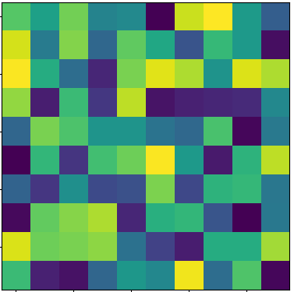
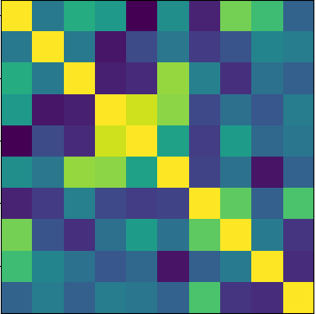
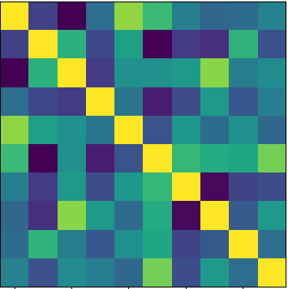

























































3 – EXPERIMENT RESULTS
$$v_{1}$$
$$v_{2}$$
$$v_{3}$$
$$v_{4}$$
$$v_{5}$$
$$v_{6}$$
$$v_{7}$$
$$v_{8}$$
$$v_{9}$$
$$v_{10}$$
Test set: 20 video from SymMV [1] (vocals removed)
Baseline: GVMGen [2]
Metrices:
Music Theory Benchmark [3] and MMLU [4]
Video-Music relationship
$$a_{1}$$
$$a_{2}$$
$$a_{3}$$
$$a_{4}$$
$$a_{5}$$
$$a_{6}$$
$$a_{7}$$
$$v_{t}$$
$$a_{8}$$
$$a_{9}$$
Avg
$$a_{10}$$
ImageBind
Cross-Modal Similarity Alignment
$$a_{10}$$
Cross-Modal Embedding Correlation (CMEC)
$$v_{1}$$
$$v_{2}$$
$$v_{3}$$
$$v_{4}$$
$$v_{5}$$
$$v_{6}$$
$$v_{7}$$
$$v_{8}$$
$$v_{9}$$
$$v_{10}$$
$$a_{1}$$
$$a_{2}$$
$$a_{3}$$
$$a_{4}$$
$$a_{5}$$
$$a_{6}$$
$$a_{7}$$
$$a_{8}$$
$$a_{9}$$
$$v_{1}$$
$$a_{1}$$
$$v_{2}$$
$$a_{2}$$
Video
(1 fps)
$$a_{3}$$
Beat-Motion Synchrony (BMS)
$$v_{3}$$
Pearson product-moment
correlation coefficients
$$v_{4}$$
$$a_{4}$$
$$v_{5}$$
$$a_{5}$$
Audio
(music)
Cross-Modal Similarity Alignment (CMSA)
$$v_{6}$$
$$a_{6}$$
$$v_{7}$$
ImageBind
$$a_{7}$$
$$v_{8}$$
$$a_{8}$$
Self-Similarity Matrix (SSM) Alignment
$$v_{9}$$
$$a_{9}$$
3 seconds sliding window
(1 second overlapped)
$$a_{t}$$
$$v_{10}$$
$$a_{10}$$
Self-Similarity of video embedding
Self-Similarity of audio embedding
[3] Yuan, Ruibin et al, "Chatmusician: Understanding and generating music intrinsically with llm," in arXiv preprint, 2024.
[4] Hendrycks, Dan, et al, "Measuring massive multitask language understanding," in arXiv preprint, 2020.
Notes:
This slide presents the overall architecture of the proposed Hybrid RAG chatbot system.
First, the interaction starts from the user query on the web interface.
Each query, together with previous messages, is stored in the local chat history, allowing the system to maintain conversation context across turns.
The query is then sent to the backend implemented using FastAPI, which acts as the central controller of the system.
Inside the backend, the system performs authentication and session management, followed by safety and scope filtering.
Scope filtering restricts retrieval to allowed domains, such as STI-related content, specific languages, or predefined sections like prevention or treatment.
This step helps ensure both information safety and retrieval precision.
Next, the filtered query is passed to the hybrid retrieval module.
At this stage, the query is processed in two parallel ways:
A BM25 index performs lexical retrieval to capture exact keyword matches.
In parallel, the query is converted into an embedding using the text-embedding-3-small model, with L2 normalization, and searched against a FAISS vector index using inner-product similarity.
The results from BM25 and FAISS are then merged using Reciprocal Rank Fusion (RRF) to produce a final top-k ranked list of relevant chunks.
In addition, the architecture supports an optional GraphRAG module, which can further expand retrieval by traversing relationships between entities and documents, providing more global and structured context.
Finally, the retrieved context, together with the conversation memory, is sent to the LLM.
The LLM generates a grounded and safety-aware answer, which is returned to the user and stored back into the chat history for future turns.

Slide 13
3 – EXPERIMENT RESULTS
Models | MMLU | MusicTheoryBench
 |  | Zero-Shot Knowledge | Zero-Shot Reasoning | Few-Shot Knowledge | Few-Shot Reasoning
ChatMusician | 41.58 | 41.26 | 22.45 | 41.64 | 26.53
ChatMusician-Base | 43.54 | 41.26 | 25.51 | 42.75 | 26.53
Qwen3 1.7B | 53.99 | 56.88 | 26.53 | 54.64 | 31.63
Qwen3 4B | 66.81 | 58.36 | 28.57 | 56.13 | 33.67
Qwen3 4B 2507 Instruct | 68.87 | 58.36 | 32.65 | 56.88 | 34.69
Qwen3 4B 2507 Thinking | 67.13 | 58.36 | 27.55 | 59.85 | 34.69
Models | THD ↓ | SF ↓ | SCV ↑ | ZCR ↓
GroundTruth | 0.1577 | 0.0163 | 707.7187 | 0.0635
GVMGen [2] | 0.1320 | 0.0132 | 714.7862 | 0.0633
V1 | 0.2345 | 0.0137 | 561.9450 | 0.0671
V2 | 0.2025 | 0.0195 | 627.6425 | 0.0757
Table 1: Comparation between ChatMusician [3] variant and Qwen3 [5] variant in music theory understanding
Table 2: Music quality evaluation results
[5] Yang, An, Anfeng Li, Baosong Yang, et al, "Qwen3 technical report," arXiv preprint, 2025.
Notes:
This slide presents the overall architecture of the proposed Hybrid RAG chatbot system.
First, the interaction starts from the user query on the web interface.
Each query, together with previous messages, is stored in the local chat history, allowing the system to maintain conversation context across turns.
The query is then sent to the backend implemented using FastAPI, which acts as the central controller of the system.
Inside the backend, the system performs authentication and session management, followed by safety and scope filtering.
Scope filtering restricts retrieval to allowed domains, such as STI-related content, specific languages, or predefined sections like prevention or treatment.
This step helps ensure both information safety and retrieval precision.
Next, the filtered query is passed to the hybrid retrieval module.
At this stage, the query is processed in two parallel ways:
A BM25 index performs lexical retrieval to capture exact keyword matches.
In parallel, the query is converted into an embedding using the text-embedding-3-small model, with L2 normalization, and searched against a FAISS vector index using inner-product similarity.
The results from BM25 and FAISS are then merged using Reciprocal Rank Fusion (RRF) to produce a final top-k ranked list of relevant chunks.
In addition, the architecture supports an optional GraphRAG module, which can further expand retrieval by traversing relationships between entities and documents, providing more global and structured context.
Finally, the retrieved context, together with the conversation memory, is sent to the LLM.
The LLM generates a grounded and safety-aware answer, which is returned to the user and stored back into the chat history for future turns.

Slide 14
3 – EXPERIMENT RESULTS
Models | CMEC ↑ | BMS ↑ | CMSA ↑ | SSM ↑
GroundTruth | 0.2864 | 0.2367 | 0.1683 | 0.2608
GVMGen | 0.1450 | 0.0963 | 0.1447 | 0.1164
V1 | 0.2317 | 0.0427 | 0.1727 | 0.1303
V2 | 0.2122 | 0.1033 | 0.1615 | 0.1405
Average values of test set | GVMGen | Proposed pipeline
Video duration | 198.54
Computational time (seconds) | 8197.75 | 2245.19
Memory usage (GB VRAM) | 20.93 | 10.57
Number of parameters (Billions) | 2.2 | 12.9
Table 3: Video-Music relationship evaluation results
Table 4: Computational cost comparation between 2 systems
[5] Yang, An, Anfeng Li, Baosong Yang, et al, "Qwen3 technical report," arXiv preprint, 2025.
Notes:
This slide presents the overall architecture of the proposed Hybrid RAG chatbot system.
First, the interaction starts from the user query on the web interface.
Each query, together with previous messages, is stored in the local chat history, allowing the system to maintain conversation context across turns.
The query is then sent to the backend implemented using FastAPI, which acts as the central controller of the system.
Inside the backend, the system performs authentication and session management, followed by safety and scope filtering.
Scope filtering restricts retrieval to allowed domains, such as STI-related content, specific languages, or predefined sections like prevention or treatment.
This step helps ensure both information safety and retrieval precision.
Next, the filtered query is passed to the hybrid retrieval module.
At this stage, the query is processed in two parallel ways:
A BM25 index performs lexical retrieval to capture exact keyword matches.
In parallel, the query is converted into an embedding using the text-embedding-3-small model, with L2 normalization, and searched against a FAISS vector index using inner-product similarity.
The results from BM25 and FAISS are then merged using Reciprocal Rank Fusion (RRF) to produce a final top-k ranked list of relevant chunks.
In addition, the architecture supports an optional GraphRAG module, which can further expand retrieval by traversing relationships between entities and documents, providing more global and structured context.
Finally, the retrieved context, together with the conversation memory, is sent to the LLM.
The LLM generates a grounded and safety-aware answer, which is returned to the user and stored back into the chat history for future turns.

Slide 15
4 – CONCLUSION AND FUTURE WORK
CONCLUSION
LIMITATION
Proposed a language-mediated video-to-music framework
Demonstrated improved semantic alignment and interpretability
Fully open-source and suitable for web-based deployment
Limited beat-level synchronization
Dependence on language models
Limited controll over low-level musical elements
Rely on embedding-based and signal-level metrics
Notes:
To conclude, my thesis makes three main contributions.
First, it builds a bilingual STI chatbot that can answer sensitive questions in both
Vietnamese and English, using a carefully curated medical knowledge base as its main
source of truth.
Second, on the retrieval side, it designs and experimentally compares several strategies
— BM25 for lexical search, FAISS for semantic search, and a hybrid BM25 + FAISS
pipeline with RRF fusion.
The results show that the hybrid setup retrieves more relevant passages and helps the
model answer more accurately than using BM25 or FAISS alone.
Third, it implements a complete end-to-end system with a FastAPI backend, a MySQL
database, JWT-based authentication and a custom web interface, so the chatbot can actually
be deployed and extended in practice.
For future work, I would like to:
– Enrich the dataset with more local and up-to-date medical sources.
– Add stronger safety filters and clearer disclaimers to further reduce potential risks for
users.
– And implement the planned GraphRAG-style extension and evaluate the system using
standardized benchmarks or together with medical experts.
Overall, I hope this system is a small but meaningful step toward safer and more
accessible sexual-health education for young people.

Slide 16
4 – CONCLUSION AND FUTURE WORK
FUTURE WORK
Incorporating human-in-the-loop interaction
Low-level musical constraints
Improved temporal and rhythmic alignment
User interactive prompt editing
Integration with diffusion-based music models
Notes:
This slide presents the overall architecture of the proposed Hybrid RAG chatbot system.
First, the interaction starts from the user query on the web interface.
Each query, together with previous messages, is stored in the local chat history, allowing the system to maintain conversation context across turns.
The query is then sent to the backend implemented using FastAPI, which acts as the central controller of the system.
Inside the backend, the system performs authentication and session management, followed by safety and scope filtering.
Scope filtering restricts retrieval to allowed domains, such as STI-related content, specific languages, or predefined sections like prevention or treatment.
This step helps ensure both information safety and retrieval precision.
Next, the filtered query is passed to the hybrid retrieval module.
At this stage, the query is processed in two parallel ways:
A BM25 index performs lexical retrieval to capture exact keyword matches.
In parallel, the query is converted into an embedding using the text-embedding-3-small model, with L2 normalization, and searched against a FAISS vector index using inner-product similarity.
The results from BM25 and FAISS are then merged using Reciprocal Rank Fusion (RRF) to produce a final top-k ranked list of relevant chunks.
In addition, the architecture supports an optional GraphRAG module, which can further expand retrieval by traversing relationships between entities and documents, providing more global and structured context.
Finally, the retrieved context, together with the conversation memory, is sent to the LLM.
The LLM generates a grounded and safety-aware answer, which is returned to the user and stored back into the chat history for future turns.

Slide 17
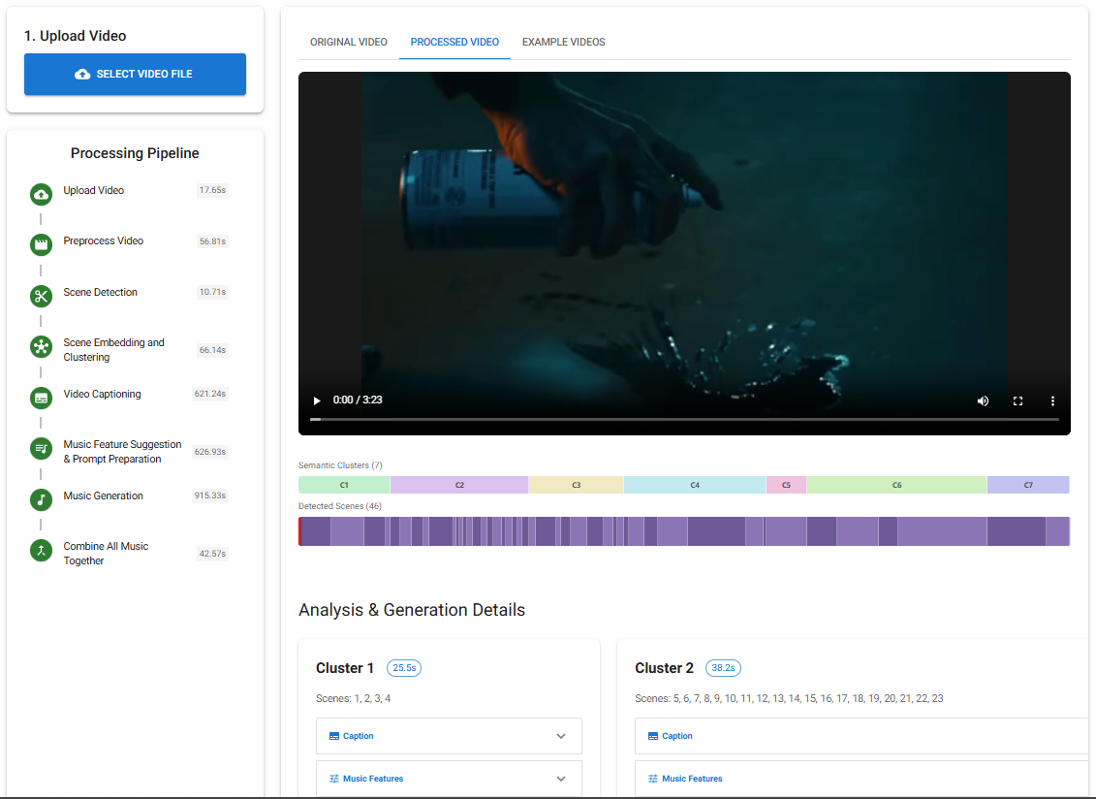
5 – DEMOSTRATION
Notes:
This slide presents the overall architecture of the proposed Hybrid RAG chatbot system.
First, the interaction starts from the user query on the web interface.
Each query, together with previous messages, is stored in the local chat history, allowing the system to maintain conversation context across turns.
The query is then sent to the backend implemented using FastAPI, which acts as the central controller of the system.
Inside the backend, the system performs authentication and session management, followed by safety and scope filtering.
Scope filtering restricts retrieval to allowed domains, such as STI-related content, specific languages, or predefined sections like prevention or treatment.
This step helps ensure both information safety and retrieval precision.
Next, the filtered query is passed to the hybrid retrieval module.
At this stage, the query is processed in two parallel ways:
A BM25 index performs lexical retrieval to capture exact keyword matches.
In parallel, the query is converted into an embedding using the text-embedding-3-small model, with L2 normalization, and searched against a FAISS vector index using inner-product similarity.
The results from BM25 and FAISS are then merged using Reciprocal Rank Fusion (RRF) to produce a final top-k ranked list of relevant chunks.
In addition, the architecture supports an optional GraphRAG module, which can further expand retrieval by traversing relationships between entities and documents, providing more global and structured context.
Finally, the retrieved context, together with the conversation memory, is sent to the LLM.
The LLM generates a grounded and safety-aware answer, which is returned to the user and stored back into the chat history for future turns.

Slide 18
Thank you for your listening

Slide 20
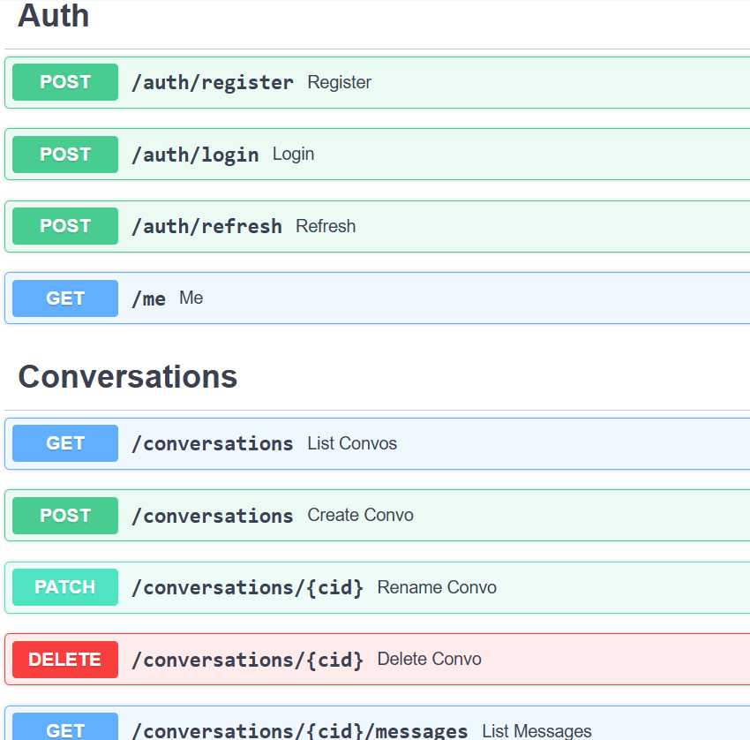
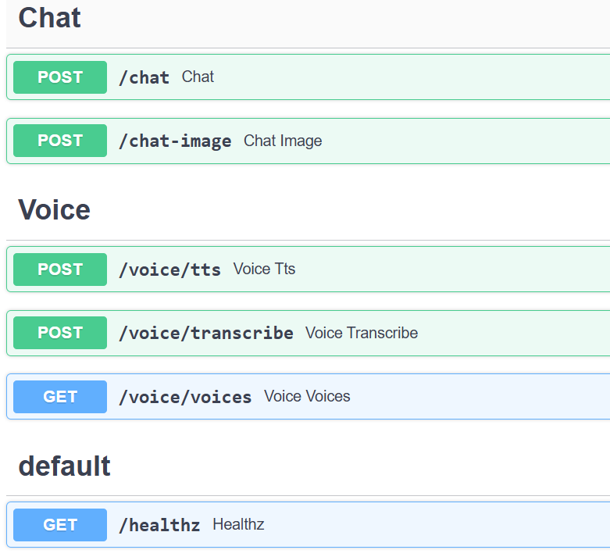
CHAPTER 3 - METHODOLOGY
3.2 Backend & API

Slide 25

CHAPTER 01 — INTRODUCTION
1.2 Target
research
Development of a bilingual STI chatbot.
1.3
Target audience: users aged 16–35 years who need to ask about sexually transmitted infections (STIs).
Location: Vietnam (Vietnamese preferred), English supported.
Time: 2025; data updated periodically according to CDC/WHO/NHS/Vinmec.
Object and
scope

Slide 26

CHAPTER 01 — INTRODUCTION
1.4 Method
Data preprocessing (CDC/WHO/NHS/Vinmec)
Recall BM25 + FAISS
RRF Fusion Top-K Context
GraphRAG (optional) Concept extension
Evaluation
1.5 Practical significance
Contribute to standardizing STI information in Vietnamese, increasing accessibility and reducing incorrect self-treatment.
Provide reusable technical solutions: hybrid retrieval + GraphRAG, source citation, security policy.
Create a foundation for real-world implementation at school/local level, expanding to other health consulting.

