Slide 1





Login
LOCAL
DATABASE
Change
Account Information
Sign out
View
Account Information
Change Password
Login
Search Bus Trip
Choose Seat
Register
View
Bus Trip Information
VNPAY
View
Booked Ticket
Book Ticket
THIRD PARTY
USER
DEVICE
INTERNET
Bank
Customer
Desktop

Slide 2
Login
CLIENT
DATABASE
Sign out
Delete Account
View
Account
Information
Change
Account Information
Search
Customer
Account
Reset Password
Login
Change
Seat Number
Manage Booked Ticket
View The Statistic
Delete Booked Ticket
USER
DEVICE
Admin
Desktop

Slide 3
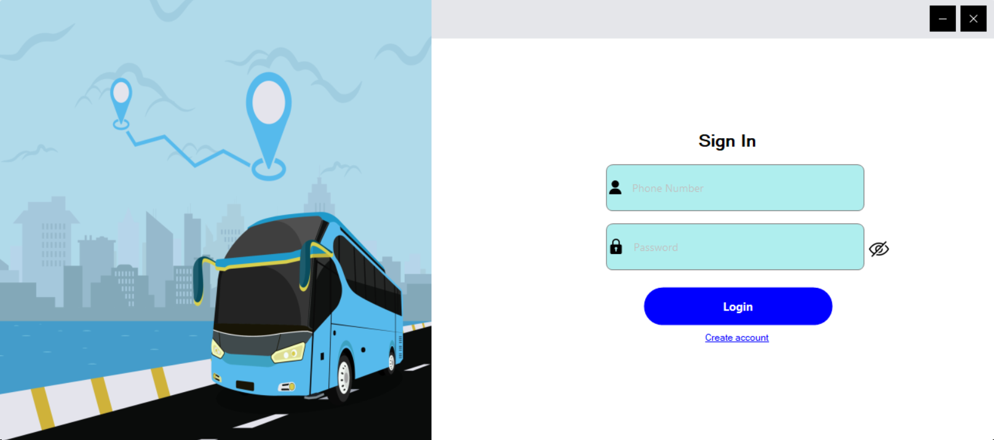
4
1
2
5
3
4

Slide 4
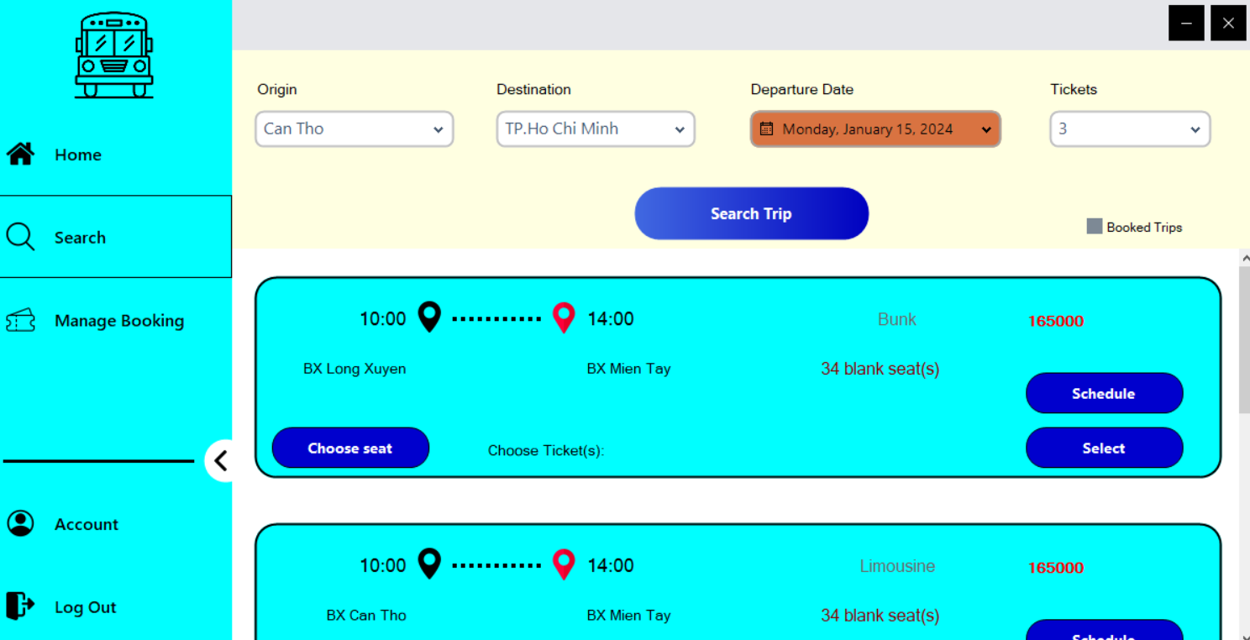
4
2
3.2
3.1
1
3.3
3

Slide 5
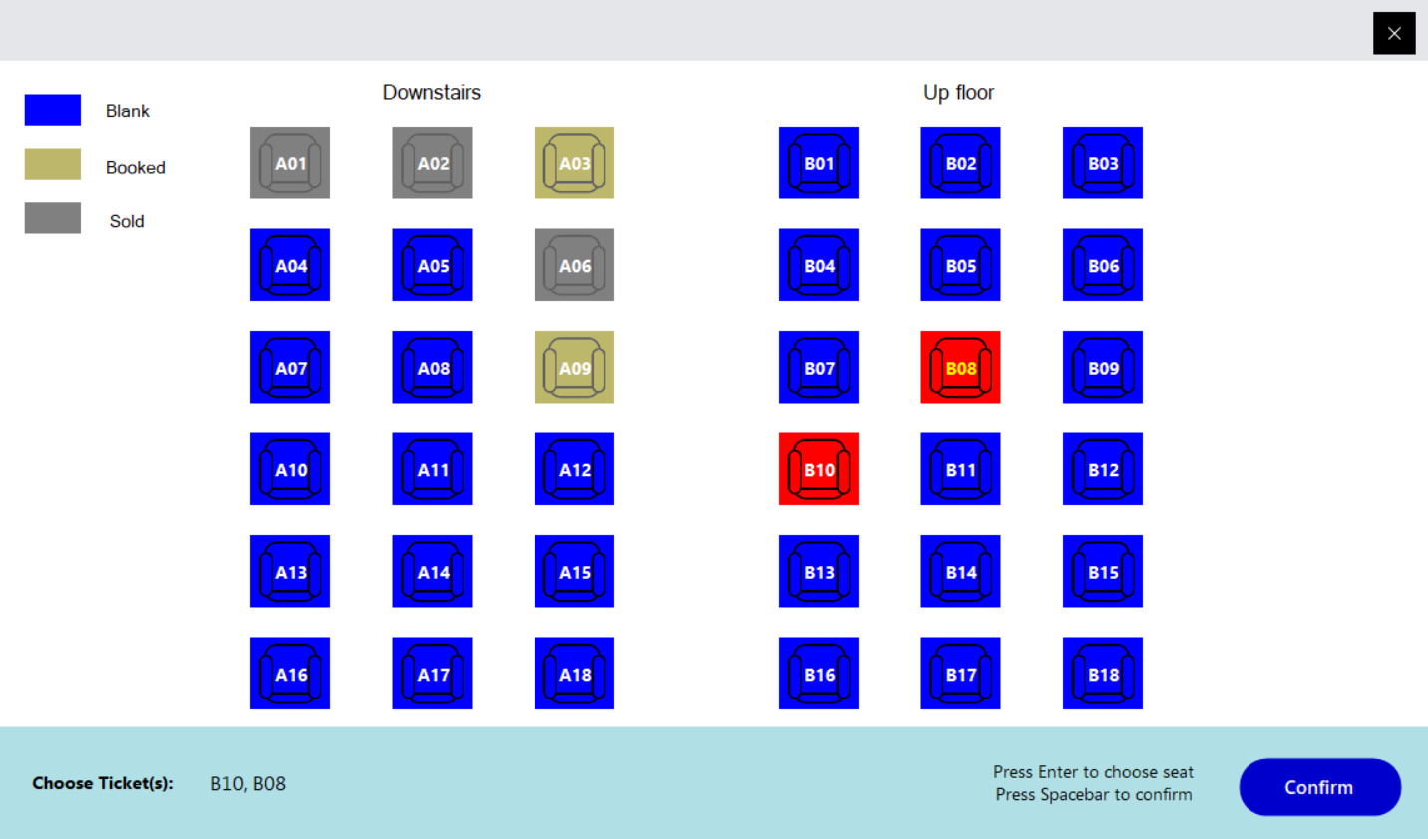
4

Slide 6
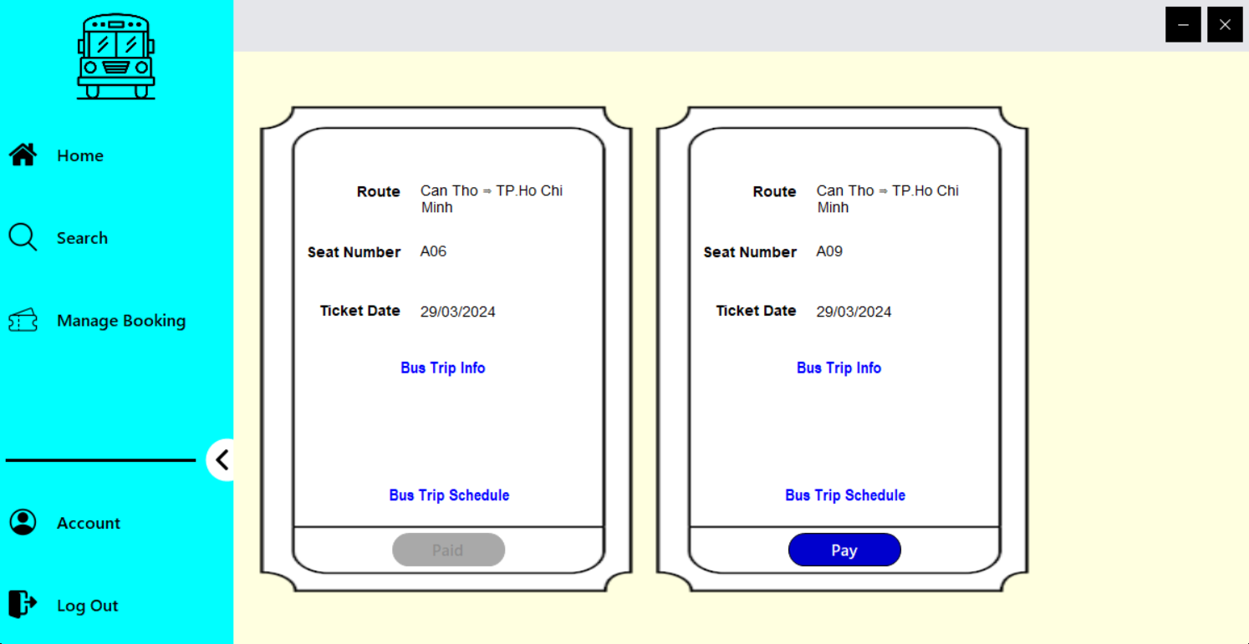
2
2
3.1
1
2.1
2.2
2.3

Slide 7
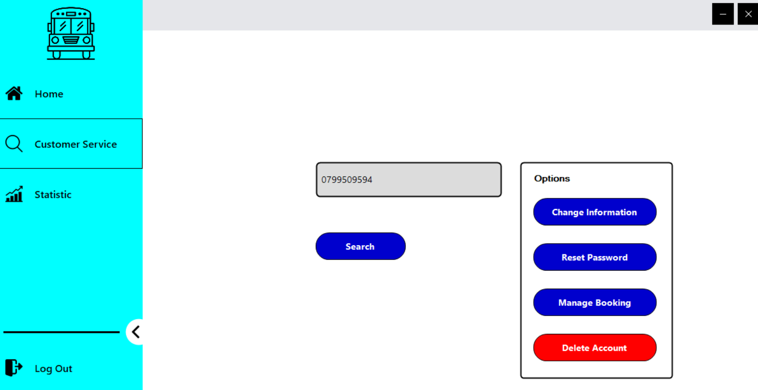
1
3.1
2
3
1

Slide 8
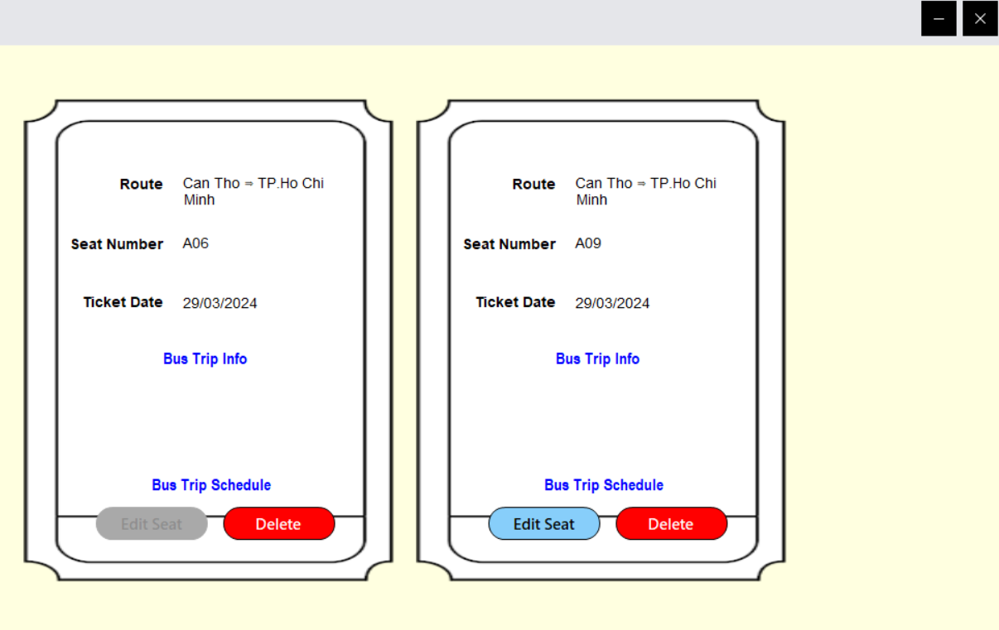
1
2
1
2.1
2.2
3
3

Slide 9
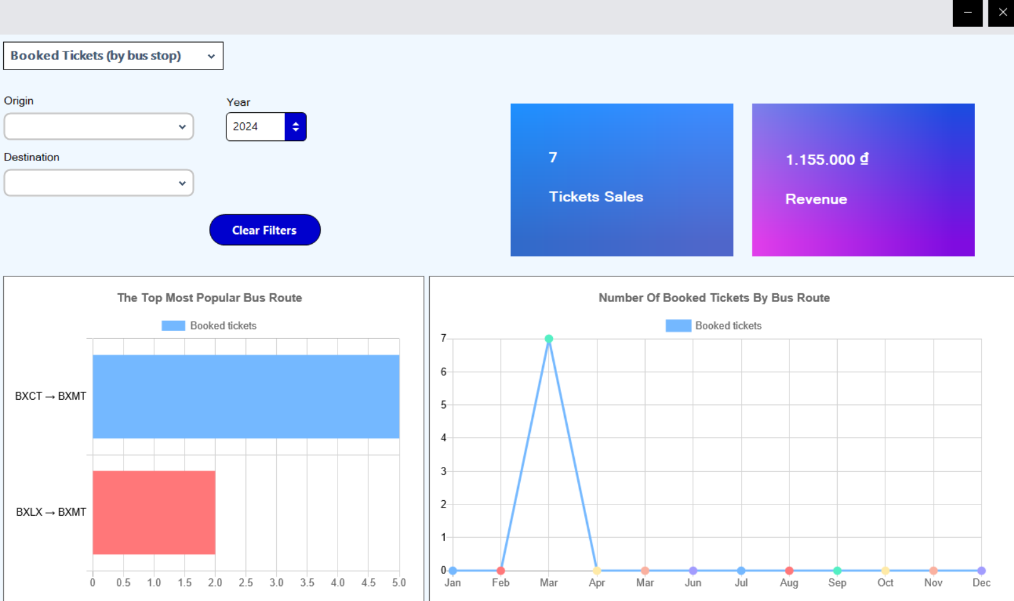
1
1
1
3
2
3

