Slide 1
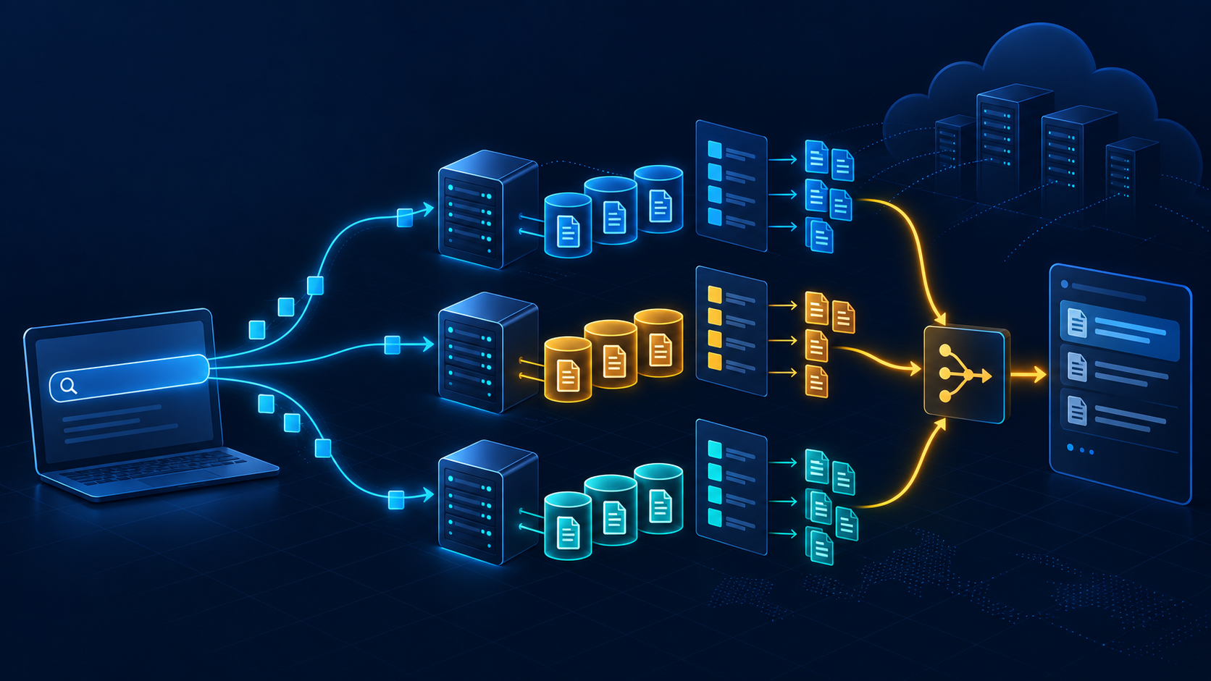
TEAM 3 · 15–30 MIN
How OpenSearch
works
From document ingestion to distributed search results
Operating principles, data flow, and scaling
Speaker split: 1) foundations 2) indexing & search 3) scale & applications
Notes:
Opening: OpenSearch is a distributed search and analytics engine built on Apache Lucene. In this talk we follow one document and one query through the system. Source: https://docs.opensearch.org/latest/getting-started/ and https://opensearch.org/About/

Slide 2
01 · BIG PICTURE
OpenSearch is a pipeline, not just a search box
Data enters, becomes searchable structure, then returns ranked results.
Sources
Ingest
OpenSearch core
Use
logs · apps · files
Data Prepper
pipelines
index · shard ·
Lucene
REST API ·
Dashboards
Core idea
OpenSearch separates the user-facing interfaces from the distributed engine that stores and searches data.
02 / OpenSearch
Speaker 1
Notes:
Explain the whole-system view first. OpenSearch documentation names Data Prepper, OpenSearch core, Dashboards, and clients as the main components. Source: https://docs.opensearch.org/latest/getting-started/

Slide 3
02 · COMPONENTS
Three layers work together
Each layer has a distinct responsibility.
INGEST
SEARCH
USE
Data Prepper
OpenSearch
Dashboards + clients
Collects, filters, enriches, and routes data before indexing.
Stores JSON documents, builds indexes, executes queries and aggregations.
REST API, language clients, Discover, Visualize, and dashboards.
A typical request path
client → coordinating node → target shards → merged response
03 / OpenSearch
Speaker 1
Notes:
Stress that OpenSearch is a suite. Data Prepper is an external collector, ingest pipelines run inside the cluster, and Dashboards is the visualization UI. Sources: https://docs.opensearch.org/latest/getting-started/ and https://docs.opensearch.org/latest/ingest-pipelines/

Slide 4
03 · DATA MODEL
The mental model: JSON → index → shards
These objects explain where data lives and how OpenSearch searches it.
Document
Index
Mapping
One JSON record
Collection of related documents
Field types and indexing rules
Shard
Replica
A subset of an index
Copy for resilience and search capacity
Rule of thumb
An index is logical; shards make it physically distributable.
04 / OpenSearch
Speaker 1
Notes:
Define the terms before showing the mechanics. The official concepts page describes documents as JSON, indexes as collections, mappings as schemas, and shards/replicas as the distributed storage units. Source: https://docs.opensearch.org/latest/getting-started/concepts/

Slide 5
04 · INDEXING
Indexing turns text into searchable structures
The analyzer and inverted index are the key ideas.
1
2
3
4
JSON arrives
Analyze
Build index
Persist
{ "title": "RAG systems" }
lowercase · tokenize · normalize
term → document IDs + positions
Lucene segments inside a shard
Inverted index
The index stores terms and their document locations so search does not scan every document from scratch.
retrieval → doc 1, doc 4, doc 9
05 / OpenSearch
Speaker 2
Notes:
Explain that text analysis happens at index time and query time. The inverted index maps words to the documents containing them, and positions support phrase queries. Source: https://docs.opensearch.org/latest/getting-started/intro/

Slide 6
05 · SEARCH
A query fans out, then results fan in
The coordinating node routes work and merges shard-level answers.
Shard 1
Client query
Coordinating
node
Merged
response
Shard 2
GET /reviews/_search
Shard 3
Each shard returns local hits and scores. The coordinator combines them into one ranked response.
06 / OpenSearch
Speaker 2
Notes:
This is the most important operational flow. The request may arrive at any node, which coordinates shard execution, gathers results, and returns the final response. Source: https://docs.opensearch.org/latest/getting-started/intro/ and https://docs.opensearch.org/latest/search-plugins/searching-data/search-shard-routing/

Slide 7
06 · QUERYING
Query DSL expresses intent; BM25 ranks relevance
A short JSON query can combine full-text search, filters, and aggregations.
GET /docs/_search
Analyzer
{
"query": {
"match": { "body": "retrieval augmented generation" }
}
}
uses the same field analysis rules
BM25
scores term frequency and rarity
Response
hits, score, fields, aggregations
07 / OpenSearch
Speaker 2
Notes:
Show that Query DSL is JSON-based. For analyzed text, the query is processed with the field’s analyzer; BM25 is used for relevance scoring. Source: https://docs.opensearch.org/latest/query-dsl/ and https://docs.opensearch.org/latest/getting-started/intro/

Slide 8
07 · SCALE
Shards distribute data; replicas protect and accelerate
Scaling is a trade-off: more shards are not automatically better.
Node A
Node B
Node C
Primary 0
Replica 1
Primary 1
Replica 0
Replica 2
Primary 2
Benefits
distribution · failover · parallel search
Caution
Every shard is a Lucene index and consumes CPU + memory.
08 / OpenSearch
Speaker 3
Notes:
Use the diagram to explain primary versus replica. Replicas can serve searches and take over after failure. The docs caution that too many shards strain a cluster; shard sizing and workload need benchmarking. Sources: https://docs.opensearch.org/latest/getting-started/intro/ and https://docs.opensearch.org/latest/tuning-your-cluster/

Slide 9
08 · MODERN SEARCH
Keyword search and vector search can coexist
OpenSearch supports classic text retrieval, vector search, and hybrid applications.
Classic
Vector
Hybrid
BM25
Exact terms + relevance
+
Embeddings
Semantic similarity
+
Combine scores
Better recall + intent
Example RAG flow
embed query → retrieve passages → generate answer with citations
Keep this as an extension: the core search principles remain indexing, routing, scoring, and retrieval.
09 / OpenSearch
Speaker 3
Notes:
Present vector and hybrid search as a modern extension, not as a replacement for the core engine. OpenSearch positions itself as a data store and vector database for AI applications. Source: https://docs.opensearch.org/latest/getting-started/

Slide 10
09 · OPERATIONS
From raw events to an operational dashboard
A useful deployment makes search observable, secure, and easy to inspect.
Collect
Transform
Index
Explore
Monitor
logs / traces / app events
pipeline processors
mapping + shards
Discover / Query DSL
visualizations + alerts
Security
authentication, authorization, encrypted transport, audit controls
Demo idea
open Dashboards → search a field → filter time range → build one chart
10 / OpenSearch
Speaker 3
Notes:
Connect architecture to an operator’s experience. Dashboards provides Discover, Visualize, Dashboards, and Dev Tools. Security is part of production readiness, but keep the details brief for this talk. Source: https://docs.opensearch.org/latest/dashboards/getting-started/learn-dashboards/

Slide 11
10 · TAKEAWAY
One sentence to remember
OpenSearch makes large collections searchable by turning documents into distributed, analyzed, and ranked data.
INGEST → INDEX → ROUTE → SCORE → VISUALIZE
Why fast?
Inverted indexes avoid full scans.
Why scalable?
Shards distribute work; replicas add resilience.
Why useful?
Query DSL, APIs, and Dashboards turn results into action.
Q&A
Thank you
11 / OpenSearch
All speakers
Notes:
Closing: repeat the five verbs and invite questions. Sources used throughout: https://docs.opensearch.org/latest/getting-started/, https://docs.opensearch.org/latest/getting-started/concepts/, https://docs.opensearch.org/latest/query-dsl/, https://docs.opensearch.org/latest/search-plugins/searching-data/search-shard-routing/

