Slide 1
Graph-based Algorithms in IR and NLP
Smaranda Muresan

Slide 2
Examples of Graph-based Representation
Data | Directed? | Nodes | Edges
Web | Yes | Web page | HTML Links
Citations | Yes | Citation | Reference relation
Text | No | Sentence | Semantic connectivity

Slide 3
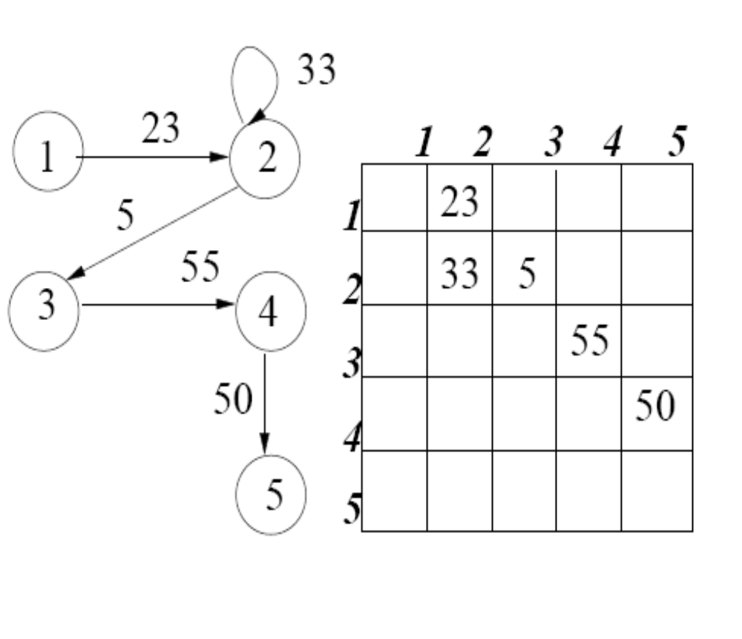
Graph-based Representation
Directed / Undirected
Weighted / Unweighted
Graph - Adjacency Matrix
Degree of a node
In_degree / Out_degree

Slide 4
Smarter IR
IR – retrieve documents relevant to a given query
Naïve Solution – text-based search
  Some relevant pages omit query terms
  Some irrelevant do include query terms
=> We need to take into account the authority of the page!

Slide 5
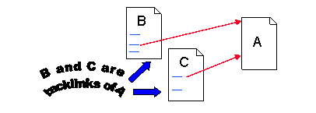
Link Analysis
Assumption – the creator of page p, by including a link to page q, has in some measure conferred authority in q
Issues
  some links are not indicative of authority (e.g., navigational links)
  We need to find an appropriate balance between the criteria of popularity and relevance

Slide 6
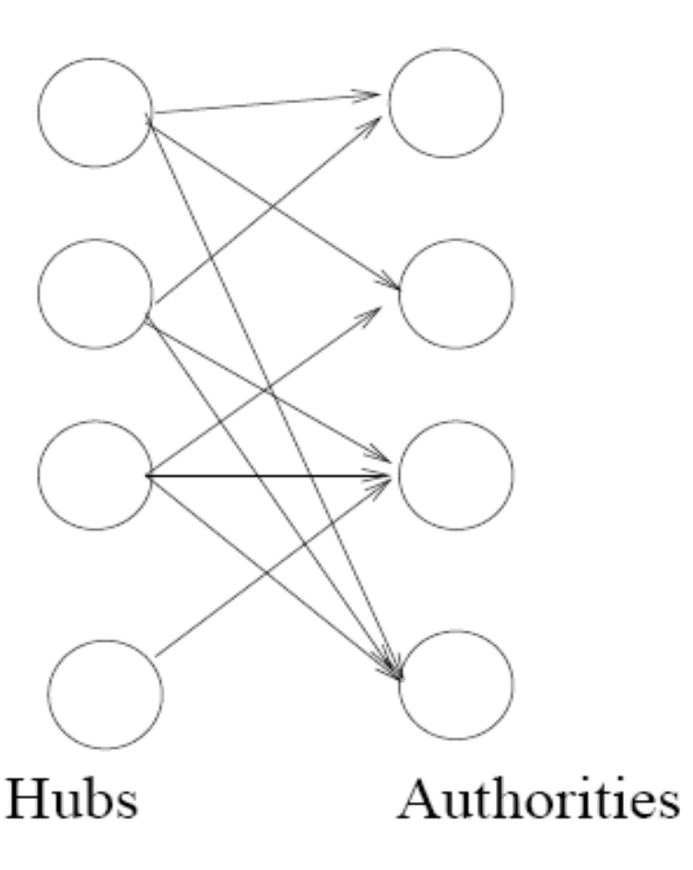
Hubs and Authorities
(Kleinberg, 1998)
Hubs are index pages that provide lots of useful links to relevant content pages (or authorities)
Authorities are pages that are recognized as providing significant, trustworthy, and useful information on a topic
Together they form a bipartite graph
Notes:
In-degree = count of backlinks as a measure of authority
Even within the base subgraph for a query, nodes with highest in-degree are not necessarily authorities
Yahoo or amazon general websites
True authority pages are pointed to by a number of hubs
In-degree = count of backlinks as a measure of authority
Even within the base subgraph for a query, nodes with highest in-degree are not necessarily authorities
Yahoo or amazon general websites
True authority pages are pointed to by a number of hubs

Slide 7
HITS (Kleinberg, 1998)
Computationally determine hubs and authorities for a given topic by analyzing a relevant subgraph of the web
Step 1. Compute a focused base subgraph S given a query
Step 2. Iteratively compute hubs and authorities in the subgraph
Step 3. Return the top hubs and authorities

Slide 8
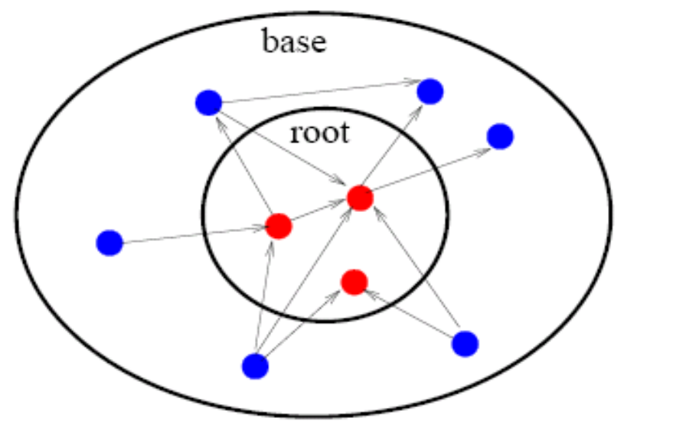
Focused Base Subgraph
For a specific query, R is a set of documents returned by a standard search engine (root set)
Initialize Base subgraph S to R
Add to S all pages pointed to by any page in R
Add to S all pages that point to any page in R

Slide 9
Compute hubs and authorities
Authorities should have considerable overlap in terms of pages pointing to them
Hubs are pages that have links to multiple authoritative pages
Hubs and authorities exhibit a mutually reinforcing relationship

Slide 10
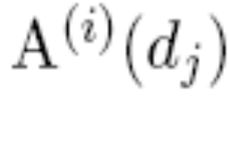
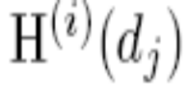
Iterative Algorithm
For every document in the base set d1, d2 ,… dn
Compute the authority score
Computer the hubs score

Slide 11

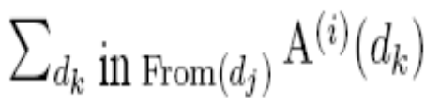
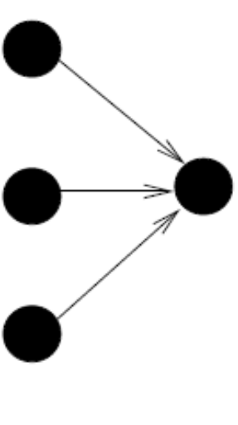
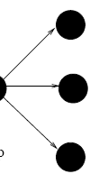

Iterative algorithm
I operation O operation

Slide 12
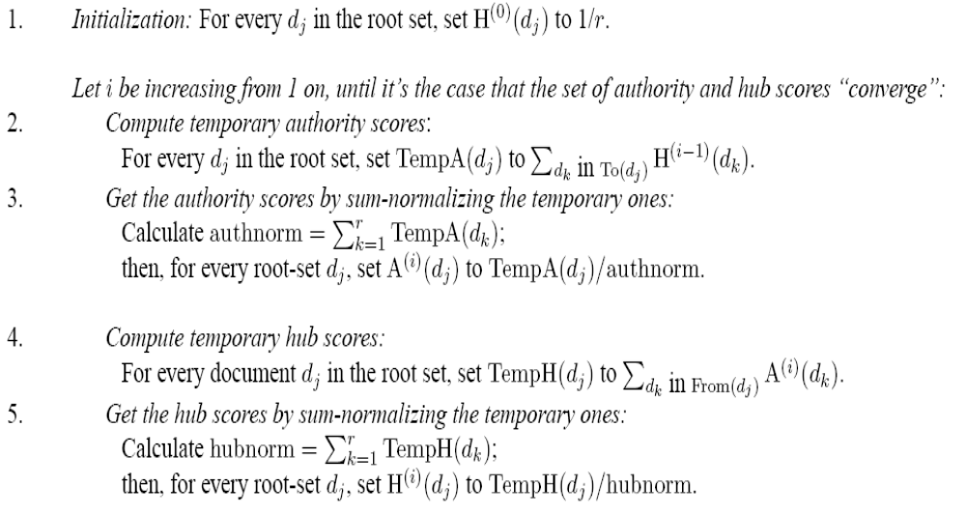
Iterative Algorithm

Slide 13
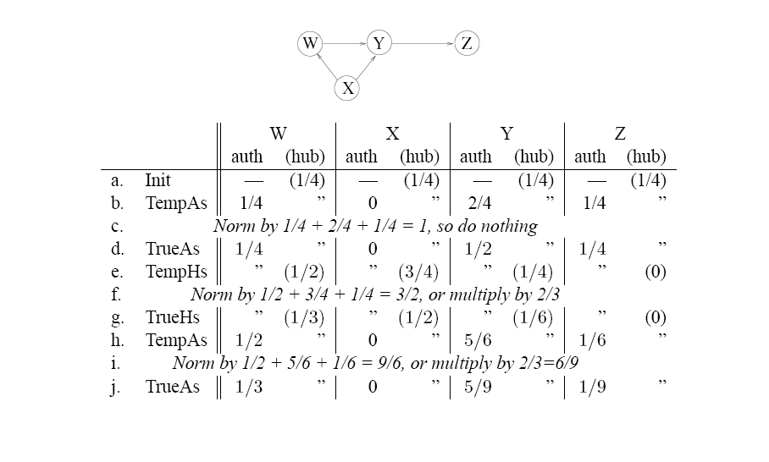

Slide 14
HITS Results
Authorities for query “Java”
  Java.sun.com; Comp.lang.java FAQ
Authorities for query “search engine”
  Yahoo.com; Excite.com; Lycos.com; Altavista.com
Authorities for query “Gates”
  Microsoft.com; Roadahead.com
In most cases, the final authorities were not in the initial root set generated by standard search engine

Slide 15
HITS applied to finding similar pages
Given a page P, let R be the t (e.g., 200) pages that point to P
Grow a base subgraph S from R
Apply HITS to S
Best similar pages to P ≡ best authorities in S

Slide 16
HITS applied to finding similar pages
Given “honda.com”
  Toyota.com
  Ford.com
  Bmwusa.com
  Saturncars.com
  Nissanmotors.com
  Audi.com
  Volvocars.com

Slide 17
PageRank (Brin&Page ’98)
Original Google ranking algorithm
Similar idea to hubs and authorities
Differences with HITS
  Independent of query (although more recent work by Haveliwala (WWW 2002) has also identified topic-based PageRank
  Authority of a page is computed offline based on the whole web, not a focused subgraph
Query relevance is computed online
    Anchor text
    Text on the page
The prediction is based on the combination of relevance and authority

Slide 18
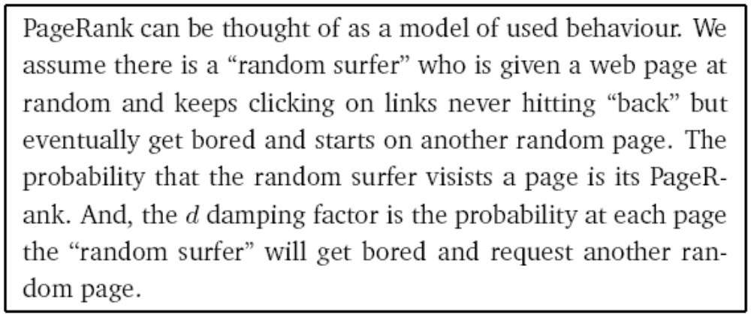
PageRank
From “The anatomy of a large-scale hypertextual web search engine”

Slide 19
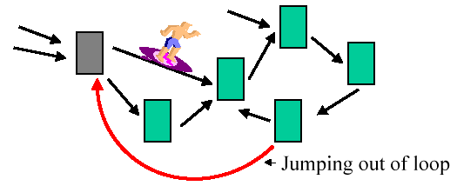
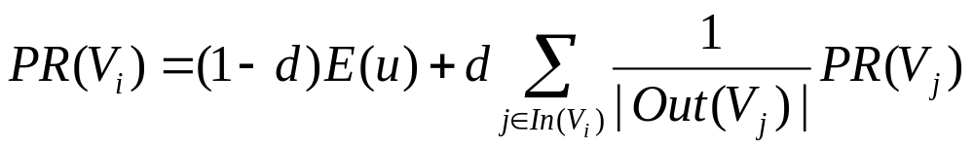
PageRank – Random surfer model
E(u) is some vector over the web pages
– uniform (1/n), favorite pages, etc.
d – damping factor, usually set to 0.85

Slide 20
PageRank
PageRank forms a probability distribution over the web
From a linear algebra viewpoint, PageRank is the principal eigenvector of the normalized link matrix of the web
  PR is a vector over web pages
  A is a matrix over pages: A_{vu}=1/C(u) if u→v,
  0 otherwise
  PR=cA.PR
Given 26M web pages, PageRank is computed in a few hours on medium workstation

Slide 21

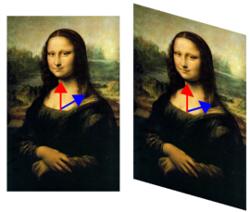
Eigenvector of a matrix
The set of eigenvectors x for A is defined as those vectors which, when multiplied by A, result in a simple scaling λ of x.
Thus, Ax = λx. The only effect of the matrix on these vectors will be to change their length, and possibly reverse their direction.

Slide 22
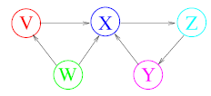
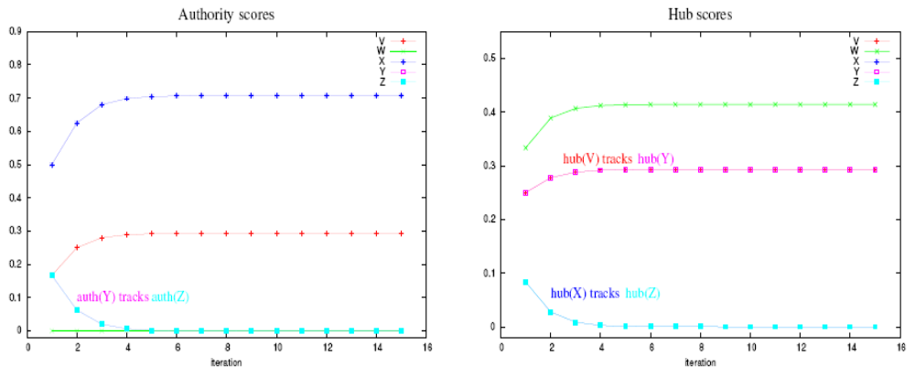
HITS vs. PageRank

Slide 23
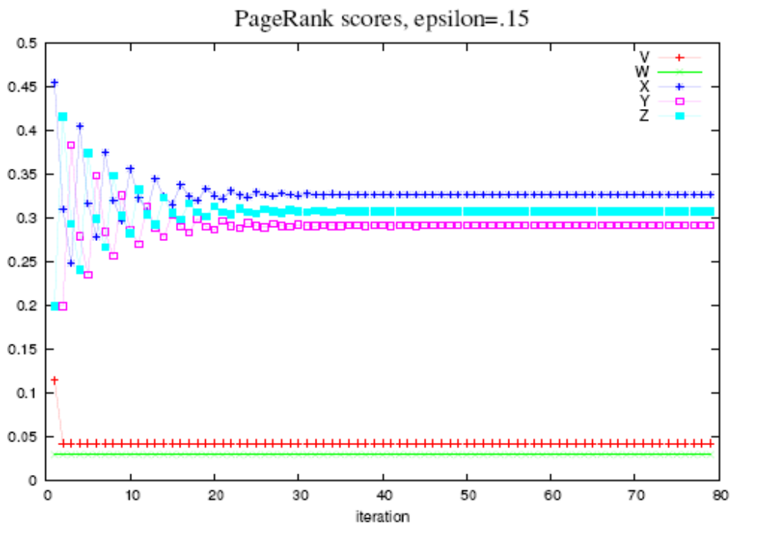
HITS vs PageRank

Slide 24
Text as a Graph
Vertices = cognitive units
  …
Edges = relations between cognitive units
  ...

Slide 25
Text as a Graph
Vertices = cognitive units
  …
Edges = relations between cognitive units
  ...
words
Word Sense Disambiguation
Word sense
sentences
Keyword Extraction
Semantic relations
Co-occurance
similarity
Sentence Extraction
TextRank (Mihalcea and Tarau, 2004), LexRank (Erkan and Radev, 2004)

Slide 26
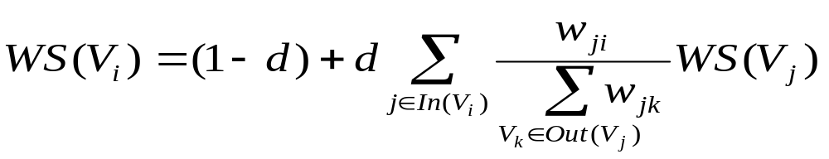
TextRank - Weigthed Graph
Edges have weights – similarity measures
Adapt PageRank, HITS to account for edge weights
PageRank adapted to weighted graphs

Slide 27
TextRank - Text Summarization
Build the graph:
  Sentences in a text = vertices
  Similarity between sentences = weighted edges
  Model the cohesion of text using intersentential similarity
2. Run link analysis algorithm(s):
  keep top N ranked sentences
  → sentences most “recommended” by other sentences

Slide 28
Underlining idea: A Process of Recommendation
A sentence that addresses certain concepts in a text gives the reader a recommendation to refer to other sentences in the text that address the same concepts
Text knitting (Hobbs 1974)
  repetition in text “knits the discourse together”
Text cohesion (Halliday & Hasan 1979)

Slide 29
Graph Structure
Undirected
  No direction established between sentences in the text
  A sentence can “recommend” sentences that precede or follow in the text
Directed forward
  A sentence “recommends” only sentences that follow in the text
  Seems more appropriate for movie reviews, stories, etc.
Directed backward
  A sentence “recommends” only sentences that preceed in the text
  More appropriate for news articles

Slide 30
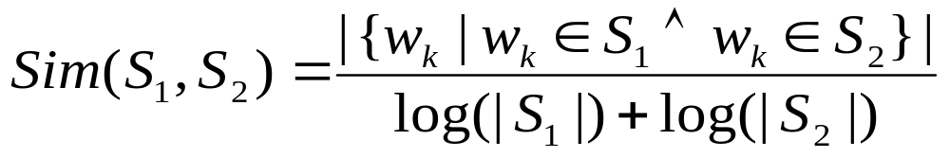
Sentence Similarity
Inter-sentential relationships
  weighted edges
Count number of common concepts
Normalize with the length of the sentence
Other similarity metrics are also possible:
  Longest common subsequence
  string kernels, etc.

Slide 31
An Example
A text from DUC 2002
on “Hurricane Gilbert”
24 sentences
3. r i BC-HurricaneGilbert 09-11 0339
4. BC-Hurricane Gilbert , 0348
5. Hurricane Gilbert Heads Toward Dominican Coast
6. By RUDDY GONZALEZ
7. Associated Press Writer
8. SANTO DOMINGO , Dominican Republic ( AP )
9. Hurricane Gilbert swept toward the Dominican Republic Sunday , and the Civil Defense alerted its heavily
populated south coast to prepare for high winds , heavy rains and high seas .
10. The storm was approaching from the southeast with sustained winds of 75 mph gusting to 92 mph .
11. " There is no need for alarm , " Civil Defense Director Eugenio Cabral said in a television alert shortly before midnight Saturday .
12. Cabral said residents of the province of Barahona should closely follow Gilbert 's movement .
13. An estimated 100,000 people live in the province , including 70,000 in the city of Barahona , about 125 miles west of Santo Domingo .
14. Tropical Storm Gilbert formed in the eastern Caribbean and strengthened into a hurricane Saturday night
15. The National Hurricane Center in Miami reported its position at 2a.m. Sunday at latitude 16.1 north ,
longitude 67.5 west , about 140 miles south of Ponce , Puerto Rico , and 200 miles southeast of Santo Domingo .
16. The National Weather Service in San Juan , Puerto Rico , said Gilbert was moving westward at 15 mph with a " broad area of cloudiness and heavy weather " rotating around the center of the storm .
17. The weather service issued a flash flood watch for Puerto Rico and the Virgin Islands until at least 6p.m. Sunday .
18. Strong winds associated with the Gilbert brought coastal flooding , strong southeast winds and up to 12 feet to Puerto Rico 's south coast .
19. There were no reports of casualties .
20. San Juan , on the north coast , had heavy rains and gusts Saturday , but they subsided during the night .
21. On Saturday , Hurricane Florence was downgraded to a tropical storm and its remnants pushed inland from the U.S. Gulf Coast .
22. Residents returned home , happy to find little damage from 80 mph winds and sheets of rain .
23. Florence , the sixth named storm of the 1988 Atlantic storm season , was the second hurricane .
24. The first , Debby , reached minimal hurricane strength briefly before hitting the Mexican coast last month

Slide 32
[0.50]
[0.71]
[1.20]
4
5
24
6
[0.15]
[0.80]
23
0.15
7
[0.15]
0.19
0.55
[0.70]
22
8
[0.70]
0.35
[1.02]
21
0.15
9
[1.83]
0.30
[0.84]
20
10
[0.99]
[0.15]
19
0.59
0.15
0.27
0.16
11
[0.56]
18
[1.58]
12
17
[0.93]
[0.70]
16
13
15
14
[0.76]
[1.65]
[1.36]
[1.09]

Slide 33
[0.50]
[0.71]
[1.20]
4
5
24
6
[0.15]
[0.80]
23
0.15
7
[0.15]
0.19
0.55
[0.70]
22
8
[0.70]
0.35
[1.02]
21
0.15
9
[1.83]
0.30
[0.84]
20
10
[0.99]
[0.15]
19
0.59
0.15
0.27
0.16
11
[0.56]
18
[1.58]
12
17
[0.93]
[0.70]
16
13
15
14
[0.76]
[1.65]
[1.36]
[1.09]

Slide 34
Automatic summary
Hurricane Gilbert swept toward the Dominican Republic Sunday, and the Civil Defense alerted its heavily populated south coast to prepare for high winds, heavy rains and high seas. The National Hurricane Center in Miami reported its position at 2a.m. Sunday at latitude 16.1 north, longitude 67.5 west, about 140 miles south of Ponce, Puerto Rico, and 200 miles southeast of Santo Domingo. The National Weather Service in San Juan, Puerto Rico, said Gilbert was moving westward at 15 mph with a " broad area of cloudiness and heavy weather " rotating around the center of the storm. Strong winds associated with the Gilbert brought coastal flooding, strong southeast winds and up to 12 feet to Puerto Rico's coast.
Reference summary I
Hurricane Gilbert swept toward the Dominican Republic Sunday with sustained winds of 75 mph gusting to 92 mph. Civil Defense Director Eugenio Cabral alerted the country's heavily populated south coast and cautioned that even though there is no nee d for alarm, residents should closely follow Gilbert's movements. The U.S. Weather Service issued a flash flood watch for Puerto Rico and the Virgin Islands until at least 6 p.m. Sunday. Gilbert brought coastal flooding to Puerto Rico's south coast on Saturday. There have been no reports of casualties. Meanwhile, Hurricane Florence, the second hurricane of this storm season, was downgraded to a tropical storm.
Reference summary II
Hurricane Gilbert is moving toward the Dominican Republic, where the residents of the south coast, especially the Barahona Province, hav e been alerted to prepare for heavy rains, and high winds and seas. Tropical Storm Gilbert formed in the eastern Caribbean and became a hurricane on Saturday night. By 2 a.m. Sunday it was about 200 miles southeast of Santo Domingo and moving westward at 15 mph with winds of 75 mph. Flooding is expected in Puerto Rico and the Virgin Islands. The second hurricane of the season, Florence, is now over the southern United States and downgraded to a tropical storm.

Slide 35
Evaluation
Task-based evaluation: automatic text summarization
  Single document summarization
    100-word summaries
  Multiple document summarization
    100-word multi-doc summaries
    clusters of ~10 documents
Automatic evaluation with ROUGE (Lin & Hovy 2003)
  n-gram based evaluations
    unigrams found to have the highest correlations with human judgment
  no stopwords, stemming

Slide 36
Evaluation
Data from DUC (Document Understanding Conference)
  DUC 2002
  567 single documents
  59 clusters of related documents
Summarization of 100 articles in the TeMario data set
  Brazilian Portuguese news articles
    Jornal de Brasil, Folha de Sao Paulo
  (Pardo and Rino 2003)

Slide 37
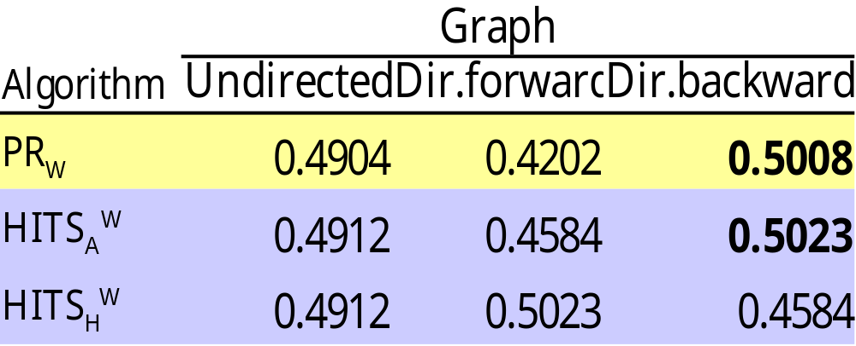
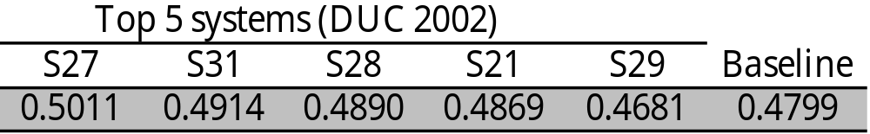
Evaluation
Single-doc summaries for 567 documents (DUC 2002)

Slide 38
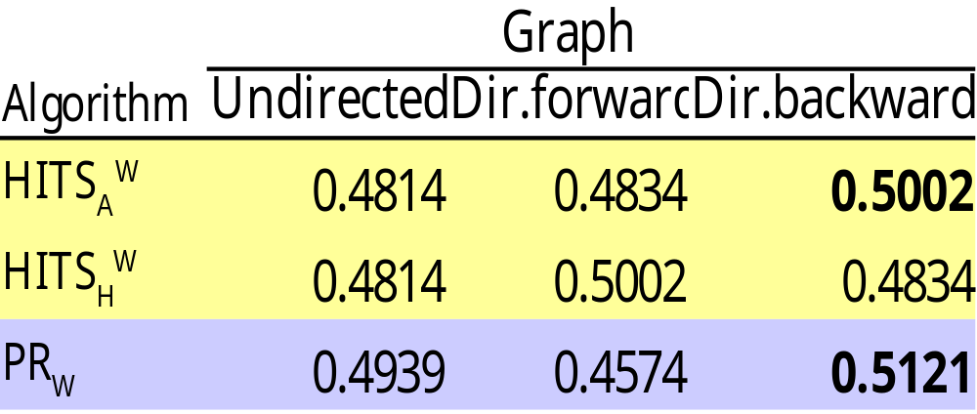
Evaluation
Summarization of Portuguese articles
Test the language independent aspect
  No resources required other than the text itself
Summarization of 100 articles in the TeMario data set
Baseline: 0.4963

Slide 39
Multiple Document Summarization
Cascaded summarization (“meta” summarizer)
  Use best single document summarization alorithms
    PageRank (Undirected / Directed Backward)
    HITS_{A} (Undirected / Directed Backward)
  100-word single document summaries
  100-word “summary of summaries”
Avoid sentence redundancy:
  set max threshold on sentence similarity (0.5)
Evaluation:
  build summaries for 59 clusters of ~10 documents
  compare with top 5 performing systems at DUC 2002
  baseline: first sentence in each document

Slide 40
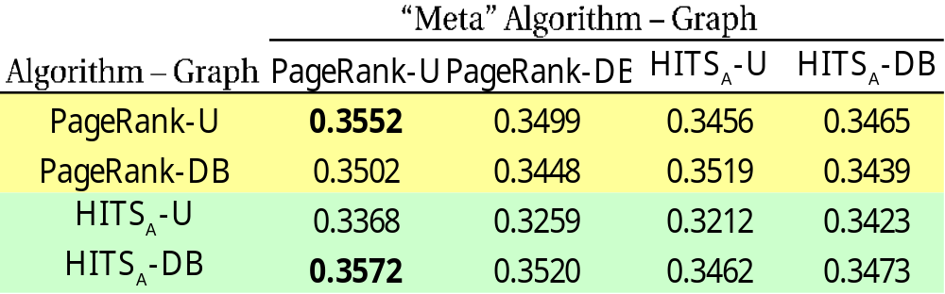
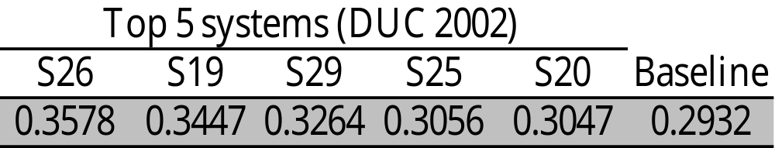
Evaluation
  Multi-doc summaries for 59 clusters (DUC 2002)

Slide 41
TextRank – Keyword Extraction
Identify important words in a text
Keywords useful for
  Automatic indexing
  Terminology extraction
  Within other applications: Information Retrieval, Text Summarization, Word Sense Disambiguation
Previous work
  mostly supervised learning
  genetic algorithms [Turney 1999], Naïve Bayes [Frank 1999], rule induction [Hulth 2003]

Slide 42
TextRank – Keyword Extraction
Store words in vertices
Use co-occurrence to draw edges
Rank graph vertices across the entire text
Pick top N as keywords
Variations:
  rank all open class words
  rank only nouns
  rank only nouns + adjectives

Slide 43
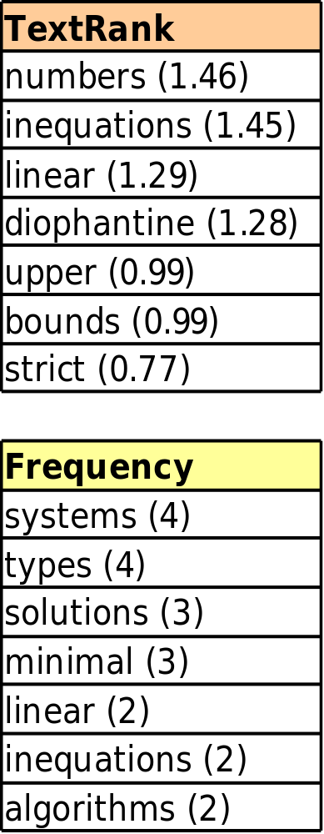
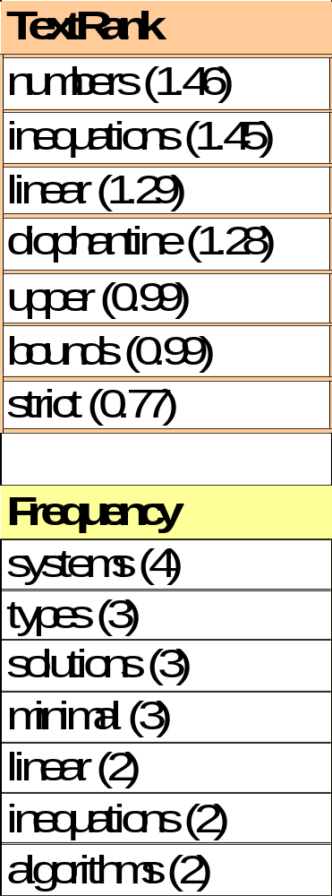
An Example
Compatibility of systems of linear constraints over the set of natural numbers
Criteria of compatibility of a system of linear Diophantine equations, strict
inequations, and nonstrict inequations are considered. Upper bounds for
components of a minimal set of solutions and algorithms of construction of
minimal generating sets of solutions for all types of systems are given.
These criteria and the corresponding algorithms for constructing a minimal
supporting set of solutions can be used in solving all the considered types of
systems and systems of mixed types.
systems
compatibility
types
linear
system
criteria
diophantine
natural
constraints
numbers
equations
non-strict
solutions
strict
upper
bounds
algorithms
inequations
sets
construction
components
minimal
Keywords by TextRank: linear constraints, linear diophantine equations,
natural numbers, non-strict inequations, strict inequations, upper bounds
Keywords by human annotators: linear constraints, linear diophantine equations, non-strict inequations, set of natural numbers, strict inequations,upper bounds
Compatibility of systems of linear constraints over the set of natural numbers
Criteria of compatibility of a system of linear Diophantine equations, strict
inequations, and nonstrict inequations are considered. Upper bounds for
components of a minimal set of solutions and algorithms of construction of
minimal generating sets of solutions for all types of systems are given.
These criteria and the corresponding algorithms for constructing a minimal
supporting set of solutions can be used in solving all the considered types of
systems and systems of mixed types.
Compatibility of systems of linear constraints over the set of natural numbers
Criteria of compatibility of a system of linear Diophantine equations, strict
inequations, and nonstrict inequations are considered. Upper bounds for
components of a minimal set of solutions and algorithms of construction of
minimal generating sets of solutions for all types of systems are given.
These criteria and the corresponding algorithms for constructing a minimal
supporting set of solutions can be used in solving all the considered types of
systems and systems of mixed types.

Slide 44
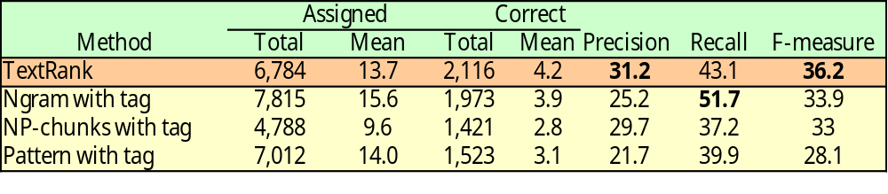
Evaluation
Evaluation:
  500 INSPEC abstracts
  collection previously used in keyphrase extraction [Hulth 2003]
Various settings. Here:
  nouns and adjectives
  select top N/3
Previous work
  [Hulth 2003]
  training/development/test : 1000/500/500 abstracts
Notes:
abstracts of journal papers
collection already used in keyphrase extraction evaluations
… also, collapse consecutive words into a multi-word keyword

Slide 45
TextRank on Semantic Networks
Goal: build a semantic graph that represents the meaning of the text
Input: Any open text
Output: Graph of meanings (synsets)
  “importance” scores attached to each synset
  relations that connect them
Models text cohesion
  (Halliday and Hasan 1979)
  From a given concept, follow “links” to semantically related concepts
Graph-based ranking identifies the most recommended concepts

Slide 46
Two U.S. soldiers and an unknown number of civilian
contractors are unaccounted for after a fuel convoy was
attacked near the Baghdad International Airport today,
a senior Pentagon official said. One U.S. soldier and an
Iraqi driver were killed in the incident.
…
…
…

Slide 47
Main Steps
Step 1: Preprocessing
  SGML parsing, text tokenization, part of speech tagging, lemmatization
Step 2: Assume any possible meaning of a word in a text is potentially correct
  Insert all corresponding synsets into the graph
Step 3: Draw connections (edges) between vertices
Step 4: Apply the graph-based ranking algorithm
  PageRank, HITS

Slide 48
Semantic Relations
Main relations provided by WordNet
  ISA (hypernym/hyponym)
  PART-OF (meronym/holonym)
  causality
  attribute
  nominalizations
  domain links
Derived relations
  coord: synsets with common hypernym
Edges (connections)
  directed (direction?) / undirected
  Best results with undirected graphs
Output: Graph of concepts (synsets) identified in the text
  “importance” scores attached to each synset
  relations that connect them

Slide 49
Word Sense Disambiguation
Rank the synsets/meanings attached to each word
Unsupervised method for semantic ambiguity resolution of all words in unrestricted text (Mihalcea et al. 2004)
Related algorithms:
  Lesk
  Baseline (most frequent sense / random)
Hybrid:
  Graph-based ranking + Lesk
  Graph-based ranking + Most frequent sense
Evaluation
  “Informed” (with sense ordering)
  “Uninformed” (no sense ordering)
Data
  Senseval-2 all words data (three texts, average size 600)
  SemCor subset (five texts: law, sports, debates, education, entertainment)

Slide 50
Till Now
Graph-based ranking algorithm
Smarter IR
NLP - TextRank, LexRank
  Text summarization
  Keyword extraction
  Word Sense Disambiguation

Slide 51
Other graph-based algorithms for NLP
Find entities that satisfy certain structural properties defined with respect to other entities
Find globally optimal solutions given relations between entities
Min-Cut Algorithm

Slide 52
Subjectivity Analysis for Sentiment Classification
The objective is to detect subjective expressions in text (opinions against facts)
Use this information to improve the polarity classification (positive vs. negative)
  E.g. Movie reviews ( see: www.rottentomatoes.com)
Sentiment analysis can be considered as a document classification problem, with target classes focusing on the authors sentiments, rather than topic-based categories
  Standard machine learning classification techniques can be applied

Slide 53
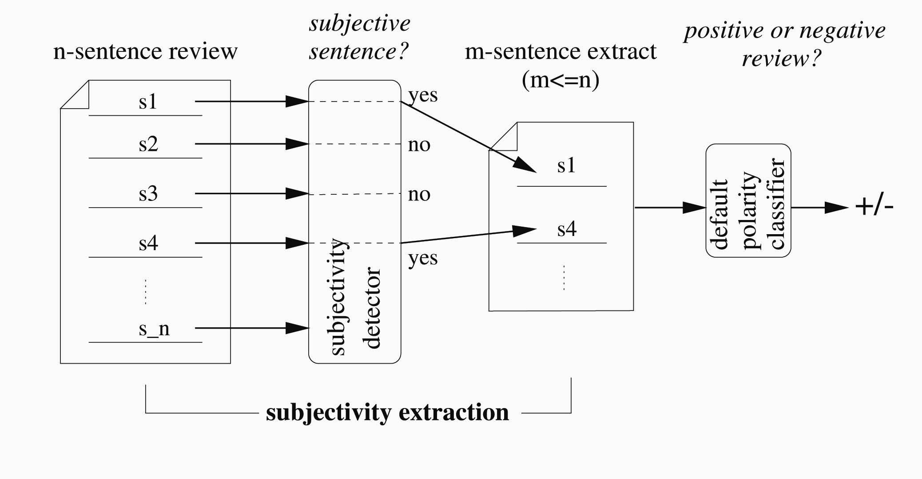
Subjectivity Extraction

Slide 54
Subjectivity Detection/Extraction
Detecting the subjective sentences in a text may be useful in filtering out the objective sentences creating a subjective extract
Subjective extracts facilitate the polarity analysis of the text (increased accuracy at reduced input size)
Subjectivity detection can use local and contextual features:
  Contextual: uses context information, such as e.g. sentences occurring near each other tend to share the same subjectivity status (coherence)
  Local: relies on individual sentence classifications using standard machine learning techniques (SVM, Naïve Bayes, etc) trained on an annotated data set
(Pang and Lee, 2004)

Slide 55
Cut-based Subjectivity Classification
Standard classification techniques usually consider only individual features (classify one sentence at a time).
Cut-based classification takes into account both individual and contextual (structural) features

Slide 56

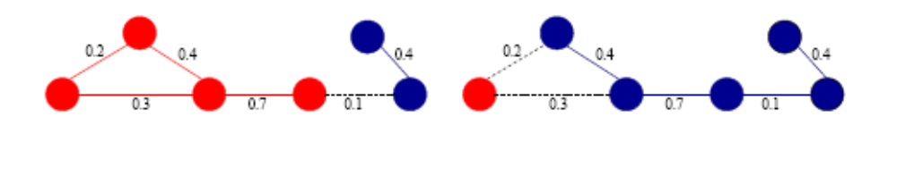
Min-Cut definition
Graph cut: partitioning the graph in two disjoint sets of nodes
Graph cut weight:
  i.e., sum of crossing edge weights
Minimum cut: the cut that minimizes the cross-partition similarity

Slide 57
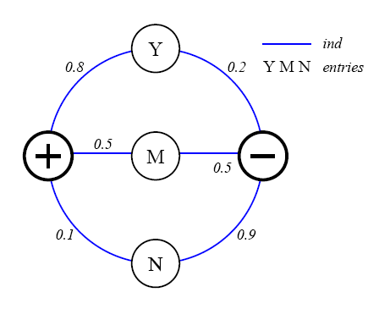
Modeling Individual Features

Slide 58
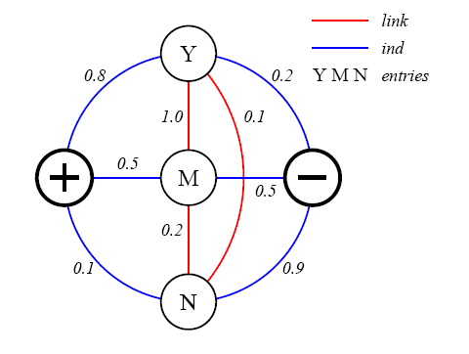
Modeling Contextual Features

Slide 59
Collective Classification
Suppose we have n items x₁,…,x_{n} to divide in two classes: C₁ and C₂ .
Individual scores: ind_{j}(x_{i}) - non-negative estimates of each x_{i} being in C_{j} based on the features of x_{i} alone
Association scores: assoc(x_{i},x_{k}) - non-negative estimates of how important it is that x_{i} and x_{k} be in the same class

Slide 60
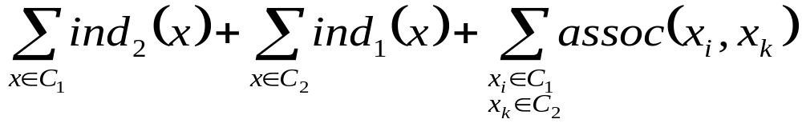
Collective Classification
Maximize each item’s assignment score (individual score for the class it is assigned to, minus its individual score for the other class), while penalize the assignment of different classes to highly associated items
Formulated as an optimization problem: assign the x_{i} items to classes C₁ and C₂ so as to minimize the partition cost:

Slide 61
Cut-based Algorithm
There are 2^{n} possible binary partitions of the n elements, we need an efficient algorithm to solve the optimization problem
Build an undirected graph G with vertices {v₁,…v_{n},s,t} and edges:
  (s,v_{i}) with weights ind₁(x_{i})
  (v_{i},t) with weights ind₂(x_{i})
  (v_{i},v_{k}) with weights assoc(x_{i},x_{k})

Slide 62
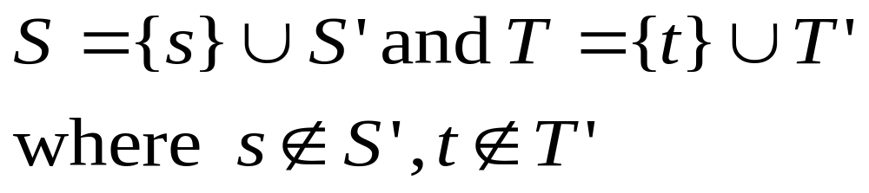
Cut-based Algorithm (cont.)
Cut: a partition of the vertices in two sets:
The cost is the sum of the weights of all edges crossing from S to T
A minimum cut is a cut with the minimal cost
A minimum cut can be found using maximum-flow algorithms, with polynomial asymptotic running times
Use the min-cut / max-flow algorithm

Slide 63
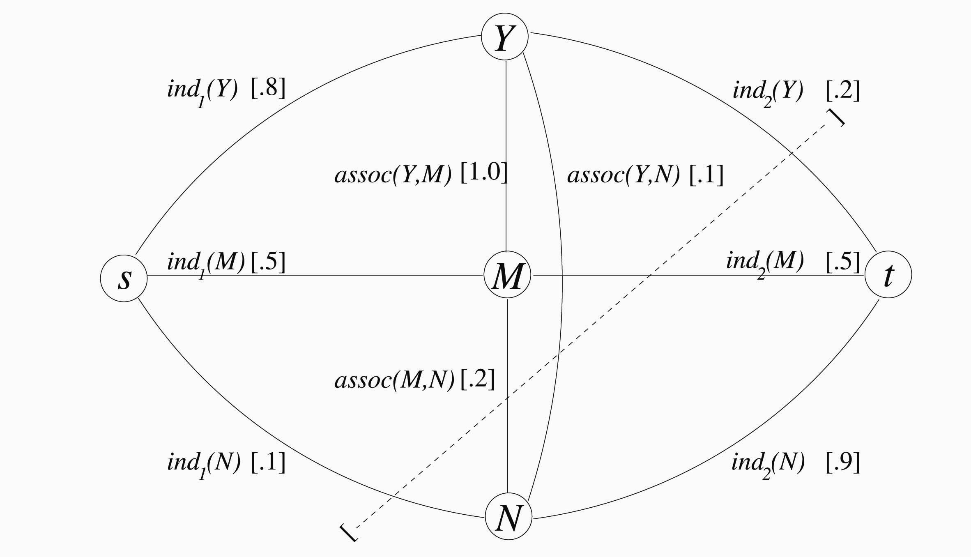
Cut-based Algorithm (cont.)
Notice that without the structural information we would be undecided
about the assignment of node M

Slide 64
Subjectivity Extraction
Assign every individual sentence a subjectivity score
  e.g. the probability of a sentence being subjective, as assigned by a Naïve Bayes classifier, etc
Assign every sentence pair a proximity or similarity score
  e.g. physical proximity = the inverse of the number of sentences between the two entities
Use the min-cut algorithm to classify the sentences into objective/subjective

Slide 65
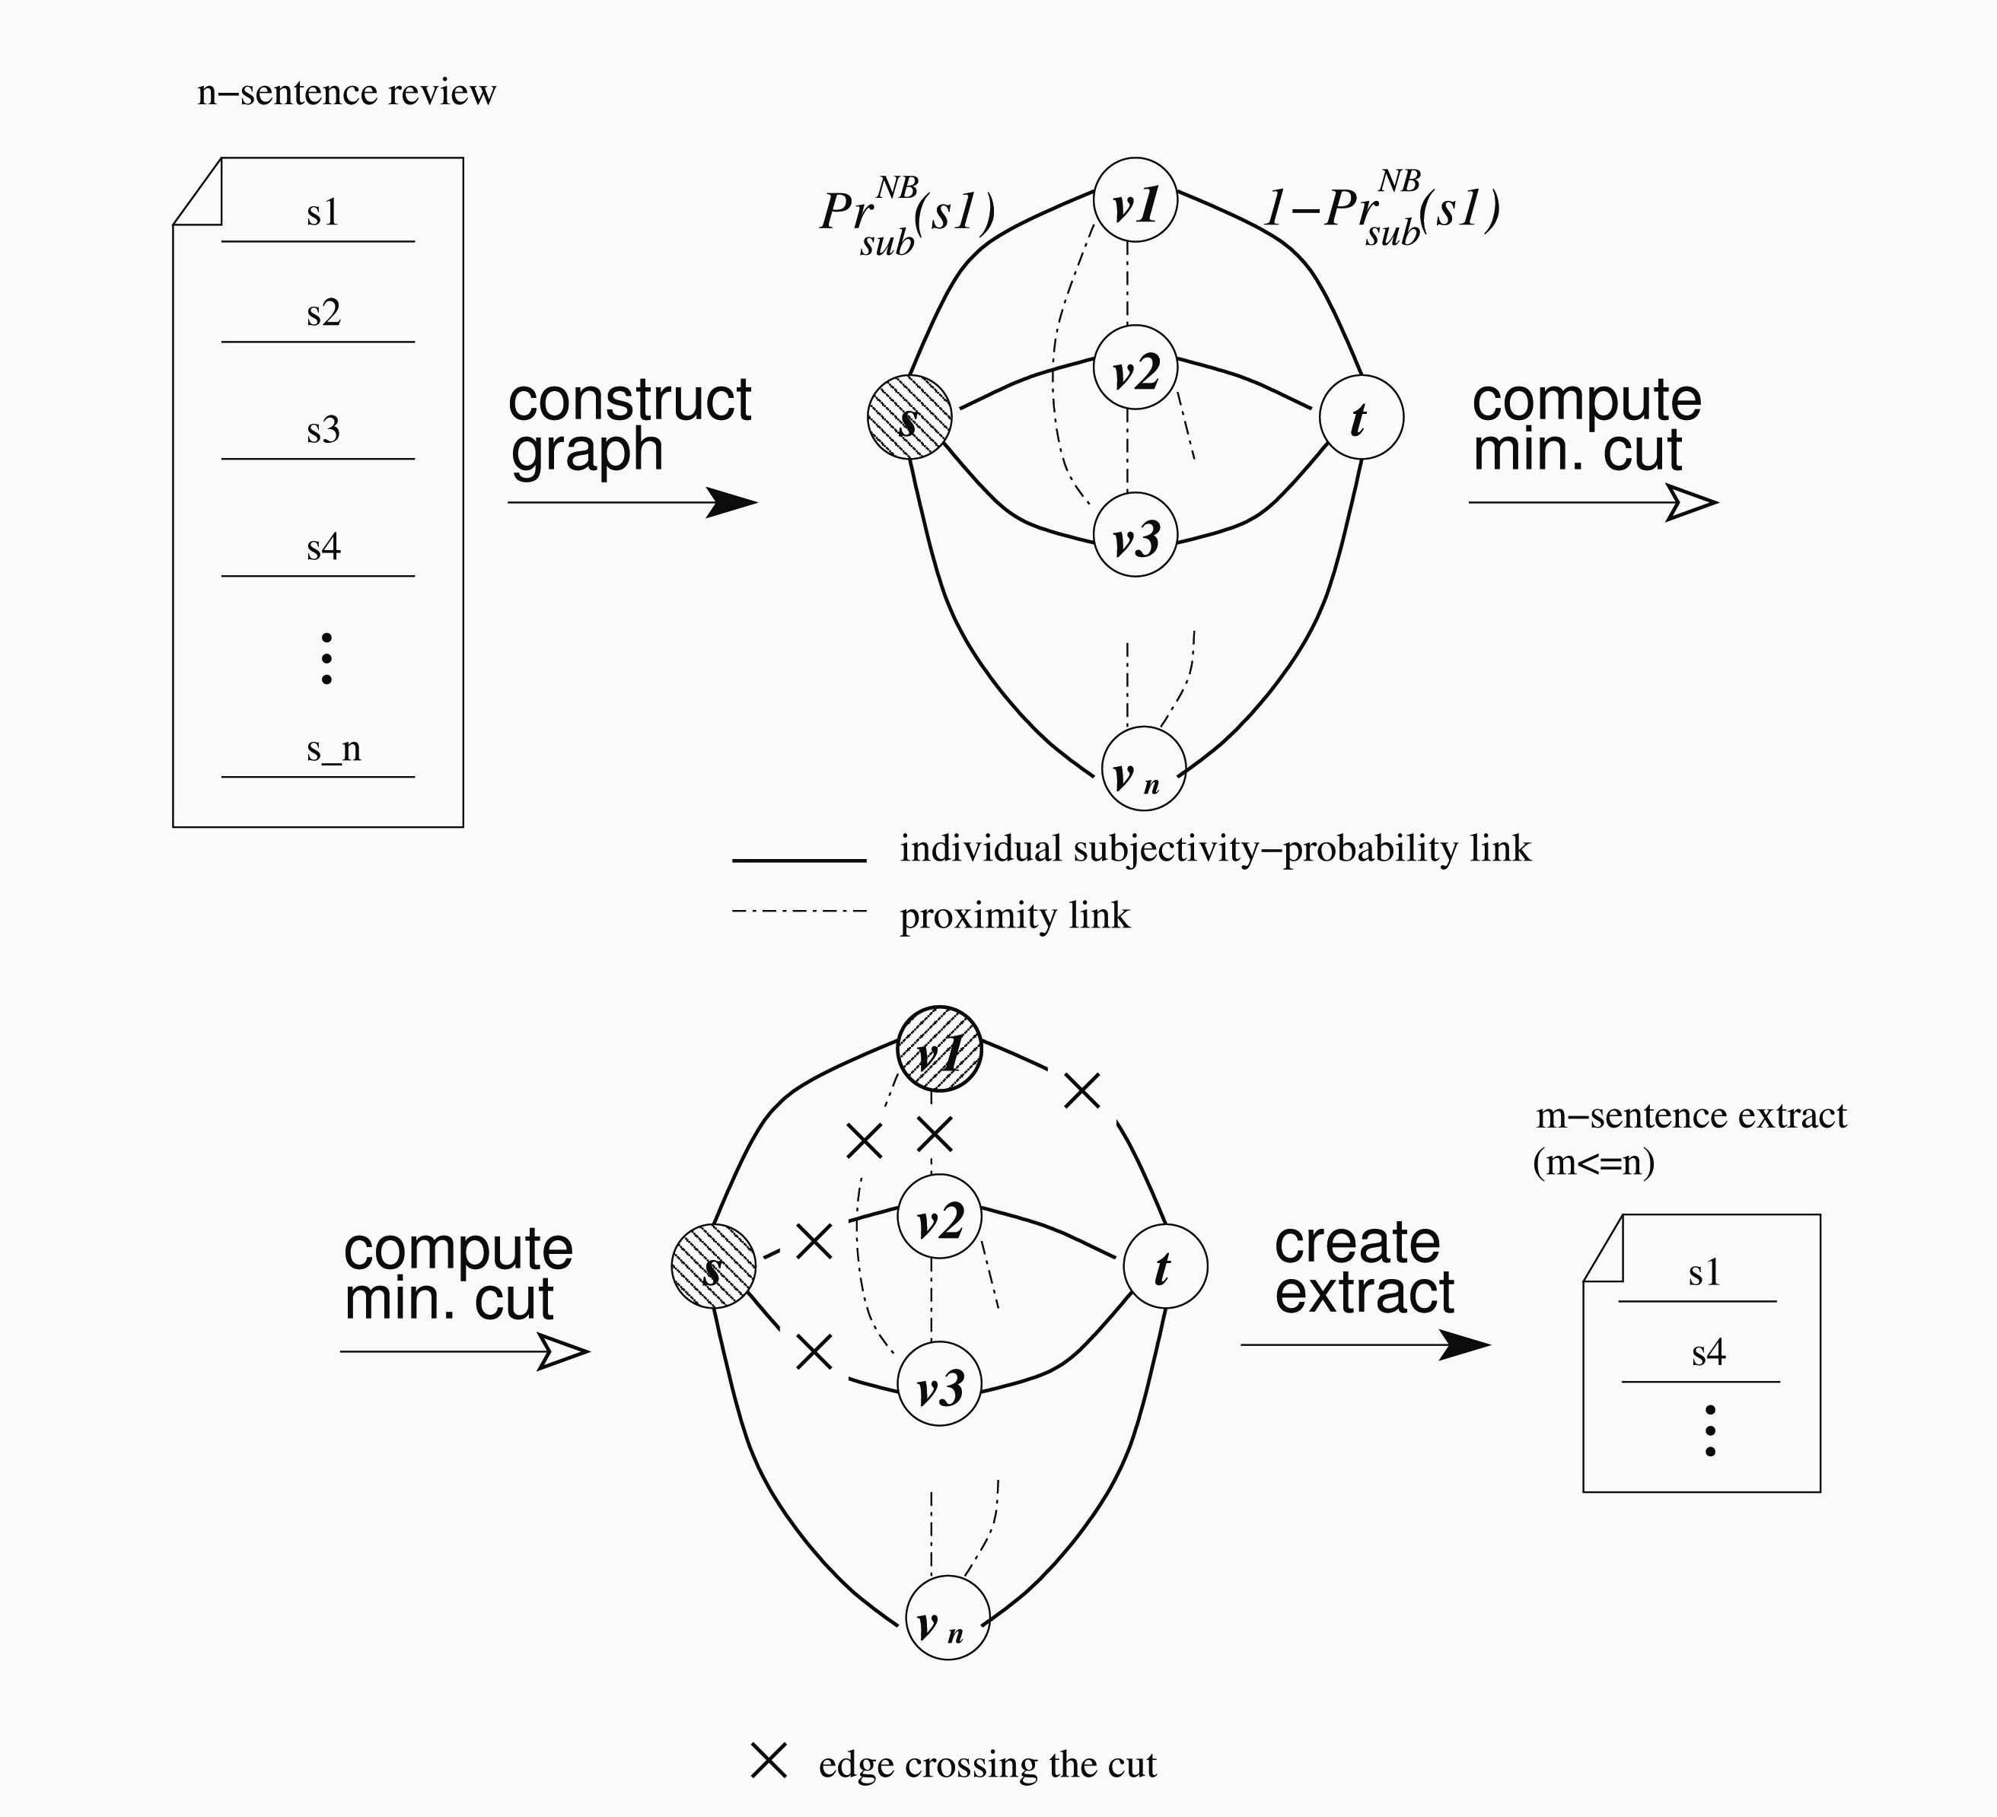
Subjectivity Extraction with Min-Cut

Slide 66
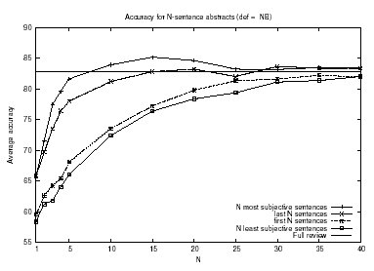
Results
2000 movie reviews (1000 positive / 1000 negative)
The use of subjective extracts improves or maintains the accuracy of the polarity analysis while reducing the input data size

