Slide 1
Text summarization
Dragomir R. Radev

Slide 2
Part I
Introduction

Slide 3
Information overload
The problem:
  4 Billion URLs indexed by Google
  200 TB of data on the Web [Lyman and Varian 03]
Possible approaches:
  information retrieval
  document clustering
  information extraction
  visualization
  question answering
  text summarization

Slide 4
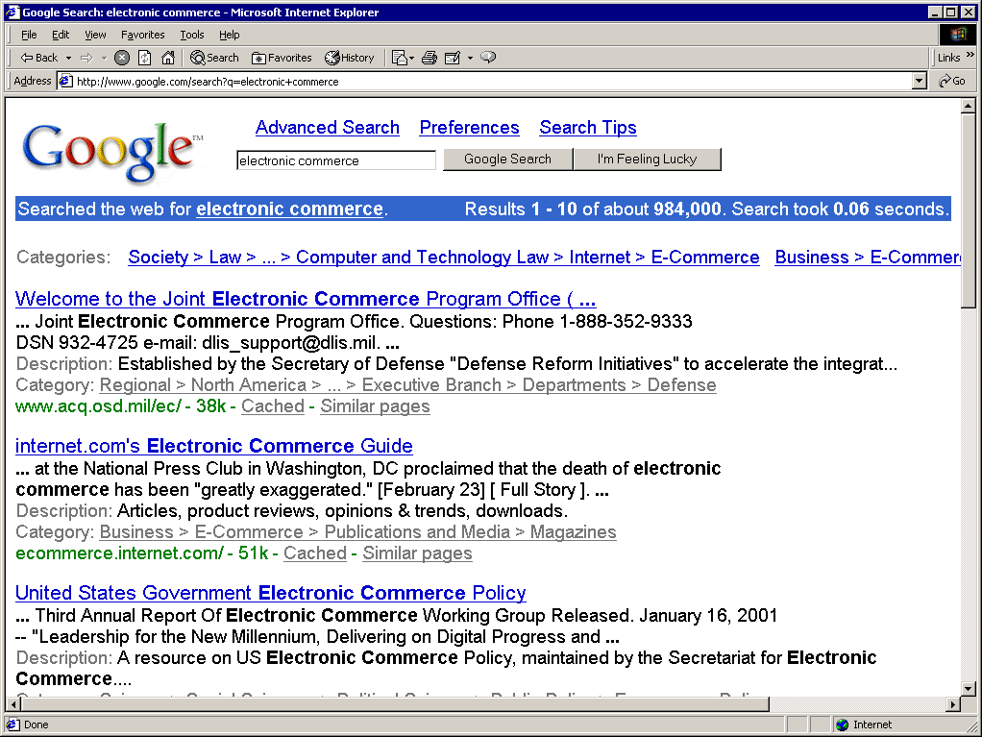
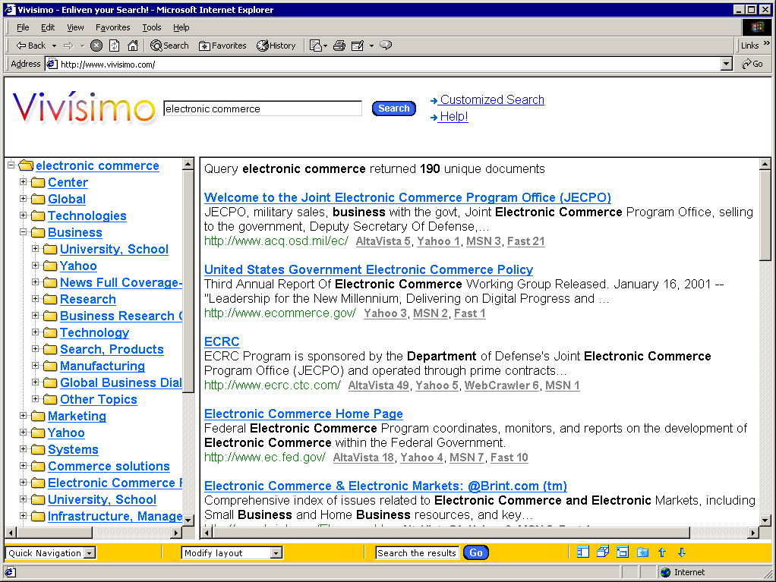
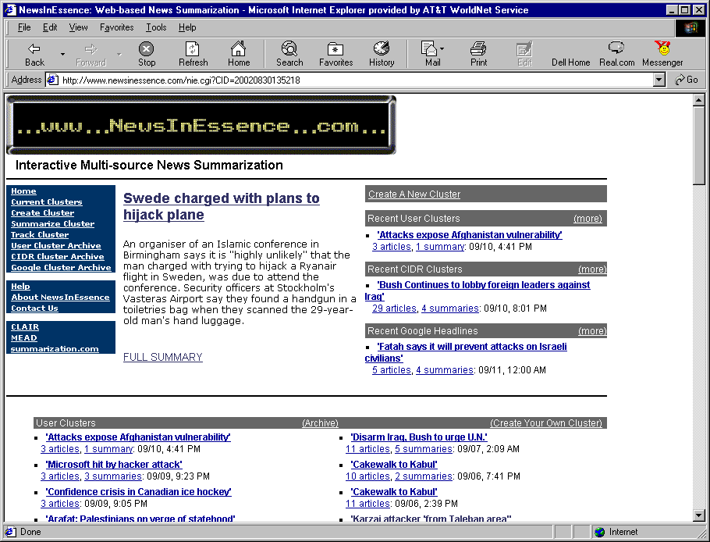
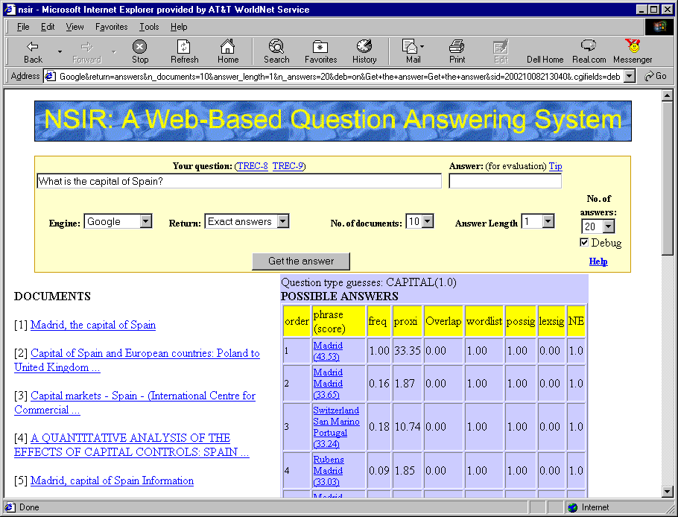
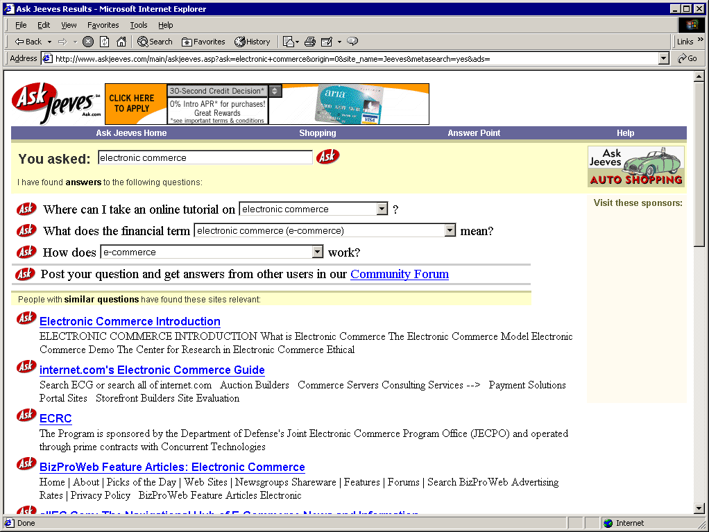

Slide 5
MILAN, Italy, April 18. A small airplane crashed into a government
building in heart of Milan, setting the top floors on fire, Italian
police reported. There were no immediate reports on casualties as
rescue workers attempted to clear the area in the city's financial
district. Few details of the crash were available, but news reports
about it immediately set off fears that it might be a terrorist act
akin to the Sept. 11 attacks in the United States. Those fears sent
U.S. stocks tumbling to session lows in late morning trading.
Witnesses reported hearing a loud explosion from the 30-story
office building, which houses the administrative offices of the local
Lombardy region and sits next to the city's central train station.
Italian state television said the crash put a hole in the 25th floor
of the Pirelli building. News reports said smoke poured from the
opening. Police and ambulances rushed to the building in downtown
Milan. No further details were immediately available.

Slide 6
MILAN, Italy, April 18. A small airplane crashed into a government
building in heart of Milan, setting the top floors on fire, Italian
police reported. There were no immediate reports on casualties as
rescue workers attempted to clear the area in the city's financial
district. Few details of the crash were available, but news reports
about it immediately set off fears that it might be a terrorist act
akin to the Sept. 11 attacks in the United States. Those fears sent
U.S. stocks tumbling to session lows in late morning trading.
Witnesses reported hearing a loud explosion from the 30-story
office building, which houses the administrative offices of the local
Lombardy region and sits next to the city's central train station.
Italian state television said the crash put a hole in the 25th floor
of the Pirelli building. News reports said smoke poured from the
opening. Police and ambulances rushed to the building in downtown
Milan. No further details were immediately available.

Slide 7
What happened?
MILAN, Italy, April 18. A small airplane crashed into a government
building in heart of Milan, setting the top floors on fire, Italian
police reported. There were no immediate reports on casualties as
rescue workers attempted to clear the area in the city's financial
district. Few details of the crash were available, but news reports
about it immediately set off fears that it might be a terrorist act
akin to the Sept. 11 attacks in the United States. Those fears sent
U.S. stocks tumbling to session lows in late morning trading.
Witnesses reported hearing a loud explosion from the 30-story
office building, which houses the administrative offices of the local
Lombardy region and sits next to the city's central train station.
Italian state television said the crash put a hole in the 25th floor
of the Pirelli building. News reports said smoke poured from the
opening. Police and ambulances rushed to the building in downtown
Milan. No further details were immediately available.
When, where?
How many victims?
Says who?
Was it a terrorist act?
What was the target?

Slide 8
1. How many people were injured?
2. How many people were killed? (age, number, gender, description)
3. Was the pilot killed?
4. Where was the plane coming from?
5. Was it an accident (technical problem, illness, terrorist act)?
6. Who was the pilot? (age, number, gender, description)
7. When did the plane crash?
8. How tall is the Pirelli building?
9. Who was on the plane with the pilot?
10. Did the plane catch fire before hitting the building?
11. What was the weather like at the time of the crash?
12. When was the building built?
13. What direction was the plane flying?
14. How many people work in the building?
15. How many people were in the building at the time of the crash?
16. How many people were taken to the hospital?
17. What kind of aircraft was used?

Slide 9
Types of summaries
Purpose
  Indicative, informative, and critical summaries
Form
  Extracts (representative paragraphs/sentences/phrases)
  Abstracts: “a concise summary of the central subject matter of a document” [Paice90].
Dimensions
  Single-document vs. multi-document
Context
  Query-specific vs. query-independent
Generic vs. query-oriented
  ...provides author’s view vs. reflects user’s interest.

Slide 10
Genres
headlines
outlines
minutes
biographies
abridgments
sound bites
movie summaries
chronologies, etc.
[Mani and Maybury 1999]

Slide 11
Aspects that Describe Summaries
Input (Sparck Jones 97)
  subject type: domain
  genre: newspaper articles, editorials, letters, reports...
  form: regular text structure; free-form
  source size: single doc; multiple docs (few; many)
Purpose
  situation: embedded in larger system (MT, IR) or not?
  audience: focused or general
  usage: IR, sorting, skimming...
Output
  completeness: include all aspects, or focus on some?
  format: paragraph, table, etc.
  style: informative, indicative, aggregative, critical...

Slide 12
Introduction - History
The problem has been addressed since the 50’ [Luhn 58]
Numerous methods are currently being suggested
[In my opinion] most methods still rely on 50’-70’ algorithms
Problem is still hard yet there are many commercial aplications (MS Word, www.newsinessence.com, etc.)

Slide 13
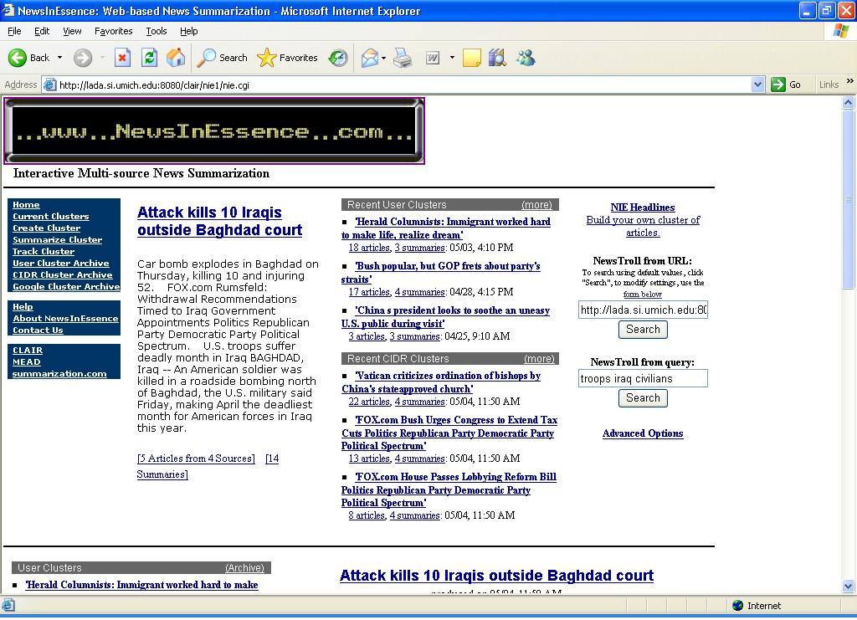

Slide 14
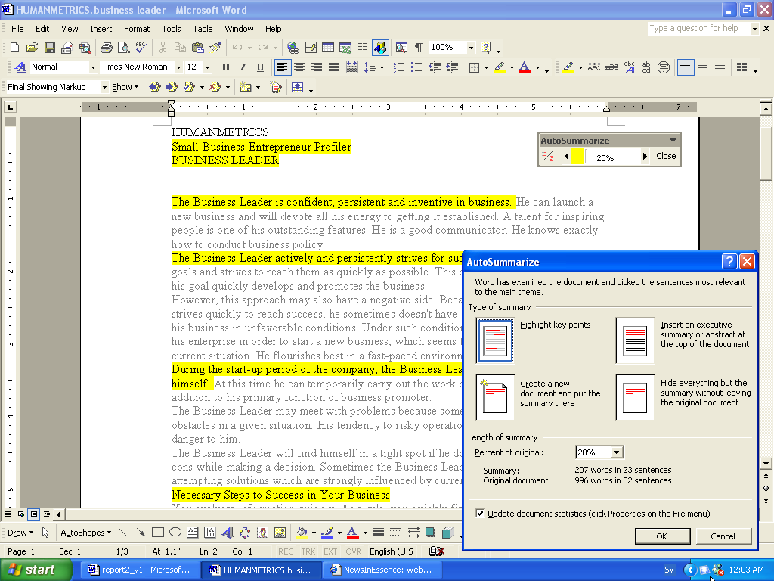
MSWord AutoSummarize

Slide 15
What does summarization involve?
Three stages (typically)
  content identification
    find/extract the most important material
  Conceptual organization
  Realization

Slide 16
BAGHDAD, Iraq (CNN) 6 July 2004 -- Three U.S. Marines have died in al Anbar Province west of Baghdad, the Coalition Public Information Center said Tuesday.
According to CPIC, "Two Marines assigned to [1st] Marine Expeditionary Force were killed in action and one Marine died of wounds received in action Monday in the Al Anbar Province while conducting security and stability operations.“
Al Anbar Province -- a hotbed for Iraqi insurgents -- includes the restive cities of Ramadi and Fallujah and runs to the Syrian and Jordanian borders.
Meanwhile, officials said eight people died Monday in a U.S. air raid on a house in Fallujah that American commanders said was used to harbor Islamic militants.
A statement from interim Iraqi Prime Minister Ayad Allawi said his government's security forces provided "clear and compelling intelligence" that led to the raid.
A senior U.S. military official told CNN the target was a group of people suspected of planning suicide attacks using vehicles.
The strike was the latest in a series of raids on the city to target what U.S. military spokesmen have called safehouses for the network led by fugitive Islamic militant leader Abu Musab al-Zarqawi.
A statement from Allawi said: "The people of Iraq will not tolerate terrorist groups or those who collaborate with any other foreign fighters such as the Zarqawi network to continue their wicked ways.
"The sovereign nation of Iraq and our international partners are committed to stopping terrorism and will continue to hunt down these evil terrorists and weed them out, one by one. I call upon all Iraqis to close ranks and report to the authorities on the activities of these criminal cells.“
American planes dropped two 1,000-pound bombs and four 500-pound bombs on the house about 7:15 p.m. (11:15 a.m. ET), according to a statement from the U.S.-led Multi-National Force-Iraq.
"This operation employed precision weapons and underscores the resolve of multinational forces and Iraqi security forces to jointly destroy terrorist networks in Iraq," a military statement said.
A doctor at Fallujah Hospital said the dead included four men, a woman and three children, some of them members of the same family. Another three people were wounded, the doctor said.
U.S. officials blame Zarqawi, who is believed to have links to al Qaeda, for numerous attacks on Iraqi and U.S. civilians and coalition troops.
At least four previous air raids have targeted suspected Zarqawi safehouses in Fallujah.
Notes:
REPLACE!!!

Slide 17
BAGHDAD, Iraq (CNN) 6 July 2004 -- Three U.S. Marines have died in al Anbar Province west of Baghdad, the Coalition Public Information Center said Tuesday.
According to CPIC, "Two Marines assigned to [1st] Marine Expeditionary Force were killed in action and one Marine died of wounds received in action Monday in the Al Anbar Province while conducting security and stability operations.“
Al Anbar Province -- a hotbed for Iraqi insurgents -- includes the restive cities of Ramadi and Fallujah and runs to the Syrian and Jordanian borders.
Meanwhile, officials said eight people died Monday in a U.S. air raid on a house in Fallujah that American commanders said was used to harbor Islamic militants.
A statement from interim Iraqi Prime Minister Ayad Allawi said his government's security forces provided "clear and compelling intelligence" that led to the raid.
A senior U.S. military official told CNN the target was a group of people suspected of planning suicide attacks using vehicles.
The strike was the latest in a series of raids on the city to target what U.S. military spokesmen have called safehouses for the network led by fugitive Islamic militant leader Abu Musab al-Zarqawi.
A statement from Allawi said: "The people of Iraq will not tolerate terrorist groups or those who collaborate with any other foreign fighters such as the Zarqawi network to continue their wicked ways.
"The sovereign nation of Iraq and our international partners are committed to stopping terrorism and will continue to hunt down these evil terrorists and weed them out, one by one. I call upon all Iraqis to close ranks and report to the authorities on the activities of these criminal cells.“
American planes dropped two 1,000-pound bombs and four 500-pound bombs on the house about 7:15 p.m. (11:15 a.m. ET), according to a statement from the U.S.-led Multi-National Force-Iraq.
"This operation employed precision weapons and underscores the resolve of multinational forces and Iraqi security forces to jointly destroy terrorist networks in Iraq," a military statement said.
A doctor at Fallujah Hospital said the dead included four men, a woman and three children, some of them members of the same family. Another three people were wounded, the doctor said.
U.S. officials blame Zarqawi, who is believed to have links to al Qaeda, for numerous attacks on Iraqi and U.S. civilians and coalition troops.
At least four previous air raids have targeted suspected Zarqawi safehouses in Fallujah.
Notes:
REPLACE!!!

Slide 18
Outline
I
Introduction
II
Traditional approaches
III
Multi-document summarization
IV
Knowledge-rich techniques
V
Evaluation methods
VI
Recent approaches
VII
Appendix

Slide 19
Part II
Traditional approaches

Slide 20
Human summarization and abstracting
What professional abstractors do
Ashworth:
    “To take an original article, understand it and pack it neatly into a nutshell without loss of substance or clarity presents a challenge which many have felt worth taking up for the joys of achievement alone. These are the characteristics of an art form”.

Slide 21
Borko and Bernier 75
The abstract and its use:
  Abstracts promote current awareness
  Abstracts save reading time
  Abstracts facilitate selection
  Abstracts facilitate literature searches
  Abstracts improve indexing efficiency
  Abstracts aid in the preparation of reviews

Slide 22
Cremmins 82, 96
American National Standard for Writing Abstracts:
  State the purpose, methods, results, and conclusions presented in the original document, either in that order or with an initial emphasis on results and conclusions.
  Make the abstract as informative as the nature of the document will permit, so that readers may decide, quickly and accurately, whether they need to read the entire document.
  Avoid including background information or citing the work of others in the abstract, unless the study is a replication or evaluation of their work.

Slide 23
Cremmins 82, 96
  Do not include information in the abstract that is not contained in the textual material being abstracted.
  Verify that all quantitative and qualitative information used in the abstract agrees with the information contained in the full text of the document.
  Use standard English and precise technical terms, and follow conventional grammar and punctuation rules.
  Give expanded versions of lesser known abbreviations and acronyms, and verbalize symbols that may be unfamiliar to readers of the abstract.
  Omit needless words, phrases, and sentences.

Slide 24
Cremmins 82, 96
Original version:
There were significant positive associations between the concentrations of the substance administered and mortality in rats and mice of both sexes.
There was no convincing evidence to indicate that endrin ingestion induced and of the different types of tumors which were found in the treated animals.
Edited version:
Mortality in rats and mice of both sexes was dose related.
No treatment-related tumors were found in any of the animals.

Slide 25
Morris et al. 92
Reading comprehension of summaries
75% redundancy of English [Shannon 51]
Compare manual abstracts, Edmundson-style extracts, and full documents
Extracts containing 20% or 30% of original document are effective surrogates of original document
Performance on 20% and 30% extracts is no different than informative abstracts

Slide 26
Automated Summarization Methods
(Pseudo) Statistical scoring methods
Higher semantic/syntactic structures
  Network (graph) based methods
  Other methods (rhetorical analysis, lexical chains, co-reference chains)
AI methods

Slide 27
Word Frequencies: Luhn 58
Very first work in automated summarization
Computes measures of significance
Words:
  stemming
  bag of words
E
FREQUENCY
WORDS
Resolving power of significant words

Slide 28
Luhn 58
Sentences:
  concentration of high-score words
Cutoff values established in experiments with 100 human subjects
SENTENCE
SIGNIFICANT WORDS
*
*
*
*
1 2 3 4 5 6 7
ALL WORDS
SCORE = 4²/7 ≈ 2.3

Slide 29
Word frequencies (Luhn 58)
Running nose. Raging fever. Aching joints. Splitting headache. Are there any poor souls suffering from the flu this winter who haven’t longed for a pill to make it all go away? Relief may be in sight. Researchers at Gilead Sciences, a pharmaceutical company in Foster City, California, reported last week in the Journal of the American Chemical Society that they have discovered a compound that can stop the influenza virus from spreading in animals. Tests on humans are set for later this year.
The new compound takes a novel approach to the familiar flu virus. It targets an enzyme, called neuraminidase, that the virus needs in order to scatter copies of itself throughout the body. This enzyme acts like a pair of molecular scissors that slices through the protective mucous linings of the nose and throat. After the virus infects the cells of the respiratory system and begins replicating, neuraminidase cuts the newly formed copies free to invade other cells. By blocking this enzyme, the new compound, dubbed GS 4104, prevents the infection from spreading.

Slide 30
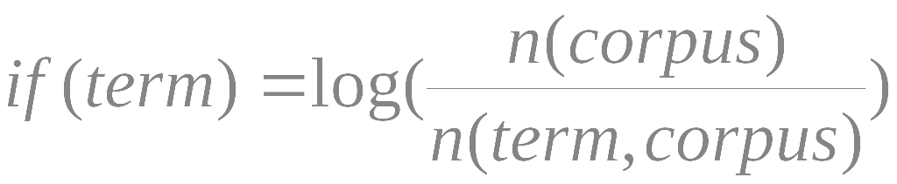
Word frequencies (Luhn 58)
Calculate term frequency in document: f(term)
Calculate inverse log-frequency in corpus : if(term)
Words with high f(term)if(term) are indicative
Keyword clusters are found (accord. To maximal width) and weighted
Sentence with highest sum of cluster weights is chosen

Slide 31
Edmundson 69
Cue method:
  stigma words (“hardly”, “impossible”)
  bonus words (“significant”)
Key method:
  similar to Luhn
Title method:
  title + headings
Location method:
  sentences under headings
  sentences near beginning or end of document and/or paragraphs (also [Baxendale 58])

Slide 32
Position in the text
(Edmunson 69, Lin&Hovy 97)
Claim : Important sentences occur in specific positions
  “lead-based” summary (Brandow’95)
  inverse of position in document works well for the “news”
  Important information occurs in specific sections of the document (introduction/conclusion)

Slide 33
Position in the text
(Edmunson 69, Lin&Hovy 97)
Assign score to sentences according to location in paragraph
Assign score to paragraphs and sentences according to location in entire text
Definition of important sections might help
Position evidence (Baxendale’58)
  first/last sentences in a paragraph are topical

Slide 34
Position in the text - OPP
(Edmunson 69, Lin&Hovy 97)
Position depends on type(genre) of text
“Optimum Position Policy” (Lin & Hovy’97) method is used to learn “positions” which contain relevant information
“learning” method uses documents + abstracts + keywords provided by authors
OPP is learned for each genre (problematic when the number of abstracted publications is not large)

Slide 35
Title method (Edmunson 69)
Claim : title of document indicates its content (Duh!)
words in title help find relevant content
create a list of title words, remove “stop words”
Use those as keywords in order to find important sentences
(for example with Luhn’s methods)

Slide 36
Cue phrases method (Edmunson 69)
Claim : Important sentences contain cue words/indicative phrases
  “The main aim of the present paper is to describe…” (IND)
  “The purpose of this article is to review…” (IND)
  “In this report, we outline…” (IND)
  “Our investigation has shown that…” (INF)
Some words are considered bonus others stigma
  bonus: comparatives, superlatives, conclusive expressions, etc.
  stigma: negatives, pronouns, etc.

Slide 37
Cue phrases method (Edmunson 69)
Paice implemented a dictionary of <cue,weight>
Grammar for indicative expressions
  In + skip(0) + this + skip(2) + paper + skip(0) + we + ...
  Cue words can be learned (Teufel’98)
Implemented for French (Lehman ‘97)

Slide 38
Edmundson 69
Linear combination of four features:
α₁C + α₂K + α₃T + α₄L
Manually labelled training corpus
Key not important!
μ ± 1 σ
C + T + L
C + K + T + L
LOCATION
CUE
TITLE
KEY
RANDOM
0 10 20 30 40 50 60 70 80 90 100 %

Slide 39
Paice 90
Survey up to 1990
Techniques that (mostly) failed:
  syntactic criteria [Earl 70]
  indicator phrases (“The purpose of this article is to review…)
Problems with extracts:
  lack of balance
  lack of cohesion
    anaphoric reference
    lexical or definite reference
    rhetorical connectives

Slide 40
Paice 90
Lack of balance
  later approaches based on text rhetorical structure
Lack of cohesion
  recognition of anaphors [Liddy et al. 87]
Example: “that” is
  nonanaphoric if preceded by a research-verb (e.g., “demonstrat-”),
  nonanaphoric if followed by a pronoun, article, quantifier,…,
  external if no later than 10th word,
  else
  internal

Slide 41
Brandow et al. 95
ANES: commercial news from 41 publications
“Lead” achieves acceptability of 90% vs. 74.4% for “intelligent” summaries
20,997 documents
words selected based on tf*idf
sentence-based features:
  signature words
  location
  anaphora words
  length of abstract

Slide 42
Brandow et al. 95
Sentences with no signature words are included if between two selected sentences
Evaluation done at 60, 150, and 250 word length
Non-task-driven evaluation:
“Most summaries judged less-than-perfect would not be detectable as such to a user”

Slide 43
Lin & Hovy 97
Optimum position policy
Measuring yield of each sentence position against keywords (signature words) from Ziff-Davis corpus
Preferred order
[(T) (P2,S1) (P3,S1) (P2,S2) {(P4,S1) (P5,S1) (P3,S2)} {(P1,S1) (P6,S1) (P7,S1) (P1,S3)
(P2,S3) …]

Slide 44
Kupiec et al. 95
Extracts of roughly 20% of original text
Feature set:
  sentence length
    |S| > 5
  fixed phrases
    26 manually chosen
  paragraph
    sentence position in paragraph
  thematic words
    binary: whether sentence is included in manual extract
  uppercase words
    not common acronyms
Corpus:
    188 document + summary pairs from scientific journals

Slide 45
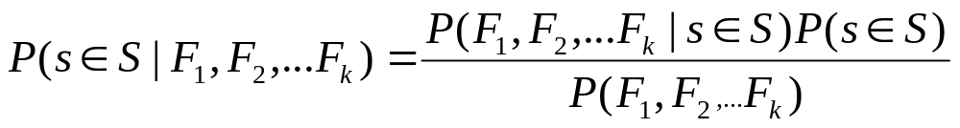
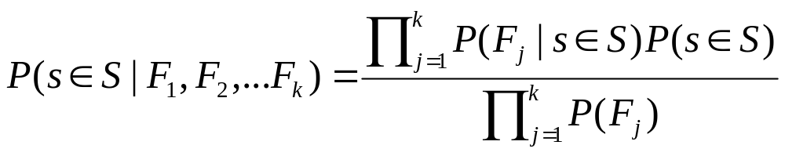
Kupiec et al. 95
Uses Bayesian classifier:
Assuming statistical independence:

Slide 46
Kupiec et al. 95
Performance:
  For 25% summaries, 84% precision
  For smaller summaries, 74% improvement over Lead

Slide 47
Higher semantic/syntactic structures
Claim: Important sentences/paragraphs are the highest connected entities in more or less elaborate semantic structures.
Classes of approaches
  word co-occurrences;
  co-reference;
  lexical similarity (WordNet, lexical chains);
  combinations of the above.

Slide 48
Coreference method
Build co-reference chains (noun/event identity, part-whole relations) between
  query and document - In the context of query-based summarization
  title and document
  sentences within document
Important sentences are those traversed by a large number of chains:
  a preference is imposed on chains (query > title > doc)

Slide 49
Lexical chains (Stairmand 96)
Mr. Kenny is the person that invented the anesthetic machine which uses micro-computers to control the rate at which an anesthetic is pumped into the blood. Such machines are nothing new. But his device uses two micro-computers to achieve much closer monitoring of the pump feeding the anesthetic into the patient.
  Lexical chain :
    Sequence of words which have lexical cohesion (Reiteration/Collocation)
    Semantically related words

Slide 50
Barzilay and Elhadad 97
Lexical chains are used to summarize
WordNet-based
three types of relations:
  extra-strong (repetitions)
  strong (WordNet relations)
  medium-strong (link between synsets is longer than one + some additional constraints)

Slide 51
Barzilay and Elhadad 97
Compute the contribution of N to C as follows
  If C is empty consider the relation to be “repetition” (identity)
  If not identify the last element M of the chain to which N is related
  Compute distance between N and M in number of sentences ( 1 if N is the first word of chain)
  Contribution of N is looked up in a table with entries given by type of relation and distance
    e.g., collocation & distance=3 -> contribution=0.5

Slide 52
Barzilay and Elhadad 97
After inserting all nouns in chains there is a second step
For each noun, identify the chain where it most contributes; delete it from the other chains and adjust weights

Slide 53
Barzilay and Elhadad 97
Strong chain (Length, Homogenity):
  weight(C) > threshold
  threshold = E(weight(Cs)) + 2Sigma(weight(Cs))
selection:
  H1: select the first sentence that contains a member of a strong chain
  H2: select the first sentence that contains a “representative” (frequency) member of the chain
  H3: identify a text segment where the chain is highly dense (density is the proportion of words in the segment that belong to the chain)

Slide 54
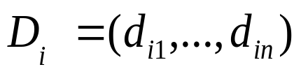
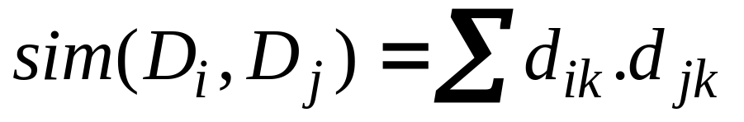
Network based method (Salton&al’97)
Vector Space Model
  each text unit represented as vector
Standard similarity metric
Construct a graph of paragraphs or other entities. Strength of link is the similarity metric
Use threshold to decide upon similar paragraphs or entities (pruning of the graph)
The result is a network (graph)

Slide 55
Network based method: Salton et al. 97
document analysis based on semantic hyperlinks (among pairs of paragraphs related by a lexical similarity significantly higher than random)
Bushy paths (or paths connecting highly connected paragraphs) are more likely to contain information central to the topic of the article

Slide 56
Salton et al. 97
…
…

Slide 57
Text relation map
sim>thr
B
C
A
sim<thr
D
B=1
C=2
A=3
F
D=1
E
similarities
F=2
links based on thr
E=3

Slide 58
Network based method (Salton&al’97)
identify regions where paragraphs are well connected
paragraph selection heuristics
  bushy path
    select paragraphs with many connections with other paragraphs and present them in text order
  depth-first path
    select one paragraph with many connections; select a connected paragraph (in text order) which is also well connected; continue
  segmented bushy path
    follow the bushy path strategy but locally including pargraphs from all “segments of text”: a bushy path is created for each segment

Slide 59
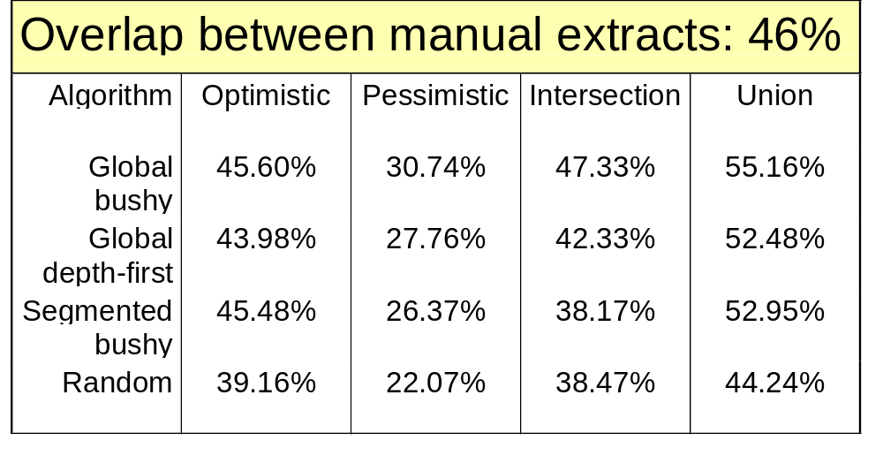
Salton et al. 97

Slide 60
Rhetorical analysis
Rhetorical Structure Theory (RST)
  Mann & Thompson’88
Descriptive theory of text organization
Relations between two text spans
  nucleus & satellite
  nucleus & nucleus
  Relations as
    Background text
    Preparation
    Concession (“Even though”)

Slide 61
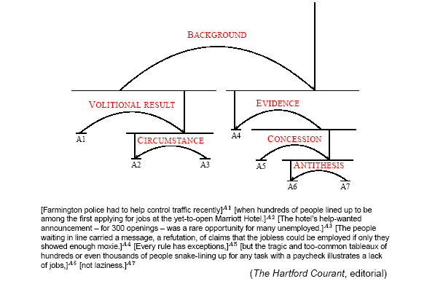
Rhetorical analysis

Slide 62
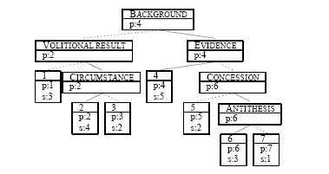
Rhetorical analysis (Marcu 97)
Promotion of text segments invoked partial order
Hundreds of people lined up to be among the first applying for jobs at the yetto-open Marriott Hotel. The people waiting in line carried a message, a refutation,of claims that the jobless could be employed if only they showed enough moxie.

Slide 63
Rhetorical analysis
A built RST captures relations in the text and can be used for high quality smart summarization
creates a spectrum of summaries due to the partial ordering invoked on the text parts
Building the RST (automatically) is hard nowadays
Not suitable for question answering (targeted summarization)

Slide 64
Marcu 97-99
Based on RST (nucleus+satellite relations)
text coherence
70% precision and recall in matching the most important units in a text
Example: evidence
[The truth is that the pressure to smoke in junior high is greater than it will be any other time of one’s life:][we know that 3,000 teens start smoking each day.]
N+S combination increases R’s belief in N [Mann and Thompson 88]

Slide 65
2
Elaboration
2
Elaboration
8
Example
2
Background
Justification
3
Elaboration
8
Concession
10
Antithesis
With its distant orbit (50 percent farther from the sun than Earth) and slim atmospheric blanket,
(1)
Mars experiences frigid weather conditions
(2)
Surface temperatures typically average about -60 degrees Celsius (-76 degrees Fahrenheit) at the equator and can dip to -123 degrees C near the poles
(3)
4 5
Contrast
Although the atmosphere holds a small amount of water, and water-ice clouds sometimes develop,
(7)
Most Martian weather involves blowing dust and carbon monoxide.
(8)
Each winter, for example, a blizzard of frozen carbon dioxide rages over one pole, and a few meters of this dry-ice snow accumulate as previously frozen carbon dioxide evaporates from the opposite polar cap.
(9)
Yet even on the summer pole, where the sun remains in the sky all day long, temperatures never warm enough to melt frozen water.
(10)
Only the midday sun at tropical latitudes is warm enough to thaw ice on occasion,
(4)
5
Evidence
Cause
but any liquid water formed in this way would evaporate almost instantly
(5)
because of the low atmospheric pressure
(6)

Slide 66
Barzilay and Elhadad 97
Lexical chains [Stairmand 96]
Mr. Kenny is the person that invented the anesthetic machine which uses micro-computers to control the rate at which an anesthetic is pumped into the blood. Such machines are nothing new. But his device uses two micro-computers to achineve much closer monitoring of the pump feeding the anesthetic into the patient.

Slide 67
Barzilay and Elhadad 97
WordNet-based
three types of relations:
  extra-strong (repetitions)
  strong (WordNet relations)
  medium-strong (link between synsets is longer than one + some additional constraints)

Slide 68
Barzilay and Elhadad 97
Scoring chains:
  Length
  Homogeneity index:
  = 1 - # distinct words in chain
  Score = Length * Homogeneity
  Score > Average + 2 * st.dev.

Slide 69
Osborne 02
Maxent (loglinear) model – no independence assumptions
Features: word pairs, sentence length, sentence position, discourse features (e.g., whether sentence follows the “Introduction”, etc.)
Maxent outperforms Naïve Bayes

Slide 70
Part III
Multi-document summarization

Slide 71
Mani & Bloedorn 97,99
Summarizing differences and similarities across documents
Single event or a sequence of events
Text segments are aligned
Evaluation: TREC relevance judgments
Significant reduction in time with no significant loss of accuracy

Slide 72
Carbonell & Goldstein 98
Maximal Marginal Relevance (MMR)
Query-based summaries
Law of diminishing returns
C = doc collection
Q = user query
R = IR(C,Q,θ)
S = already retrieved documents
Sim = similarity metric used
MMR = argmax [ λ (Sim₁(D_{i},Q) - (1-λ) max Sim₂(D_{i},D_{j})]
D_{i}∈R\S
D_{i}∈S

Slide 73
Radev et al. 00
MEAD
Centroid-based
Based on sentence utility
Topic detection and tracking initiative [Allen et al. 98, Wayne 98]
TIME

Slide 74
ARTICLE 18853: ALGIERS, May 20 (AFP)
ARTICLE 18854: ALGIERS, May 20 (UPI)
1. Eighteen decapitated bodies have been found in a mass grave in northern Algeria, press reports said Thursday, adding that two shepherds were murdered earlier this week.
2. Security forces found the mass grave on Wednesday at Chbika, near Djelfa, 275 kilometers (170 miles) south of the capital.
3. It contained the bodies of people killed last year during a wedding ceremony, according to Le Quotidien Liberte.
4. The victims included women, children and old men.
5. Most of them had been decapitated and their heads thrown on a road, reported the Es Sahafa.
6. Another mass grave containing the bodies of around 10 people was discovered recently near Algiers, in the Eucalyptus district.
7. The two shepherds were killed Monday evening by a group of nine armed Islamists near the Moulay Slissen forest.
8. After being injured in a hail of automatic weapons fire, the pair were finished off with machete blows before being decapitated, Le Quotidien d'Oran reported.
9. Seven people, six of them children, were killed and two injured Wednesday by armed Islamists near Medea, 120 kilometers (75 miles) south of Algiers, security forces said.
10. The same day a parcel bomb explosion injured 17 people in Algiers itself.
11. Since early March, violence linked to armed Islamists has claimed more than 500 lives, according to press tallies.
1. Algerian newspapers have reported that 18 decapitated bodies have been found by authorities in the south of the country.
2. Police found the ``decapitated bodies of women, children and old men,with their heads thrown on a road'' near the town of Jelfa, 275 kilometers (170 miles) south of the capital Algiers.
3. In another incident on Wednesday, seven people -- including six children -- were killed by terrorists, Algerian security forces said.
4. Extremist Muslim militants were responsible for the slaughter of the seven people in the province of Medea, 120 kilometers (74 miles) south of Algiers.
5. The killers also kidnapped three girls during the same attack, authorities said, and one of the girls was found wounded on a nearby road.
6. Meanwhile, the Algerian daily Le Matin today quoted Interior Minister Abdul Malik Silal as saying that ``terrorism has not been eradicated, but the movement of the terrorists has significantly declined.''
7. Algerian violence has claimed the lives of more than 70,000 people since the army cancelled the 1992 general elections that Islamic parties were likely to win.
8. Mainstream Islamic groups, most of which are banned in the country, insist their members are not responsible for the violence against civilians.
9. Some Muslim groups have blamed the army, while others accuse ``foreign elements conspiring against Algeria.’’

Slide 75
Vector-based representation
Term 1
Document
Term 3
α
Centroid
Term 2

Slide 76
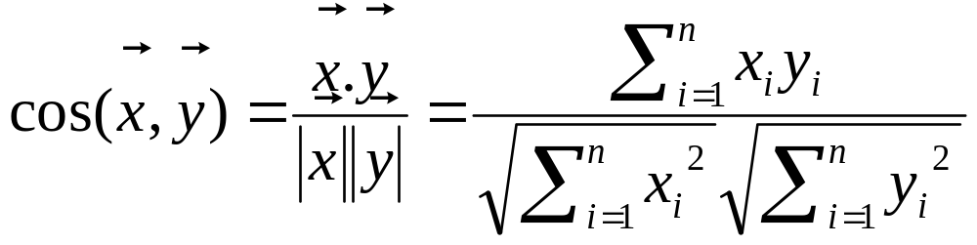
Vector-based matching
The cosine measure

Slide 77
CIDR
sim ≥ T
sim < T

Slide 78
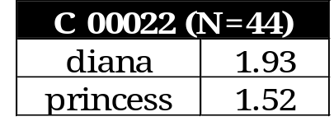
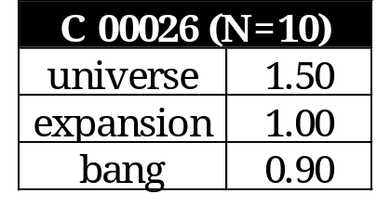
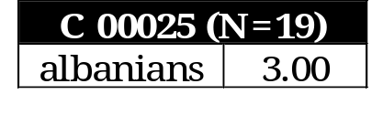
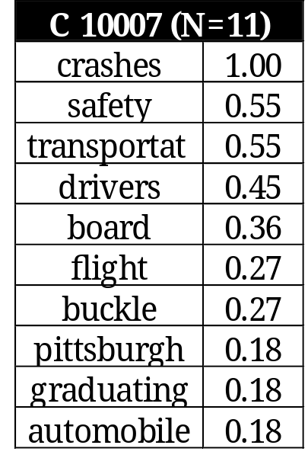
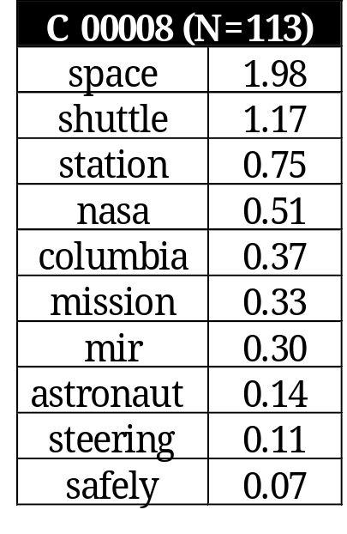
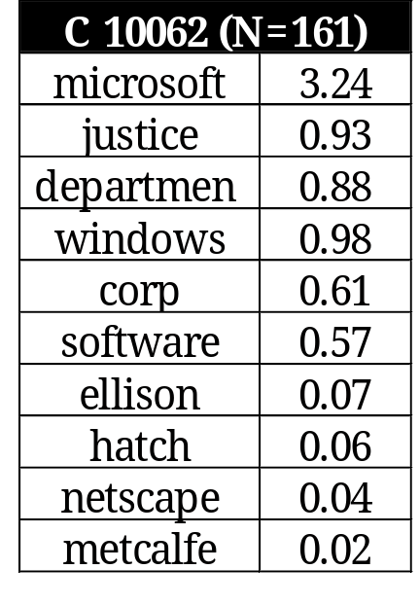
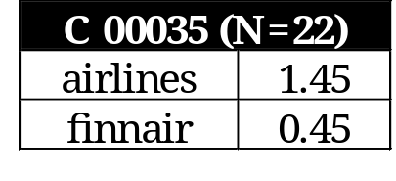
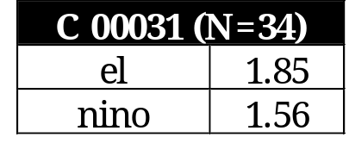
Centroids

Slide 79
MEAD
...
...

Slide 80
MEAD
INPUT: Cluster of d documents with n sentences (compression rate = r)
OUTPUT: (n * r) sentences from the cluster with the highest values of SCORE
SCORE (s) = Σ_{i} (w_{c}C_{i} + w_{p}P_{i} + w_{f}F_{i})

Slide 81
[Barzilay et al. 99]
Theme intersection (paraphrases)
Identifying common phrases across multiple sentences:
  evaluated on 39 sentence-level predicate-argument structures
  74% of p-a structures automatically identified

Slide 82
Other multi-document approaches
Reformulation [McKeown et al. 99, McKeown et al. 02]
Generation by Selection and Repair [DiMarco et al. 97]

Slide 83
Part IV
Knowledge-rich approaches

Slide 84
Overview
Schank and Abelson 77
  scripts
DeJong 79
  FRUMP (slot-filling from UPI news)
Graesser 81
  Ratio of inferred propositions to these explicitly stated is 8:1
Young & Hayes 85
  banking telexes

Slide 85
Radev and McKeown 98
MESSAGE: ID TST3-MUC4-0010
MESSAGE: TEMPLATE 2
INCIDENT: DATE 30 OCT 89
INCIDENT: LOCATION EL SALVADOR
INCIDENT: TYPE ATTACK
INCIDENT: STAGE OF EXECUTION ACCOMPLISHED
INCIDENT: INSTRUMENT ID
INCIDENT: INSTRUMENT TYPE
PERP: INCIDENT CATEGORY TERRORIST ACT
PERP: INDIVIDUAL ID "TERRORIST"
PERP: ORGANIZATION ID "THE FMLN"
PERP: ORG. CONFIDENCE REPORTED: "THE FMLN"
PHYS TGT: ID
PHYS TGT: TYPE
PHYS TGT: NUMBER
PHYS TGT: FOREIGN NATION
PHYS TGT: EFFECT OF INCIDENT
PHYS TGT: TOTAL NUMBER
HUM TGT: NAME
HUM TGT: DESCRIPTION "1 CIVILIAN"
HUM TGT: TYPE CIVILIAN: "1 CIVILIAN"
HUM TGT: NUMBER 1: "1 CIVILIAN"
HUM TGT: FOREIGN NATION
HUM TGT: EFFECT OF INCIDENT DEATH: "1 CIVILIAN"
HUM TGT: TOTAL NUMBER
Notes:
25 slots
We add four more slots: for primary and secondary sources of the information.

Slide 86
Generating text from templates
On October 30, 1989, one civilian was killed in a reported FMLN attack in El Salvador.
Notes:
25 slots
We add four more slots: for primary and secondary sources of the information.

Slide 87
Input: Cluster of templates
…..
T₁
T₂
T_{m}
Conceptual combiner
Domain
ontology
Combiner
Planning
operators
Paragraph planner
Linguistic realizer
Sentence planner
Lexicon
Lexical chooser
Sentence generator
SURGE
OUTPUT: Base summary

Slide 88
Excerpts from four articles
JERUSALEM - A Muslim suicide bomber blew apart 18 people on a Jerusalem bus and wounded 10 in a mirror-image of an attack one week ago. The carnage could rob Israel's Prime Minister Shimon Peres of the May 29 election victory he needs to pursue Middle East peacemaking. Peres declared all-out war on Hamas but his tough talk did little to impress stunned residents of Jerusalem who said the election would turn on the issue of personal security.
JERUSALEM - A bomb at a busy Tel Aviv shopping mall killed at least 10 people and wounded 30, Israel radio said quoting police. Army radio said the blast was apparently caused by a suicide bomber. Police said there were many wounded.
A bomb blast ripped through the commercial heart of Tel Aviv Monday, killing at least 13 people and wounding more than 100. Israeli police say an Islamic suicide bomber blew himself up outside a crowded shopping mall. It was the fourth deadly bombing in Israel in nine days. The Islamic fundamentalist group Hamas claimed responsibility for the attacks, which have killed at least 54 people. Hamas is intent on stopping the Middle East peace process. President Clinton joined the voices of international condemnation after the latest attack. He said the ``forces of terror shall not triumph'' over peacemaking efforts.
TEL AVIV (Reuter) - A Muslim suicide bomber killed at least 12 people and wounded 105, including children, outside a crowded Tel Aviv shopping mall Monday, police said.
Sunday, a Hamas suicide bomber killed 18 people on a Jerusalem bus. Hamas has now killed at least 56 people in four attacks in nine days.
The windows of stores lining both sides of Dizengoff Street were shattered, the charred skeletons of cars lay in the street, the sidewalks were strewn with blood.
The last attack on Dizengoff was in October 1994 when a Hamas suicide bomber killed 22 people on a bus.
1
2
3
4

Slide 89
Four templates
MESSAGE: ID TST-REU-0001
SECSOURCE: SOURCE Reuters
SECSOURCE: DATE March 3, 1996 11:30
PRIMSOURCE: SOURCE
INCIDENT: DATE March 3, 1996
INCIDENT: LOCATION Jerusalem
INCIDENT: TYPE Bombing
HUM TGT: NUMBER “killed: 18''
“wounded: 10”
PERP: ORGANIZATION ID
MESSAGE: ID TST-REU-0002
SECSOURCE: SOURCE Reuters
SECSOURCE: DATE March 4, 1996 07:20
PRIMSOURCE: SOURCE Israel Radio
INCIDENT: DATE March 4, 1996
INCIDENT: LOCATION Tel Aviv
INCIDENT: TYPE Bombing
HUM TGT: NUMBER “killed: at least 10''
“wounded: more than 100”
PERP: ORGANIZATION ID
1
2
MESSAGE: ID TST-REU-0003
SECSOURCE: SOURCE Reuters
SECSOURCE: DATE March 4, 1996 14:20
PRIMSOURCE: SOURCE
INCIDENT: DATE March 4, 1996
INCIDENT: LOCATION Tel Aviv
INCIDENT: TYPE Bombing
HUM TGT: NUMBER “killed: at least 13''
“wounded: more than 100”
PERP: ORGANIZATION ID “Hamas”
MESSAGE: ID TST-REU-0004
SECSOURCE: SOURCE Reuters
SECSOURCE: DATE March 4, 1996 14:30
PRIMSOURCE: SOURCE
INCIDENT: DATE March 4, 1996
INCIDENT: LOCATION Tel Aviv
INCIDENT: TYPE Bombing
HUM TGT: NUMBER “killed: at least 12''
“wounded: 105”
PERP: ORGANIZATION ID
3
4

Slide 90
Fluent summary with comparisons
Reuters reported that 18 people were killed on Sunday in a bombing in Jerusalem. The next day, a bomb in Tel Aviv killed at least 10 people and wounded 30 according to Israel radio. Reuters reported that at least 12 people were killed and 105 wounded in the second incident. Later the same day, Reuters reported that Hamas has claimed responsibility for the act.
(OUTPUT OF SUMMONS)

Slide 91
Operators
If there are two templates
AND
the location is the same
AND
the time of the second template is after the time of the first template
AND
the source of the first template is different from the source of the second template
AND
at least one slot differs
THEN
combine the templates using the contradiction operator...

Slide 92
Operators: Change of Perspective
Change of perspective
Precondition:
The same source reports a change in a small number of slots
March 4th, Reuters reported that a bomb in Tel Aviv killed at least 10 people and wounded 30. Later the same day, Reuters reported that exactly 12 people were actually killed and 105 wounded.
Notes:
Other operators: generalization, addition…
Future work: operators for including non-textual information and for generating updates

Slide 93
Operators: Contradiction
Contradiction
Precondition:
Different sources report contradictory values for a small number of slots
The afternoon of February 26, 1993, Reuters reported that a suspected bomb killed at least six people in the World Trade Center. However, Associated Press announced that exactly five people were killed in the blast.
Notes:
Other operators: generalization, addition…
Future work: operators for including non-textual information and for generating updates

Slide 94
Operators: Refinement and Agreement
Refinement
On Monday morning, Reuters announced that a suicide bomber killed at least 10 people in Tel Aviv. In the afternoon, Reuters reported that Hamas claimed responsibility for the act.
Agreement
The morning of March 1st 1994, both UPI and Reuters reported that a man was kidnapped in the Bronx.
Notes:
Other operators: generalization, addition…
Future work: operators for including non-textual information and for generating updates

Slide 95
Operators: Generalization
Generalization
According to UPI, three terrorists were arrested in Medellín last Tuesday. Reuters announced that the police arrested two drug traffickers in Bogotá the next day.
A total of five criminals were arrested in Colombia last week.
Notes:
Other operators: generalization, addition…
Future work: operators for including non-textual information and for generating updates

Slide 96
Other conceptual methods
Operator-based transformations using terminological knowledge representation [Reimer and Hahn 97]
Topic interpretation [Hovy and Lin 98]

Slide 97
Part V
Evaluation techniques

Slide 98
Ideal evaluation
Information content
|S|
Compression Ratio =
|D|
i (S)
Retention Ratio =
i (D)

Slide 99
Overview of techniques
Extrinsic techniques (task-based)
Intrinsic techniques

Slide 100
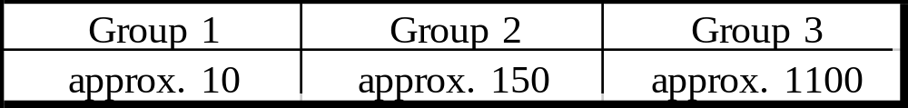
Hovy 98
Can you recreate what’s in the original?
  the Shannon Game [Shannon 1947–50].
  but often only some of it is really important.
Measure info retention (number of keystrokes):
  3 groups of subjects, each must recreate text:
    group 1 sees original text before starting.
    group 2 sees summary of original text before starting.
    group 3 sees nothing before starting.
Results (# of keystrokes; two different paragraphs):

Slide 101
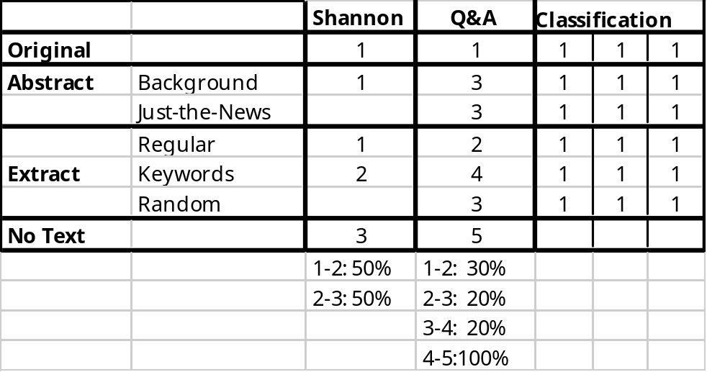
Hovy 98
Burning questions:
1. How do different evaluation methods compare for each type of summary?
2. How do different summary types fare under different methods?
3. How much does the evaluator affect things?
4. Is there a preferred evaluation method?
Small Experiment
  2 texts, 7 groups.
Results:
  No difference!
  As other experiment…
  ? Extract is best?

Slide 102
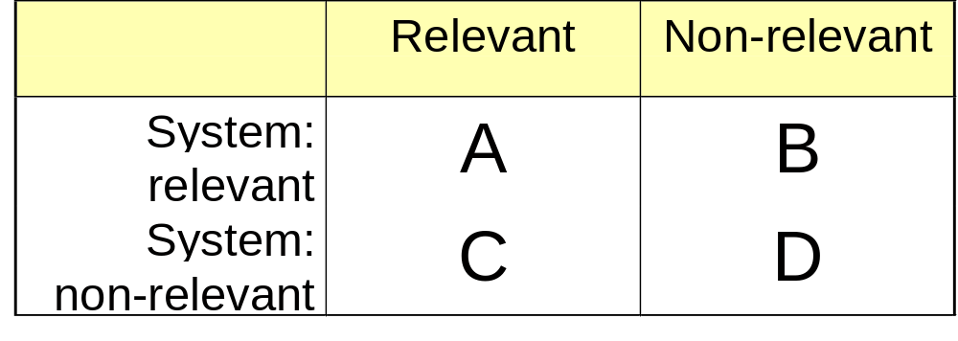
Precision and Recall

Slide 103


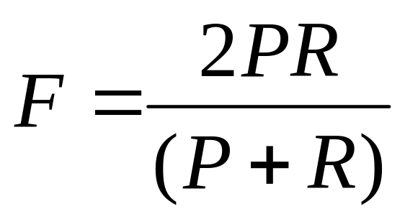
Precision and Recall

Slide 104
Jing et al. 98
Small experiment with 40 articles
When summary length is given, humans are pretty consistent in selecting the same sentences
Percent agreement
Different systems achieved maximum performance at different summary lengths
Human agreement higher for longer summaries

Slide 105
SUMMAC [Mani et al. 98]
16 participants
3 tasks:
  ad hoc: indicative, user-focused summaries
  categorization: generic summaries, five categories
  question-answering
20 TREC topics
50 documents per topic (short ones are omitted)

Slide 106
SUMMAC [Mani et al. 98]
Participants submit a fixed-length summary limited to 10% and a “best” summary, not limited in length.
variable-length summaries are as accurate as full text
over 80% of summaries are intelligible
technologies perform similarly

Slide 107
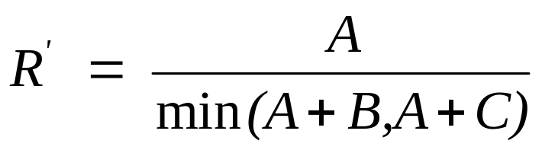
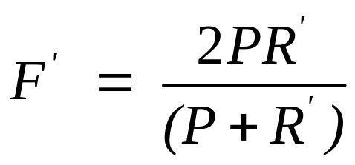
Goldstein et al. 99
Reuters, LA Times
Manual summaries
Summary length rather than summarization ratio is typically fixed
Normalized version of R & F.

Slide 108
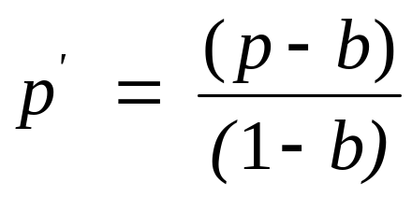
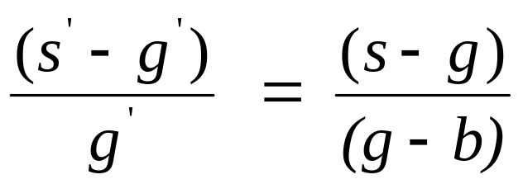
Goldstein et al. 99
How to measure relative performance?
p = performance
b = baseline
g = “good” system
s = “superior” system

Slide 109
Radev et al. 00
Ideal
System 1
System 2
S1
+
+
-
S2
+
+
+
S3
-
-
-
S4
-
-
+
S5
-
-
-
S6
-
-
-
S7
-
-
-
S8
-
-
-
S9
-
-
-
S10
-
-
-
Cluster-Based Sentence Utility

Slide 110
Cluster-Based Sentence Utility
Ideal
System 1
System 2
Ideal
System 1
System 2
S1
+
+
-
S1
10(+)
10(+)
5
S2
+
+
+
S2
8(+)
9(+)
8(+)
S3
-
-
-
S3
2
3
4
S4
-
-
+
S4
7
6
9(+)
S5
-
-
-
S6
-
-
-
CBSU method
S7
-
-
-
S8
-
-
-
S9
-
-
-
CBSU(system, ideal)= % of ideal utility
covered by system summary
S10
-
-
-
Summary sentence extraction method

Slide 111
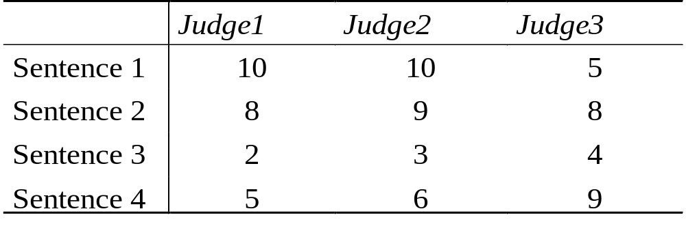
Interjudge agreement

Slide 112
Relative utility
RU =

Slide 113
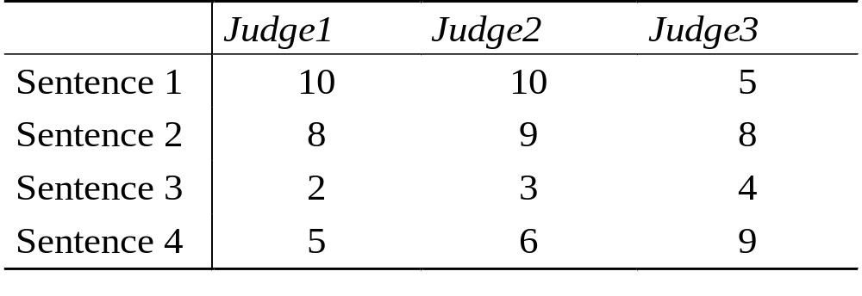
Relative utility
RU =
17

Slide 114
Relative utility
13
RU =
= 0.765
17

Slide 115
Normalized System Performance
Judge 1
Judge 2
Judge 3
Average
Judge 1
1.000
1.000
0.765
0.883
Judge 2
1.000
1.000
0.765
0.883
Judge 3
0.722
0.789
1.000
0.756
System performance
Normalized system performance
Random performance
(S-R)
D =
(J-R)
Interjudge agreement

Slide 116
Random Performance
(S-R)
D =
(J-R)

Slide 117
Random Performance
n !
average of all
systems
( n(1-r))! (r*n)!
(S-R)
D =
(J-R)

Slide 118
Random Performance
n !
average of all
systems
( n(1-r))! (r*n)!
{12}
{13}
{14}
{23}
{24}
{34}
(S-R)
D =
(J-R)

Slide 119
Examples
(S-R)
0.833 - 0.732
D {14} =
=
= 0.927
(J-R)
0.841 - 0.732

Slide 120
Examples
(S-R)
0.833 - 0.732
D {14} =
=
= 0.927
(J-R)
0.841 - 0.732
D {24} =
0.963

Slide 121
Normalized evaluation of {14}
1.0
J’ = 1.0
S’ = 0.927 = D
J = 0.841
S = 0.833
R = 0.732
0.5
0.5
0.0
R’= 0.0

Slide 122
Cross-sentence Informational Subsumption and Equivalence
Subsumption: If the information content of sentence a (denoted as I(a)) is contained within sentence b, then a becomes informationally redundant and the content of b is said to subsume that of a:
I(a) ⊂ I(b)
Equivalence: If I(a) ⊂ I(b) ∧ I(b) ⊂ I(a)

Slide 123
Example
(1) John Doe was found guilty of the murder.
(2) The court found John Doe guilty of the murder of Jane Doe last August and sentenced him to life.

Slide 124
Cross-sentence Informational Subsumption
Article 1
Article 2
Article 3
S1
10
10
5
S2
8
9
8
S3
2
3
4
S4
7
6
9

Slide 125
Evaluation
Cluster
# docs
# sents
source
news sources
topic
A
2
25
clari.world.africa.northwestern
AFP, UPI
Algerian terrorists threaten Belgium
B
3
45
clari.world.terrorism
AFP, UPI
The FBI puts Osama bin Laden on the most wanted list
C
2
65
clari.world.europe.russia
AP, AFP
Explosion in a Moscow apartment building (Sept. 9, 1999)
D
7
189
clari.world.europe.russia
AP, AFP, UPI
Explosion in a Moscow apartment building (Sept. 13, 1999)
E
10
151
TDT-3 corpus, topic 78
AP, PRI, VOA
General strike in Denmark
F
3
83
TDT-3 corpus, topic 67
AP, NYT
Toxic spill in Spain

Slide 126
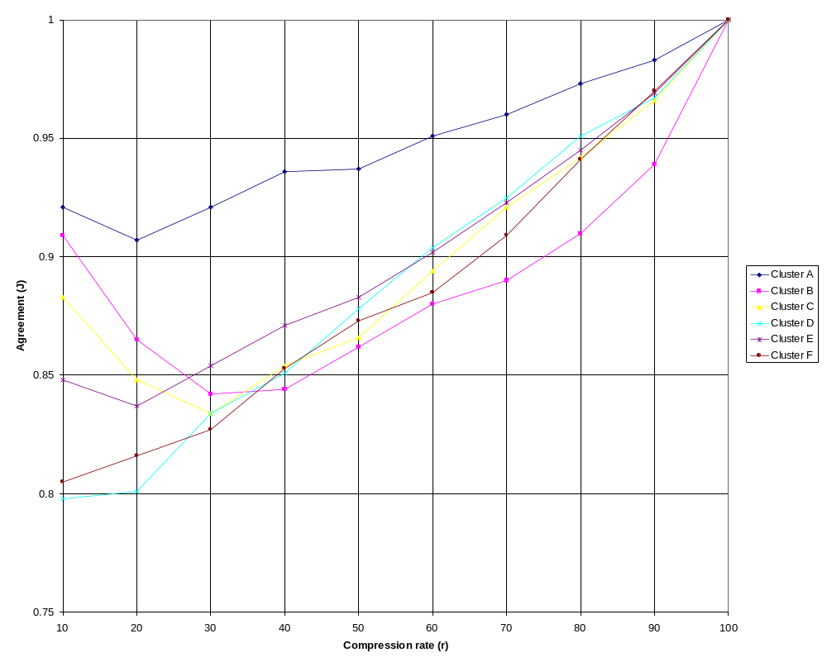
Inter-judge agreement
versus compression

Slide 127
Evaluating Sentence Subsumption
Sent
Judge1
Judge2
Judge3
Judge4
Judge5
+ score
- score
A1-1
-
A2-1
A2-1
-
A2-1
3
A1-2
A2-5
A2-5
-
-
A2-5
3
A1-3
-
-
-
-
A2-10
4
A1-4
A2-10
A2-10
A2-10
-
A2-10
4
A1-5
-
A2-1
-
A2-2
A2-4
2
A1-6
-
-
-
-
A2-7
4
A1-7
-
-
-
-
A2-8
4

Slide 128
Subsumption (Cont’d)
SCORE (s) = Σ_{i} (w_{c}C_{i} + w_{p}P_{i} + w_{f}F_{i}) ₋ w_{R}R_{s}
R_{s} = cross-sentence word overlap
R_{s} = 2 * (# overlapping words) / (# words in sentence 1 + # words in sentence 2)
w_{R} = Max_{s} (SCORE(s))

Slide 129
Subsumption analysis
Cluster A
Cluster B
Cluster C
Cluster D
Cluster E
Cluster F
#judges agreeing
+
-
+
-
+
-
+
-
+
-
+
-
5
0
7
0
24
0
45
0
88
1
73
0
61
4
1
6
3
6
1
10
9
37
8
35
0
11
3
3
6
4
5
4
4
28
20
5
23
3
7
2
1
1
2
1
1
0
7
0
7
0
1
0
Total: 558 sentences, full agreement on 292 (1+291), partial on 406 (23+383)
Of 80 sentences with some indication of subsumption, only 24 had agreement of 4 or more judges.

Slide 130
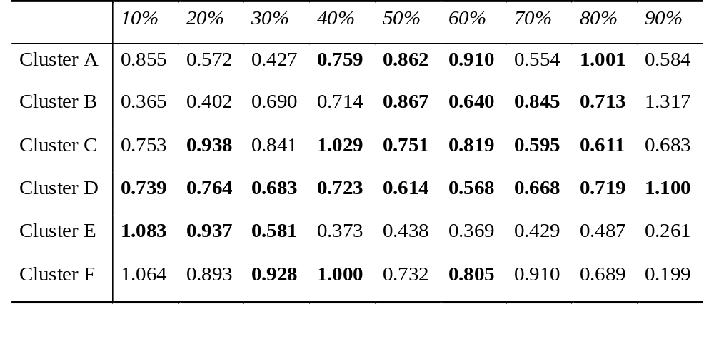
Results
MEAD performed better than Lead in 29 (in bold) out of 54 cases.
MEAD+Lead performed better than the Lead baseline in 41 cases

Slide 131
Donaway et al. 00
Sentence-rank based measures
  IDEAL={2,3,5}:
  compare {2,3,4} and {2,3,9}
Content-based measures
  vector comparisons of summary and document

Slide 132
The MEAD project
Summer 2001
Eight weeks
Johns Hopkins University
Participants: Dragomir Radev, Simone Teufel, Horacio Saggion, Wai Lam, Elliott Drabek, Hong Qi, Danyu Liu, John Blitzer, and Arda Çelebi

Slide 133
Technical objectives
Develop a summarization toolkit including a modular state-of-the art summarizer: single-document, multi-document, generic, query-based
Develop a summarization evaluation toolkit allowing comparisons between extractive and non-extractive summaries
Produce an annotated corpus for further research in text summarization

Slide 134
Sample scenarios
Evaluate an existing summarizer
Build a summarizer from scratch
Test a summarization feature
Test a new evaluation metric
Test a machine translation system

Slide 135
Resources
manual summaries (extracts and abstracts)
baseline summaries
automatic summaries
manual and automatic relevance judgements
XREF, lemmatized, tagged versions of the corpus
manual and automatic query translations
sentence segmentation
sentence alignments
XML DTDs, converters
subsumption judgements
guidelines for judges
guidelines for building summarizers
evaluation software
modular, trainable summarizer

Slide 136
Sample English Query
<?xml version='1.0'?>
<!DOCTYPE QUERY SYSTEM "../../../dtd/query.dtd" >
<QUERY QID="Q-241-E" QNO="241" TRANSLATED="NO">
<TITLE>
Fire safety, building management concerns
</TITLE>
</QUERY>
Sample Chinese Query
<?xml version='1.0'?>
<!DOCTYPE QUERY SYSTEM “../../../dtd/query.dtd" >
<QUERY QID="Q-241-C" QNO="241" TRANSLATED="NO">
<TITLE>
¨¾¤õ·NÃÑ,¤j·HºÞ²z
</TITLE>
</QUERY>

Slide 137
Sample Retrieval Result for Full-length Documents
<?xml version='1.0'?>
<!DOCTYPE DOC-JUDGE SYSTEM "/export/ws01summ/dtd/docjudge.dtd" >
<DOC-JUDGE QID="Q-241-E" SYSTEM="SMART" LANG="ENG">
<D DID="D-20000126_008.e" RANK="1" SCORE="135.0000" CORR-DOC="D-20000126_012.c"/>
<D DID="D-19980625_007.e" RANK="2" SCORE="99.0000" CORR-DOC="D-19980625_006.c"/>
<D DID="D-19990126_017.e" RANK="3" SCORE="98.0000" CORR-DOC="D-19990126_018.c"/>
<D DID="D-19981007_018.e" RANK="4" SCORE="91.0000" CORR-DOC="D-19981007_023.c"/>
<D DID="D-19980121_004.e" RANK="5" SCORE="78.0000" CORR-DOC="D-19980121_009.c"/>
<D DID="D-19971016_004.e" RANK="6" SCORE="72.0000" CORR-DOC="D-19971016_005.c"/>
Sample Retrieval Result for Lead-Based Summary (5%)
<?xml version='1.0'?>
<!DOCTYPE DOC-JUDGE SYSTEM
"/export/ws01summ/dtd/docjudge.dtd" >
<DOC-JUDGE QID="Q-241-E" SYSTEM="SMART" LANG="ENG">
<D DID="D-20000126_008.e" RANK="1" SCORE="14.0000" CORR-DOC="D-20000126_012.c"/>
<D DID="D-19991214_002.e" RANK="2" SCORE="11.0000" CORR-DOC="D-19991214_001.c"/>
<D DID="D-19980810_006.e" RANK="3" SCORE="10.0000" CORR-DOC="D-19980810_003.c"/>
<D DID="D-19990505_028.e" RANK="4" SCORE="9.0000" CORR-DOC="D-19990505_034.c"/>
<D DID="D-19980115_009.e" RANK="4" SCORE="9.0000" CORR-DOC="D-19980115_013.c"/>:

Slide 138
Single-document situation
query
Ranked
document
list
IR results
SMART
document
Correlation
LDC Judges
Ranked
document
list
Summarizer
Extract
Summary
comparison
Baselines
1. Co-selection
2. Similarity

Slide 139
Multi-document situation
document
LDC Judges
cluster
Manual sum.
Summarizer
Extracts
Summary
comparison
Baselines
1. Co-selection
2. Similarity

Slide 140
Summaries produced
Single-document extracts
  automatic (135 runs on 18,146 documents each): 10 compression rates, Word/Sentence, English/Chinese/Xlingual, 10 summarization methods
  manual (80 runs on 200 documents each): 10 compression rates, Word/Sentence, (3 judges + average)

Slide 141
Summaries produced
Multi-document summaries
  3 lengths, 3 judges, 14 queries (out of 40)
Multi-document extracts
  automatic (160 extracts) = 8 compression rates (5-40%,50-200AW) x 20 clusters
  manual (320 extracts) = 8 compression rates x 10 clusters x (3 judges + average)

Slide 142
List of summarizers
MEAD, Websumm, Summarist, LexChains, Align
English, Chinese
Single-document, Multi-document

Slide 143
MEAD architecture
…
…
…
…
…
…
…
…
…
…
Feature scorer
…
…
…
…
…
Relation scorer
…
…
…
…
…
Extractor
…
…
…
SVM
Subsumption

Slide 144
Emergency relief by SWD
The Social Welfare Department has provided relief articles and hot meals to 114 people who were affected by the rainstorm or mudslip throughout the territory. The people, comprising adults and children, come from 30 families. Some of them are taking temporary shelter at Lung Hang Estate Community Centre in Sha Tin, and Shek Lei Estate Community Centre and Princess Alexandra Community Centre in Tsuen Wan. The Regional Social Welfare Officer (New Territories East), Mrs Lily Wong, visited victims at Lung Hang State Community Centre this (Thursday) afternoon to offer any necessary assistance. Six victims have so far requested for Comprehensive Social Security Allowance and the applications are being processed. Social workers also escorted an 88-year old man who was feeling unwell to the Prince of Wales hospital for medical checkup.
WEBSUMM:
Some of them are taking temporary shelter at Lung Hang Estate Community Centre in Sha Tin, and Shek Lei Estate Community Centre and Princess Alexandra Community Centre in Tsuen Wan.
RANDOM:
The Social Welfare Department has provided relief articles and hot meals to 114 people who were affected by the rainstorm or mudslip throughout the territory. Some of them are taking temporary shelter at Lung Hang Estate Community Centre in Sha Tin, and Shek Lei Estate Community Centre and Princess Alexandra Community Centre in Tsuen Wan.
MEAD:
The Social Welfare Department has provided relief articles and hot meals to 114 people who were affected by the rainstorm or mudslip throughout the territory. The Regional Social Welfare Officer (New Territories East), Mrs Lily Wong, visited victims at Lung Hang State Community Centre this (Thursday) afternoon to offer any necessary assistance.
LEAD:
The Social Welfare Department has provided relief articles and hot meals to 114 people who were affected by the rainstorm or mudslip throughout the territory. The people, comprising adults and children, come from 30 families.

Slide 145
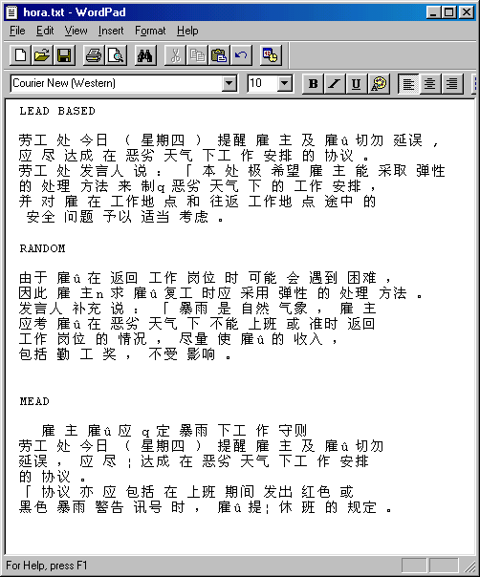


Slide 146
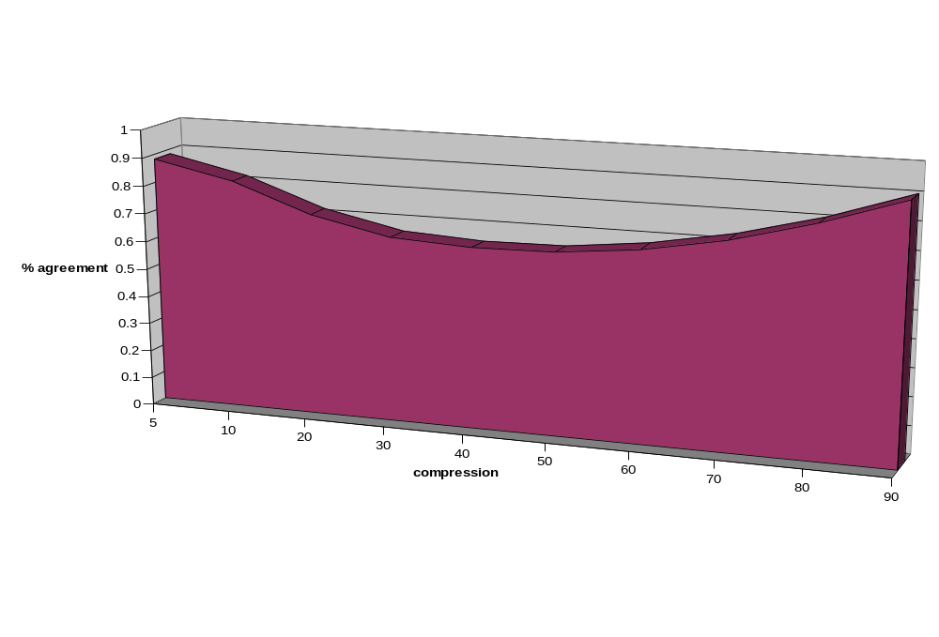
Humans: Percent Agreement (20-cluster average) and compression

Slide 147
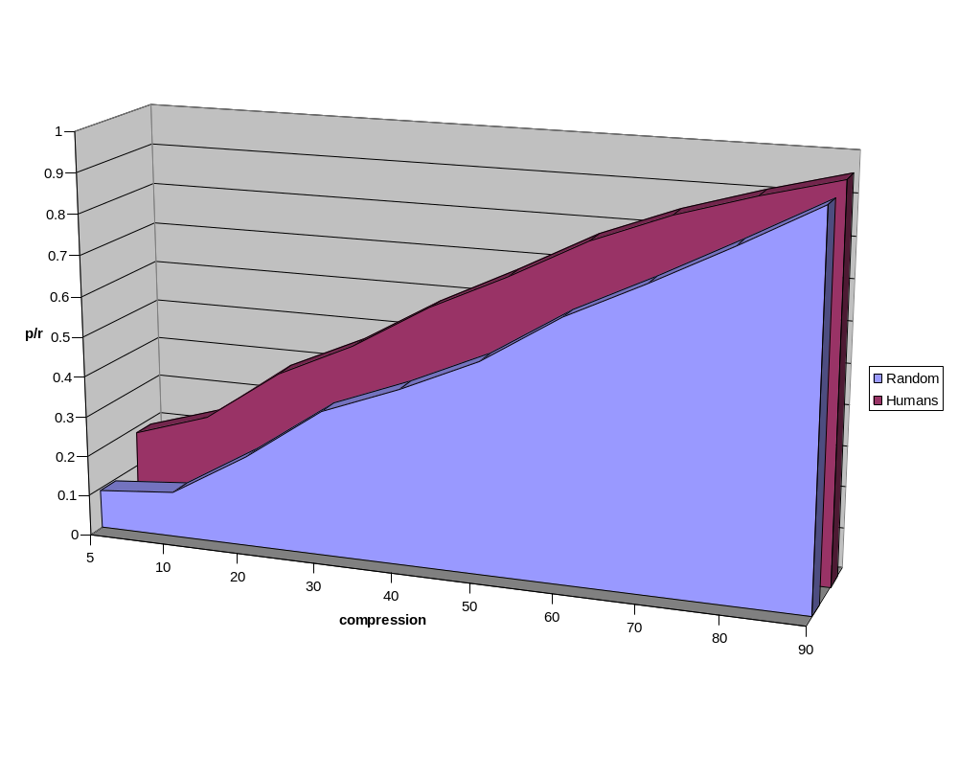
Humans: precision/recall (cluster average) and compression

Slide 148
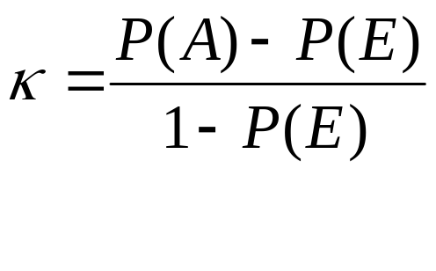
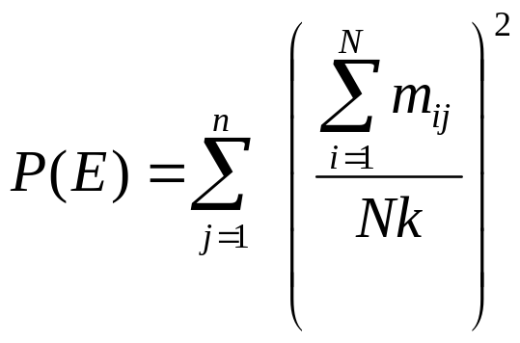
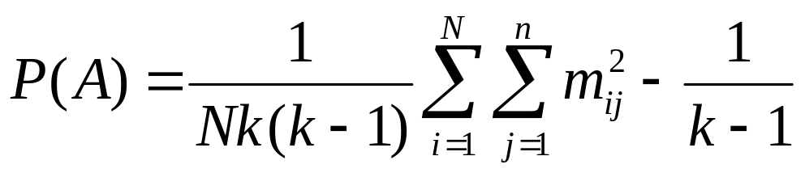
Kappa
N: number of items (index i)
n: number of categories (index j)
k: number of annotators

Slide 149
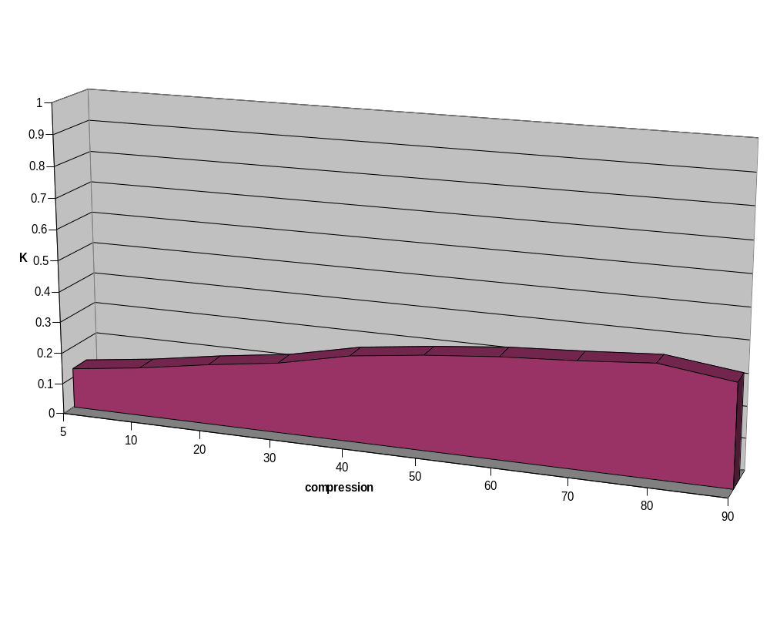
Humans: Kappa and compression

Slide 150
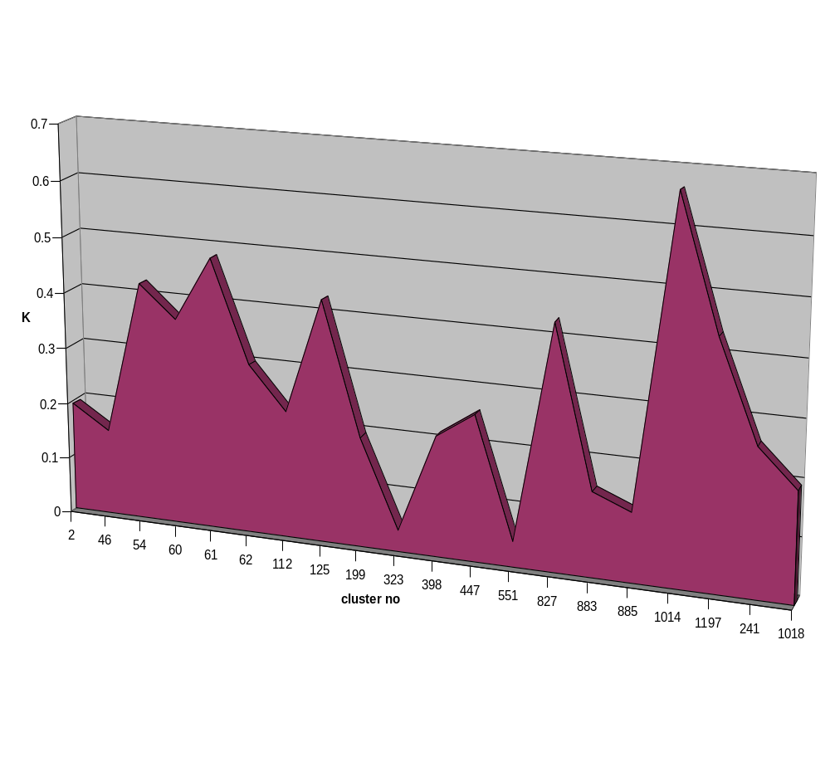
Kappa, human agreement, 40%

Slide 151
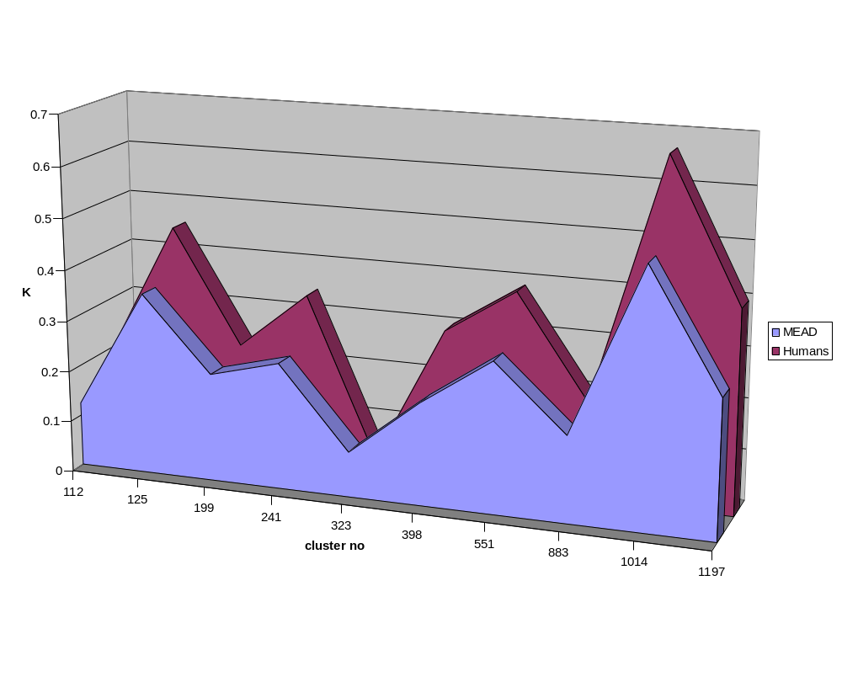
Multi-document summaries of length 50 words, kappa on 10 clusters

Slide 152
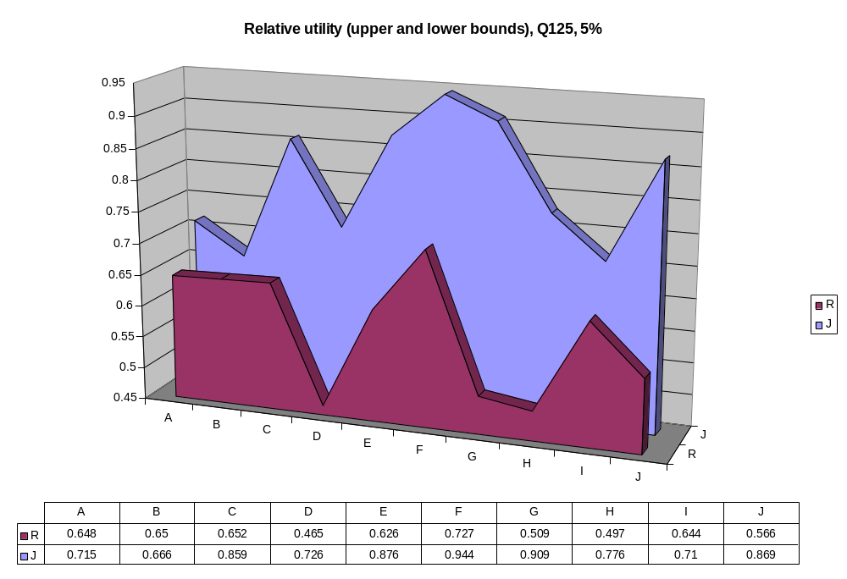

Slide 153
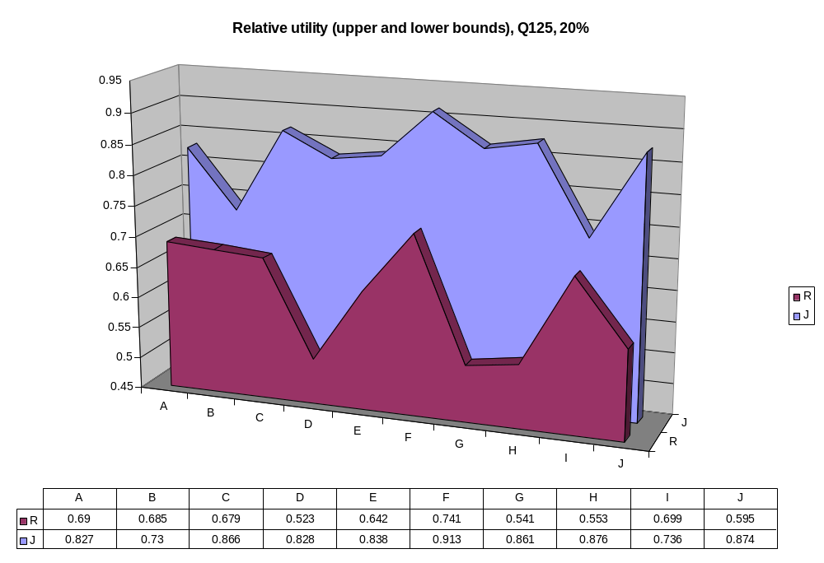

Slide 154
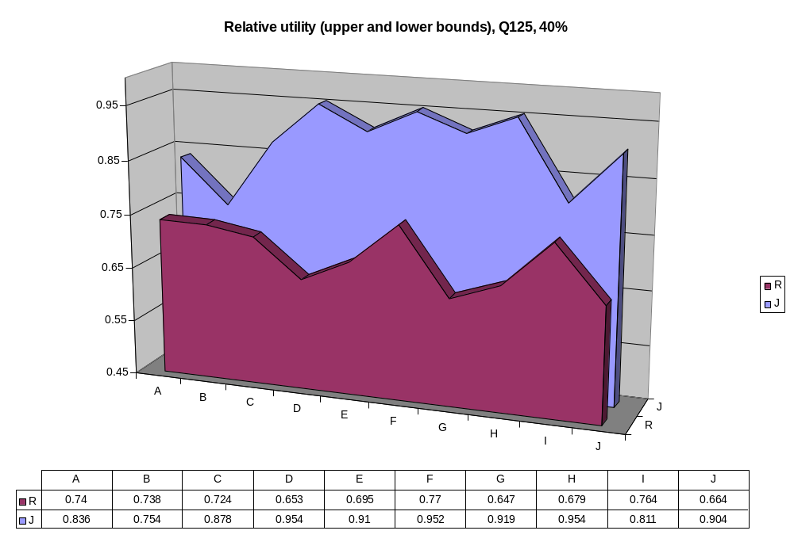

Slide 155
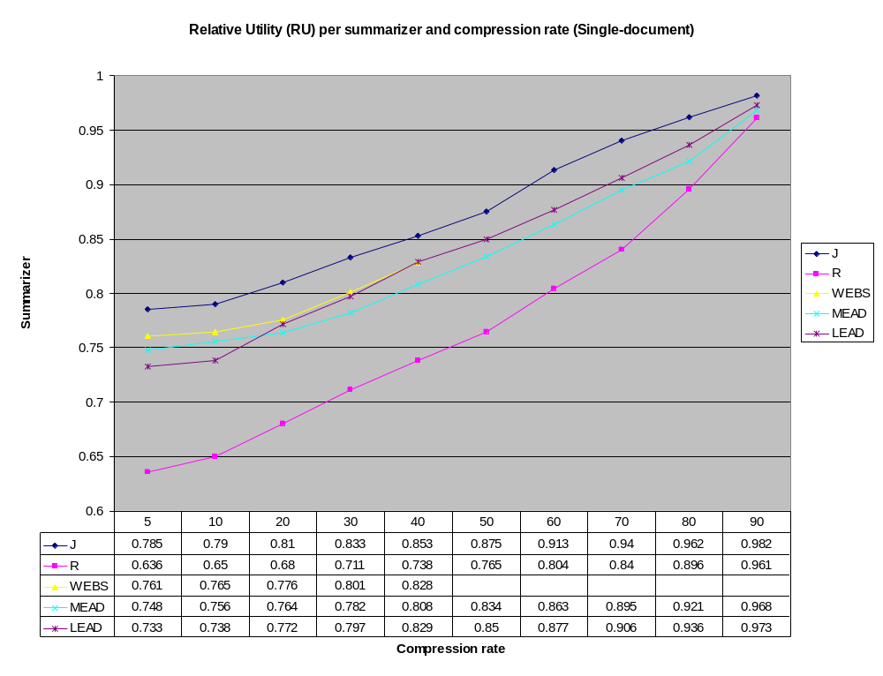

Slide 156
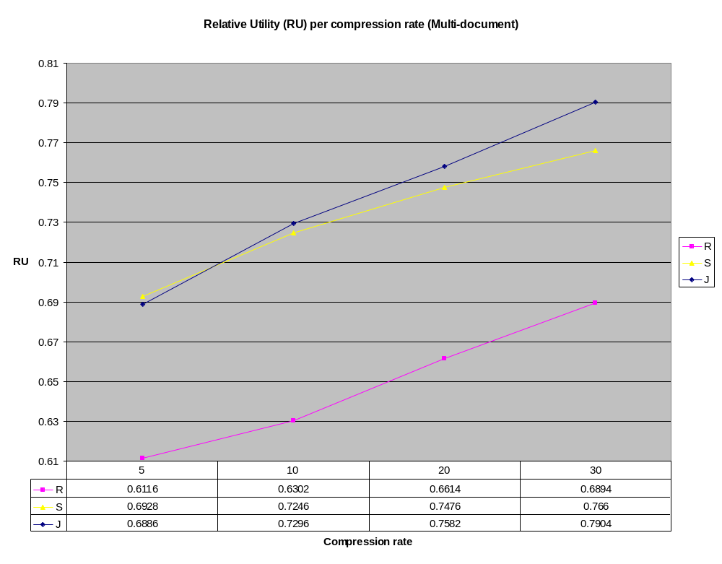

Slide 157

Relevance correlation (RC)

Slide 158


Slide 159


Slide 160


Slide 161


Slide 162


Slide 163


Slide 164


Slide 165


Slide 166
DUC 2003 [Harman and Over]
Data: documents, topics, viewpoints, manual summaries
Tasks:
  1: very short (~10-word) single document summaries
  2-4: short (~100-word) multi-document summaries with focus
    2: TDT event topics
    3: viewpoints
    4: question/topic
Evaluation: procedures, measures
  Experience with implementing the evaluation procedure
Notes:
UPDATE

Slide 167
Task 2: Mean LAC with penalty
REGWQ Grouping Mean N peer
A 0.18900 30 13
A
B A 0.18243 30 6
B A
B A 0.17923 30 16
B A
B A 0.17787 30 22
B A
B A 0.17557 30 23
B A
B A 0.17467 30 14
B A
B A C 0.16550 30 20
B A C
B D A C 0.15193 30 18
B D A C
B D A C 0.14903 30 11
B D A C
B D A C 0.14520 30 10
B D A C
B D E A C 0.14357 30 12
B D E A C
B D E A C 0.14293 30 26
B D E C
B D E C 0.12583 30 21
D E C
D E C 0.11677 30 3
D E
D E F 0.09960 30 19
D E F
D E F 0.09837 30 17
E F
E F 0.09057 30 2
F
F 0.05523 30 15

Slide 168
Task 4: Mean LAC with penalty
REGWQ Grouping Mean N peer
A 0.155814 118 23
A
A 0.144517 118 14
B A
B A C 0.141136 118 22
B C
B D C 0.134596 114 16
B D C
B D C 0.131220 118 5
B D C
B D C 0.123449 118 10
D C
D C 0.122186 118 13
D
D 0.116576 118 4
E 0.092966 118 17
E
E 0.091059 118 20
F 0.058780 118 19

Slide 169

Properties of evaluation metrics

Slide 170
Evaluation metrics
Difficult to evaluate summaries
  Intrinsic vs. extrinsic evaluations
  Extractive vs. non-extractive evaluations
  Manual vs. automatic evaluations
ROUGE = mixture of n-gram recall for different values of n.
Example:
  Reference = “The cat in the hat”
  System = “The cat wears a top hat”
  1-gram recall = 3/5; 2-gram recall = 1/4;
  3,4-gram recall = 0
ROUGE-W = longest common subsequence
Example above: 3/5
Notes:
ROUGE

Slide 171
Part VI
Recent approaches

Slide 172
Language modeling
Source/target language
Coding process
Noisy channel
Recovery
e
f
e*

Slide 173
Language modeling
Source/target language
Coding process
e* = argmax p(e|f) = argmax p(e) . p(f|e)
e
e
p(E) = p(e₁).p(e₂|e₁).p(e₃|e₁e₂)…p(e_{n}|e₁…e_{n-1})
p(E) = p(e₁).p(e₂|e₁).p(e₃|e₂)…p(e_{n}|e_{n-1})

Slide 174
Summarization using LM
Source language: full document
Target language: summary

Slide 175
Berger & Mittal 00
Gisting (OCELOT)
content selection (preserve frequencies)
word ordering (single words, consecutive positions)
search: readability & fidelity
g* = argmax p(g|d) = argmax p(g) . p(d|g)
g
g

Slide 176
Berger & Mittal 00
Limit on top 65K words
word relatedness = alignment
Training on 100K summary+document pairs
Testing on 1046 pairs
Use Viterbi-type search
Evaluation: word overlap (0.2-0.4)
transilingual gisting is possible
No word ordering

Slide 177
Berger & Mittal 00
Sample output:
Audubon society atlanta area savannah georgia chatham and local birding savannah keepers chapter of the audubon georgia and leasing

Slide 178
Banko et al. 00
Summaries shorter than 1 sentence
headline generation
zero-level model: unigram probabilities
other models: Part-of-speech and position
Sample output:
Clinton to meet Netanyahu Arafat Israel

Slide 179
Knight and Marcu 00
Use structured (syntactic) information
Two approaches:
  noisy channel
  decision based
Longer summaries
Higher accuracy

Slide 180
Social networks
Induced by a relation
Allison and Bill are friends
Prestige (centrality) in social networks:
  Degree centrality: number of friends
  Geodesic centrality: bridge quality
  Eigenvector centrality: who your friends are
Recommendation systems

Slide 181
Text as a Graph
Vertices = cognitive units
  …
Edges = relations between cognitive units
  ...
words
Word Sense Disambiguation
Word sense
sentences
Keyword Extraction
Semantic relations
Co-occurance
similarity
Sentence Extraction
TextRank (Mihalcea and Tarau, 2004), LexRank (Erkan and Radev, 2004)

Slide 182

TextRank - Weigthed Graph
Edges have weights – similarity measures
Adapt PageRank, HITS to account for edge weights
PageRank adapted to weighted graphs

Slide 183
TextRank - Text Summarization
Build the graph:
  Sentences in a text = vertices
  Similarity between sentences = weighted edges
  Model the cohesion of text using intersentential similarity
2. Run link analysis algorithm(s):
  keep top N ranked sentences
  → sentences most “recommended” by other sentences

Slide 184
Underlining idea: A Process of Recommendation
A sentence that addresses certain concepts in a text gives the reader a recommendation to refer to other sentences in the text that address the same concepts
Text knitting (Hobbs 1974)
  repetition in text “knits the discourse together”
Text cohesion (Halliday & Hasan 1979)

Slide 185
Graph Structure
Undirected
  No direction established between sentences in the text
  A sentence can “recommend” sentences that precede or follow in the text
Directed forward
  A sentence “recommends” only sentences that follow in the text
  Seems more appropriate for movie reviews, stories, etc.
Directed backward
  A sentence “recommends” only sentences that preceed in the text
  More appropriate for news articles

Slide 186

Sentence Similarity
Inter-sentential relationships
  weighted edges
Count number of common concepts
Normalize with the length of the sentence
Other similarity metrics are also possible:
  Longest common subsequence
  string kernels, etc.

Slide 187
An Example
A text from DUC 2002
on “Hurricane Gilbert”
24 sentences
3. r i BC-HurricaneGilbert 09-11 0339
4. BC-Hurricane Gilbert , 0348
5. Hurricane Gilbert Heads Toward Dominican Coast
6. By RUDDY GONZALEZ
7. Associated Press Writer
8. SANTO DOMINGO , Dominican Republic ( AP )
9. Hurricane Gilbert swept toward the Dominican Republic Sunday , and the Civil Defense alerted its heavily
populated south coast to prepare for high winds , heavy rains and high seas .
10. The storm was approaching from the southeast with sustained winds of 75 mph gusting to 92 mph .
11. " There is no need for alarm , " Civil Defense Director Eugenio Cabral said in a television alert shortly before midnight Saturday .
12. Cabral said residents of the province of Barahona should closely follow Gilbert 's movement .
13. An estimated 100,000 people live in the province , including 70,000 in the city of Barahona , about 125 miles west of Santo Domingo .
14. Tropical Storm Gilbert formed in the eastern Caribbean and strengthened into a hurricane Saturday night
15. The National Hurricane Center in Miami reported its position at 2a.m. Sunday at latitude 16.1 north ,
longitude 67.5 west , about 140 miles south of Ponce , Puerto Rico , and 200 miles southeast of Santo Domingo .
16. The National Weather Service in San Juan , Puerto Rico , said Gilbert was moving westward at 15 mph with a " broad area of cloudiness and heavy weather " rotating around the center of the storm .
17. The weather service issued a flash flood watch for Puerto Rico and the Virgin Islands until at least 6p.m. Sunday .
18. Strong winds associated with the Gilbert brought coastal flooding , strong southeast winds and up to 12 feet to Puerto Rico 's south coast .
19. There were no reports of casualties .
20. San Juan , on the north coast , had heavy rains and gusts Saturday , but they subsided during the night .
21. On Saturday , Hurricane Florence was downgraded to a tropical storm and its remnants pushed inland from the U.S. Gulf Coast .
22. Residents returned home , happy to find little damage from 80 mph winds and sheets of rain .
23. Florence , the sixth named storm of the 1988 Atlantic storm season , was the second hurricane .
24. The first , Debby , reached minimal hurricane strength briefly before hitting the Mexican coast last month

Slide 188
[0.50]
[0.71]
[1.20]
4
5
24
6
[0.15]
[0.80]
23
0.15
7
[0.15]
0.19
0.55
[0.70]
22
8
[0.70]
0.35
[1.02]
21
0.15
9
[1.83]
0.30
[0.84]
20
10
[0.99]
[0.15]
19
0.59
0.15
0.27
0.16
11
[0.56]
18
[1.58]
12
17
[0.93]
[0.70]
16
13
15
14
[0.76]
[1.65]
[1.36]
[1.09]

Slide 189
[0.50]
[0.71]
[1.20]
4
5
24
6
[0.15]
[0.80]
23
0.15
7
[0.15]
0.19
0.55
[0.70]
22
8
[0.70]
0.35
[1.02]
21
0.15
9
[1.83]
0.30
[0.84]
20
10
[0.99]
[0.15]
19
0.59
0.15
0.27
0.16
11
[0.56]
18
[1.58]
12
17
[0.93]
[0.70]
16
13
15
14
[0.76]
[1.65]
[1.36]
[1.09]

Slide 190
Automatic summary
Hurricane Gilbert swept toward the Dominican Republic Sunday, and the Civil Defense alerted its heavily populated south coast to prepare for high winds, heavy rains and high seas. The National Hurricane Center in Miami reported its position at 2a.m. Sunday at latitude 16.1 north, longitude 67.5 west, about 140 miles south of Ponce, Puerto Rico, and 200 miles southeast of Santo Domingo. The National Weather Service in San Juan, Puerto Rico, said Gilbert was moving westward at 15 mph with a " broad area of cloudiness and heavy weather " rotating around the center of the storm. Strong winds associated with the Gilbert brought coastal flooding, strong southeast winds and up to 12 feet to Puerto Rico's coast.
Reference summary I
Hurricane Gilbert swept toward the Dominican Republic Sunday with sustained winds of 75 mph gusting to 92 mph. Civil Defense Director Eugenio Cabral alerted the country's heavily populated south coast and cautioned that even though there is no nee d for alarm, residents should closely follow Gilbert's movements. The U.S. Weather Service issued a flash flood watch for Puerto Rico and the Virgin Islands until at least 6 p.m. Sunday. Gilbert brought coastal flooding to Puerto Rico's south coast on Saturday. There have been no reports of casualties. Meanwhile, Hurricane Florence, the second hurricane of this storm season, was downgraded to a tropical storm.
Reference summary II
Hurricane Gilbert is moving toward the Dominican Republic, where the residents of the south coast, especially the Barahona Province, hav e been alerted to prepare for heavy rains, and high winds and seas. Tropical Storm Gilbert formed in the eastern Caribbean and became a hurricane on Saturday night. By 2 a.m. Sunday it was about 200 miles southeast of Santo Domingo and moving westward at 15 mph with winds of 75 mph. Flooding is expected in Puerto Rico and the Virgin Islands. The second hurricane of the season, Florence, is now over the southern United States and downgraded to a tropical storm.

Slide 191
Eigenvectors of stochastic graphs
Square connectivity matrix
Directed vs. undirected
An eigenvalue for a square matrix A is a scalar λ such that there exists a vector x≠0 such that Ax = λx
The normalized eigenvector associated with the largest λ is called the principal eigenvector of A
A matrix is called a stochastic matrix when the sum of entries in each row sum to 1 and none is negative. All stochastic matrices have a principal eigenvector
The connectivity matrix used in PageRank [Page & al. 1998] is irreducible [Langville & Meyer 2003]
An iterative method (power method) can be used to compute the principal eigenvector
That eigenvector corresponds to the stationary value of the Markov stochastic process described by the connectivity matrix
This is also equivalent to performing a random walk on the matrix

Slide 192


Eigenvectors of stochastic graphs
The stationary value of the Markov stochastic matrix can be computed using an iterative power method:
PageRank adds an extra twist to deal with dead-end pages. With a probability 1-ε, a random starting point is chosen. This has a natural interpretation in the case of Web page ranking
su = successor nodes
pr = predecessor nodes
Eigenvector centrality: the paths in the random walk are weighted by the centrality of the nodes that the path connects

Slide 193

The MEAD summarizer
MEAD: salience-based extractive summarization (in 6 languages)
Centroid-based summarization (single and multi document)
Vector space model
Additional features: position, length, lexrank
Cross-document structure theory
Reranker – similar to MMR

Slide 194
Centrality in summarization
Motivation: capture the most central words in a document or cluster
Sentence salience [Boguraev & Kennedy 1999]
Centroid score [Radev & al. 2000, 2004a]
Alternative methods for computing centrality?

Slide 195
LexPageRank (Cosine centrality)
Example (cluster d1003t)
1 (d1s1) Iraqi Vice President Taha Yassin Ramadan announced today, Sunday, that Iraq refuses to back down from its decision to stop cooperating with disarmament inspectors before its demands are met.
2 (d2s1) Iraqi Vice president Taha Yassin Ramadan announced today, Thursday, that Iraq rejects cooperating with the United Nations except on the issue of lifting the blockade imposed upon it since the year 1990.
3 (d2s2) Ramadan told reporters in Baghdad that "Iraq cannot deal positively with whoever represents the Security Council unless there was a clear stance on the issue of lifting the blockade off of it.
4 (d2s3) Baghdad had decided late last October to completely cease cooperating with the inspectors of the United Nations Special Commission (UNSCOM), in charge of disarming Iraq's weapons, and whose work became very limited since the fifth of August, and announced it will not resume its cooperation with the Commission even if it were subjected to a military operation.
5 (d3s1) The Russian Foreign Minister, Igor Ivanov, warned today, Wednesday against using force against Iraq, which will destroy, according to him, seven years of difficult diplomatic work and will complicate the regional situation in the area.
6 (d3s2) Ivanov contended that carrying out air strikes against Iraq, who refuses to cooperate with the United Nations inspectors, ``will end the tremendous work achieved by the international group during the past seven years and will complicate the situation in the region.''
7 (d3s3) Nevertheless, Ivanov stressed that Baghdad must resume working with the Special Commission in charge of disarming the Iraqi weapons of mass destruction (UNSCOM).
8 (d4s1) The Special Representative of the United Nations Secretary-General in Baghdad, Prakash Shah, announced today, Wednesday, after meeting with the Iraqi Deputy Prime Minister Tariq Aziz, that Iraq refuses to back down from its decision to cut off cooperation with the disarmament inspectors.
9 (d5s1) British Prime Minister Tony Blair said today, Sunday, that the crisis between the international community and Iraq ``did not end'' and that Britain is still ``ready, prepared, and able to strike Iraq.''
10 (d5s2) In a gathering with the press held at the Prime Minister's office, Blair contended that the crisis with Iraq ``will not end until Iraq has absolutely and unconditionally respected its commitments'' towards the United Nations.
11 (d5s3) A spokesman for Tony Blair had indicated that the British Prime Minister gave permission to British Air Force Tornado planes stationed in Kuwait to join the aerial bombardment against Iraq.

Slide 196
Cosine centrality
 | 1 | 2 | 3 | 4 | 5 | 6 | 7 | 8 | 9 | 10 | 11
1 | 1.00 | 0.45 | 0.02 | 0.17 | 0.03 | 0.22 | 0.03 | 0.28 | 0.06 | 0.06 | 0.00
2 | 0.45 | 1.00 | 0.16 | 0.27 | 0.03 | 0.19 | 0.03 | 0.21 | 0.03 | 0.15 | 0.00
3 | 0.02 | 0.16 | 1.00 | 0.03 | 0.00 | 0.01 | 0.03 | 0.04 | 0.00 | 0.01 | 0.00
4 | 0.17 | 0.27 | 0.03 | 1.00 | 0.01 | 0.16 | 0.28 | 0.17 | 0.00 | 0.09 | 0.01
5 | 0.03 | 0.03 | 0.00 | 0.01 | 1.00 | 0.29 | 0.05 | 0.15 | 0.20 | 0.04 | 0.18
6 | 0.22 | 0.19 | 0.01 | 0.16 | 0.29 | 1.00 | 0.05 | 0.29 | 0.04 | 0.20 | 0.03
7 | 0.03 | 0.03 | 0.03 | 0.28 | 0.05 | 0.05 | 1.00 | 0.06 | 0.00 | 0.00 | 0.01
8 | 0.28 | 0.21 | 0.04 | 0.17 | 0.15 | 0.29 | 0.06 | 1.00 | 0.25 | 0.20 | 0.17
9 | 0.06 | 0.03 | 0.00 | 0.00 | 0.20 | 0.04 | 0.00 | 0.25 | 1.00 | 0.26 | 0.38
10 | 0.06 | 0.15 | 0.01 | 0.09 | 0.04 | 0.20 | 0.00 | 0.20 | 0.26 | 1.00 | 0.12
11 | 0.00 | 0.00 | 0.00 | 0.01 | 0.18 | 0.03 | 0.01 | 0.17 | 0.38 | 0.12 | 1.00

Slide 197
Cosine centrality (t=0.3)
d3s3
d2s3
d3s2
d3s1
d1s1
d4s1
d2s1
d5s1
d5s2
d5s3
d2s2

Slide 198
Cosine centrality (t=0.2)
d3s3
d2s3
d3s2
d3s1
d1s1
d4s1
d2s1
d5s1
d5s2
d5s3
d2s2

Slide 199
Cosine centrality (t=0.1)
d3s3
d2s3
d3s2
d3s1
d1s1
d4s1
d2s1
d5s1
d5s2
d5s3
d2s2
Sentences vote for the most central sentence!

Slide 200
Cosine centrality vs. centroid centrality
ID LPR (0.1) LPR (0.2) LPR (0.3) Centroid
d1s1 0.6007 0.6944 0.0909 0.7209
d2s1 0.8466 0.7317 0.0909 0.7249
d2s2 0.3491 0.6773 0.0909 0.1356
d2s3 0.7520 0.6550 0.0909 0.5694
d3s1 0.5907 0.4344 0.0909 0.6331
d3s2 0.7993 0.8718 0.0909 0.7972
d3s3 0.3548 0.4993 0.0909 0.3328
d4s1 1.0000 1.0000 0.0909 0.9414
d5s1 0.5921 0.7399 0.0909 0.9580
d5s2 0.6910 0.6967 0.0909 1.0000
d5s3 0.5921 0.4501 0.0909 0.7902

Slide 201
CODE | ROUGE-1 | ROUGE-2 | ROUGE-W
C0.5 | 0.39013 | 0.10459 | 0.12202
C10 | 0.38539 | 0.10125 | 0.11870
C1.5 | 0.38074 | 0.09922 | 0.11804
C1 | 0.38181 | 0.10023 | 0.11909
C2.5 | 0.37985 | 0.10154 | 0.11917
C2 | 0.38001 | 0.09901 | 0.11772
Degree0.5T0.1 | 0.39016 | 0.10831 | 0.12292
Degree0.5T0.2 | 0.39076 | 0.11026 | 0.12236
Degree0.5T0.3 | 0.38568 | 0.10818 | 0.12088
Degree1.5T0.1 | 0.38634 | 0.10882 | 0.12136
Degree1.5T0.2 | 0.39395 | 0.11360 | 0.12329
Degree1.5T0.3 | 0.38553 | 0.10683 | 0.12064
Degree1T0.1 | 0.38882 | 0.10812 | 0.12286
Degree1T0.2 | 0.39241 | 0.11298 | 0.12277
Degree1T0.3 | 0.38412 | 0.10568 | 0.11961
Lpr0.5T0.1 | 0.39369 | 0.10665 | 0.12287
Lpr0.5T0.2 | 0.38899 | 0.10891 | 0.12200
Lpr0.5t0.3 | 0.38667 | 0.10255 | 0.12244
Lpr1.5t0.1 | 0.39997 | 0.11030 | 0.12427
Lpr1.5t0.2 | 0.39970 | 0.11508 | 0.12422
Lpr1.5t0.3 | 0.38251 | 0.10610 | 0.12039
Lpr1T0.1 | 0.39312 | 0.10730 | 0.12274
Lpr1T0.2 | 0.39614 | 0.11266 | 0.12350
Lpr1T0.3 | 0.38777 | 0.10586 | 0.12157
Centroid
Degree
LexPageRank

Slide 202
Some comments
Very high results:
  task 3 (very short summary of automatic translations from Arabic)
  task 4 (short summary of automatic translations from Arabic) in all recall oriented measures
Punctuation problems (with LCS: ROUGE-L and ROUGE-W)
Task 2 – lower results due to a bug

Slide 203
Results
Peer code | Task | ROUGE-1 | ROUGE-2 | ROUGE-3 | ROUGE-4 | ROUGE-L | ROUGE-W
141 | 3 | 5 | 2 | 1 | 1 | 2 | 2
142 | 3 | 5 | 1 | 1 | 1 | 4 | 3
143 | 4 | 1 | 2 | 1 | 1 | 6 | 6
144 | 4 | 3 | 1 | 1 | 1 | 7 | 7
145 | 4 | 1 | 2 | 2 | 2 | 4 | 4
Recall
LCS

Slide 204
Teufel & Moens 02
Scientific articles
Argumentative zoning (rhetorical analysis)
Aim, Textual, Own, Background, Contrast, Basis, Other

Slide 205
Buyukkokten et al. 02
Portable devices (PDA)
Expandable summarization (progressively showing “semantic text units”)

Slide 206
Barzilay, McKeown, Elhadad 02
Sentence reordering for MDS
Multigen
“Augmented ordering” vs. Majority and Chronological ordering
Topic relatedness
Subjective evaluation
14/25 “Good” vs. 8/25 and 7/25

Slide 207

Zhang, Blair-Goldensohn, Radev 02
Multidocument summarization using Crossdocument Structure Theory (CST)
Model relationships between sentences: contradiction, followup, agreement, subsumption, equivalence
Followup (2003): automatic id of CST relationships

Slide 208
Wu et al. 02
Question-based summaries
Comparison with Google
Uses fewer characters but achieves higher MRR

Slide 209
Jing 02
Using HMM to decompose human-written summaries
Recognizing pieces of the summary that match the input documents
Operators: syntactic transformations, paraphrasing, reordering
F-measure: 0.791

Slide 210
Grewal et al. 03
Take the sentence :
“Peter Piper picked a peck of pickled peppers.”
Gzipped size of this sentence is : 66
Next take the group of sentences:
“Peter Piper picked a peck of pickled peppers.
Peter Piper picked a peck of pickled peppers.”
Gzipped size of these sentences is : 70
Finally take the group of sentences:
“Peter Piper picked a peck of pickled peppers.
Peter Piper was in a pickle in Edmonton.”
Gzipped size of these sentences is : 92

Slide 211

Newsinessence [Radev & al. 01]

Slide 213


Slide 214


Slide 215


Slide 216


Slide 217

Newsblaster [McKeown & al. 02]

Slide 218

Google News [02]

Slide 219
Part VII
APPENDIX

Slide 220
Summarization meetings
Dagstuhl Meeting, 1993 (Karen Spärck Jones, Brigitte Endres-Niggemeyer)
ACL/EACL Workshop, Madrid, 1997 (Inderjeet Mani, Mark Maybury)
AAAI Spring Symposium, Stanford, 1998 (Dragomir Radev, Eduard Hovy)
ANLP/NAACL Workshop, Seattle, 2000 (Udo Hahn, Chin-Yew Lin, Inderjeet Mani, Dragomir Radev)
NAACL Workshop, Pittsburgh, 2001 (Jade Goldstein and Chin-Yew Lin)
DUC 2001, New Orleans (Donna Harman and Daniel Marcu)
DUC 2002 + ACL workshop, Philadelphia (Udo Hahn and Donna Harman)
HLT-NAACL Workshop, Edmonton, 2003 (Dragomir Radev, Simone Teufel)
DUC 2003, Edmonton (Donna Harman and Paul Over)
DUC 2004, Boston (Donna Harman and Paul Over)
ACL Workshop, Barcelona, 2004 (Marie-Francine Moens, Stan Szpakowicz)

Slide 221
Readings
Advances in Automatic Text Summarization by Inderjeet Mani and Mark Maybury (eds.), MIT Press, 1999
Automated Text Summarization by Inderjeet Mani, John Benjamins, 2002 (list of papers is on next page)
Computational Linguistics special issue (Dragomir Radev, Eduard Hovy, Kathy McKeown, editors), 2002

Slide 222
1 Automatic Summarizing : Factors and Directions (K. Spärck-Jones )
2 The Automatic Creation of Literature Abstracts (H. P. Luhn)
3 New Methods in Automatic Extracting (H. P. Edmundson)
4 Automatic Abstracting Research at Chemical Abstracts Service (J. J. Pollock and A. Zamora)
5 A Trainable Document Summarizer (J. Kupiec, J. Pedersen, and F. Chen)
6 Development and Evaluation of a Statistically Based Document Summarization System (S. H. Myaeng and D. Jang)
7 A Trainable Summarizer with Knowledge Acquired from Robust NLP Techniques (C. Aone, M. E. Okurowski, J. Gorlinsky, and B. Larsen)
8 Automated Text Summarization in SUMMARIST (E. Hovy and C. Lin)
9 Salience-based Content Characterization of Text Documents (B. Boguraev and C. Kennedy)
10 Using Lexical Chains for Text Summarization (R. Barzilay and M. Elhadad)
11 Discourse Trees Are Good Indicators of Importance in Text (D. Marcu)
12 A Robust Practical Text Summarizer (T. Strzalkowski, G. Stein, J. Wang, and B. Wise)
13 Argumentative Classification of Extracted Sentenses as a First Step Towards Flexible Abstracting (S. Teufel and M. Moens)
14 Plot Units: A Narrative Summarization Strategy (W. G. Lehnert)
15 Knowledge-based text Summarization: Salience and Generalization Operators for Knowledge Base Abstraction (U. Hahn and U. Reimer)
16 Generating Concise Natural Language Summaries (K. McKeown, J. Robin, and K. Kukich)
17 Generating Summaries from Event Data (M. Maybury)
18 The Formation of Abstracts by the Selection of Sentences (G. J. Rath, A. Resnick, and T. R. Savage)
19 Automatic Condensation of Electronic Publications by Sentence Selection (R. Brandow, K. Mitze, and L. F. Rau)
20 The Effects and Limitations of Automated Text Condensing on Reading Comprehension Performance (A. H. Morris, G. M. Kasper, and D. A. Adams)
21 An Evaluation of Automatic Text Summarization Systems (T. Firmin and M J. Chrzanowski)
22 Automatic Text Structuring and Summarization (G. Salton, A. Singhal, M. Mitra, and C. Buckley)
23 Summarizing Similarities and Differences among Related Documents (I. Mani and E. Bloedorn)
24 Generating Summaries of Multiple News Articles (K. McKeown and D. R. Radev)
25 An Empirical Study of the Optimal Presentation of Multimedia Summaries of Broadcast News (A Merlino and M. Maybury)
26 Summarization of Diagrams in Documents (R. P. Futrelle)

Slide 223
2003 papers
  Headline generation (Maryland, BBN)
  Compression-based MDS (Michigan)
  Summarization of OCRed text (IBM)
  Summarization of legal texts (Edinburgh)
  Personalized annotations (UST&MS, China)
  Limitations of extractive summ (ISI)
  Human consensus (Cambridge, Nijmegen)
Notes:
UPDATE!!!

Slide 224
2004 papers
  Probabilistic content models (MIT, Cornell)
  Content selection: the pyramid (Columbia)
  Lexical centrality (Michigan)
  Multiple sequence alignment (UT-Dallas)
Notes:
UPDATE!!!

Slide 225
Available corpora
  DUC corpus
    http://duc.nist.gov
  SummBank corpus
    http://www.summarization.com/summbank
  SUMMAC corpus
    send mail to mani@mitre.org
  <Text+Abstract+Extract> corpus
    send mail to marcu@isi.edu
  Open directory project
    http://dmoz.org

Slide 226
Possible research topics
Corpus creation and annotation
MMM: Multidocument, Multimedia, Multilingual
Evolving summaries
Personalized summarization
Centrality identification
Web-based summarization
Embedded systems

Slide 227
Conclusion
Summarization is coming of age
For general domains: sentence extraction
Strong focus on evaluation
New challenges: language modeling, multilingual summaries, summarization of email, spoken document summarization
www.summarization.com

