Slide 1
Chapter 1
1.1 Introduction
1.2 Computer hardware review
1.3 Operating system concepts

Slide 2
1.1 Introduction
  What is an operating system
  History of operating systems
  The operating system zoo

Slide 3
What is an operating system

Slide 4
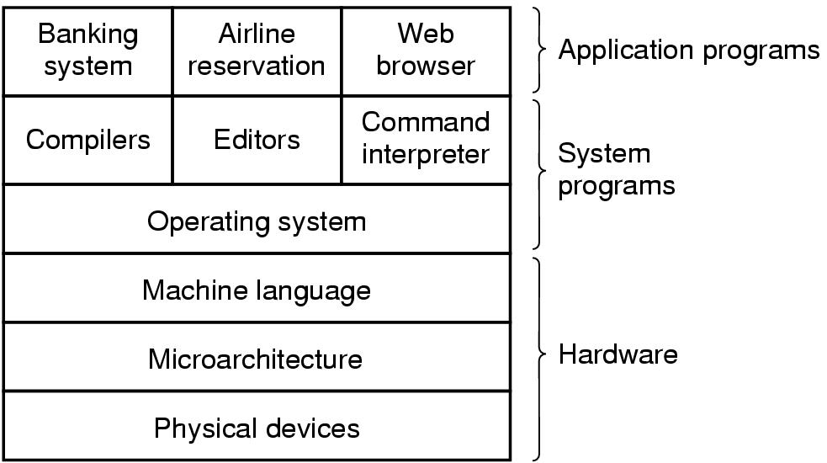
Computer system
A computer system consists of
  hardware
  system programs
  application programs

Slide 5

What is an Operating System
A program that acts as an intermediary between a user of a computer and the computer hardware

Slide 6
What is an Operating System
OS is an extended machine
  Hides the messy details which must be performed
  Presents user with a virtual machine, easier to use
OS is a resource manager
  Each program gets time with the resource
  Each program gets space on the resource

Slide 7
History of Operating Systems

Slide 8
History of Operating Systems
First generation 1945 - 1955
  vacuum tubes, plug boards
Second generation 1955 - 1965
  transistors, batch systems
Third generation 1965 – 1980
  ICs and multiprogramming
Fourth generation 1980 – present
  personal computers

Slide 9
History of Operating Systems
First generation 1945 - 1955
Computers:ENIAC, UNIVAC…
Operating System: No OS,
Machine Language, plugboards
Single group: designed, built, programmed, operated and maintained each machine

Slide 10
History of Operating Systems
Second Generation 1955 – 1965 (1)
Computers: IBM 1401, IBM 7094…
Operating System : FMS (Fortran Monitor System), IBSYS for Computer 7094
Batch Systems
  Function of Early Batch System
  Structure of a typical FMS job
Separation between designers, builders, programmers, operators and maintenance personnel

Slide 11

History of Operating Systems
Second Generation 1955 – 1965 (2)
Early batch system
  bring cards to 1401
  read cards to tape
  put tape on 7094 which does computing
  put tape on 1401 which prints output

Slide 12
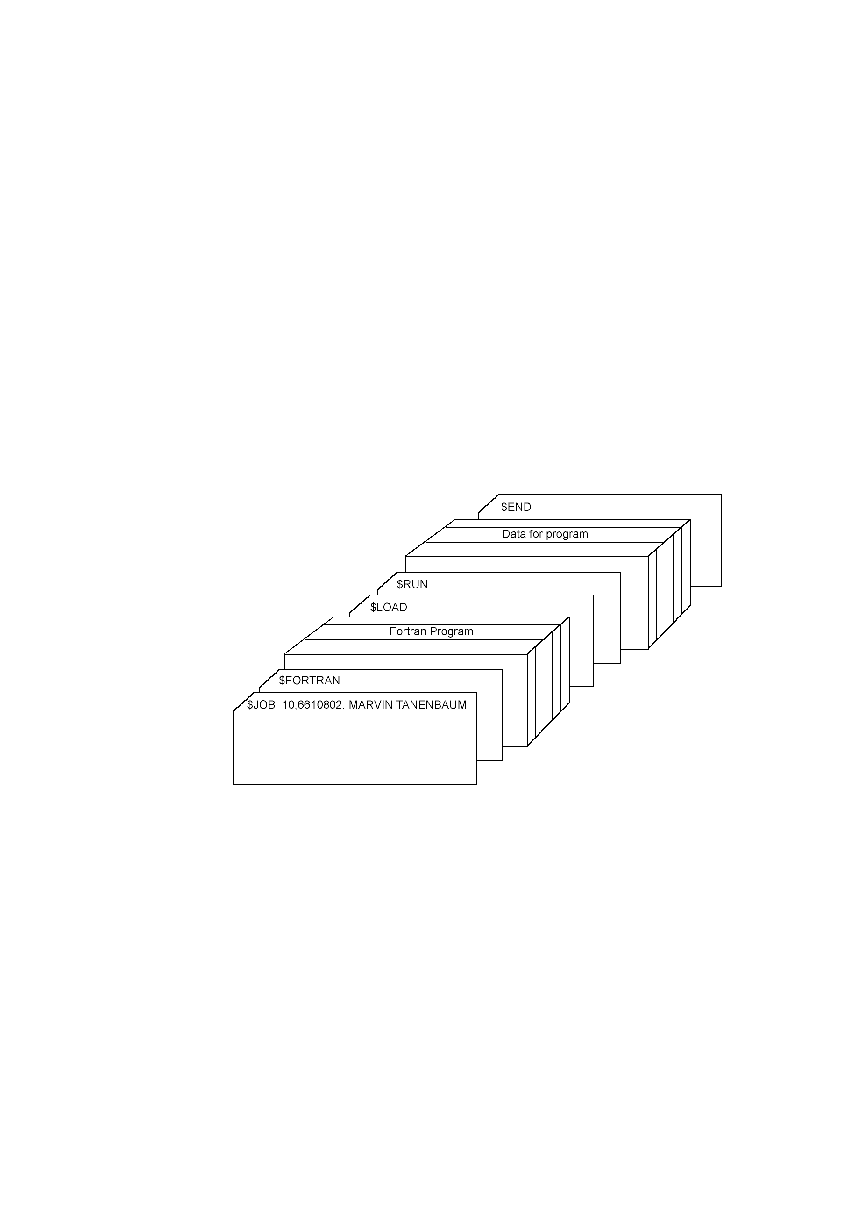
History of Operating Systems
Second Generation 1955 – 1965 (3)
Structure of a typical FMS job – 2nd generation

Slide 13
History of Operating Systems
Third generation 1965 – 1980 (1)
Computers: System/360, IBM370, IBM4300…
Operating System:
  OS/360: to work on all models
  Multiprogamming
  Time Sharing:
    CTSS (Compatible Time Sharing System),
    MULTICS (MULTiplexed Information and Computing Service),
    Unix

Slide 14

History of Operating Systems
Third generation 1965 – 1980 (2)
Multiprogramming system
  three jobs in memory – 3rd generation

Slide 15
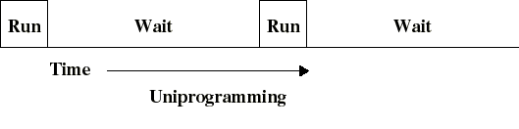
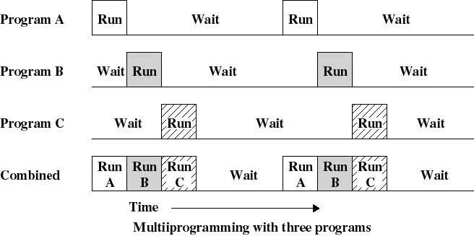
History of Operating Systems
Third generation 1965 – 1980 (3)

Slide 16
History of Operating Systems
Fourth generation 1980 – present
Computers: IBM PC 80x86, Macintosh…
Operating System:
  1977: CP/M (Control Program for Microcomputer)
  1980: DOS (Disk Operating System)
  GUI with Macintosh
  1985-1995: Window 3.x
  1995: Window 95
  1996: Window NT 4.0
  1999: Window 2000
  Window 2003
  Unix

Slide 17
The Operating System Zoo

Slide 18
The Operating System Zoo
Mainframe operating systems
Server operating systems
Multiprocessor operating systems
Personal computer operating systems
Real-time operating systems
Embedded operating systems
Smart card operating systems

Slide 19
The Operating System Zoo
Mainframe operating systems
  batch
  multiprogrammed
  time-sharing, multitasking
  Application: High-End Web Server, Servers for Business-To Business transactions
  Example: OS/390

Slide 20
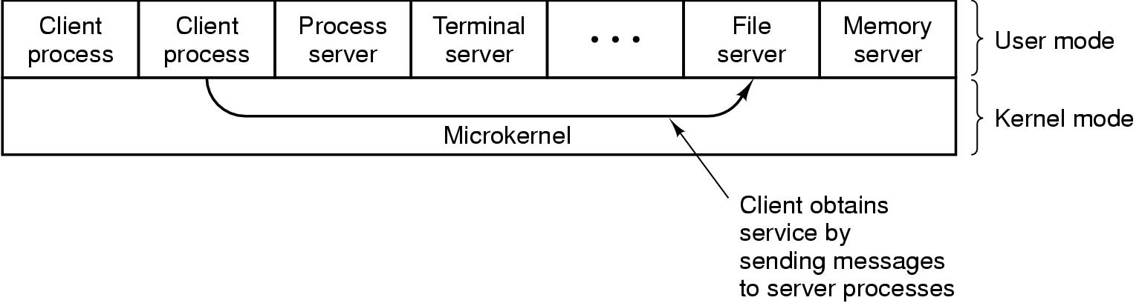
The Operating System Zoo
Server operating systems

Slide 21
The Operating System Zoo Multiprocessor operating systems
  Multiple CPU
  Share computer bus, clock
  Advantage:
    High system throughput
    High availability
    Multiprocessor system and Multicomputer system

Slide 22
The Operating System Zoo
Personal computer operating systems
  Many I/O devices
  Interface to single user
  Many OS (MS Windows, Mac OS, Solaris, Linux,...).

Slide 23
The Operating System Zoo
Real-time operating systems
  Time is a key parameter
  Two types of real-time system
    Hard real-time system for industrial process control system…
    Soft real-time system for multimedia system

Slide 24
The Operating System Zoo
Embedded operating systems
  Personal digital assistant (PDA): Palm, Pocket-PC, Cellular phones), control devices
  Restriction of memory size, speed of CPU,
  screen size, powers
  Operating System: PalmOS, Windows CE (Consumer Electronic)

Slide 25
The Operating System Zoo
Smart card operating systems
CPU chips on Card
Server processing power and memory constraint
Specific Application:
  Single function: electronic payments
  Multiple function: proprietary systems
  Java oriented: holds interpreter JVM

Slide 26
Review 1
  Xem CPU trong máy tính? Thông số tốc độ? Tốc độ xGHz có nghĩa là gì? Chức năng CPU
  Bộ nhớ trong là gì? Ram dùng để làm gì? Bộ nhớ Cache, Register là gì ở đâu? Xem thông số Ram?
  Kể ra 2 thiết bị vào, 2 thiết bị ra?
  Bộ nhớ ngoài là gì? Lấy 3 ví dụ? HDD là gì, xem thông số HDD trong máy?
  Buses là gì? Chức năng? Lấy 3 ví dụ?
  List 4 OSs in PC environments: Market shares? Which one having the maximum market share value? Reasons to make that one become the best
  List 4 Operating systems in Smart Phone environments: The same questions as above ones.

Slide 27
1.2 Computer Hardware Review
    - CPU
    - Memory
    - I/O Devices
    - Buses

Slide 28

Computer Hardware Review
Monitor
Bus
Components of a simple personal computer

Slide 29
Computer Hardware Review
The CPU (1)
PC Program Counter
SP Stack Pointer
PSW Program Status Word
General Registers
Instruction Cycle
Pipeline
Superscalar
System Call

Slide 30
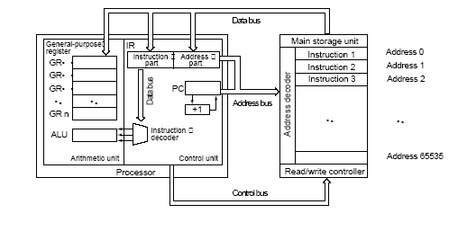
Computer Hardware Review
The CPU (2)

Slide 31
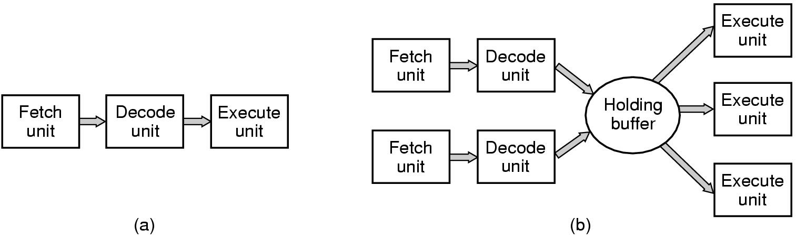
Computer Hardware Review
The CPU (3)
(a) A three-stage pipeline
(b) A superscalar CPU

Slide 32
Computer Hardware Review
The CPU (4)
Dual-mode operation allows OS to protect itself and other system components
  User mode and kernel mode
  Mode bit provided by hardware
    Provides ability to distinguish when system is running user code or kernel code
    Some instructions designated as privileged, only executable in kernel mode
    System call changes mode to kernel, return from call resets it to user

Slide 33

Computer Hardware Review
The CPU (5)
Transition from User to Kernel Mode

Slide 34
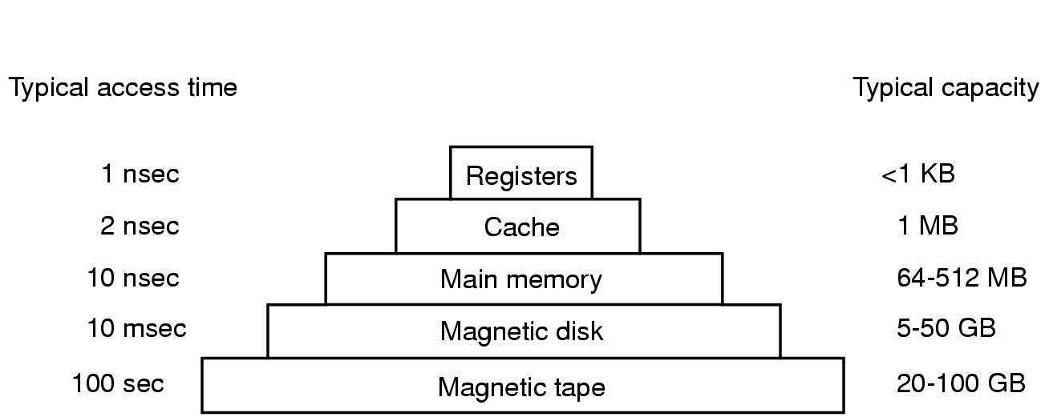
Computer Hardware Review
Memory (1)
Typical memory hierarchy
  numbers shown are rough approximations

Slide 35
Computer Hardware Review
Memory (2)
Storage systems organized in hierarchy.
  Speed
  Cost
  Size
  Volatility

Slide 36
Computer Hardware Review
Memory (3)
Registers:
Small number, Fast
Capacity:
  32*32 bit on 32-bit CPU
  64*64 bit on 64-bit CPU

Slide 37
Computer Hardware Review
Memory (4)
Caching – copying information into faster storage system; main memory can be viewed as a last cache for secondary storage.

Slide 38
Computer Hardware Review
Memory (5)
Caching
Important principle, performed at many levels in a computer (in hardware, operating system, software)
Information in use copied from slower to faster storage temporarily
Faster storage (cache) checked first to determine if information is there
  If it is, information used directly from the cache (fast)
  If not, data copied to cache and used there
Cache smaller than storage being cached
  Cache management important design problem
  Cache size and replacement policy

Slide 39
Computer Hardware Review
Memory (6)
Main Memory
RAM (Random Access Memory)
Problem:
  How protect the program from one another and the kernel from them all
  How to handle relocation
Solution: CPU equipped with two special registers
Base Register and Limit Register
MMU (Memory Management Unit) convert Virtual Address to Physical Address
Context Switch; switching from one to another

Slide 40
Computer Hardware Review
Memory (7)
Relocation and Protection
Cannot be sure where program will be loaded in memory
  address locations of variables, code routines cannot be absolute
  must keep a program out of other processes’ partitions
Use base and limit values
  address locations added to base value to map to physical addr
  address locations larger than limit value is an error

Slide 41
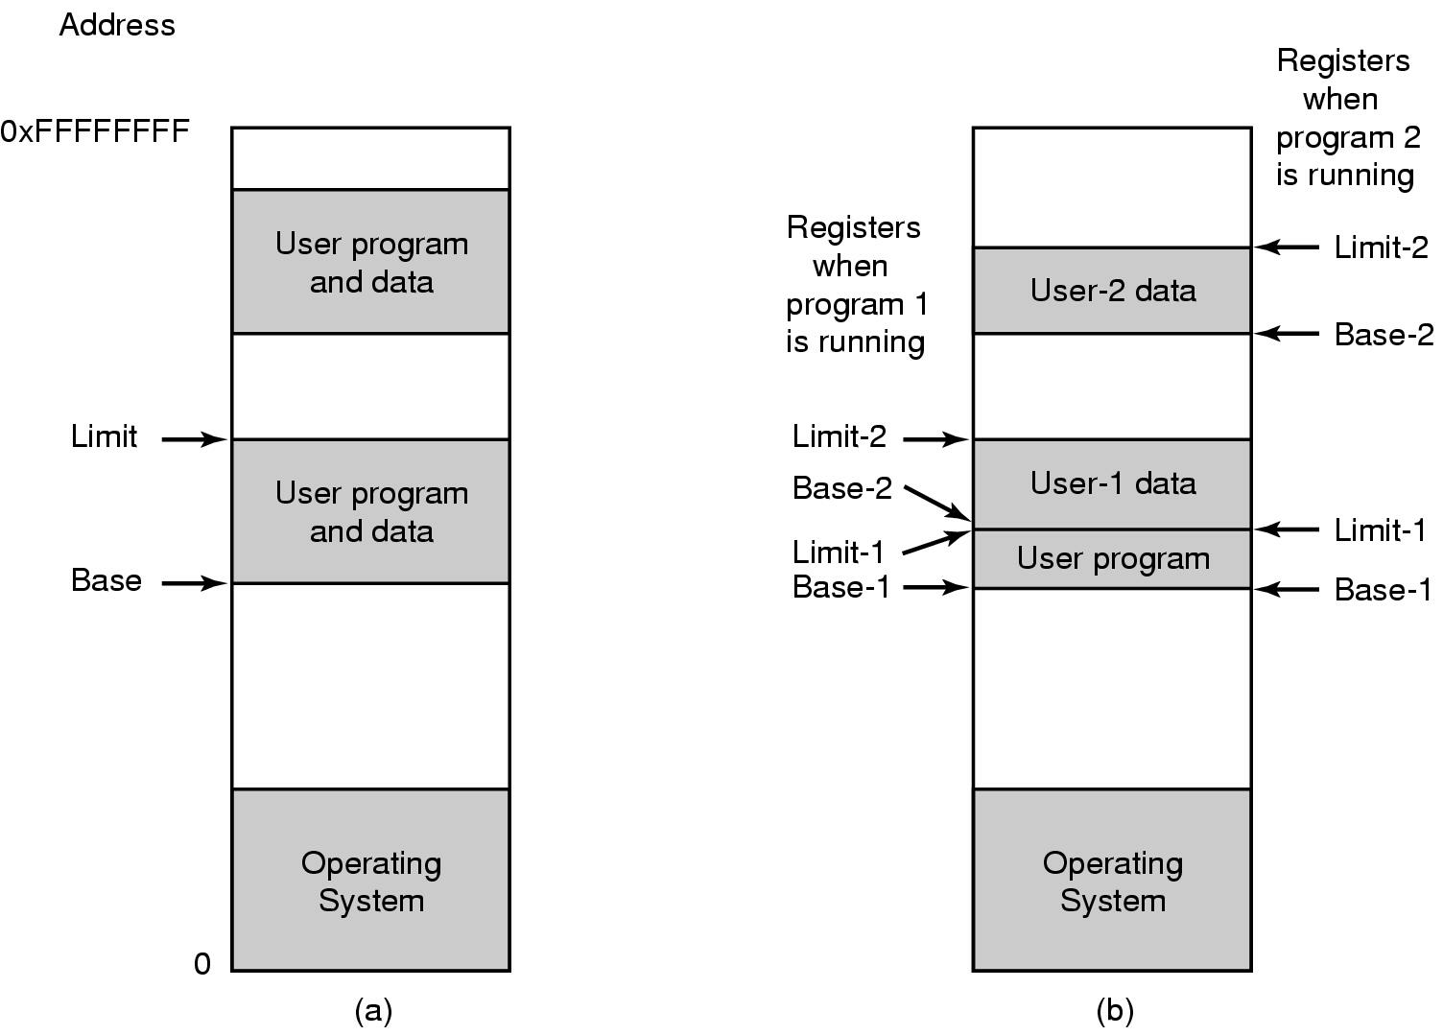
Computer Hardware Review
Memory (8)
One base-limit pair and two base-limit pairs

Slide 42

Computer Hardware Review
Memory (9)

Slide 43
Computer Hardware Review
Memory (10)
Other memory in computer
ROM (Read Only Memory)
EEPROM (Electrically Erasable ROM):
  BIOS Basic Input Output System
CMOS:
  Real time clock
  Configuration Information

Slide 44
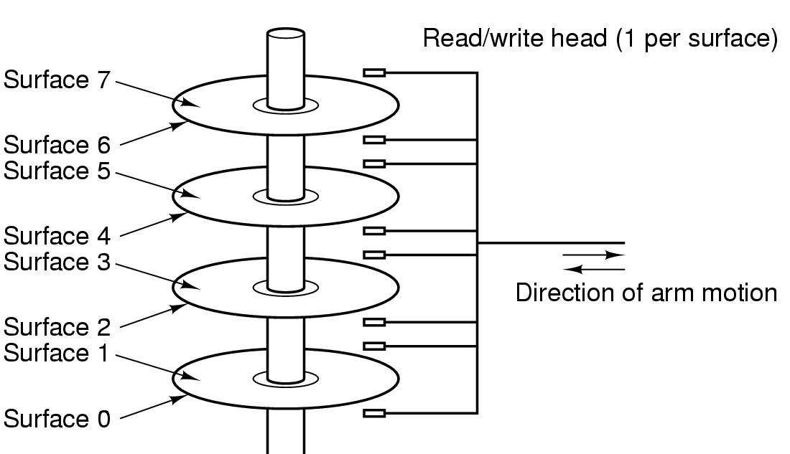
Computer Hardware Review
Memory (11)
Structure of a disk drive

Slide 45
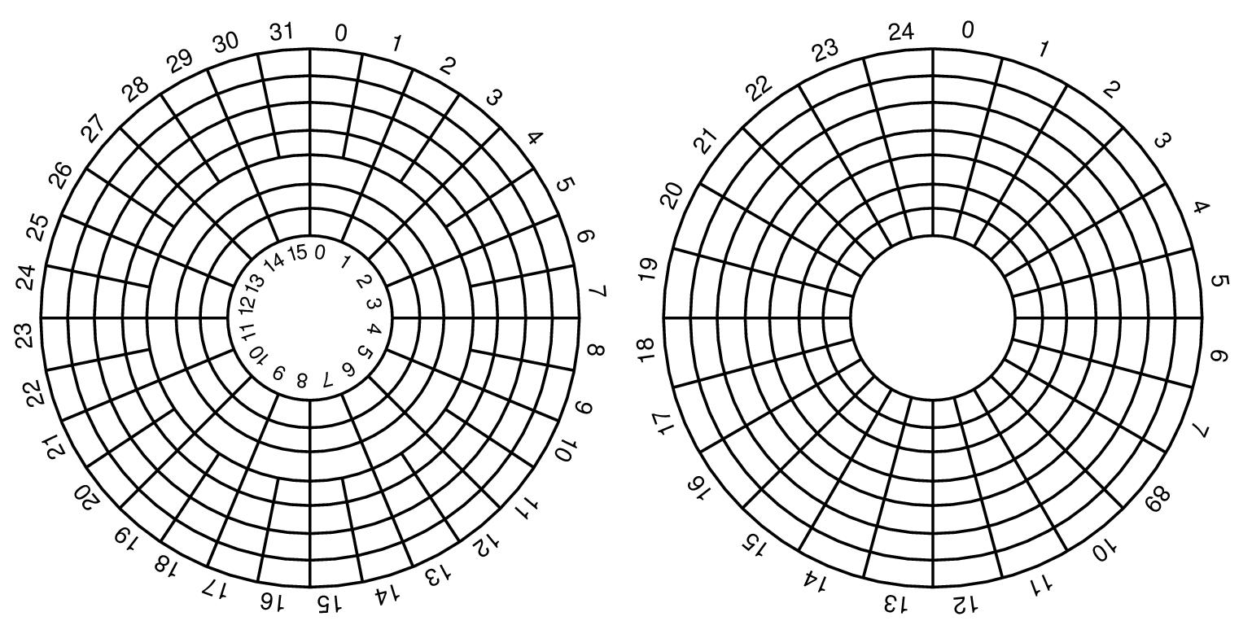
Computer Hardware Review
Memory (12)
Disk: Cylinder, Track, sector

Slide 46
Computer Hardware Review
I/O Devices (1)
Computer-System Operation
I/O devices and the CPU can execute concurrently.
Each device controller is in charge of a particular device type.
Each device controller has a local buffer.
CPU moves data from/to main memory to/from local buffers
I/O is from the device to local buffer of controller.
Device controller informs CPU that it has finished its operation by causing an interrupt.

Slide 47

Computer Hardware Review
I/O Devices (2)
How interrupts happens. Connections between devices and interrupt controller actually use interrupt lines on the bus rather than dedicated wires

Slide 48
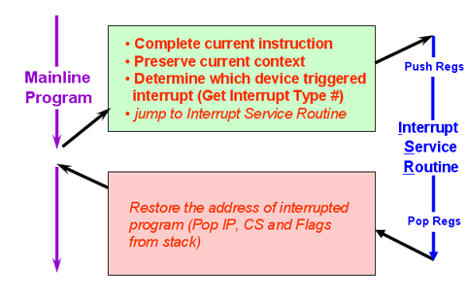
Computer Hardware Review
I/O Devices (3)
Example of Interrupt processing for PC

Slide 49
Computer Hardware Review
I/O Devices (3)
Common Functions of Interrupts
Interrupt transfers control to the interrupt service routine generally, through the interrupt vector table, which contains the addresses of all the service routines.
Interrupt architecture must save the address of the interrupted instruction.
Incoming interrupts are disabled while another interrupt is being processed to prevent a lost interrupt.
A trap is a software-generated interrupt caused either by an error or a user request.
An operating system is interrupt driven.

Slide 50
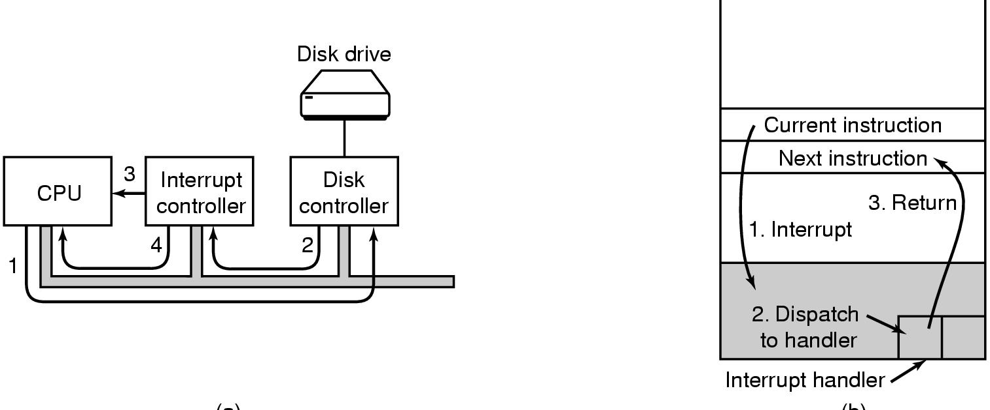
Computer Hardware Review
I/O Devices (4)
(a)
(b)
(a) Steps in starting an I/O device and getting interrupt
(b) How the CPU is interrupted

Slide 51

Computer Hardware Review
I/O Devices (6)
Operation of a DMA transfer
DMA (Direct Memory Access)

Slide 52
Computer Hardware Review
I/O Devices (7)
DMA
Used for high-speed I/O devices able to transmit information at close to memory speeds.
Device controller transfers blocks of data from buffer storage directly to main memory without CPU intervention.
Only one interrupt is generated per block, rather than the one interrupt per byte.

Slide 53

Computer Hardware Review
Structure of a large Pentium system

Slide 54
Computer Hardware Review
BUS
Cache BUS
Local BUS
System BUS
ISA Industry Standard Architecture
PCI Peripheral Component Interconnect
USB Universal Serial BUS
SCSI Small Computer System Interface
IDE Integrated Drive Electronic

Slide 55
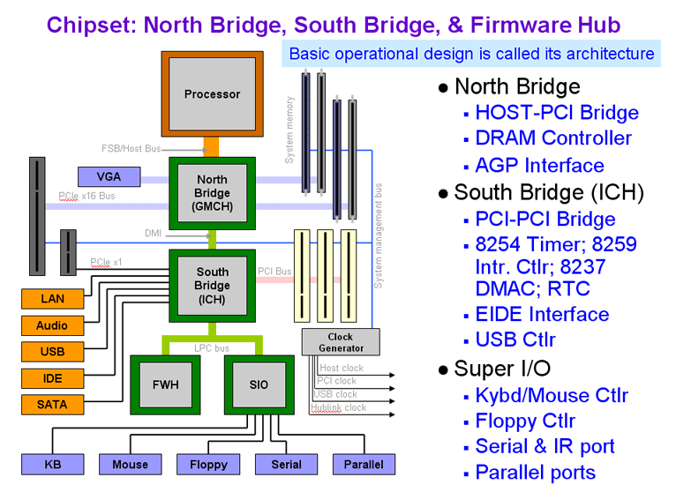
Computer Hardware Review
Personal Computer (PC)

Slide 56
1.3 Operating System Concepts
  OS Components
  System calls
  Operating system structure

Slide 57
OS Components
  Process Management
  Main Memory Management
  File management
  I/O Management
  Secondary Storage Management
  Protection and Security

Slide 58
Operating System Concepts
OS Components (1)
Process Management
  Process is a Program in execution
  A process needs certain resources, including CPU time, memory, files, and I/O devices, to accomplish its task.
  Tasks of process management of OS:
    Process creation and deletion.
    process suspension and resume
    Provision of mechanisms for:
    - Process synchronization
    - Interprocess communication
    - Prevent or avoid deadlock

Slide 59

Operating System Concepts
OS Components (2)
A process tree
  A created two child processes, B and C
  B created three child processes, D, E, and F

Slide 60
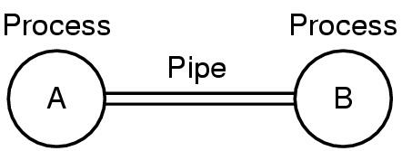
Operating System Concepts
OS Components (3)
Two processes connected by a pipe

Slide 61
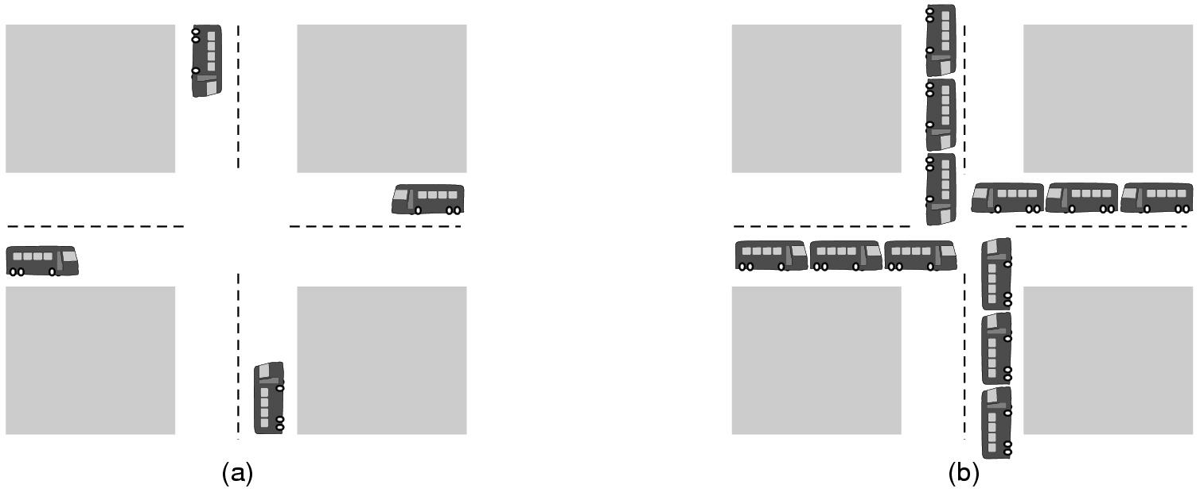
Operating System Concepts
OS Components (4)
(a) A potential deadlock. (b) an actual deadlock.

Slide 62
Operating System Concepts
OS Components (5)
The Deadlock Problem
A set of blocked processes each holding a resource and waiting to acquire a resource held by another process in the set.
Example
  System has 2 disk drives.
  P₁ and P₂ each hold one disk drive and each needs another one.

Slide 63
Operating System Concepts
OS Components (6)
Main Memory Management:
  Motivations:
    Increase system performance
    Maximize memory utilization
  Task of main memory of management:
    Keep track of which parts of memory are currently being used and by whom.
    Decide which processes to load when memory space becomes available.
    Allocate and deallocate memory space as needed

Slide 64
Operating System Concepts
OS Components (7)
File management
  File system
    File
    Directory
  Task of file management of OS:
    Create and delete File/Dicrectory
    Manipulate: rename, copy, move, new,…
    Mapping files onto secondary storage.
    File backup on stable (nonvolatile) storage media

Slide 65
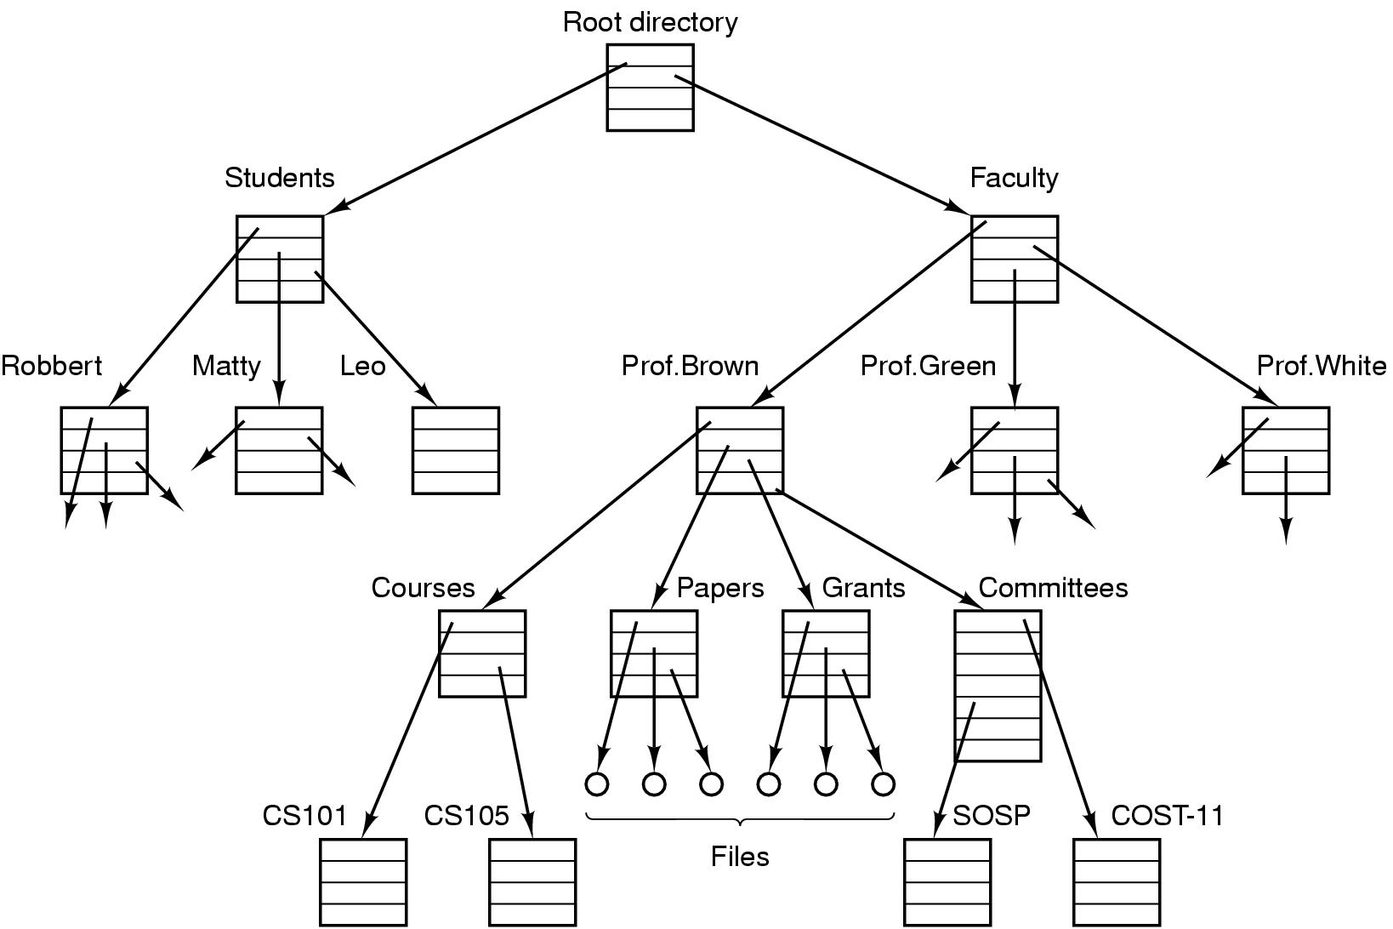
Operating System Concepts
OS Components (8)
File system for a university department

Slide 66
Operating System Concepts
OS Components (9)
I/O Management
  Hide the specialty of H/W devices
  Task of I/O Management of OS:
    Manage main memory for the devices using caching, buffering, and spooling
    Maintain and provide a general device-driver interfaces
    Drivers for specific hardware devices.

Slide 67
Operating System Concepts
OS Components (10)
Secondary Storage Management:
  Since main memory (primary storage) is volatile and too small to accommodate all data and programs permanently, the computer system must provide secondary storage to back up main memory.
  Common secondary storage devices: Magnetic disk and Optical disk
  Task of Secondary Storage Management of OS:
    Free space management
    Storage allocation
    Disk scheduling

Slide 68
Operating System Concepts
OS Components (11)
Protection and Security
Protection – any mechanism for controlling access of processes or users to resources defined by the OS
Security – defense of the system against internal and external attacks
  Huge range, including denial-of-service, worms, viruses, identity theft, theft of service

Slide 69
Operating System Concepts
OS Components (12)
Protection and Security
Systems generally first distinguish among users, to determine who can do what
  User identities (user IDs, security IDs) include name and associated number, one per user
  User ID then associated with all files, processes of that user to determine access control
  Group identifier (group ID) allows set of users to be defined and controls managed, then also associated with each process, file
  Privilege escalation allows user to change to effective ID with more rights

Slide 70
Operating System Concepts
Operating System Services
One set of operating-system services provides functions that are helpful to the user:
  User interface - Almost all operating systems have a user interface (UI)
    Varies between Command-Line (CLI), Graphics User Interface (GUI)
  Program execution - The system must be able to load a program into memory and to run that program, end execution, either normally or abnormally (indicating error)
  Control access to I/O device.
  File-system manipulation

Slide 71
Operating System Concepts
Operating System Services
  Communications – Processes may exchange information, on the same computer or between computers over a network
  Error detection – OS needs to be constantly aware of possible errors
  ….

Slide 72
System Calls
  Making System Calls
  Major POSIX System Calls
  Examples of System Calls

Slide 73

System Calls
Making System Calls (1)
There are 11 steps in making the system call
read (fd, buffer, nbytes)

Slide 74

System Calls
Making System Calls (2)
C program invoking printf() library call, which calls write() system call

Slide 75
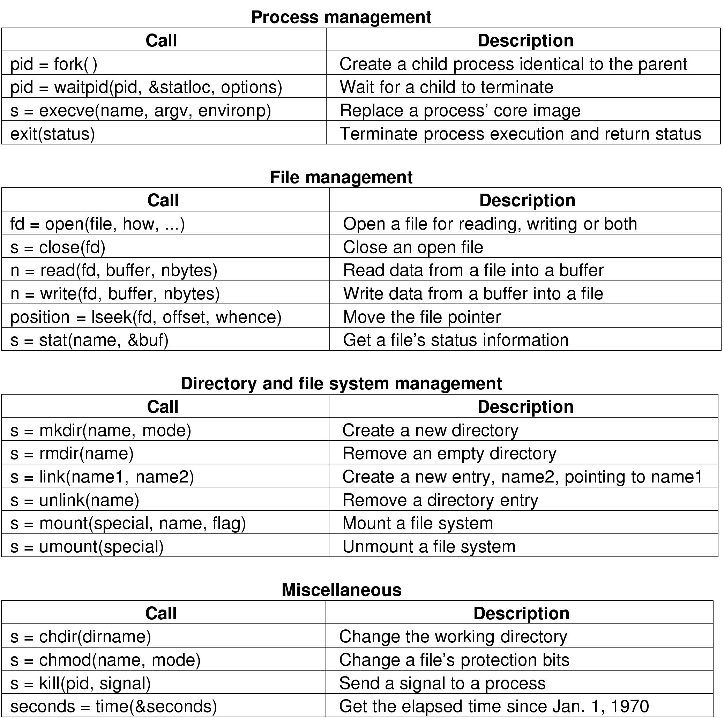
System Calls
POSIX System Calls (1)
Some System Calls For Process Management
POSIX (Portable Operating System Interface)

Slide 76
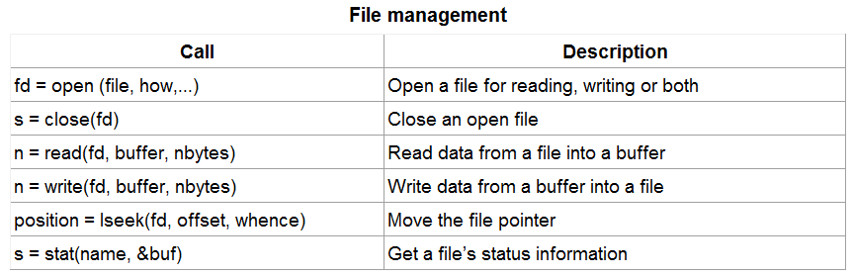
System Calls
POSIX System Calls (2)
Some System Calls For File Management

Slide 77
System Calls
POSIX System Calls (3)
Some System Calls For Directory Management

Slide 78
System Calls
POSIX System Calls (4)
Some System Calls For Miscellaneous Tasks

Slide 79
System Calls
Examples (1)
A stripped down shell:
while (TRUE) { /* repeat forever */
type_prompt( ); /* display prompt */
read_command (command, parameters) /* input from terminal */
if (fork() != 0) { /* fork off child process */
/* Parent code */
waitpid( -1, &status, 0); /* wait for child to exit */
} else {
/* Child code */
execve (command, parameters, 0); /* execute command */
}
}

Slide 80
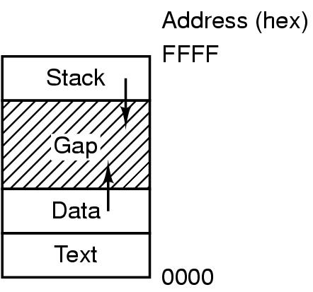
System Calls
Examples (2)
Processes have three segments: text, data, stack

Slide 81
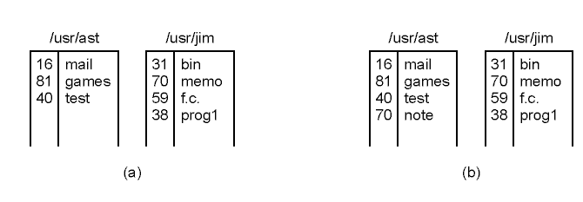
System Calls
Examples (3)
(a) Two directories before linking
/usr/jim/memo to ast's directory
(b) The same directories after linking

Slide 82
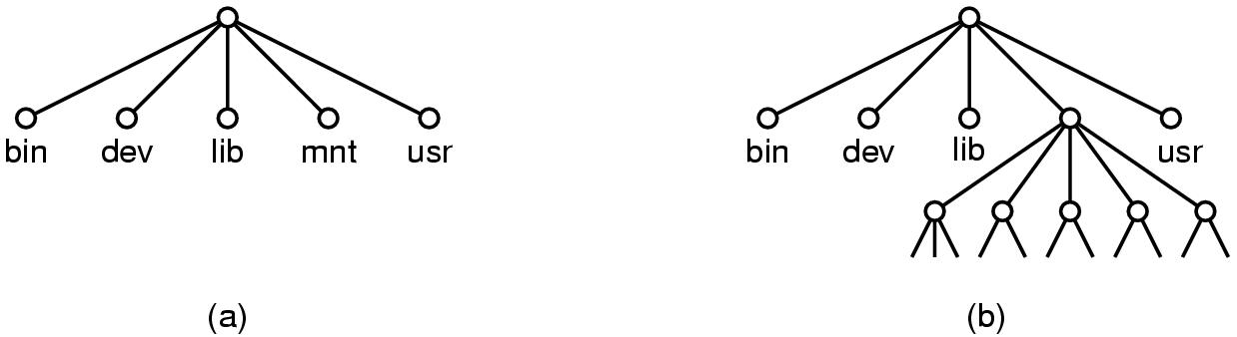
System Calls
Examples (4)
(a) File system before the mount
(b) File system after the mount

Slide 83
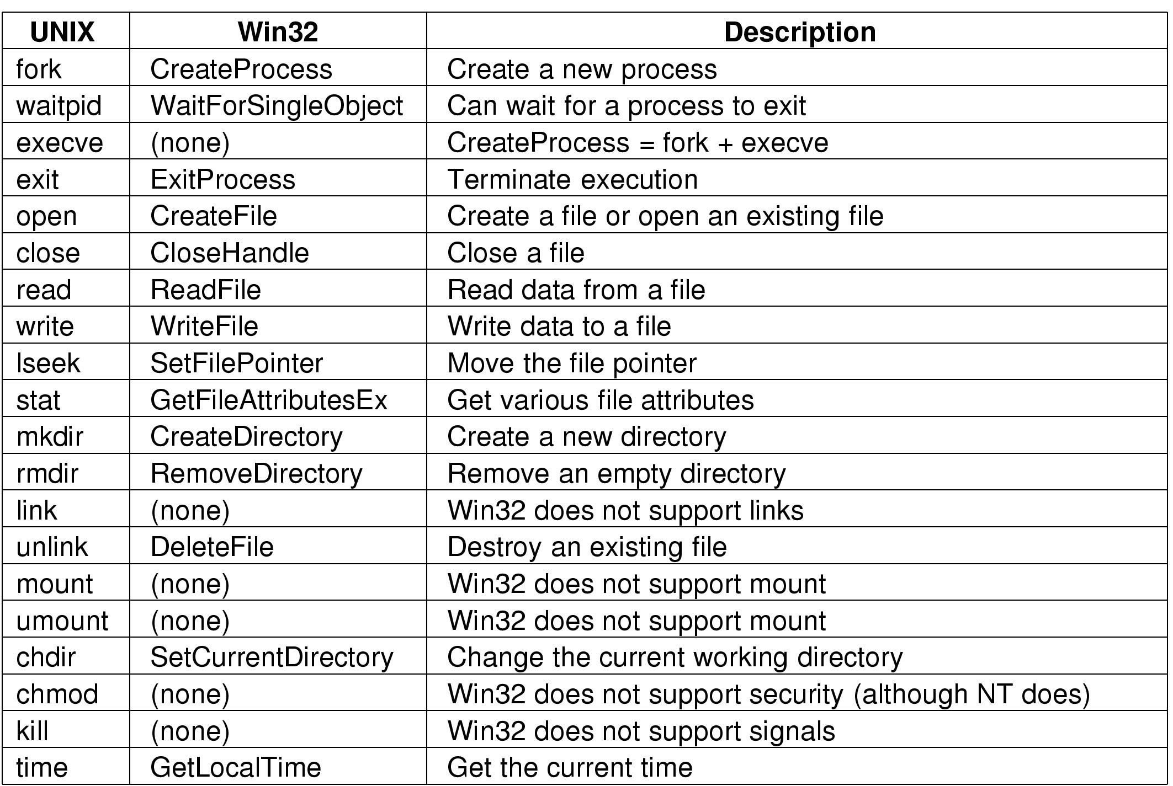
System Calls
Some Win32 API calls

Slide 84
Operating System Structure
  Monolithic system
  Layered System
  Virtual Machine
  Client-server model
  Microkernel

Slide 85
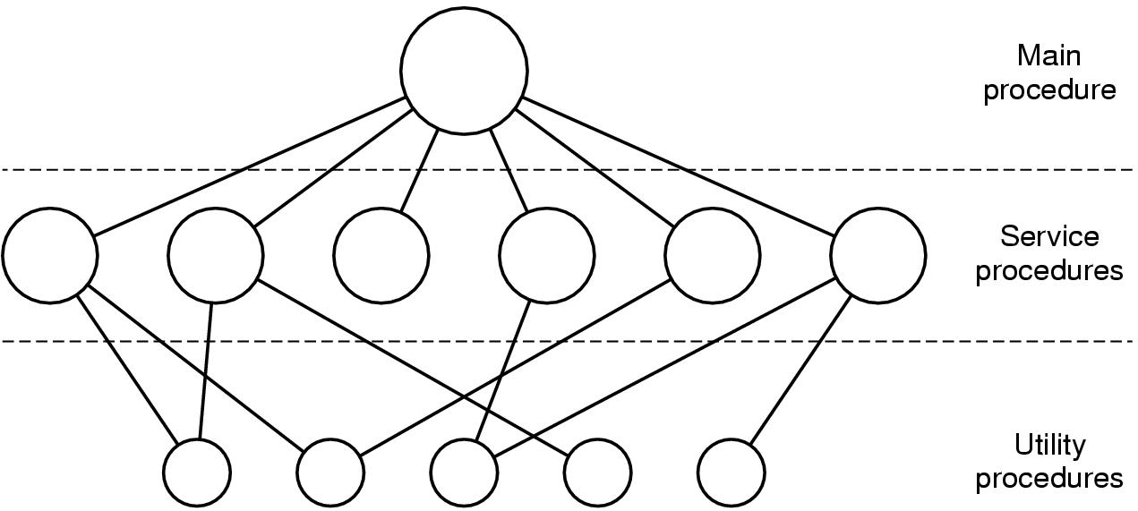
Operating System Structure
Monolithic system (1)
Simple structuring model for a monolithic system

Slide 86
Operating System Structure
Monolithic system (2)
Structure of Operating System:
A main program that invokes the requested service procedure.
A set of service procedures that carry out the system calls.
A set of utility procedures that help the service procedures.

Slide 87
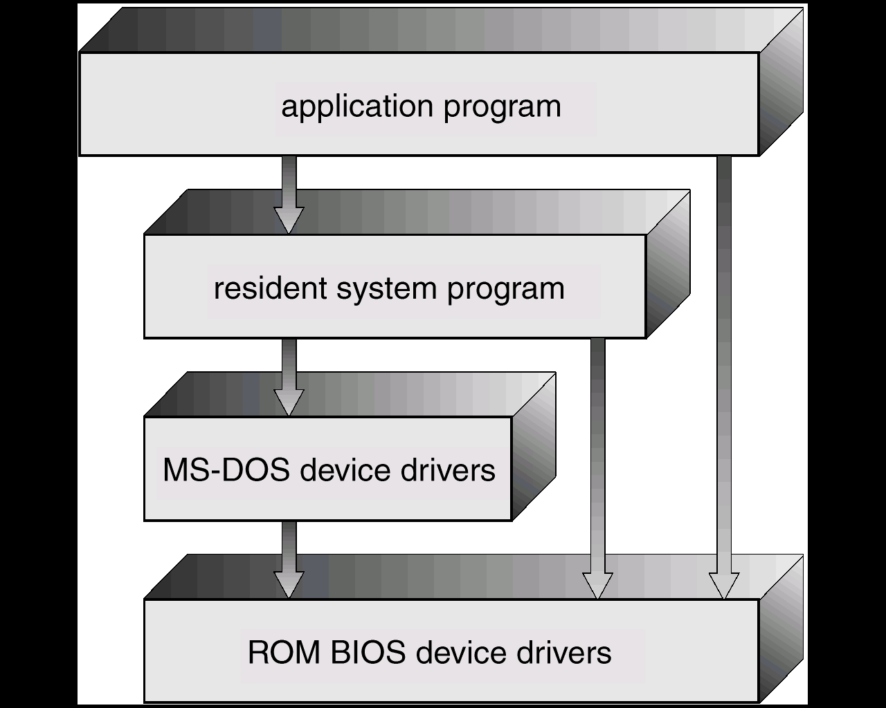
Operating System Structure
Monolithic system (3) : Example
Monolithic
  MS-DOS – written to provide the most functionality in the least space:
    not divided into modules;
    Although MS-DOS has some structure, its interfaces and levels of functionality are not well separated

Slide 88
Operating System Structure
Layered System (1)
Many Layers
Each layer has well defined functions
Upper layer can only calls functions of closely lower layer
Advantages:
  Easier to extend
  Easier to debug from lower to upper layer

Slide 89
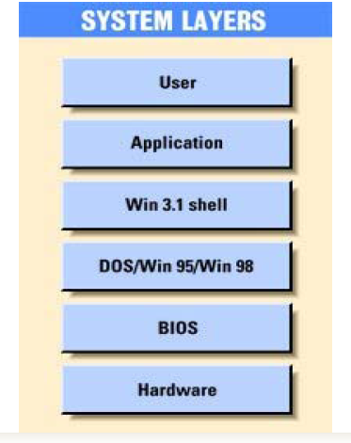
Operating System Structure
Layered System (2): Example

Slide 90
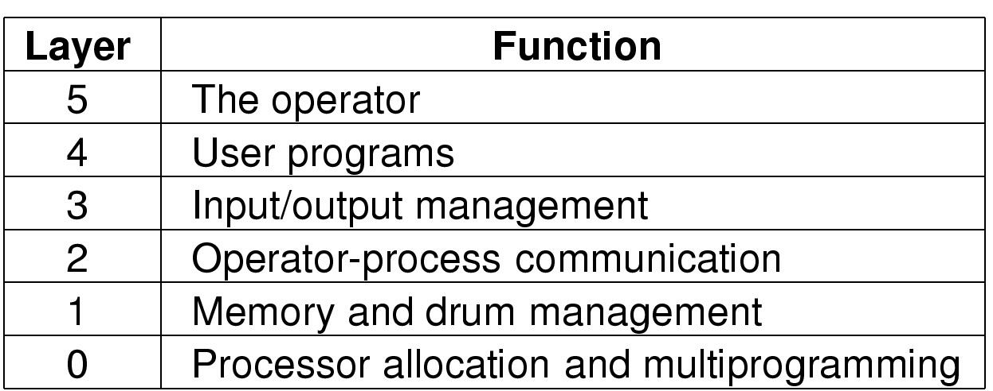
Operating System Structure
Layered System (3): Example
Structure of the THE operating system

Slide 91
Operating System Structure
Virtual Machine (1)
processes
kernel
hardware
processes | processes | processes
kernel | kernel | kernel
VM1 | VM2 | VM3
Virtual-machine implementation
hardware
programming
interface
Non-virtual machine
system model
Virtual machine system model

Slide 92
Operating System Structure
Virtual Machine (2)
A virtual machine takes the layered approach to its logical conclusion. It treats hardware and the operating system kernel as though they were all hardware
A virtual machine provides an interface identical to the underlying bare hardware
The operating system creates the illusion of multiple processes, each executing on its own processor with its own (virtual) memory

Slide 93
Operating System Structure
Virtual Machine (3)
The resources of the physical computer are shared to create the virtual machines
  CPU scheduling can create the appearance that users have their own processor
  Spooling and a file system can provide virtual card readers and virtual line printers
  A normal user time-sharing terminal serves as the virtual machine operator’s console

Slide 94
Operating System Structure
Client-server model (1)
The client-server model

Slide 95
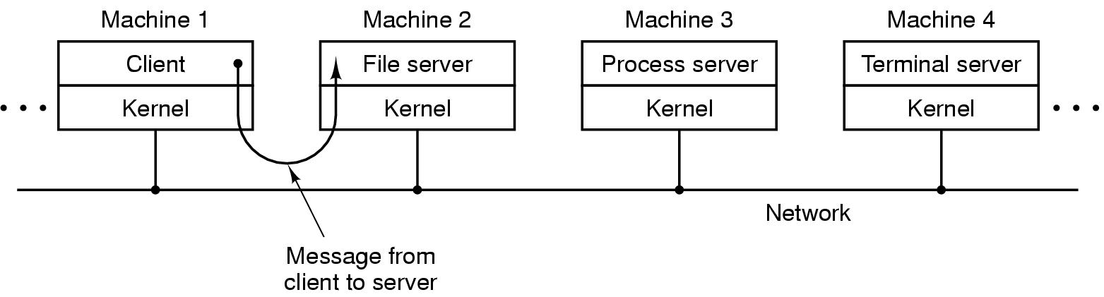
Operating System Structure
Client-server model (2)
The client-server model in a distributed system

Slide 96
Operating System Structure
Microkernel: Example
Microkernel
OS design: The operating system is divided into microkernel (CMU Mach OS - 1980)
  Moves as much from the kernel into “user” space
  kernel → microkernel
  Communication takes place between user modules using message passing.
Application
POSIX
application
X-application
File
server
POSIX
server
X-window
server

Slide 97
Explain terms: multiprogramming, Register (Program counter, stack pointer, Program status word).
List all security functions are provided by your OS?
Study to know how to turn on your firewall and block some programs.
One reason GUIs were initially slow to be adopted was the cost of the hardware needed to support them. How much video RAM is needed to support a 25 line × 80 row character monochrome text screen? How much for a 1024 × 768 pixel 24-bit color bitmap? What was the cost of this RAM at 1980 prices ($5/KB)? How much is it now?
List 5 antivirus softwares? Which one is the best in your opinion?

Slide 98
Reivew 1
List 4 Operating systems in PC environments
  Market shares? Which one having the maximum market share value?
  Reasons to make that one become the best one?
List 4 Operating systems in Smart Phone environments
  The same questions as above ones.

Slide 99
Review 2
Install Ubuntu OS
Virtual Machine: VMWare, Virtual Box

Slide 100
Review 3: OS Structure
Android OS
  http://www.techotopia.com/index.php/An_Overview_of_the_Android_Architecture
Mac OS X
  https://developer.apple.com/library/mac/documentation/Darwin/Conceptual/KernelProgramming/Architecture/Architecture.html
iOS
  http://code.tutsplus.com/tutorials/exploring-the-ios-sdk--mobile-13959

Slide 101
Review 2
List 5 OS & its market share in PC environment
The same question with Smart Phone environment?
List some security functions are provided by your OS?
List 5 antivirus softwares? Which one is the best in your opinion?
Study to know how to turn on your firewall and block some programs…

