Slide 1

CHAPTER 6
Computer Networks
and Internet
Notes:
1.#

Slide 2
Objectives
After studying this chapter, the student should be able to:
Describe local and wide area networks (LANs and Wans).
Distinguish an internet from the Internet.
Describe the TCP/IP protocol suite as the network model in the internet.
Define the layers in the TCP/IP protocol suite and their relationship.
Describe some application at the application layer.
Describe the services provided by the transport-layer protocols
Describe the services provided by the network-layer protocol.
Describe different protocols used at the data-link layer.
Describe the duties of the physical layer.
Describe different transmission media used in networking.

Slide 3
6-1 OVERVIEW
6.1.1 Networks
A network is the interconnection of devices capable of communication.
A device can be a host (such as a computer, desktop, laptop, workstation, mobile phone, or security system) and can be a connecting device such as a router connecting the network to other networks, a switch which connects devices together, a modem (modulator-demodulator) that changes the form of data, etc.
These devices in a network are connected using wired or wireless transmission media.
When connecting two computers, we have created a network, although very small.
6.<number>

Slide 4
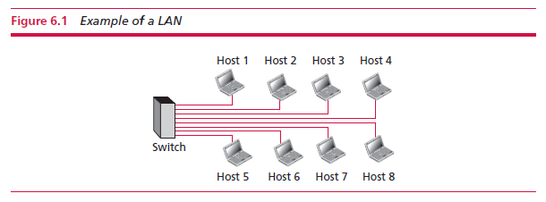
Local area network
A local area network (LAN) is privately owned and connects hosts in a single office, building, or campus.
LANs can be as simple as two PCs and a printer in someone’s home office, or it can extend throughout a company and include audio and video devices.
Each host in a LAN has an identifier, an address, that uniquely defines them. A packet sent by a host to another carries both the source host’s and the destination host’s addresses.
6.<number>

Slide 5
Wide area network
A wide area network (WAN) is an interconnection of devices capable of communication.
Differences between LAN and WAN:
A LAN is limited in size, spanning an office, a building, or a campus; a WAN has a wider geographical span, spanning a town, a state, a country, or even the world.
A LAN interconnects hosts; a WAN interconnects connecting devices such as switches, routers, or modems.
A LAN is normally privately owned by the organization that uses it; a WAN is normally created and run by communication companies and leased by an organization that uses it.
6.<number>

Slide 6
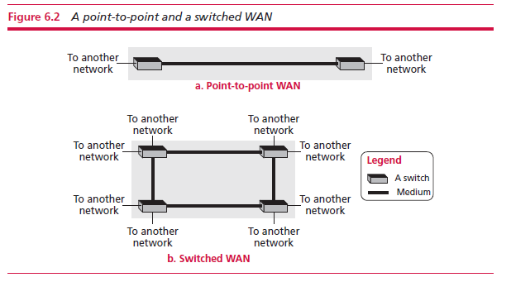
A point-to-point WAN is a network that connects two communicating devices through a transmission medium (cable or air).
A switched WAN is a network with more than two ends. A switched WAN is used in global communication today. A switched WAN is a combination of several point-to-point WANs that are connected by switches.
6.<number>

Slide 7
Internetwork
It is rare to see an isolated LAN or WAN – they are connected to one another. When two or more networks are connected, they make an internetwork, or internet.
Example: an organization has two offices. Both have a LAN that allows all employees to communicate. To make the communication between employees at different offices possible, the management leases a point-to-point dedicated WAN from a service provider, such as a telephone company, and connects the two LANs. Now the company has an internetwork, or a private internet (with lowercase i).
6.<number>

Slide 8
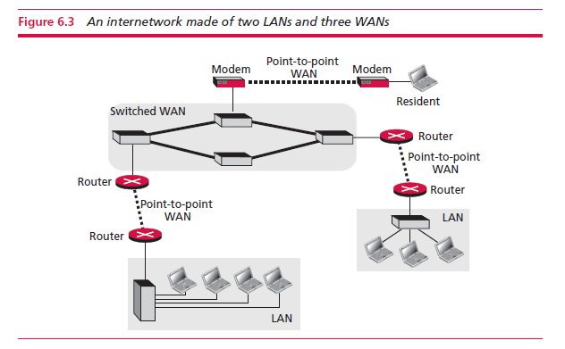
6.<number>

Slide 9
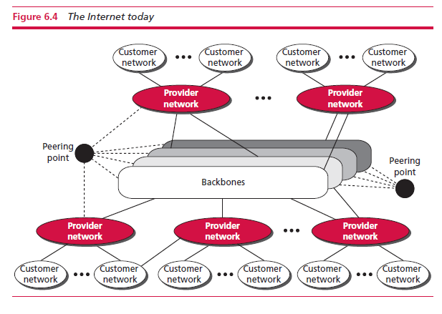
6.1.2 The Internet
An internet is two or more networks that can communicate with each other. The most notable is the Internet which is made of thousands of networks.
6.<number>

Slide 10
The Internet as several backbones, provider networks, and customer networks.
Large networks owned by communication companies, connected through complex switching systems, called peering points.
Smaller networks, called provider networks, use the services of the backbones for a fee. They are connected to backbones and sometimes to other providers.
The customer networks are at the edge of the Internet and use the services provided for a fee.
Backbones and provider networks are also called internet service providers (ISPs) Backbones are often referred to as international ISPs; the provider networks are often referred to as national or regional ISPs.
6.<number>

Slide 11
6.1.3 Hardware and software
For communication to happen both hardware and software are required.
This is similar to a complex computation in which both a computer and a program are needed.
These combinations are coordinated with each other using protocol layering.
6.<number>

Slide 12
6.1.4 Protocol layering
A protocol defines the rules that both the sender and receiver and all intermediate devices need to follow to
be able to communicate effectively.
When communication is simple, we may need only one
simple protocol; when the communication is complex, we may need to divide the task between different layers, in which case we need a protocol at each layer, or protocol layering.
6.<number>

Slide 13
A scenario
Ann and Maria are neighbours with a lot of common ideas. They communicate with each other every time they meet about a project for the time when they will be retired.
Ann is offered a higher position in her company and needs to move to a branch far from Maria. The two friends want to continue exchanging ideas relating to a start up business they want to start when they retire.
They decide to use regular mail but worry their letters might get intercepted. They agree on an encryption/decryption technique. The sender of the letter encrypts it to make it unreadable by an intruder; the receiver of the letter decrypts it to get the original letter. Assume that Maria and Ann use one technique that makes it hard to decrypt the letter if one does not have the key for doing so.
Now we can say that the communication between Maria and Ann takes place in three layers, as shown in Figure 6.5. We assume that Ann and Maria each have three machines (or robots) that can perform the task at each layer.
6.<number>

Slide 14
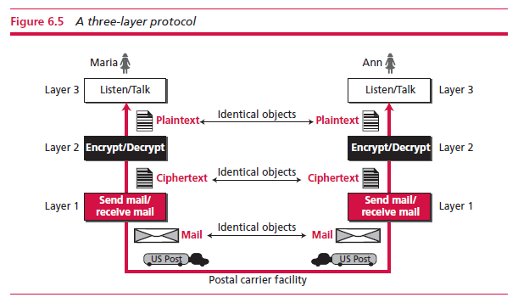
Maria talks to the machine at the third layer which listens and creates the plaintext that is passed to the second-layer machine.
The second-layer machine encrypts it and creates a ciphertext to pass to the first-layer machine. This first layer machine takes the ciphertext, puts it in an envelope, adds the sender and receiver addresses, and mails it.
At Ann’s side, the first-layer machine picks up the letter, passes on the ciphertext to the second-layer machine which decrypts it, creates the plaintext, and passes it to the third-layer machine. The third-layer machine takes the plaintext and reads it as though Maria is speaking.
6.<number>

Slide 15
If the encryption/decryption is not enough they need to change only the second-layer machine. This is referred to as modularity.
Modularity in this case means Independent layers. A layer (module) can be defined as a black box with inputs and outputs, without concern about how inputs are changed to outputs.
Note: If two machines provide the same outputs when given the same inputs, they can replace each other.
Advantages:
Separation of the services from the implementation. A layer needs to be able to receive a set of services from the lower layer and to give the services to the upper layer.
Communication does not always use only two end systems; there are intermediate systems that need only some layers, but not all layers. If we did not use protocol layering, we would have to make each intermediate system as complex as the end systems, which makes the whole system more expensive.
6.<number>

Slide 16
Principles of protocol layering
The first principle dictates that if we want bidirectional communication, we need to make each layer so that it is able to perform two opposite tasks, one in each direction.
Example:
The third-layer task is to listen (in one direction) and talk (in the other direction).
The second layer needs to be able to encrypt and decrypt.
The first layer needs to send and receive mail.
The second important principle is that the two objects under each layer at both sites should be identical.
Example:
The object under layer 3 at both sites should be a plaintext letter.
The object under layer 2 at both sites should be a ciphertext letter.
The object under layer 1 at both sites should be a piece of mail.
6.<number>

Slide 17
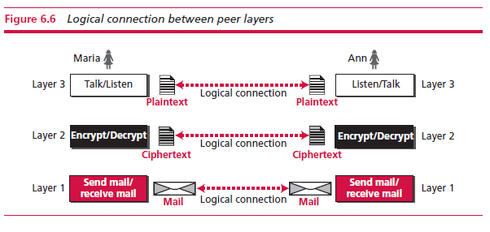
Logical connections
Logical connection will help us understand the task of layering in data communication and networking.
6.<number>

Slide 18
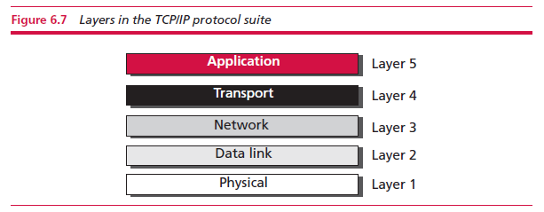
6.1.5 TCP/IP protocol suite
TCP/IP is a protocol suite (a set of protocols organized in different layers) used in the Internet today.
It is a hierarchical protocol made up of interactive modules, each of which provides a specific functionality.
The term hierarchical means that each upper-level protocol is supported by the services provided by one or more lower-level protocols. The TCP/IP protocol suite is made of five layers.
6.<number>

Slide 19
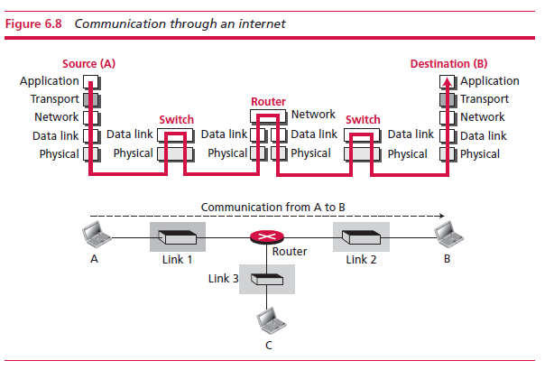
Layered architecture
The two hosts are involved in all five layers; the source host needs to create a message in the application layer and send it down the layers so that it is physically sent to the destination host.
The destination host needs to receive the communication at the physical layer and then deliver it through the other layers to the application layer.
6.<number>

Slide 20
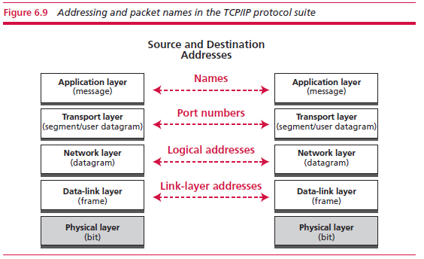
Addressing and packet names
Communication involving two parties needs two addresses: source and destination
At the transport layer, addresses are called port numbers: local addresses that distinguish between several programs running at the same time.
At the network-layer, the addresses are global, with the whole Internet as the scope.
6.<number>

Slide 21
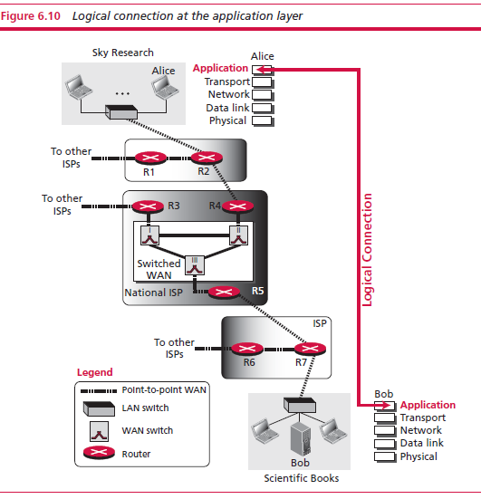
6-2 APPLICATION LAYER
The fifth layer of the TCP/IP protocol is called the application layer; it provides services to the user.
6.<number>

Slide 22
6.2.1 Providing services
The application layer is different from other layers in that it is the highest layer in the suite.
The protocols in this layer do not provide services to any other protocol in the suite; they only receive services from the protocols in the transport layer.
  Note: This means that protocols can be removed from this layer easily. New protocols can be also added to this layer as long as the new protocol can use the service provided by one of the transport-layer protocols.
The flexibility of the application layer allows new application protocols to be easily added to the Internet.
6.<number>

Slide 23
6.2.2 Application-layer paradigms
We have not discussed what the relationship should be between these interacting programs.
Should both application programs be able to request services and provide services, or should the application programs just do one or the other?
Two paradigms have been developed to answer this question:
  the client–server paradigm
  the peer-to-peer paradigm.
6.<number>

Slide 24
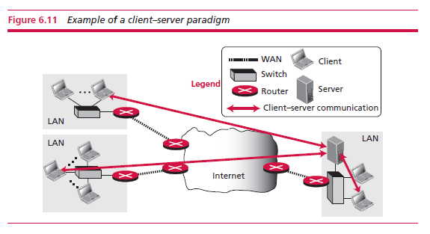
Traditional paradigm: client-server
In this paradigm, the service provider is an application program, called the server process; it runs continuously, waiting for another application program, called the client process, to make a connection through the Internet and ask for service.
Although the communication in the client–server paradigm is between two application programs, the role of each program is different. We cannot run a client program as a server program or vice versa.
6.<number>

Slide 25
Challenges:
  the concentration of the communication load is on the shoulder of the server, which means the server should be a powerful computer.
  even a powerful computer may become overwhelmed if a large number of clients try to connect to the server at the same time.
  need for a service provider willing to accept the cost and create a powerful server for a specific service, which means the service must always return some type of income for the server in order to encourage such an arrangement.
Several services use this paradigm, including the World Wide Web (WWW) and its vehicle HyperText Transfer Protocol (HTTP), file transfer protocol (FTP), secure shell (SSH), email, and so on.
6.<number>

Slide 26
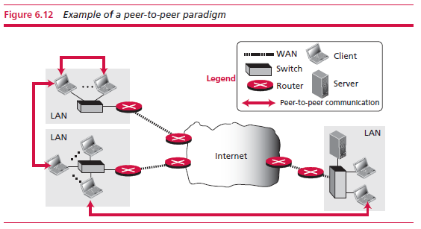
New paradigm: peer-to-peer
Often abbreviated P2P paradigm
No need for a server process to be running all the time and waiting for the client processes to connect. The responsibility is shared between peers.
A computer connected to the Internet can provide service at one time and receive service at another time. A computer can even provide and receive services at the same time.
Perks:
  Easily scalable
  Cost-effective
Challenges:
  Security – secure connections are harder to ensure.
  Applicability – not all applications can use this paradigm / not all users are ready to become
  involved.
6.<number>

Slide 27
6.2.3 Standard client-server applications
World Wide Web and HTTP
World Wide Web
A repository of information in which the documents (Web pages) are distributed over the world and related documents are linked together.
Distribution allows the growth of the Web. Each web server in the world can add a new web page to the repository without overloading servers.
Linking allows one web page to refer to another (even on another server in the world) through hypertext.
Hypertext has been changed to hypermedia, to show that a web page can be a text document, an image, an audio file, or a video file.
The service provided is distributed over many locations called sites holding one or more web page. Each web page, can contain some links to other web pages in the same or other sites.
A web page can be simple or composite. A simple web page has no links to other web pages; a composite web page has one or more links to other web pages. Each web page is a file with a name and address.
6.<number>

Slide 28
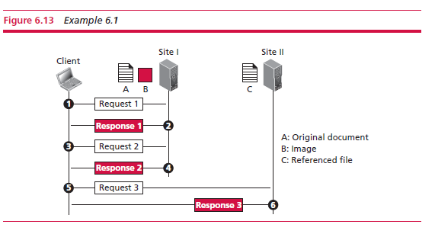
Example 6.1
Assume we need to retrieve a document that contains one reference to another text file and one reference to a large image stored in two separate files in the same site (file A and B); the referenced text file is stored in another site (file C). We need three transactions if we want to see the whole document.
Request/response retrieves a copy of file A, which has references (pointers) to the second and third files.
Retrieve a copy of file B. If needed 3. Click on its reference invoking the third transaction and retrieving a copy of file C.
Note: although files A and B both are stored in site I, they are independent files with different names and addresses. Although references to file B or C are included in file A, it does not mean that each of these files cannot be retrieved independently
6.<number>

Slide 29
Web client (browser)
A variety of vendors offer commercial browsers that interpret and display a web page.
Each browser usually consists of three parts: a controller, client protocols, and interpreters.
  The controller receives input from the keyboard or the mouse and uses the client programs to access the document. After the document has been accessed, the controller uses one of the interpreters to display the document on the screen. The client protocol can be HTTP or FTP. The interpreter can be HyperText Markup Language (HTML), Java, or JavaScript, depending on the type of document.
Some commercial browsers include Internet Explorer, Netscape Navigator, and Firefox.
Web server
The web page is stored at the server. Each time a request arrives, the corresponding document is sent to the client.
6.<number>

Slide 30

Uniform resource locator (URL)
A web page has a unique identifier that distinguishes it from other web pages. To define a web page, we need three identifiers: host, port, and path.
❑ Protocol. The first identifier is the abbreviation for the client–server program that we need in order to access the web page.
❑ Host identifier. The host identifier can be the IP address of the server or the unique name given to the server.
❑ Port number. The port, a 16-bit integer, is normally predefined for the client–server application.
❑ Path. The path identifies the location and the name of the file in the underlying operating system. The format of this identifier normally depends on the operating system
6.<number>

Slide 31
HyperText Transfer Protocol (HTTP)
The HyperText Transfer Protocol (HTTP) is a protocol that is used to define how the client–server programs can be written to retrieve web pages from the Web.
An HTTP client sends a request; an HTTP server returns a response. The server uses the port number 80; the client uses a temporary port number.
6.<number>

Slide 32
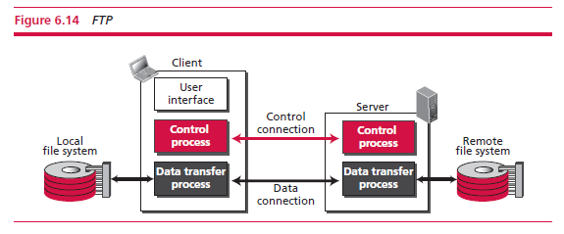
6.2.4 File Transfer Protocol (FTP)
File Transfer Protocol (FTP) is the standard protocol provided by TCP/IP for copying a file from one host to another.
Two systems may use different file name conventions/have different ways to represent data/have different directory structures. All of these problems have been solved by FTP.
Separation of commands and data transfer makes FTP more efficient.
The data connection, on the other hand, needs more complex rules due to the variety of data types transferred.
6.<number>

Slide 33
Lifetimes of two connections
The two connections in FTP have different lifetimes.
The control connection remains connected during the entire interactive FTP session.
The data connection is opened and then closed for each file transfer activity. It opens each time commands that involve transferring files are used, and it closes when the file is transferred.
6.<number>

Slide 34
6.2.5 Electronic mail
Electronic mail (or email) allows users to exchange messages.
This application is different. In an application such as HTTP or FTP, the server program is running all the time, waiting for a request from a client. In the case of electronic mail, the situation is different.
  Email is considered a one-way transaction.
  Client/server programming needs to be implemented using some intermediate computers (servers).
The users run only client programs when they want, and the intermediate servers apply the client/server paradigm.
6.<number>

Slide 35
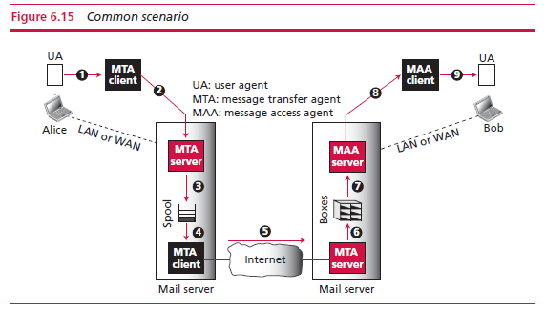
Architecture
An email takes nine different steps, using three different agents: a user agent (UA), a Mail Transfer Agent (MTA), and a Message Access Agent (MAA).
6.<number>

Slide 36
6.2.6 TELNET
It is impossible to have a client/server pair for each type of service we need.
A solution is to have a specific client/server program for a set of common scenarios, but to have some generic client/server programs that allow a user on the client site to log into the computer at the server site and use the services available there.
We can use a client logging program to log into a server and use a compiler program. We refer to these generic client/server pairs as remote login applications.
One of the original remote logging protocols is TELNET, which is an abbreviation for TErminaL NETwork.
TELNET requires a logging name and password, but it is vulnerable to hacking because it sends all data including the password in plaintext (not encrypted). A hacker can eavesdrop and obtain the logging name and password.
6.<number>

Slide 37
6.2.7 Secure Shell (SSH)
Secure Shell (SSH) is a secure application program that can be used today for several purposes such as remote logging and file transfer.
It was originally designed to replace TELNET.
There are two versions of SSH: SSH-1 and SSH-2, which are totally incompatible.
The first version, SSH-1, is now deprecated because of security flaws in it. The current version is called SSH-2.
6.<number>

Slide 38
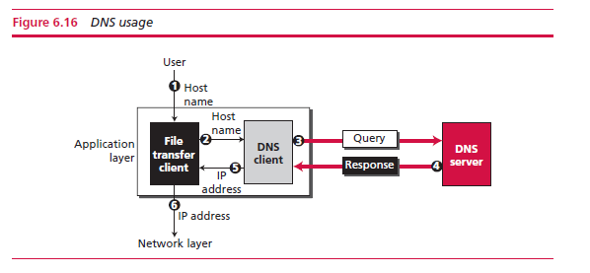
6.2.8 Domain Name System
To identify an entity, TCP/IP protocols use the IP address, which uniquely identifies the connection of a host to the Internet.
The Internet has a directory system that can map a name to an address.
Since the Internet is so huge today, a central directory system cannot hold all the mapping. In addition, if the central computer fails, the whole communication network will collapse.
A better solution is to distribute the information among many computers in the world. In this method, the host that needs mapping can contact the closest computer holding the needed information.
6.<number>

Slide 39
The following six steps map the host name to an IP address:
  1. The user passes the host name to the file transfer client.
  2. The file transfer client passes the host name to the DNS client.
  3. Each computer, after being booted, knows the address of one DNS server. The DNS client sends a message to a DNS server with a query that gives the file transfer server name using the known IP address of the DNS server.
  4. The DNS server responds with the IP address of the desired file transfer server.
  5. The DNS client passes the IP address to the file transfer server.
  6. The file transfer client now uses the received IP address to access the file transfer server.
6.<number>

Slide 40
Name space
The names assigned to machines must be carefully selected from a name space with complete control over the binding between the names and IP addresses.
A name space can map each address to a unique name and is normally organized hierarchically.
In a hierarchical name space, each name is made of several parts. The first part can define the nature of the organization, the second part can define the name of an organization, the third part can define departments in the organization, and so on.
In this case, the authority to assign and control the name spaces can be decentralized. A central authority can assign the part of the name that defines the nature of the organization and the name of the organization.
6.<number>

Slide 41
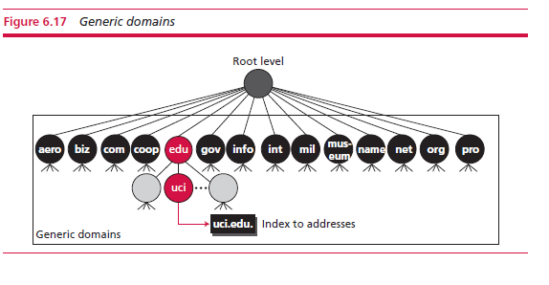
DNS in the internet
DNS is a protocol that can be used in different platforms. In the Internet, the domain name space (tree) was originally divided into three different sections: generic domains, country domains, and the inverse domain.
Generic domains
Define registered hosts according
to their generic behaviour.
Each node in the tree defines a
domain, which is an index to the
domain name space database
6.<number>

Slide 42
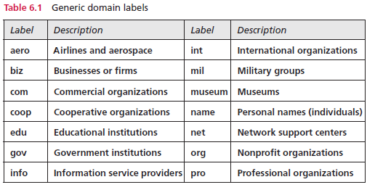
6.<number>

Slide 43
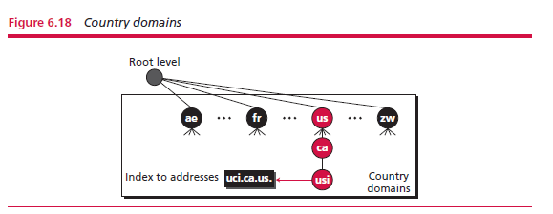
Country domains
The country domains section uses two-character country abbreviations (e.g., us for United States). Second labels can be organizational, or they can be more specific, national designations.
6.<number>

Slide 44
6.2.9 Peer-to-peer paradigm
Internet users that are ready to share their resources become peers and form a network.
When a peer in the network has a file (for example, an audio or video file) to share, it makes it available to the rest of the peers. An interested peer can connect itself to the computer where the file is stored and download it. After a peer downloads a file, it can make it available for other peers to download. As more peers join and download that file, more copies of the file become available to the group.
6.<number>

Slide 45
Centralized networks
In a centralized P2P network, the directory system listing of the peers and what they offer uses the client–server paradigm, but the storing and downloading of the files are done using the peer-to-peer paradigm.
A centralized P2P network is sometimes referred to as a hybrid P2P network.
Centralized networks make the maintenance of the directory simple but have several drawbacks.
  Accessing the directory can generate huge traffic and slow down the system.
  The central servers are vulnerable to attack, and if all of them fail, the whole system goes down.
Example: The central component of the system was ultimately responsible for Napster’s losing the copyright lawsuit and its closure in July 2001.
6.<number>

Slide 46
Decentralized networks
Peers arrange themselves into an overlay network, which is a logical network made on top of the physical network.
A decentralized P2P network is classified as either unstructured or structured.
  In an unstructured P2P network, the nodes are linked randomly. A search in an unstructured P2P is not very efficient because a query to find a file must be flooded through the network, which produces significant traffic and still the query may not be resolved.
  A structured network uses a predefined set of rules to link nodes so that a query can be effectively and efficiently resolved. The most common technique used for this purpose is the Distributed Hash Table (DHT). DHT is used in many applications including Distributed Data Structure (DDS), Content Distributed Systems (CDS), Domain Name System (DNS), and P2P file sharing.
  One popular P2P file sharing protocol that uses the DHT is BitTorrent.
6.<number>

Slide 47
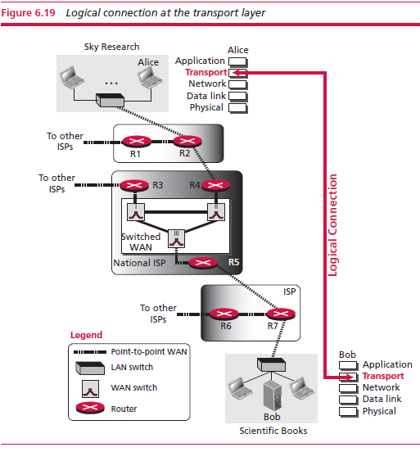
6-3 TRANSPORT LAYER
The transport layer in the TCP/IP suite is located between the application layer and the network layer. It provides services to the application layer and receives services from the network layer. The transport layer acts as a liaison between a client program and a server program, a process-to-process connection. The transport layer is the heart of the TCP/IP protocol suite; it is the end-to-end logical vehicle for transferring data from one point to another in the Internet
6.<number>

Slide 48
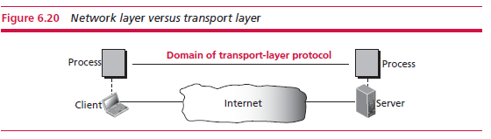
6.3.1 Transport-layer services
Process-to-process communication
The first duty of a transport-layer protocol is to provide process-to-process communication.
A process is an application-layer entity (running program) that uses the services of the transport layer.
The network layer is responsible for communication at the computer level (host-to-host communication). A network-layer protocol can deliver the message only to the destination computer. However, this is an incomplete delivery. The message still needs to be handed to the correct process. This is where a transport-layer protocol takes over. A transport-layer protocol is responsible for delivery of the message to the appropriate process.
6.<number>

Slide 49
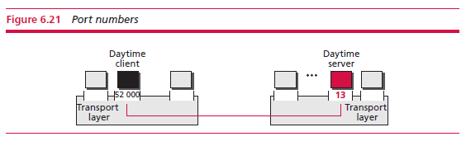
Addressing: port numbers
For communication, we must define the local host, local process, remote host, and remote process. The local host and the remote host are defined using IP addresses (discussed in the next section). To define the processes, we need second identifiers, called port numbers.
In the TCP/IP protocol suite, the port numbers are integers between 0 and 65 535 (16 bits).
The client program defines itself with a port number, called the ephemeral port number.
TCP/IP has decided to use universal port numbers for servers; well-known port numbers. Every client process knows the well-known port number of the corresponding server process.
6.<number>

Slide 50
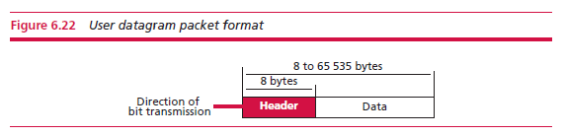
6.3.2 Transport-layer protocols
User Datagram Protocol (UDP)
The User Datagram Protocol (UDP) is a connectionless, unreliable transport protocol. It does not add anything to the services of network layer except for providing process-to-process communication instead of host-to-host communication.
Sending a small message using UDP takes less interaction between the sender and receiver than using TCP.
User datagrams
UDP packets, called user datagrams, have a fixed-size header of 8 bytes.
The total length needs to be less because a UDP user datagram is stored in an IP datagram with the total length of 65 535 bytes.
6.<number>

Slide 51
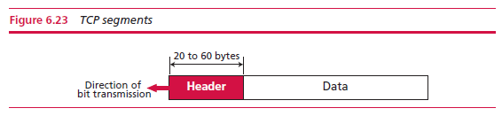
Transmission Control Protocol (TCP)
Transmission Control Protocol (TCP) is a connection-oriented, reliable protocol. TCP explicitly defines connection establishment, data transfer, and connection teardown phases to provide a connection-oriented service.
TCP uses sequence numbers to define the order of the segments. The sequence number is related to the number of bytes in each segment.
If a segment is lost, the receiver holds the other two until the lost one is reset by the sender.
Segments
At the transport layer, TCP groups a number of bytes together into a packet called a segment.
TCP adds a header to each segment (for control purposes) and delivers the segment to the network layer for transmission.
6.<number>

Slide 52
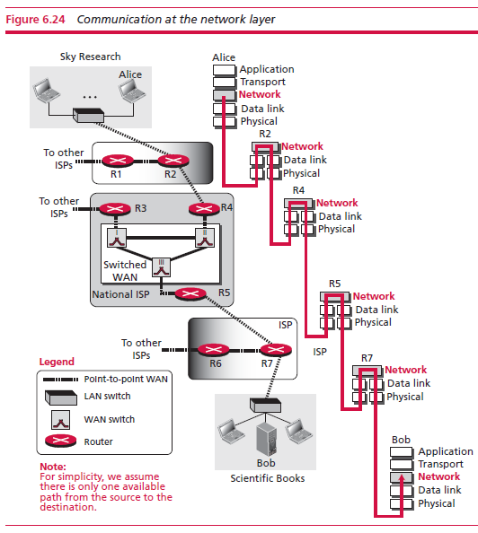
6-4 NETWORK LAYER
The network layer in the TCP/IP protocol suite is responsible for the host-to-host delivery of messages.
6.<number>

Slide 53
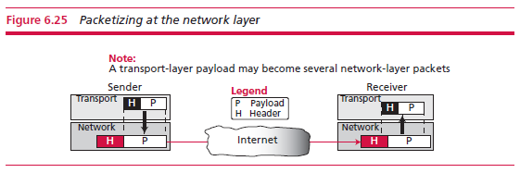
6.4.1 Services Provided by network layer
Packetizing
Packetizing: encapsulating the payload (data received from the upper layer) in a network-layer packet at the source and decapsulating the payload from the network-layer packet at the destination.
1. The source network-layer protocol receives a packet from the transport-layer protocol, adds a header that contains the source and destination addresses and other information required by the network-layer protocol.
2. The network layer protocol then logically delivers the packet to the network-layer protocol at the destination.
3. The destination host receives the network-layer packet, decapsulates the payload and delivers to the upper-layer protocol.
6.<number>

Slide 54
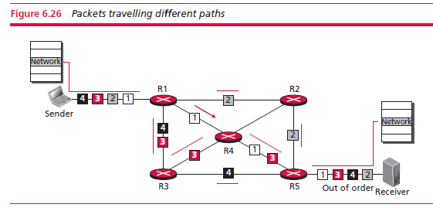
Packet delivery
Unreliable delivery
The delivery of packets at the network layer is unreliable.
They can be corrupted, lost, duplicated, etc.
Connectionless delivery
Means that the network layers treats each packet independently.
There is no relationship between packets in the same transport-layer payload, so hey may take different paths and arrive in a different order than sent.
6.<number>

Slide 55
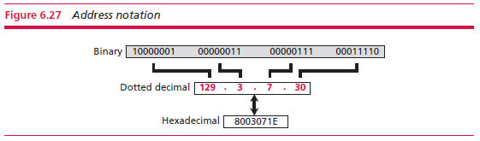
6.4.2 Network-layer protocols
Internet protocol version 4 (IPv4)
IPv4 addressing
The identifier used in the IPv4 layer of the TCP/IP protocol suite to identify the connection of each device to the Internet is called the Internet address or IP address.
An IPv4 address is a 32-bit address that uniquely and universally defines the connection of a host or a router to the Internet.
IPv4 addresses are universal in the sense that the addressing system must be accepted by any host that wants to be connected to the Internet.
There are three common notations to show an IPv4 address: binary notation (base 2), dotted-decimal notation (base 256), and hexadecimal notation (base 16).
6.<number>

Slide 56
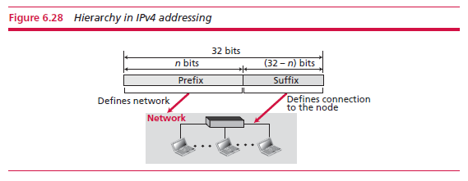
32-bit IPv4 address is also hierarchical, but divided only into two parts. The first part of the address, called the prefix, defines the network; the second part of the address, called the suffix, defines the node (connection of a device to the Internet).
6.<number>

Slide 57
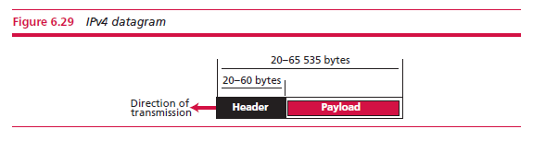
IPv4 datagram
Packets used by the IP are called datagrams.
A datagram is a variable-length packet consisting of two parts: header and payload (data).
The header is 20 to 60 bytes in length and contains information essential to routing and delivery.
6.<number>

Slide 58
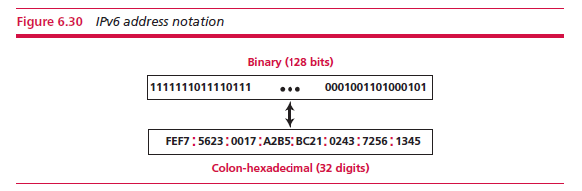
Internet protocol version 6 (IPv6)
IPv6 addressing
To prevent address depletion, IPv6 uses 128 bits to define any device connected to the Internet.
An address is represented as either binary or colon-hexadecimal form. The first form is used to store an address in the computer; the second form is used by humans.
6.<number>

Slide 59
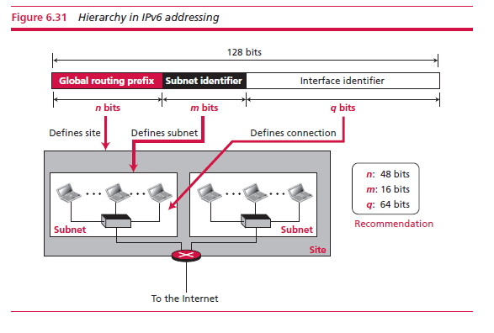
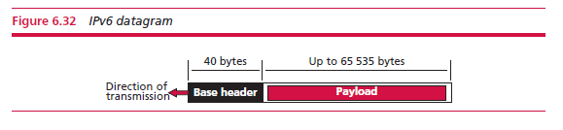
The address in IPv6 actually defines three levels of hierarchy: site (organization), subnetwork, and connection
IPv6 datagram
6.<number>

Slide 60
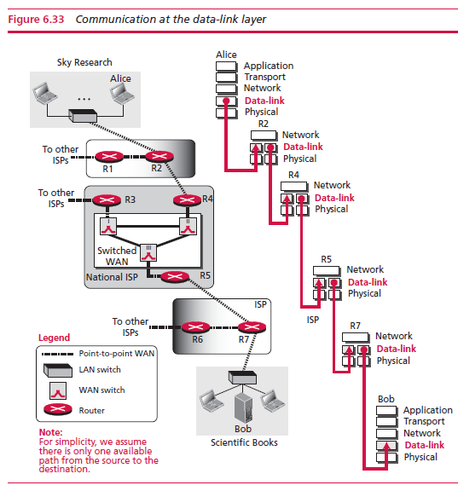
6-5 DATA-LINK LAYER
This layer is the territory of networks that when connected make up the Internet.
These networks, wired or wireless, receive services and provide services to the network layer.
6.<number>

Slide 61
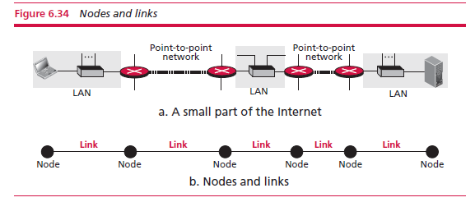
6.5.1 Nodes and links
Although communication at the application, transport, and network layers is end-to-end, communication at the data-link layer is node-to-node. Data units from one point in the Internet need to pass through many networks (LANs and WANs) to reach another point.
These LANs and WANs are connected by routers. It is customary to refer to the two end hosts and the routers as nodes and the networks in between as links.
6.<number>

Slide 62
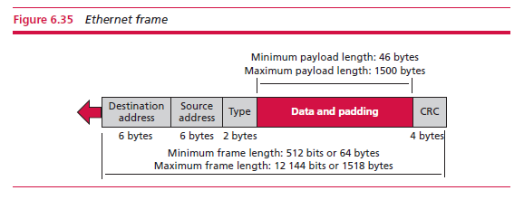
6.5.2 Local area networks (LANs)
Wired LANs: Ethernet
Standard Ethernet
We refer to the original Ethernet technology with the data rate of 10 Mbps as the Standard Ethernet. The data rate in this case defines the speed in which data can be sent out of the station to the LAN.
A group of bits are packaged together and are referred to as a frame. A frame does not carry only data from the sender to the destination. It
6.<number>

Slide 63
Fast Ethernet (100Mbps)
Transmission rate of 100Mbps
Most of the protocol remained unchanged to be compatible with the Standard Ethernet.
Gigabit Ethernet
Transmission rate of 1,000Mbps
Kept the address length, the frame format, and the maximum and minimum frame length the same.
10-Gigabit Ethernet
The idea is to extend the technology, the data rate, and the coverage distance so that the Ethernet can be used as LAN and MAN (metropolitan area network).
The goals of the 10-Gigabit Ethernet design can be summarized as upgrading the data rate to 10 Gbps, keeping the same frame size and format, and allowing the interconnection of LANs, MANs, and WAN possible.
This data rate is possible only with fibre-optic technology at this time.
6.<number>

Slide 64
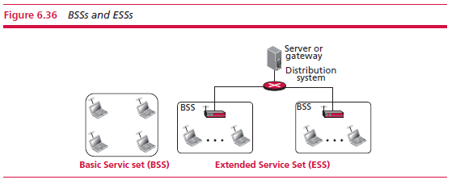
Wireless LANs
Wireless Ethernet (WiFi)
A wireless LAN that is certified by the WiFi Alliance, a global, non-profit industry association of more than 300 member companies.
The standard defines two kinds of services: the basic service set (BSS) and the extended service set (ESS). The second service uses an extra device (access point or AP) that serves as a switch for connection to other LANs or WANs.
6.<number>

Slide 65
Bluetooth
Bluetooth is a wireless LAN technology designed to connect devices of different functions such as telephones, notebooks, computer, etc. when they are at a short distance from each other.
A Bluetooth LAN is an ad hoc network, which means that the network is formed spontaneously; the devices find each other and make a network called a piconet.
A Bluetooth LAN can even be connected to the Internet.
A Bluetooth LAN, by nature, cannot be large.
6.<number>

Slide 66
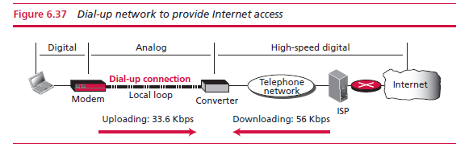
6.5.3 Wide area networks (WANs)
Wired WANs
Point-to-point wireless WANs
Dial-up service
A dial-up network or connection uses the services provided by the telephone networks to transmit data frame does not carry only data from the sender to the destination.
The need to communicate digital data resulted in the invention of the dial-up modem.
6.<number>

Slide 67
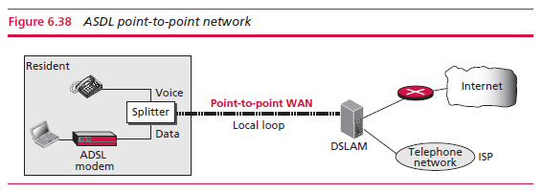
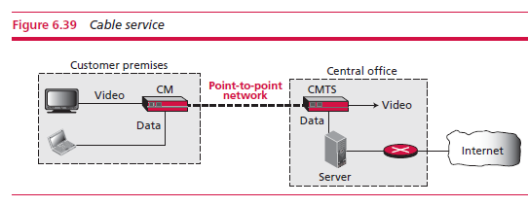
Digital subscriber line (DSL)
DSL technology is a set of technologies, each differing in the first letter (ADSL, VDSL, HDSL, and SDSL).
ADSL provides higher speed (bit rate) in the downstream direction (from the Internet to the resident) than in the upstream direction (from the resident to the Internet)
Cable network
Cable companies compete with telephone companies for customers who want high-speed data transfer.
DSL uses the existing unshielded twisted-pair cable, which is very susceptible to interference. This imposes an
upper limit on the data rate.
6.<number>

Slide 68
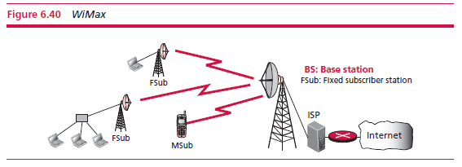
Wireless WANs
WiMax
The Worldwide
Interoperability Access
(WiMax) is the wireless
version of DSL or Cable
connection to the Internet.
It provides two types of services (fixed WiMax) to connect the main station to fixed station or to mobile stations such as cellular phones.
Cellular telephony network
The mobile stations communicate with the fixed antenna in the cell that they are inside at each moment. When the user moves to another cell, the communication is between the mobile device and the new antenna.
Satellite networks
A satellite network is a combination of nodes, some of which are satellites, that provides communication from one point on the Earth to another.
6.<number>

Slide 69
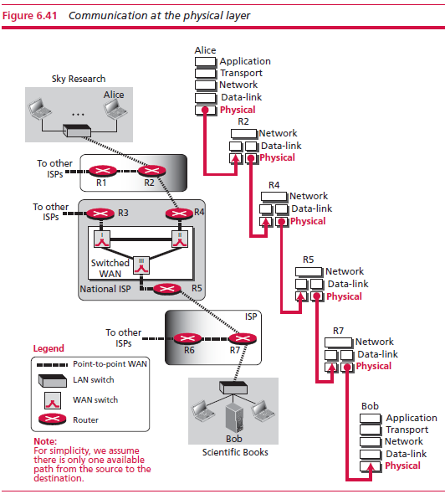
6-6 PHYSICAL LAYER
6.<number>

Slide 70
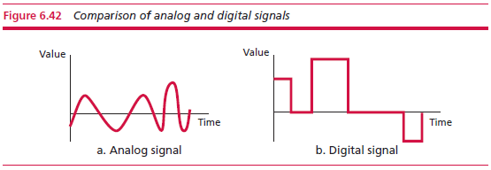
6.6.1 Data and signals
Major function: to route bits between nodes by converting these bits into electromagnetic signals
Analog and Digital
Analog data refers to information that is continuous. Analog data, such as the sounds made by a human voice, take on continuous values.
Digital data take on discrete values.
Signals can be either analog or digital. An analog signal has infinitely many levels of intensity over a period of time. A digital signal can have only a limited number of defined values.
6.<number>

Slide 71
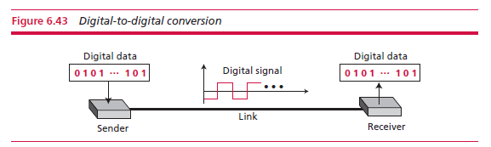
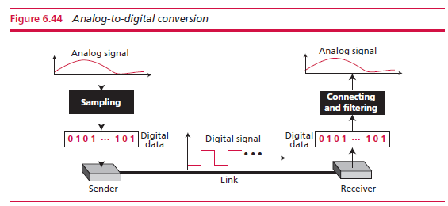
6.6.2 Digital transmission
Digital-to-digital conversion
Analog-to-digital conversion
6.<number>

Slide 72
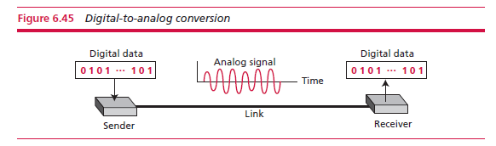
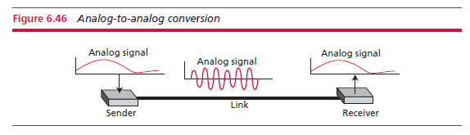
6.6.3 Analog transmission
Digital-to-analog conversion
Analog-to-analog conversion
6.<number>

Slide 73
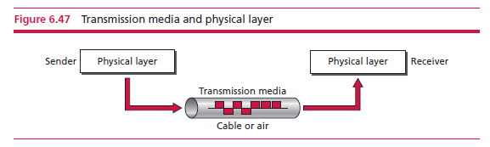
6-7 Transmission Media
Transmission media are actually located below the physical layer and are directly controlled by the physical layer. We could say that transmission media belong to layer zero.
A transmission medium can be broadly defined as anything that can carry information from a source to a destination.
6.<number>

Slide 74
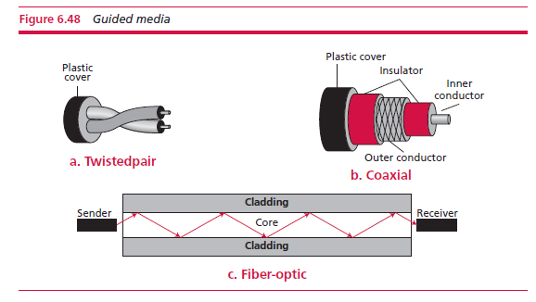
6.7.1 Guided media
Twisted-pair cable
A twisted-pair consists of two conductors (normally copper), each with plastic insulation, twisted together. One carries signals to the receiver, and the other is used only as a ground reference. The receiver uses the difference between the two.
Fibre-optic cable
Coaxial cable
Made of glass or plastic and transmits signals in the form of light. This
technology uses the property of a beam of light that is refracted when it
encounters a medium of less density. Fibre-optic cable is often found in backbone networks because its wide bandwidth is
cost-effective.
A central core conductor of solid or stranded wire (usually copper) in an insulating sheath, also encased in a conductor. The wrapping serves both as a shield against noise and as second conductor, which completes the circuit. This outer conductor protected by a plastic cover.
6.<number>

Slide 75
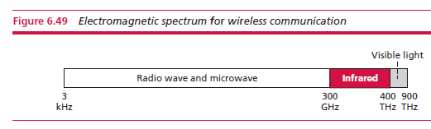
6.7.1 Unguided media: wireless
Radio waves
Electromagnetic waves ranging in frequencies between 3 kHz and 1 GHz are normally called radio waves. They are used mostly for radio communication.
Microwaves
Infrared
Electromagnetic waves having frequencies between 1 and 300 GHz are called microwaves.
Microwaves are unidirectional. When an antenna transmits microwaves, they can
be narrowly focused.
Infrared waves, with frequencies from 300 GHz to 400 THz (wavelengths from 1 mm
to 770 nm), can be used for short-range communication. Infrared waves cannot penetrate walls. This prevents interference.
This same characteristic makes infrared signals useless for long-range communication. Infrared waves cannot be used outdoors as the sun’s waves can interfere with the communication.
6.<number>

