Slide 1
Session 6
Chapter 3 - Design theory for Relational Database - FDs
Database Systems

Slide 2
Objectives
1
Understand what are functional dependencies
2
Understand the rules about FDs
3
3
Understand what are keys, super-keys
4
Understand what are closure-sets and how to determine them
5
Understand what are closing sets of FD’s and how to determine them
6
Understand what is projecting FD’s

Slide 3
Contents
1
Functional Dependencies
2
Rules about FDs
3
Key & Super-Key
4
Closure-sets and Algorithm for calculating the closure-set of a relation
5
Closing set of FD’s
6
Projecting FD’s

Slide 4
1. Functional Dependency Definition
A functional dependency (FD) is a constraint between two sets of attributes in a Relation from a database
Given a relation R, a set of attributes X in R is said to functionally determine another set of attributes Y, also in R, (written X → Y) if and only if each X value is associated with precisely one Y value
Customarily we call X the determinant set and Y the dependent attribute
A functional dependency FD: is called trivial if Y is a subset of X

Slide 5
1. Functional Dependency Definition
A Functional Dependency (FD) X → Y on a relation R is a statement of the form:
“If 2 tuples of R agree on attribute X, then they must also agree on Y”
X → Y ⇔ (t₁(X) = t₂(X) ⇒ t₁(Y) = t₂(Y))

Slide 6

Example: Functional Dependency
Easy to see that: the following FD is true
(title, year) → (length, genre, studioName)
Exercise: How about this FD (TRUE or FALSE)?
(title, year) → (starName)

Slide 7
2. Rules about functional dependencies
Given that X, Y, and Z are sets of attributes in a relation R, one can derive several properties of functional dependencies. Among the most important are Armstrong’s axiom, which are used in database normalization:
Subset Property (Axiom of Reflexivity):
If Y is a subset of X, then X → Y
Augmentation (Axiom of Augmentation): If X → Y, then XZ → YZ
Transitivity (Axiom of Transitivity): If X → Y and Y → Z, then X → Z
From these rules, we can derive these secondary rules:
Union: If X → Y and X → Z, then X → YZ
Decomposition: If X → YZ, then X → Y and X → Z
Pseudo transitivity: If X → Y and YZ → W, then XZ → W
Accumulation: If X → YZ and Z → V, then X → YZV
Extension: If X → Y and W → Z, then WX → YZ

Slide 8
Find functional dependencies
Course | Roll# | Name | Comments
DB | 00511 | Nguyen Van A | Good
DB | 00139 | Nguyen Van C | Good
DB | 00981 | Tran Van X | Bad

Slide 9
Find functional dependencies
Date | Slot | StartTime | EndTime | Class | Subject
21/10/2018 | 1 | 7:00 | 8:30 | SE1023 | Database
21/10/2018 | 2 | 8:45 | 10:15 | SE1022 | Database
21/10/2018 | 3 | 10:30 | 12:00 | SE1016 | Database

Slide 10
Find functional dependencies
Date | Slot | Room | Teacher# | Teacher Name
1/1/2011 | 1 | 133 | 00788 | Thutv
1/2/2011 | 1 | 135 | 00788 | Thutv
3/1/2011 | 1 | 129 | 00788 | Thutv

Slide 11
3. Keys
A set of one or more attributes {A₁, A₂, .., A_{n}} is called a key of the relation R if:
1. Those attributes functionally determine all other attributes of R.
This means that: It is impossible for 2 tuples of R to agree on all of {A₁, A₂, .., A_{n}}
2. No proper subset of {A₁, A₂, .., A_{n}} functionally determines all other attributes of R
This means that: A Key must be minimal

Slide 12
Example: Keys
Exercise 1:
(title, year) forms a key?
Exercise 2:
(title, year, starName) forms a key ?

Slide 13
3. Super-keys
A set of attributes that contains a key is called a Super-key, short for “superset of a key”
Every key is a superkey
A superkey is a set of attributes of a relation whose values can be used to uniquely identify a row
A superkey need not satisfy the second condition of a key: minimality

Slide 14
Example: Super-key
There are many Super-key in the above schema:
(title, year, starName)
(title, year, starName, length, studioName)
Exercise: Can (title, year, starName, length, studioName) form a key?

Slide 15
An efficient algorithm to finding KEYS for a relation
Suppose L contains those attributes that occur only on the left-hand side of FDs
Suppose R contains those attributes that occur only on the right-hand side of FDs
Suppose M contains those attributes that occur on both side of FDs
Note:
  L Intersects M = EMPTY
  M Intersects R = EMPTY
  L Intersects R = EMPTY

Slide 16
Some LEMAs
Lemma 1: for every attribute A, if A is in L then A must be part of every key
Lemma 2: if L+ is super-key then L is the only key
Lemma 3: for every attribute A, if A is in R then A will not be part of any key
Conclusion: we only focus only on L and M to find all keys

Slide 17
Exercises
R (A, B, C, D)
S = {BC→D, D→A, A→B}
What are all the keys of R?
What are all the super-keys for R that are not keys?

Slide 18
Exercises
R (A, B, C, D)
S = {AD→B, AB→C, BC→D, CD→A}
What are all the keys of R?
  {A,B,C}, {B,C,D}, {A,C,D}, {A,B,D}
What are all the super-keys for R that are not keys?
  {A,B,C,D}

Slide 19
Exercise
People(name, Social Security number, street address, city, state, ZIP code, area code, phone)
  What FD’s would you expect to hold?
  What are the keys for the relation

Slide 20
4. Closure sets
Suppose: {A1,…, An} is a set of attributes. And S is a set of FD’s.
1) The closure of {A1,…, An} under the FD’s in S is the set of attributes B such that: Every relation that satisfies all the FD’s in set S also satisfies: {A1,..,An}→B
This means that: {A1,..,An}→B follows from the FD’s of S
Closure of a set of attributes {A1, ..., An} is denoted {A1, A2, ..., An}+
2) Closure of a set of FD’s S is the set of functional dependencies Q that includes all FDs are derived from S by Amstrong rules.

Slide 21
Example: Closure Set
R (A, B, C, D, E, F)
S = {A → C, A → D, D → E,
E → F}
Easy to see that:
{A}+ = {A, C, D, E, F}

Slide 22
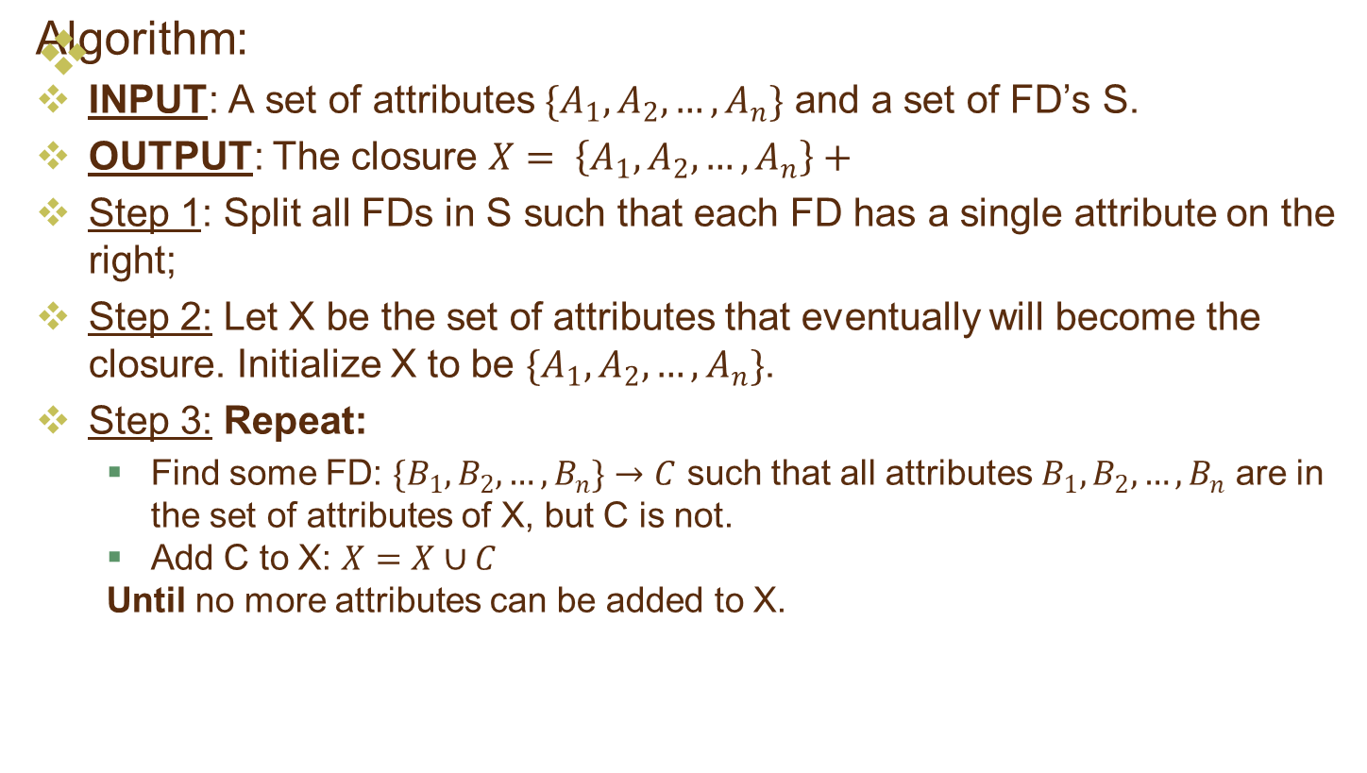
5. Closure set algorithm

Slide 23
Example for finding closure set
Let's consider an example to demonstrate the concept of closure.
Suppose we have a set of functional dependencies as follows:
A → B
BC → D
D → E
We want to find the closure of the set of attributes {A, C}.
Start with the given set of attributes: {A, C}.
Check the functional dependencies:
  From A → B, we can add B to the set of attributes: {A, C, B}.
  From BC → D, we cannot add any new attribute since BC is not a subset of {A, C, B}.
  From D → E, we cannot add any new attribute since D is not a subset of {A, C, B}.
No new attributes can be added to the set.
The closure of {A, C} is {A, C, B}.
Therefore, the closure of {A, C} is {A, C, B}.

Slide 24
Exercises
R (A, B, C, D, E, F)
S = {AB → C, BC → AD, D → E,
CF → B}
compute {AB}+

Slide 25
6. Closing sets of FD’s
Given a set of FD’s S, any set of FD’s equivalent to S is said to be a basis for S
A minimal basic (or closing sets) of FD’s for a relation is a set of functional dependencies B that satisfies three conditions:
  All the FD’s in B have single attribute on right sides.
  If any FD is removed from B, the result is no longer the basis.
  If for any FD in B we remove one or more attributes from the left side, the result is no longer a basis.

Slide 26
Projecting FD’s
Suppose we have R with set of FD’s S, and we project R by computing R1 = Π_{L}(R) for some list of attributes R. What FD’s hold in R1?
Projection of FD’s S includes all FD’s that:
  Follow from S, and
  Involve only attributes of R1.

Slide 27
Algorithm for projecting a set of FD’s
Input: Relation R, FD’s S that hold in R. Relation R₁ = Π_{L}(R)
Output: The set of FD’s that hold in R1.
Method:
  Initially, T is empty
  ∀ X ⊂ R_{1,} compute X⁺ based on S. Add to T all non trivial FD’s X → A such that A is both in X⁺ and R₁
  Now T is a basic for the FD’s that hold in R1. We must construct a minimal basis of T.

Slide 28
Example
R(A,B,C,D) and FD’s:
A → B, B → C, C → D
Project the set of FD in R₁(A,C,D)
Kết quả: A → C, C → D, A → D

Slide 29
Tóm tắt nội dung chính
Functional Dependencies( FD)
Key
Closure set
Closing set of FD

Slide 30
Thank You !

