Slide 1
Memory Management
Chapter 3
4.1 Basic memory management
4.2 Swapping
4.3 Virtual memory
4.4 Design issues for paging systems
4.5 Implementation issues
4.6 Segmentation

Slide 2
Memory Management

Slide 3
Memory Management
Ideally programmers want memory that is
  large
  fast
  non volatile
Memory hierarchy
  small amount of fast, expensive memory – cache
  some medium-speed, medium price main memory
  gigabytes of slow, cheap disk storage
Memory manager handles the memory hierarchy

Slide 4
Basic Memory Management
Logical vs. Physical Address Space
The concept of a logical address space that is bound to a separate physical address space is central to proper memory management
  Logical address – generated by the CPU; also referred to as virtual address
  Physical address – address seen by the memory unit

Slide 5

Basic Memory Management
Monoprogramming without Swapping or Paging
Three simple ways of organizing memory
- an operating system with one user process

Slide 6
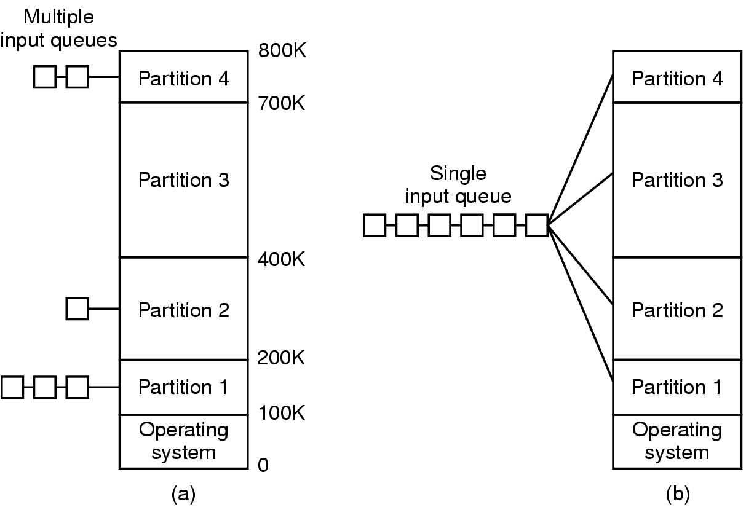
Basic Memory Management
Multiprogramming with Fixed Partitions
Fixed memory partitions
  (a) separate input queues for each partition
  (b) single input queue

Slide 7

Basic Memory Management
Dynamic relocation using a relocation register

Slide 8
Basic Memory Management
Relocation and Protection
Cannot be sure where program will be loaded in memory
  address locations of variables, code routines cannot be absolute
  must keep a program out of other processes’ partitions
Use base and limit values
  address locations added to base value to map to physical addr
  address locations larger than limit value is an error

Slide 9
Basic Memory Management
Relocation and Protection
Relocation registers used to protect user processes from each other, and from changing operating-system code and data
  Base register contains value of smallest physical address
  Limit register contains range of logical addresses – each logical address must be less than the limit register
  MMU maps logical address dynamically

Slide 10

Basic Memory Management
HW address protection with base and limit registers

Slide 11

Swapping (1)
Schematic View of Swapping

Slide 12

Swapping (2)
Memory allocation changes as
  processes come into memory
  leave memory
Shaded regions are unused memory
External Fragmentation – total memory space exists to satisfy a request, but it is not contiguous
Internal Fragmentation – allocated memory may be slightly larger than requested memory; this size difference is memory internal to a partition, but not being used

Slide 13

Swapping (3)
(a) Allocating space for growing data segment
(b) Allocating space for growing stack & data segment

Slide 14
Swapping (4)
Multiple-partition allocation
Multiple-partition allocation
  Hole – block of available memory; holes of various size are scattered throughout memory
  When a process arrives, it is allocated memory from a hole large enough to accommodate it
  Operating system maintains information about:
  a) allocated partitions b) free partitions (hole)
  There are two ways to keep track of memory usages
    Memory Management with Bit Maps
    Memory Management with Linked Lists

Slide 15

Swapping (4)
Multiple-partition allocation
Memory Management with Bit Maps
(a) Part of memory with 5 processes, 3 holes
  tick marks show allocation units
  shaded regions are free
(b) Corresponding bit map
(c) Same information as a list

Slide 16
Swapping (5)
Dynamic Storage-Allocation Problem
How to satisfy a request of size n from a list of free holes
First-fit: Allocate the first hole that is big enough
Next fit: Start seaching the list from the place where it left off last time
Best-fit: Allocate the smallest hole that is big enough; must search entire list, unless ordered by size
  Produces the smallest leftover hole
Worst-fit: Allocate the largest hole; must also search entire list
  Produces the largest leftover hole
First-fit and best-fit better than worst-fit in terms of speed and storage utilization

Slide 17
Xem PC của chúng ta: (CPU) Cache, Ram, HDD: capacity, price.
List 4 Operating systems in PC environments
  Market shares? Which one having the maximum market share value?
  Reasons to make that one become the best one?
List 4 Operating systems in Smart Phone environments
  The same questions as above ones.

Slide 18
Virtual Memory
Paging

Slide 19
Virtual Memory
Virtual memory – separation of user logical memory from physical memory.
  Only part of the program needs to be in memory for execution
  Logical address space can therefore be much larger than physical address space
  Allows address spaces to be shared by several processes
  Allows for more efficient process creation
Virtual memory can be implemented via:
  Demand paging
  Demand segmentation

Slide 20
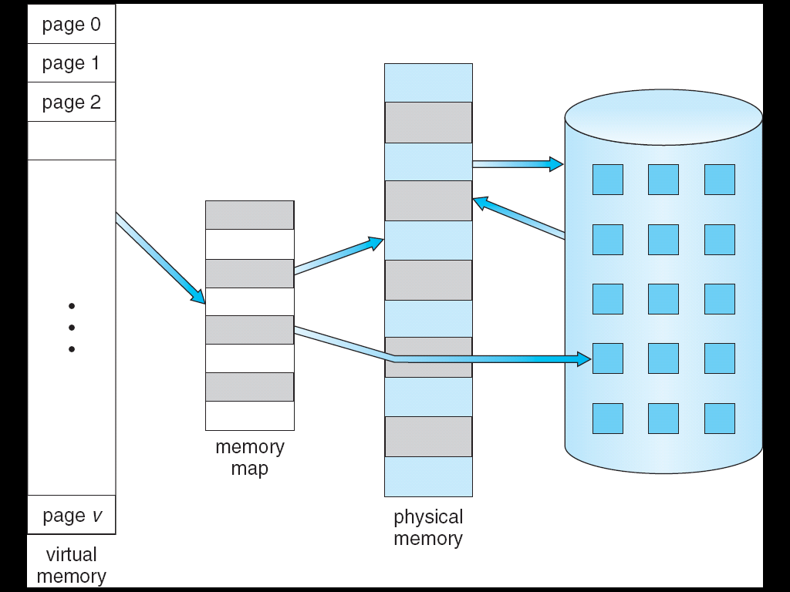
Virtual Memory
Paging
⇒

Slide 21

Virtual Memory
Paging
The position and function of the MMU

Slide 22
Virtual Memory
Paging
Virtual address space of a process can be noncontiguous; process is allocated physical memory whenever the latter is available
Divide physical memory into fixed-sized blocks called Page frames (size is power of 2, between 512 bytes and 8,192 bytes)
Divide logical memory into blocks of same size called pages
Keep track of all free frames
To run a program of size n pages, need to find n free frames and load program
Set up a page table to translate logical to physical addresses
Internal fragmentation

Slide 23
Virtual Memory
Address Translation Scheme
Address generated by CPU is divided into:
  Page number (p) – used as an index into a page table which contains base address of each page in physical memory
  Page offset (d) – combined with base address to define the physical memory address that is sent to the memory unit
  For given logical address space 2^{m} and page size 2^{n}
page number
page offset
p
d
m - n
n

Slide 24

Virtual Memory
Paging Hardware

Slide 25
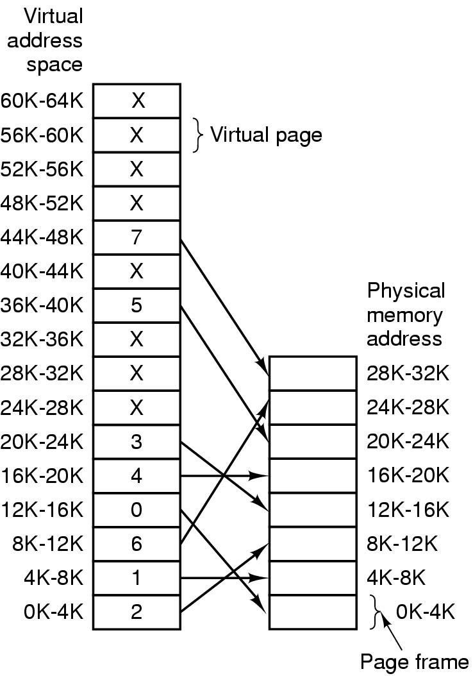
Virtual Memory
Paging: Example
The relation between
virtual addresses
and physical
memory addres-
ses given by
page table

Slide 26

Virtual Memory
Page Tables: Example
Internal operation of MMU with 16 4 KB pages

Slide 27
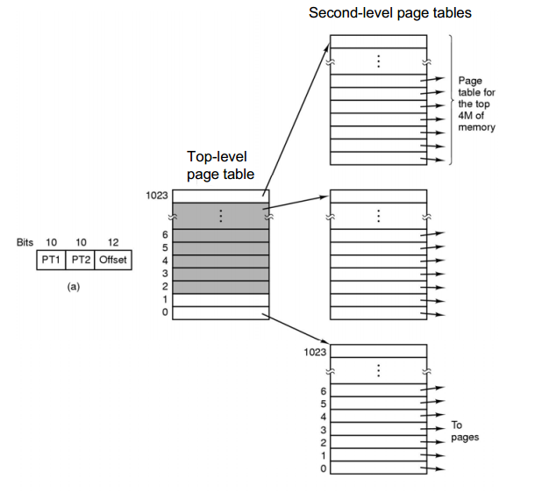
Virtual Memory
Two-level page tables
32 bit address with 2 page table fields
Two-level page tables

Slide 28

Virtual Memory
Typical page table entry
Typical page table entry

Slide 29
Virtual Memory
Implementation of Page Table
Page table is kept in main memory
Page-table base register (PTBR) points to the page table
Page-table length register (PRLR) indicates size of the page table
In this scheme every data/instruction access requires two memory accesses. One for the page table and one for the data/instruction.
The two memory access problem can be solved by the use of a special fast-lookup hardware cache called associative memory or translation look-aside buffers (TLBs)

Slide 30

Virtual Memory
Paging Hardware With TLB

Slide 31
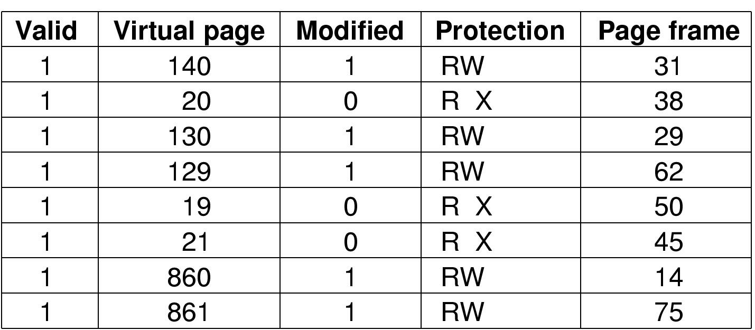
Virtual Memory
TLBs – Translation Lookaside Buffers
A TLB to speed up paging

Slide 32
Virtual Memory
Page Fault
If there is a reference to a page, Just not in memory: page fault,
Trap to operating system:
Get empty page frame, Determine page on backing store
Swap page from disk into page frame in memory
Modifies page tables, Set validation bit = v
Restart the instruction that caused the page fault

Slide 33

Virtual Memory
Steps in Handling a Page Fault

Slide 34
Virtual Memory
Page Replacement Algorithms
What happens if there is no free frame?
Page replacement – find some page in memory, but not really in use, swap it out
  algorithm
  performance – want an algorithm which will result in minimum number of page faults
Same page may be brought into memory several times

Slide 35
Virtual Memory
Basic Page Replacement
Find the location of the desired page on disk
Find a free frame:
- If there is a free frame, use it
- If there is no free frame, use a page replacement algorithm to select a victim frame
Bring the desired page into the (newly) free frame; update the page and frame tables
Restart the process

Slide 36

Virtual Memory
Page Replacement

Slide 37
Virtual Memory
Page Replacement Algorithms

Slide 38
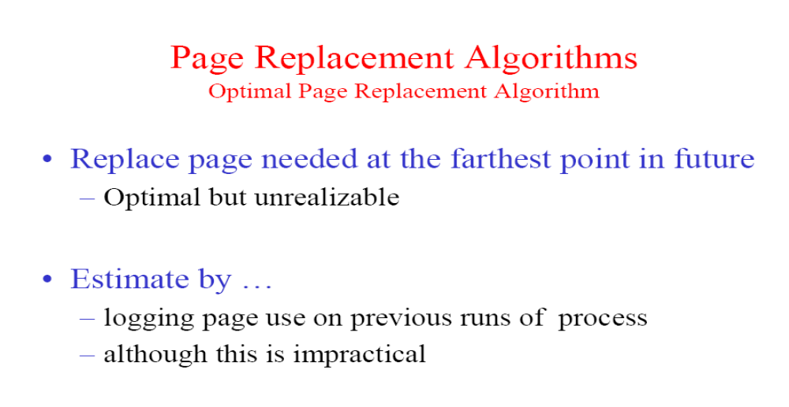
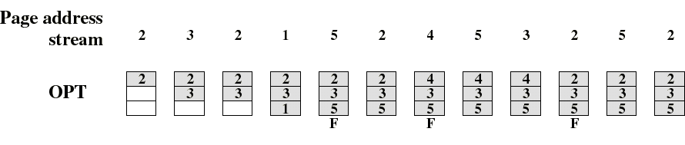
Example: the process has 5 pages, and is allocated in 3 frames

Slide 39
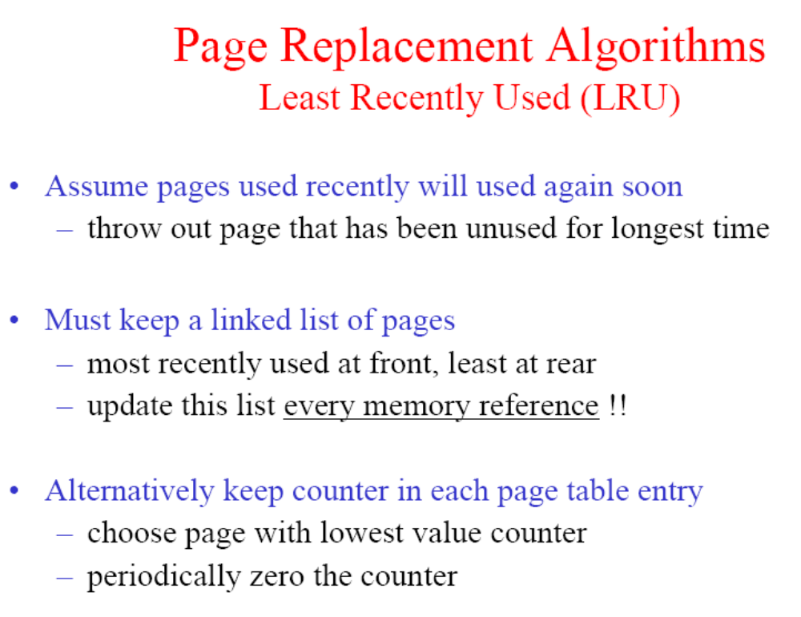

Slide 40
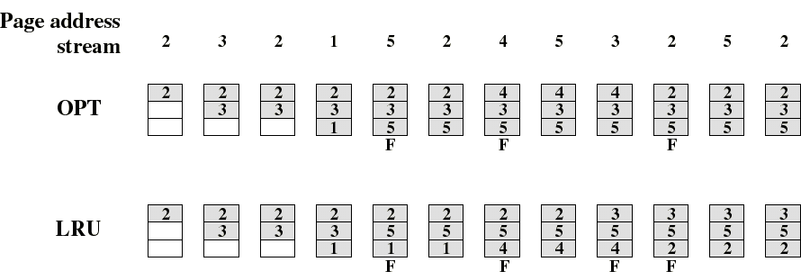
Example: the process has 5 pages, and is allocated in 3 frames

Slide 41
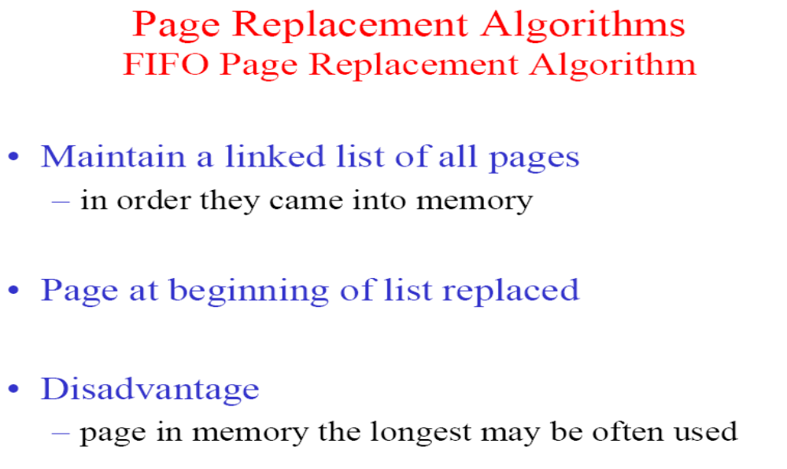
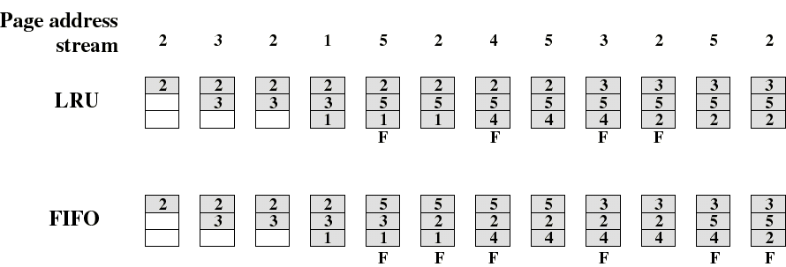
→
→
→
→
→
→
→
→
→
→
→
→

Slide 42
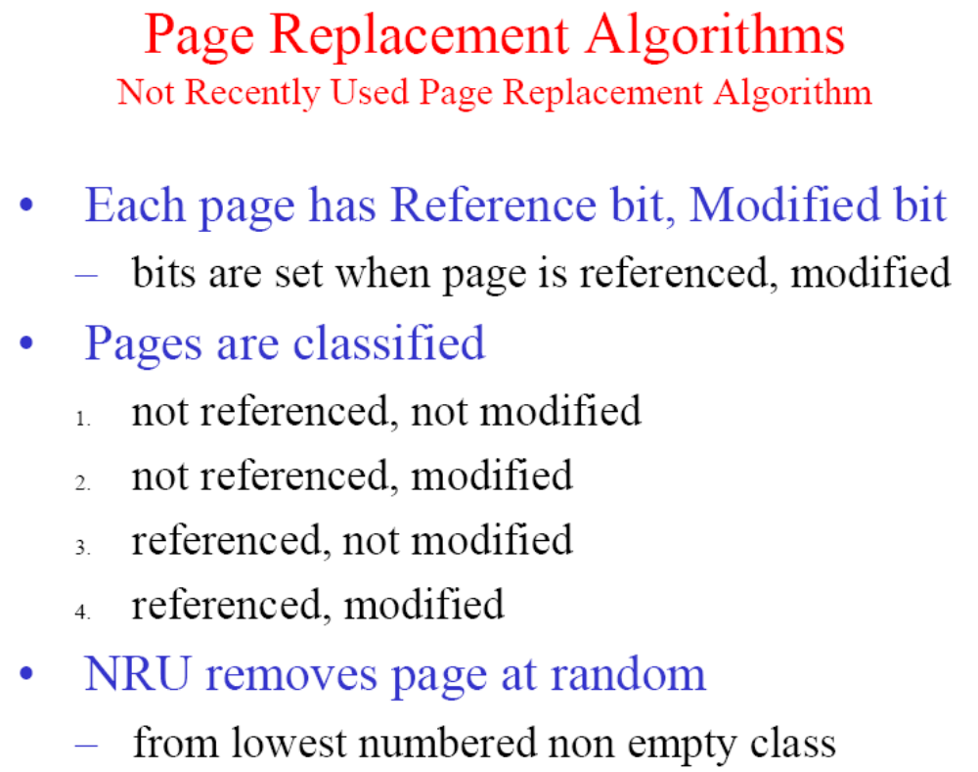

Slide 43
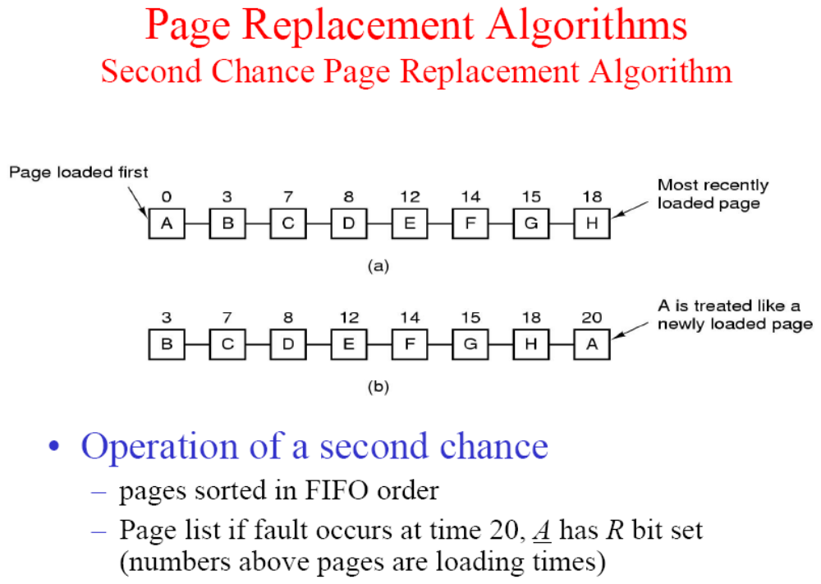

Slide 44
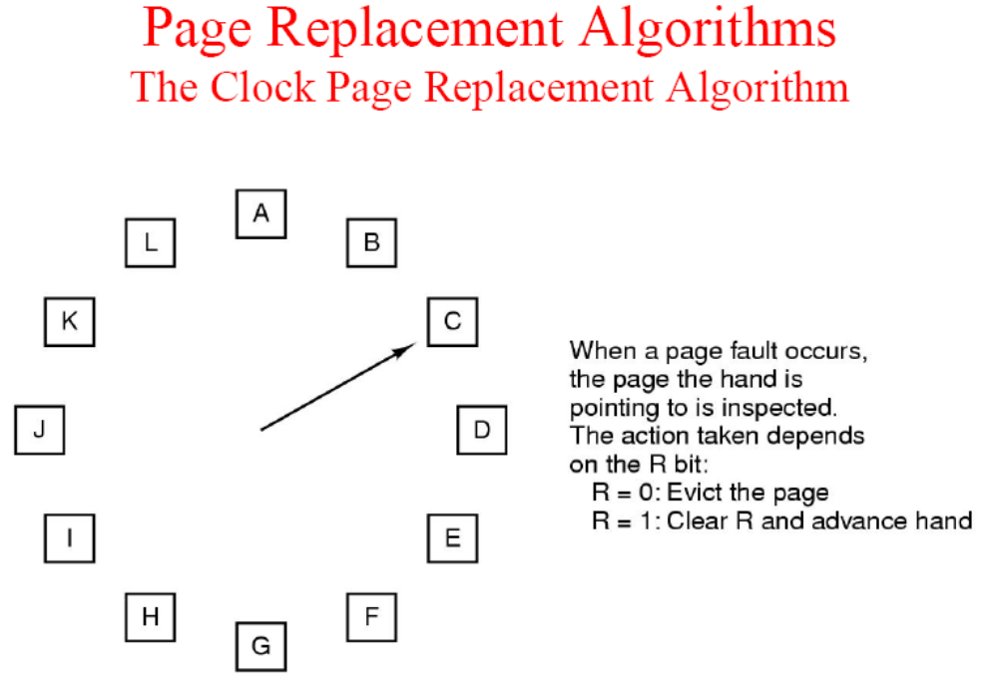

Slide 45
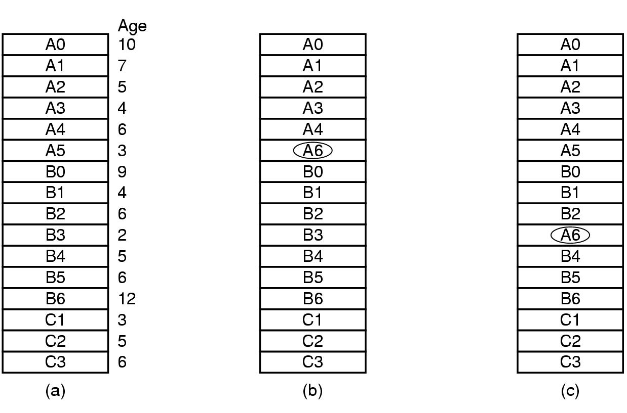
Virtual Memory
Design issues: Local versus Global Allocation Policies
(a) Original configuration
(b) Local page replacement
(c) Global page replacement

Slide 46
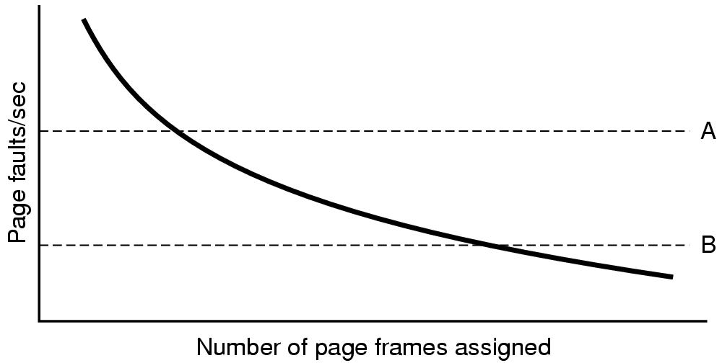
Virtual Memory
Design issues: Page Frame Allocation
Page fault rate as a function of the number of page frames assigned

Slide 47
Virtual Memory
Design issues: Page Size (1)
Small page size
Advantages
  less internal fragmentation
  better fit for various data structures, code sections
  less unused program in memory
Disadvantages
  programs need many pages, larger page tables

Slide 48
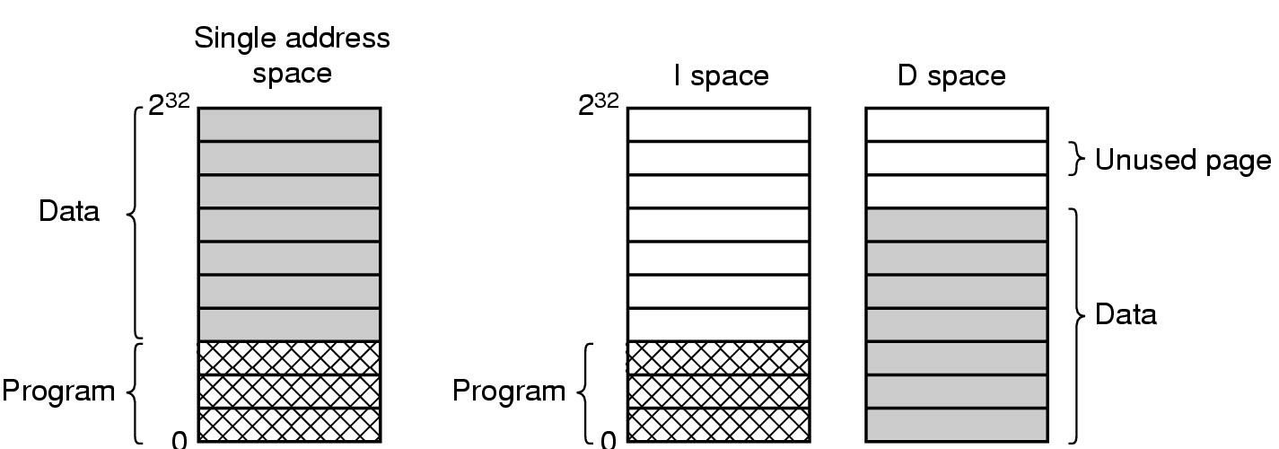
Virtual Memory
Design issues: Separate Instruction and Data Spaces
One address space
Separate I and D spaces

Slide 49
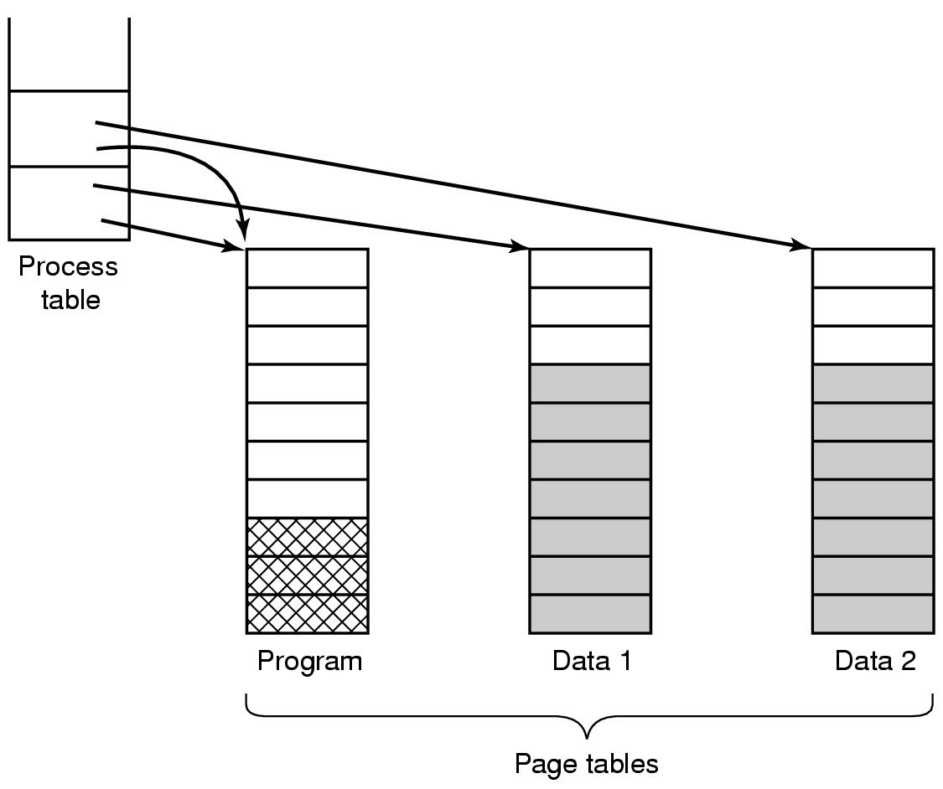
Virtual Memory
Design issues: Shared Pages
Two processes sharing same program sharing its page table

Slide 50
Virtual Memory
Implementation Issues
Operating System Involvement with Paging
Four times when OS involved with paging
Process creation
  determine program size
  create page table
Process execution
  MMU reset for new process
  TLB flushed
Page fault time
  determine virtual address causing fault
  swap target page out, needed page in
Process termination time
  release page table, pages

Slide 51
Virtual Memory
Implementation Issues
Page Fault Handling (1)
Hardware traps to kernel
General registers saved
OS determines which virtual page needed
OS checks validity of address, seeks page frame
If selected frame is dirty, write it to disk

Slide 52
Virtual Memory
Implementation Issues
Page Fault Handling (2)
6. OS brings schedules new page in from disk
7. Page tables updated
8. Faulting instruction backed up to when it began
9. Faulting process scheduled
10. Registers restored, Program continues

Slide 53
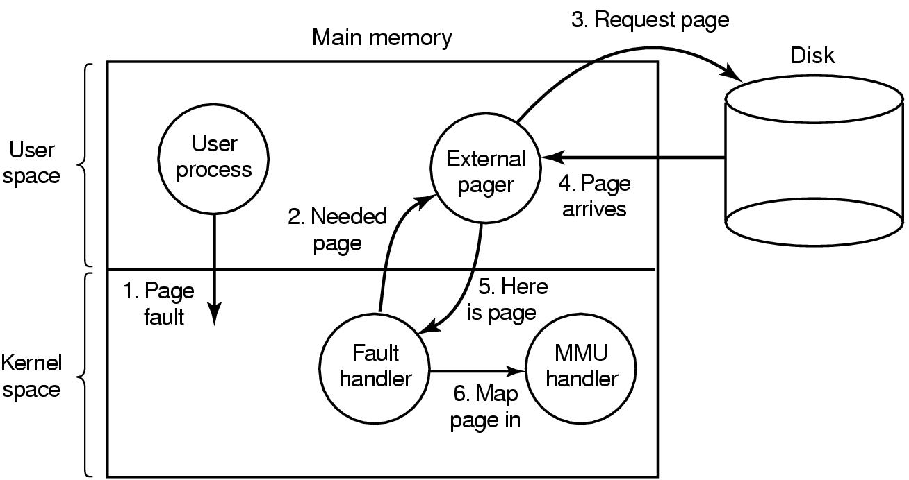
Virtual Memory
Implementation Issues
Separation of Policy and Mechanism
Page fault handling with an external pager

Slide 54
Virtual Memory
Segmentation

Slide 55

Virtual Memory
Segmentation (1)
One-dimensional address space with growing tables
One table may bump into another

Slide 56
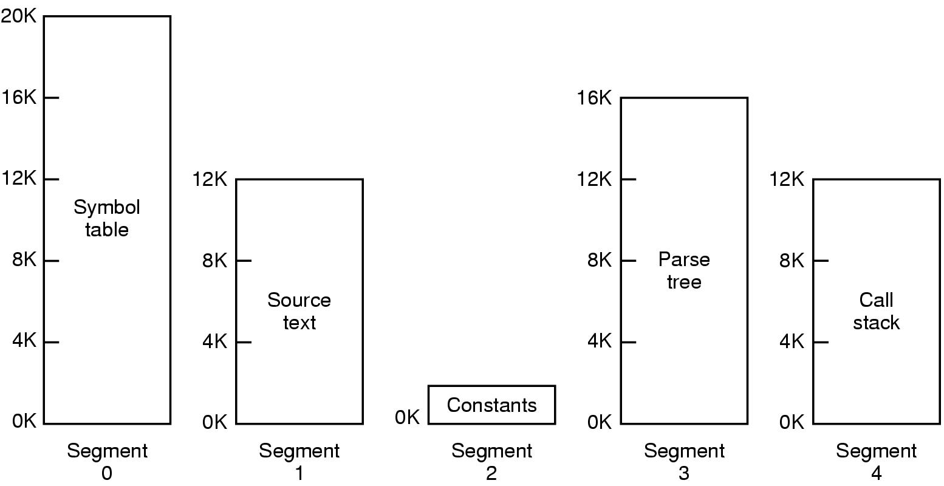
Virtual Memory
Segmentation (2)
Allows each table to grow or shrink, independently

Slide 57
An example of Segmentation
procedure
stack
main
symbol table
function sqrt
stack
1400
procedure
segment 3
2400
 | limit | base
0 | 1000 | 1400
1 | 400 | 6300
2 | 400 | 4300
3 | 1100 | 3200
4 | 1000 | 4700
segment 0
symbol
table
3200
function
sqrt
segment 4
4300
main program
4700
segment 1
segment
table
segment 2
5700
6300
logical address space
physical memory space

Slide 58
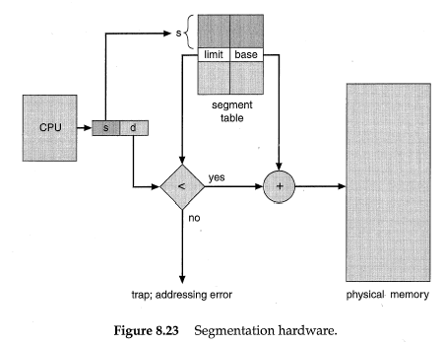

Segmentation Hardware

Slide 59
Segmentation translation
Virtual address: <segment-number, offset>
Segment table maps segment-number to segment information
  Base: starting address of segment in physical memory
  Limit: length of segment
  Addition metadata inlcudes protection bits
Limit & protection checked on each access
Segment-table base register (STBR) points to the segment table’s location in memory.
Segment-table length register (STLR) indicates number of segments used by a program;
segment number s is legal if s < STLR.

Slide 60

Virtual Memory
Segmentation (3)
Comparison of paging and segmentation

Slide 61
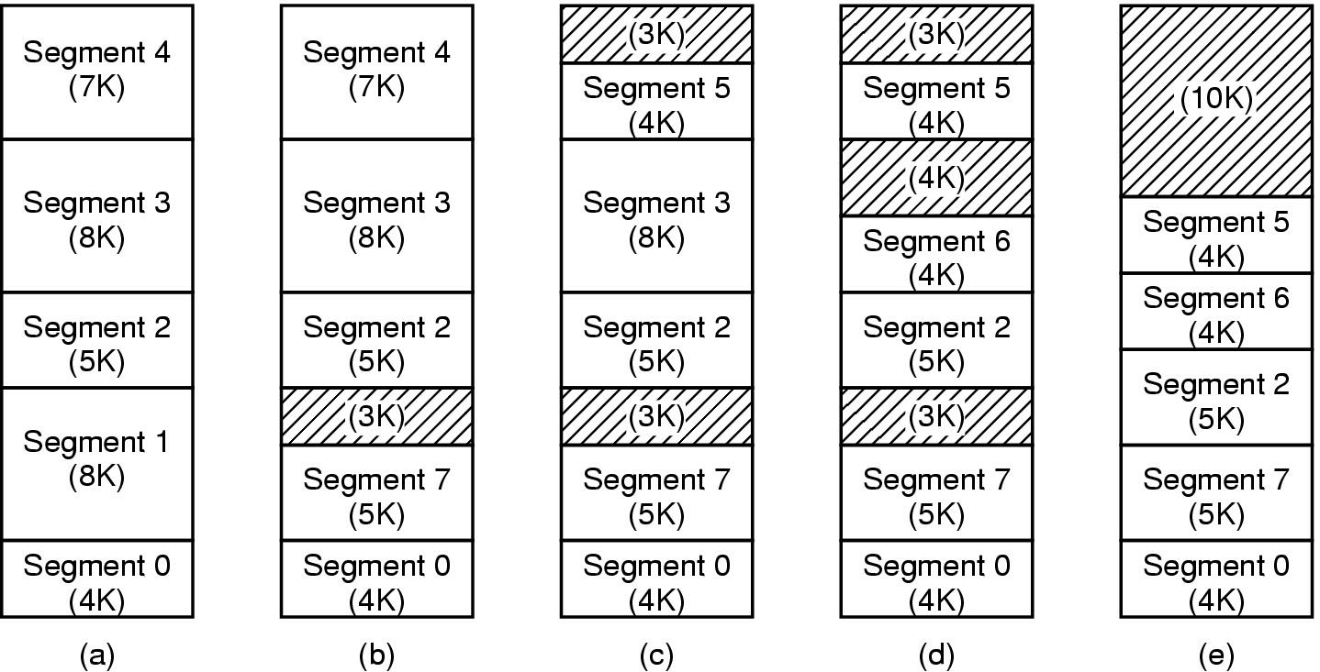
Virtual Memory
Implementation of Pure Segmentation (4)
(a)-(d) Development of checkerboarding
(e) Removal of the checkerboarding by compaction

Slide 62
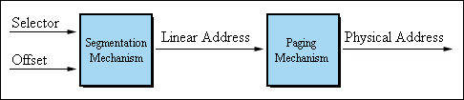
Virtual Memory
Segmentation with Paging: Pentium (1)

Slide 63
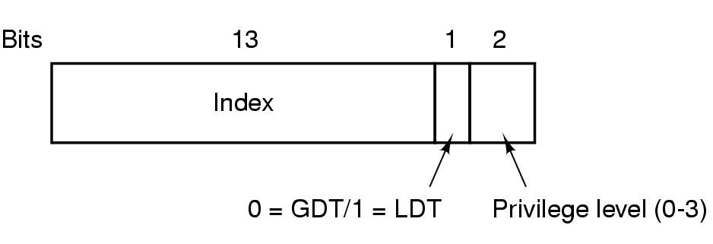
Virtual Memory
Segmentation with Paging: Pentium (2)
A Pentium selector
GDT (Global Descriptor Table), LDT (Local Descriptor Table)

Slide 64
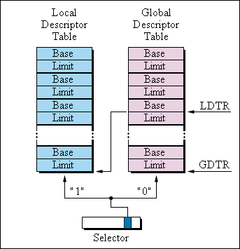
Virtual Memory
Segmentation with Paging: Pentium (3)

Slide 65
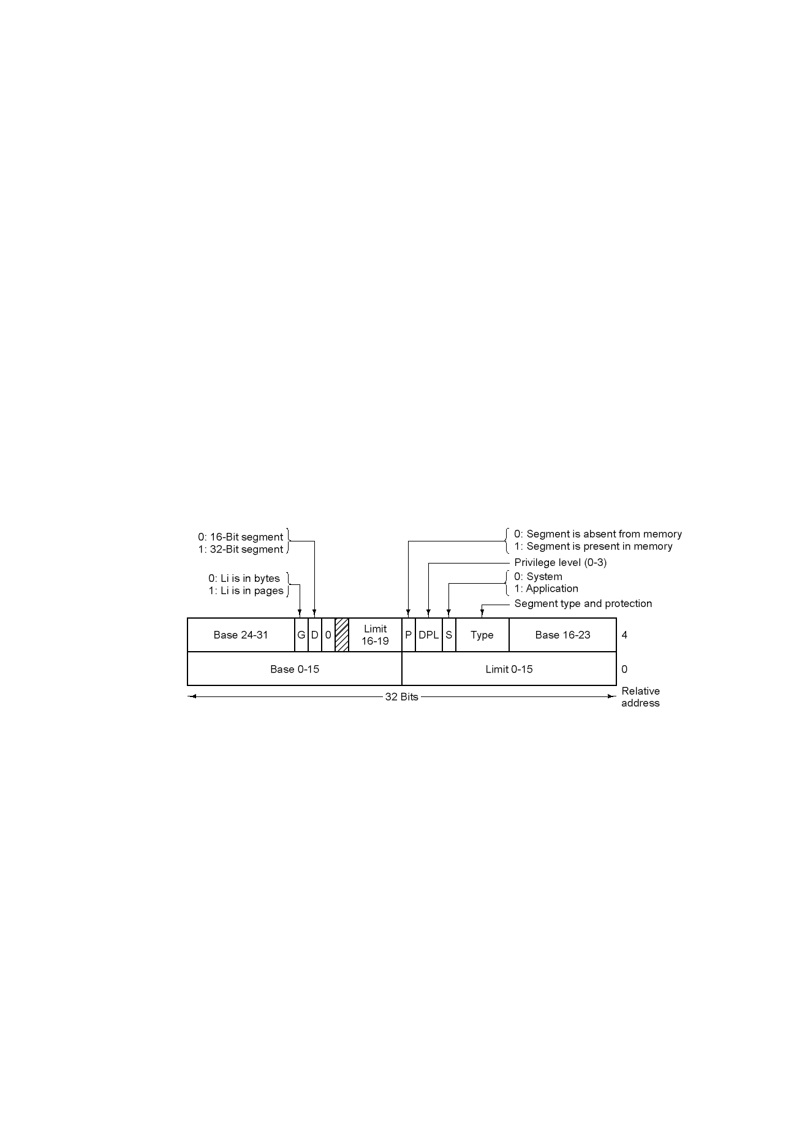
Virtual Memory
Segmentation with Paging: Pentium (4)
Pentium code segment descriptor
Data segments differ slightly

Slide 66
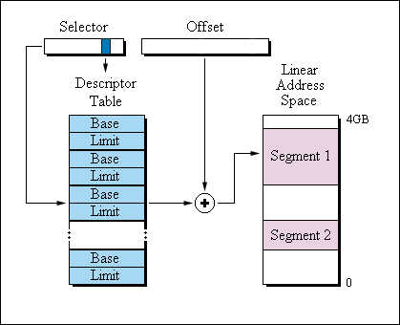
Virtual Memory
Segmentation with Paging: Pentium (5)

Slide 67
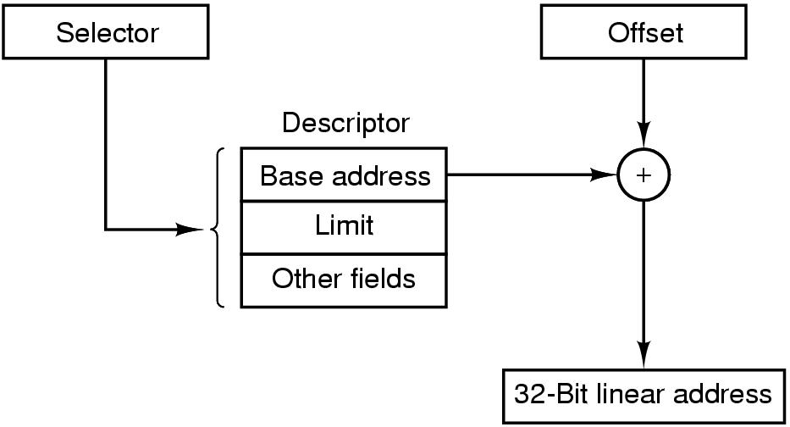
Virtual Memory
Segmentation with Paging: Pentium (6)
Conversion of a (selector, offset) pair to a linear address

Slide 68
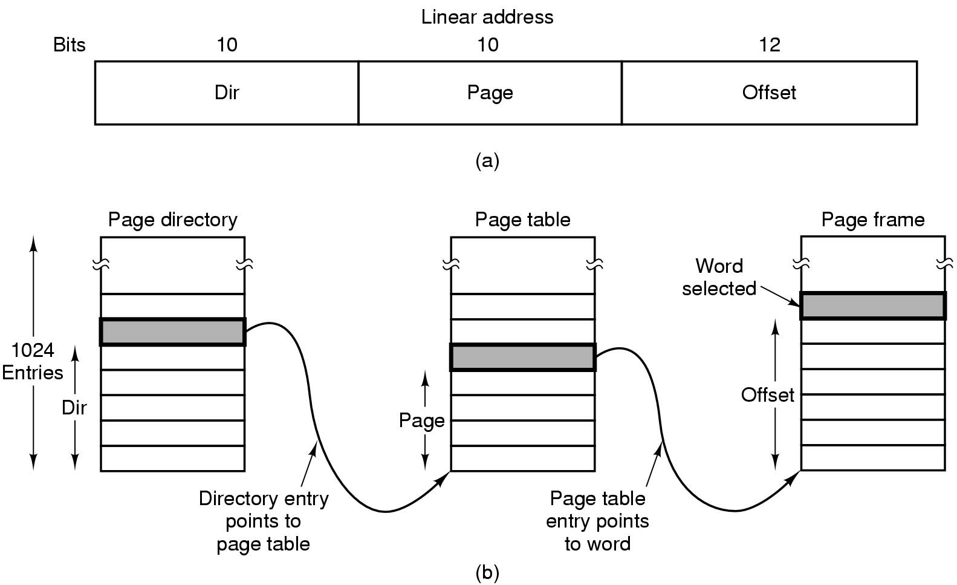
Virtual Memory
Segmentation with Paging: Pentium (7)
Mapping of a linear address onto a physical address

Slide 69
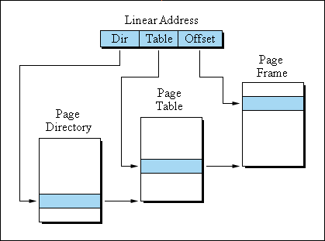
Virtual Memory
Segmentation with Paging: Pentium (8)

Slide 70

Pentium address translation
10
10
12
Can cover up to 4 MB
physical address space

Slide 71
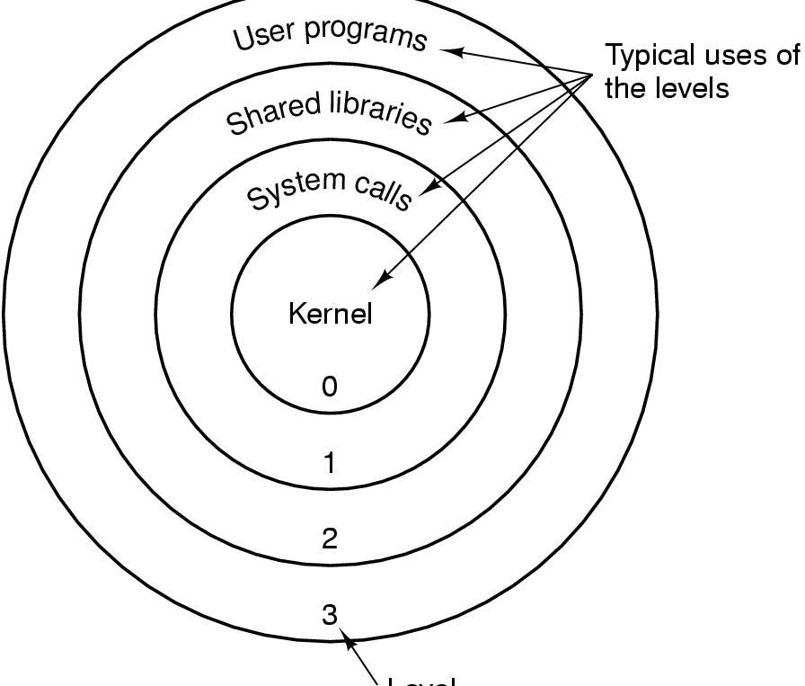
Virtual Memory
Segmentation with Paging: Pentium (9)
Level
Protection on the Pentium

