Slide 1
Input/Output
Chapter 5
5.1 Principles of I/O hardware
5.2 Principles of I/O software
5.3 I/O software layers
5.4 I/O devices: Disks,
Character-oriented terminals,
Clocks

Slide 2
5.1 Principles of I/O hardware

Slide 3
Principles of I/O Hardware
Types of I/O devices
Two main groups: Block and Character Devices
Block devices include disk drives
  Commands include read, write, seek
  Raw I/O or file-system access
  Memory-mapped file access possible
Character devices include keyboards, mice, serial ports
  Commands include get, put
  Libraries layered on top allow line editing

Slide 4
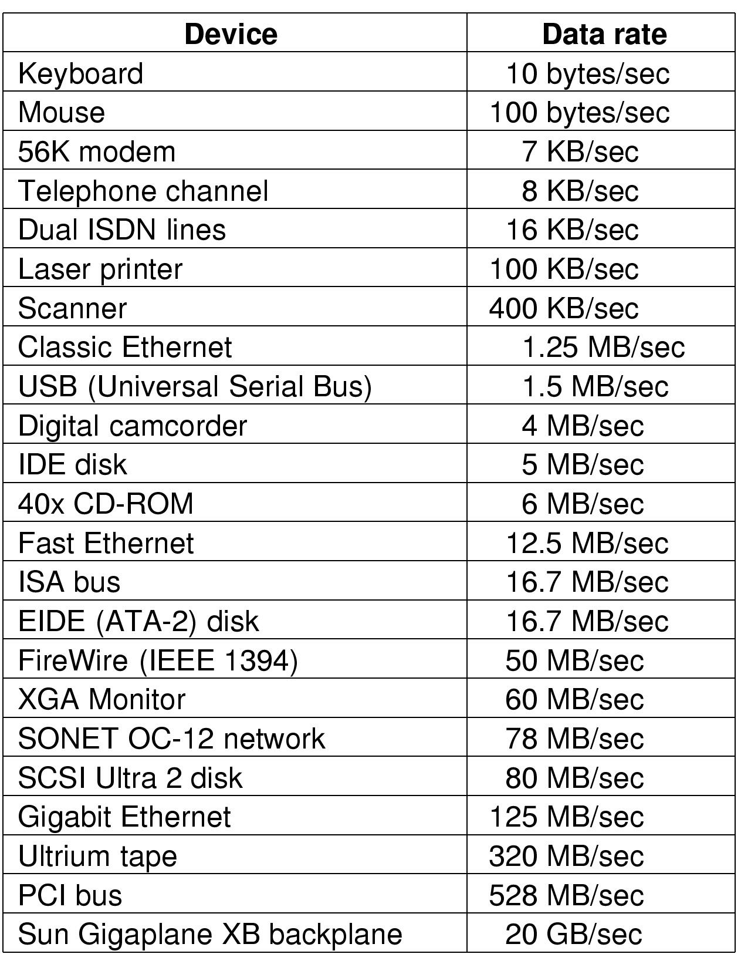
Principles of I/O Hardware
Types of I/O devices
Some typical device, network, and data base rates

Slide 5
Principles of I/O Hardware
Common concepts
Common concepts
  I/O Device Controller
  I/O Port
  I/O Bus

Slide 6

Principles of I/O Hardware
Device Controllers
Monitor
Bus
Components of a simple personal computer

Slide 7
Principles of I/O Hardware
Device Controllers
I/O devices have components:
  electromechanical component
  electronic component
The electronic component is the device controller
  may be able to handle multiple devices
Controller's tasks (Disk)
  convert serial bit stream to block of bytes
  perform error correction as necessary
  make available to main memory

Slide 8
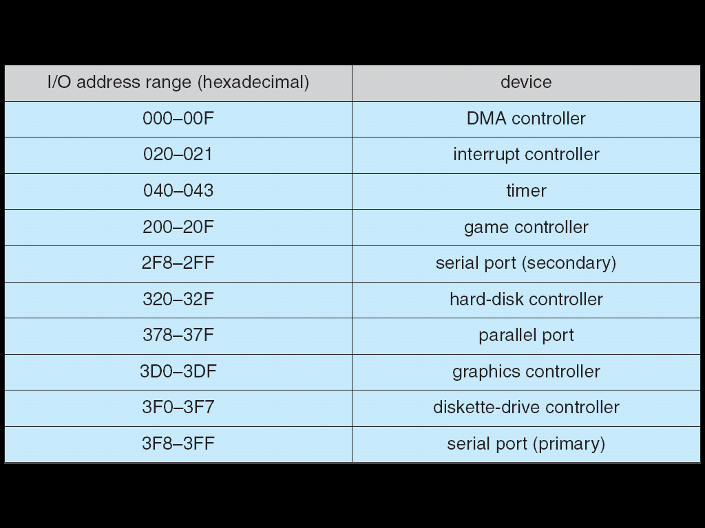
Principles of I/O Hardware
I/O Port
I/O Port is a register in device interface. Example: Device I/O Port Locations on PCs (partial)

Slide 9
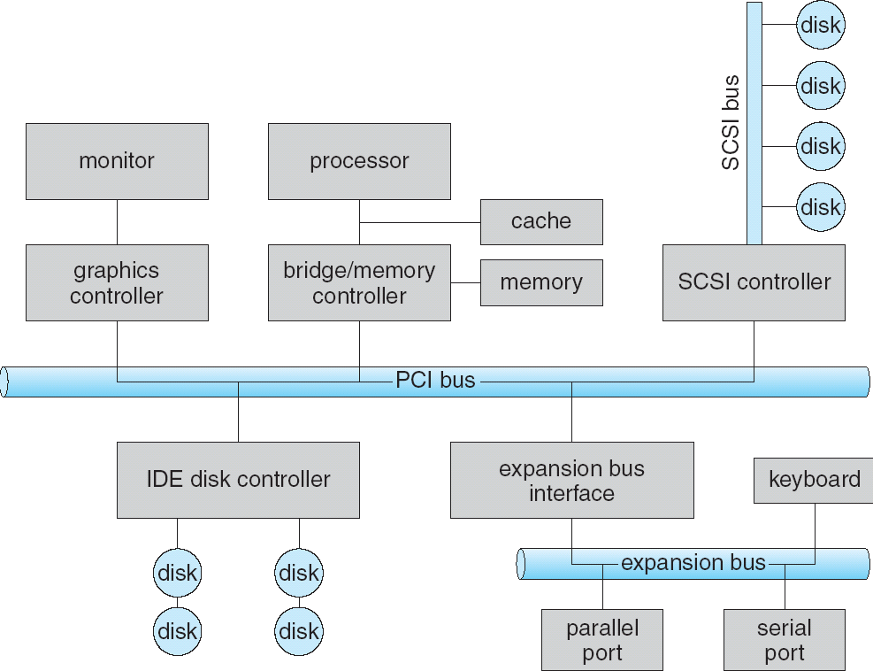
Principles of I/O Hardware
A Typical PC Bus Structure

Slide 10
Principles of I/O Hardware
I/O address
I/O instructions control devices
Devices have addresses, used by
  Direct I/O instructions
  Memory-mapped I/O

Slide 11
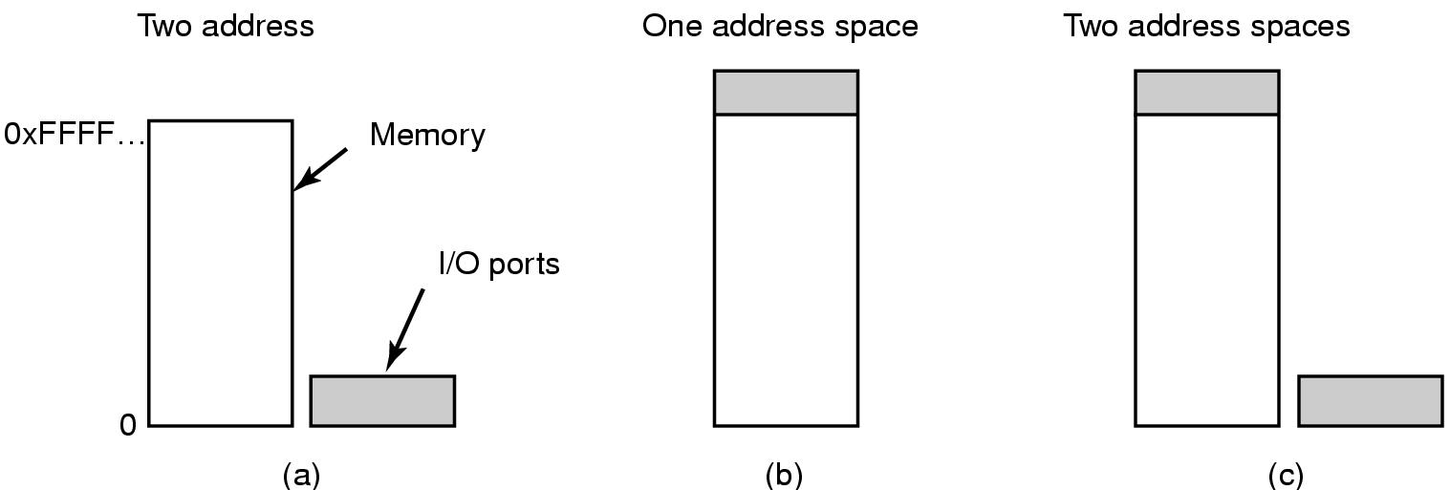
Principles of I/O Hardware
Memory-Mapped I/O (1)
Separate I/O and memory space
Memory-mapped I/O
Hybrid

Slide 12
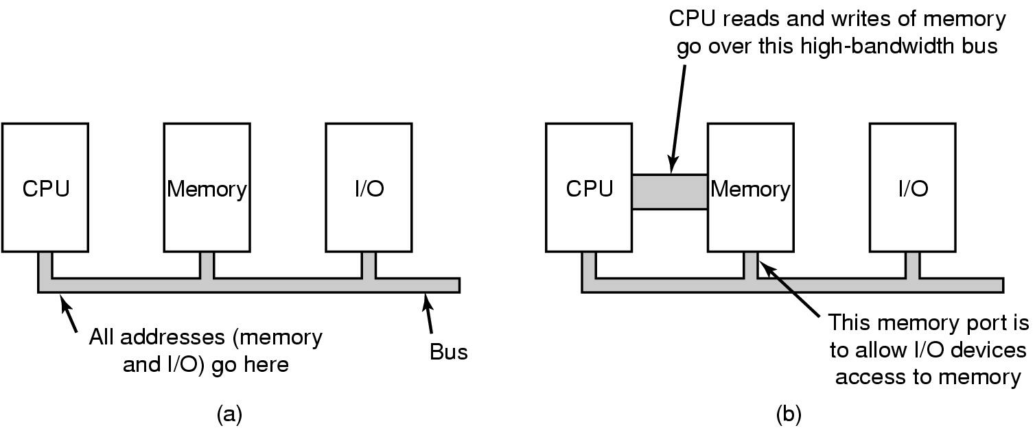
Principles of I/O Hardware
Memory-Mapped I/O (2)
(a) A single-bus architecture
(b) A dual-bus memory architecture

Slide 13
Principles of I/O Hardware
Data transfer Method between CPU and I/O device
Three Data I/O transfer Methods:
Programmed I/O
Interrupt-Driven I/O
Direct Memory Access

Slide 14
Principles of I/O Hardware
Programmed I/O, Polling
Determines state of device
  ready
  busy
  Error
Busy-wait cycle to wait for I/O from device

Slide 15

Principles of I/O Hardware
Interrupt-Driven I/O
How interrupts happens. Connections between devices and interrupt controller actually use interrupt lines on the bus rather than dedicated wires

Slide 16
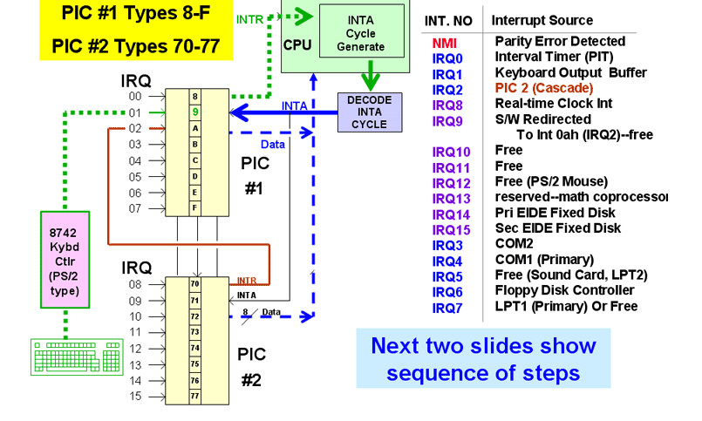
Principles of I/O Hardware
Example: Interrupts of PC computer

Slide 17

Principles of I/O Hardware
Direct Memory Access (DMA)
Operation of a DMA transfer

Slide 18
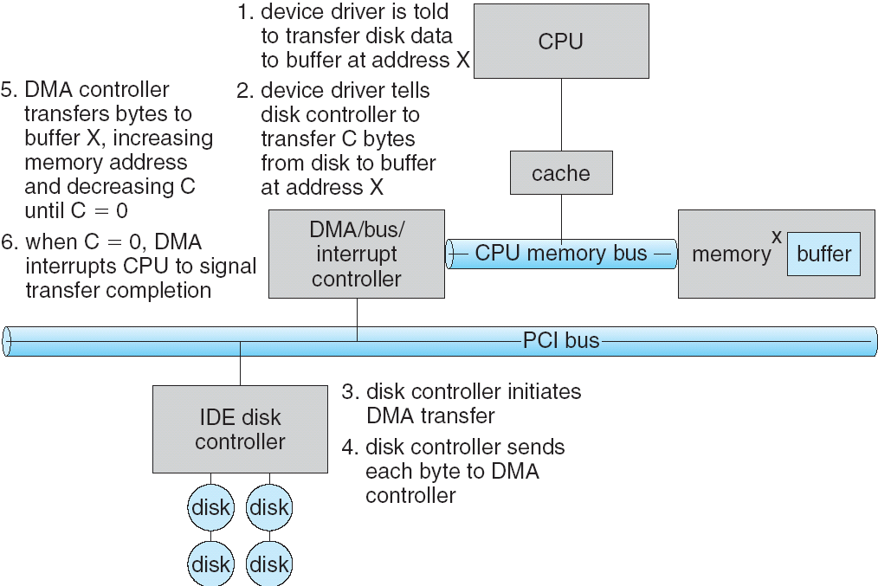
Principles of I/O Hardware
Example: DMA Transfer in PC Computer

Slide 19
5.2 Principles of I/O software

Slide 20
Principles of I/O Software
Goals of I/O Software (1)
Device independence
  programs can access any I/O device
  without specifying device in advance
    (floppy, hard drive, or CD-ROM)
Uniform naming
  name of a file or device is a string or an integer
  not depending on which machine
Error handling
  handle as close to the hardware as possible

Slide 21
Principles of I/O Software
Goals of I/O Software (2)
Synchronous vs. asynchronous transfers
  blocked transfers vs. interrupt-driven
Buffering
  data coming off a device cannot be stored in final destination
Sharable vs. dedicated devices
  disks are sharable
  tape drives would not be

Slide 22
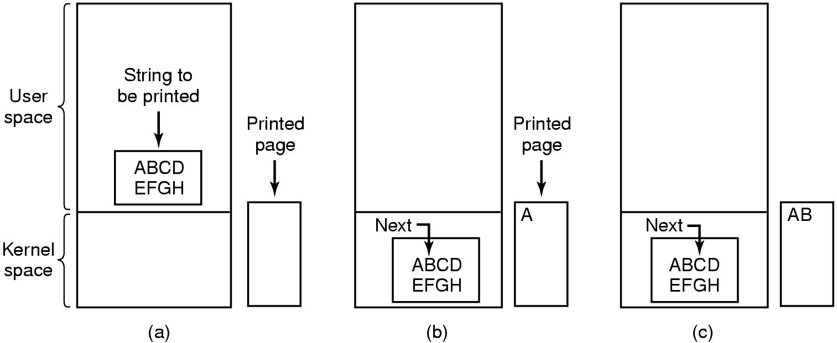
Principles of I/O Software Programmed I/O (1)
Steps in printing a string

Slide 23
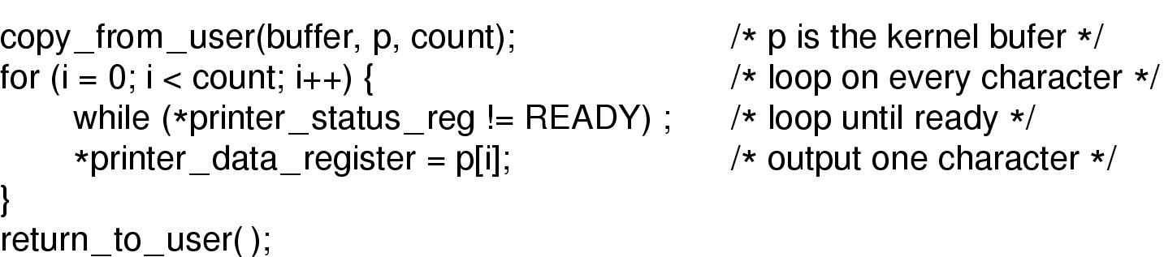
Principles of I/O Software Programmed I/O (2)
Writing a string to the printer using programmed I/O

Slide 24
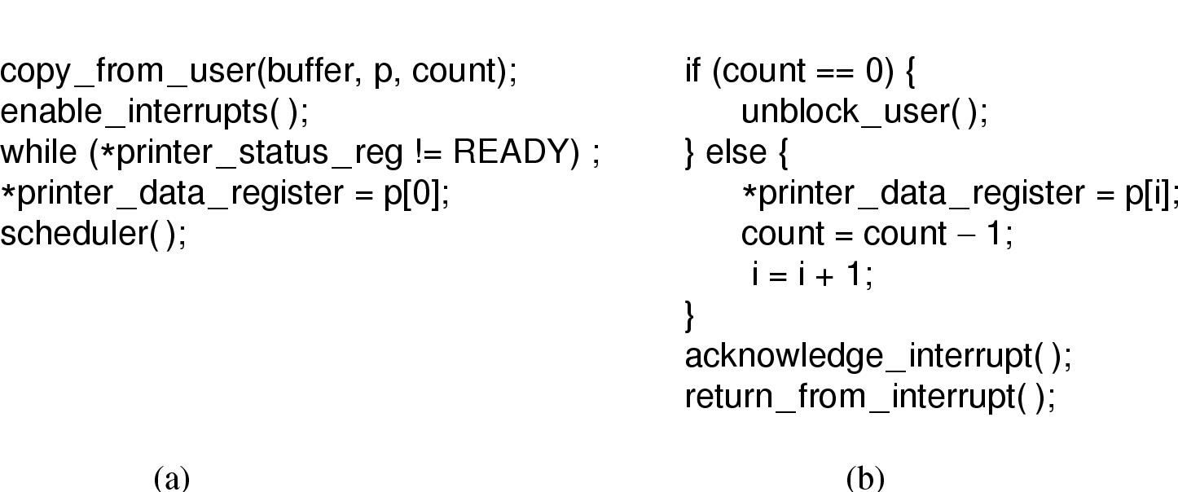
Principles of I/O Software Interrupt-Driven I/O
Writing a string to the printer using interrupt-driven I/O
  Code executed when print system call is made
  Interrupt service procedure

Slide 25
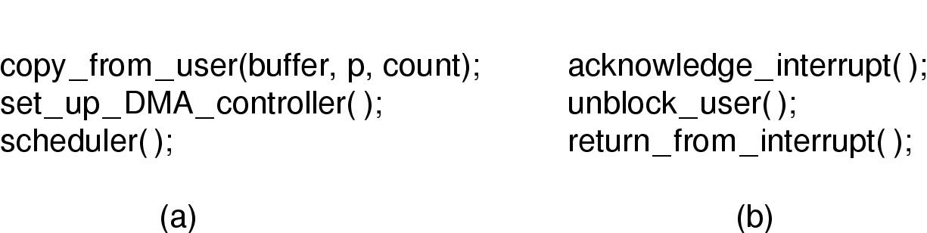
Principles of I/O Software
I/O Using DMA
Printing a string using DMA
  code executed when the print system call is made
  interrupt service procedure

Slide 26
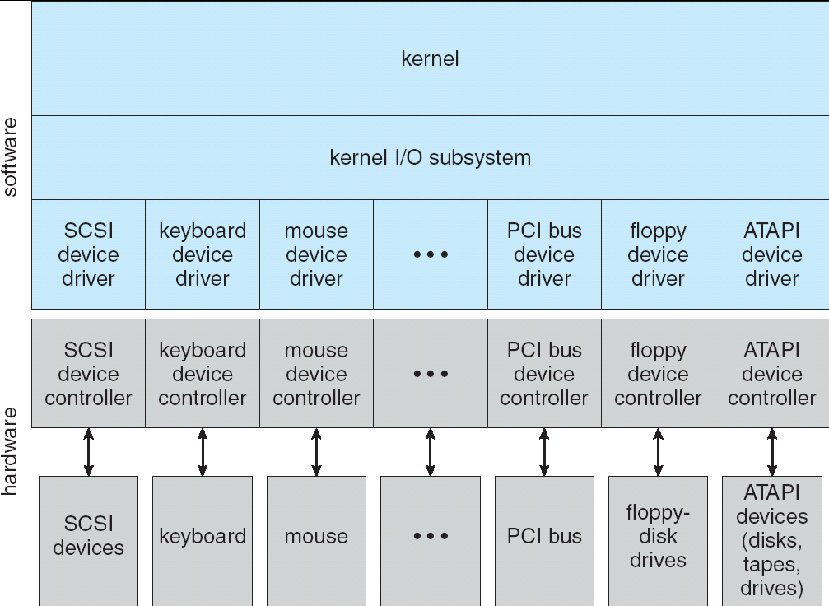
A Kernel I/O Structure:
Hardware And Software

Slide 27
5.3 I/O software layers

Slide 28
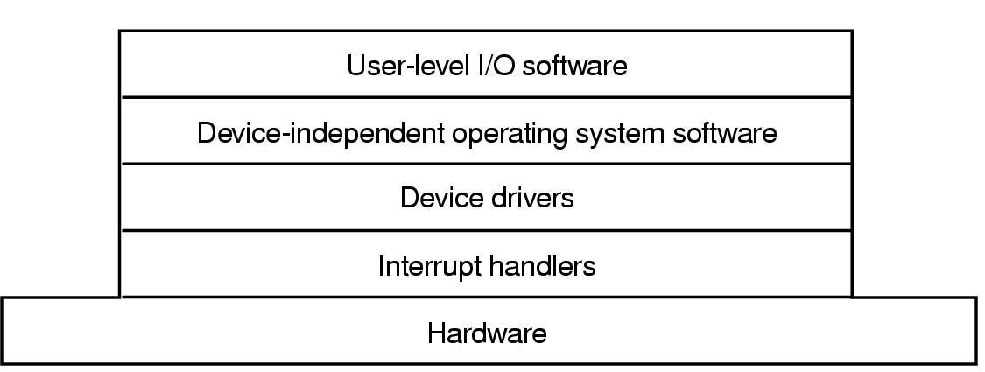
I/O Software Layers
Layers of the I/O Software System

Slide 29
I/O Software Layers
Interrupt Handlers (1)
Interrupt handlers are best hidden
  have driver starting an I/O operation block until interrupt notifies of completion
Interrupt procedure does its task
  then unblocks driver that started it
Steps must be performed in software after interrupt completed
  Save regs not already saved by interrupt hardware
  Set up context for interrupt service procedure

Slide 30
I/O Software Layers
Interrupt Handlers (2)
  Set up stack for interrupt service procedure
  Ack interrupt controller, reenable interrupts
  Copy registers from where saved to process table
  Run service procedure
  Set up MMU context for process to run next
  Load new process' registers
  Start running the new process

Slide 31
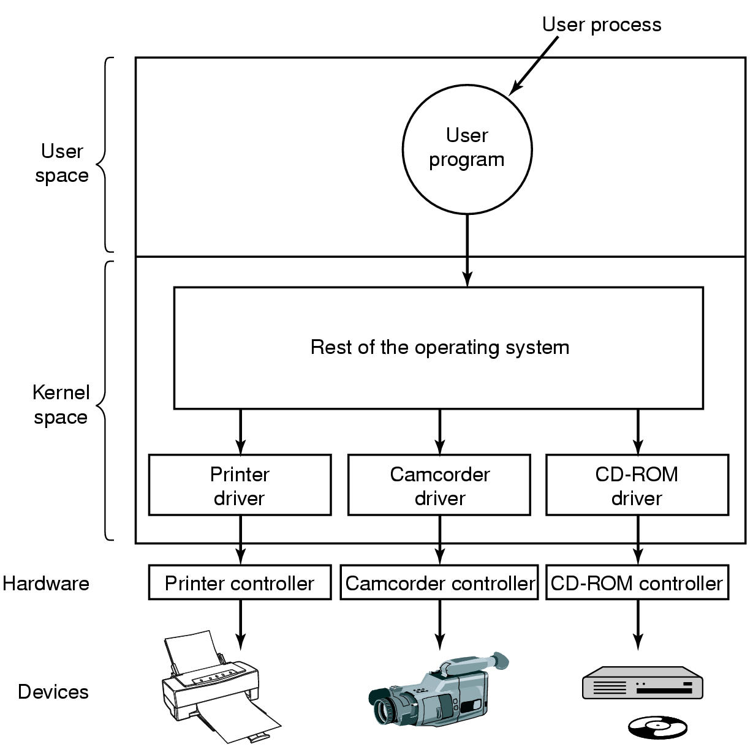
I/O Software Layers
Device Drivers
Logical position of device drivers is shown here
Communications between drivers and device controllers goes over the bus

Slide 32
I/O Software Layers
Device-Independent I/O Software (1)
Uniform interfacing for device drivers
Buffering
Error reporting
Allocating and releasing dedicate devices
Providing a device-independent block size
Functions of the device-independent I/O software

Slide 33
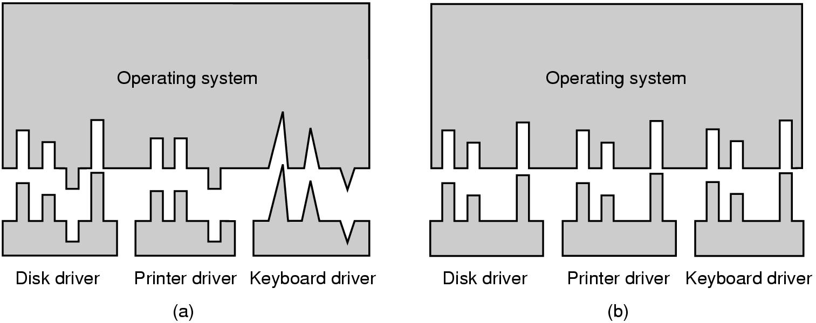
I/O Software Layers
Device-Independent I/O Software (2)
(a) Without a standard driver interface
(b) With a standard driver interface

Slide 34
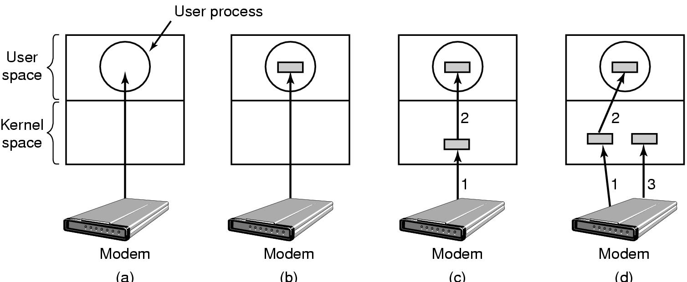
I/O Software Layers
Device-Independent I/O Software (3)
(a) Unbuffered input
(b) Buffering in user space
(c) Buffering in the kernel followed by copying to user space
(d) Double buffering in the kernel

Slide 35
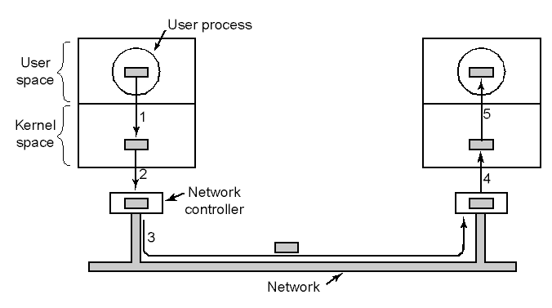
I/O Software Layers
Device-Independent I/O Software (4)
Networking may involve many copies

Slide 36
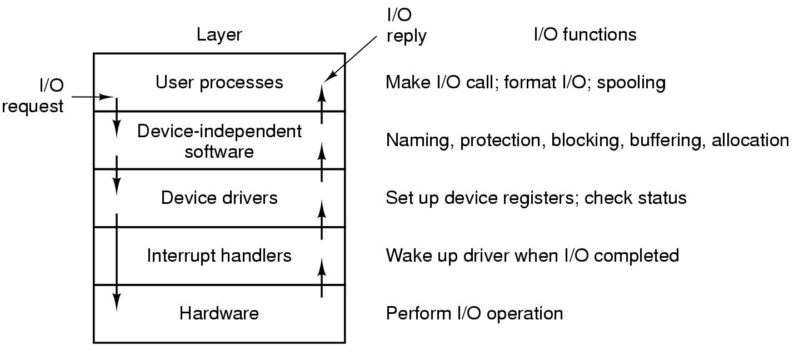
User-Space I/O Software
Layers of the I/O system and the main functions of each layer

Slide 37
5.4 I/O devices

Slide 38
I/O devices
Storage devices: Hard Disks, CD-ROM, CD-R, DVD…
Display devices: Character-oriented terminals, Graphical user interfaces
Clocks

Slide 39
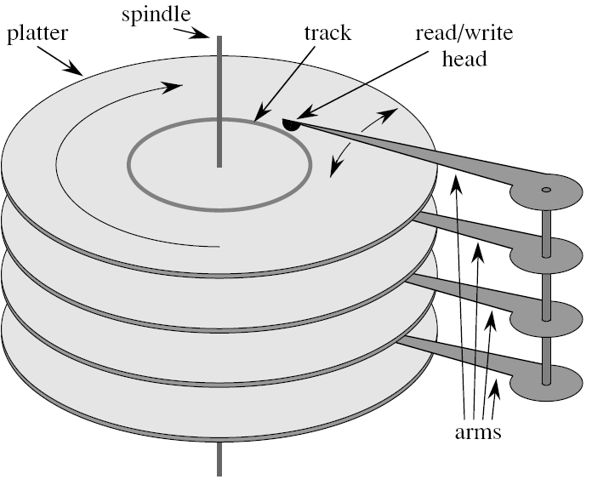

Hard Disk Drive

Slide 40
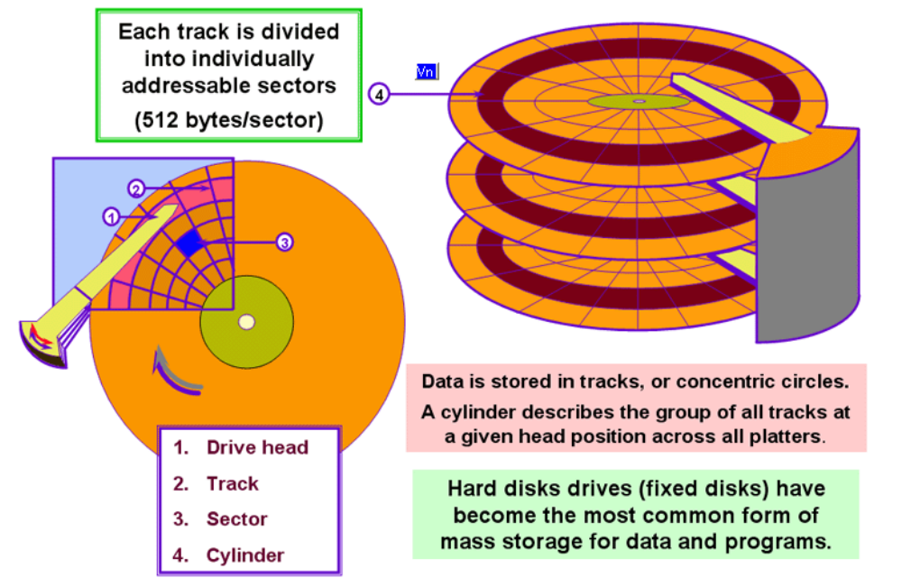
Disk Hardware (2)

Slide 41
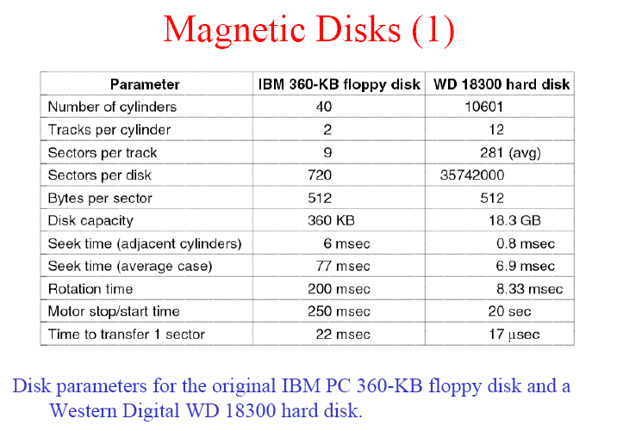

Slide 42
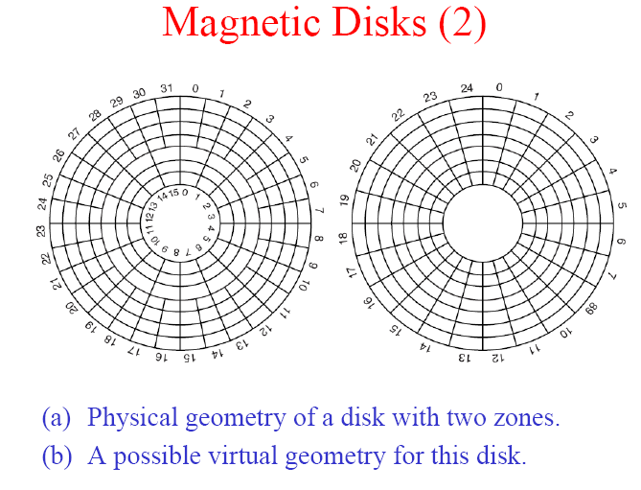

Slide 43
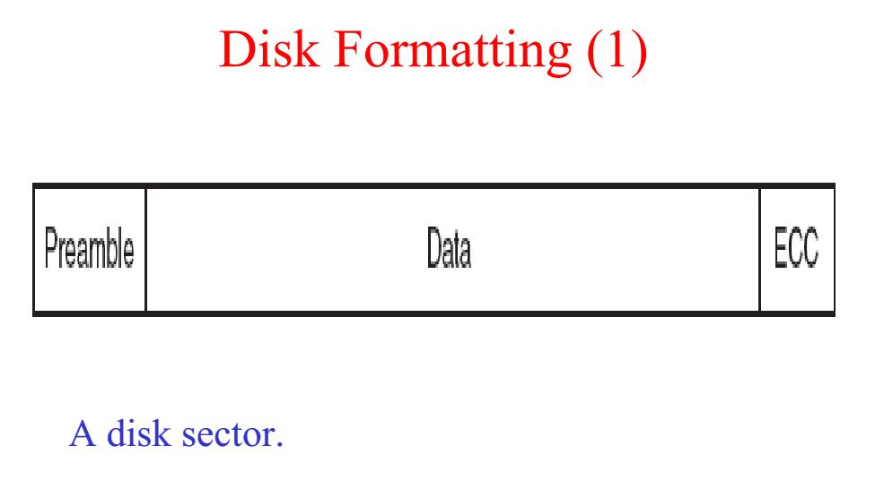

Slide 44
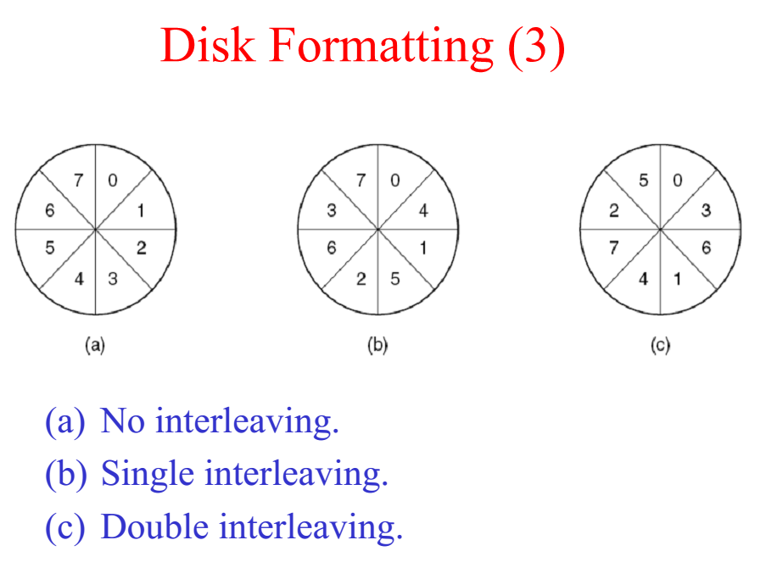

Slide 45
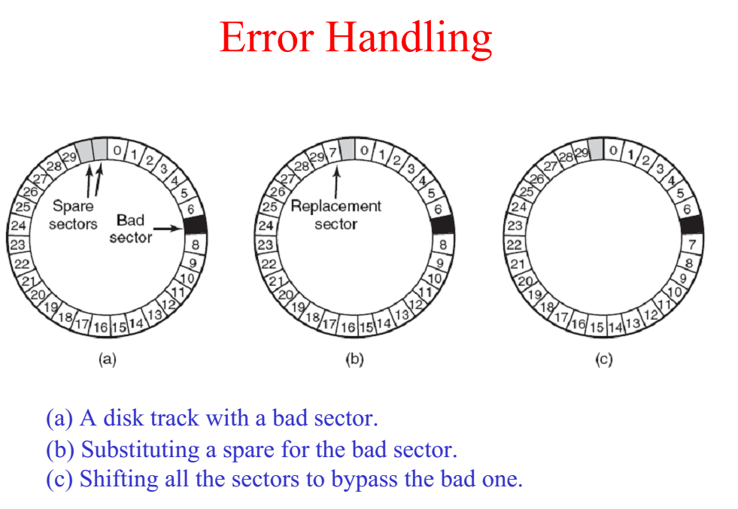

Slide 46
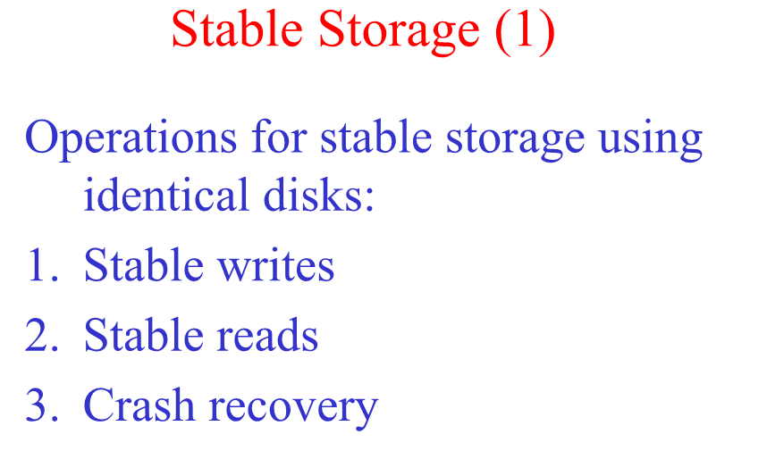

Slide 47
Disk Performance Parameters
To read or write, disk head must be positioned at desired track and at beginning of desired sector
Read/write time factors:
  Seek time: time it takes to position the head at desired track
  Rotational delay or rotational latency: time its takes for beginning of sector to reach head
  Actual data transfer time

Slide 48
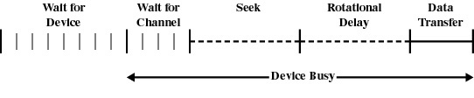
Timing of a Disk I/O Transfer

Slide 49
Disk Performance Parameters
Transfer time
  data transfer occurs as the disk moves under head
  depends on rotational speed of disk
Tt=b/rN
Tt = transfer time
b = no of bytes to transfer
N = no of bytes on a track
r = rotational speed (rps)

Slide 50
HDD Access Time
Sum of seek time, rotational delay and transfer time
Average seek time → Ts
Time for half a revolution → Tr
Ta = Ts + Tr + Tt
Ta = Ts + 0.5/r + b/rN
assuming that all data to be read is on the same track, i.e. no head re-positioning is required

Slide 51
Disk Scheduling Algorithms
For a single disk there will be a number of I/O requests
If requests are selected randomly we will get the worst possible performance
  seek time will dominate
FCFS will not be entirely random due to locality

Slide 52
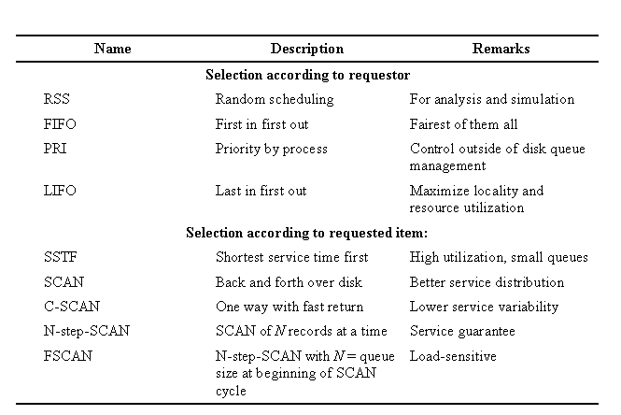
Disk Scheduling Algorithms

Slide 53
Disk Scheduling Algorithms
First In First Out (FIFO)
simplest form of scheduling
Each request processed in arrival order
Advantages
  simple and fair
  no starvation
    unless a single request is extremely long.
Disadvantages
  stupid and slow.

Slide 54
Disk Scheduling Algorithms
Shortest Seek Time First (SSTF)
Request causing least disk arm movement selected
  a priority based policy
Advantages
  Performs better than FIFO
  offers "locality" -- benefits disk operations close together
Disadvantages
  can cause starvation during high request rate
  No guarantee that average seek time will be minimum over time

Slide 55
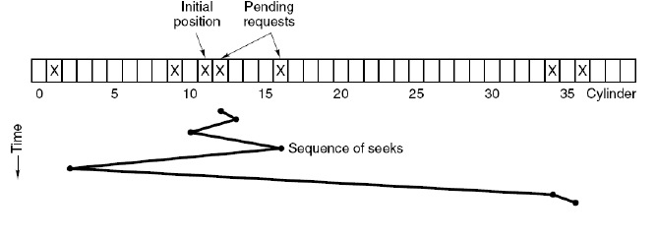
Shortest Seek Time First (SSTF)

Slide 56
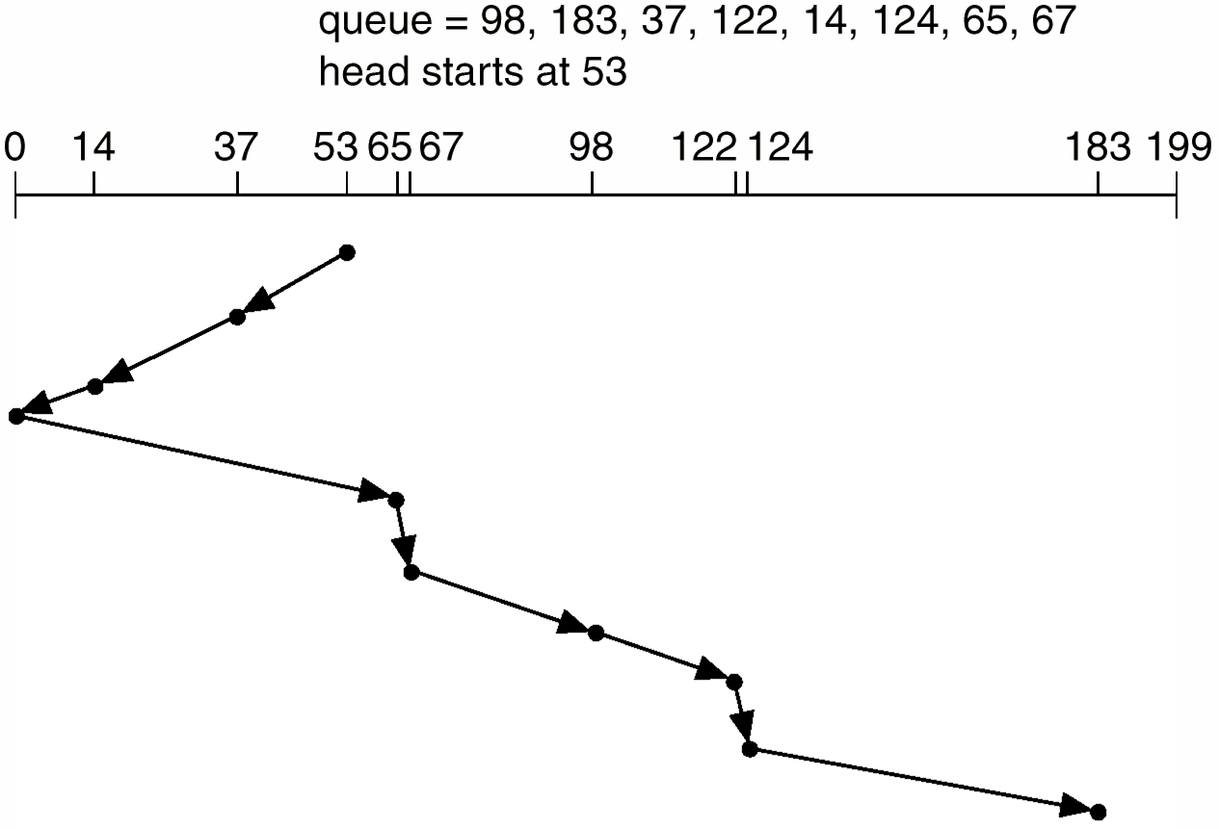
SCAN (elevator algorithm)
and is moving toward cylinder 0

Slide 57
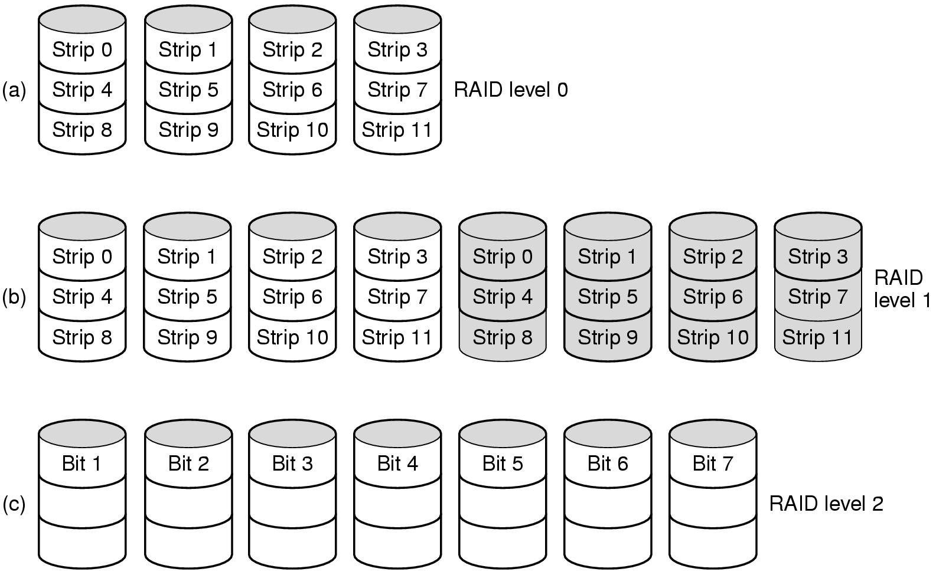
RAID (1)
Raid levels 0 through 2
Backup and parity drives are shaded

Slide 58
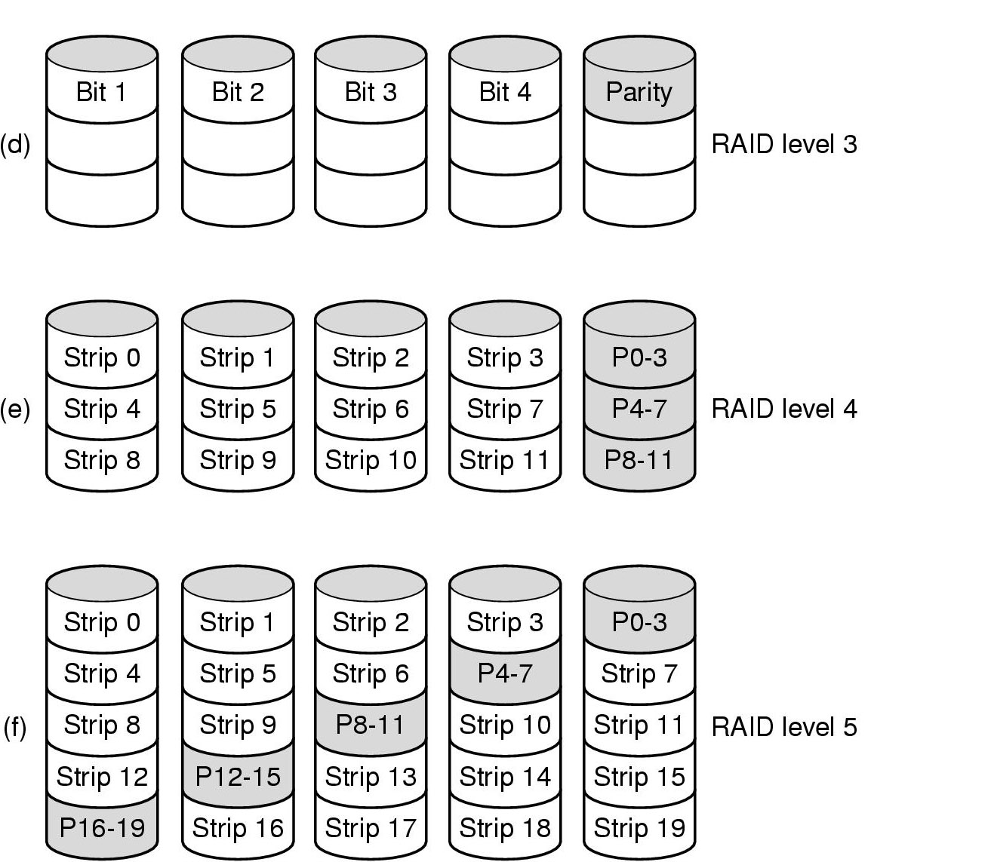
RAID (2)
Raid levels 3 through 5
Backup and parity drives are shaded

Slide 59
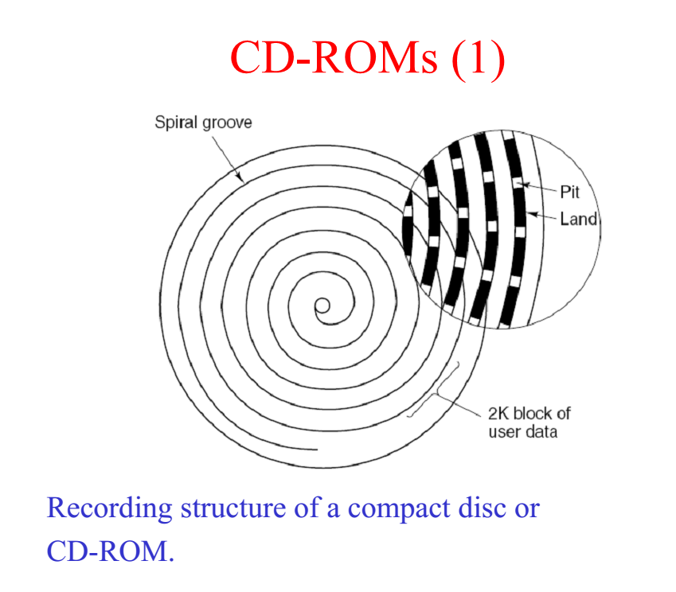

Slide 60
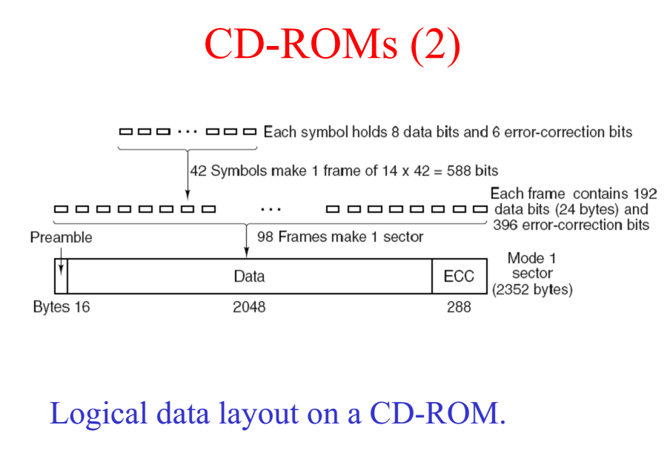

Slide 61
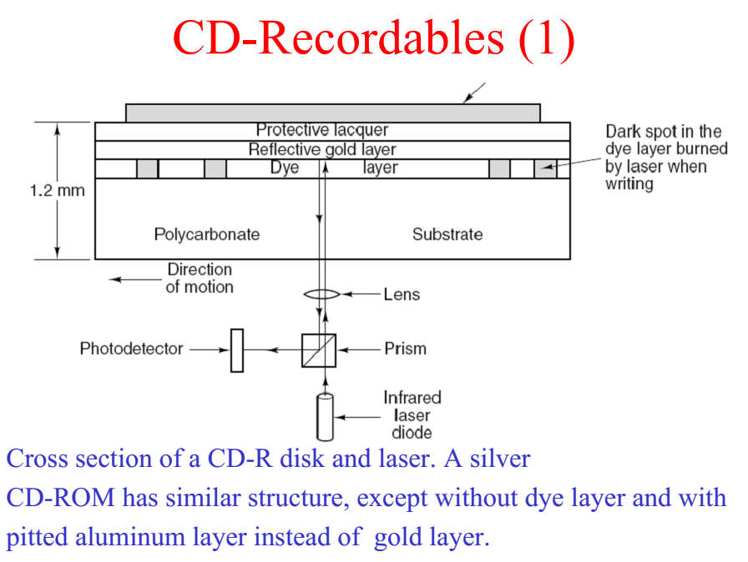

Slide 62
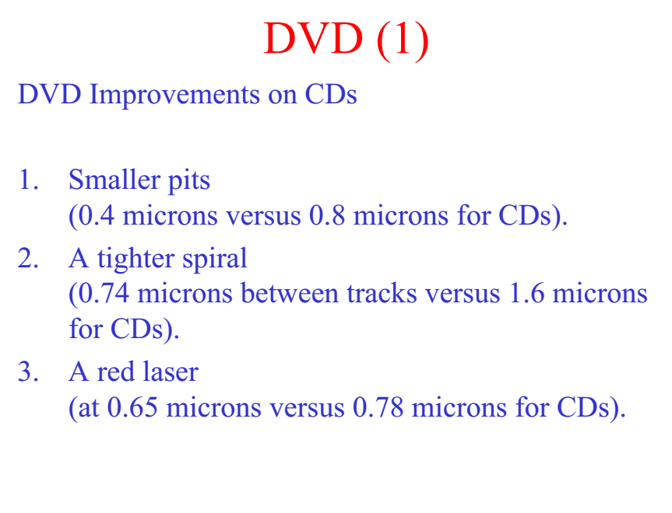

Slide 63
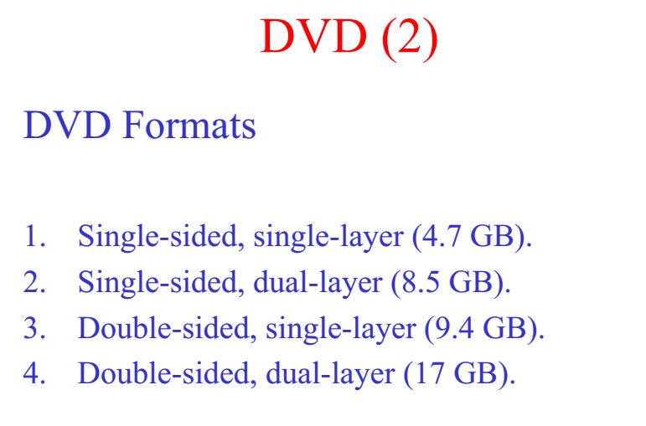

Slide 64
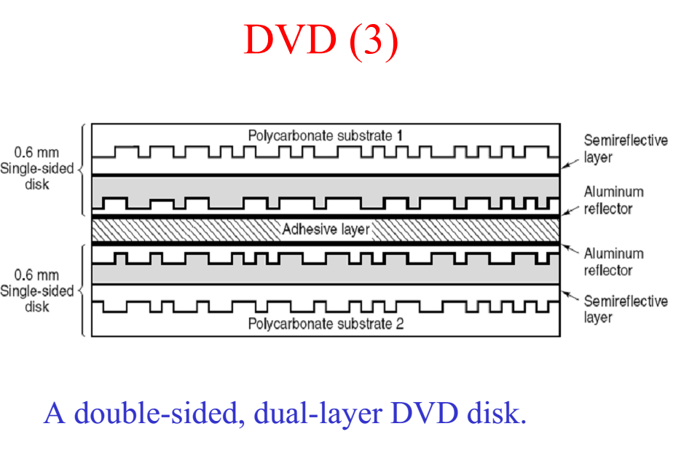

Slide 65
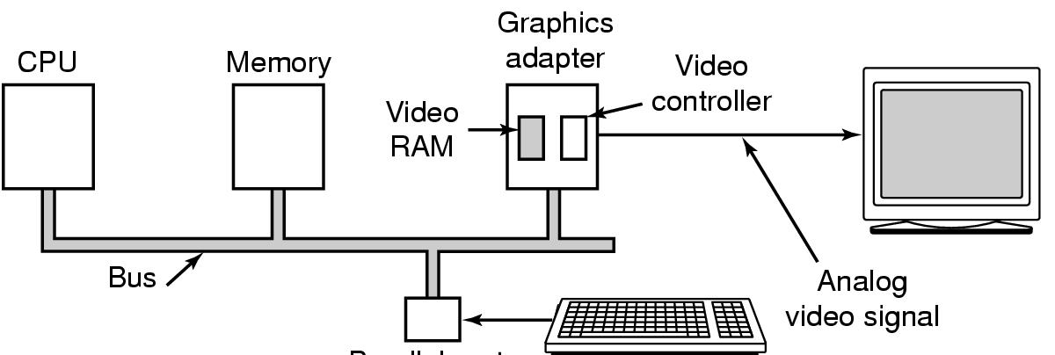
Display Hardware (1)
Parallel port
Memory-mapped displays
driver writes directly into display's video RAM

Slide 66
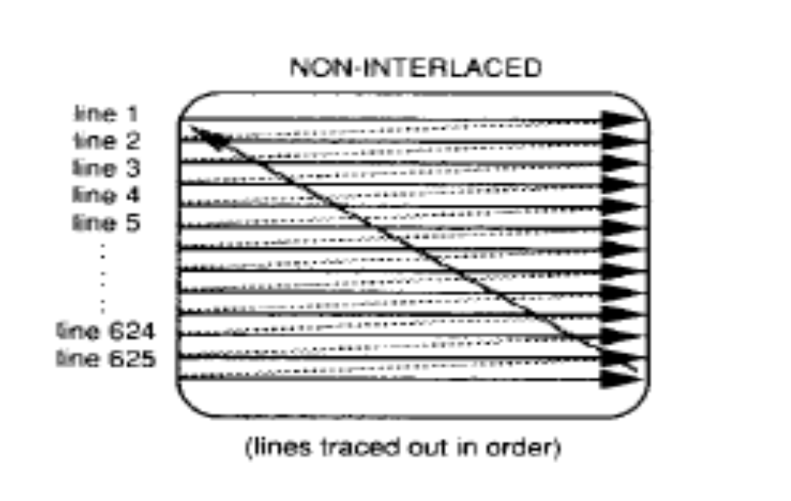
Display Hardware (2)

Slide 67
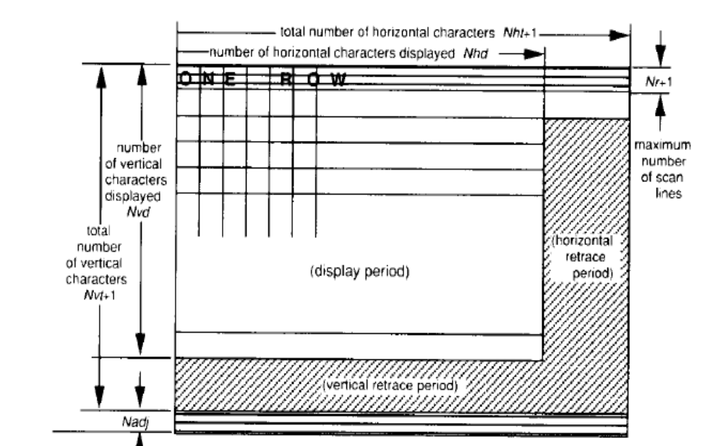
Display Hardware (3)

Slide 68
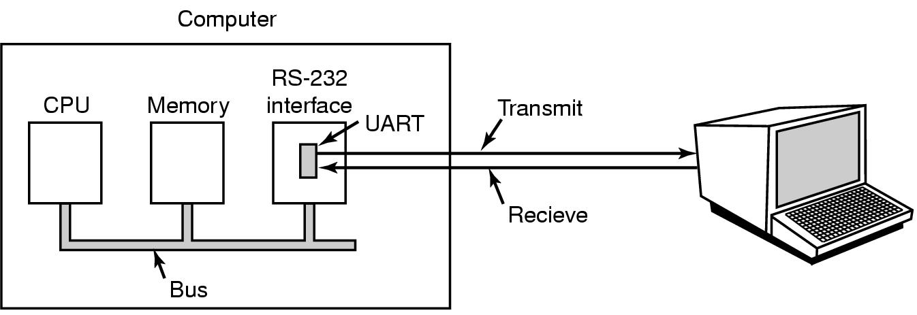
Character Oriented Terminals
RS-232 Terminal Hardware
An RS-232 terminal communicates with computer 1 bit at a time
Called a serial line – bits go out in series, 1 bit at a time
Windows uses COM1 and COM2 ports, first to serial lines
Computer and terminal are completely independent

Slide 69
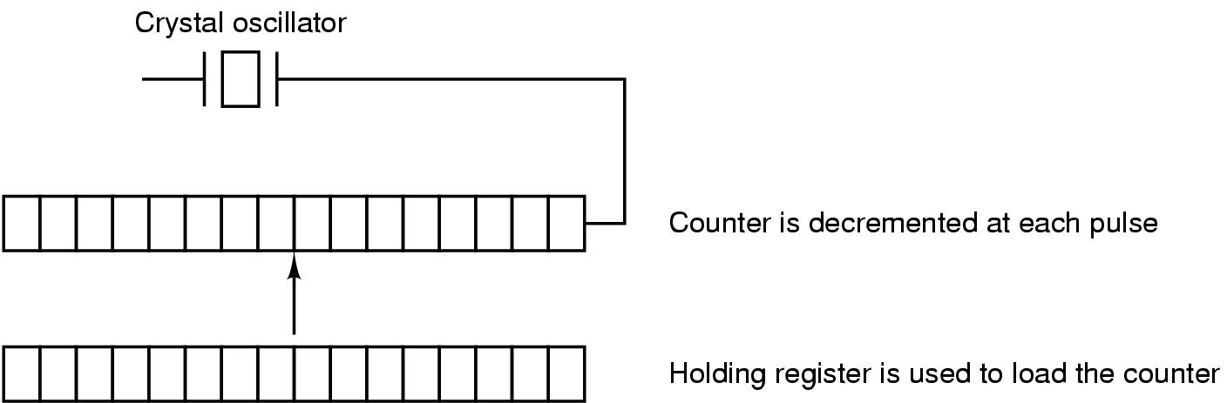
Clocks
Clock Hardware
A programmable clock

Slide 70
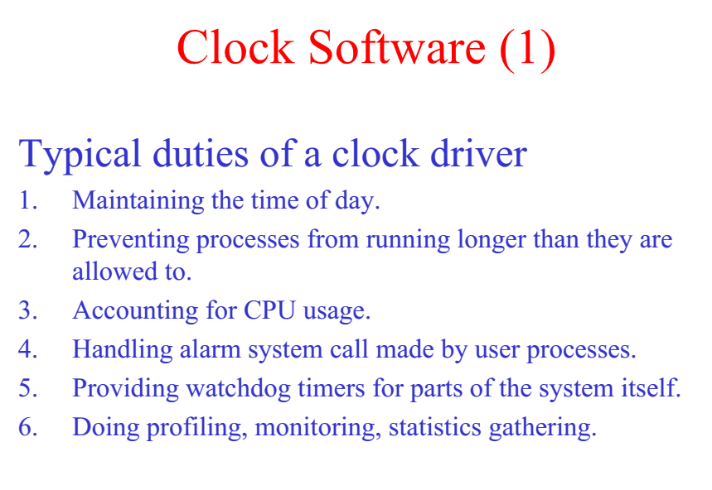

Slide 71
Cấu trúc đĩa CD, DVD: chia vùng ntnao? Lưu trữ dữ liệu theo kiểu gì?
DVD khác CD ở điểm nào mà dung lượng nhiều hơn?
HDD, SSD.

Slide 72
Tìm 3 nhà sản xuất đĩa cứng HDD. Thị phần và khuyến cáo lợi thế, bất lợi của sản phẩm từng công ty.
Western Digital (43%), Segate (41%), Toshiba (16%)…
SATA, ATA, SCSI, EIDE…
16MB, 8MB…
FAT32, NTFS, ext2-3, …
3.5inch, 1.8, 2.5, …
Xem các thông số của 1 ổ đĩa cứng, giải thích ý nghĩa của từng thông số: tốc độ quay, giao tiếp, bộ nhớ đệm, dung lượng, kích thước…
Trình bày cấu trúc vật lý của ổ đĩa cứng: track, sector, cylinder, trục quay, đầu đọc/ghi…
Các định dạng phân vùng dùng được cho HDD

Slide 73
List 3 HDD manufactures, their market shares, the advantages and disadvantages of each one?
List all factors of HDD, explain the meaning of each one, such as: rotation speed, interface, buffer, capacity, size,…
Xem các thông số của 1 ổ đĩa cứng, giải thích ý nghĩa của từng thông số: tốc độ quay, giao tiếp, bộ nhớ đệm, dung lượng, kích thước…
Trình bày cấu trúc vật lý của ổ đĩa cứng: track, sector, cylinder, trục quay, đầu đọc/ghi…
Các định dạng phân vùng dùng được cho HDD

