Slide 1
Session 2
Chapter 2 - Relational Data Model - Part 1
Database Systems

Slide 2
Objectives
1
Understand what is a Data Model
2
Understand what belong to a Data Model
3
Understand what are Relations, Attributes, Tuples, Domains
4
Understand what are Relation instances, Schema, DB schema
5
5
Understand how to use SQL to define relation schemas

Slide 3
Contents
1
An Overview of Data Models
2
Basics of the Relational Model
3
Defining a Relation Schema in SQL

Slide 4
2.1. An Overview of Data Models

Slide 5
2.1.1. What is a Data Model?
A Data Model is a notation for describing data or information. The description generally consists of 3 parts:
  Structure of the data
  Operations on data.
  Constraints.

Slide 6
2.1.2.Important Data Models
Today, two important data models are:
The relational model, including object-relational extensions
The semi-structured data model, including XML and related standards

Slide 7
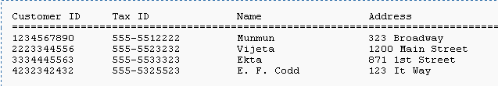
2.1.3. Overview of Relational Model

Slide 8
2.1.4. Overview of Semi-structured Data
Another data model, based on trees rather than tables or arrays.
The point-of-view today is XML: a way to represent data by hierarchically nested tagged elements.

Slide 9
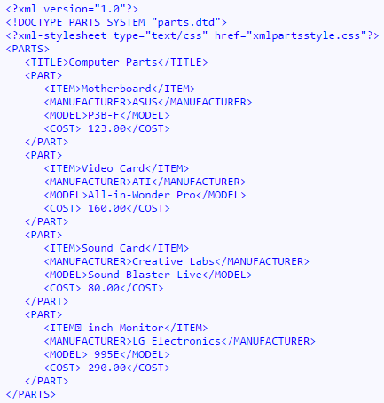
XML file example

Slide 10
2.2. Basics of Relational Model

Slide 11
2.2.1. Attributes
The relational model represents data as a 2-dimensional table (called a relation)
Each row represents a CUSTOMER
Each column represent a property of CUSTOMER and also called a “attribute”

Slide 12
2.2.2. Schemas
The name of a relation and the set of attributes for that relation is called the schema for that relation, exp:
CUSTOMER (Customer ID, Tax ID, Name, Address)

Slide 13
2.2.3. Tuples
A row of a relation is called a tuple (or record)
When we want to write a tuple in isolation, not as part of a relation, we normally use commas to separate components
Exp: (1234567890,555-5512222, Munmun, 323 Broadway)

Slide 14
2.2.4. Domains
The relational model requires that each component of each tuple must be atomic, that is, it must be of some elementary type such as INTEGER or STRING
It is not permitted for a value to be a record structure, set, list, array or any type that can have its values broken into smaller components
A Domain is a particular elementary type of a attribute

Slide 15
2.2.5. Equivalent representation of a relation
Relations are sets of tuples, not lists of tuples
So, the order in which the tuples of a relation are presented is not important

Slide 16
2.2.6. Relation instances
A relation about CUSTOMER is not static but changing over time:
  We want to insert tuples for new CUSTOMER as these appear
  We want to edit existing tuples if we get corrected information about a CUSTOMER
  We want to delete a tuple from the database
A set of tuples for a given relation is called an instance of that relation

Slide 17
2.2.7. Keys of relations
A set of attributes forms a key for a relation if we don’t allow 2 tuples in a relation instance to have the same values in all the attributes of the key
Exp: The key of relation
CUSTOMER (Customer ID, Tax ID, Name, Address)
is CustomerID or TaxID

Slide 18
2.3. Defining a Relation Schema in SQL
2.3.1. Relations in SQL
2.3.2. Data Types
2.3.3. Simple Table Declarations
2.3.4. Modifying Relation Schemas
2.3.5. Default Values
2.3.6. Declaring Keys

Slide 19
Exercises
Write SQL queries to create the following Schemas in SQL Server:
  Address(House#, StreetName, City, Province, Country)
  Salaries(ID, IDPerson, PersonName, SalaryValue, Month, Year)
  Contacts(ID, ContactName, Address, Tel, eMail)
Write SQL queries to drop the above tables

Slide 20
Summary 1: Relational Model
Table = relation.
Column headers = attributes.
Row = tuple
Relation schema = name(attributes) + other structure info.,
e.g., keys, other constraints. Example: Beers(name, manf)
  Order of attributes is arbitrary, but in practice we need to assume the order given in the relation schema.
Relation instance is current set of rows for a relation schema.
Database schema = collection of relation schemas.

Slide 21
Summary 2: Why Relations?
Very simple model.
Often a good match for the way we think about our data.
Abstract model that underlies SQL, the most important language in DBMS’s today.
  But SQL uses “bags” while the abstract relational model is set-oriented.

Slide 22
Thank You !

