Slide 1
Session 9
Chapter 4 – High-level Design Principles
& convert E/R diagram to relational model
Database Systems

Slide 2
Objectives
1
Understand design principles
2
Understand constraints in ERDs
3
Know how to convert from ERD to relational designs

Slide 3
Contents
1
Design Principles
2
From ERDs to relational designs

Slide 4
4.2. Design Principles
Faithfulness
Avoid redundancy.
Simplicity Counts
Choose the Right Relationships
Picking the Right Kind of Element
Limit the use of weak entity sets.
Don’t use an entity set when an attribute will do.

Slide 5
4.2.1. Faithfulness
First and Foremost, the design should be faithful to the specifications of the application
This means that, Entity Sets and their attributes should reflect the reality.

Slide 6
4.2.2. Avoiding Redundancy
Redundancy = saying the same thing in two (or more) different ways.
Wastes space and (more importantly) encourages inconsistency.
  Two representations of the same fact become inconsistent if we change one and forget to change the other.
  Recall anomalies due to FD’s.

Slide 7
Example: Bad
name
name
addr
ManfBy
Beers
Manfs
manf
This design states the manufacturer of a beer twice: as an attribute and as a related entity.

Slide 8
Example: Good
name
name
addr
ManfBy
Beers
Manfs
This design gives the address of each manufacturer exactly once.

Slide 9
4.2.3. Simplicity Counts
Avoid introducing more elements into your design than is absolutely nessessary.

Slide 10
Example: A poor design with an Un-necessary entity set
Represents
Movies
Holdings
Owns
Studios
Instead of a relationship between Movies and Studios, the design postulated the existence of “Movie-holding” – the ownership of a single movie
That diagram truly represents the real world, since it is possible to go from a movie to its unique owning studio via Holdings, however, Holdings serves no useful purpose and we are better off without it. It makes programs that use the Movie-Studio relationship more complicated, waste space and encourages errors

Slide 11
Example: A better design without an Un-necessary entity set
Owns
Movies
Studios

Slide 12
4.2.4. Choosing the Right Relationships
Entity Sets can be connected in various ways by relationships. However, adding to our design every possible relationship is not often a good idea. Doing so can lead to redundancy, update anomalies and deletion anomalies because the connected pairs or sets of entities for one relationship can be deduced from one or more other relationship

Slide 13
Example: Choosing the Right Relationships
Salary
title
year
name
addr
Contracts
Movies
Stars
Do we need the relationships between Movies and Studios and Movies and Stars directly?
What if a star can work on a movie without there being a contract?
length
genre
Studios
name
addr

Slide 14
4.2.5. Picking the Right Kind of Element
Sometimes we have many options regarding the type of design element used to represent a real-world concepts. Many of these choices are between using attributes and using Entity set / Relationship combinations. In general, an attribute is simpler to implement than either an Entity set or a Relationship

Slide 15
4.2.5. Picking the Right Kind of Element
Entity Sets Versus Attributes
An entity set should satisfy at least one of the following conditions:
  It is more than the name of something; it has at least one nonkey attribute.
  or
  It is the “many” in a many-one or many-many relationship.

Slide 16
Example: Good
name
name
addr
ManfBy
Beers
Manfs
Manfs deserves to be an entity set because of the nonkey attribute addr.
Beers deserves to be an entity set because it is the “many” of the many-one relationship ManfBy.

Slide 17
Example: Bad
name
name
ManfBy
Beers
Manfs
Since the manufacturer is nothing but a name, and is not at the “many” end of any relationship, it should not be an entity set.

Slide 18
Example: Good
name
manf
Beers
There is no need to make the manufacturer an entity set, because we record nothing about manufacturers besides their name.

Slide 19
4.2.6. Don’t Over-use Weak Entity Sets
Beginning database designers often doubt that anything could be a key by itself.
  They make all entity sets weak, supported by all other entity sets to which they are linked.
In reality, we usually create unique ID’s for entity sets.
  Examples include social-security numbers, automobile VIN’s etc.

Slide 20
4.2.7. When Do We Need Weak Entity Sets?
The usual reason is that there is no global authority capable of creating unique ID’s.
Sometimes, an Entity Set falls into a hierarchy

Slide 21
4.3. From E/R diagrams to Relational Designs
Step 1: Create a table for each entity with the same name)
Step 2: Create a table for each Relation (the table name is the concatenation of the two Entities in the relation)
Step 3: The entity attributes become the attributes (columns) for the table/relation.
Step 4: Potentially, include some foreign keys to represent relationships shown in the ERD.
Step 5: Ensure that the tables are in 2NF or 3NF.

Slide 22
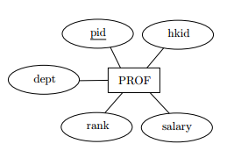
Convert entity set
Entity set => table
PROF(pid, hkid, dept, rank, salary)
Where pid is set as a candidate key

Slide 23
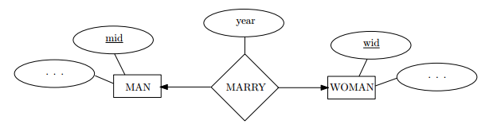
Convert one-one relationship
One-one relationship => Table that has two candidate keys.
MARRY(mid, wid, year)
Where candidate key is mid, and another is wid

Slide 24
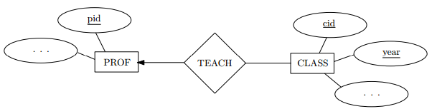
Convert one-many relationship
PROF(pid) - candidate key is pid
CLASS(cid, year) – candidate key is (cid, year) and pid is foreign key references to PROF(pid)

Slide 25
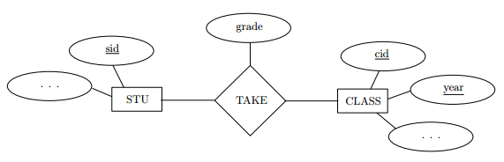
Convert many-many relationship
STU(sid) - candidate key is sid
CLASS(cid, year, pid) – candidate key is (cid, year)
TAKE(sid, cid, year, grade) – candidate key is (sid, cid, year) and
- foreign key sid references to STU(sid)
- foreign key (cid, year) references to CLASS(cid, year)

Slide 26
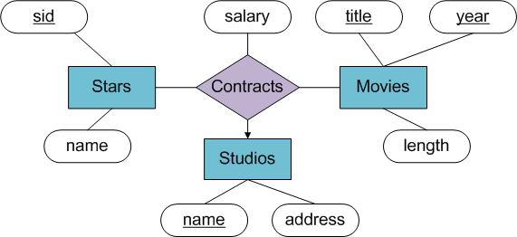
Convert multi-way relationship
MOVIES(title, year, length) - candidate key is (title, year)
STARS(sid, name) – candidate key is sid
STUDIOS(name, address) – candidate key is name
CONTRACTS(sid, title, year, studio-name, salary) – candidate key is (sid, title, year, studio-name) and
- foreign key sid references to STARS(sid)
- foreign key (title, year) references to MOVIES(title, year)
- foreign key studio-name references to STUDIOS(name)

Slide 27
Convert weak entity
name
number
name
Players
Plays-
on
Teams
TEAMS(name) - candidate key is name
PLAYERS(number, team-name, name) – candidate key is (number, team-name) and
- foreign key team-name references to TEAMS(name)

Slide 28
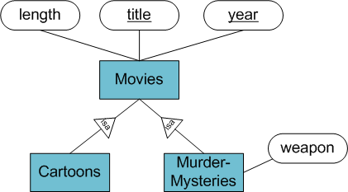
Convert sub-class structures
There are three strategy for conversion to relations:
E/R style conversion
An Object-oriented approach
Using null values to combine relations

Slide 29
Convert sub-class structures
E/R style conversion
MOVIES (title, year, length) – candidate key is (title, year)
MURDERMYSTERIES(title, year, weapon) – candidate key is (title, year)
CARTOONS(title, year) – candidate key is (title, year)
Movies relation has every movie.
Movies that are murder mysteries have a tuple in both Movies and Murdermysteries relations.
Movies that are cartoons have a tuple in both Movies and Cartoons relations.
Movies that are both cartoons and murder mysteries have a tuple in all three relations.

Slide 30
Convert sub-class structures
An Object oriented approach
MOVIES (title, year, length)
MOVIESC (title, year, length)
MOVIESMM (title, year, length, weapon)
MOVIESCMM (title, year, length, weapon)
Candidate key of all relations are the same – (title, year)
This approach enumerate all the possible sub-trees of hierarchy.
For each, create one relation that represents entities having components in exactly those sub-trees.

Slide 31
Convert sub-class structures
Using Null values to combine relations
In this approach, there is only one relation that has all attributes belonging to any entity set of the hierarchy.
Tuple has Null in each attribute that is not defined for appropriate entity.
MOVIES (title, year, length, weapon)
Candidate key of all relations are the same – (title, year)

Slide 32
Step 5: The questions to Ensure that the tables are in 3NF
Does the table contain any repeating groups?
If not, and the table has a primary key then it is First normal form (1NF)
Does the table contain any partial dependencies?
If not, and it is in 1NF then it is in 2NF
Does the table contain any transitive dependencies or derived attributes?
If not, and it is in 2NF then it is in 3NF

Slide 33
Example: Convert this ERD to Relational Design
aName
fName
SIN
cName
lName
Presenter
represented
Agent
city
hair
phone
times
presents
rating
sName
pcName
station
Show
prod by
ProdComp
netWorth
season
country

Slide 34
Example: Convert this ERD to Relational Design
There are 4 entities in above ERD, so we have 4 tables create with following names:
- PRESENTER
- AGENT
- SHOW
- PRODUCTION_COMPANY
There are 3 relationships in above ERD, so we have more 3 tables:
- PRESENTER_AGENT (for “represent” relationship)
- PRESENTER_SHOW (for “present” relationship)
- SHOW_PROD_COMP (for “Pro-by” relationship)

Slide 35
Example: Convert this ERD to Relational Design
The table PRESENTER has following columns:
- SIN
- FNAME
- LNAME
- HAIR_COLOR
Exercise: Students must determine the attributes for AGENT, SHOW, PRODUCTION_COMPANY…
Exercise: Students must decompose to make the Relations 3NF

Slide 36
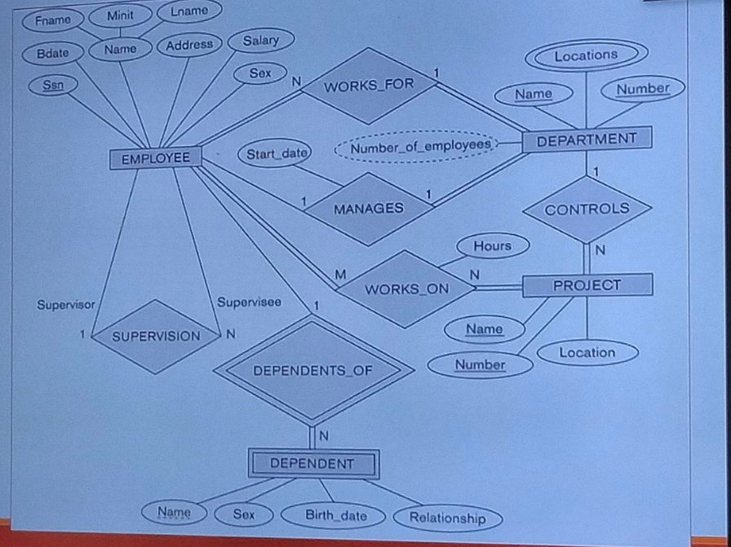

Slide 37
Thank You !

